Slide 1
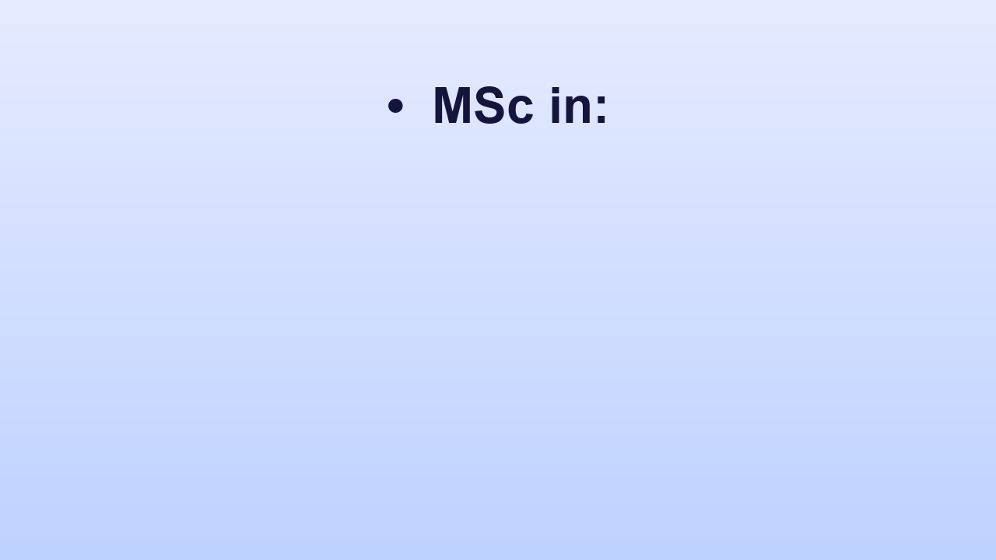
• MSc in:
Notes:
• MSc in:

Slide 2
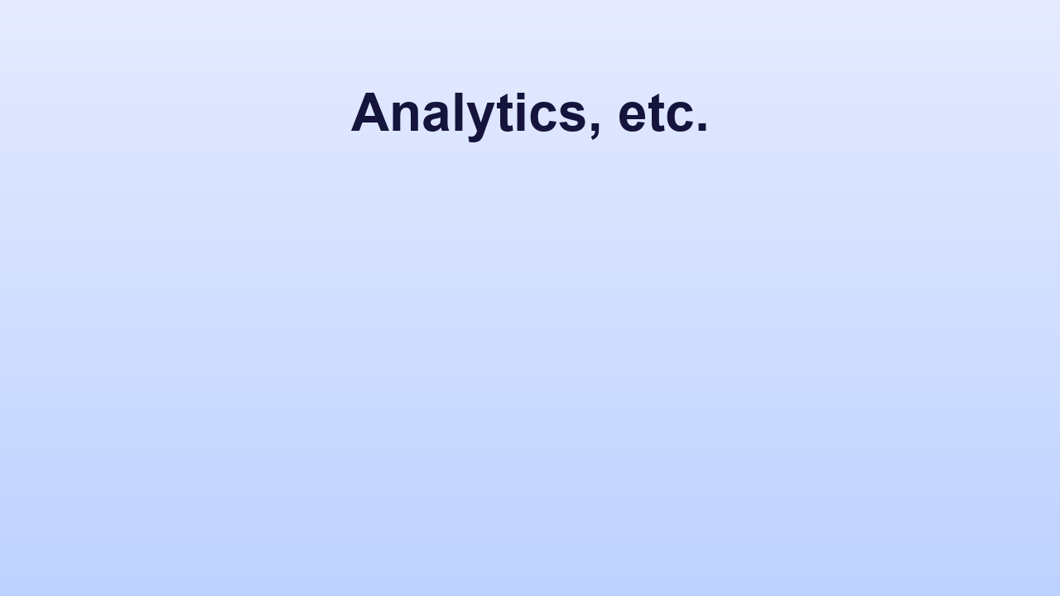
Analytics, etc.
Notes:
Analytics, etc.

Slide 3

Library: Well-equipped with digital access & research journals
Notes:
Library: Well-equipped with digital access & research journals

Slide 4

• Strong emphasis on undergraduate research
Notes:
• Strong emphasis on undergraduate research

Slide 5

• Xavier’s Science Association
Notes:
• Xavier’s Science Association

Slide 6
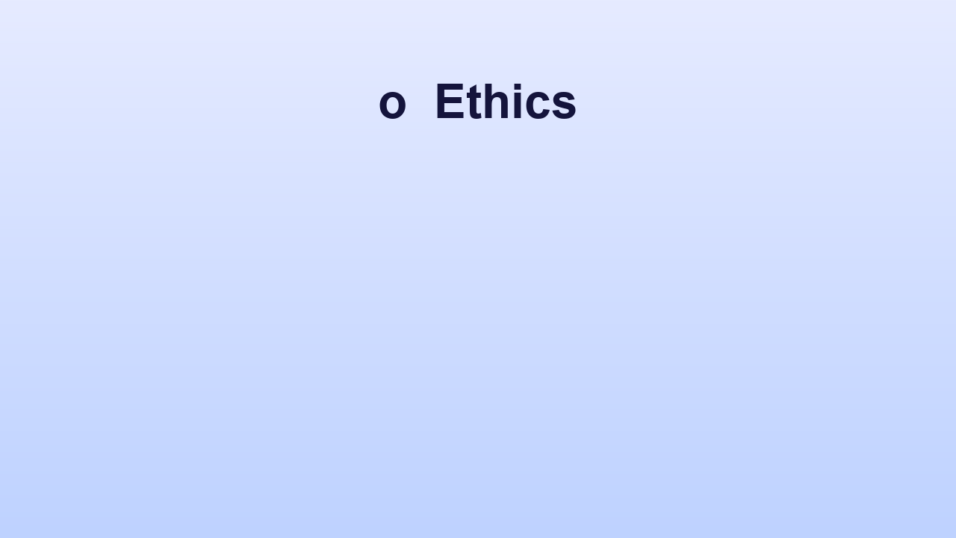
o Ethics
Notes:
o Ethics

Slide 7
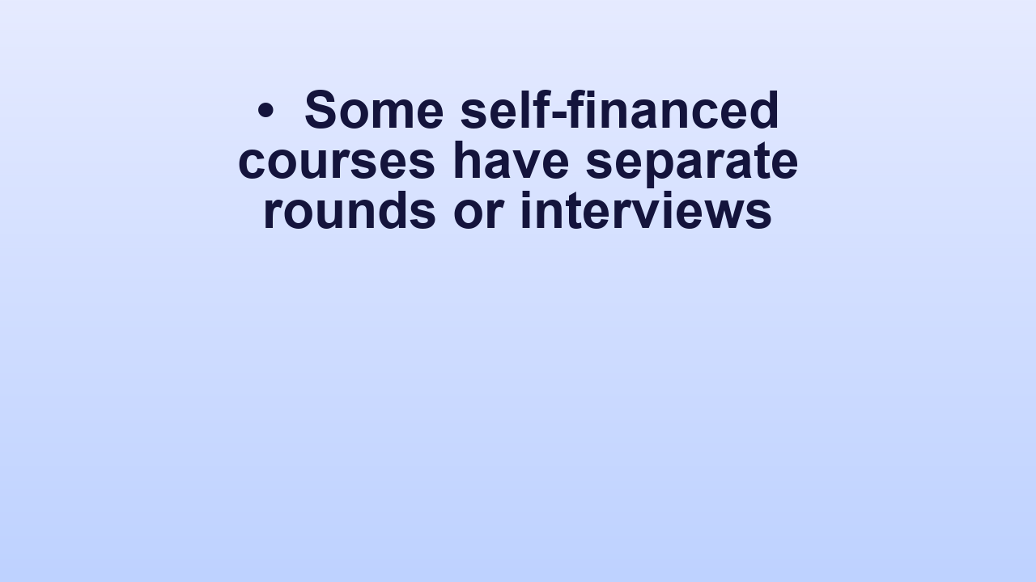
• Some self-financed courses have separate rounds or interviews
Notes:
• Some self-financed courses have separate rounds or interviews

Slide 8
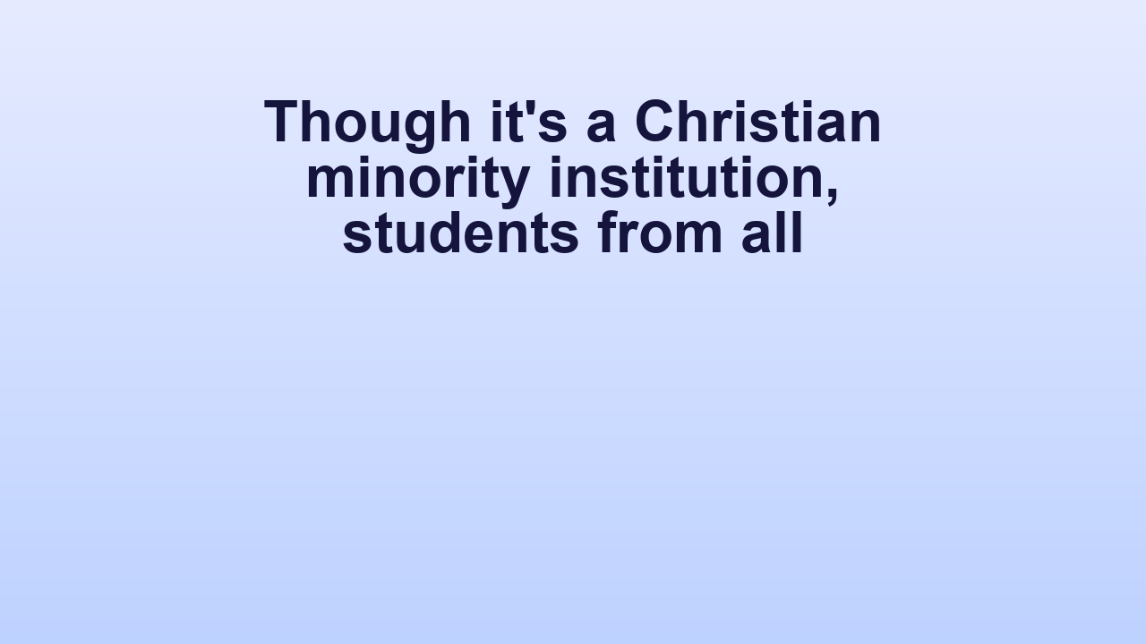
Though it's a Christian minority institution, students from all
• Yes, it’s open to all.
Notes:
• Yes, it’s open to all.

