Slide 1
Statistics Tutorial

Slide 2
What is Statistics
Statistics is a fundamental part of data science, and is used to analyze data, build models, and make predictions:

Slide 3
Population & Sample
Population : The Population is the Entire group that you are taking for analysis or prediction.
Sample : Sample is the Subset of the Population(i.e. Taking random samples from the population). The size of the sample is always less than the total size of the population.

Slide 4
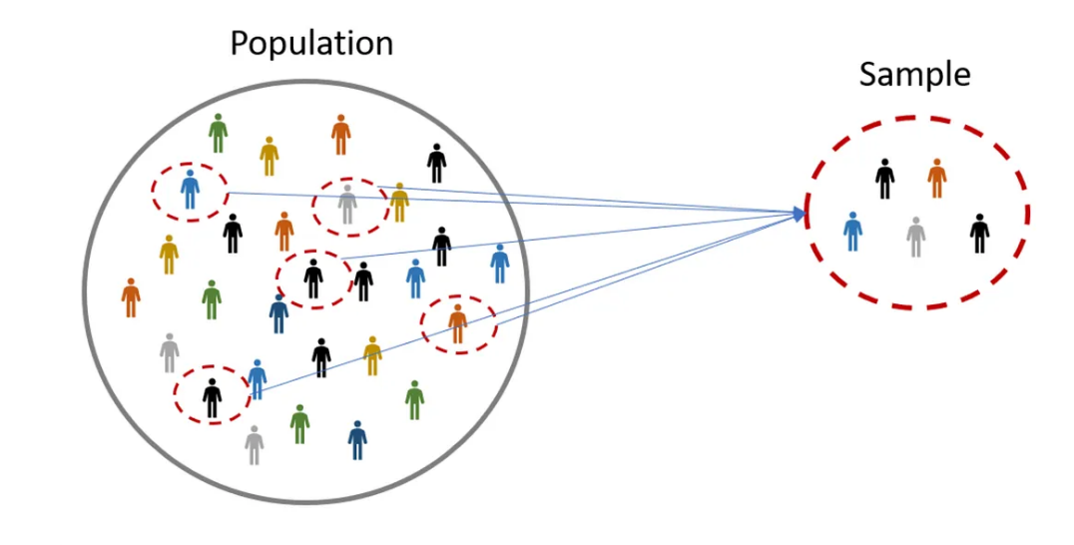
Reference

Slide 5
Types of statistics
descriptive statistics
inferential statistics

Slide 6
descriptive statistics
If a business analyst is using data gathered on a group to describe or reach conclusions about that same group, the statistics are called descriptive statistics.
Example
if the analyst has data for all customers of a company and uses descriptive statistics to analyze their behavior, they are working with population data.

Slide 7
Inferential statistics
if the analyst uses the sample data to draw conclusions about the entire population, that process involves inferential statistics
Example
One application of inferential statistics is in pharmaceutical research. Some new drugs are expensive to produce, and therefore tests must be limited to small samples of patients. Utilizing inferential statistics, researchers can design experiments with small randomly selected samples of patients and attempt to reach conclusions and make inferences about the population.

Slide 8
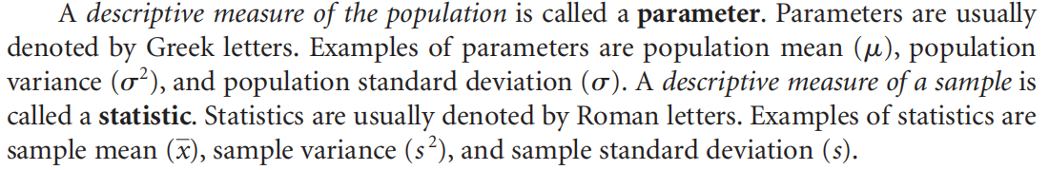
Measurement’s

Slide 9
Why Probability Need in Statisitic ?
a manufacturer of washing machines would probably want to determine the average number of loads that a new machine can wash before it needs repairs. The parameter is the population mean or average number of washes per machine before repair. A company researcher takes a sample of machines, computes the number of washes before repair for each machine, averages the numbers, and estimates the population value or parameter by using the statistic, which in this case is the sample average.
Inferences about parameters are made under uncertainty. Unless parameters are computed directly from the population, the statistician never knows with certainty whether the estimates or inferences made from samples are true. In an effort to estimate the level of confidence in the result of the process, statisticians use probability statements. For this and other reasons, part of this text is devoted to probability

Slide 10
Types of Data
Quantitative Data
Qualitative Data

Slide 11
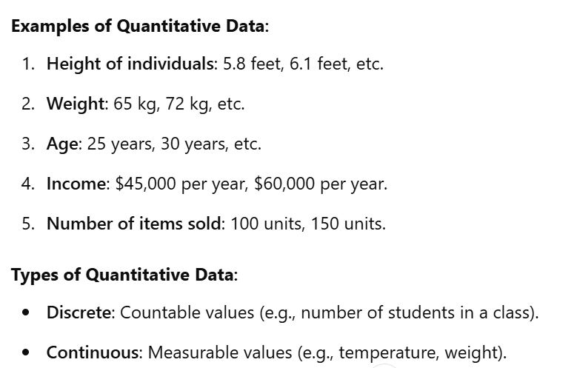
Quantitative Data
Quantitative data represents numerical information that can be measured or counted. It is used to quantify variables

Slide 12
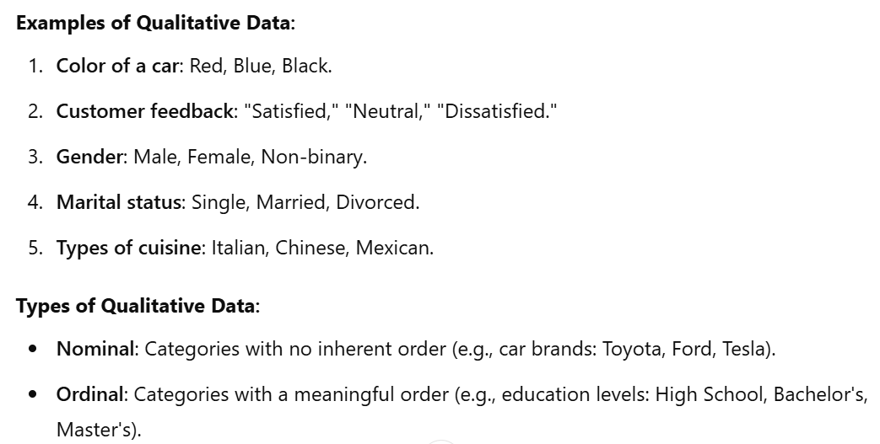
Qualitative Data
Qualitative data represents categorical information that describes qualities, characteristics, or attributes. It is used for classification and cannot be measured numerically.

Slide 13
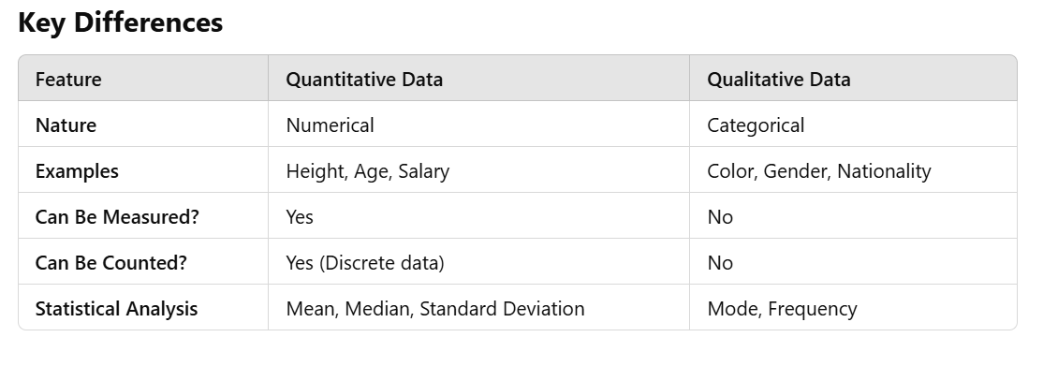
Difference

Slide 14
Data Measurements
Nominal
Ordinal
Interval
Ratio

Slide 15
Nominal
The lowest level of data measurement is the nominal level. Numbers representing nominal_x0002_level data (the word level often is omitted) can be used only to classify or categorize. Employee identification numbers are an example of nominal data. The numbers are used only to differentiate employees and not to make a value statement about them

Slide 16
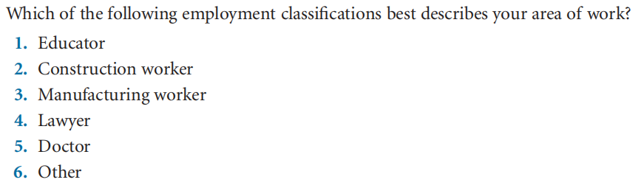
Example of Nominal Data

Slide 17
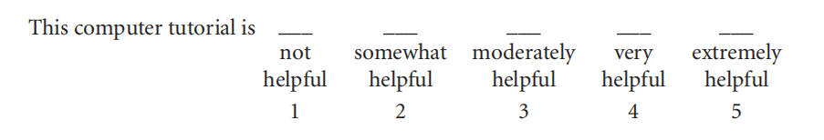
Ordinal Level
Ordinal-level data measurement is higher than the nominal level. In addition to the nominal_x0002_level capabilities, ordinal-level measurement can be used to rank or order objects.
Example

Slide 18
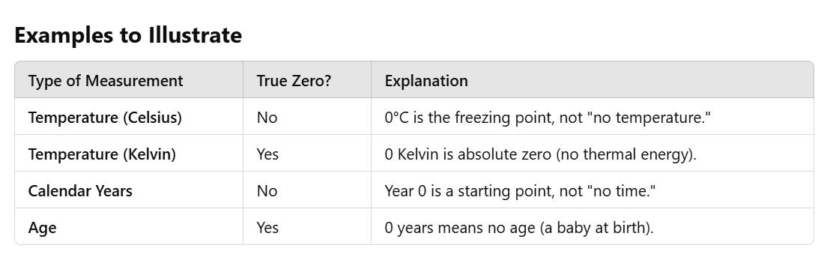
Interval Level & Ratio
Interval: Ordered with equal intervals, no true zero (e.g., temperature, time).
Ratio: Ordered with equal intervals and a true zero (e.g., weight, height, income).

Slide 19
Chapter 2 ( Charts & Graphs )
Construct a frequency distribution from a set of data
Construct different types of quantitative data graphs, including
histograms, frequency polygons, ogives, dot plots, and stem-and-leaf
plots, in order to interpret the data being graphed
Construct different types of qualitative data graphs, including pie charts,
bar graphs, and Pareto charts, in order to interpret the data being
graphed
Recognize basic trends in two-variable scatter plots of numerical data

Slide 20
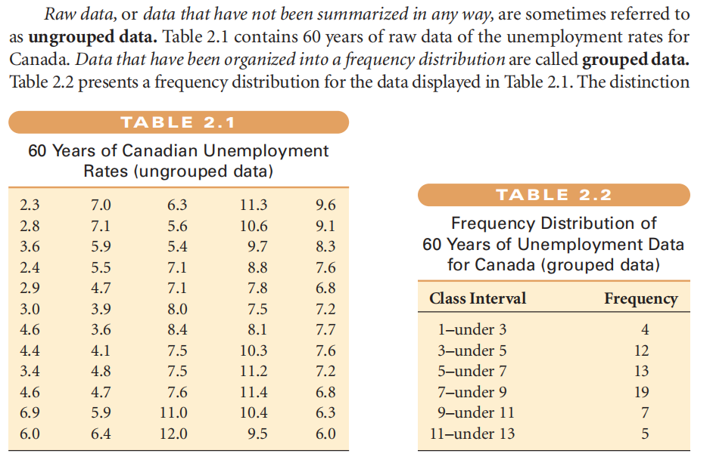
Frequency distribution
Frequency distribution is a method used to organize and summarize ungrouped data by grouping it into classes or intervals, and then counting how many data points fall into each group.

Slide 21
Frequency Distribution
One particularly useful tool for grouping data is the frequency distribution, which is a
summary of data presented in the form of class intervals and frequencies.

Slide 22
How to find the Frequency distribution class & Intervals
Let’s work through a proper example with
n=100 data points step by step, using Sturges' Rule to determine the number of intervals.

Slide 23
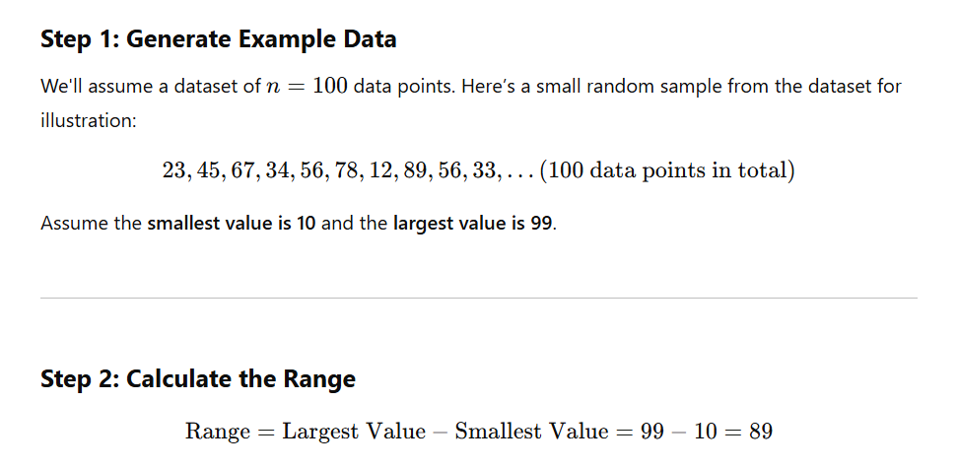
Example : ( Step 1 & 2)

Slide 24
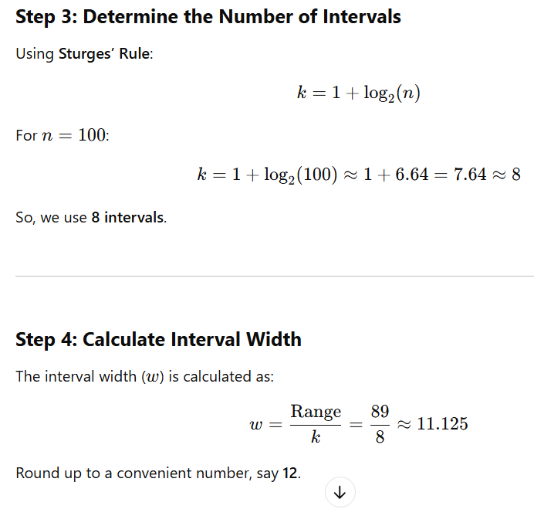
Example : ( Step 3 & 4)

Slide 25
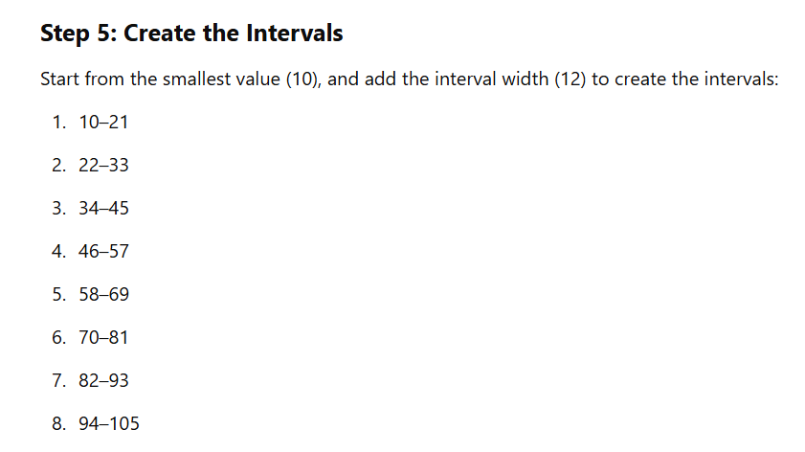
Step :5
above example are converting ungrouped data into grouped data .

Slide 26
Example of Relative frequency, and cumulative frequency

Slide 27
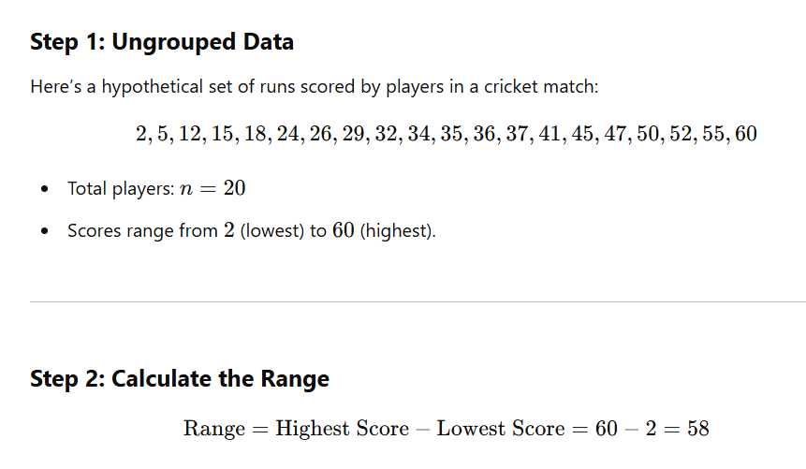
Let’s create a real-time cricket score example to explain how to convert ungrouped data into grouped data and calculate range, intervals, relative frequency, and cumulative frequency.

Slide 28
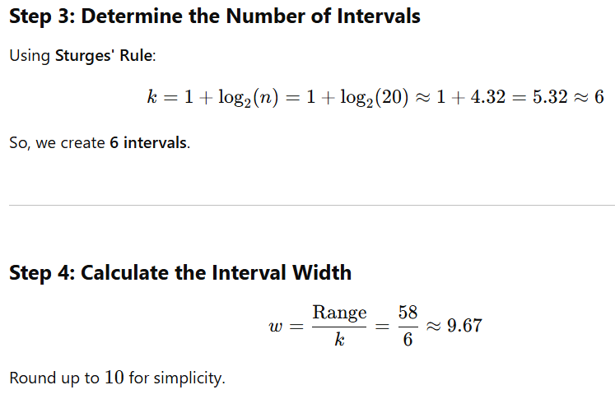
Step : 3 & 4

Slide 29
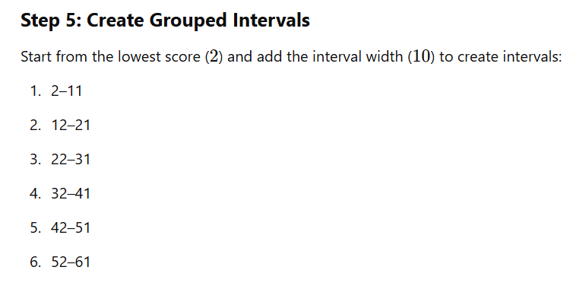
Step 5:

Slide 30
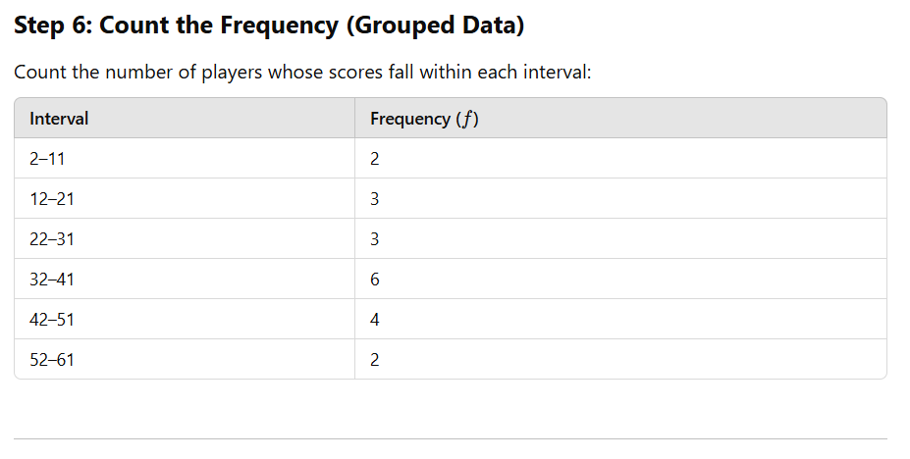
Step 6:

Slide 31
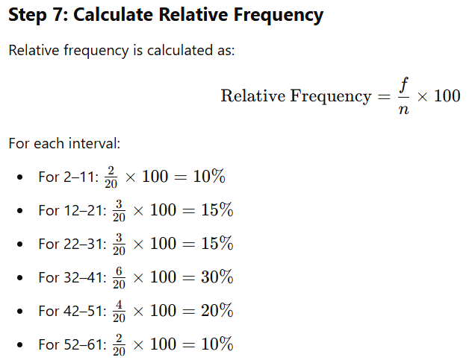
Step : 7

Slide 32
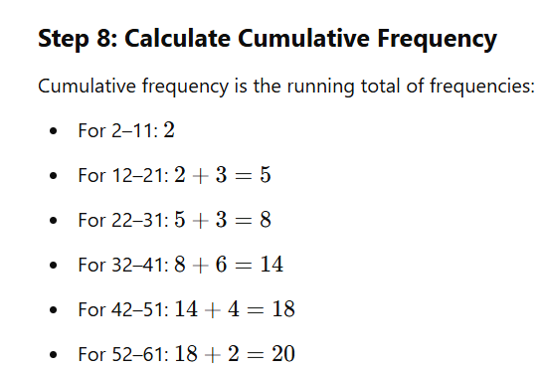
Step : 8

Slide 33
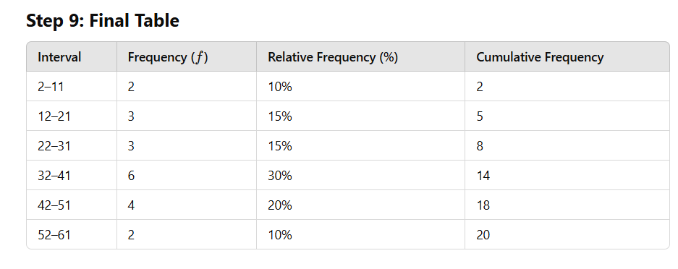
Step : 9

Slide 34
Conclusion
Relative Frequency tells us the percentage of players scoring in each interval (e.g.30% of players scored between 32 and 41 runs).
Cumulative Frequency shows how many players scored up to a certain range (e.g.14 players scored 41 runs or less).

