Slide 1
TABLEAU BUSINESS INTELLIGENCE PROJECT
Central Superstore Business Intelligence Project
From a flat CSV of 2,323 order lines to a SQL Server warehouse and a ten-dashboard Tableau story
Momen, Jowairya, Shehab, Haneen. and Shaza
Notes:
Hi everyone, we are the team behind the Central Superstore project. I'm Jowairya, and I built the Executive Overview and pulled the final workbook together. Shaza, Shehab, Haneen and Momen each owned one analysis area. Over the next few minutes we want to walk you through the story of this project: why we started, how we built it, and what the data told us.

Slide 2



The business problem: lots of sales, unclear profit
Sales data is easy to collect and hard to read
WHAT WE FOUND FIRST
Thousands of order lines do not tell a manager where money is made or lost.
$501K
in sales across 2013 to 2016
Decisions need answers, not rows
Which products, states, customers and months actually drive results?
$39.7K
kept as profit: a 7.92% margin
Numbers have to be trusted
A dashboard that disagrees with the database is worse than no dashboard.
Notes:
We started with a simple frustration. A superstore generates thousands of rows of sales, and a spreadsheet tells you what was sold but not whether the business is healthy. When we first added things up, the gap jumped out: about 501 thousand dollars in sales but only about 39.7 thousand dollars of profit. That is under 8 cents kept per dollar. A number like that is exactly why organisations need business intelligence, and it is why this project felt worth building.

Slide 3



Our plan: one warehouse, five questions, five owners
WHAT WE SET OUT TO DO
THE FIVE QUESTIONS
Build a star-schema warehouse in SQL Server
Jowairya
How is the business performing overall?
Shaza
Where is profit made and lost?
Define every KPI once, so every dashboard agrees
Shehab
Who are our customers and how do they behave?
Answer five business questions in Tableau
Haneen
How do sales change over time?
Check dashboard logic against SQL and document it
Momen
Where do we sell, and how do we ship?
Notes:
So the plan was to build the whole pipeline ourselves. First a proper SQL Server data warehouse, then Tableau dashboards on top of it. Instead of making one giant dashboard, we split the business into five questions and each of us took one. I took the overall performance question, Shaza took profitability, Shehab customers, Haneen sales over time, and Momen geography and shipping. The business value is that anyone can open the workbook and move from the headline numbers down to the reason behind them.

Slide 4

Understanding the data: one flat file, four years of orders
2,323
21
13
2013 to 2016
order lines
columns
states
order dates
How we slice it (dimensions)
What we measure (measures)
Customer: ID, name, segment
Product: ID, name, category, sub-category
Geography: state, city, postal code
Date: order date and ship date
Ship mode: four delivery options
Sales, the revenue of each line
Profit, which can be negative
Discount, a rate from 0 to 80%
Quantity, units on the line
Order ID, so we can count real orders
Notes:
Our raw material was a single CSV from the Central region of the Superstore dataset: 2,323 order lines and 21 columns, with orders from January 2013 to December 2016. Each row is one product on one order. Sales, quantity, discount and profit are what we measure, and customer, product, location, date and ship mode are how we slice them. One thing we noticed early is that the Region column only ever says Central, so a region comparison is a single bar. State and city became the real geography. That shaped the geography work later.

Slide 5
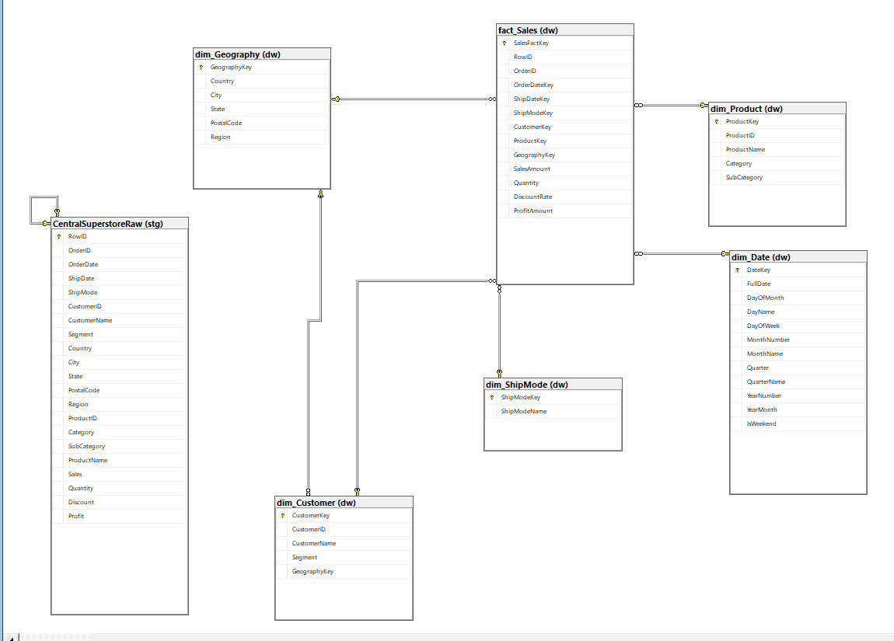
Building the foundation: from CSV to a star schema
1
Land the CSV in stg.CentralSuperstoreRaw with BULK INSERT
2
Build five dimensions from the distinct values
3
Load dw.fact_Sales and swap natural keys for surrogate keys
4
Add indexes, then the 20 analytics queries, a view and a stored procedure
Our star schema in SQL Server Management Studio: dw.fact_Sales at the centre, five dimensions around it
Notes:
A flat file is fine for a spreadsheet but awkward for analysis, so our first big step was the data warehouse. In SQL Server we created the CentralSuperstoreDW database with three schemas: staging, warehouse and reporting. The CSV lands untouched in a staging table with BULK INSERT. From there we split it into one fact table, where each row is an order line, and five dimensions: date, customer, product, geography and ship mode. This picture is the real diagram from SQL Server Management Studio. The reason structure matters is consistency: a total or a count means the same thing everywhere.

Slide 6


Project architecture: five layers, each with a job
Data source
Data warehouse
Validation layer
Tableau layer
Dashboard layer
Central_Superstore.csv
CentralSuperstoreDW
SQL checks
Live connection
10 dashboards
2,323 rows, 21 columns, Central region
stg staging table, dw fact and 5 dimensions, rpt reporting schema
20 analytics queries, rpt.vw_ExecutiveKPIs, usp_GetSalesKPIsByDateRange
localhost\SQLEXPRESS, relationships between fact and dimensions
Home, Executive, Profitability, Customer, Trends, Geography, Shipping
One shared data source feeds every dashboard, so a filter means the same thing everywhere
Notes:
Here is the whole system on one slide. Data flows left to right. The CSV is the source, SQL Server holds the staging and warehouse layers, then the validation layer is our SQL queries, the reporting view and a stored procedure. Tableau connects live to the warehouse, and on top of that sit the ten dashboards. Everything shares one data source, which is why a filter on the same field behaves the same on every dashboard.

Slide 7

Project workflow: how the work actually moved
1
2
3
4
5
6
Raw Data
Data Warehouse
SQL Validation
Tableau Development
Dashboard Design
Business Insights
CSV export of the Central sheet
Star schema in SQL Server
20 queries, view and procedure
One workbook per owner, one branch each
Merged into 10 dashboards, 1400 x 900
Findings and recommendations
Notes:
The architecture is what we built, the workflow is how we worked. We began with raw data, loaded it into the warehouse, wrote SQL to validate and explore it, and only then opened Tableau. Each of us developed a dashboard on our own GitHub branch, and I merged them into one final workbook. The last step is the point of everything: turning dashboards into business insights.

Slide 8
The SQL validation journey: trusting the numbers first
Baseline KPIs (unfiltered)
How we checked
What the checks caught
Total Sales
$501,239.89
Matched each Tableau formula to a SQL query (Q1 to Q20)
Checked the relationships use order date and surrogate keys
Counted orders and customers with COUNT DISTINCT
Matched tier and repeat-customer rules to Q7 and Q8
Empty 2012 and 2017 dates from the date dimension buffer
Profit Swing showing all nulls until Compute Using was set
Top 10 in Tableau versus Top 20 in SQL Q1
RANK versus ROW_NUMBER on tied order lines
Total Profit
$39,706.36
Profit Margin
7.92%
Total Orders
1,175
Total Customers
629
Avg Order Value
$426.59
Confirmed against SQL Server and the source CSV
Notes:
Before we told anyone what the data meant, we needed to be sure our dashboards were not lying. We took each Tableau calculation and compared it with the matching SQL query. All 13 logic checks matched, things like distinct order counts, the profit margin formula and the customer tier rules. The baseline totals were confirmed against the warehouse. The process also caught four real discrepancies, which you can see on the right. To be honest about the status, we compared the logic and the headline baseline, and a full side by side of every chart is still on our to-do list. We would rather say that clearly than pretend it is finished.

Slide 9

The Executive Overview: six numbers to start with
$501,240
$39,706
7.92%
Questions it answers
How big is the business?
Is it profitable, and how thinly?
How do sales and profit move month by month?
Which categories and regions carry the revenue?
Which products sell the most?
Total Sales
Total Profit
Profit Margin
1,175
629
$426.59
Total Orders
Total Customers
Avg Order Value
Average order value = sales divided by distinct orders, so multi-line orders count once
Four filters keep it explorable: Year, Category, Region and Segment
Notes:
With a trusted warehouse behind us, I built the Executive Overview. The idea was a manager should be able to open one page and answer: how big is the business, are we profitable, and how many people buy from us? Six KPI cards do that. Total sales, total profit, margin, orders, customers and average order value. Below them sit trends, category and region mix and top products, with filters for year, category, region and segment. Note that I count orders and customers as distinct values, otherwise an order with five products would be counted five times.

Slide 10
What it revealed: balanced sales, uneven profit
84.9%
of all profit comes from Technology
-$2.9K
Furniture lost money on $164K of sales
3 of 3
categories sell about the same, yet profit is very uneven
Chart rebuilt from Central_Superstore.csv
Notes:
This is where the story got interesting. When we split sales by category they are almost even: furniture about 164 thousand, office supplies 167 thousand, technology 170 thousand. If you only looked at sales you would say the three categories are equal partners. But the profit chart tells a different story. Technology produced about 33.7 thousand dollars, which is 84.9 percent of all profit. Office supplies made about 8.9 thousand, and furniture actually lost 2.9 thousand dollars. What surprised us most was how little the sales chart gave away. From a business perspective, that means selling more furniture does not help unless something changes. These charts are rebuilt from the dataset for this presentation.

Slide 11
Sales trends: growth, and a strong autumn
Charts rebuilt from Central_Superstore.csv. Monthly values are the 4-year total divided by 4.
+43%
2015 sales jump over 2014 ($103K to $147K)
53%
of all sales land between September and December
Feb
is the weakest month, about $2K a year on average
Notes:
Haneen's trend work answered how sales move over time. Revenue was flat at about 103 thousand dollars in 2013 and 2014, then jumped about 43 percent to 147 thousand in 2015 and held there in 2016. Looking at months, the pattern repeats every year: the strongest stretch is September to December, and February is the quietest month. Those four months together bring in 53 percent of all sales. The interesting twist is that profit did not follow growth: 2016 had the same sales as 2015 but much lower profit, which leads us into the profitability story.

Slide 12
Profitability: where the money is made and where it leaks
Technology and a few sub-categories carry the profit. Heavy discounting lines up with heavy losses, though it is an association, not proof of cause.
Charts rebuilt from the dataset
Notes:
Shaza's analysis went inside the categories. On the left, each sub-category's profit. Copiers and phones are the heroes, together earning about 28 thousand dollars. Seven sub-categories lose money: furnishings, tables, appliances, bookcases, machines, binders and supplies. Then the question we kept asking was why. Shaza's discount analysis gave a strong hint: lines with no discount made about 76 thousand in profit, while lines discounted by more than 40 percent lost about 41 thousand. We need to be careful here: this is an association, not proof that discounts alone caused the losses, but it is a very strong signal. Binding systems even appear in both the top and bottom product lists.

Slide 13
Geography and shipping: our biggest state loses the most
SHIPPING AT A GLANCE
Standard Class
715 orders
8.0% margin
Second Class
224 orders
8.8% margin
First Class
174 orders
6.3% margin
Same Day
62 orders
7.5% margin
Texas: $170K in sales, $25.7K lost. Michigan: $76K in sales, $24.5K earned.
Chart rebuilt from the dataset
Notes:
Momen's geography work gave us probably the most surprising chart. Texas is by far our largest state by sales, about 170 thousand dollars, yet it lost about 25.7 thousand. Illinois is second worst, losing 12.6 thousand. In Shaza's data their average discounts are 37 and 39 percent. Michigan and Indiana, with far lower sales, earned 24 and 18 thousand. At city level Houston, San Antonio and Chicago are the biggest losers, and Detroit is the top earner. For shipping, Standard Class is the workhorse: about 61 percent of orders and 63 percent of sales. Same Day is tiny, only 62 orders, and First Class carries a higher average discount of about 27 percent.

Slide 14


Interactive features: letting people ask their own questions
Filters
Actions
Year, Category, Region and Segment on the Executive page. Customer, Quarter, Month, State, City and Ship Mode appear where they matter.
Selecting a category highlights it across the charts. Clicking a state on the map filters Geography Analysis.
Parameters
Navigation
Top Customers (default 5) and Profit Bin Size (default 200) let viewers control the detail.
A Home page with a card per analysis area, and ten dashboards fixed at 1400 x 900 so nothing scrolls.
Why it matters: one shared data source means the same filter gives the same answer on every dashboard
Notes:
A dashboard that only shows one view answers our questions, not the viewer's. So we made the workbook interactive. Filters change by dashboard: year, category and region on the executive page, and ship mode and city on the geography page. Because all dashboards share one data source, a filter behaves the same everywhere. We added actions: clicking a category highlights it across charts, and clicking a state on the map filters the Geography Analysis page. Two parameters let people choose how many top customers to see and the profit bucket size. For navigation there is a Home page with a card for each area, and we split long pages into ten dashboards at a fixed 1400 by 900 so nothing needs scrolling.

Slide 15
Key business insights: six things the data told us
7.92%
84.9%
-$40.8K
Thin margin
Technology share of profit
Lines with over 40% discount
$39.7K profit on $501K of sales
Furniture lost $2.9K
versus +$76.1K with no discount
-$38.3K
-62%
53%
Texas and Illinois combined
2016 profit vs 2015
Sales from Sep to Dec
on $250K of sales
while orders rose 33% (305 to 406)
Q4 is the season that matters
Notes:
If we had to put the whole analysis on one slide, these are the six findings. A very thin margin of 7.92 percent. Technology producing nearly 85 percent of profit while furniture loses money. Discounting that lines up with losses. Texas and Illinois losing over 38 thousand dollars on 250 thousand of sales. A 2016 where orders grew by a third but profit fell by 62 percent. And a business that makes more than half its sales in the last four months of the year. Every one of these comes straight from the data and dashboards, nothing is invented.

Slide 16
Our recommendations: from findings to actions
WE NOTICED
SO WE WOULD
Discounts
Over 40% discount lines lost $40.8K
Review and cap deep discounts, and test the effect on volume
Texas and Illinois
$250K of sales, $38.3K lost
Check discount levels and pricing in these states first
Furniture and weak lines
Furniture, tables, bookcases and binders all lose money
Rework pricing or sourcing, or reduce what does not earn
Grow what earns
Copiers and phones made $28K; Corporate margin 11.8% vs Consumer 3.4%
Put promotion behind high-margin products and segments
Plan for autumn
53% of sales fall in Sep to Dec
Line up stock and staffing before September
Notes:
Based on these findings, here is what we would recommend. Each one follows directly from an insight. One, review the discount policy, especially above 40 percent. Two, investigate Texas and Illinois, where large sales and heavy discounts meet. Three, rethink the loss-making furniture lines like tables and bookcases, and the other loss-making sub-categories. Four, protect and grow what works: copiers, phones, and the Corporate and Home Office segments, which earn healthier margins than Consumer. Five, plan for autumn. These are suggestions based on associations in the data, so we would test them before making big changes.

Slide 17

Challenges and lessons learned
What we learned
Empty dates and null warnings
Validate early and compare against SQL
Agree on KPI definitions before building
Keep one shared data source
Say what is not finished
Redesign when a page gets too crowded
The date dimension runs 2012 to 2017. Fix: filter Year Number to 2013 to 2016.
Blank Profit Swing chart
The table calculation needed Compute Using set to Year Month.
Map and layout fixes
Map defaulted to Egypt, so we set it to United States. Long pages became ten 1400 x 900 dashboards.
Notes:
Honestly, not everything went smoothly. Our first problem was that a hand-edited workbook would not load in Tableau and gave us a version error, so we stopped editing workbook files by hand and made fixes in Tableau Desktop. The date dimension had a buffer of extra dates, which created empty periods and null warnings on trend charts. The profit swing chart was blank until we set Compute Using. The map defaulted to Egypt instead of the United States. We also split big pages into ten dashboards so nothing needed scrolling. And we noticed customer tier thresholds were not identical in every file, so we aligned the final workbook with the SQL. The biggest lesson: validate early, and write down what is not finished.

Slide 18


Tools and technologies behind the project
Tableau Desktop
SQL Server and SSMS
Built ten dashboards and 44 worksheets on a live connection, with filters, actions and parameters.
Held the database, ran the 20 analytics queries, and let us check dashboard logic.
Star schema warehouse
Git and GitHub
One fact table and five dimensions so every KPI is defined once and reused.
One branch per team member, then a merge into the final workbook, plus documentation in Markdown.
Notes:
Four tools did most of the heavy lifting. Tableau gave us the interactive dashboards. SQL Server and SSMS gave us a real database to build and query. The data warehouse design, the star schema, is what keeps every number consistent. And GitHub let five people work in parallel: each of us had a branch for our own dashboard, and I merged the results into the final workbook.

Slide 19

Project impact and reflection
10
44
If we kept going
dashboards
worksheets
Finish the numeric SQL versus Tableau comparison for every chart
Set the 2013 to 2016 data source filter permanently
Use one set of customer tier thresholds everywhere
Analyse delivery time using the ship dates we already have
Test the discount recommendations before rolling them out
20
5
SQL queries
analysts
A thin margin became a set of explanations: categories, discounts, states and seasons.
Notes:
Looking back, what we achieved is a complete pipeline: from a flat CSV to a warehouse, to ten dashboards that managers can explore. The numbers on the left give the scale. The project matters because it turns a thin 7.92 percent margin from a surprising number into something with explanations: categories, discounts, states and seasons. If we kept going, we would finish the full numeric comparison between SQL and Tableau, apply the 2013 to 2016 filter permanently, align tier thresholds everywhere, and look at delivery time using the ship dates we already have.

Slide 20
Thank you
A thin 7.92% margin, and now we can explain it.
Momen | Jowairya | Shehab | Haneen | Shaza
github.com/jowairyakassem/CentralSuperstore_Tableau
Questions?
Notes:
Thank you for listening. We started with one question, why a half-million dollars of sales left so little profit, and we finished with answers about categories, discounts, states and seasons. Everything is on our GitHub repository. We're happy to take questions, and to open any dashboard live.

