Slide 1
Cheers!
John West @ jowest90
https://github.com/jowest90/cheers

Slide 2
Description
Cheers is a drinking rating app allows users to submit and rate a variety of drinks. It allows people to show the most rated drinks at the time to show what’s popular. User’s can create an account, submit a drink , give a rating, and look up others drinks that were already submitted and give a rating as well. Non-registered users can look up a specific drink and view the rating. This allows users an ability to either share their opinion of a drink they already had or find something they never even heard of before.

Slide 3
Features
Users can create an account.
Registered users can submit, rate, search and view drinks.
Non-Registered users can view drinks and search drinks.

Slide 4
Planning - User Stories
As a viewer I can search and view new drinks. This entire project is built on having viewers to look and see what drinks are currently popular and find exotic drinks that they may not tried yet.
As a registered user I can submit drinks that aren’t in the system while give my own rating. For this list to exist, viewers create an account to register drinks that they have had and give a rating of that drink.

Slide 5
Planning - Database
I have three tables in my database -- Users, Drinks, and Rating. All three have a primary key (id). The Rating table is linked to both the Users table and Drinks table.
Making the Rating table having a one-to-one relationship between the Users and the Drinks.
When a user rates a drink, the User_ID is linked to that Drink_ID with the rating of that said drink.

Slide 6
Technology Stack
Spring Boot
MySQL
Thymeleaf
BootStrap

Slide 7
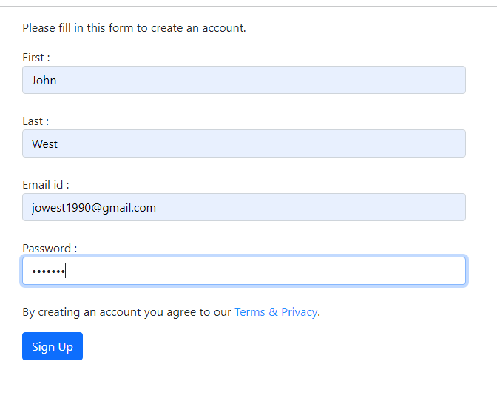
Demo - Create User 1

Slide 8
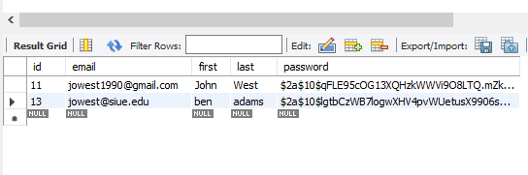
Demo - Create User 2

Slide 9
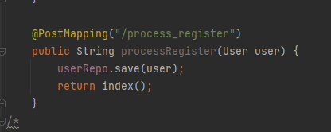
Demo Code - Create User

Slide 10
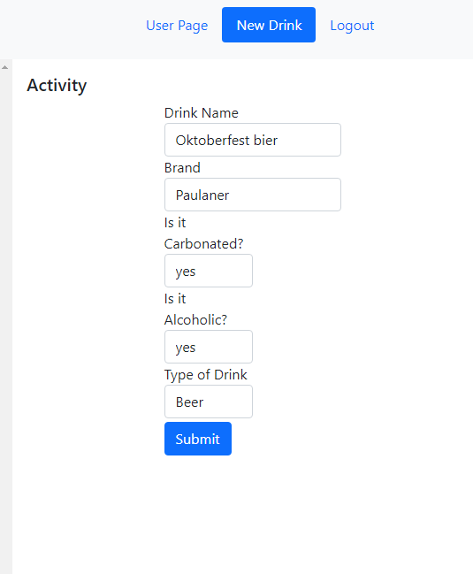
Demo – Create drink 1

Slide 11
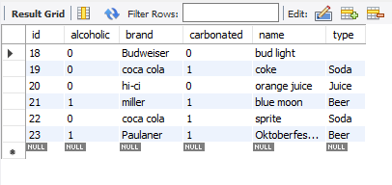
Demo – Create drink 2

Slide 12
Demo code – Create drink

Slide 13
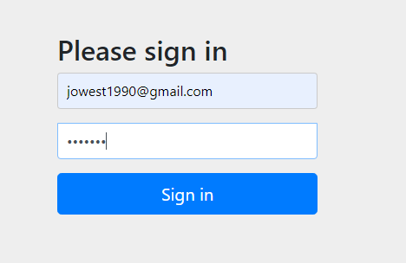
Demo – login 1

Slide 14
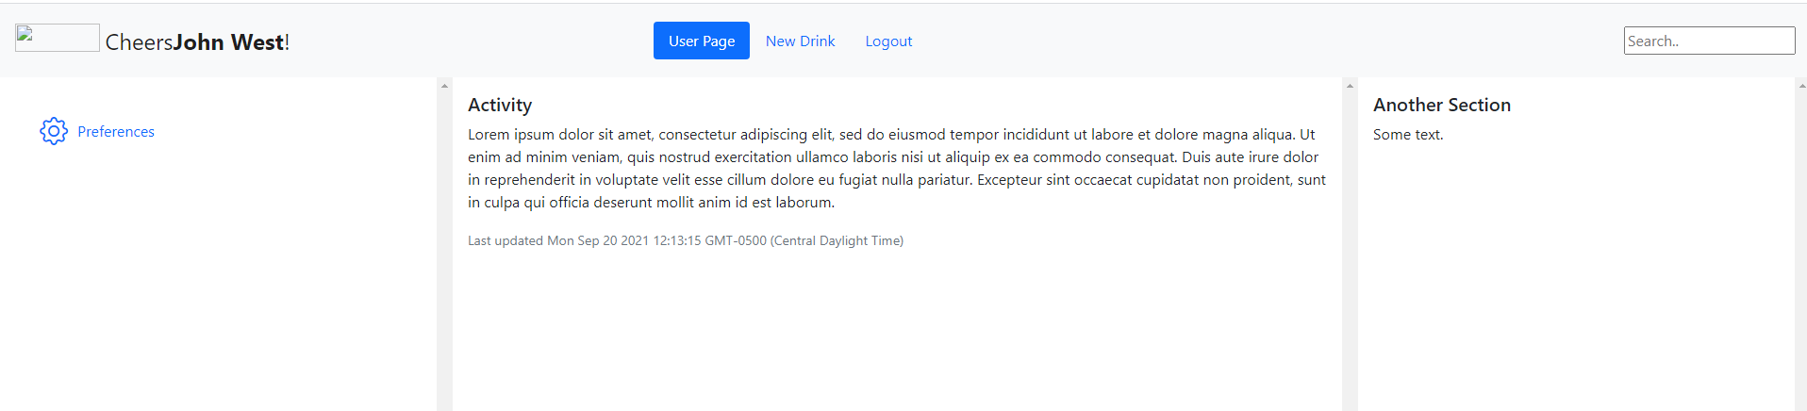
Demo – login 2

Slide 15
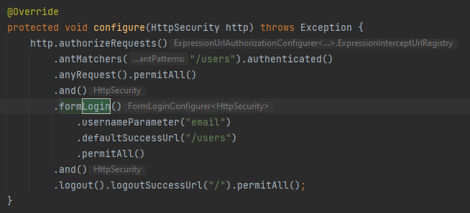
Demo code- login

Slide 16
Demo - login
The code from the previous slide handles the user authentication.
The configure() method; when a user selects a link or button containing @{/login}, a login form is generated by Spring Boot Security package for the user to enter their email and password.
Once entered, the system will search the user by email and to authenticate, it matches the password that is saved in the DB.
If successful, the user is redirected to the /users page and can logout at any moment the user pleases

Slide 17
What I Learned
This was my first-time using Spring Boot even though I have heard of it in the past as I am familiar with the Model-View-Controller methodology, but I’ve only used a PHP framework, Laravel instead. The big differences I noticed, aside from the fact that it’s java, there’s a lot more that goes into the development in the Model. In Laravel, I never had to worry about adding a repository to ensure the data will be saved to my db.
This would be the first-time where I was the leader of the group. While I did not intend that to happen, but with experience of working on projects with groups, without some form of leadership, the project is going to go south very fast. I also knew how to use workflow charts and how to create tasks and assign them to one another. It was awkward at first because I would suggest we do x, y, and z, and have no objections. As time went on, we got more comfortable and figuring out how to down-scale the project.

Slide 18
What’s Next
To rate drinks.
To view drinks for both registered and non-registered users.
To search and filter out a specific drink or a group of drinks.

