Slide 1

Azaran Warehouse Expansion Project
Britney Cook, Behrooz Kazemi, and Mohammad Jokar-Konavi

Slide 2
Project Introduction
We are coming to the board members with an expansion project. We want to open a new warehouse in a more centralized location to be able to meet the needs of our consumers in a timelier manner. This expansion is going to increase our sales and expand to further distances to reach more consumers.

Slide 3
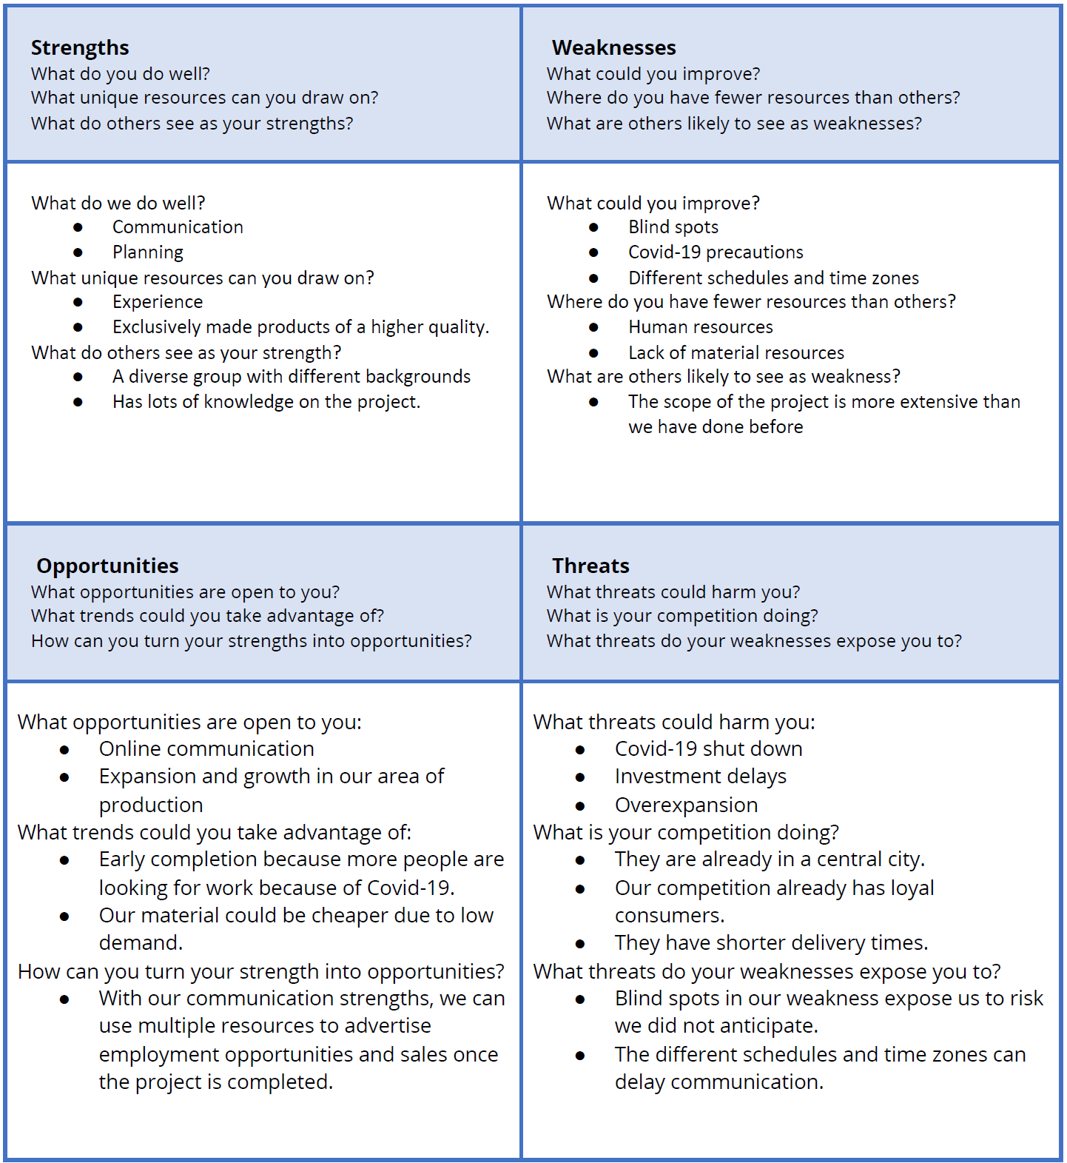
SWOT Analysis

Slide 4
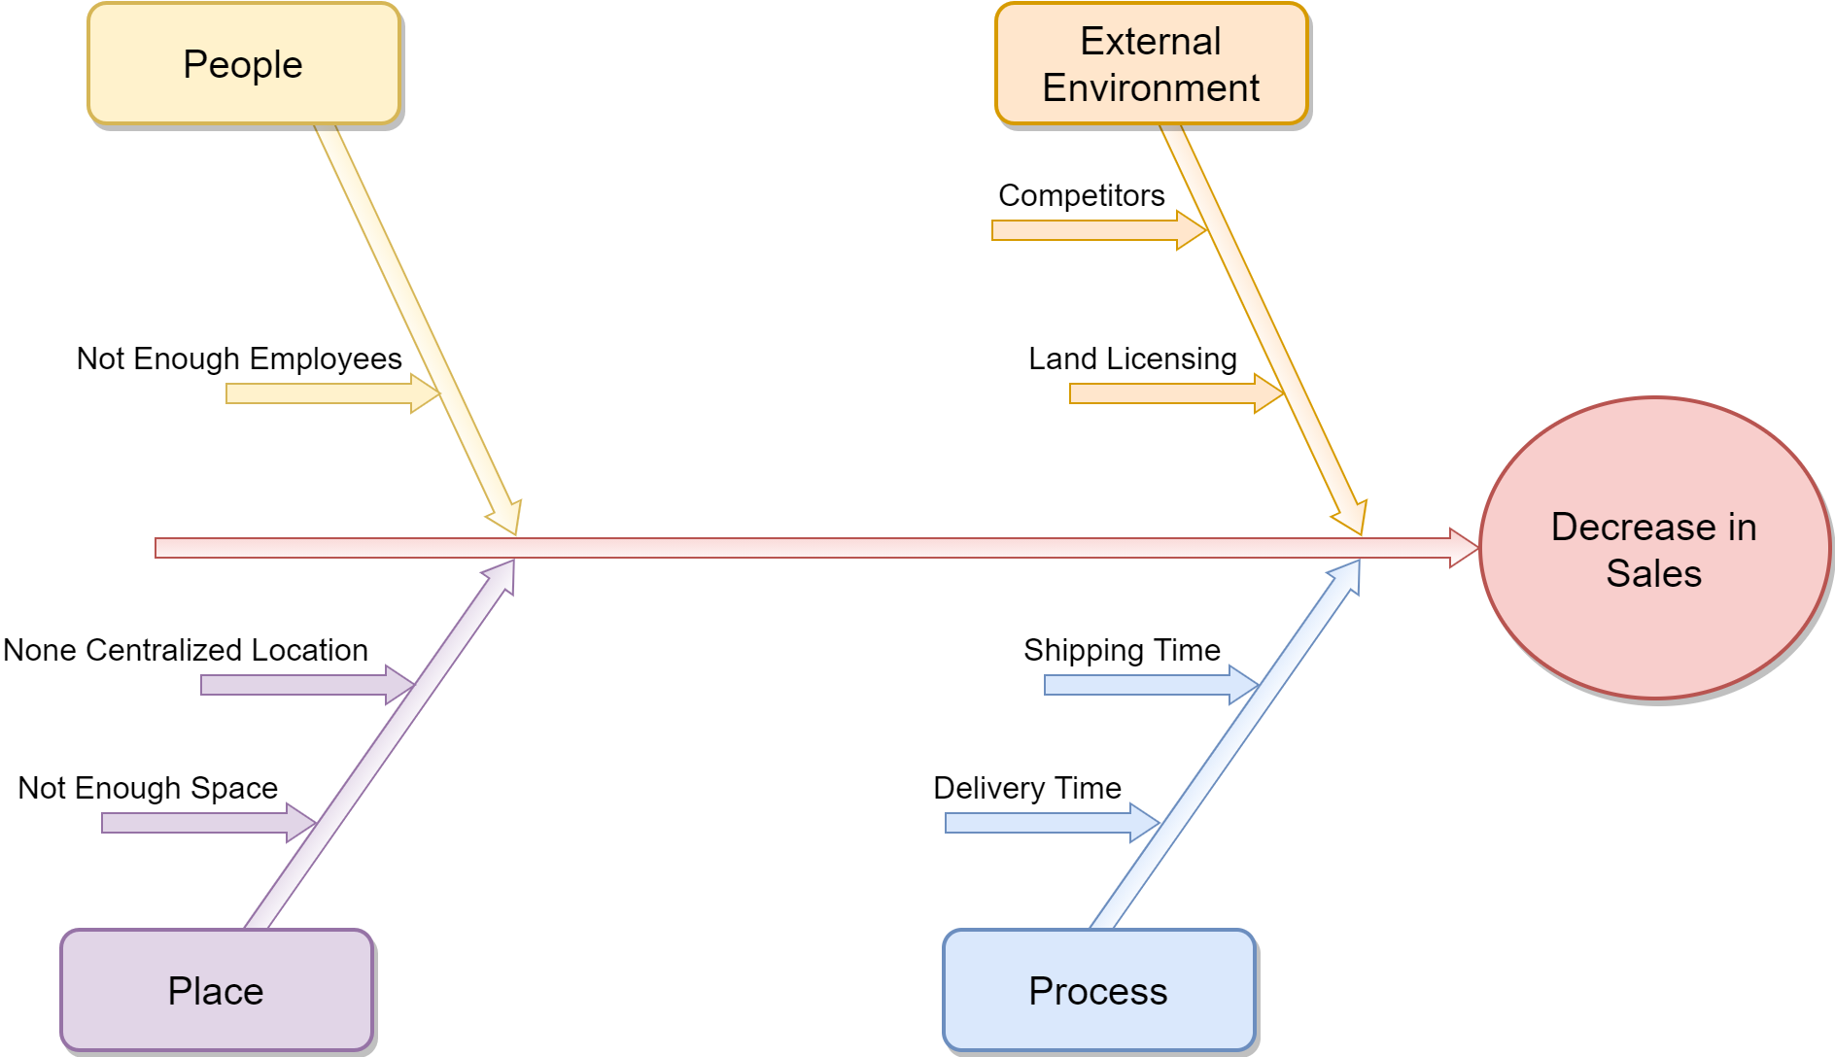
Fishbone Diagram

Slide 5
Project Scope
Find a location for warehouse
Hire employees for the new location
Contract drivers for deliveries, work with material companies to make sure we have enough inventory to fill new orders
Provide mandatory safety classes

Slide 6
Project Constraints
We cannot start the construction project until the spring season, and we need to finish the warehouse’s construction before April 2022.
We have limitations to find land because we will build the warehouse in a big city.
We may face limitations in human resources to find skilled employees.
We do not have skilled employees for the new warehouse.

Slide 7
Project Constraints
We probably will face some regulatory restrictions from governmental organizations.
COVID-19 and its impact on our project is another restriction.
Sanctions can impact our abilities to order specific machines and gain certain technology due to the US sanctions.
The solution implementation should not increase the work pressure on our current employees.
The policies of the company for hiring probably makes the hiring process slower.

Slide 8
Fact-Finding
Project Usability: We will be able to produce new products in a timely manner.
Average cost: 11,550,258,480.89 IRR (274,290.08 USD)
Average Schedule: Estimated a little over a year
Benefits:
New Customers
Larger Consumer Area
Cheaper Cost For Delivery
Increase in Sales

Slide 9
Operational Feasibility
Our warehouse expansion project is a response to the long delivery time and a constant decrease in sales. It is not complicated, and we do not see any lack of feasibility in this area.

Slide 10
Technical Feasibility
We hired a construction company for the building of the warehouse. We also employ a consulting team for this project. So we do not have any technical problems.

Slide 11
Economic Feasibility
Tangible Costs: Land costs, licensing costs, training costs, cost of hiring a construction contractor, facility costs, hiring new employees’ expenses, safety costs, and consulting costs.
Intangible Costs: Lost production and delivery while we are adapting our system to the new warehouse.
Tangible benefits: Increased sales, shorter delivery time
Intangible benefits: Increased market share, Improved customer service, increased brand recognition.

Slide 12
Schedule Feasibility
We cannot start the construction project until the spring season, and we need to finish the warehouse’s construction before April 2022.

Slide 13
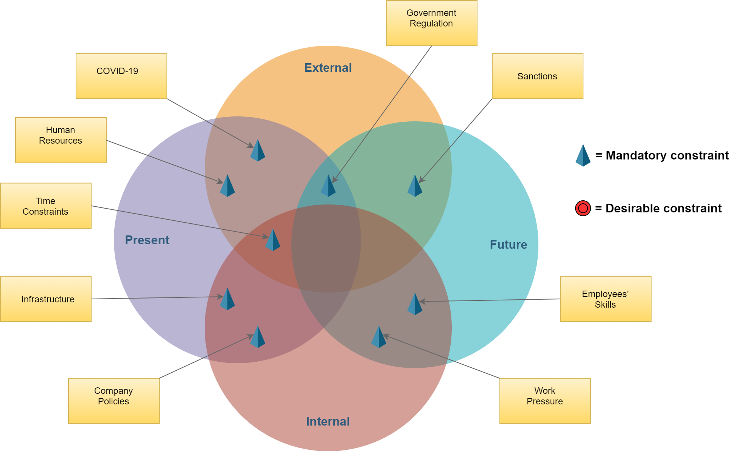
Feasibility Grid

Slide 14
The risks associated with each of the feasibility areas
The risk of situations that could delay the schedule
The risk of not finding the proper land and delaying the start of the construction
A lack of interest in our jobs that are being offered due to Covid-19
In Iran, the government has stricter policies that can frequently change, which can cause multiple issues and delays
The US recently started to enforce new technology and machinery sanctions against Iran, delaying certain projects

Slide 15
Feasibility Analysis
Previously we learned the importance of having a SWOT analysis to determine our strengths, weaknesses, opportunities, and threats. We also learned we could not solve a problem without knowing the root cause, thanks to the fishbone diagram. When learning about feasibility, we learned there were multiple kinds of feasibility, including operational, technical, and economical. They were all different kinds of feasibility required to perform our project in a positive, successful manner. We learned that it's not just a matter of learning each step of those feasibilities but also understanding what risks are associated with each feasibility concept. I would be interested to know more about feasibility analysis and different scenarios, not just in our warehouse scenario, so I can have a broader sense of how it's used regularly in a business form.

Slide 16
Assumptions
The project start date is February 1, 2021
Delivery times shortened
Expansion to more cities
Increase of sales
Economy is stable
Covid-19 continuing to be an ongoing issue that we will have to stay on top of
Project finish date April 20, 2021

Slide 17
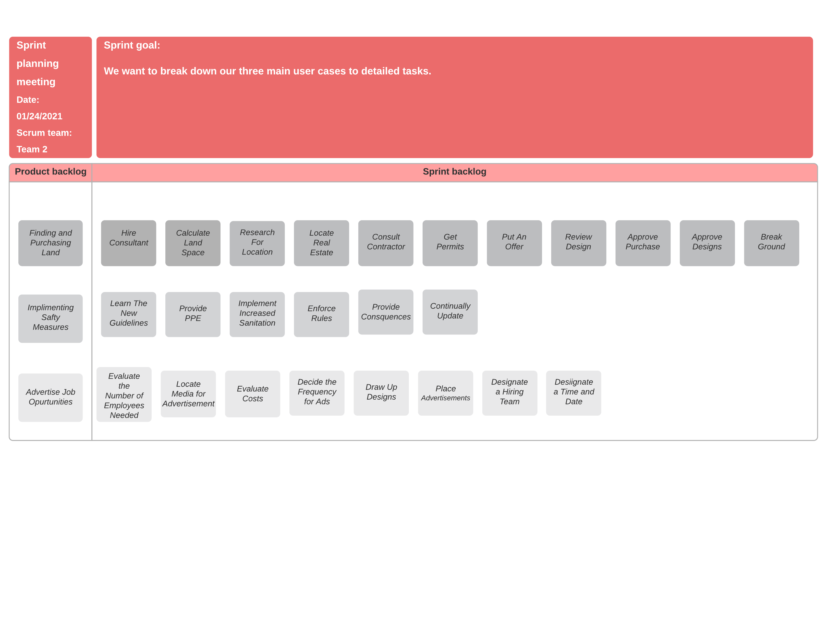
Sprint Plan

Slide 18
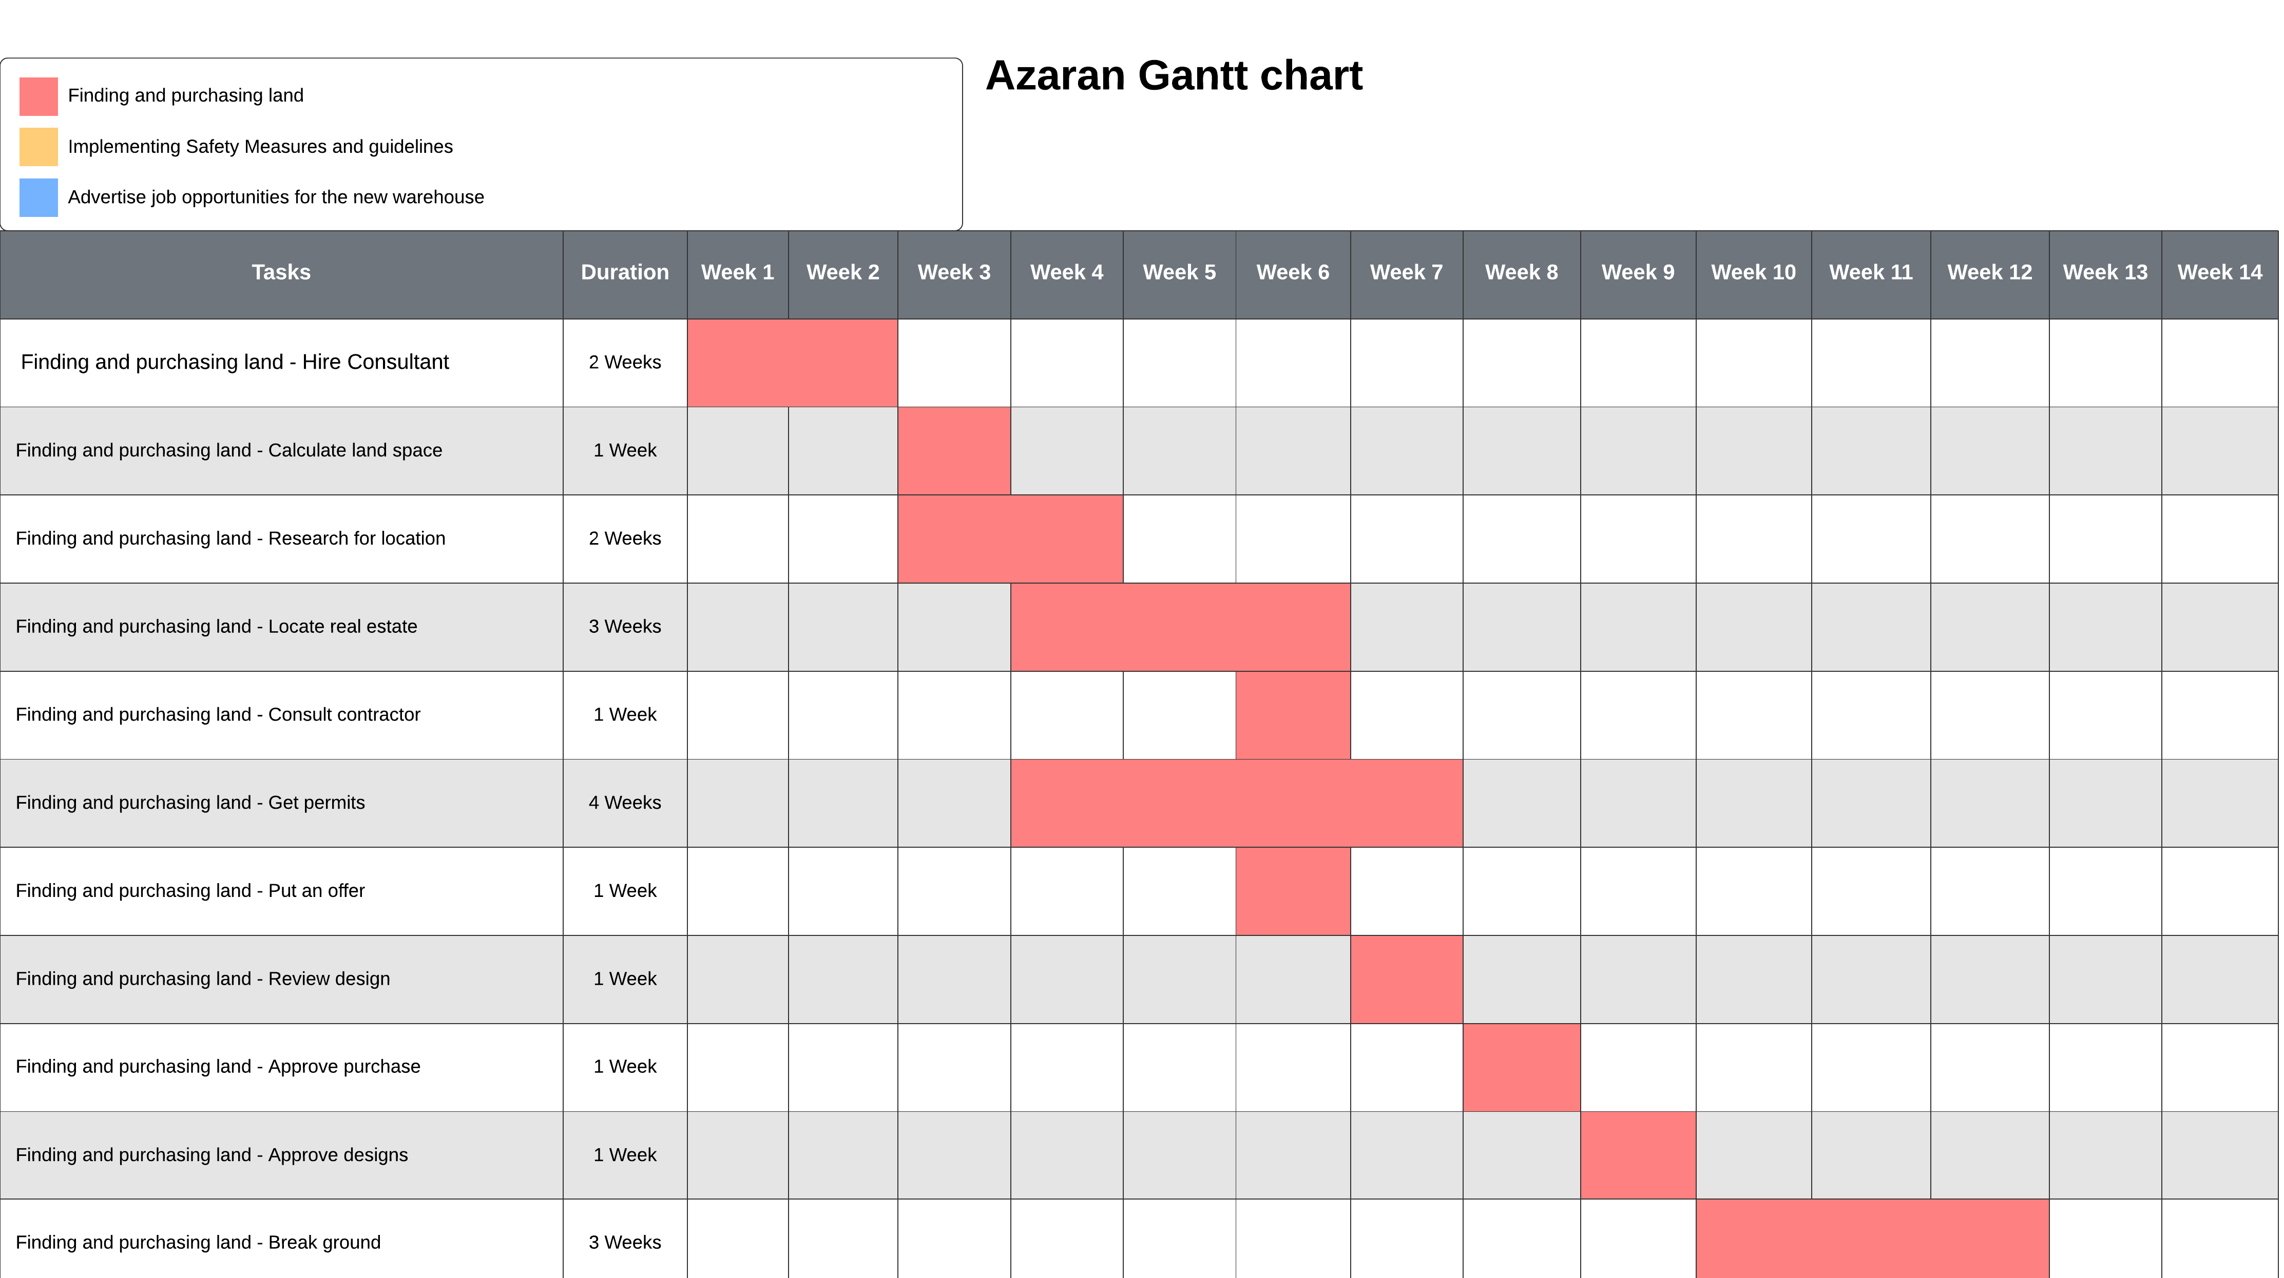

Slide 19
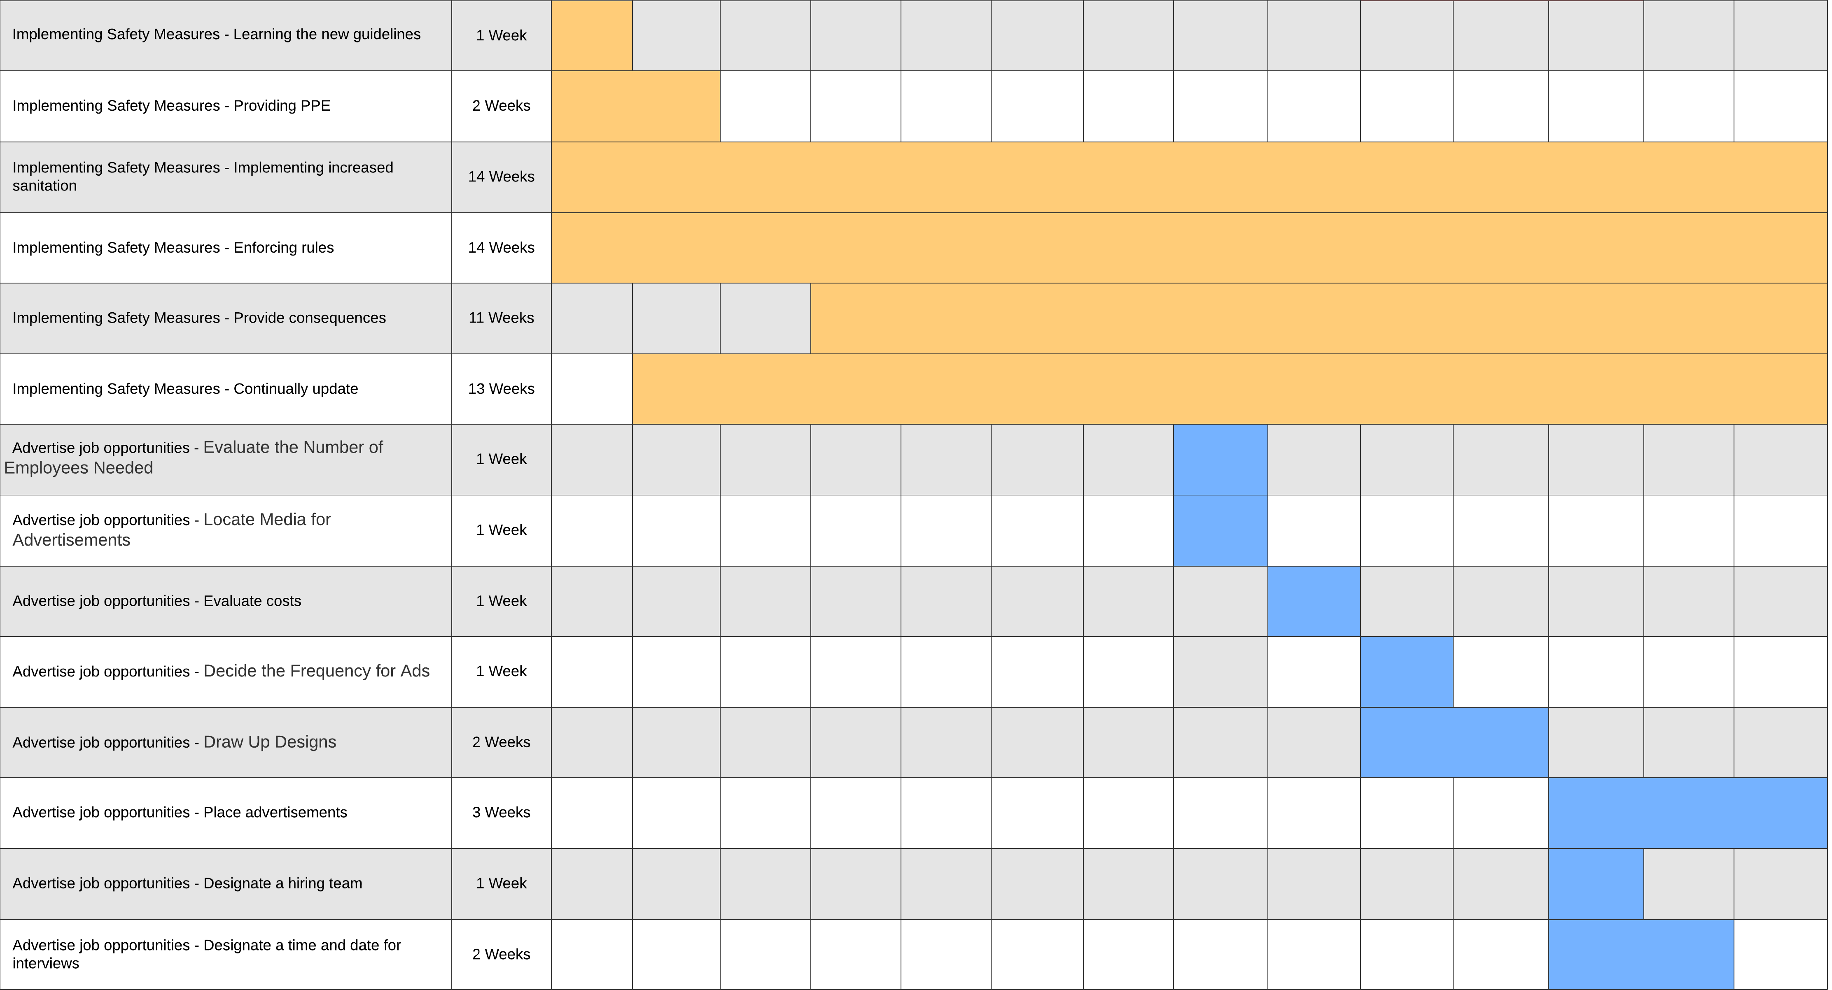

Slide 20
Project Plan
We have learned what a project plan is, what shapes the project, how it continues, and how we can eliminate it. We've learned more about creating a work breakdown structure, including Gantt charts, PERT/CPM charts, identifying tasks in a work breakdown structure, and what may affect the duration. These are important and determine our project plan and how to make sure our plan has critical pathways that show the beginning to the end of the project. These are to help us identify items or issues that may pop up or that we're currently dealing with, like Covid-19, that we need to make critical action plans to prevent any hold up of our project. I would love to know more ways of possibly identifying other problems that may occur. I think currently we have a good group where we are well-rounded in that information but wonder how we independently could help identify other issues or critical path Waze that could hold projects back or end up having to close our project down.

Slide 21
Output Requirements
The company owners will get more revenue, which will help the company stay in business, so we continue to offer the community jobs.
The business analysts will complete this project and will receive job experience and gain a reputation.
The construction company will build a bigger network by building our warehouse, giving them more business options.

Slide 22
Process Requirements
New employees will need to be trained and educated on CDC guidelines in a timely fashion so that work can be completed safely.
Consumers will receive their orders in a timelier manner with regular status updates.
New applicants who get hired will receive living wages and gain job experience.
Advertise for job opportunities for the new warehouse
Providing local surveys to gather information on what the consumers want
Updating our IT infrastructure

Slide 23
Control Requirements
The insurance company will cover building, employees, equipment, and any accidents on site with respect, honesty, and fairness so that our reputation shows we are for the people and not just about money.
Implementing safety standards and cleaning procedures to follow the CDC guidelines concerning Covid-19
Interviewing, hiring, and training all new applicants

Slide 24
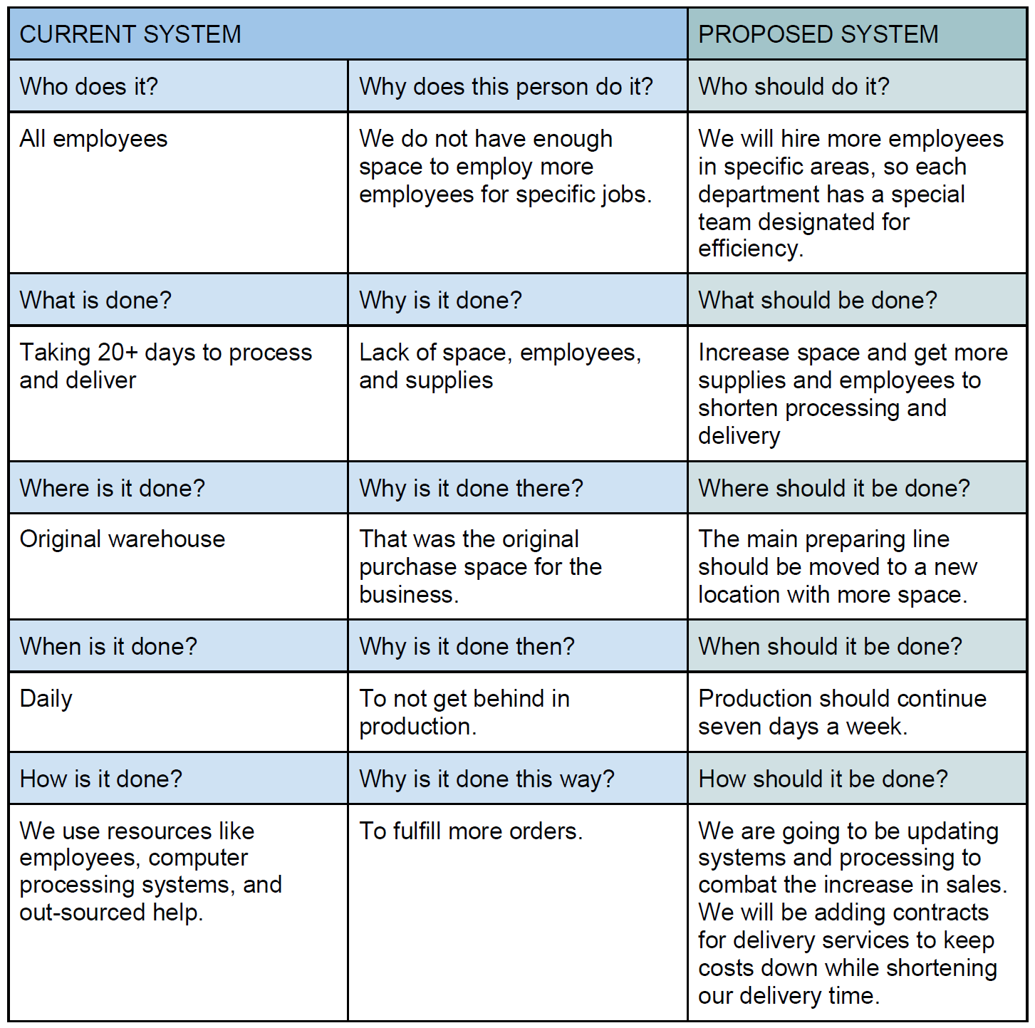
Zachman Framework

Slide 25
Requirements Models
There are multiple model requirements and diagrams that we could have used, including the system requirement checklist. We could have used scalability fact-finding, but we felt to limit how many we offered so that we would not overwhelm ourselves and our clientele. We learned how to set up our Zackman framework as well as how to complete a fact-finding overview and why they were important. Including who our consumers are, what, where, when, how, and why were the big questions we had to ask ourselves to make sure we are meeting all the needs and touching on every angle that would be beneficial to the company. I do hope we go further into learning the different processes like joint application development, rapid application, and development of the agile method. We could gain a lot more information on those as we continue learning.

Slide 26
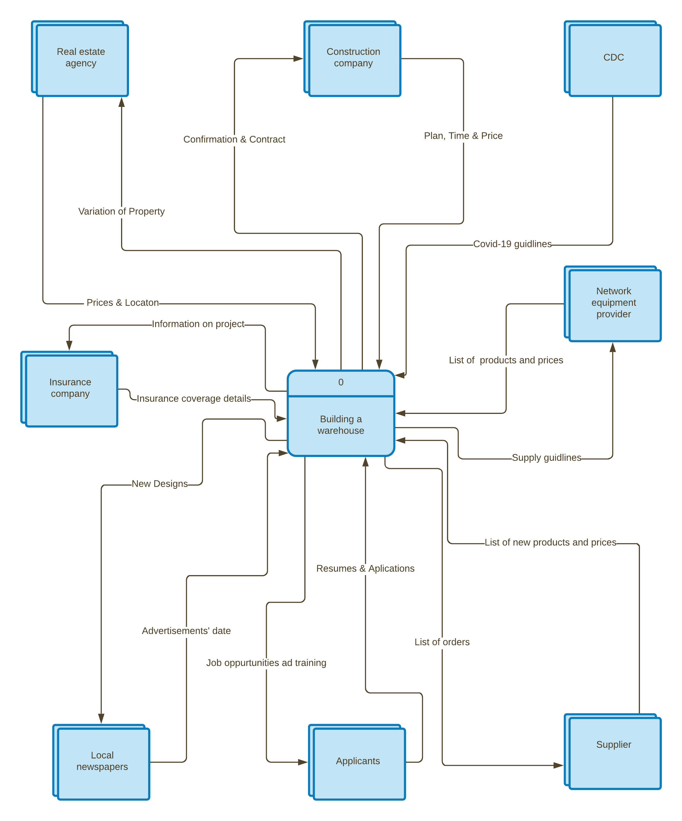
Context Diagram

Slide 27
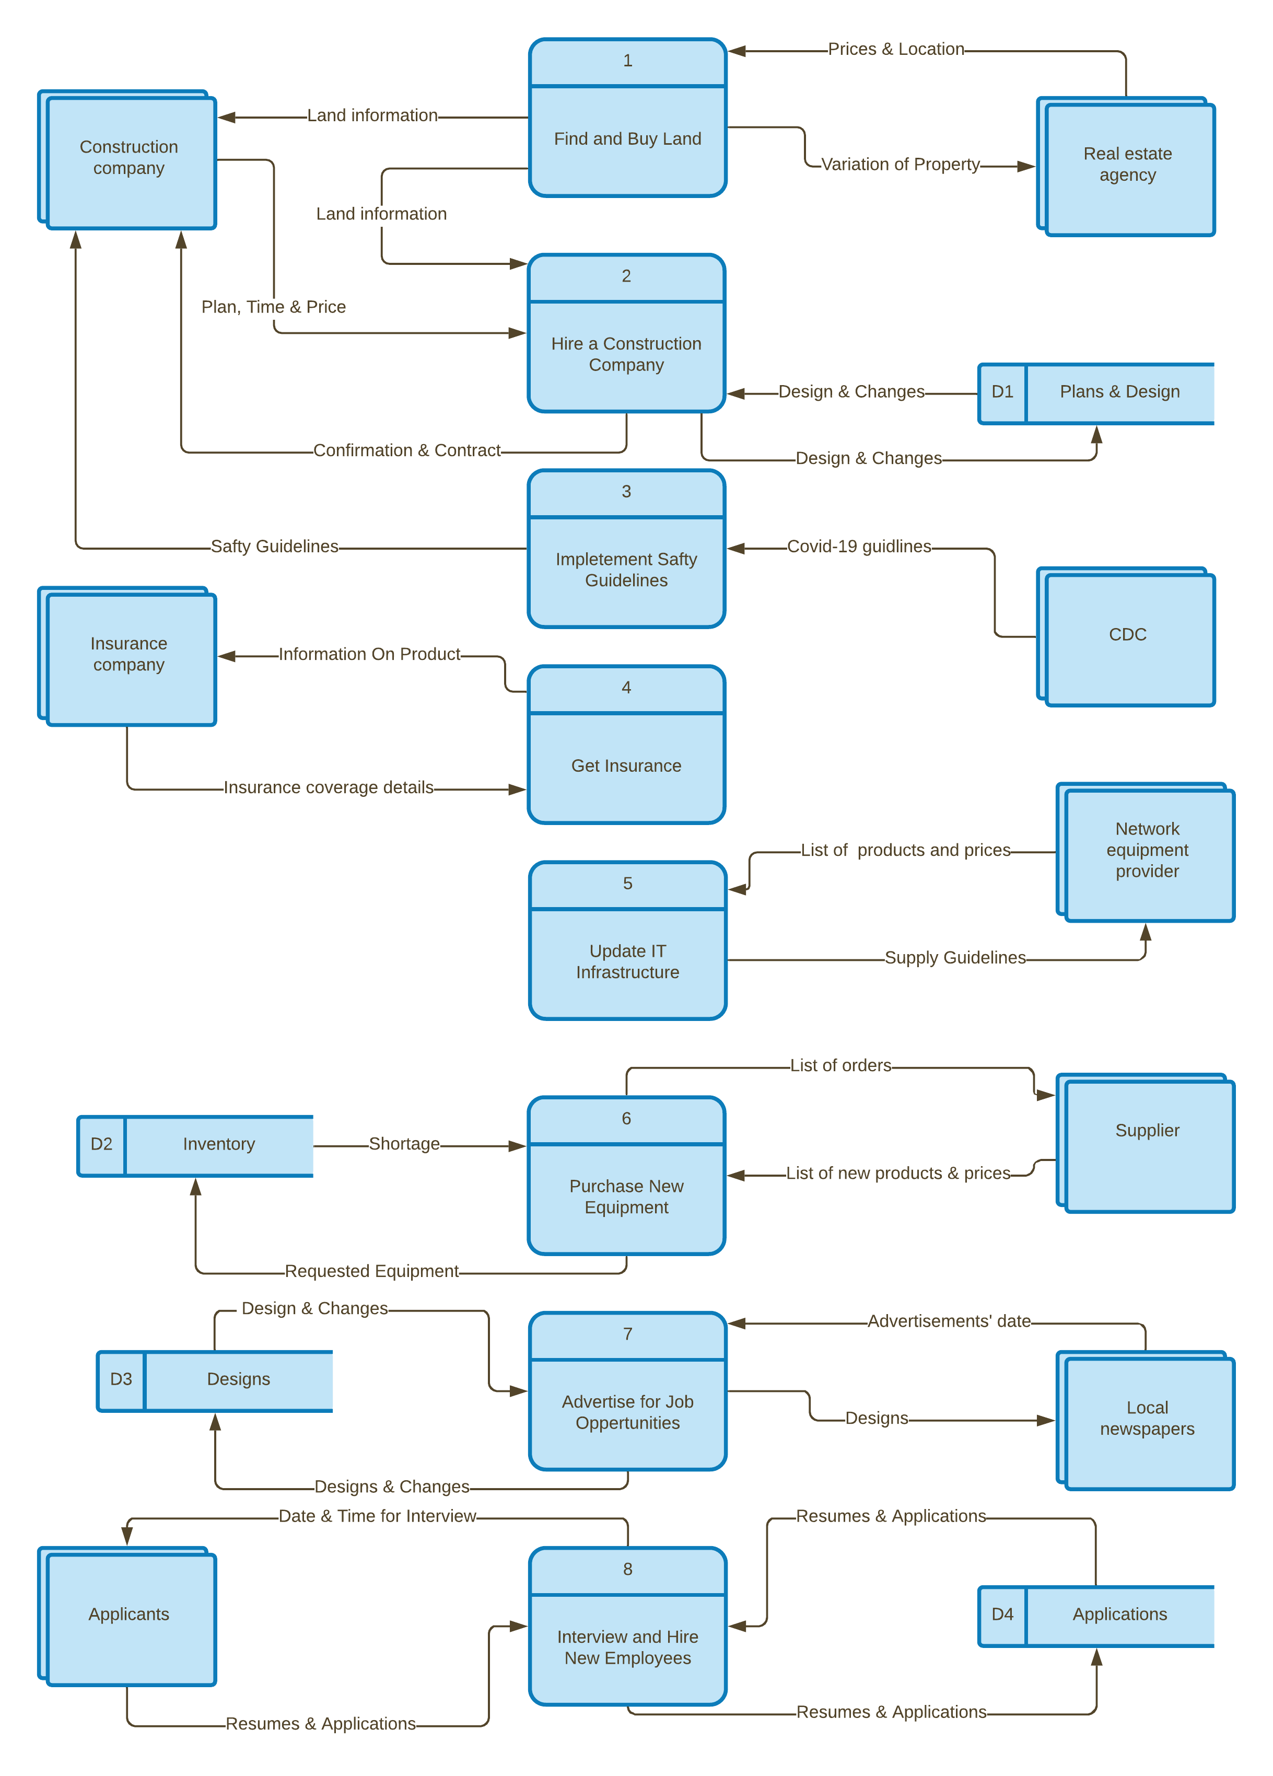
Diagram
0 DFD

Slide 28
Data Flow Diagram
After learning about how important a data flow diagram is, it was fascinating to dive deeper into those different styles of data flow diagrams. When learning about the various data flow diagrams, we understand the importance of a data dictionary and how it should be labeled and filled out so that whoever is viewing our project will have a clear understanding of our process. I would be curious to know if our data flow diagrams always go to the brain diagrams, we use.

Slide 29
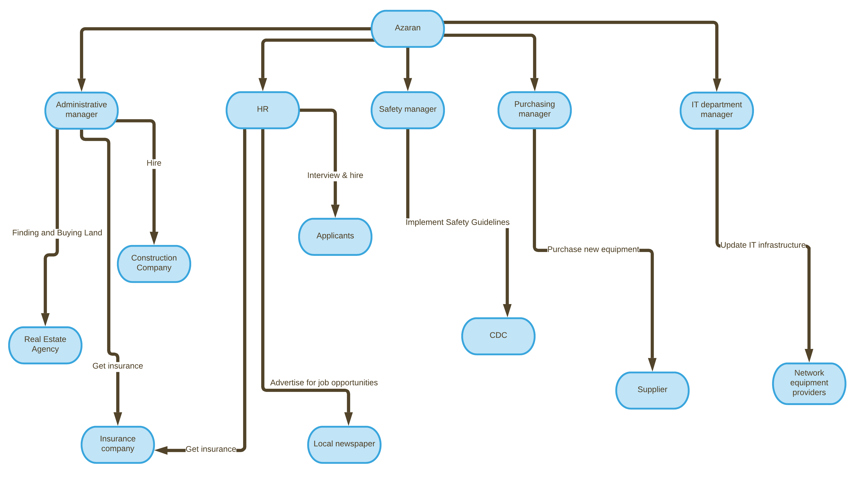
Object Relationship Diagram

Slide 30
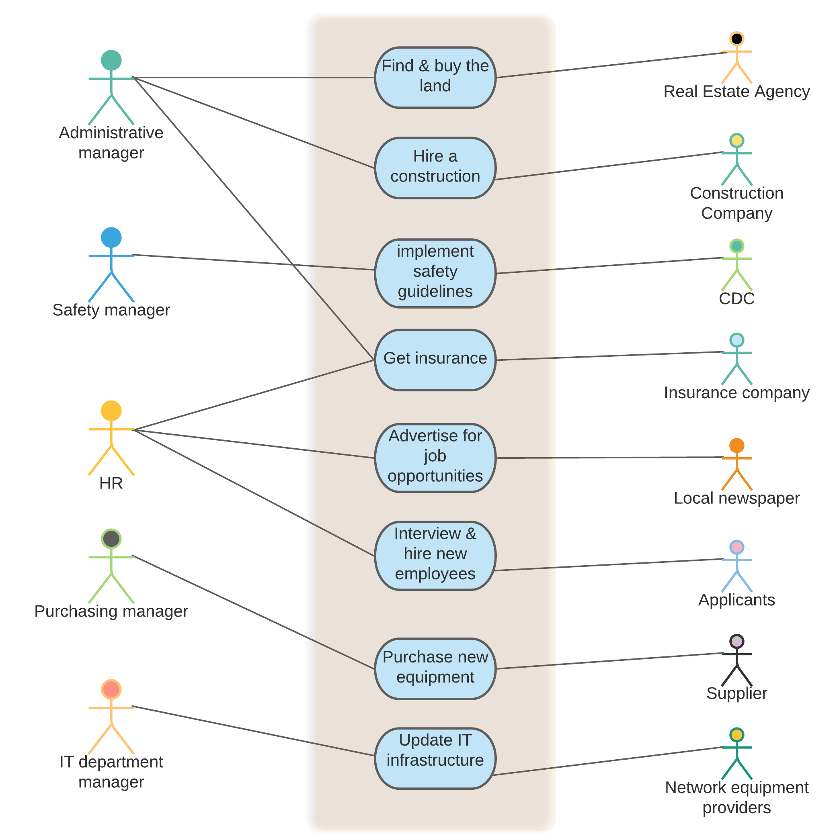
Use Case Diagram

Slide 31
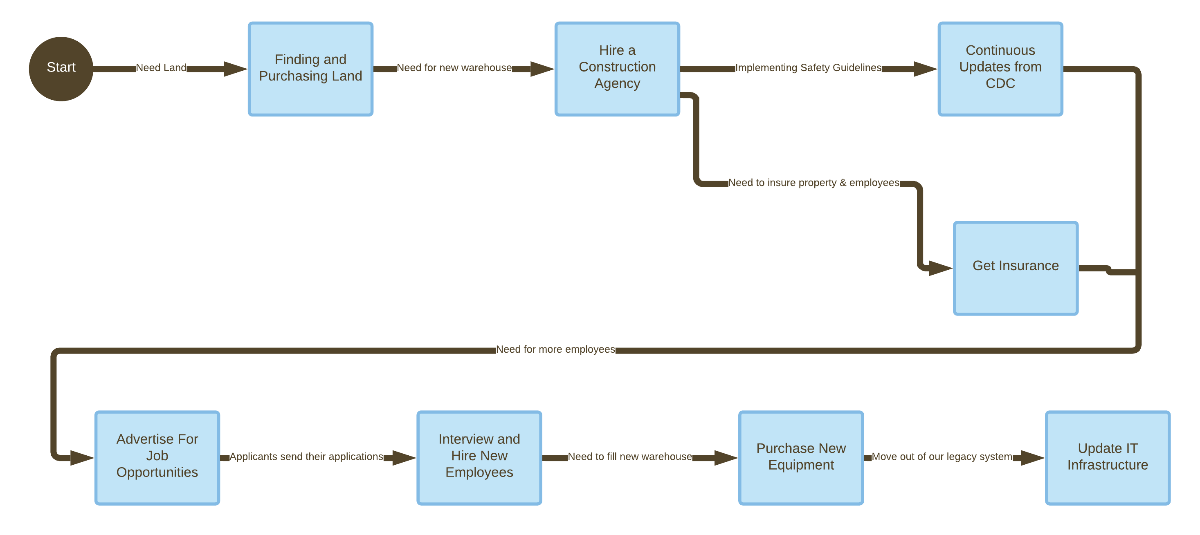
Activity Diagram

Slide 32
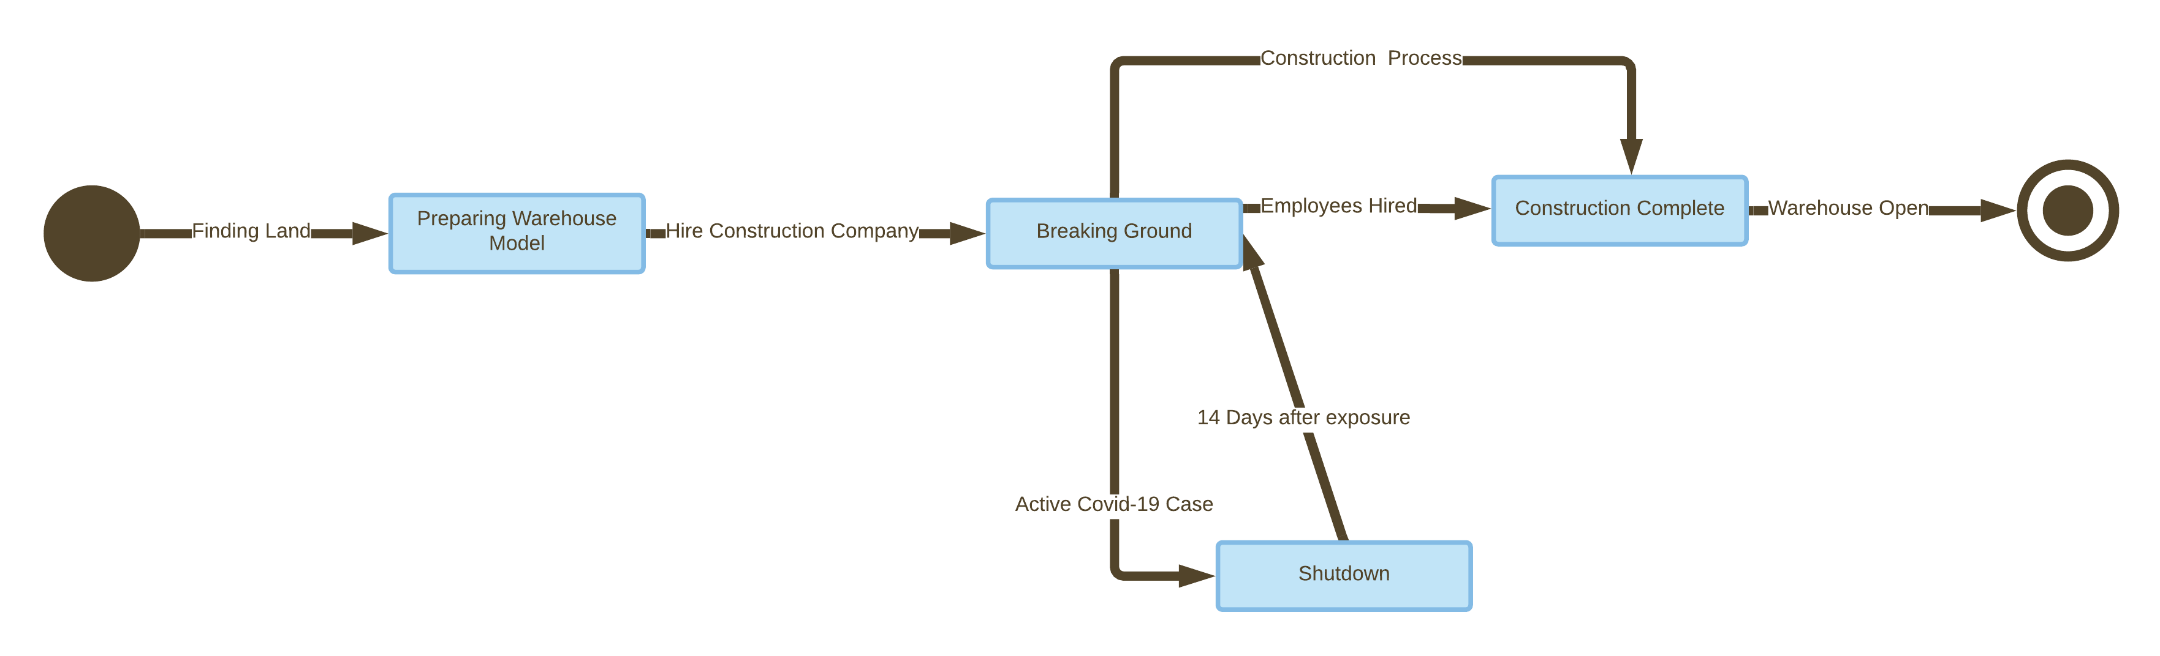
State Transition Diagram

Slide 33
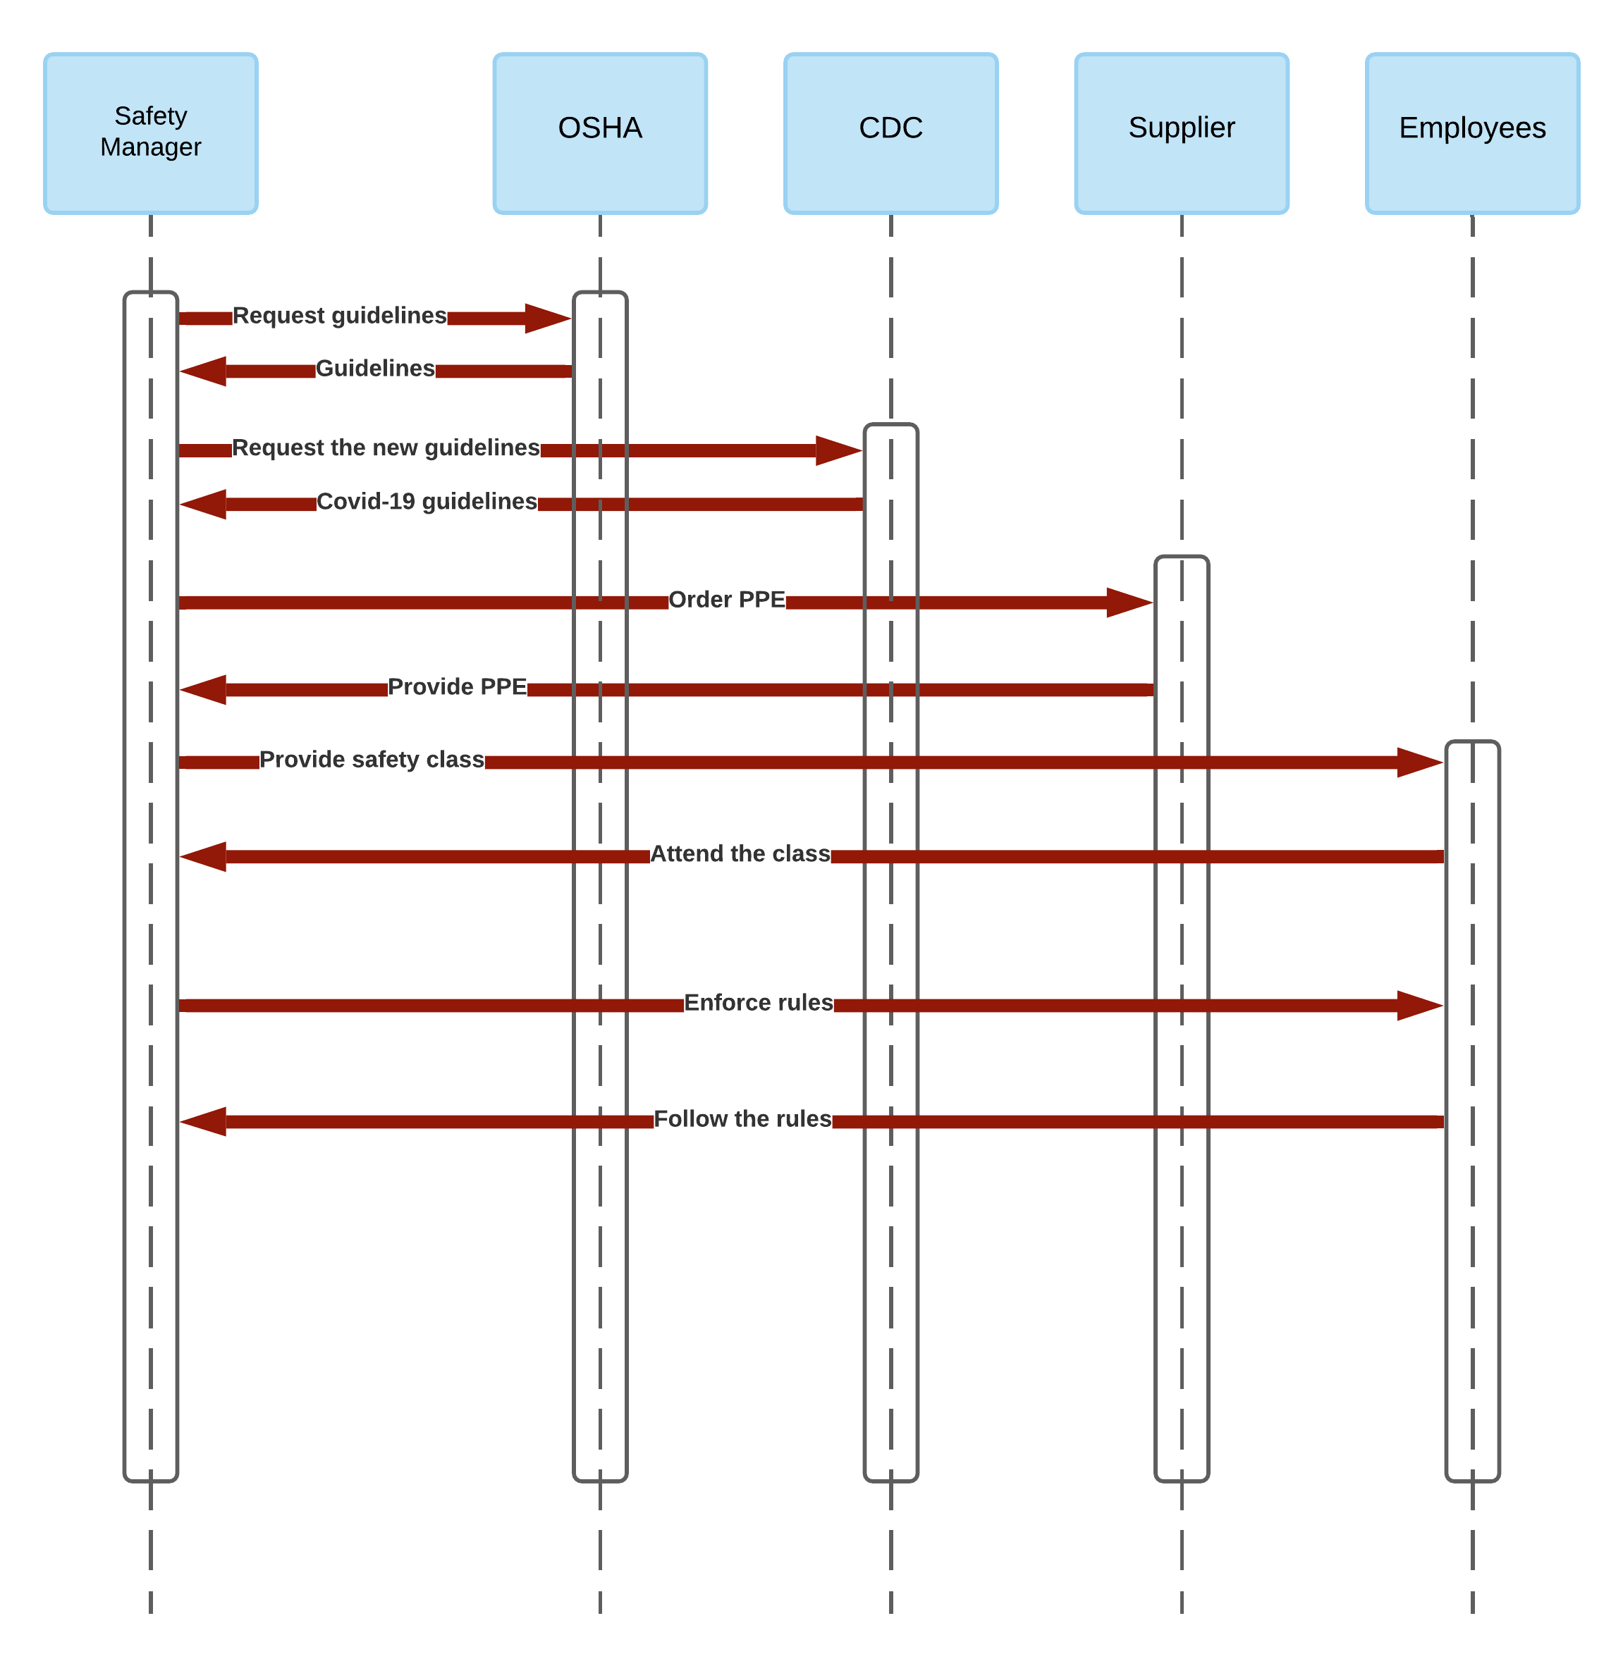
Sequence Diagram

Slide 34
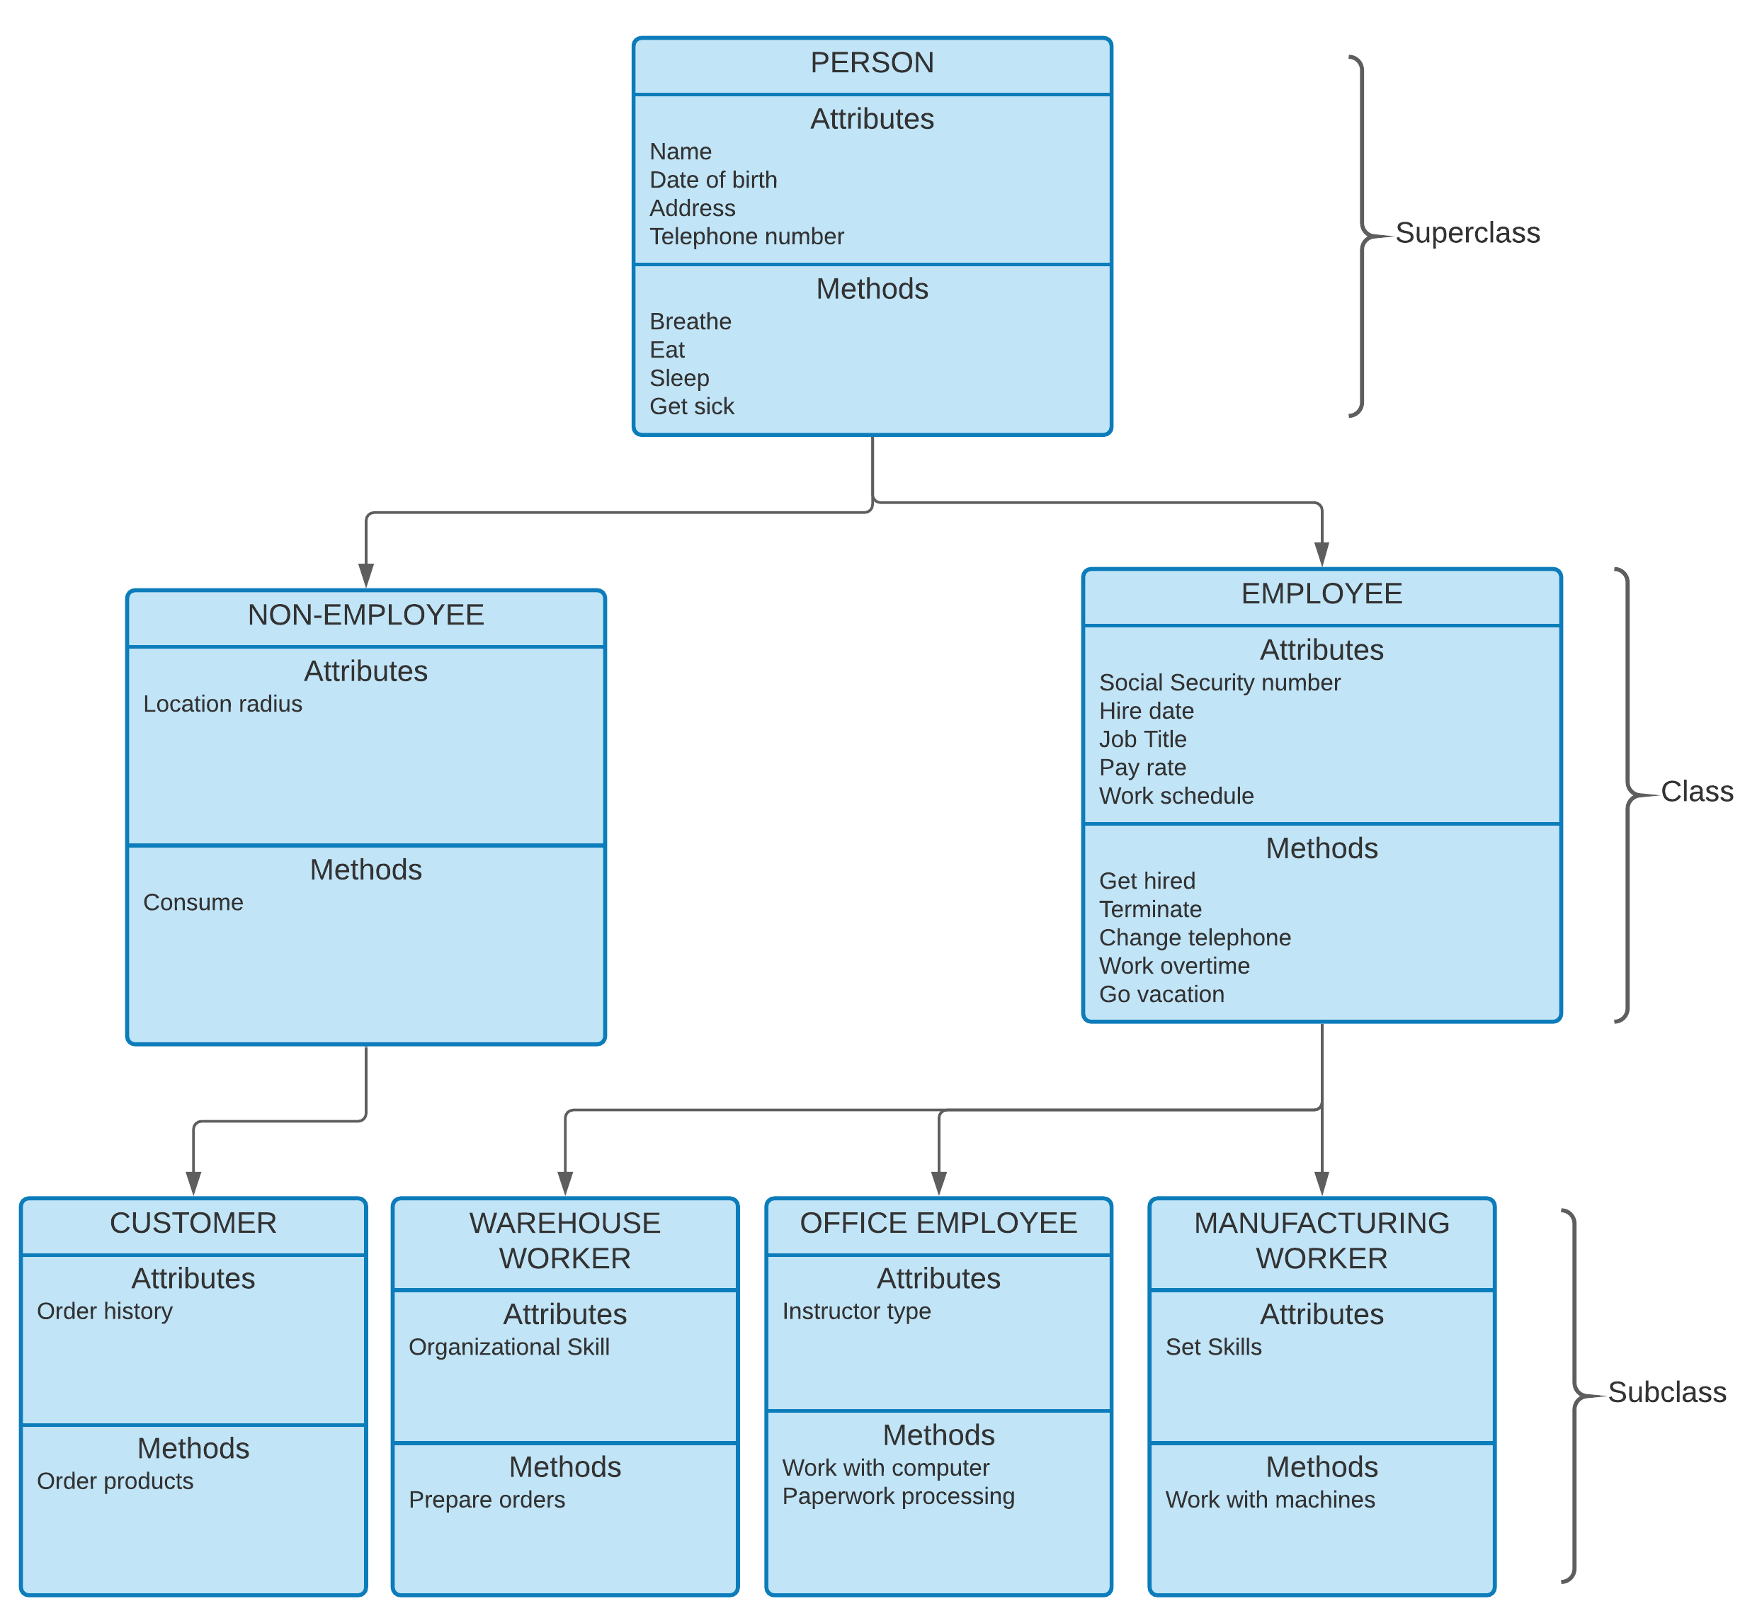
Superclass
Class
Subclass

Slide 35
UML/Object Models
Object models and unified modeling language were something that we knew a little bit about like the DFD models but not nearly as much as we learned from this chapter. We learned that there were multiple structure analysis models that we could use to analyze our systems, including the Use Case model, class diagrams, sequence diagrams, and state transition diagrams; these were all new diagrams that we learned. I feel we could go into more detail with State diagrams as well as business process modeling; though they make sense, it was a little bit trickier making sure the points and lines and activities aligned correctly.

