Slide 1
TRACES User Manual
Tagged Records of Accountable Equipment and Supplies
Supply Unit, Department of Science and Technology Region 1
How to use the system, step by step. No experience needed.
TRACES User Manual · page 1

Slide 2
How to read this manual
Every picture in this manual is a real TRACES screen.
A red number with an arrow points at the part of the screen to look at or click. The numbered steps beside the picture say what to do, in the same order as the red numbers.
Words in bold or in "quotes" are written exactly as they appear on the screen, so you can find them.
The names, slip numbers and amounts in the pictures are made up for training. Your screens show your office's own records.
You cannot break anything by looking around. Nothing changes until you press a button such as Save, Upload or Remove, and every change is recorded in the audit log.
TRACES User Manual · page 2

Slide 3
Words used in TRACES
ICS (Inventory Custodian Slip): the slip given when semi-expendable property (costing less than ₱50,000) is handed to an officer.
PAR (Property Acknowledgment Receipt): the same for property, plant and equipment (PPE) costing ₱50,000 or more.
Accountable officer: the person who receives the property and is responsible for it ("Received by").
Card (SPC or PC): the property card of one model, for example "Laptop, Acer TravelMate P2". Every time that model is received or issued, a row is added to its card.
Registry: the list of everything issued (RegSPI for semi-expendable property, the PPE registry for PPE).
Report (RPCSP or RPCPPE): the physical count report: everything one officer holds on a date, printed for the inventory count.
Property number: the number that identifies one item, like 2026-11ICT-0017 (year, month, type, running number). TRACES suggests it.
Component: a part of a set, like the monitor of a desktop set. It has its own number (main number plus a letter) and its own sticker.
QR sticker: the sticker on the item. Scanning it with a phone opens the item's records.
Signed copy: the scan of the slip after it was signed. Once it is uploaded, the slip cannot be changed any more.
TRACES User Manual · page 3

Slide 4
The usual order of work
1. Enter the issuance on the "New issuance" page: what was bought, who receives it, and the slip numbers. TRACES fills the card, the registry and the report, and makes the ICS or PAR.
2. Print the ICS or PAR and have it signed.
3. Scan the signed slip and upload it ("Upload signed copy"). The slip is now locked.
4. Print the QR stickers and put them on the items.
5. At inventory time, open "Reports", print the report of each officer and count the items by hand.
Old paper slips can be encoded the same way: use "Save, I'll upload the PDF" and upload the existing scan.
TRACES User Manual · page 4

Slide 5
Contents
Part 1. Getting started
Part 2. People and property types
Part 3. Entering an issuance
Part 4. ICS and PAR documents
Part 5. Cards, registry and property
Part 6. Reports
Part 7. QR stickers
Part 8. Scanning a sticker
Part 9. Administration
Part 10. Your account
TRACES User Manual · page 5

Slide 6
Part 1. Getting started
TRACES User Manual · page 6

Slide 7
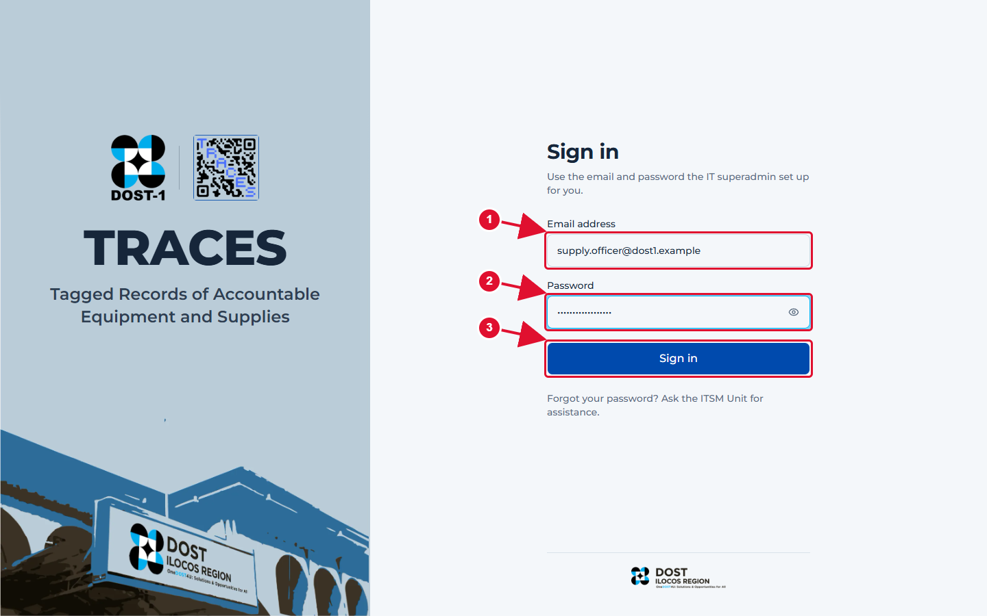
Sign in
1 Type the email address the IT administrator gave you.
2 Type your password. Click the eye icon to see what you typed.
3 Click Sign in.
Good to know: Forgot your password? Ask the ITSM Unit. There is no "reset my password" link on purpose.
TRACES User Manual · page 7

Slide 8
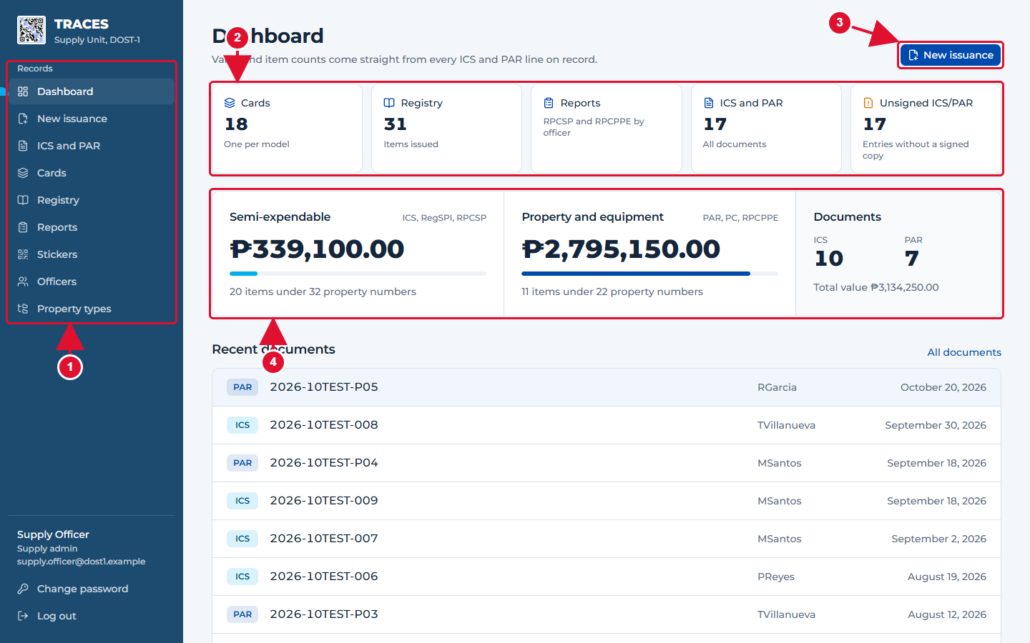
The dashboard: where every day starts
1 The menu. It is always on the left. Click a name to open that page.
2 Shortcuts. Each box shows a count and opens its page when clicked.
3 New issuance: start here whenever property is handed to someone.
4 The amounts of semi-expendable property and of property, plant and equipment (PPE) on record.
TRACES User Manual · page 8

Slide 9
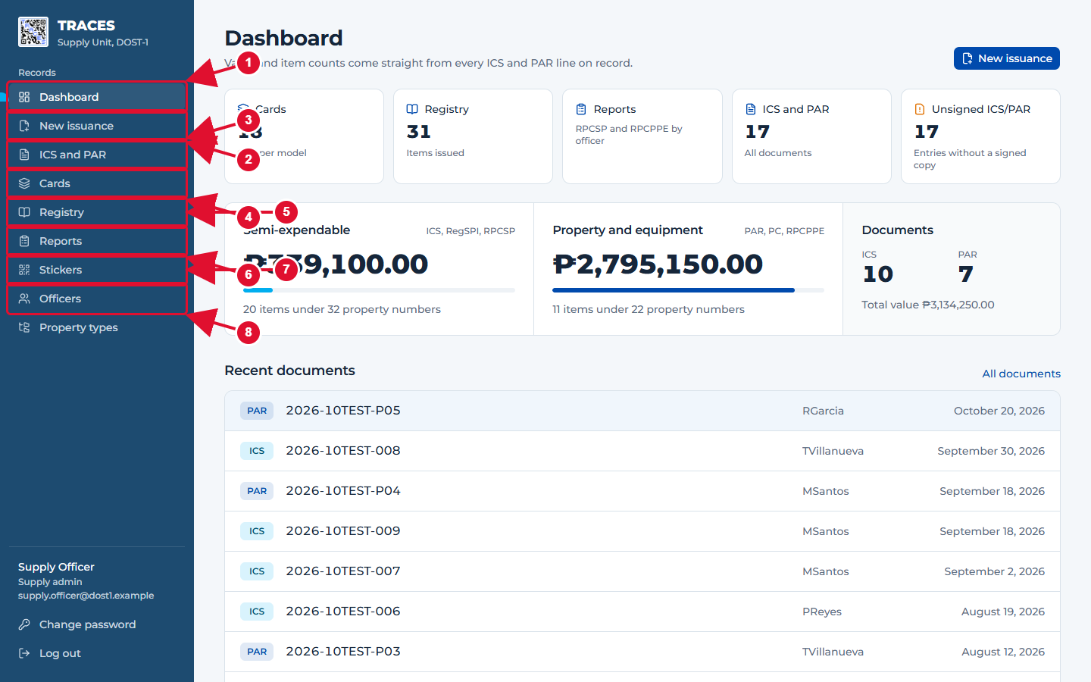
What each menu item is for
1 Dashboard: totals and shortcuts.
2 New issuance: record property given to an officer. TRACES makes the ICS or PAR for you.
3 ICS and PAR: every slip and receipt, printed or signed.
4 Cards: one property card per model (SPC or PC).
5 Registry: the registry of property issued (RegSPI and the PPE registry).
6 Reports: what one officer holds on a date (RPCSP or RPCPPE), for the physical count.
7 Stickers: print QR stickers.
8 Officers and Property types: the lists the forms pick from.
TRACES User Manual · page 9

Slide 10
Part 2. People and property types
TRACES User Manual · page 10

Slide 11
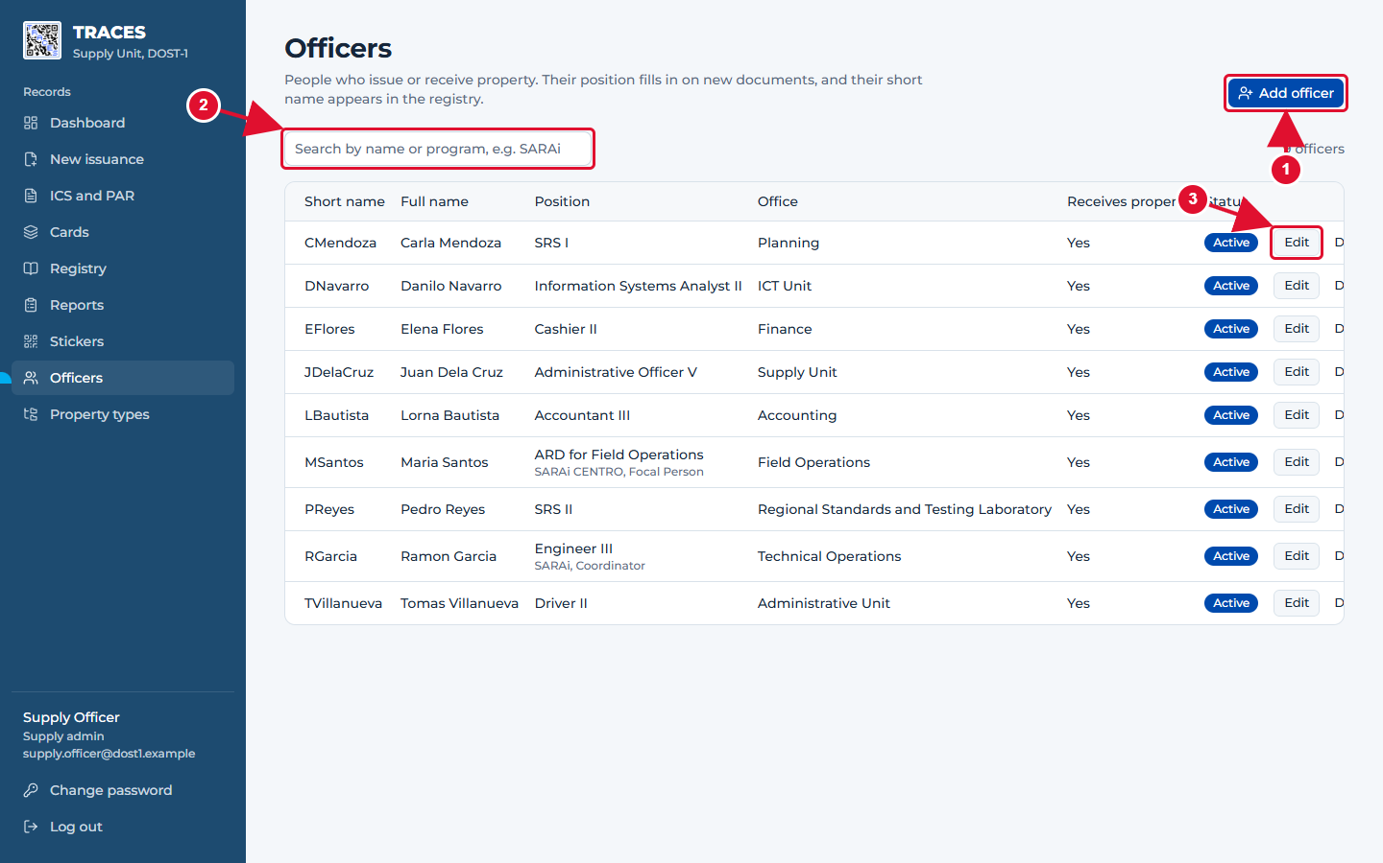
Officers: the people who issue and receive property
1 Click Add officer to add a person.
2 Type a name or a program (for example SARAi) to find someone.
3 Edit changes a person; Deactivate hides them from new forms but keeps their records.
TRACES User Manual · page 11

Slide 12
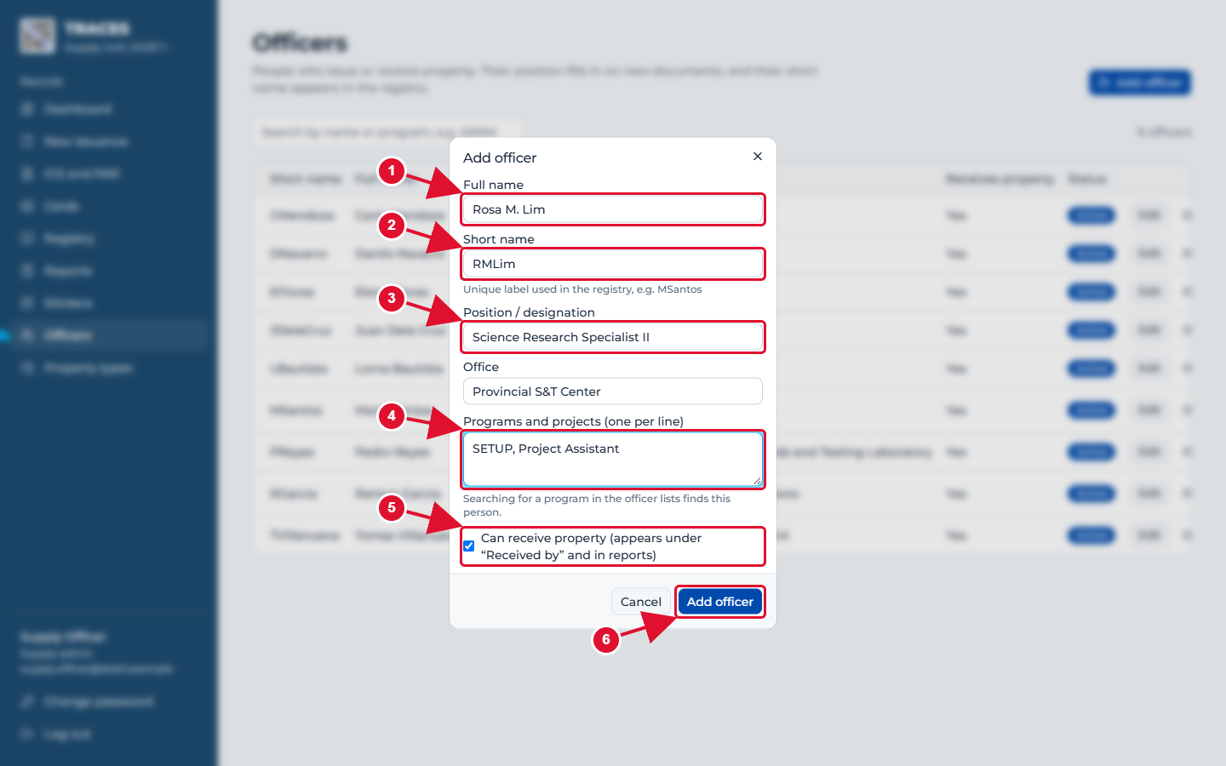
Adding an officer
1 Full name, as it should be printed on forms.
2 Short name: a short label that must be unique, like RMLim. It appears in the registry.
3 Position: printed under the name on the ICS and PAR (you can still change it on each form).
4 Programs and projects, one per line. Searching for a program finds this person.
5 Leave "Can receive property" ticked for anyone who will sign as "Received by".
6 Click Add officer to save.
TRACES User Manual · page 12

Slide 13
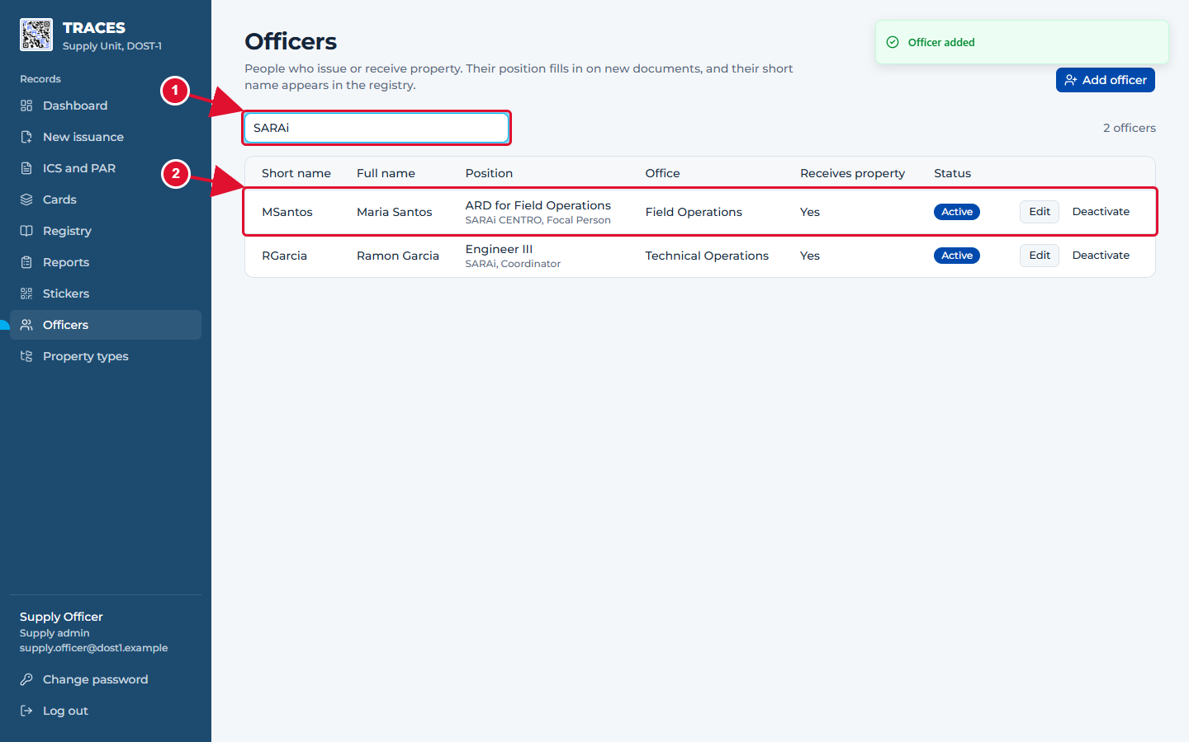
Finding an officer by program
1 Typing a program name lists everyone working on it.
2 The programs are shown under each position.
TRACES User Manual · page 13

Slide 14
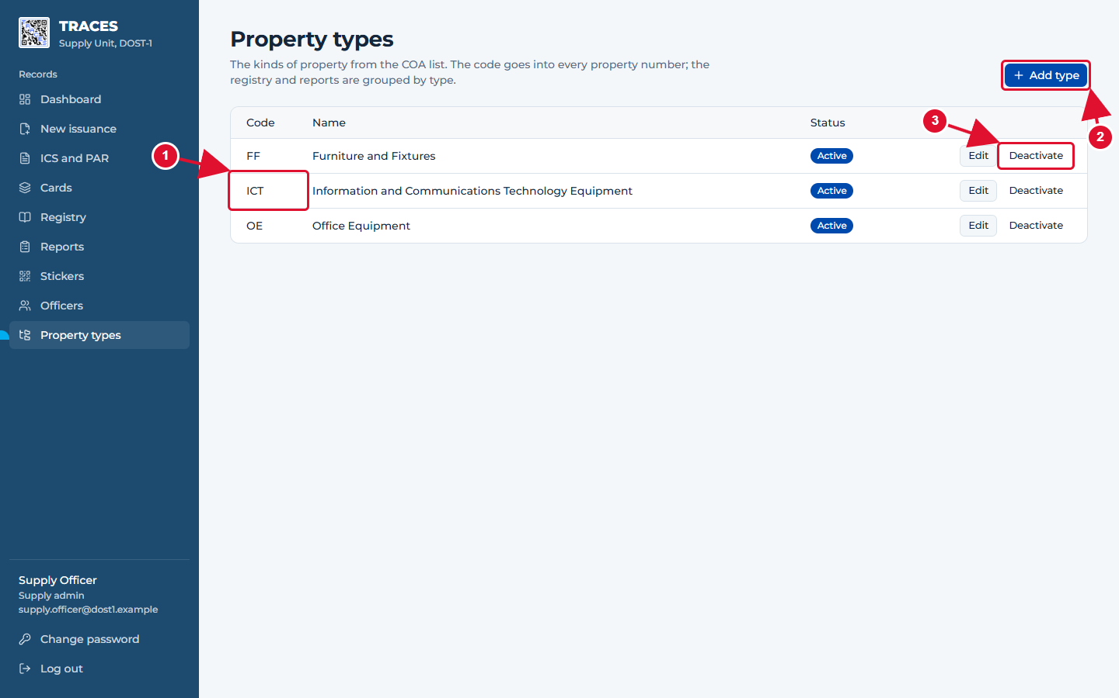
Property types
1 The code is the letters inside every property number, like ICT in 2026-11ICT-0005.
2 Add type when the COA list has a kind of property that is not here yet.
3 Deactivate a type that should no longer be used for new property.
TRACES User Manual · page 14

Slide 15
Part 3. Entering an issuance
TRACES User Manual · page 15

Slide 16
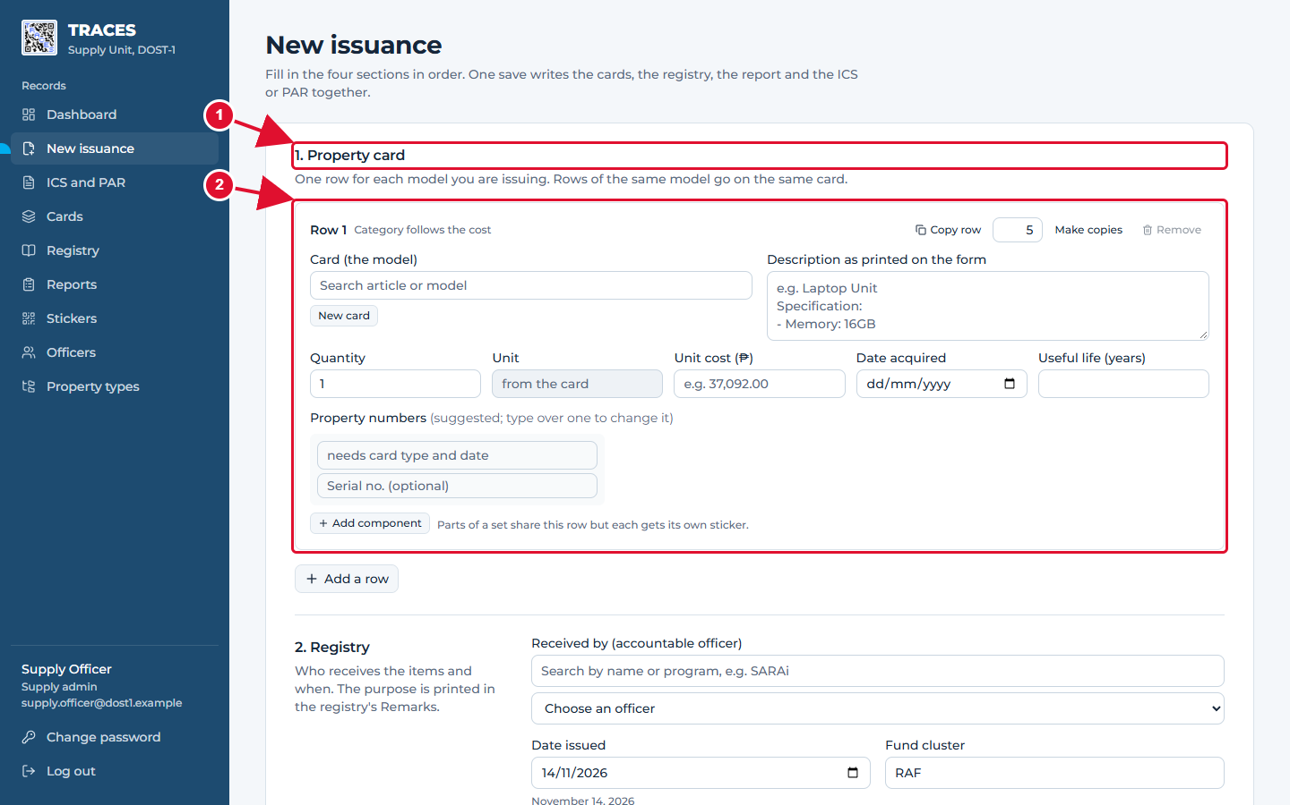
New issuance: the four parts of the form
1 Part 1, Property card: one row for each model you are handing over.
2 Each row is a box like this one. You can add as many rows as you need.
3 Parts 2 to 4 are further down: Registry (who receives it), Report (a preview) and ICS/PAR (the slip numbers).
Good to know: Nothing is saved until you press a Save button at the bottom. If the page is closed by accident, your typing is kept on this computer and comes back when you open the form again.
TRACES User Manual · page 16

Slide 17
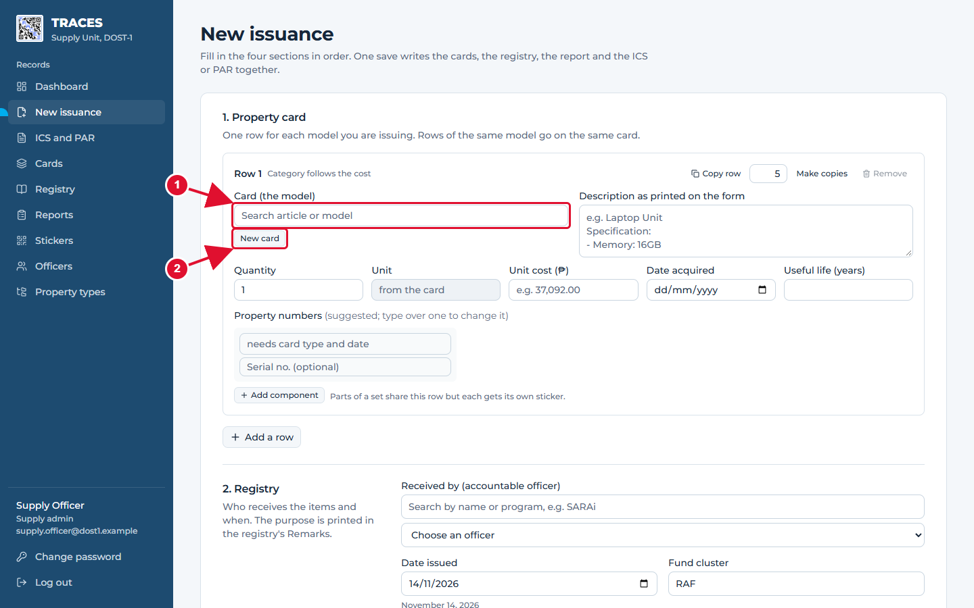
Step 1: choose the card (the model)
1 If this model was issued before, type part of its name here and pick it from the list.
2 If it is a new model, click New card.
TRACES User Manual · page 17

Slide 18
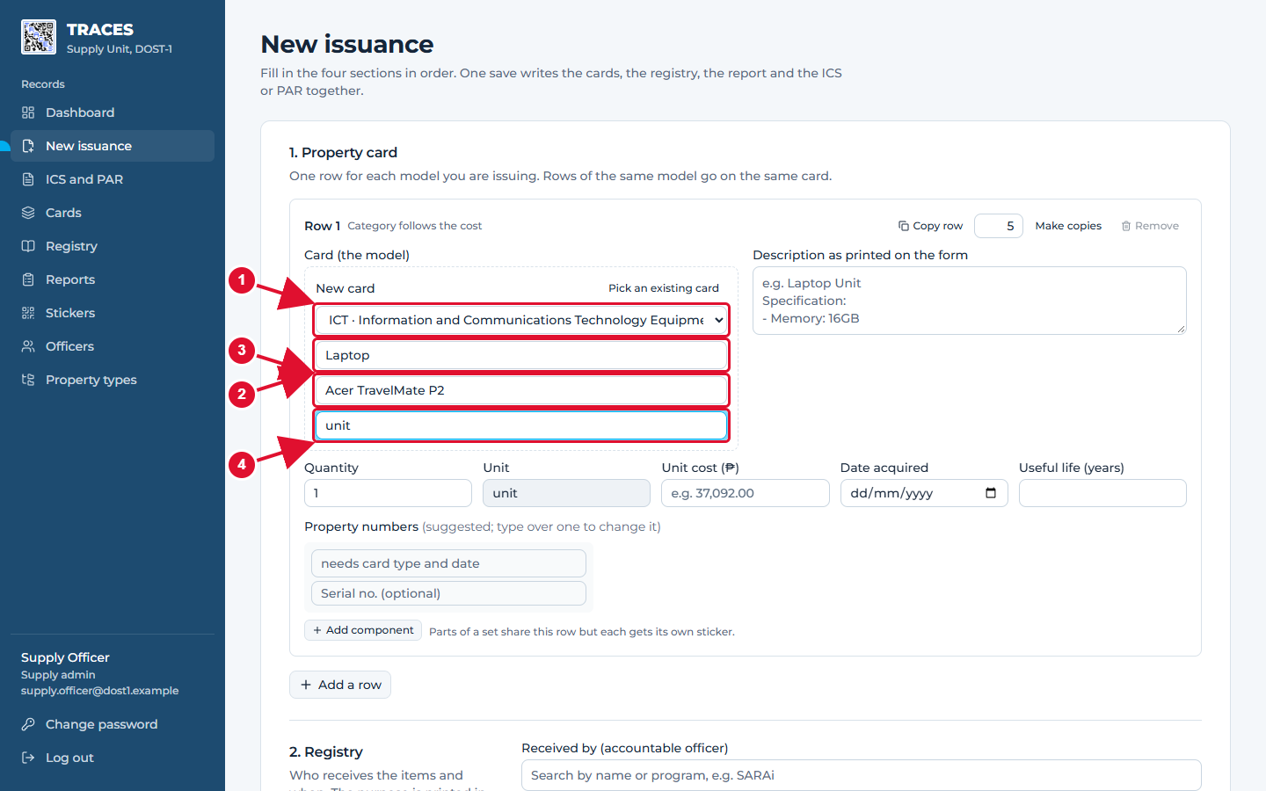
Step 2: describe a new card
1 Property type: pick from the list. It decides the letters in the property number.
2 Article: the general name, like Laptop.
3 Model: brand and model, like Acer TravelMate P2. All laptops of this model share one card.
4 Unit: how it is counted, like unit or set.
TRACES User Manual · page 18

Slide 19
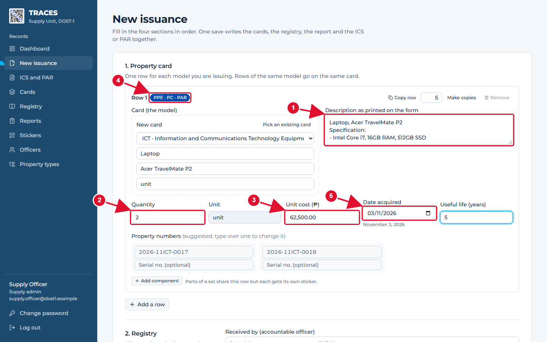
Step 3: what was bought
1 Description: type it exactly as it should appear on the slip, specifications included.
2 Quantity: how many units of this model.
3 Unit cost in pesos. At ₱50,000 or more the item is PPE and goes on a PAR; below that it goes on an ICS.
4 The label shows the result: here PPE, so a PAR.
5 Date acquired: the delivery date. The month goes into the property number.
TRACES User Manual · page 19

Slide 20
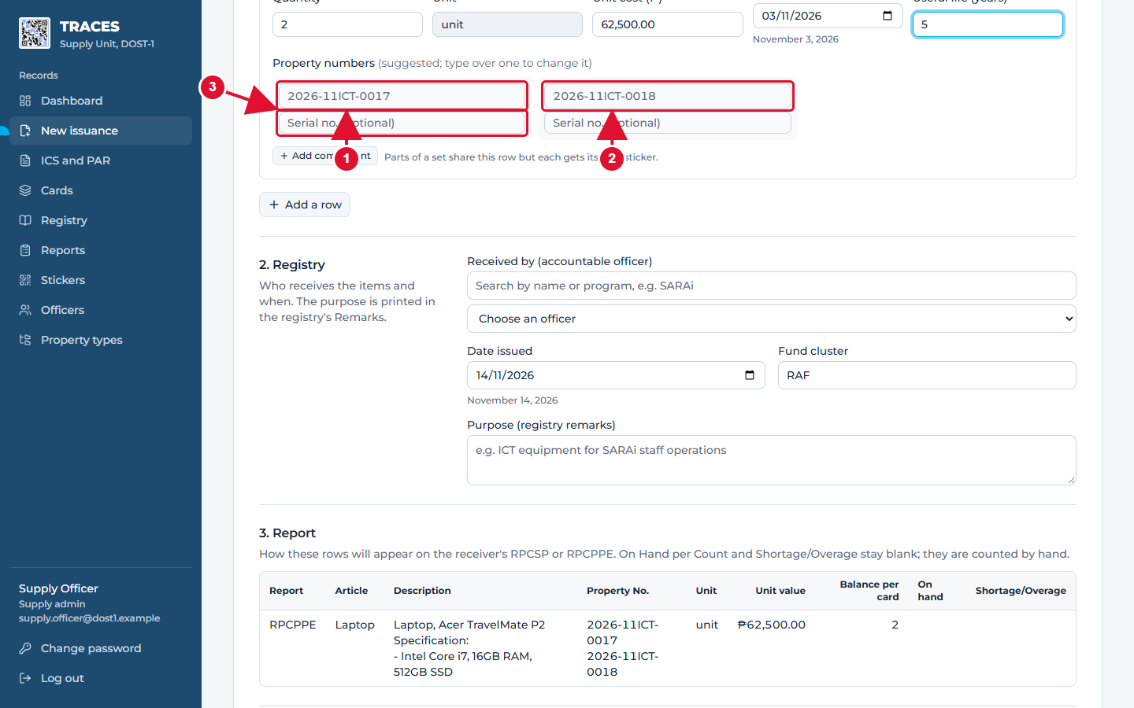
Step 4: property numbers are suggested for you
1 One box per unit. The grey number is TRACES's suggestion: the next free number for this type and year.
2 To use a different number (for example an old one), just type it in the box.
3 Serial numbers are optional.
TRACES User Manual · page 20

Slide 21
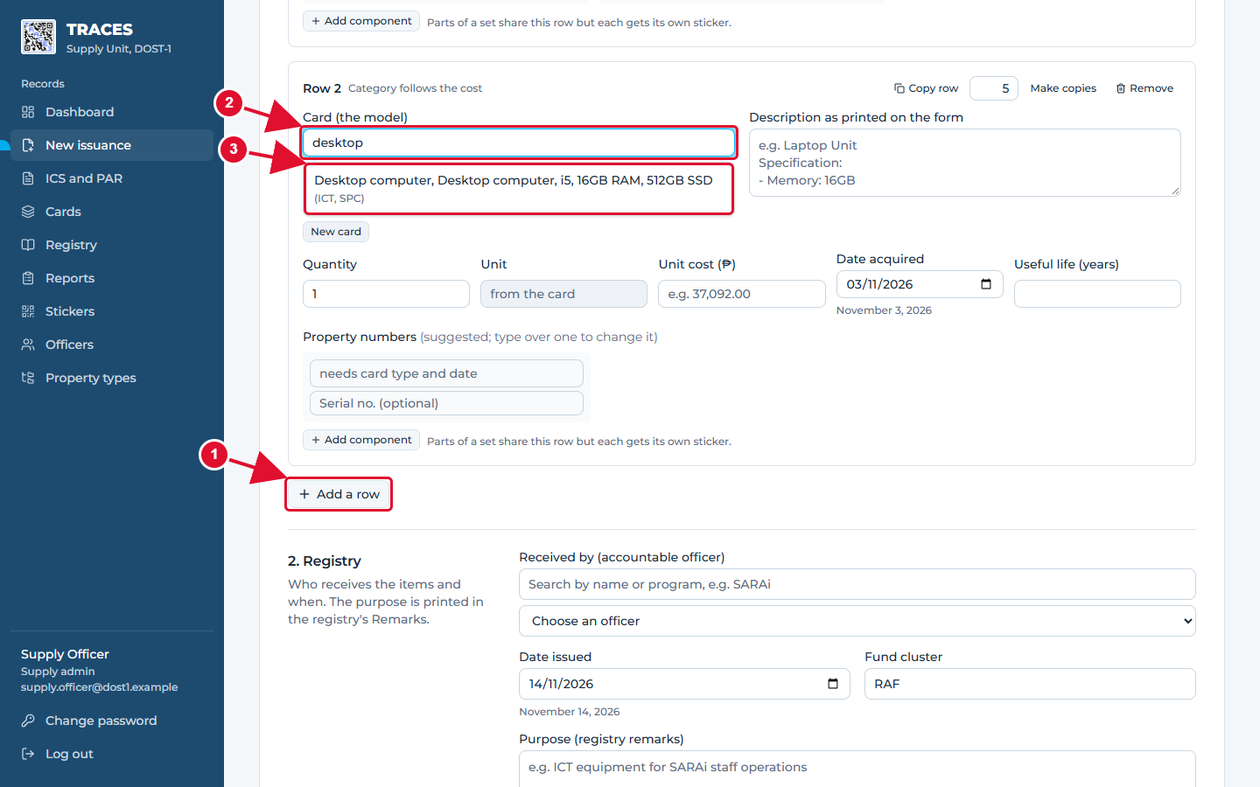
Picking a card that already exists
1 Click Add a row for the next model.
2 Type part of the name.
3 Click the matching card. Only cards of the right kind (SPC or PC) are offered once the cost is entered.
TRACES User Manual · page 21

Slide 22
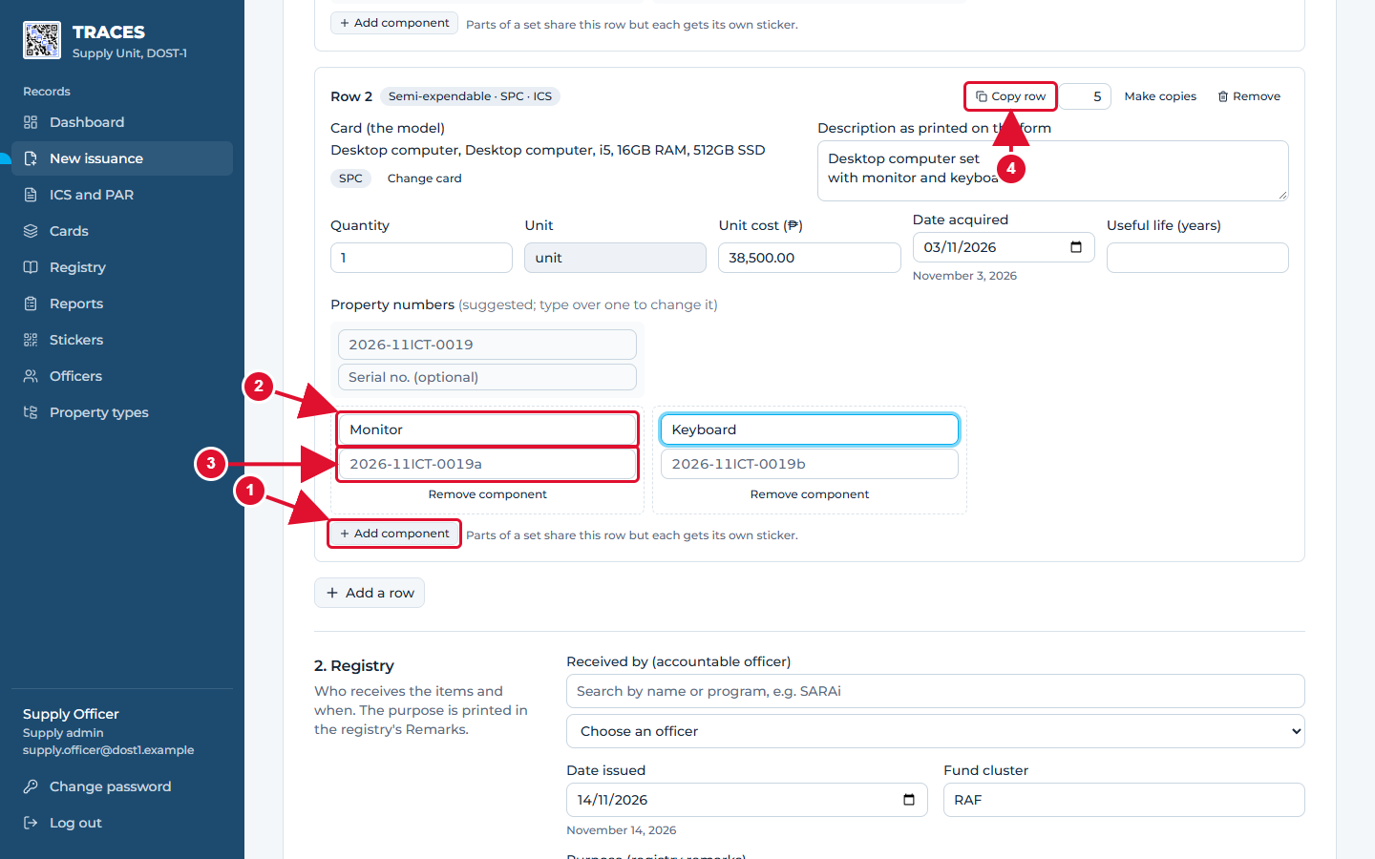
Sets: one row, a sticker for every part
1 For a set, click Add component once for each part.
2 Name the part, like Monitor.
3 Its number is the main number plus a letter (a, b, c…). Each part gets its own QR sticker, but the set stays one row on the card, registry and report.
4 Copy row (or Ctrl+D) repeats a row; Make copies repeats it as many times as the number beside it. Remove deletes the row.
TRACES User Manual · page 22

Slide 23
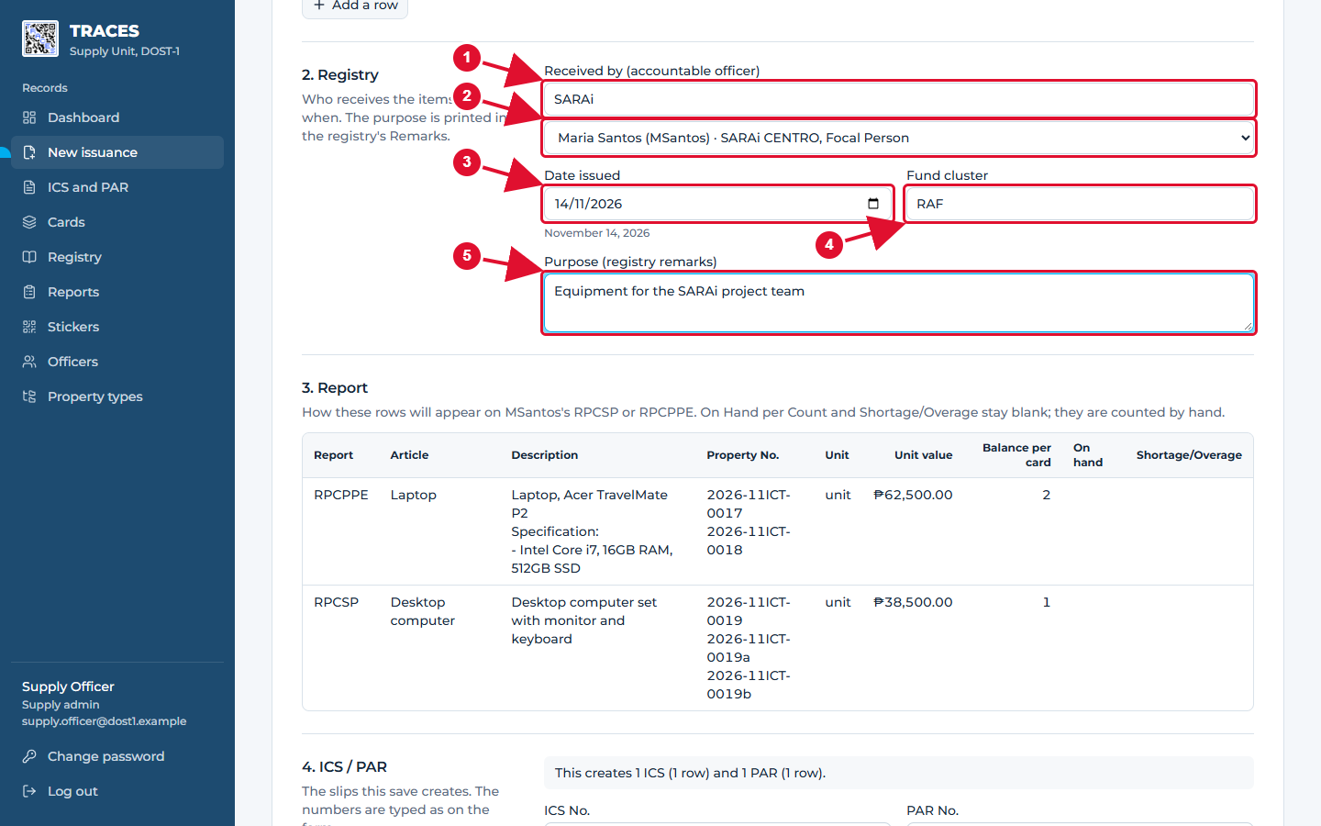
Part 2, Registry: who receives the items
1 Type a name or a program to shorten the list.
2 Pick the accountable officer who receives the items. Only officers allowed to receive property are listed.
3 Date issued: the date on the slip.
4 Fund cluster: filled in for you.
5 Purpose: printed in the registry's Remarks column.
TRACES User Manual · page 23

Slide 24
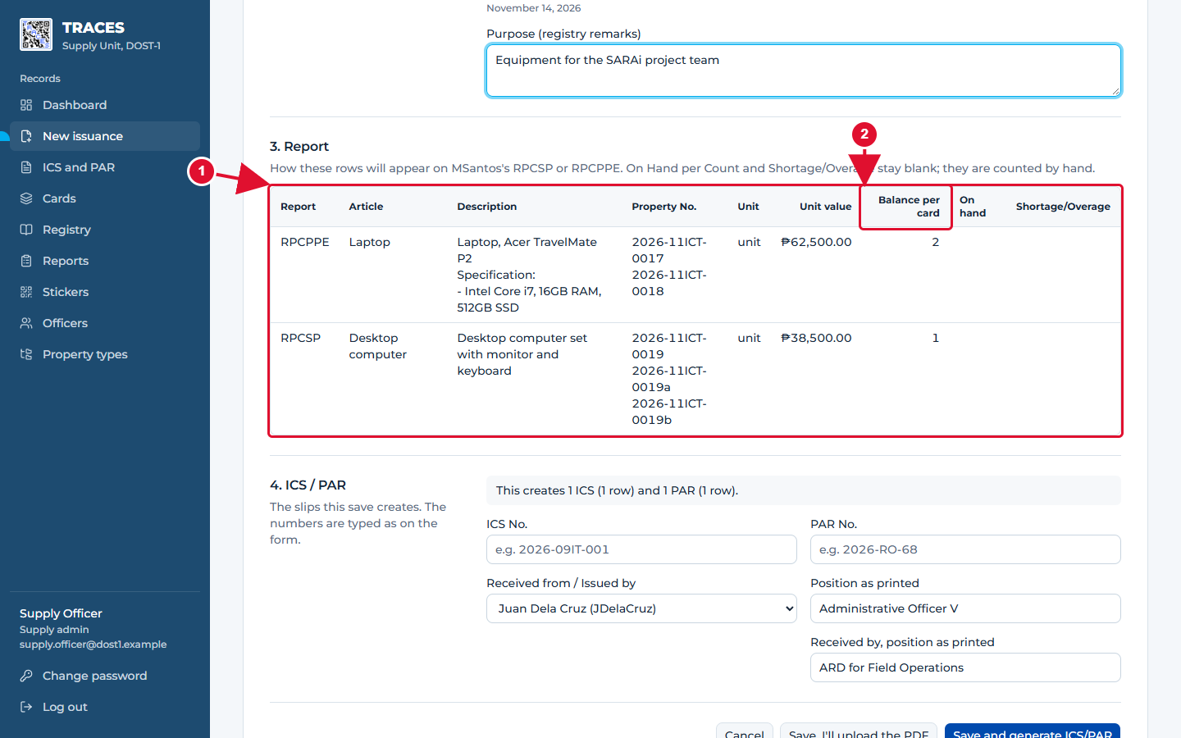
Part 3, Report: a preview, nothing to type
1 This is how the rows will look on the receiver's physical count report (RPCSP or RPCPPE).
2 Balance per card is filled in; the count columns stay empty until the physical count.
TRACES User Manual · page 24

Slide 25
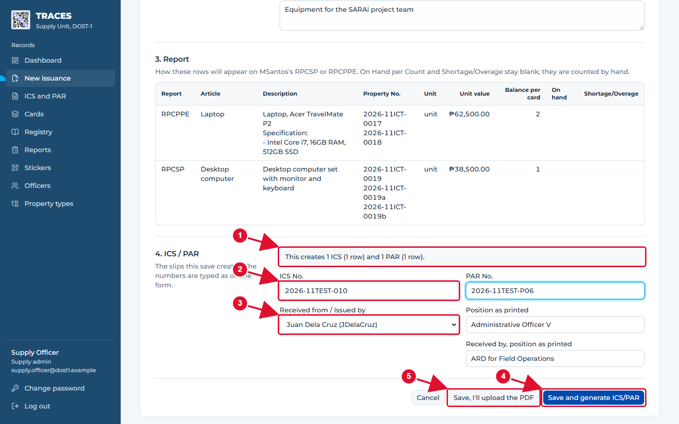
Part 4, ICS/PAR: the slip numbers, then save
1 TRACES tells you which slips this makes. Here: one ICS (the cheaper desktop) and one PAR (the laptops).
2 Type the ICS number and the PAR number. A box only appears when that slip is needed.
3 Received from / Issued by: the supply officer is filled in. Positions can be changed to match the printed form.
4 Save and generate ICS/PAR: saves everything and makes the slips ready to print.
5 Use "Save, I'll upload the PDF" only when encoding an old paper form that already exists.
TRACES User Manual · page 25

Slide 26
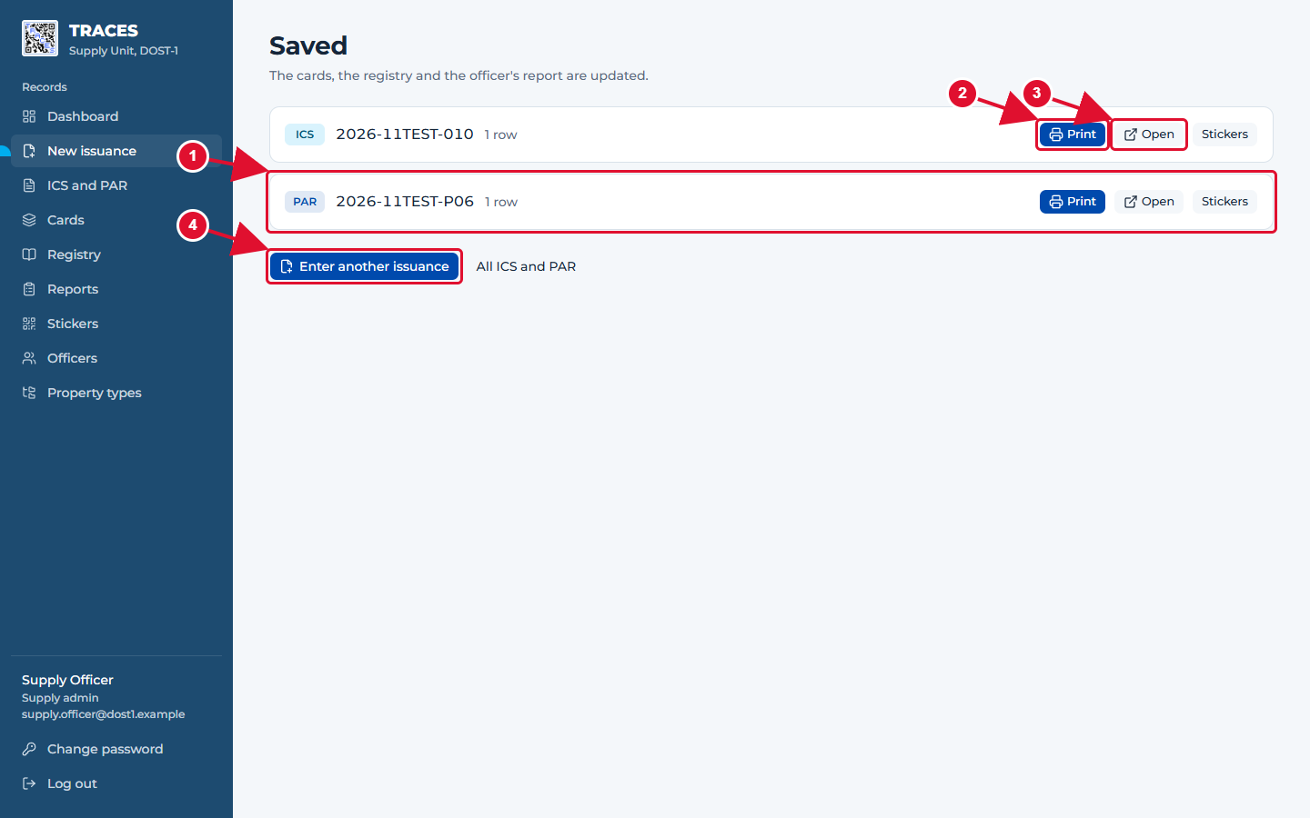
Saved: print the slips
1 Each slip that was made is listed.
2 Print opens the slip as a PDF. Print it and have it signed.
3 Open shows the slip in TRACES. Stickers prints its QR stickers.
4 Enter another issuance starts a fresh form.
TRACES User Manual · page 26

Slide 27
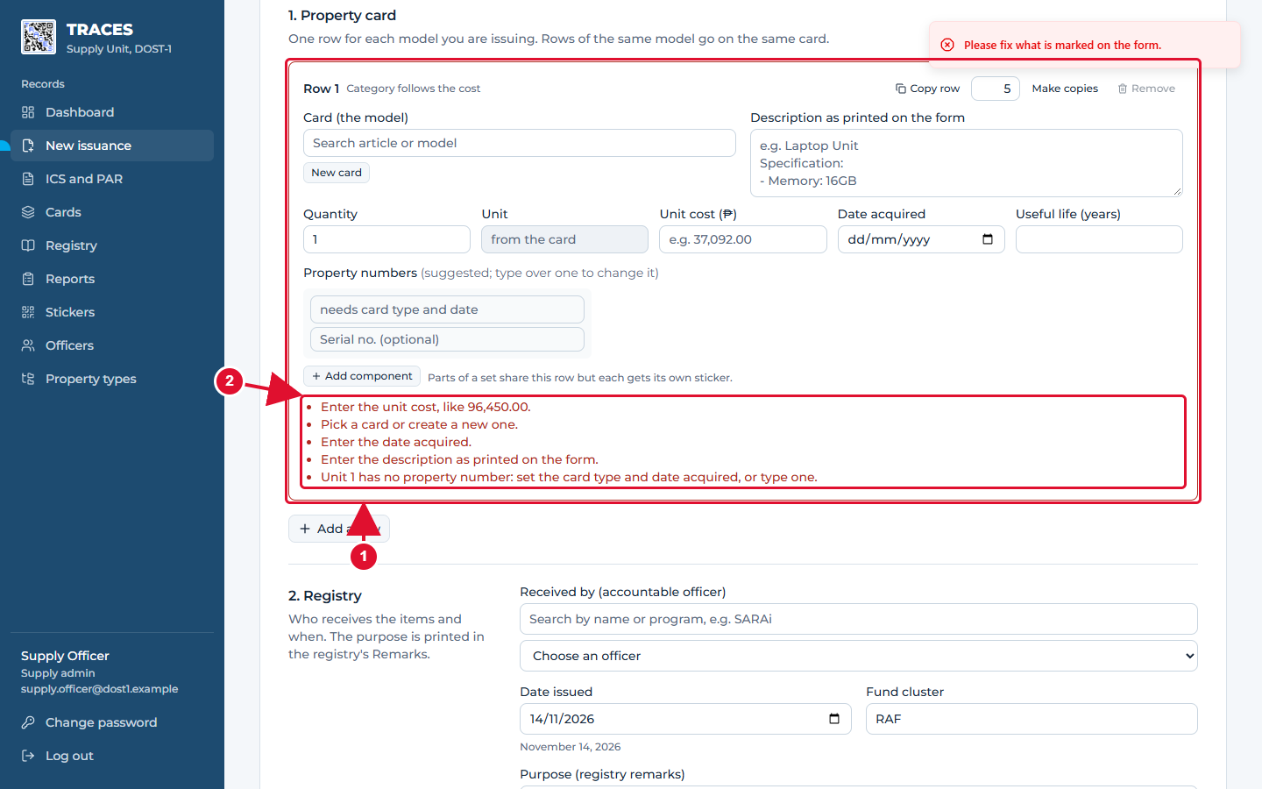
When something is missing
1 A row with a problem gets a red border.
2 The red list under it says exactly what to fix. Nothing is saved until every problem is fixed.
Good to know: Other messages you may see: "already used or repeated" (a property number is taken: type another), "Enter the ICS number" (part 4), "already exists" (that slip number was used before).
TRACES User Manual · page 27

Slide 28
Part 4. ICS and PAR documents
TRACES User Manual · page 28

Slide 29
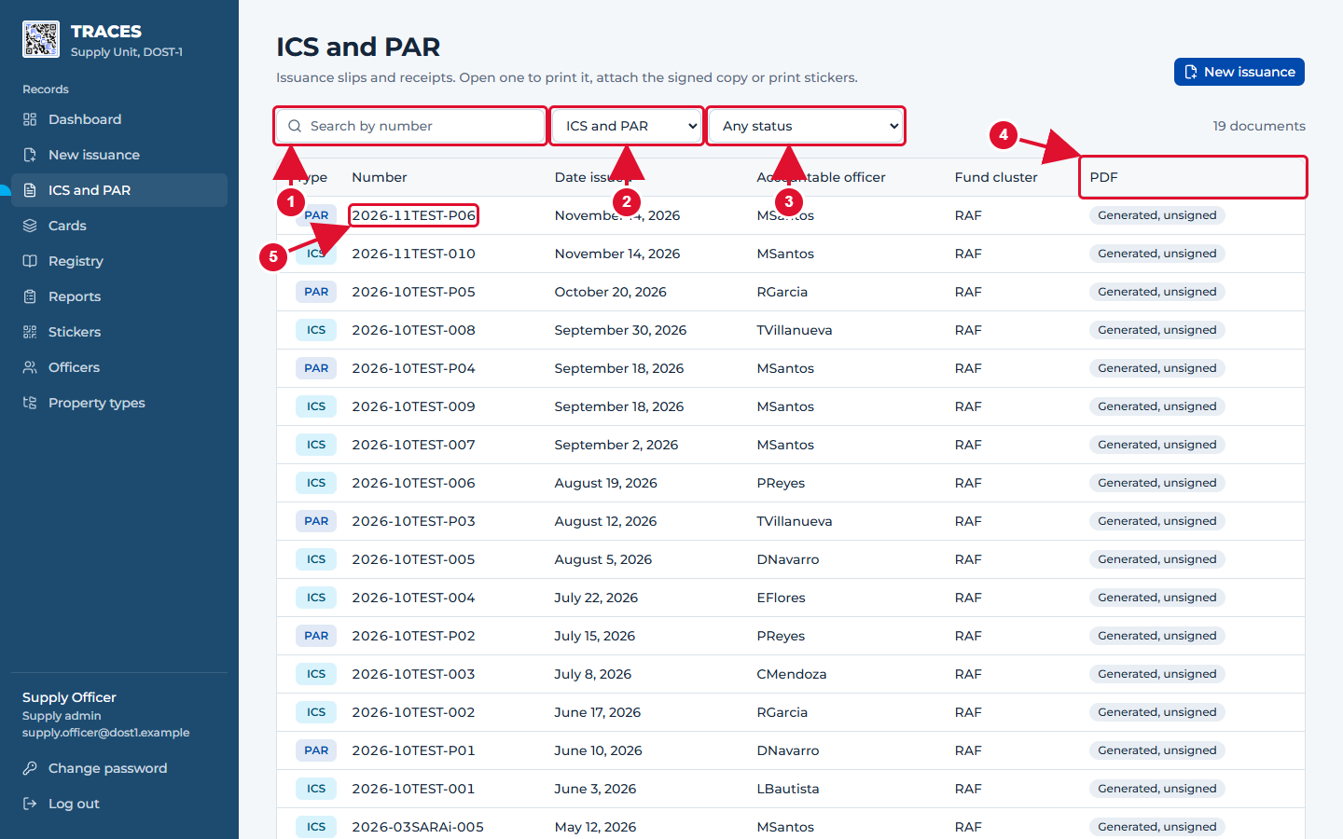
ICS and PAR: the list of slips
1 Search by slip number.
2 Show only ICS or only PAR.
3 Show only slips that still need their signed copy.
4 The PDF column: No PDF, Generated (printed, not yet signed) or Signed.
5 Click a number to open the slip.
TRACES User Manual · page 29

Slide 30
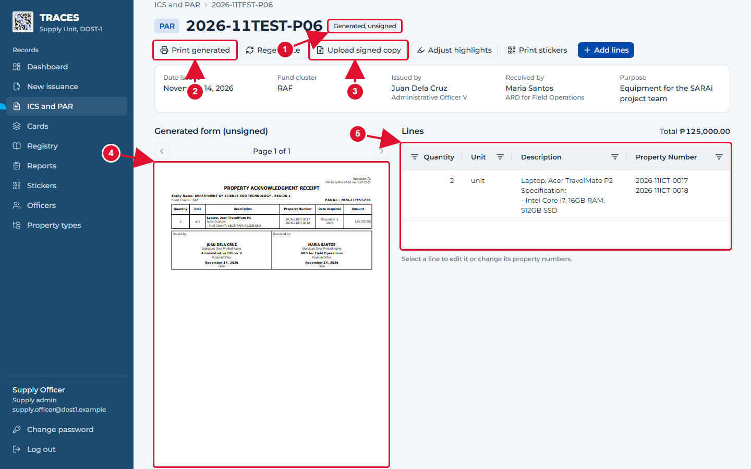
A slip that is printed but not yet signed
1 Status: Generated, unsigned.
2 Print generated: opens the PDF to print.
3 After it is signed, scan it and click Upload signed copy.
4 The slip as TRACES made it.
5 The rows of the slip. Click one to correct it (only while the slip is not signed).
TRACES User Manual · page 30

Slide 31
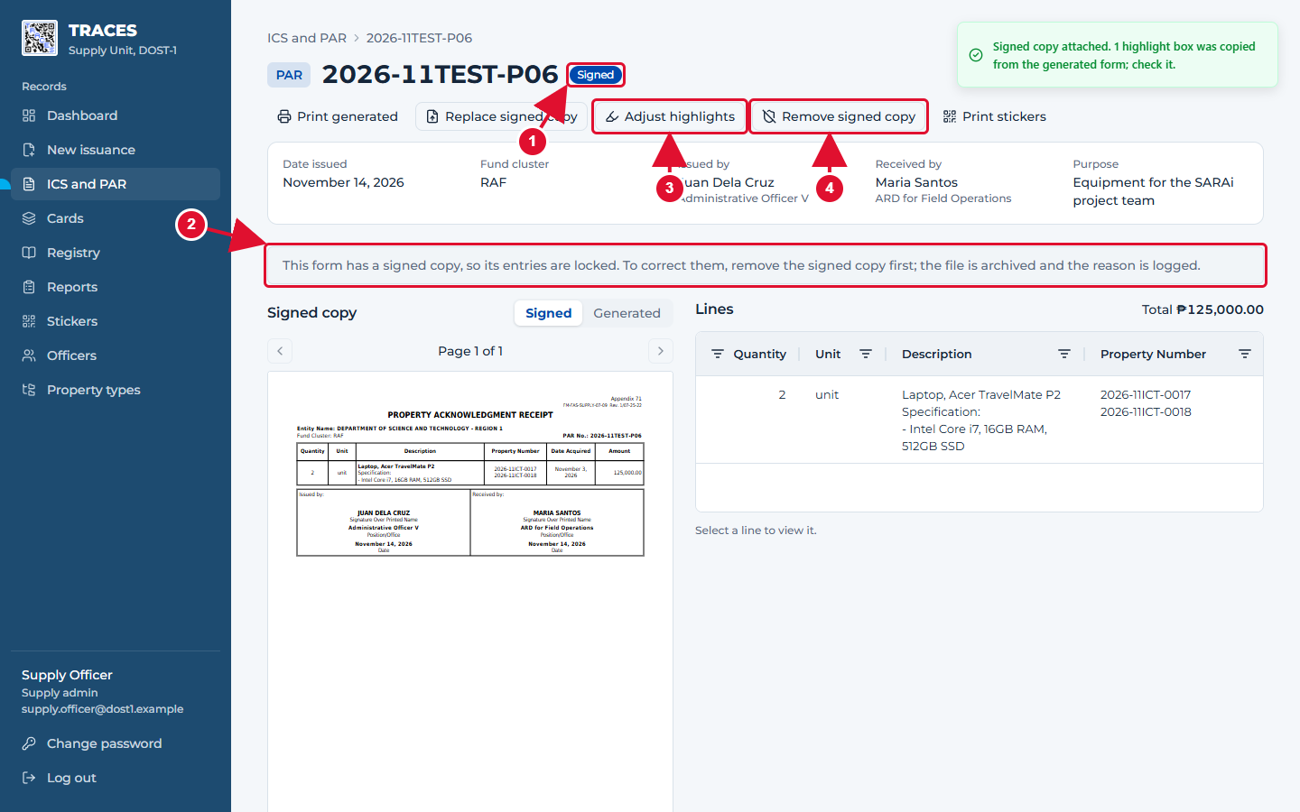
After uploading the signed copy
1 Status: Signed.
2 The slip is now locked: its rows cannot be changed. This protects what was signed.
3 Adjust highlights moves the yellow box that marks a row on the scan, if the scan came out crooked.
4 Remove signed copy is only for mistakes. It asks for a reason, keeps the file in the archive and unlocks the rows.
TRACES User Manual · page 31

Slide 32
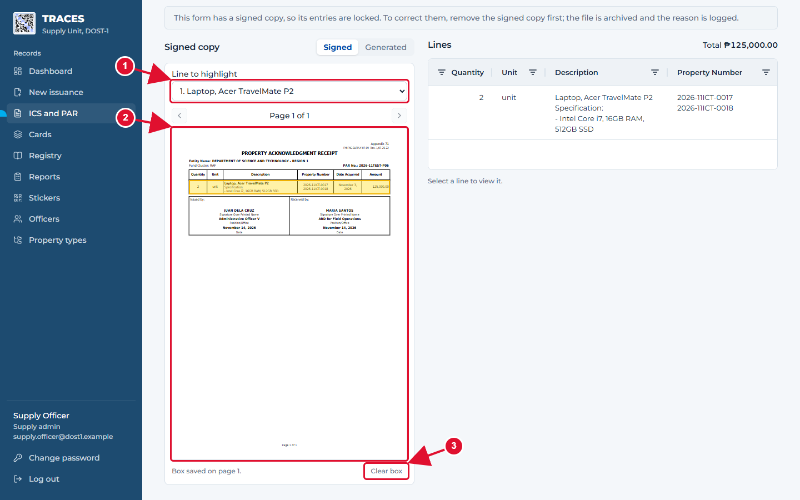
Adjusting a highlight box
1 Pick the row.
2 Drag a box around that row on the page. It is saved at once.
3 Clear box removes it.
TRACES User Manual · page 32

Slide 33
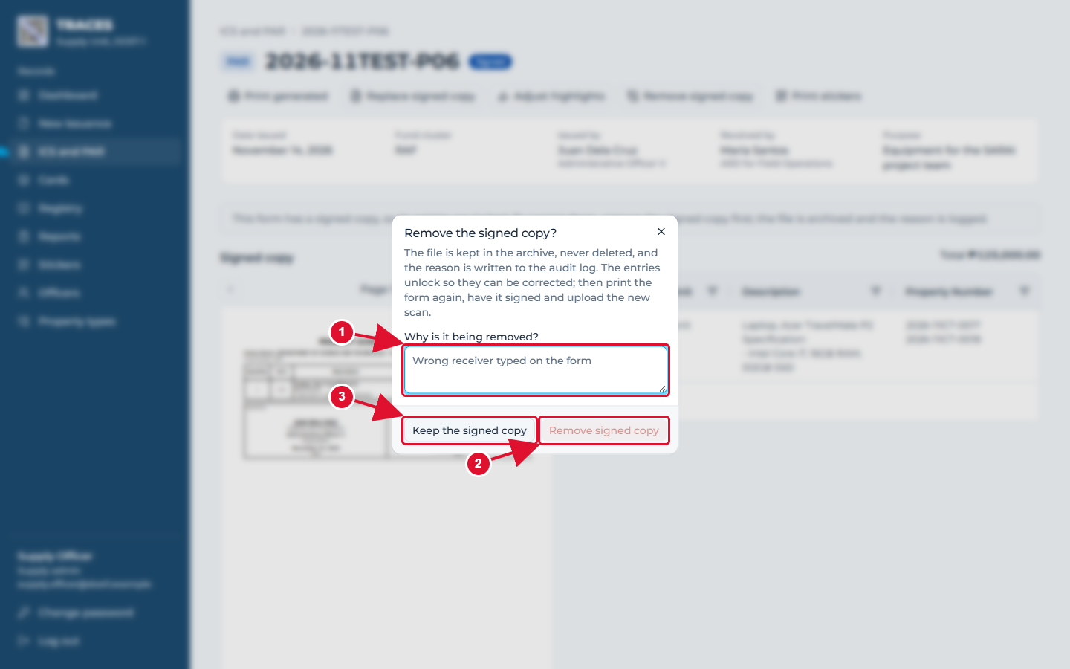
Removing a signed copy (only to correct a mistake)
1 Write why it is removed. This is kept in the audit log.
2 Click Remove signed copy. Then correct the rows, print again and have it signed again.
3 Or keep it.
TRACES User Manual · page 33

Slide 34
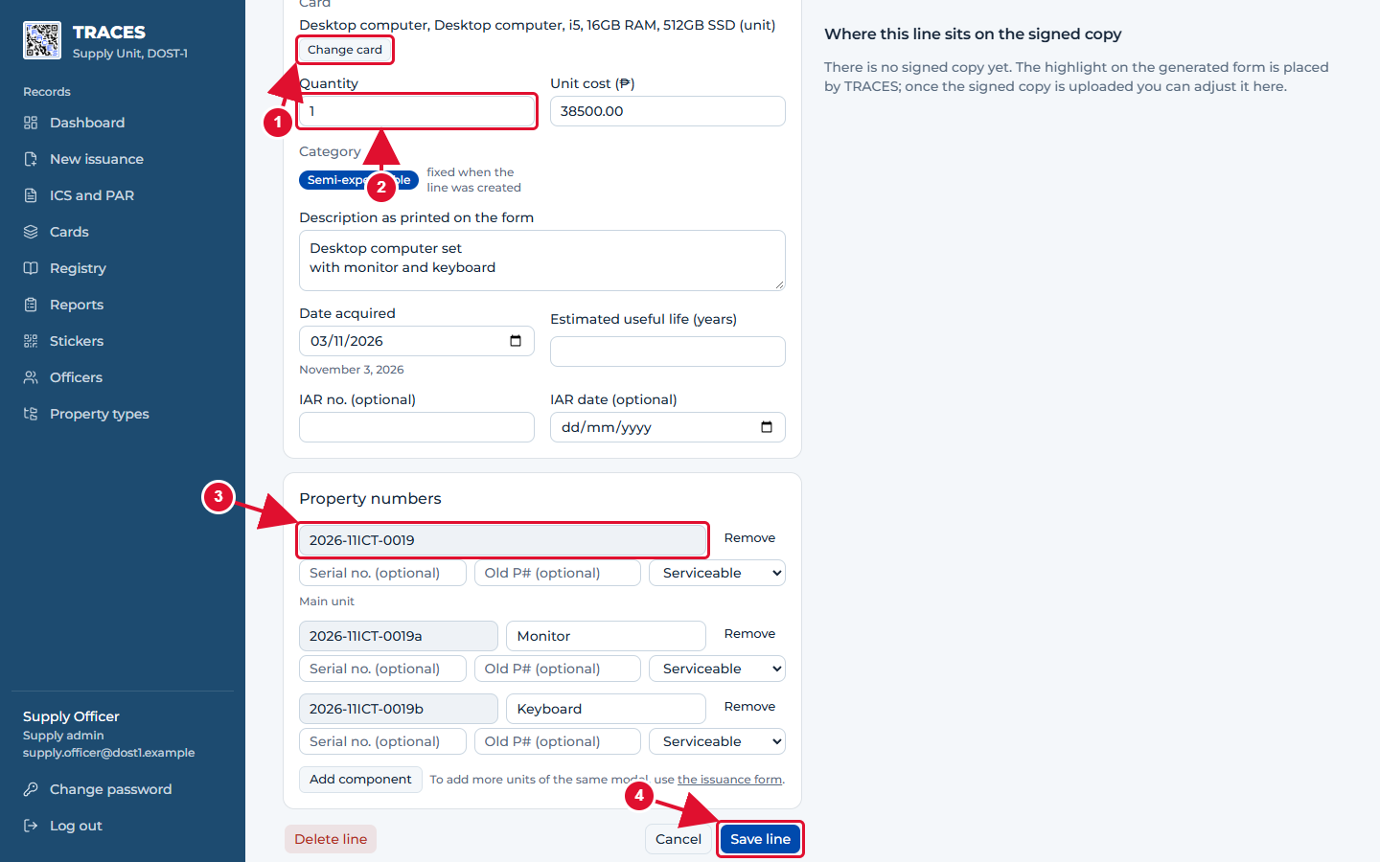
Correcting a row (before it is signed)
1 Change card moves the row to another card of the same kind, if the wrong one was picked.
2 Correct the quantity, cost, description or dates here.
3 Each property number with its serial number, old number and condition.
4 Save line. The card, registry and report change with it.
Good to know: After a correction, open the slip again: TRACES asks you to regenerate it so the printed slip matches.
TRACES User Manual · page 34

Slide 35
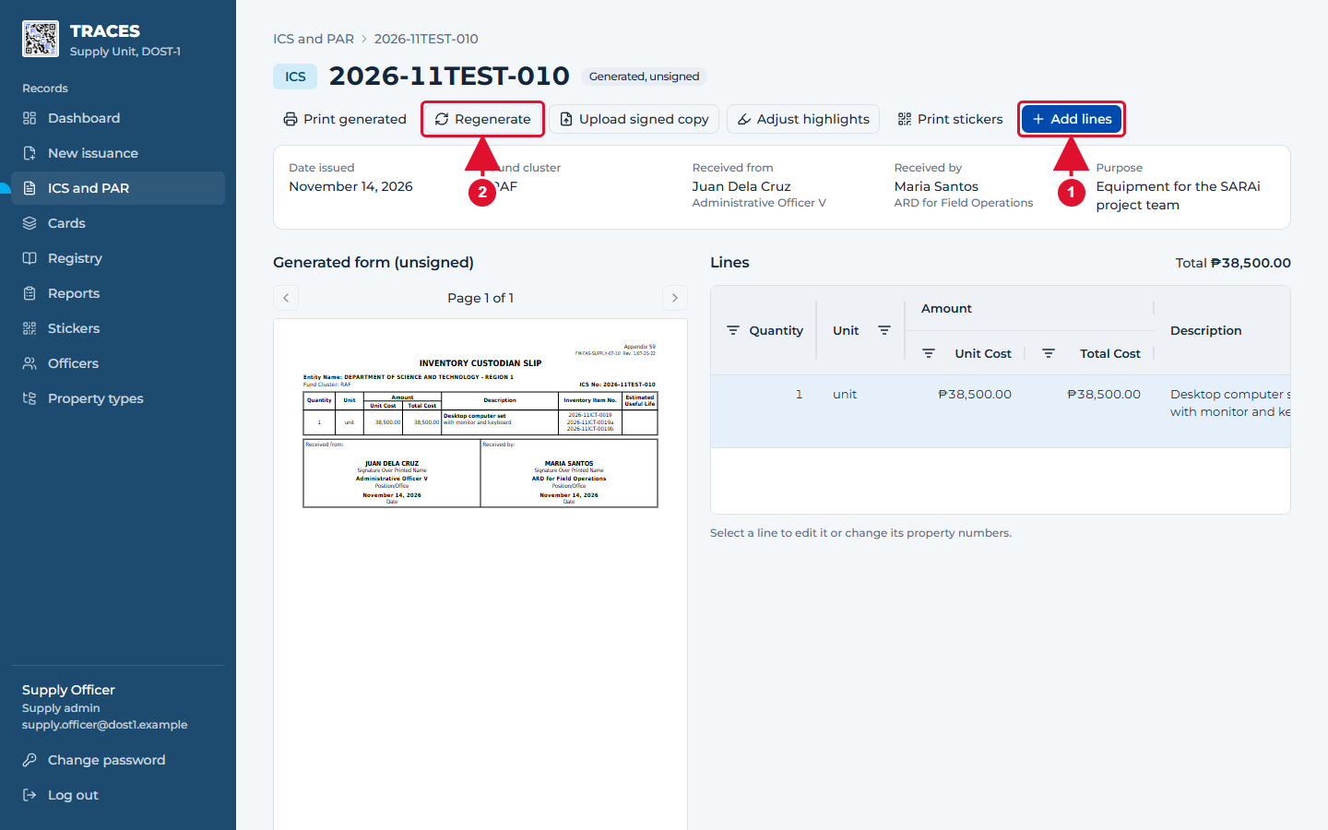
Adding rows to a slip that is not signed yet
1 Add lines opens the issuance form for this slip only. Use it to encode a long old slip over several sittings.
2 Regenerate makes the printable slip again after rows were added or corrected.
TRACES User Manual · page 35

Slide 36
Part 5. Cards, registry and property
TRACES User Manual · page 36

Slide 37
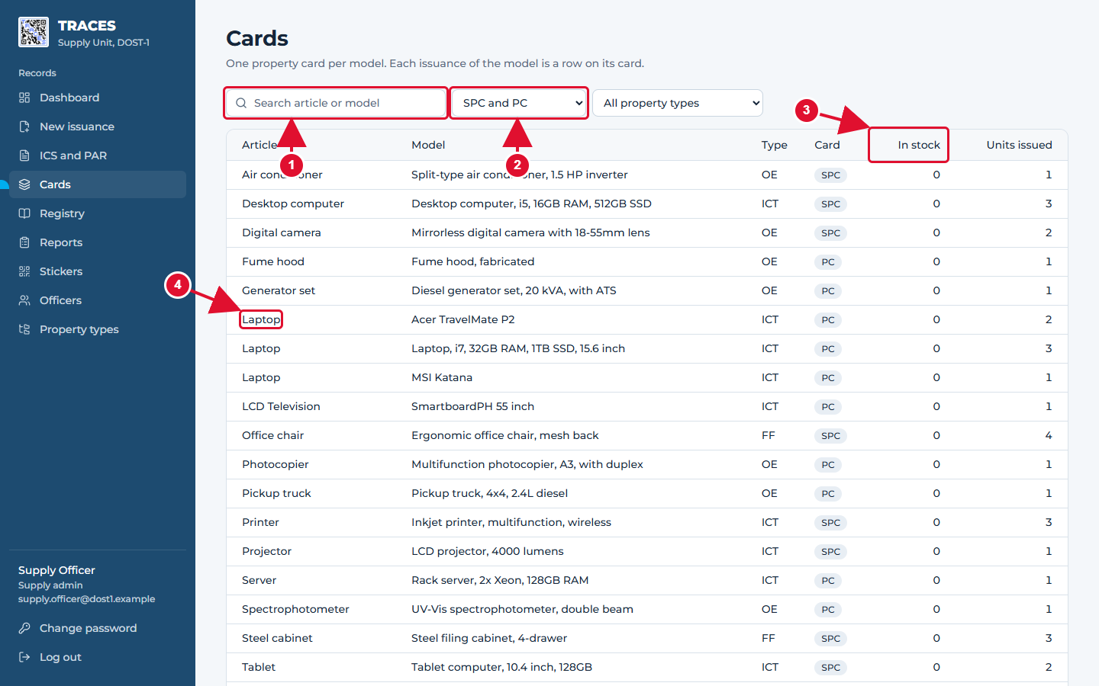
Cards: one property card per model
1 Search by article or model.
2 Show SPC (semi-expendable) or PC (PPE) cards, or one property type.
3 In stock: still with the Supply Unit. Units issued: now with officers.
4 Click a card to open it.
TRACES User Manual · page 37

Slide 38
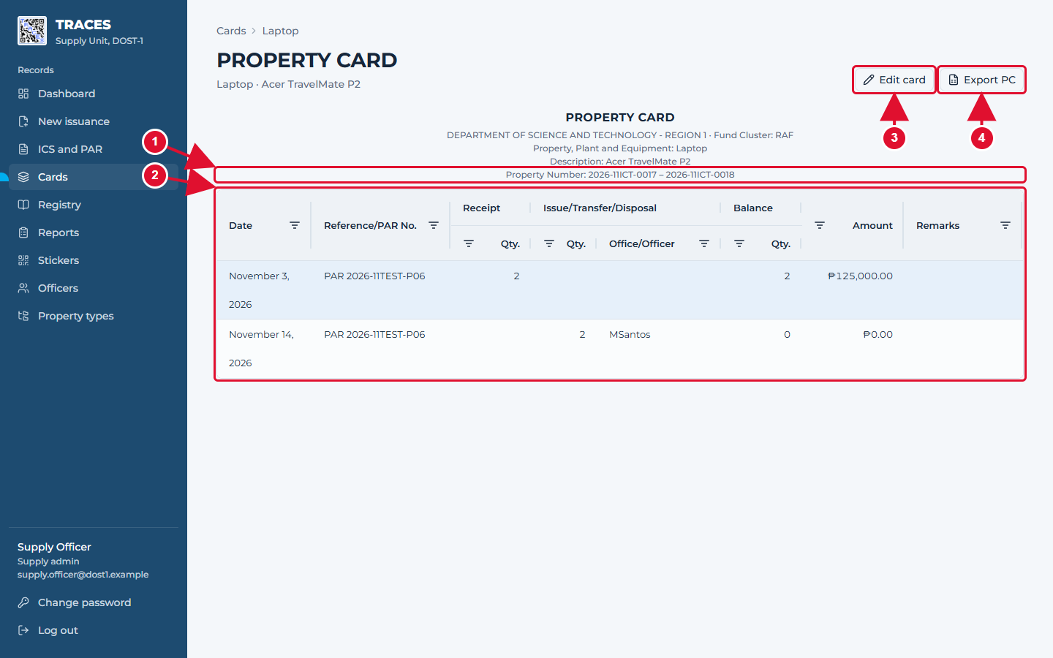
A property card
1 The card heading: article, model and the range of property numbers on this card.
2 Every receipt and issue of this model is a row. Balance is what the Supply Unit still holds.
3 Edit card fixes the name or stops offering the card on new entries.
4 Export PC (or SPC) downloads the official form as an Excel file.
TRACES User Manual · page 38

Slide 39
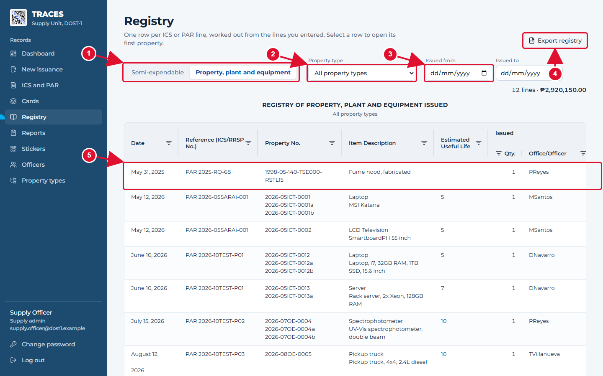
Registry of property issued
1 Choose semi-expendable or PPE.
2 Choose a property type, or all.
3 Optional dates: only slips issued between them.
4 Export downloads the registry as an Excel file.
5 Click a row to open its property.
TRACES User Manual · page 39

Slide 40
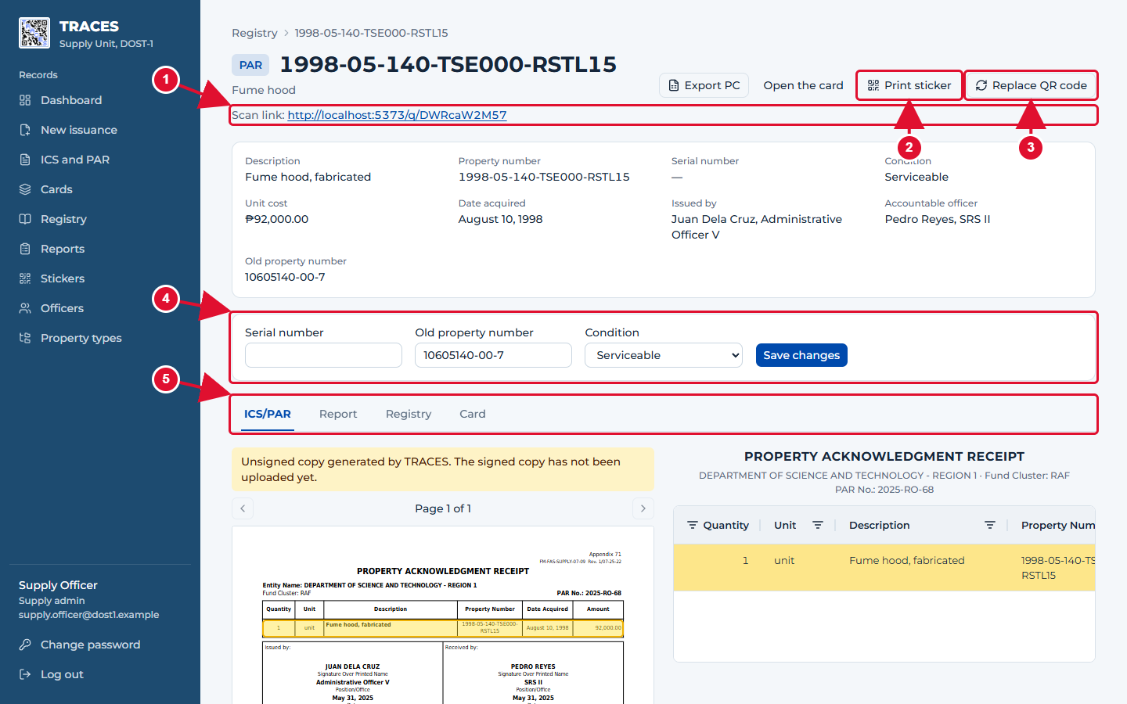
One property and everything about it
1 The link inside its QR sticker.
2 Print sticker prints this one sticker.
3 Replace QR code: use when a sticker is lost or damaged. The old sticker then says "replaced".
4 Serial number, old property number and condition can be changed here.
5 The four forms this property appears on.
TRACES User Manual · page 40

Slide 41
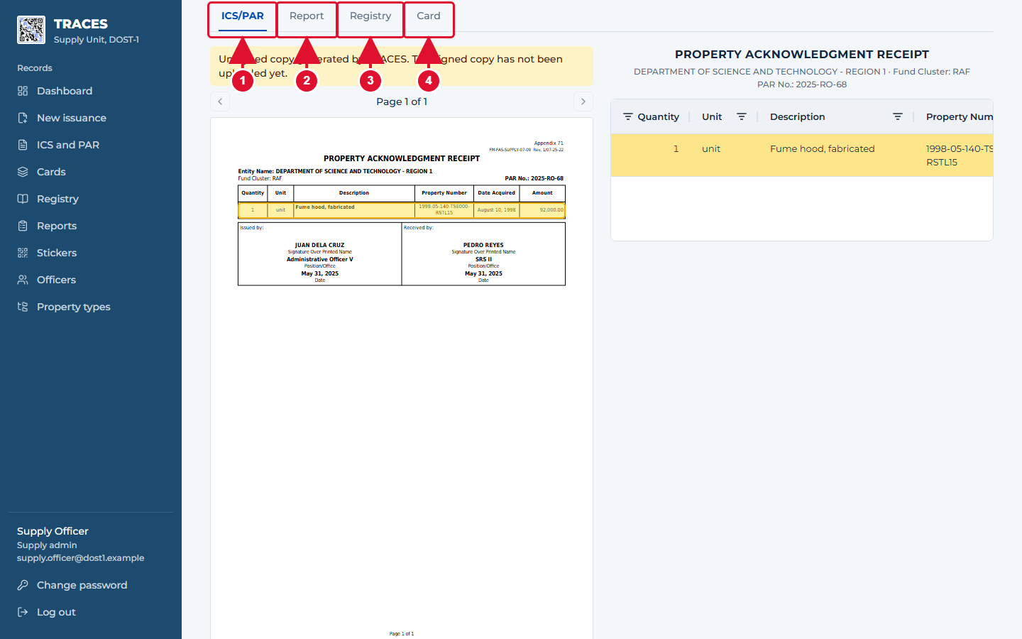
The four tabs
1 ICS/PAR: the slip, with this item's row highlighted in yellow.
2 Report: the receiver's physical count report.
3 Registry: the registry rows of this kind of property.
4 Card: the model's property card.
TRACES User Manual · page 41

Slide 42
Part 6. Reports
TRACES User Manual · page 42

Slide 43
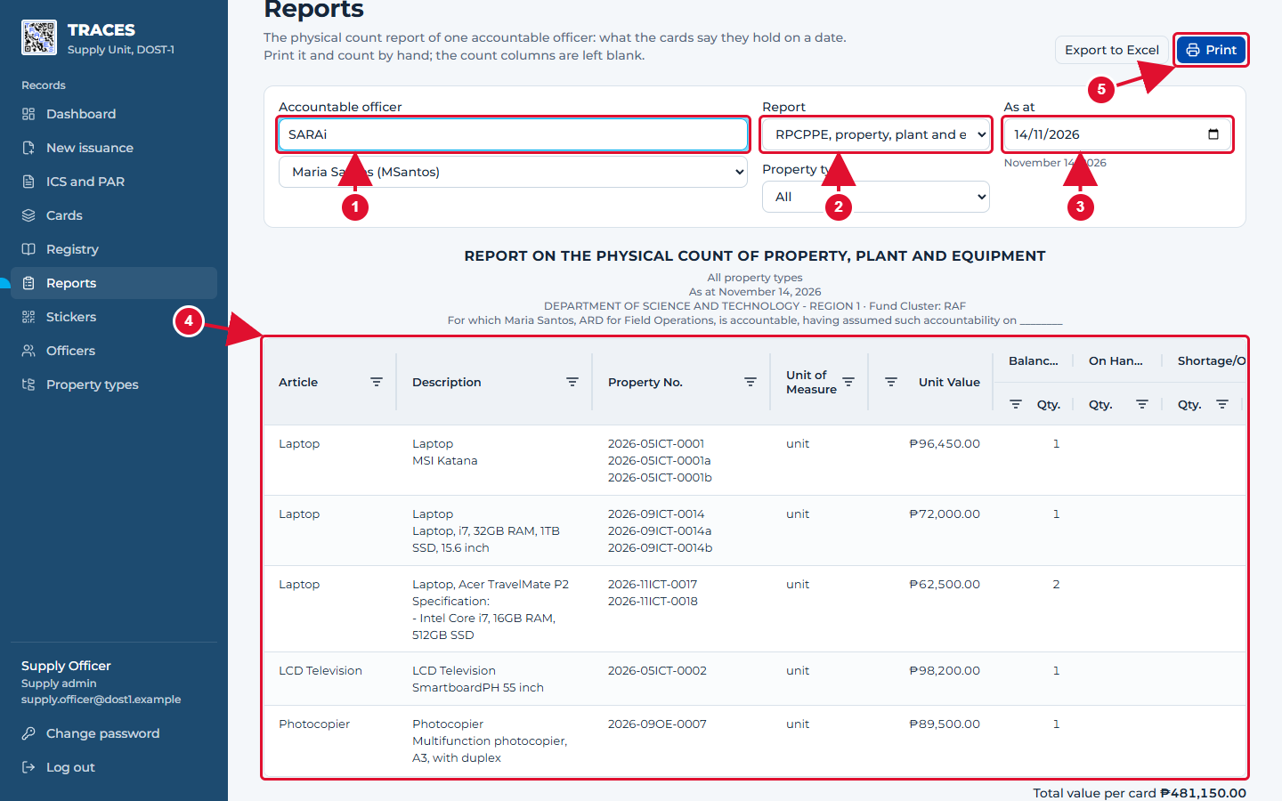
Report on the physical count
1 Find the accountable officer by name or program, then pick them in the list below it.
2 RPCPPE (PPE) or RPCSP (semi-expendable).
3 "As at": the date of the count. Today is filled in.
4 Everything the officer holds on that date, one row per slip row.
5 Print prints the report; Export to Excel downloads the official RPCPPE / RPCSP file.
Good to know: On Hand per Count and Shortage/Overage are left empty on purpose: print the report and fill them in by hand during the count.
TRACES User Manual · page 43

Slide 44
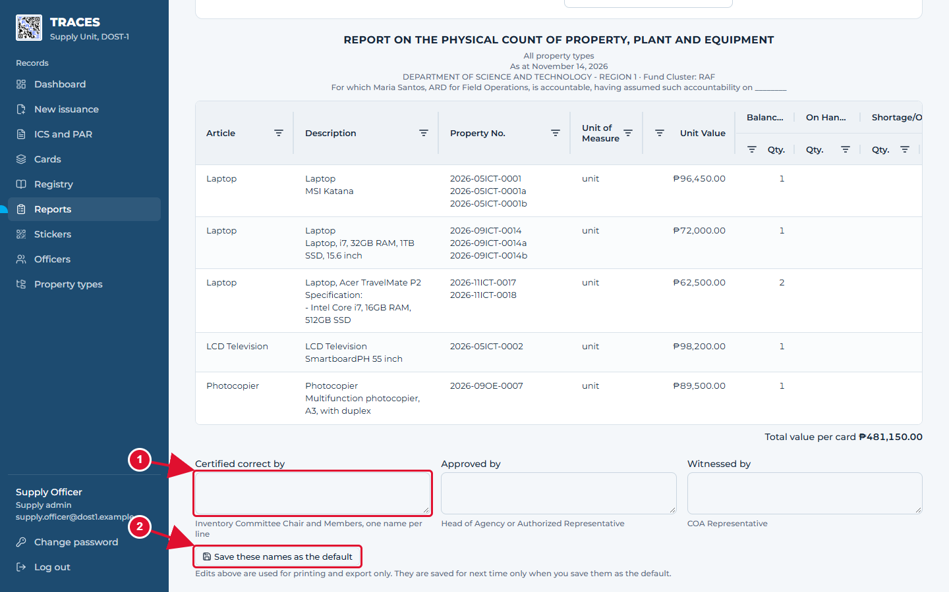
Names that sign the report
1 Type the names that sign the report, one per line, in each box.
2 Save these names as the default to have them filled in next time. Without it, the names are used only for this print or export.
TRACES User Manual · page 44

Slide 45
Part 7. QR stickers
TRACES User Manual · page 45

Slide 46
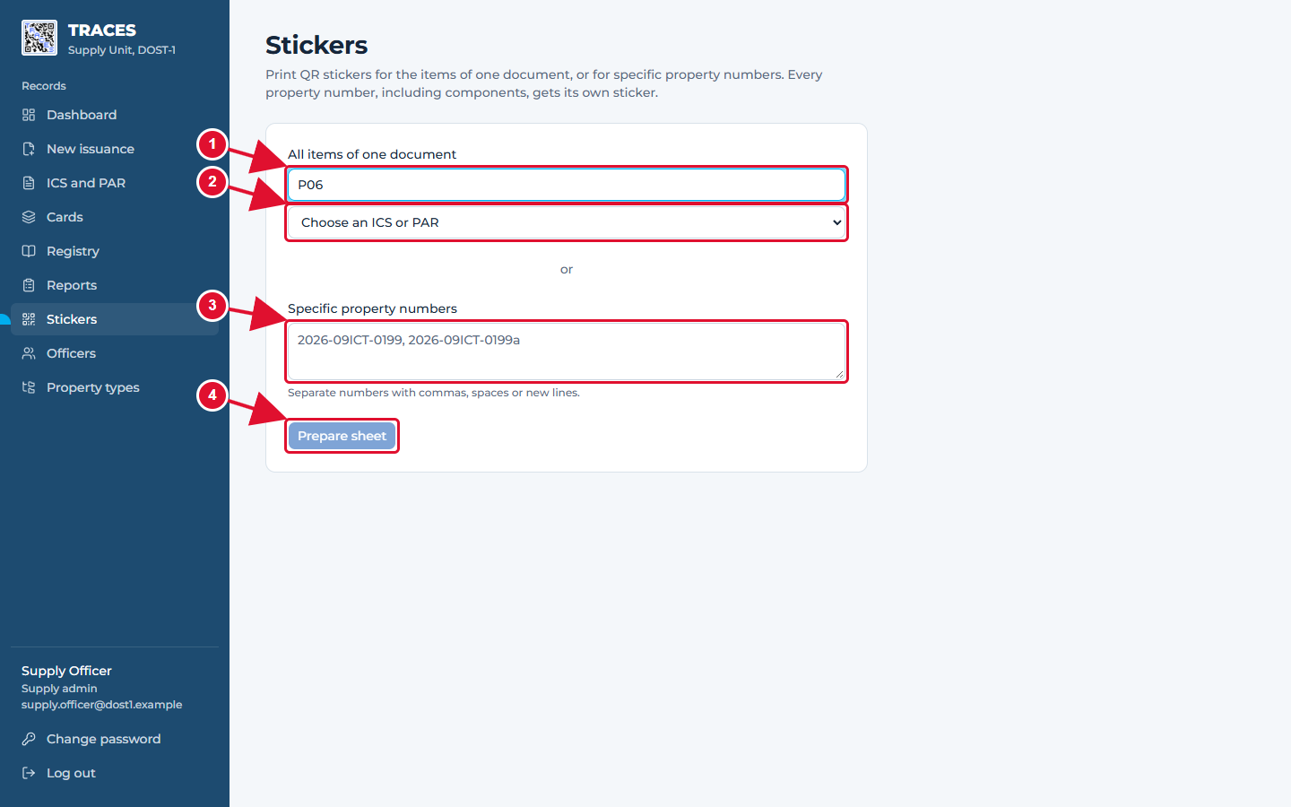
Choosing which stickers to print
1 Type part of the slip number to find it.
2 Pick the slip: you get a sticker for every item on it.
3 Or type property numbers, separated by commas.
4 Click Prepare sheet.
TRACES User Manual · page 46

Slide 47
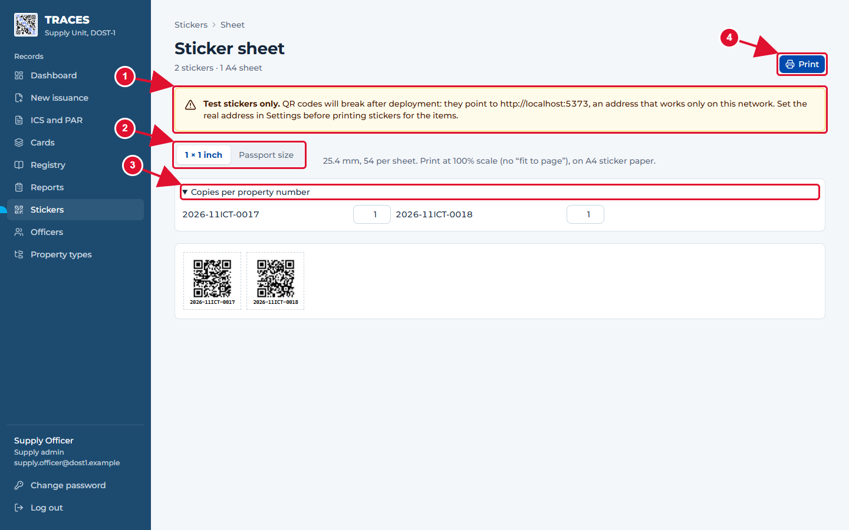
The sticker sheet
1 A warning appears while TRACES runs on a test address: those stickers will not work later. Print real stickers only after the IT administrator sets the real address.
2 Pick the sticker size of your sticker paper.
3 Need more than one sticker for an item? Set the copies here.
4 Print. Choose 100% scale (not "fit to page") in the print window.
TRACES User Manual · page 47

Slide 48
Part 8. Scanning a sticker
TRACES User Manual · page 48

Slide 49
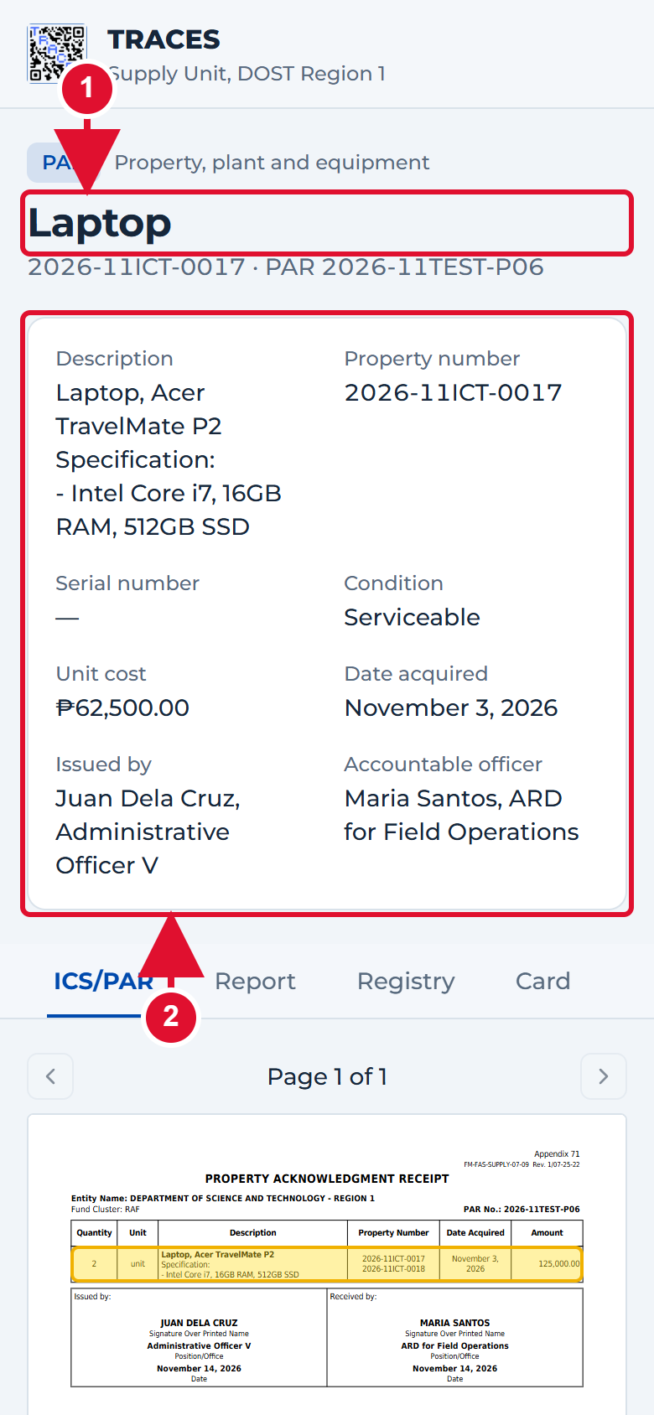
What anyone sees after scanning a sticker
1 No sign-in needed. The item and its property number.
2 The key facts: description, serial number, who holds it.
TRACES User Manual · page 49

Slide 50
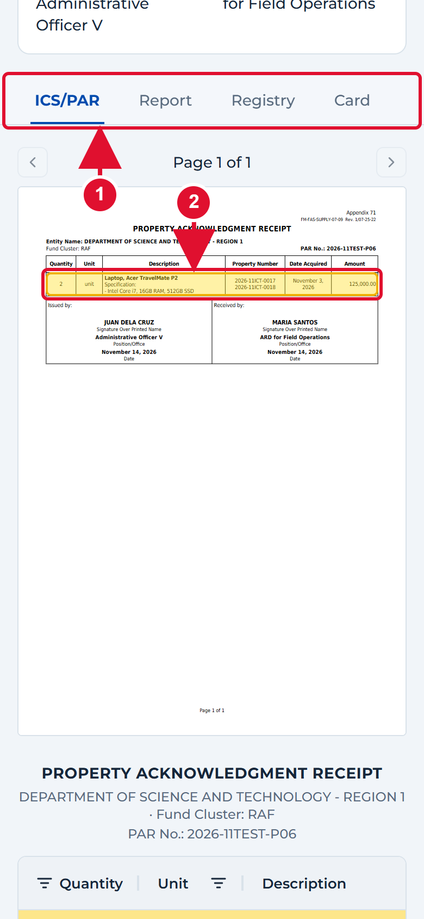
The signed slip, with the item marked
1 Tabs: ICS/PAR, Report, Registry, Card.
2 The signed slip; the yellow box marks this item's row.
TRACES User Manual · page 50

Slide 51
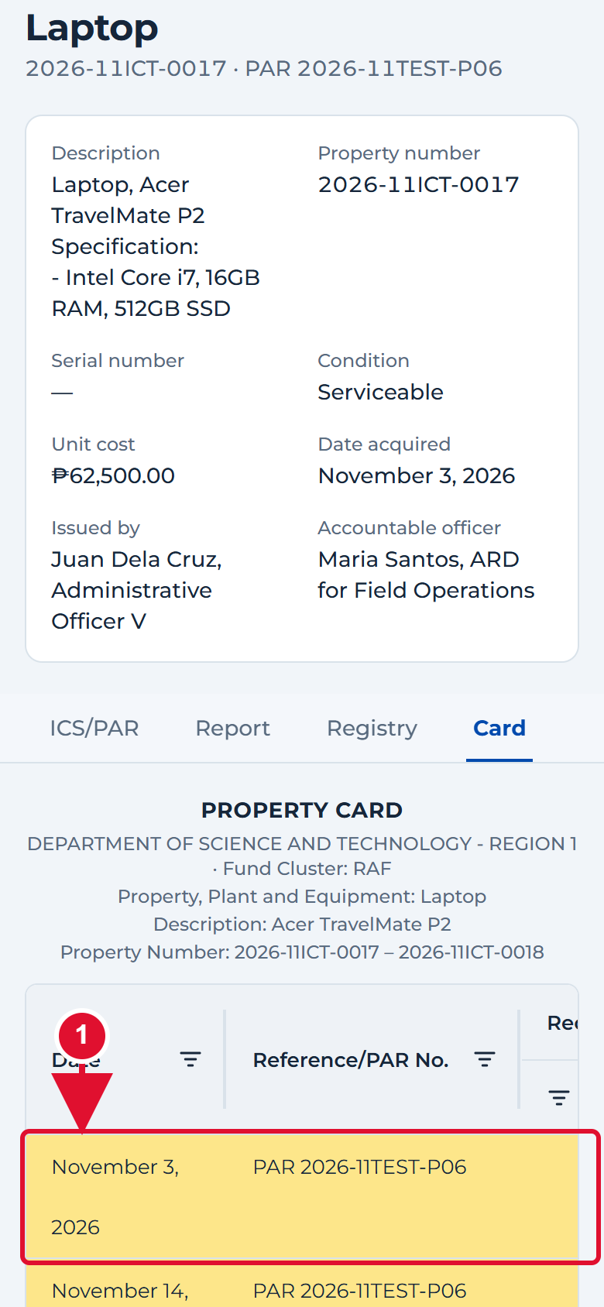
The property card on a phone
1 The rows of this item are highlighted. Other people's items of the same model are not shown to the public.
TRACES User Manual · page 51

Slide 52
Part 9. Administration
TRACES User Manual · page 52

Slide 53
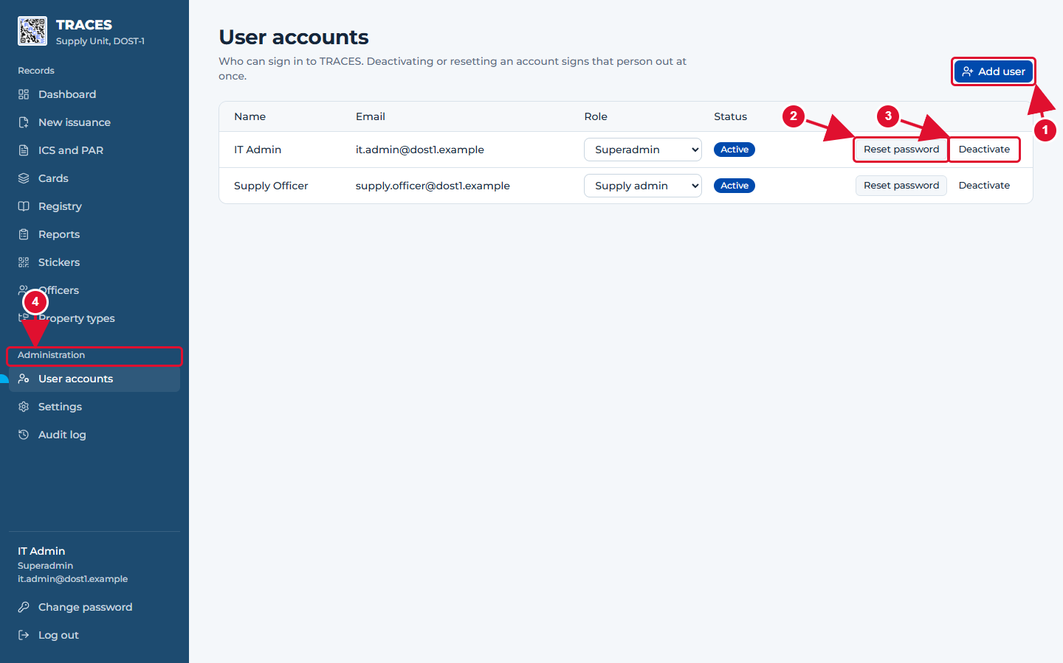
User accounts (IT administrator only)
1 Add user creates an account and shows a one-time temporary password.
2 Reset password makes a new temporary password if someone forgot theirs.
3 Deactivate signs the person out and stops them signing in.
4 The Administration menu appears only for the IT administrator.
TRACES User Manual · page 53

Slide 54
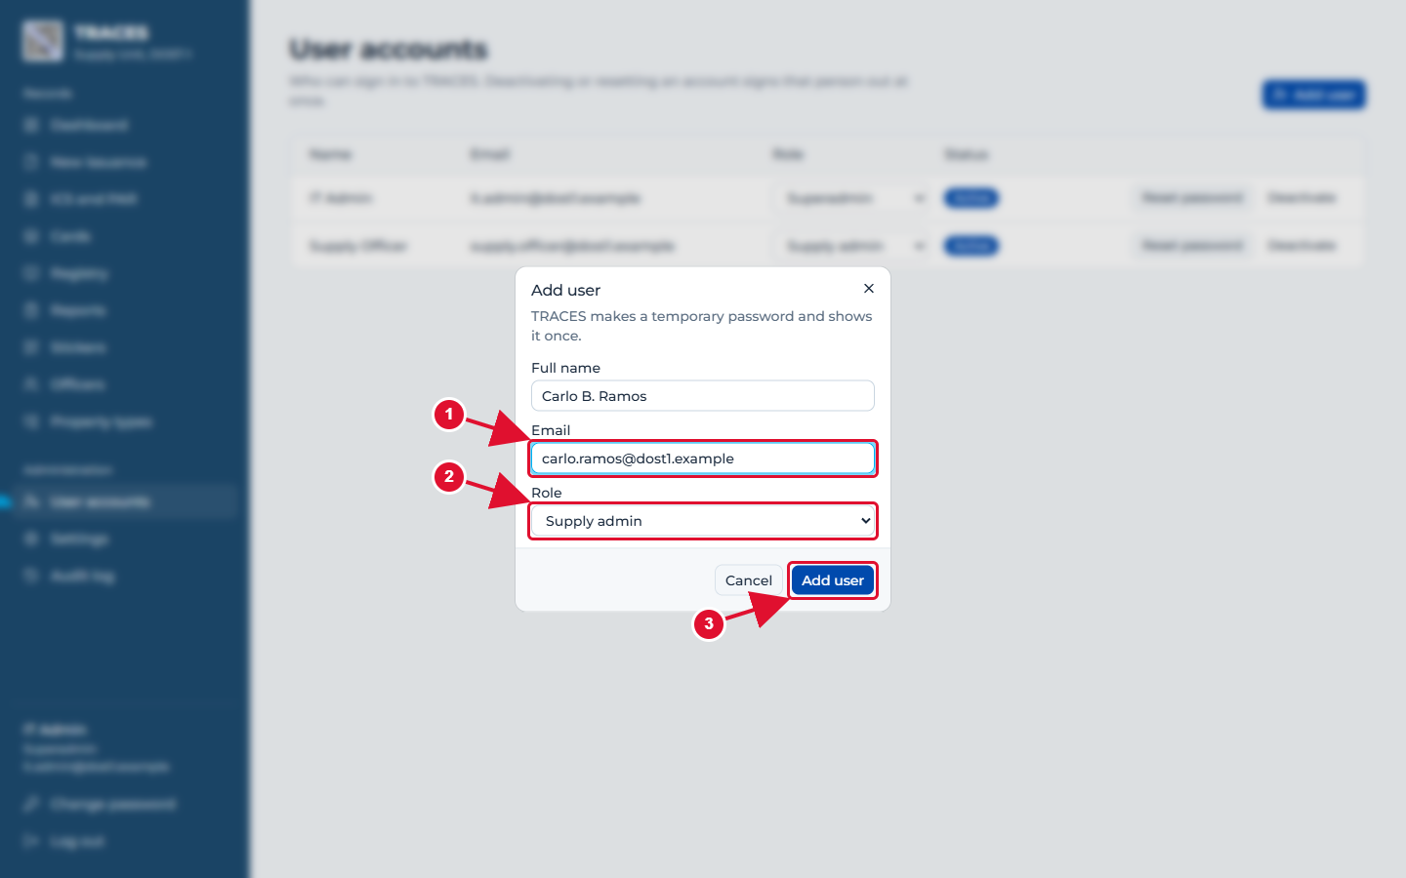
Adding a user
1 Name and work email.
2 Role: Supply admin for Supply Unit staff; Superadmin only for IT.
3 Add user.
TRACES User Manual · page 54

Slide 55
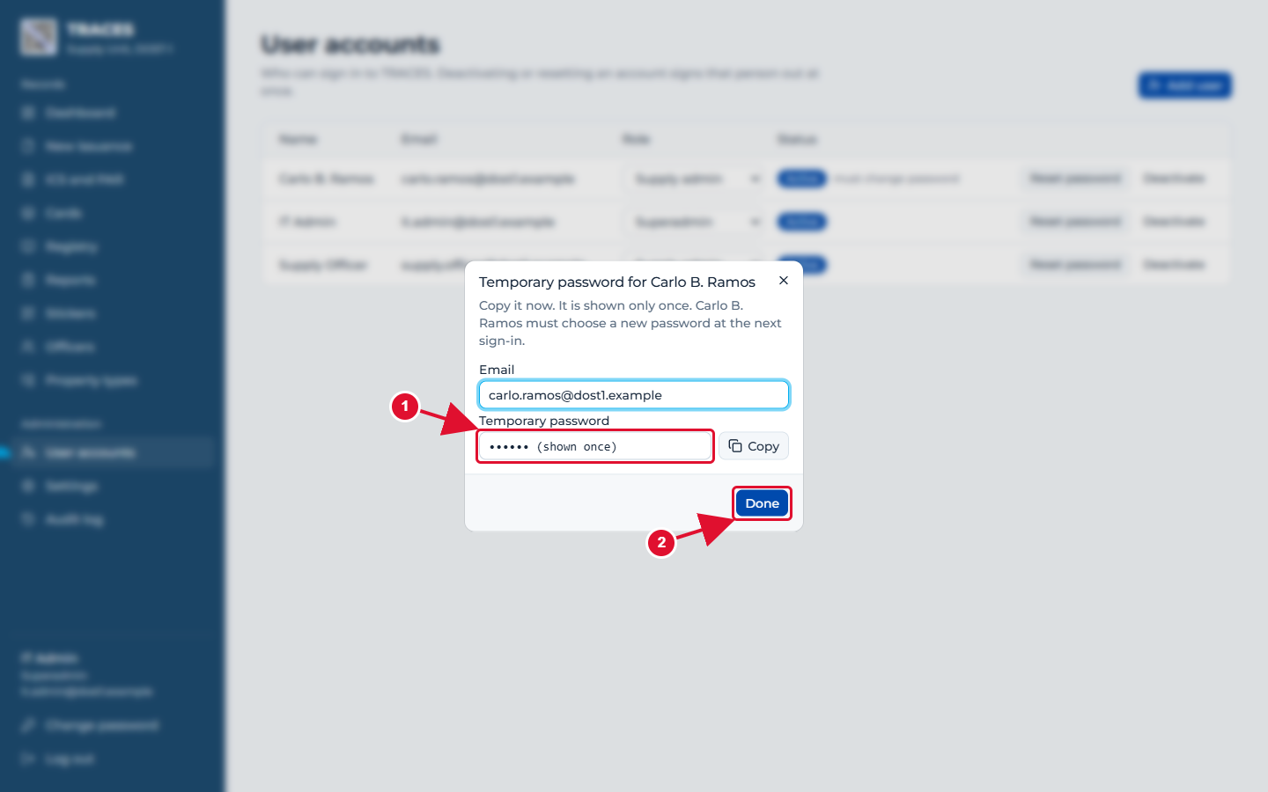
The temporary password is shown only once
1 Copy the temporary password and give it to the person privately. It is not shown again.
2 Click Done. At first sign-in they must choose their own password.
TRACES User Manual · page 55

Slide 56
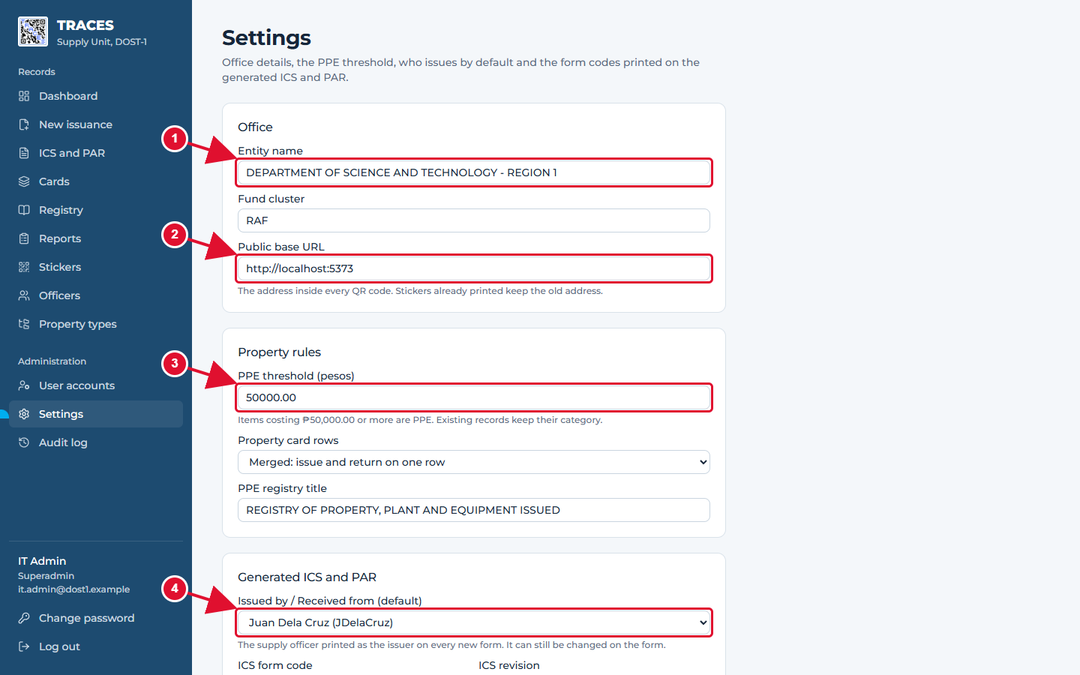
Settings
1 The office name printed on every form.
2 Public base URL: the address inside every QR code. Set it to the real address before printing real stickers.
3 PPE threshold: items costing this much or more are PPE.
4 The supply officer printed as issuer on new slips.
TRACES User Manual · page 56

Slide 57
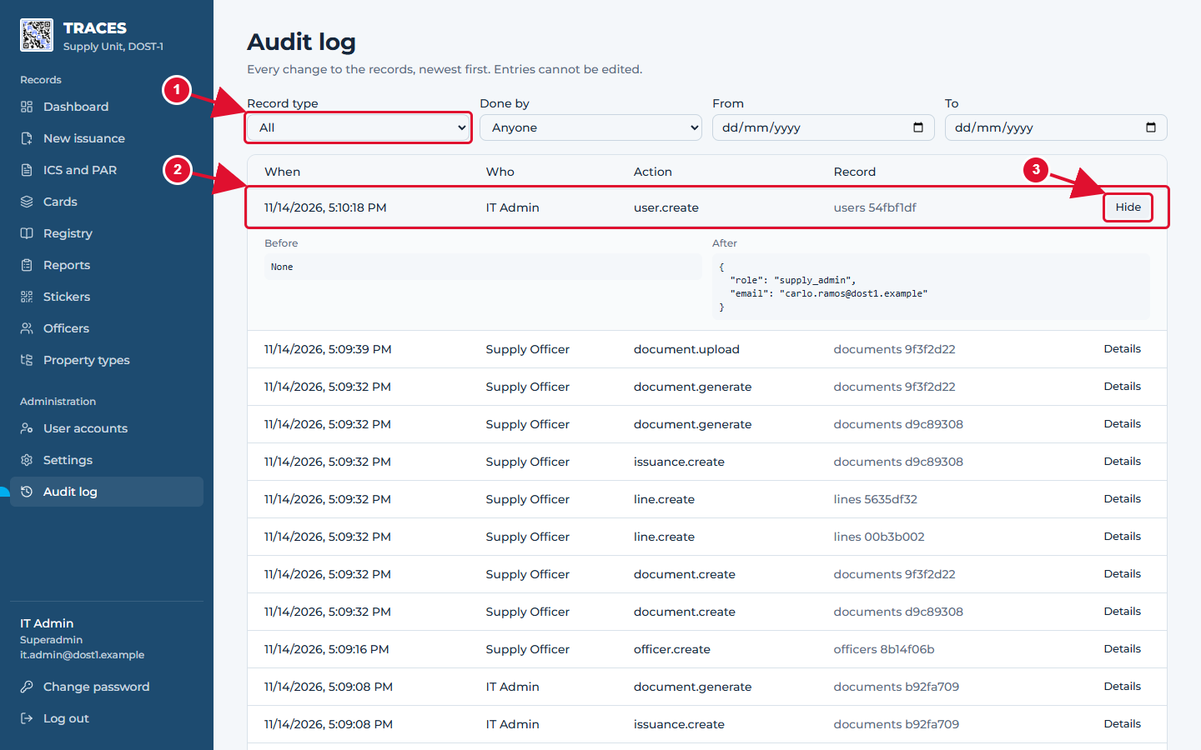
Audit log: every change, who made it and when
1 Filter by kind of record, by person or by dates.
2 Each change is one row.
3 Details shows the values before and after the change.
TRACES User Manual · page 57

Slide 58
Part 10. Your account
TRACES User Manual · page 58

Slide 59
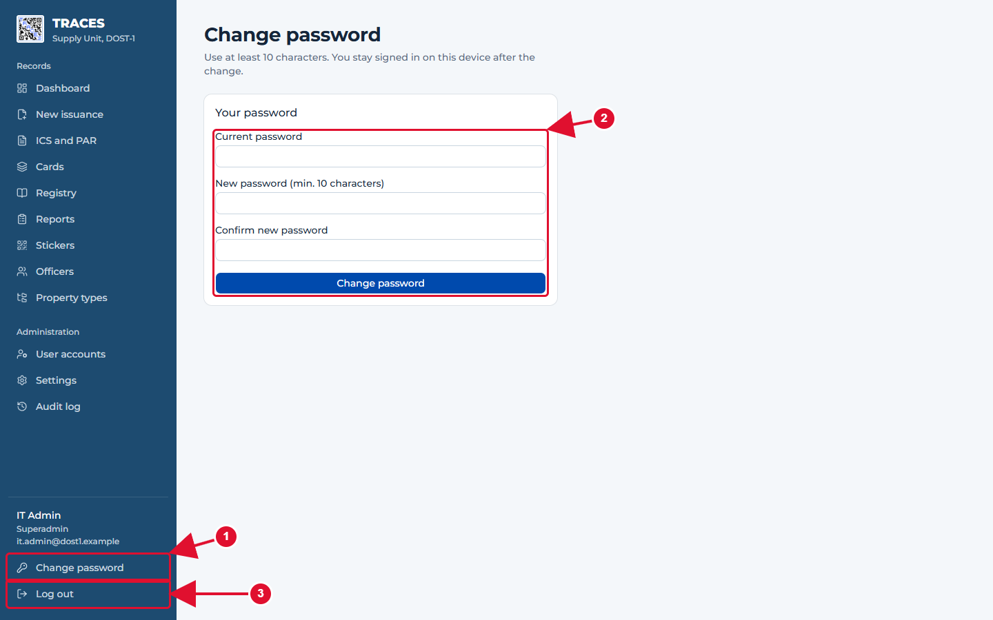
Changing your password and signing out
1 Change password is at the bottom of the menu.
2 Type your current password and the new one twice, then save.
3 Log out when you leave the computer.
TRACES User Manual · page 59

Slide 60
If something goes wrong
"Invalid email or password": check the email and the password (capital letters count). After many tries, wait 15 minutes.
A row has a red border: read the red list under it: it says exactly what is missing. Nothing was saved yet.
"…is already used or repeated on this form": that property number exists already. Leave the box empty to use the suggestion, or type another number.
"…already exists" next to the ICS or PAR number: that slip number was used before. Check the number on the paper form.
"This form has a signed copy, so its entries are locked": the slip was signed. To correct it, use "Remove signed copy" (it asks for a reason), correct, print and sign again.
"The entries changed after this form was generated": click "Regenerate now" before printing, so the printed slip matches the records.
"Test stickers only" on the sticker page: do not stick those stickers on items yet. Ask the IT administrator to set the real address first.
"This sticker was replaced" after a scan: a newer sticker exists for that item. Scan the newer one.
Anything else: ask the ITSM Unit. Tell them the page, what you clicked and the exact message.
TRACES User Manual · page 60

