Slide 1
Simple Machine Learning Techniques For Binary Diffing (with Diaphora)
Joxean Koret (Activision)

Slide 2
Introduction
Machine Learning/Artificial Intelligence is a hot topic in academia for Binary Code Similarity Analysis or, as the information security industry calls it, Binary Diffing (bindiffing for short).
In this talk I will try to discuss how a machine learning (ML) engine was added to Diaphora, the initial steps, what problems were found, which dataset(s) were used, how they were built & cleaned up, how it works in Diaphora, how it enhanced Diaphora, etc.

Slide 3
Introduction
Why?
Prior knowledge: Industry vs Academia
Ideas:
  Train a local model
  Train a gigantic model
  Train a highly specialized model
Conclusions

Slide 4
Why?
The basic idea of this research was to try to apply machine learning techniques with the aim to improve the results of Diaphora for real world use cases.
My reasoning was: “Diaphora uses a myriad of heuristics and little ‘tricks’ here and there, but there is room for improvement, perhaps I can use ML techniques for this?”
Disclaimer: I’m not an ML guy, just a reverse engineer.

Slide 5
Why?
Binary diffing (for 2 binaries) can be summarized in the following steps:
  Mapping: Pairs of functions are matched between 2 binaries.
  Classification: The matches are classified into “good” or “bad” matches, and a similarity ratio is, optionally, calculated.
Now, how can I improve any of these 2 steps?
  I honestly don’t know how to apply ML techniques to improve mapping (in a way that scales, without doing, say, a Cartesian product of the adjacency matrices of the call graphs, for example).
  But classification is actually one of the strongest point of ML techniques, isn’t it?
Cool. Next step? Check prior knowledge in this field.
  Spoiler: Meh.

Slide 6
Industry vs Academia
In the reverse engineering industry most people use Diaphora, BinDiff or Ghidriff for doing binary diffing. No one of these tools apply ML techniques (until now, I guess), so nothing to learn from the industry here.
In the academia, however, it’s the most researched topic.
Apparently. It seems. I guess.

Slide 7
Academia
Almost every single paper I have read lately coming from the academia regarding Binary Code Similarity Analysis (BCSA), BinDiffing, talks about applying Machine Learning/Artificial Intelligence techniques to this process (for classification, not for mapping).
Tools like DeepBinDiff, αdiff or BinDiffNN, or techniques like asm2vec, are some simple examples.

Slide 8
Academia
Unfortunately, most of the academic tools and techniques published about binary diffing are just proof-of-concepts (“Works For Me ™”), or don’t properly scale (they do Cartesian products or are based on adjacency matrices comparison), or are paper-ware (“write and forget”), or the dataset was a toy, or there is neither datasets nor code available, or are too “classical” (they only focus on graphs, assembly or even bytes!) for real world today’s use-cases, etc...
In short: I have tried to use academic research, but I found almost nothing I consider, personally, useful. Unfortunately.
Next step? Think about what could possibly work.

Slide 9
Ideas
The following is the list of ideas I wanted to give a try:
  Training a local model.
  Training a gigantic model.
  Training a highly specialized model.
Any guess about which techniques work, won’t work at all, or might work but require specific stuff?
Let’s first discuss them a bit more in detail...

Slide 10
Training a local model

Slide 11
Training a local model
This is how, on my mind, this idea could work:
  Diaphora uses a number of heuristics that produce highly reliable results.
  By using the matches produced by Diaphora that are good, I could train a classifier of what are good matches, and then use the model to determine if future matches found by not so reliable heuristics are good or bad.
What do you think about this idea?
  Yay or nay?

Slide 12
Training a local model
This is how, on my mind, this idea could work:
  Diaphora uses a number of heuristics that produce highly reliable results.
  By using the matches produced by Diaphora that are good, I could train a classifier of what are good matches, and then use the model to determine if future matches found by not so reliable heuristics are good or bad.
What do you think about this idea?
  Yay or nay? Answer: It’s probably a bad idea. Let’s see why.

Slide 13
Training a local model
Let’s see how it works and why it is a bad idea:
  Diaphora finds reliable matches.
  We train a classifier using these matches.
  Then we use Diaphora to classify future new matches and use the classifier we trained using Diaphora as classifier to determine if the results are good.
Do you see the problem already? I was trying to learn a model that I already have coded.
  There is no need to re-learn what I already have properly coded.
  Naturally, the model would only find whatever Diaphora was already finding.
  And the model would also add false positives due to generalization.
This is the worst idea ever. At least the worst if only 1 classifier is used.

Slide 14
Training a gigantic model

Slide 15
Training a gigantic model
When I finally realised that it was probably a bad idea to train a local model, I decided that, perhaps, the best solution would be to train a model using lots of binaries for different targets, at least for “only”:
  Gcc, clang and msvc compiled targets.
  For Linux, Windows and Mac operating systems.
  For x86, ARM, MIPS, PPC and Risc-V CPUs.
After all, it’s a proved to work thing, right? And it’s as simple as...
  Generating a huge amount of data.
  Using some algorithm to generalize a model from the data.
  Using the generalized model to make predictions.
OK, now, what do you think about this idea?
  Yay or nay?

Slide 16
Training a gigantic model
When I finally realised that it was probably a bad idea to train a local model, I decided that, perhaps, the best solution would be to train a model using lots of binaries for different targets, at least for “only”:
  Gcc, clang and msvc compiled targets.
  For Linux, Windows and Mac operating systems.
  For x86, ARM, MIPS, PPC and Risc-V CPUs.
After all, it’s a proved to work thing, right? And it’s as simple as...
  Generating a huge amount of data.
  Using some algorithm to generalize a model from the data.
  Using the generalized model to make predictions.
OK, now, what do you think about this idea?
  Yay or nay? Answer: Maybe. Do you have lots of resources? Then maybe.

Slide 17
Building Datasets

Slide 18
Finding datasets
Let’s see the problems of this approach, step by step.
The first thing one needs to train a model, naturally, is data.
In this case, “data” are “binaries”. So one needs a binaries dataset to be able to start.
  The biggest it’s, the better. I guess.
Which datasets of binary programs are available?

Slide 19
Finding datasets
There aren’t so many datasets of binaries. The only 2 ones that I know (that doesn’t include malicious and/or obfuscated software) are the following ones:
  Johns Hopkins APL ALLSTAR: Public repo of Debian sources, binaries, compiler artefacts, etc...
    https://allstar.jhuapl.edu/
  Cisco Talos Binary Function Similarity: The dataset used for the paper “How Machine Learning Is Solving the Binary Function Similarity Problem”.
    https://github.com/Cisco-Talos/binary_function_similarity/tree/main/Binaries

Slide 20
Datasets: ALLSTAR
This dataset is huge: 1.1 TB in total.
It contains around 32,000 Debian packages.
It has around ~20k executables for x86, amd64, ARM, PPC, MIPS and s390x.
Which means that even if I use some disks with a few terabytes for downloading and analysing this dataset, I still need to run IDA (and export with Diaphora) some ~20k programs.
  Sorry, I don’t have the required resources. At all.
  So… I had to search for another option.
BTW, naturally, it has no binary for Windows, Android or Macos/iOS, neither Risc-V support, nor support for, say, the MSVC compiler.

Slide 21
Datasets: Cisco Talos
This dataset is considerably smaller. It’s split in 3 subsets:
  “Dataset Vulnerability”.
  “Dataset 1”: Clamav, curl, nmap, openssl, unrar, z3 and zlib.
  “Dataset 2”: Binutils, diffutils, coreutils, findutils, ImageMagick, sqlite, putty, gmp, libmicrohttpd and tomcrypt.
Without entering into details, I decided to just use “Dataset 2”.
  Covers enough binaries to be relevant and it’s possible for me to export with Diaphora all of them in a reasonable amount of time.
  It’s around 4047 binaries exported to SQLite databases.
  45 gigabytes of data to analyse. Big enough for me.
BTW, it doesn’t have binaries for anything that isn’t Linux, or CPUs other than ARM/x86/MIPS/PPC, or the MSVC compiler.
Next step? Build a dataset out of the raw data.

Slide 22
Building a new dataset
I cannot work properly with 4,047 SQLite database files, I need to have everything into a single “thing”.
Also, I don’t need everything Diaphora exports, I just need a small subset of the artefacts exported by it for the “functions” table.
But… which artefacts?

Slide 23
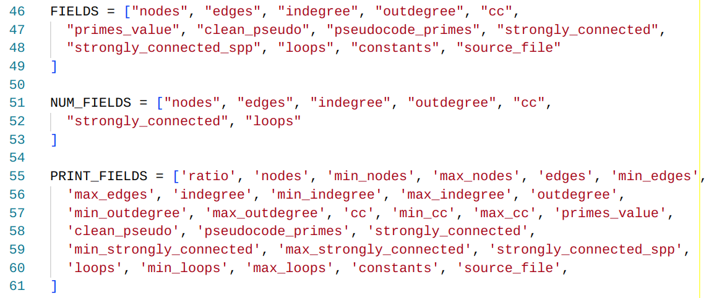
Building a new dataset: artefacts
After some trial & tests, I decided to use the fields shown in the picture below.
The fields don’t contain the real values, but a similarity degree, and the minimum and maximum values.
Similarity ratios are, basically, calculated like this: 1 - ( abs(x - y) / max(x, y) )
For text fields, the similarity ratio is calculated using Python’s SequenceMatcher.quick_ratio().

Slide 24
Building a new dataset
After choosing the proper fields and playing a bit generating small datasets it was time to play with bigger ones.
Running a Python script I built to cross-compare all the Diaphora’s exported SQLite databases and generate a dataset with the previously mentioned fields turned out to be… not very practical for an individual:
  Tip: It means doing 4,047 x 4,047 operations (16,378,209 operations).
Estimating the times it took for just 100 binaries doing so for the whole Cisco Talos Dataset-2, it would take me around 2 months for just generating the dataset. Doable. But not for an individual like me.

Slide 25
Building a new dataset
I needed a partial solution, because “the best solution” (building a huge dataset) is absolutely not practical for me.
As so, I thought about other approaches:
  Building a subset of the dataset that is significant enough.
  Building specialised datasets for specialised use-cases.
  Building a dataset comparing only binaries that match around 99% of the functions (by address or by name, when there are symbols).
    More details on this too later.

Slide 26
Building subsets of datasets
I started trying to build datasets for:
  Only diffutils.
  Only coreutils.
  Only putty binaries.
  Only “ls” binaries.
  Only another random subset of binaries.
Guess what happened?
  The generated datasets had good accuracy against the training data, but they were performing bad against the real data. Surprise.
  Let’s see some examples...

Slide 27
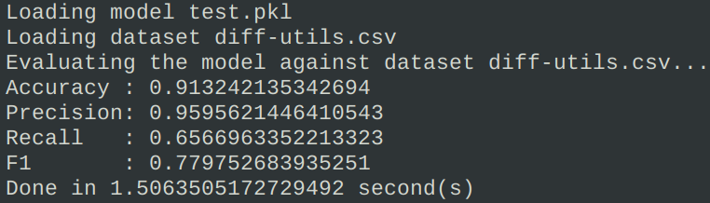
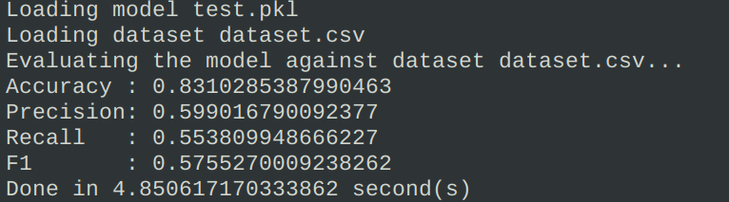
Building subsets of datasets
Example using a subset of the Cisco Talos dataset specific to diff-utils.
At the top, the results against the training dataset.
At the bottom, the results against a larger dataset involving multiple different binary types (from the same dataset)

Slide 28
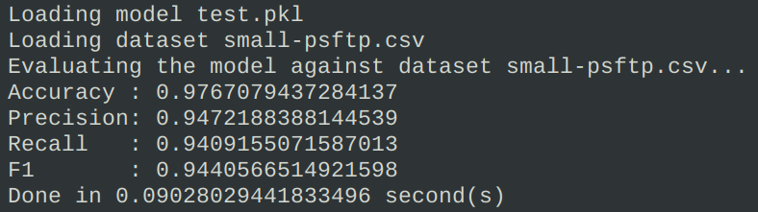
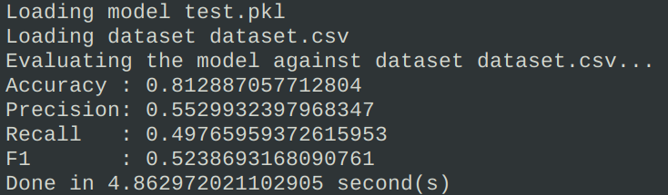
Building subsets of datasets
Example using a subset of the Cisco Talos dataset specific to Putty binaries.
At the top, the results against the training dataset.
At the bottom, the results against a larger dataset involving multiple different binary types (from the same dataset)

Slide 29
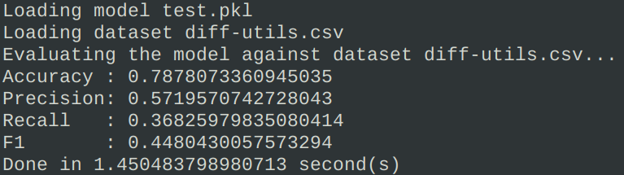
Building subsets of datasets
Example using a subset of the Cisco Talos dataset specific to Putty binaries.
At the top, the results against the training dataset.
At the bottom, the results against the diff-utils dataset previously generated.

Slide 30
Choosing an algorithm
You might think that, maybe, the problem wasn’t the data but the algorithm.
This is something that I thought. So, just in case, I gave it a try and decided to try a lot of different classifiers (and even regressors).
Results? No, the problem wasn’t the classifier at all.
Let’s see some results...

Slide 31
Choosing an algorithm (dataset.csv)
Algorithm Name | Accuracy on training data | Accuracy on testing dataset | Deviation | Duration
ExtraTreesClassifier | 0,97 | 0,91 | 0,01 | ~01:15:00
RandomForestClassifier | 0,97 | 0,92 | 0,01 | +2 hours
BaggingClassifier | 0,96 | 0,91 | 0,01 | ~01:10:00
DecisionTreeClassifier | 0,95 | 0,88 | 0,02 | 12 minutes
KNeighborsClassifier | 0,94 | 0,88 | 0,01 | ~2:30:00
MLPClassifier | 0,91 | 0,9 | 0,01 | ~5 hours
GradientBoostingClassifier | 0,9 | 0,91 | 0,01 | ~3 hours
AdaBoostClassifier | 0,89 | 0,9 | 0,02 | ~40 minutes
SGDClassifier | 0,85 | 0,85 | 0,05 | 10 minutes
LinearDiscriminantAnalysis | 0,85 | 0,88 | 0,02 | 2 minutes
LogisticRegression | 0,85 | 0,88 | 0,01 | 3 minutes
BernoulliNB | 0,83 | 0,8 | 0,02 | 1 minute
GaussianNB | 0,82 | 0,86 | 0,02 | ~2 minutes
BayesianRidge | 0,31 | 0,43 | 0,06 | 1 minute

Slide 32
Choosing an algorithm (Putty dataset)
Algorithm Name | Accuracy on testing data | Accuracy on training dataset | Deviation | Duration (sec)
MLPClassifier | 0,87 | 0,91 | 0,01 | 21745
KNeighborsClassifier | 0,86 | 0,88 | 0,01 | 17657
AdaBoostClassifier | 0,85 | 0,9 | 0,02 | 13608
RandomForestClassifier | 0,9 | 0,92 | 0,01 | 10326
ExtraTreesClassifier | 0,9 | 0,91 | 0,01 | 9815
BaggingClassifier | 0,89 | 0,91 | 0,02 | 2170
GradientBoostingClassifier | 0,86 | 0,91 | 0,01 | 1894
LogisticRegression | 0,83 | 0,88 | 0,01 | 1221
DecisionTreeClassifier | 0,89 | 0,88 | 0,02 | 310
BernoulliNB | 0,74 | 0,8 | 0,02 | 216
SGDClassifier | 0,82 | 0,86 | 0,02 | 159
GaussianNB | 0,73 | 0,86 | 0,02 | 131
LinearDiscriminantAnalysis | 0,82 | 0,88 | 0,02 | 123

Slide 33
Choosing an algorithm (diff-utils against dataset.csv)
Algorithm Name | Accuracy on training dataset | Accuracy on testing data | Precision | Recall | F1 | Training | Validation
MLPClassifier | 0,88 | 0,864126110440244 | 0,72300897599 | 0,55617944838 | 0,62871540389 | 9000 | 2
GradientBoostingClassifier | 0,87 | 0,869471201100845 | 0,79399703251 | 0,49820267142 | 0,61224506010 | 9301 | 6
RandomForestClassifier | 0,91 | 0,8579833348712 | 0,70618835148 | 0,53669976854 | 0,60988775849 | 9056 | 50
BaggingClassifier | 0,91 | 0,850788123387747 | 0,68025950341 | 0,52572184077 | 0,59308923817 | 4269 | 9
GaussianNB | 0,81 | 0,816048377282897 | 0,54759693457 | 0,63659373908 | 0,58875109870 | 107 | 2
AdaBoostClassifier | 0,86 | 0,865403208659127 | 0,81921531552 | 0,44818133622 | 0,57938769881 | 2342 | 12
DecisionTreeClassifier | 0,91 | 0,842926948644604 | 0,65091175981 | 0,51890427609 | 0,57745984865 | 537 | 3
LogisticRegression | 0,84 | 0,854233614027486 | 0,74283663432 | 0,45162406092 | 0,56173116241 | 5971 | N/A
LinearDiscriminantAnalysis | 0,84 | 0,846752894198765 | 0,70086052654 | 0,45205399743 | 0,54961022015 | 247 | N/A
SGDClassifier | 0,84 | 0,852440996056374 | 0,78310598513 | 0,39639823111 | 0,52635984341 | 1100 | N/A
BernoulliNB | 0,85 | 0,844958938952031 | 0,82583570262 | 0,31736749550 | 0,45852462461 | 119 | N/A

Slide 34
Choosing an algorithm?
After multiple other tests with multiple other datasets… I finally decided that the algorithm wasn’t really the problem here.
And, finally, decided that a decision tree classifier, actually, worked more than good enough for what I want:
  I want it to be fast at validation and, maybe, training.
  I want it to be reliable enough, but no need to be 100% bulletproof.
    Remember that this ML engine won’t be used alone: it will be used by Diaphora, and it will take care of removing potential FPs.
  As I’m not really building huge datasets overfitting seems not to be a real problem for now.
  A random forest classifier performs just slightly better but is considerably much slower. I don’t want Diaphora to be significantly slower.

Slide 35
Building datasets
So, after discussing the problems I had with big datasets, and briefly discussing that algorithms aren’t actually a problem in this scenario…
What else can I do?
Does this testing mean that I cannot, as an independent RE tools developer train a model I can distribute that would work for every use-case?
  Yes, it won’t work. Unless I have the help of someone with huge resources.
  And even in this case, the model to be distributed would probably be gigabytes in size, so probably not very practical (and I won’t be able to just put it in Github).
Does this mean that ML for Diaphora is not viable? Nope. Let’s continue...

Slide 36
Training specialized models

Slide 37
  Using specialized models
This the 3rd idea I mentioned that I wanted to give a try.
Actually, it wasn’t an idea I had at first. This is an idea that arose at the time I decided that I don’t have the resources to properly develop idea #2.
Basically, train a model with 2 or more binaries with and without symbols, that are actually the same target, but for different versions, maybe, and then use the trained model to try to improve function matching for future later versions of that product.
OK, now, what do you think about this idea?
  Yay or nay?

Slide 38
  Using specialized models
This the 3rd idea I mentioned that I wanted to give a try.
Actually, it wasn’t an idea I had at first. This is an idea that arose at the time I decided that I don’t have the resources to properly develop idea #2.
Basically, train a model with 2 or more binaries with and without symbols, that are actually the same target, but for different versions, maybe, and then use the trained model to try to improve function matching for future later versions of that product.
OK, now, what do you think about this idea?
  Yay or nay? This is the very first idea that I got properly working.

Slide 39
  Using specialized models
The idea is the following:
  A binary X version 1.0 has symbols.
  A binary X version 1.1, however, doesn’t have symbols anymore.
  Generating a dataset (CSV) comparing functions with and without symbols for binary X version 1.0, we can train a model that will improve function matching when diffing version 1.1 against 1.0 to port symbols.
Let’s see an example with, for example, MPEngine.dll.

Slide 40
  Using specialized models
I have compared binaries for MPEngine.dll versions:
  1.1.19700 and 1.1.20000, no symbols.
  1.1.19700 and 1.1.20000, with PDB symbols.
Then I generated a dataset and trained a model using a decision tree algorithm.

Slide 41
  Using specialized models
The dataset was generated like this:
  Per each function pair that is good we generate one “good” labelled row (value 1), and 5 “bad” labelled rows (value 0).
Then, we just train using a decision tree and, after some seconds, we get the following easy to understand tree...

Slide 42
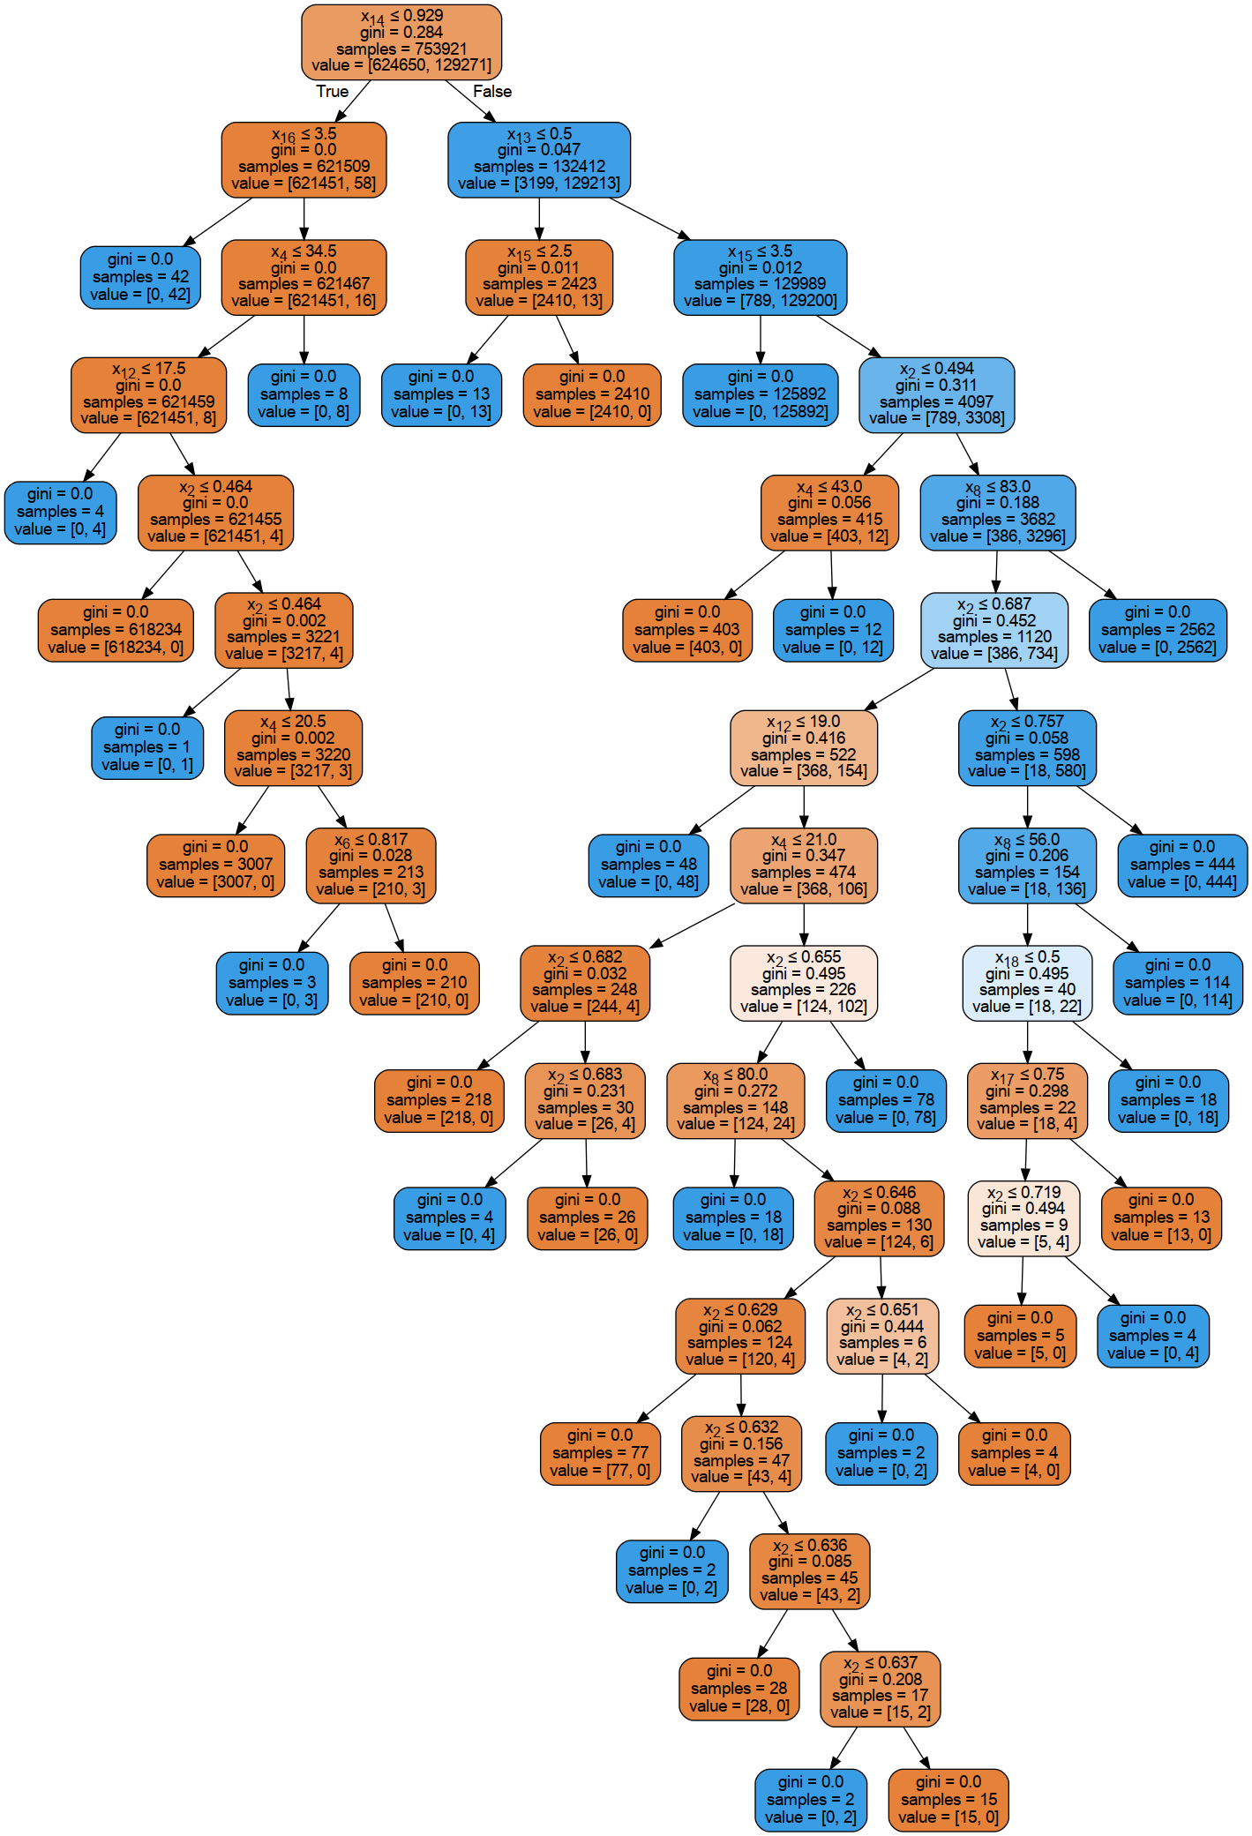
  Using specialized models
The generated dataset has 1,636,376 rows, 308 MB.
The final tree shown for it looks so easy that it looks like the model is probably correctly generalised.
And, after some basic testing in Diaphora with a newer version of MPEngine.dll, it seems that it improved a bit the results.

Slide 43
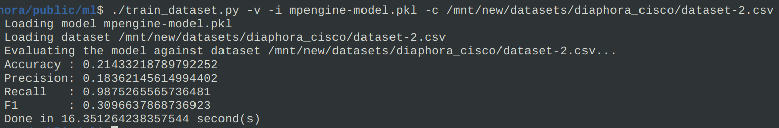
  Using specialized models
So, after seeing the results I got with the specialized model for MPEngine.dll, I thought that, perhaps, I could give a try to using this model against the Cisco Talos Dataset-2 CSV.
Guess what? The results were very bad. Surprise, right?

Slide 44
  Using specialized models
After this, the next step was kind of clear: I cannot train, with my resources, a gigantic model with millions of binaries for every single platform out there.
The smaller datasets don’t really work with other datasets.
But, perhaps, I can create a specialized dataset with relevant enough files for Diaphora? Like, the following ones:
  All binaries in the Diaphora testing suite. Private files, sorry.
  Together with the binaries from the aforementioned Dataset-2.
Guess what? The results aren’t that bad.

Slide 45
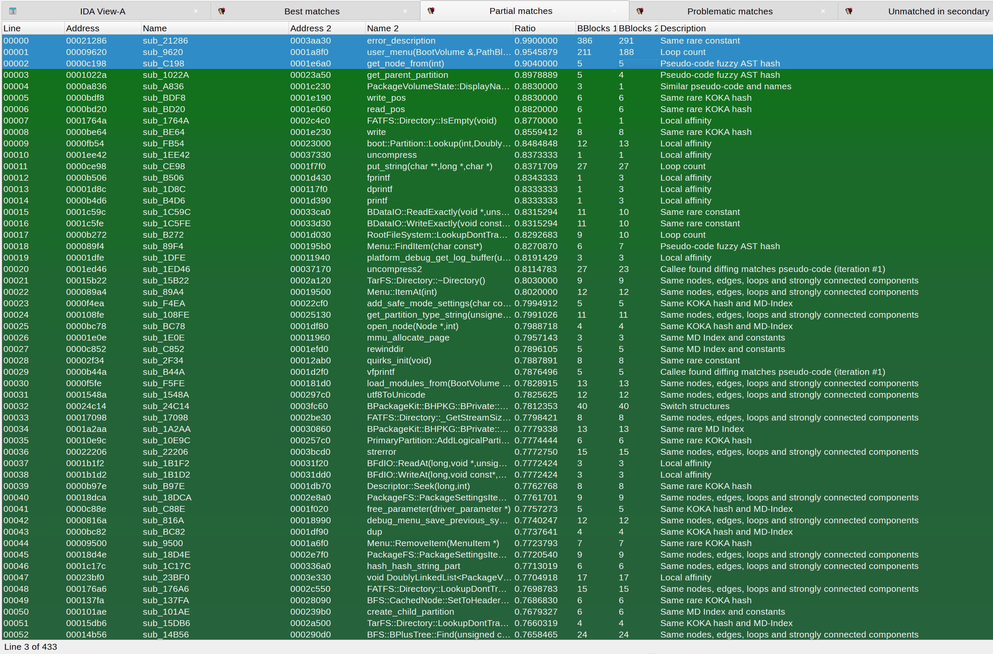
Results before with a Haiku loader for Risc-V

Slide 46
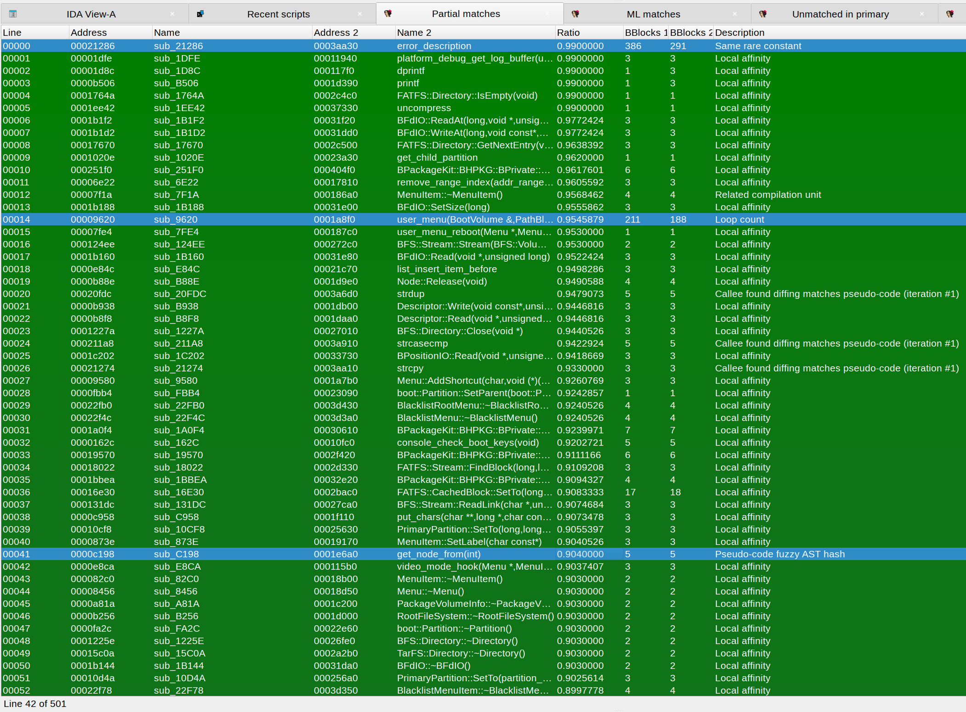
Results after with a Haiku loader for Risc-V

Slide 47
The amalgamation model
The dataset I built using...
  The Diaphora testing suite binaries.
  And all the binaries in Dataset-2.
...is what forms the dataset I called the “Diaphora’s amalgamation”.
  https://github.com/joxeankoret/diaphora-ml/blob/main/datasets/diaphora-amalgamation.csv.bz2
This dataset isn’t huge, I can distribute it. And it seems to be performing quite well, to be honest.
Let’s discuss it a bit...

Slide 48
The amalgamation model
After building the amalgamation model I did some manual tests in Diaphora to see if it looked that it was performing better.
Over all, it was finding more partial results and removing multimatches, which is an indicative of it working properly.
After manually testing some new results with a couple of binaries, it turned out that almost no false positive was added, because Diaphora is pretty good trying to remove them (for functions that aren’t tiny).
Next step? Try to, first, re-validate the model by taking the dataset and splitting it into the usual “train, validation & testing” datasets. Let’s see its results...

Slide 49
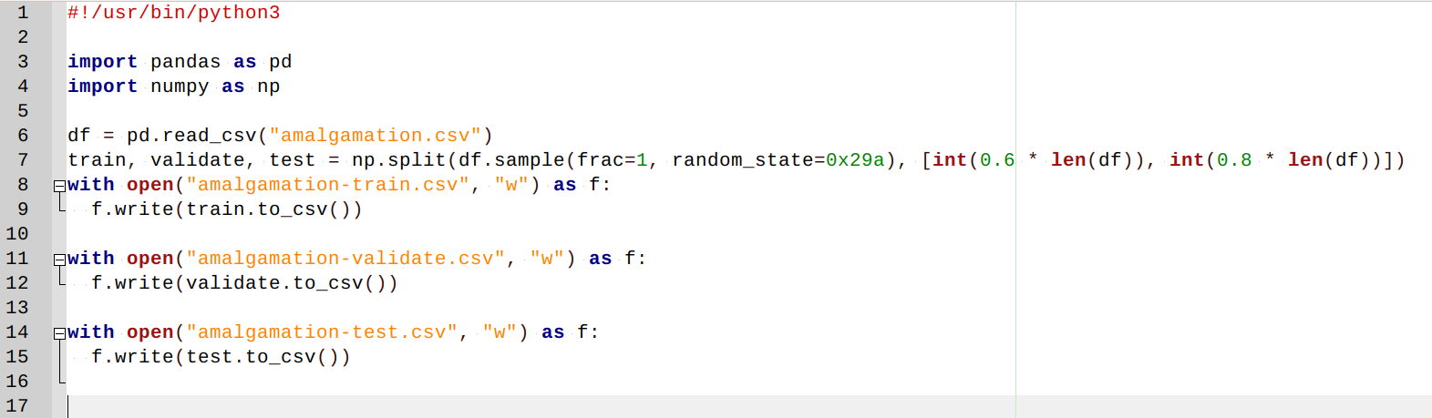
The amalgamation model
The amalgamation model was randomly split using the following trivial Python script into 3 smaller datasets: 60% for training, 20% for testing and 20% for validation.

Slide 50
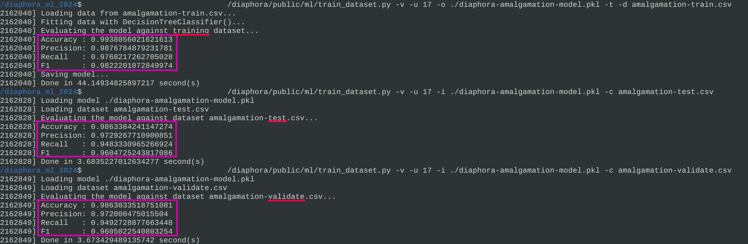
The amalgamation model

Slide 51
The amalgamation model
Now, in Diaphora, this model is used when comparing a functions match increasing its similarity ratio by a configurable value when the ML classifier considers the pair good.
After explaining how this ML engine was plugged into Diaphora, let’s take a look to the results of some example diffing projects:
  Busybox x86-64 with symbols against Busybox PowerPC.
  Haiku loader x86-64 with symbols against Haiku loader Risc-V.
  iOS kernel 10.3.1 ARM64 vs Macos kernel 10.12.4 x86-64.

Slide 52
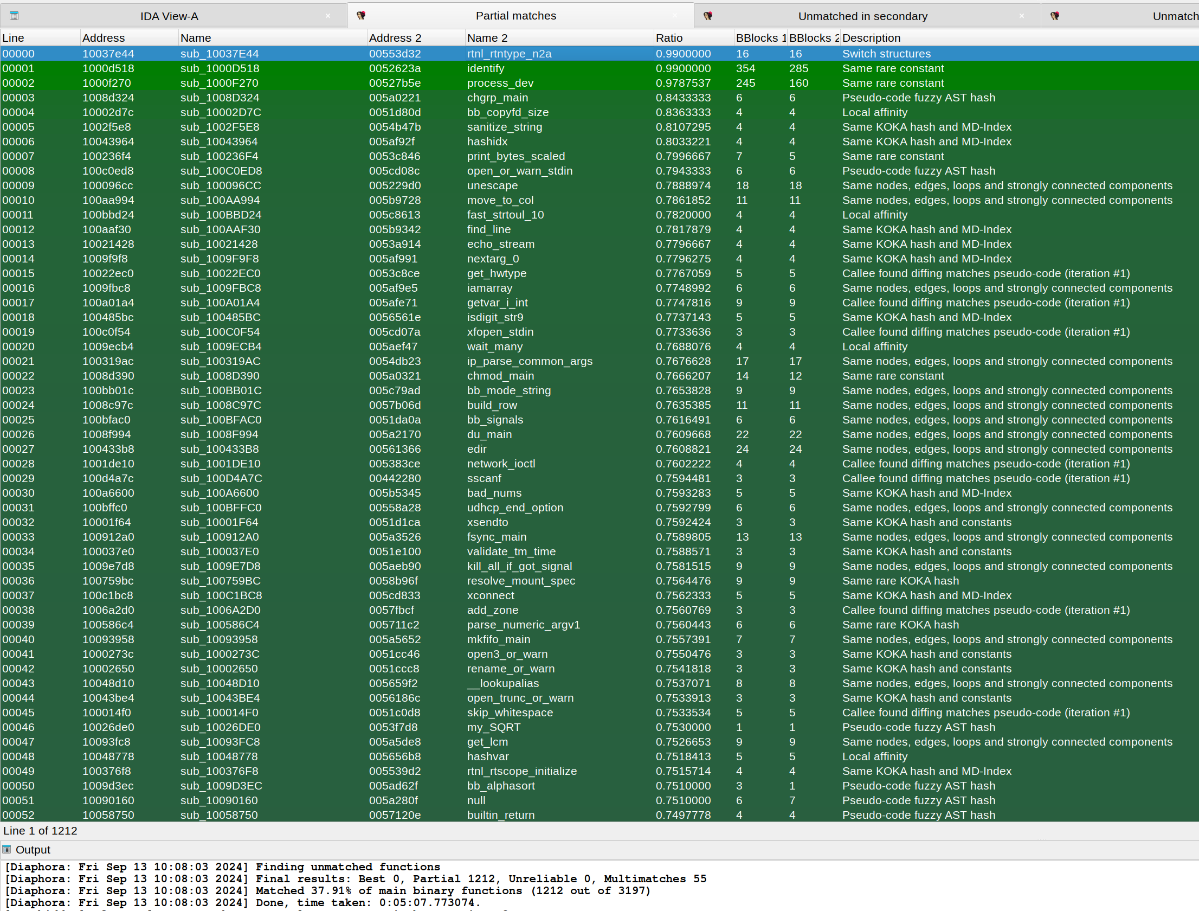
Busybox x86-64 vs PowerPC, no ML

Slide 53
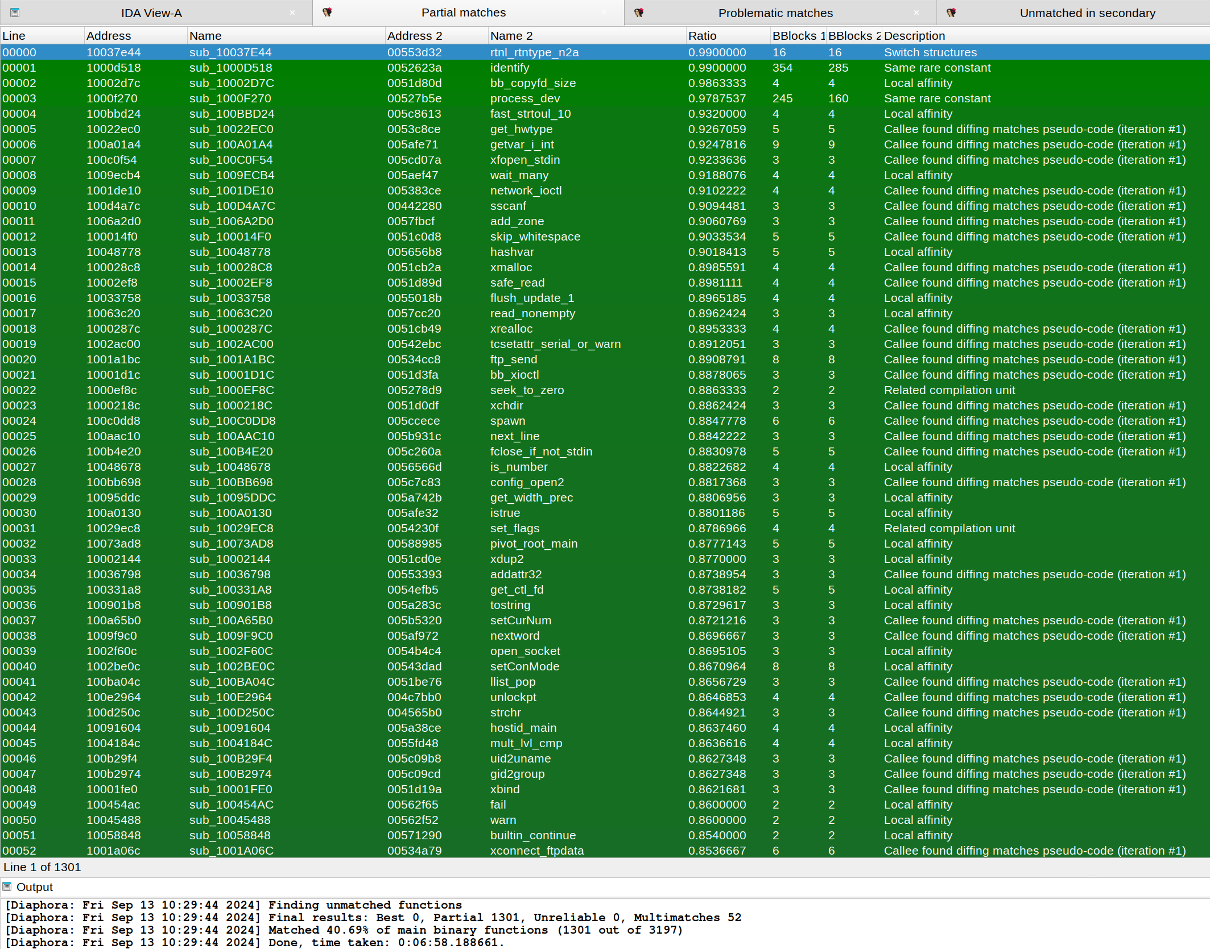
Busybox x86-64 vs PowerPC, using ML

Slide 54
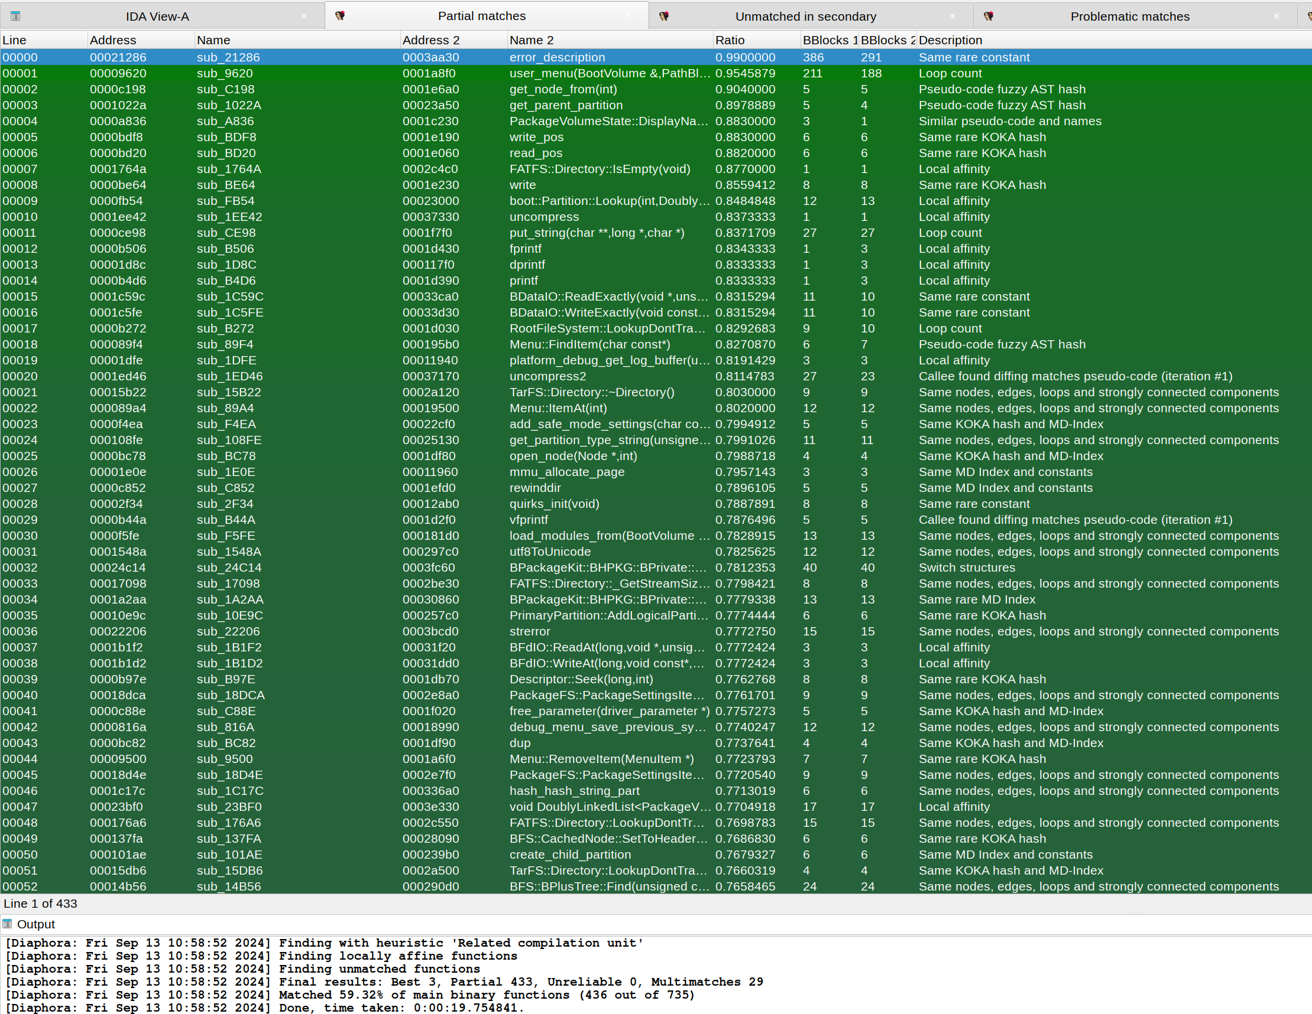
Haiku x86-64 vs Risc-V, no ML

Slide 55
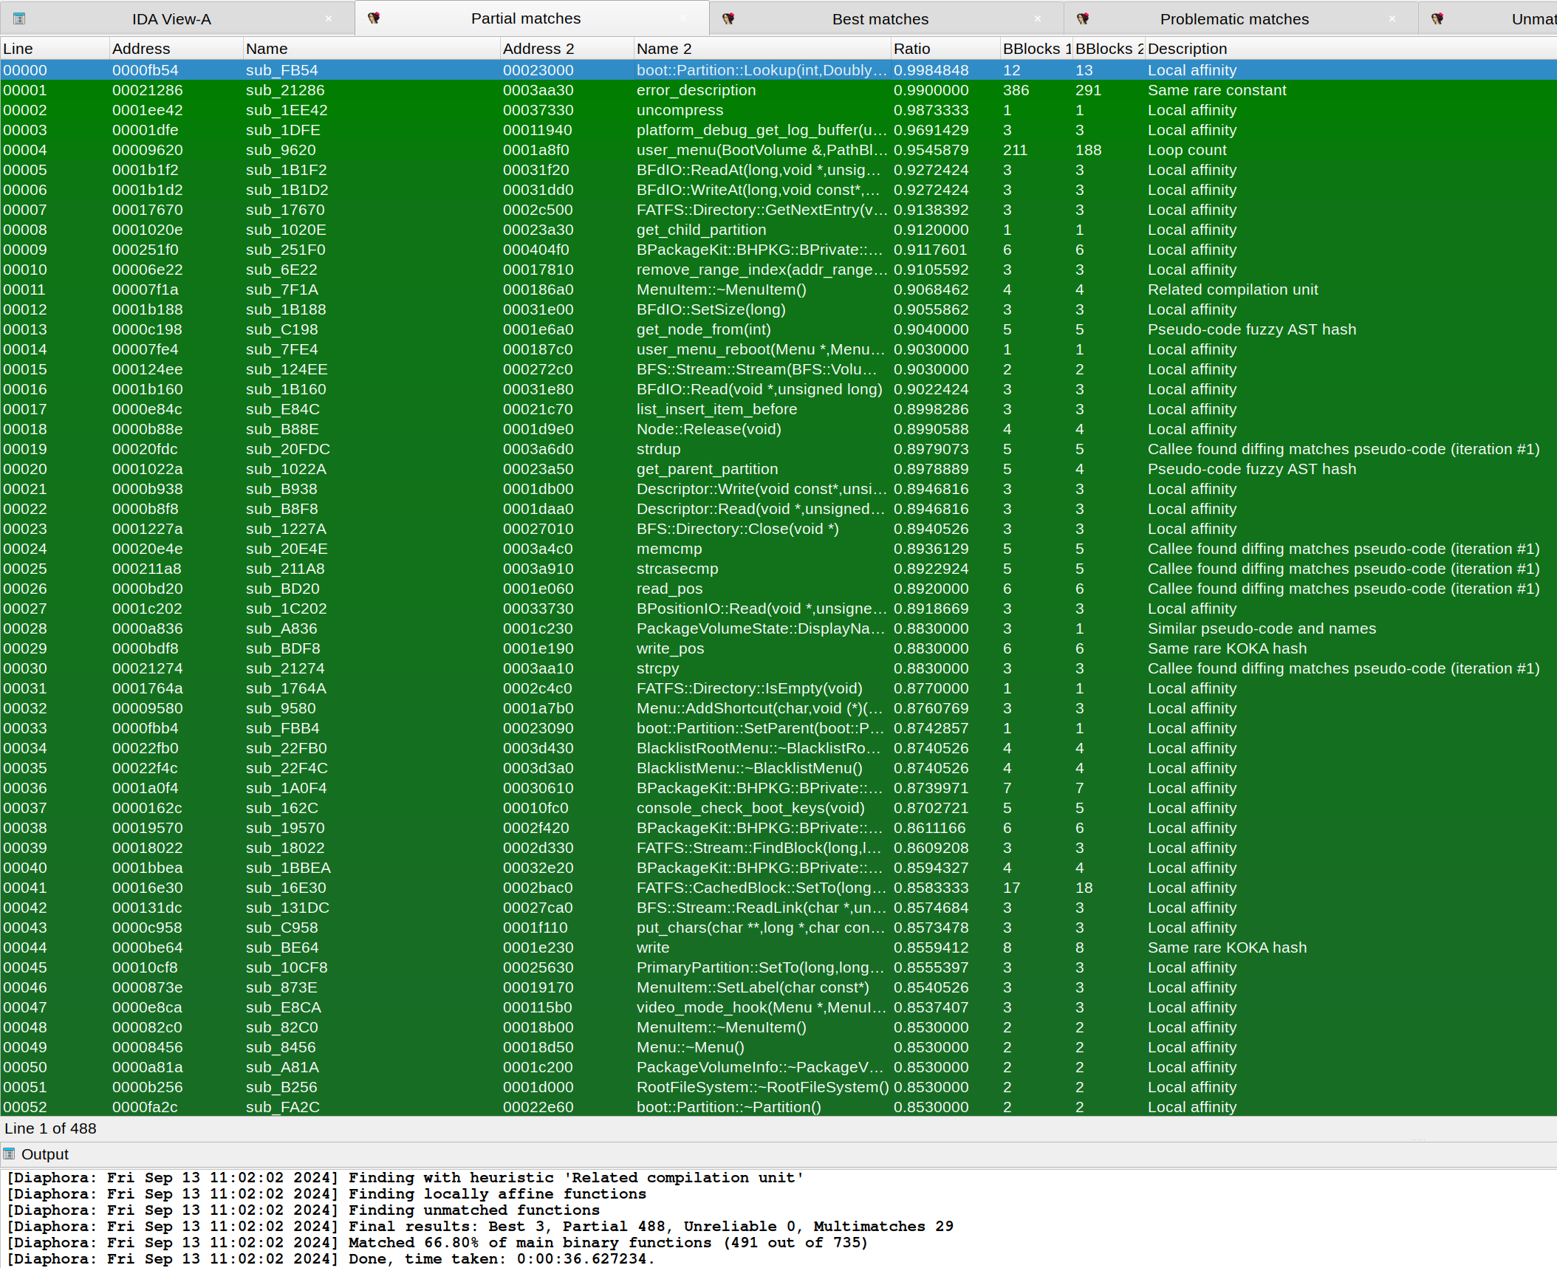
Haiku x86-64 vs Risc-V, using ML

Slide 56
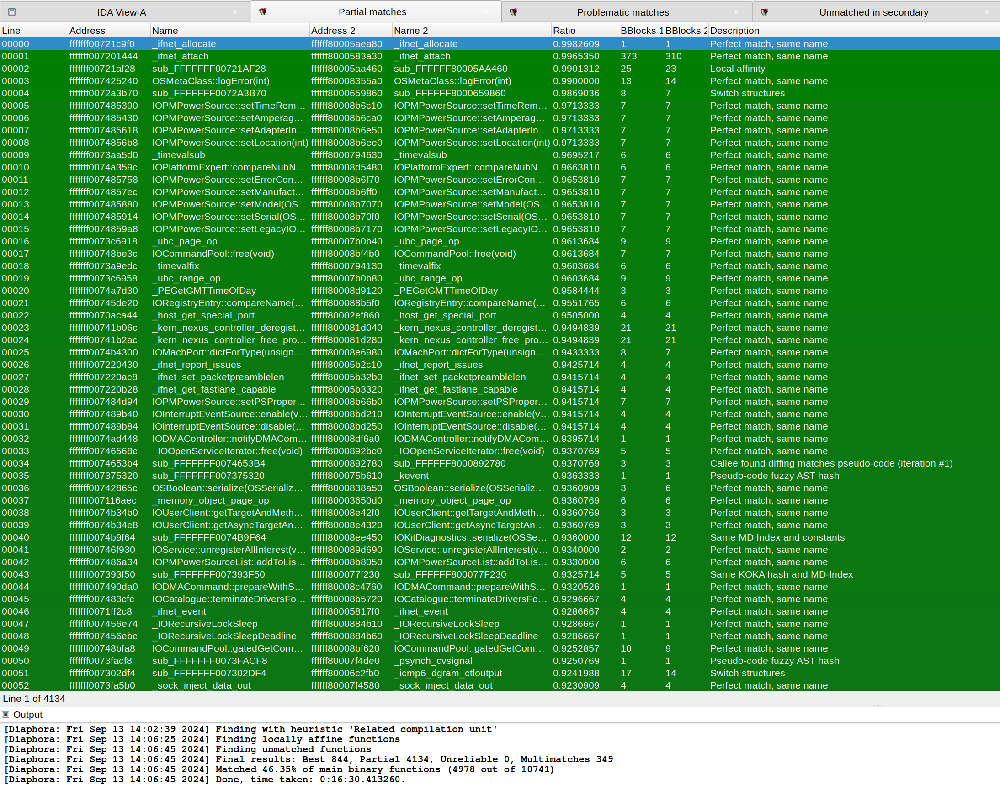
iOS kernel 10.3.1 vs Macos kernel 10.12.4, no ML

Slide 57
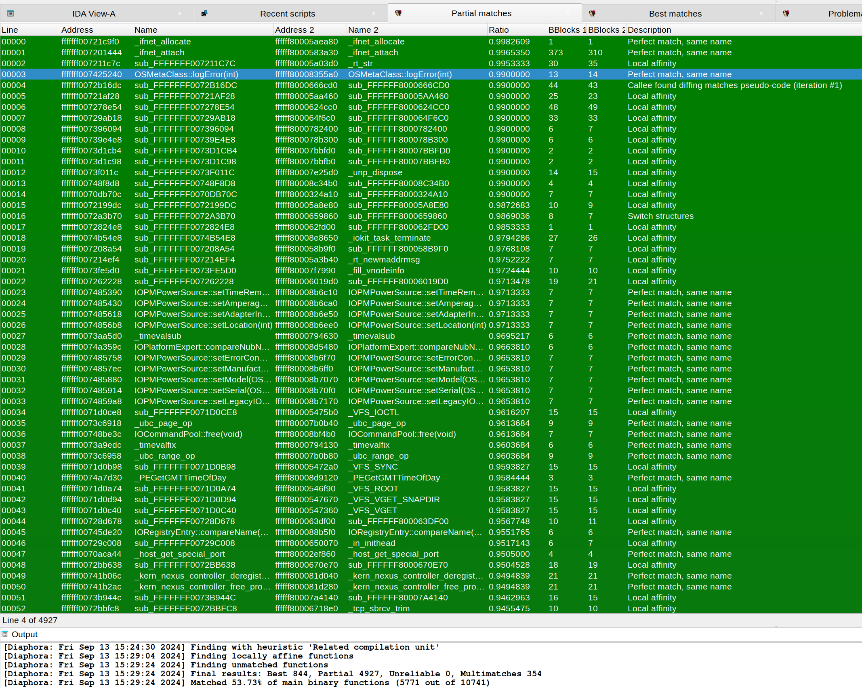
iOS kernel 10.3.1 vs Macos kernel 10.12.4, using ML

Slide 58
Training a specialized model yourself

Slide 59
Specialized models
Diaphora since September 2024 distributes an already trained model and, also, in a different repository, the tools so you can train yourself your own models:
  https://github.com/joxeankoret/diaphora-ml
Basically, you will need to do the following:
  Analyse all the binaries with IDA.
  Export all of them with Diaphora.
  Run a tool that parses Diaphora exported SQLite databases to generate a CSV file.
  Use the generated CSV file to train a model.
  Tell Diaphora in diaphora_config.py the path of your own model.

Slide 60
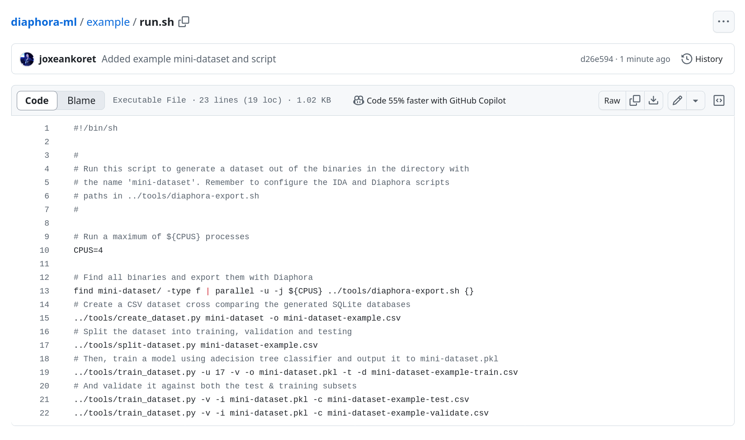
Specialized models
https://github.com/joxeankoret/diaphora-ml/blob/main/example/run.sh

Slide 61
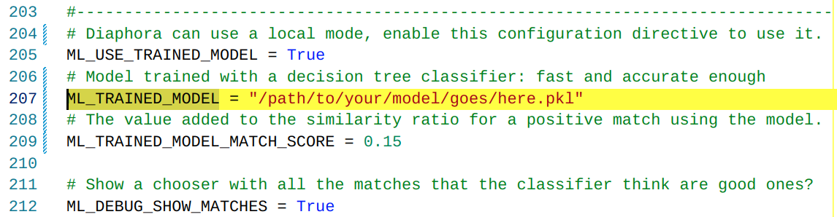
Specialized models
After your model is generated, you will need to specify in your diaphora_config.py file the path of the model to be used:

Slide 62
Specialized models
Now, let’s suppose that you want to build your model but you also want to use the model supplied by Diaphora at the same time.
What can you do? Here is the solution:
Simply, concatenate your CSV with the Diaphora’s supplied CSV file.
  The Diaphora’s CSV is in https://github.com/joxeankoret/diaphora-ml
And then train your model with the concatenation of them.
As simple as it sounds.

Slide 63
Conclusions

Slide 64
Conclusions
It’s not obvious at first sight what ML techniques might or might not work to apply to bindiffing, to be honest.
  And this talk has only been about classification, not mapping.
Building huge models from huge datasets, unfortunately, doesn’t look appropriate for everybody. At least, it is not for me.
However, building highly specialised datasets for very specific use-cases is easy to do and significantly improves results.
It’s more important, in my opinion, to release the tools to allow reversers to train their own models than actually distributing an already trained model, anyway.
And this is why I now distribute with Diaphora the model, and also the tools (separately).

Slide 65
Download
Everything is public already and, naturally, Open Source:
  The ML tools: https://github.com/joxeankoret/diaphora-ml
  The binary diffing tool: https://github.com/joxeankoret/diaphora
Enjoy! Hopefully, it makes your RE life a bit better.
Also, if you want, come join me for the Diaphora workshop right after this talk.

Slide 66
Questions anyone?
Thanks for your time!

