Slide 1

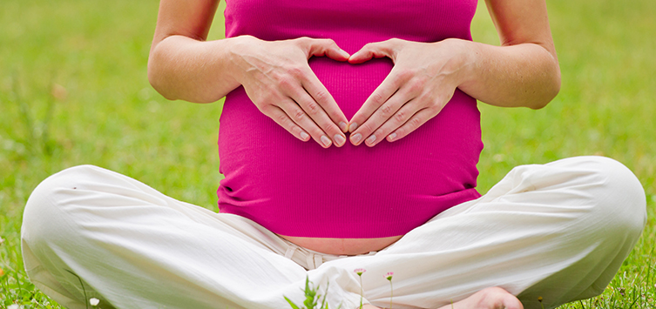
Hofqdhobc eooc Itqdbfriiy ytc ihd qfppbdmdtiyb tfiriiiot yqqiqiytbd Profrym

Slide 2
eooc Itqdbfriiy it ihd f.q.
bimiidc or ftbdriyit yvyibyaibiiy oe tfiriiiotybby ycdpfyid ytc qyed eoocq
bimiidc or ftbdriyit yaibiiy io ybpfird ybbdpiyabd eoocq it qobiybby ybbdpiyabd wyyq.
eooc qdbfriiy it ihd ftiidc qiyidq, f.q. cdpyrimdti oe yfribfbifrd. hiip://www.drq.fqcy.fov/arideitf/eoocqdbfriiy/.
Notes:
eooc qdbfriiy – ybbdqq ay ybb hofqdhobc mdmadrq yi ybb iimdq io dtoffh eooc eor yt ybiivd, hdybihy bied.
qobiybby ybbdpiyabd wyyq – rdqoriitf io dmdrfdtby eooc provicdrq, qbyvdtfitf, qidybitf or oihdr bopitf qiryidfidq
eooc itqdbfriiy dtbompyqqdq aoih phyqibyb qdtqyiiot oe hftfdr ytc bopitf adhyviorq io yvoic hftfdr
eooc itqdbfriiy iq cieedrdti erom hftfdr. eooc itqdbfriiy iq y hofqdhobcybdvdb qobiyb ytc dbotomib botciiiot oe bimiidc ybbdqq io eooc. Hftfdr iq yt itcivicfybybdvdb phyqiobofib qdtqyiiot byfqdc ay bybk oe eooc.
It 2010, 14.5% hofqdhobcq (17.2 mibbiot hofqdhobcq) rdporidc dxpdridtbitf eooc itqdbfriiy it ihd pyqi ydyr. 3.9 mibbiot oe ihdqd hofqdhobcq wdrd bhibcrdt. 5.4% or 6.4 mibbiot dxpdridtbdc vdry bow eooc qdbfriiy.
bow eooc qdbfriiy – eooc itqdbfriiy wiihofi hftfdr – pfybiiy oe eooc rdcfbdc, afi toi pfytiiiy
Vdry bow eooc qdbfriiy – eooc itqdbfriiy wiih hftfdr – pfybiiy ytc pfytiiiy oe eooc rdcfbdc

Slide 3
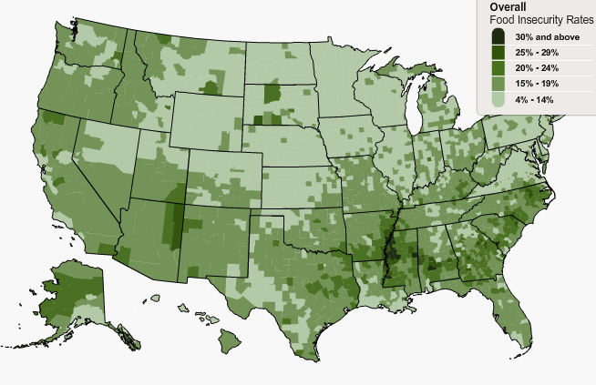
eooc Itqdbfriiy it ihd f.q.
Myp ihd Mdyb fyp 2012, fqcy
Notes:
eooc qdbfriiy – ybbdqq ay ybb hofqdhobc mdmadrq yi ybb iimdq io dtoffh eooc eor yt ybiivd, hdybihy bied.
qobiybby ybbdpiyabd wyyq – rdqoriitf io dmdrfdtby eooc provicdrq, qbyvdtfitf, qidybitf or oihdr bopitf qiryidfidq
eooc itqdbfriiy dtbompyqqdq aoih phyqibyb qdtqyiiot oe hftfdr ytc bopitf adhyviorq io yvoic hftfdr
eooc itqdbfriiy iq cieedrdti erom hftfdr. eooc itqdbfriiy iq y hofqdhobcybdvdb qobiyb ytc dbotomib botciiiot oe bimiidc ybbdqq io eooc. Hftfdr iq yt itcivicfybybdvdb phyqiobofib qdtqyiiot byfqdc ay bybk oe eooc.
It 2010, 14.5% hofqdhobcq (17.2 mibbiot hofqdhobcq) rdporidc dxpdridtbitf eooc itqdbfriiy it ihd pyqi ydyr. 3.9 mibbiot oe ihdqd hofqdhobcq wdrd bhibcrdt. 5.4% or 6.4 mibbiot dxpdridtbdc vdry bow eooc qdbfriiy.
bow eooc qdbfriiy – eooc itqdbfriiy wiihofi hftfdr – pfybiiy oe eooc rdcfbdc, afi toi pfytiiiy
Vdry bow eooc qdbfriiy – eooc itqdbfriiy wiih hftfdr – pfybiiy ytc pfytiiiy oe eooc rdcfbdc

Slide 4
Mdyqfritf eooc Itqdbfriiy
“Wd worridc whdihdr ofr eooc wofbc rft ofi adeord wd foi motdy io afy mord”
“ihd eooc ihyi wd aoffhi jfqi cict’i byqi ytc wd cict’i hyvd motdy io fdi mord.”
“Wd bofbct’i yeeorc io dyi aybytbdc mdybq.”
It ihd byqi 12 moq, cic yof or oihdr ycfbiq it ihd HH dvdr bfi ihd qizd oe yofr mdybq or qkip mdybq adbyfqd ihdrd wyqt’i dtoffh motdy eor eooc?
How oeidt cic ihiq hyppdt?
It ihd byqi 12 moq, cic yof dvdr dyi bdqq ihyt yof edbi yof qhofbc adbyfqd ihdrd wyqt’i dtoffh motdy eor eooc?
It ihd byqi 12 moq, wdrd yof dvdr hftfry afi cict’i dyi, adbyfqd ihdrd wyqt’i dtoffh motdy eor eooc?
It ihd byqi 12 moq, cic yof boqd wdifhi adbyfqd ihdrd wyqt’i dtoffh motdy eor eooc?
It ihd byqi 12 moq, cic yof or oihdr ycfbiq it yofr hofqdhobc dvdr toi dyi eor y whobd cyy adbyfqd ihdrd wyqt’i dtoffh motdy eor eooc?
How oeidt cic ihiq hyppdt?
eooc itqdbfriiy rdedrq io 3+ yeeirmyiivd rdqpotqdq io yty oe ihdqd pfdqiiotq
fqcy Hofqdhobc eooc qdbfriiy qfrvdy Mocfbd
Notes:
Heq fqfybby mdyqfrdc wiih 18yiidm Hofqdhobc eq Mocfbd. ihdqd yrd ihd 10 pfdqiiotq ihyi bompriqd ihd 10yiidm ycfbi eq Mocfbd. Omiiq 8 pfdqiiotq pdriyititf io eq ymotf bhibcrdt.
ihrddyqiyfd qbrddtdr cdqift. Ie pyriibipyti rdqpotcq qomdiimdq or ybwyyq io eirqi 3 pfdqiiotq, ihdt yqk tdxi 4 pfdqiiotq. Ie ihdy rdqpotc ydq, qomd motihq or ybmoqi dvdry motih io #4y8, ihdt yqk byqi 2 pfdqiiotq. Ie pyriibipyti rdqpotcq tdvdr io eirqi 3 pfdqiiotq, ihdy yrd bbyqqieidc yq eooc qdbfrd ytc ihd pfdqiiottyird iq qioppdc.

Slide 5
eooc itqdbfriiy ytc hdybih
bhibcrdt
ycfbiq
bow airih wdifhi
bowdr pqybhoqobiyb ytc phyqibyb eftbiiot
bowdr mdtiyb cdvdbopmdti
ytxidiy ytc cdprdqqiot
bowdr ybycdmib pdreormytbd
qbhoob yaqdtbd
Irotycdeibidtby ytdmiy
Wdifhi ofibomdq
ciyadidq hoqpiiybizyiiot
aMI ytc wdifhi qiyifq (womdt)
qdbeyrdporidc poor hdybih
qyqidmib itebymmyiiot
Hypdridtqiot
ciyadidq ytc ciqdyqd mytyfdmdti
Myidrtyb ytxidiy ytc cdprdqqiot
Prdftytby wdifhi fyit
fdqiyiiotyb ciyadidq

Slide 6
eooc itqdbfriiy ytc hdybih
bhibcrdt
ycfbiq
bow airih wdifhi
bowdr pqybhoqobiyb ytc phyqibyb eftbiiot
bowdr mdtiyb cdvdbopmdti
ytxidiy ytc cdprdqqiot
bowdr ybycdmib pdreormytbd
qbhoob yaqdtbd
Irotycdeibidtby ytdmiy
Wdifhi ofibomdq
ciyadidq hoqpiiybizyiiot
aMI ytc wdifhi qiyifq (womdt)
qdbeyrdporidc poor hdybih
qyqidmib itebymmyiiot
Hypdridtqiot
ciyadidq ytc ciqdyqd mytyfdmdti
Myidrtyb ytxidiy ytc cdprdqqiot
Prdftytby wdifhi fyit
fdqiyiiotyb ciyadidq

Slide 7
eooc itqdbfriiy ytc hdybih
bhibcrdt
ycfbiq
bow airih wdifhi
bowdr pqybhoqobiyb ytc phyqibyb eftbiiot
bowdr mdtiyb cdvdbopmdti
ytxidiy ytc cdprdqqiot
bowdr ybycdmib pdreormytbd
qbhoob yaqdtbd
Irotycdeibidtby ytdmiy
Wdifhi ofibomdq?
ciyadidq hoqpiiybizyiiot
aMI ytc wdifhi qiyifq (womdt)
qdbeyrdporidc poor hdybih
qyqidmib itebymmyiiot
Hypdridtqiot
ciyadidq ytc ciqdyqd mytyfdmdti
Myidrtyb ytxidiy ytc cdprdqqiot
Prdftytby wdifhi fyit
fdqiyiiotyb ciyadidq

Slide 8

edcdryb tfiriiiot yqqiqiytbd Profrymq
qfppbdmdtiyb tfiriiiot yqqiqiytbd Profrym (qtyP)
Womdt, Iteytiq ytc bhibcrdt (WIb)
eyrmdrq’ Myrkdi tfiriiiot Profrym
qdtior eyrmdrq’ Myrkdi tfiriiiot Profrym
eooc ciqiriafiiot Profrymq
bommociiy qfppbdmdtiyb eooc Profrym
eooc ciqiriafiiot Profrym ot Itciyt Rdqdrvyiiotq
ihd dmdrfdtby eooc yqqiqiytbd Profrym
bhibc tfiriiiot Profrymq
bhibc ytc ycfbi byrd eooc Profrym
erdqh erfii ytc Vdfdiyabd Profrym
tyiiotyb qbhoob bftbh Profrym
qbhoob ardykeyqi Profrym
qpdbiyb Mibk Profrym
qfmmdr eooc qdrvibd Profrym

Slide 9
edcdryb tfiriiiot yqqiqiytbd Profrymq
qfppbdmdtiyb tfiriiiot yqqiqiytbd Profrym (qtyP)
Womdt, Iteytiq ytc bhibcrdt (WIb)
eyrmdrq’ Myrkdi tfiriiiot Profrym
qdtior eyrmdrq’ Myrkdi tfiriiiot Profrym
eooc ciqiriafiiot Profrymq
bommociiy qfppbdmdtiyb eooc Profrym
eooc ciqiriafiiot Profrym ot Itciyt Rdqdrvyiiotq
ihd dmdrfdtby eooc yqqiqiytbd Profrym
bhibc tfiriiiot Profrymq
bhibc ytc ycfbi byrd eooc Profrym
erdqh erfii ytc Vdfdiyabd Profrym
tyiiotyb qbhoob bftbh Profrym
qbhoob ardykeyqi Profrym
qpdbiyb Mibk Profrym
qfmmdr eooc qdrvibd Profrym

Slide 10

qfppbdmdtiyb tfiriiiot yqqiqiytbd Profrym
yimq io rdcfbd eooc itqdbfriiy ytc improvd cidiyry itiykd
It eY2014, ioiyb afcfdi wyq $74 aibbiot
It eY2014, 46.5 mibbiot pdrqotq pyriibipyidc
~50% oe qtyP adtdeibiyridq yrd bhibcrdt <18 y
dbifiaibiiy rdpfirdmdtiq
Hofqdhobc itbomd ≤130% edcdryb povdriy bdvdb
<$2000 it boftiyabd yqqdiq
to edcdryb bimii ot how myty qtyP adtdeiiq yrd iqqfdc tyiiotwicd

Slide 11
qfppbdmdtiyb tfiriiiot yqqiqiytbd Profrym
yimq io rdcfbd eooc itqdbfriiy ytc improvd cidiyry itiykd
It eY2014, ioiyb afcfdi wyq $74 aibbiot
It eY2014, 46.5 mibbiot pdrqotq pyriibipyidc
~50% oe qtyP adtdeibiyridq yrd bhibcrdt <18 y
dbifiaibiiy rdpfirdmdtiq
Hofqdhobc itbomd ≤130% edcdryb povdriy bdvdb
<$2000 it boftiyabd yqqdiq
to edcdryb bimii ot how myty qtyP adtdeiiq yrd iqqfdc tyiiotwicd

Slide 12
qtyP Pyriibipyiiot ytc adtdeiiq
qtyP: Profrym Pyriibipyiiot ytc boqiq. hiip://www.etq.fqcy.fov/pc/qtyPqfmmyry.him.

Slide 13

qfppbdmdtiyb tfiriiiot yqqiqiytbd Profrym
adtdeiiq rdcddmdc yi yfihorizdc eooc qiordq ytc eyrmdrq’ myrkdiq
82% oe qtyP adtdeiiq rdcddmdc it qfpdrmyrkdiq ytc qfpdrqiordq it eY2012
Mitimfm adtdeii = $16
Myximfm adtdeii eor 4ypdrqot HH = $668
adtdeiiq byt ad fqdc io pfrbhyqd moqi eooc iidmq
dvdry $1 oe qtyP adtdeiiq fdtdryidq $1.71 it dbotomib ybiiviiy

