Slide 1
FMCG SALES DATA PIPELINE
UFUOMA EJITE

Slide 2
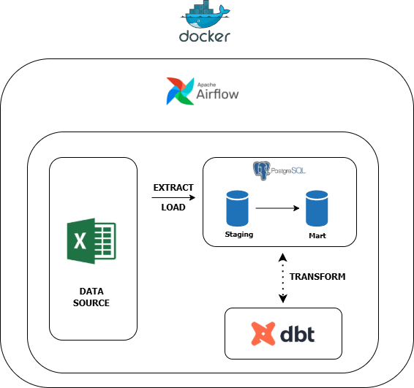
Project architecture

Slide 3


Key insights
Vegetable Oil generated the highest revenue in 2025 (₦30.83M).
Musa Ibrahim achieved the highest average sales target performance (108.33%).
Kano Wholesale Hub had the highest return rate (12.84%), indicating an area for further investigation.
Cereals and Dairy showed the strongest revenue trend across the period.
Unknown region recorded the highest month-over-month revenue growth in Q3 2025 (53.34%).

Slide 4
Conclusion & recommendation
Investigate the high product return rate at Kano Wholesale Hub to identify the root cause and reduce revenue losses, while using the sales strategies of top-performing products and salespersons to improve performance in other regions

