Slide 1
TruthLens AR - Analysis of Existing Deepfake Detector
Name: Subroto Ghosh ; ID: 2212150642 , Group: 04
• Existing Project: GitHub: https://github.com/TRahulsingh/DeepfakeDetector
• Goal: Evaluate the existing system and identify research gaps.
• Observation: The project runs successfully but struggles with modern AI-generated images.
• Our objective: Improve it through TruthLens AR.

Slide 2
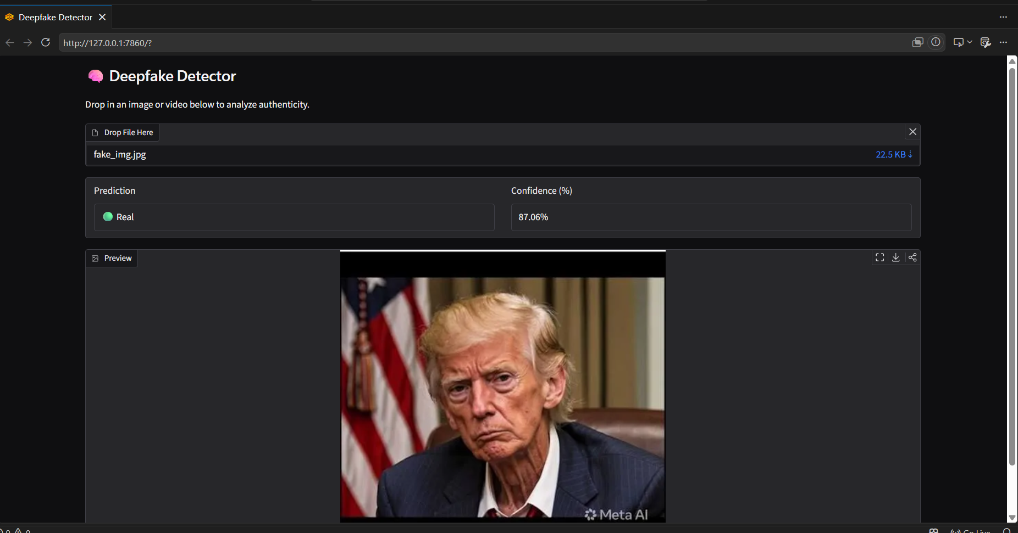
Practical Run Result
Result Summary
✓ Application launched successfully.
✗ AI-generated image predicted as REAL.
Confidence: 87.06% Real
Limitation:
This shows a major limitation in
detecting recent AI-generated images.
This image is Fake but Model provide Real.
This model is not producing accurate results.

Slide 3
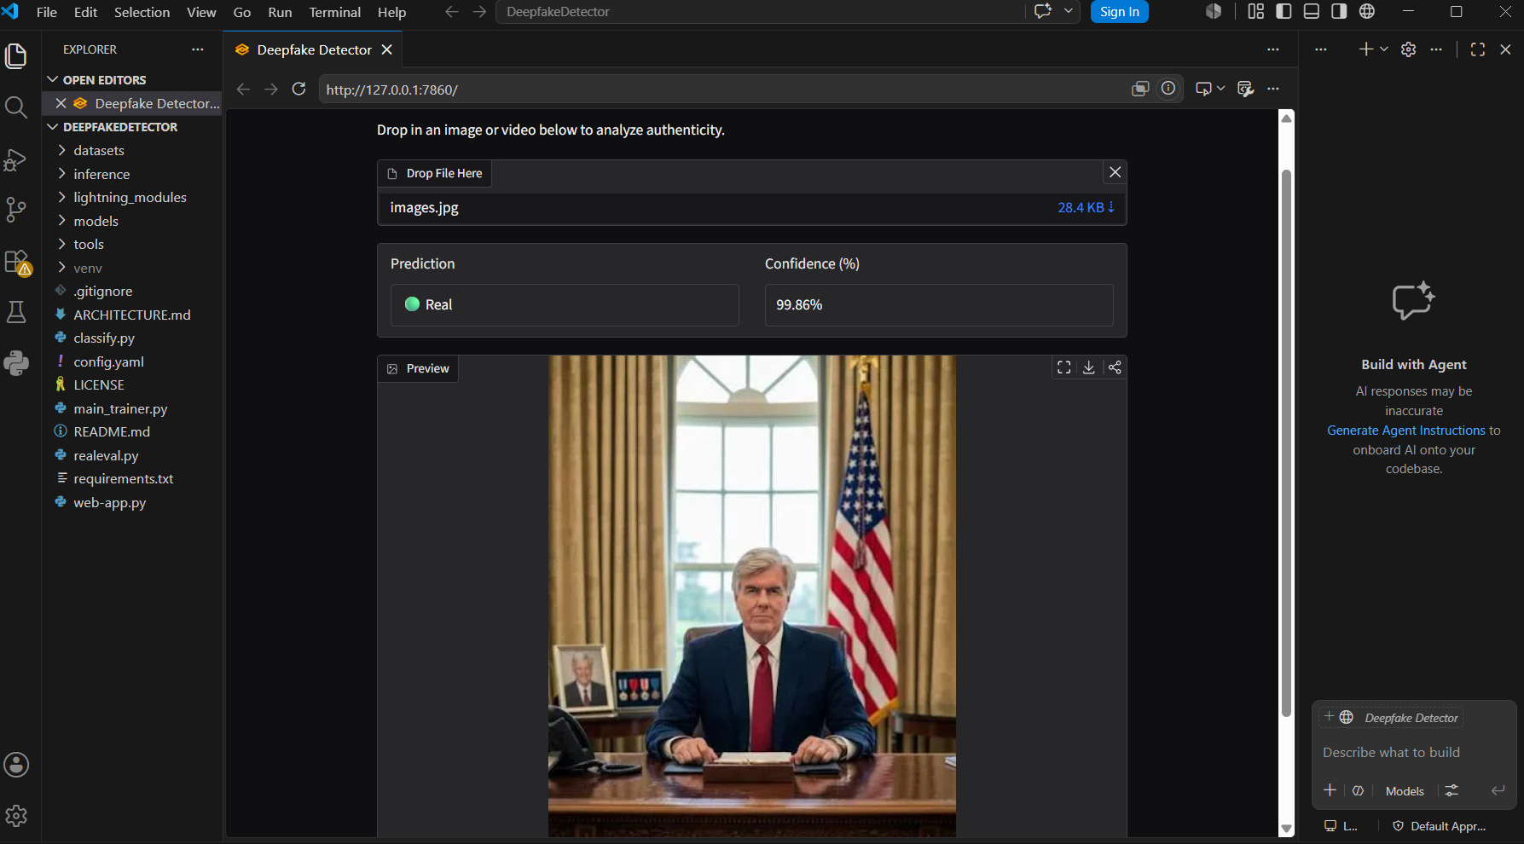
Additional Experimental Result - False Positive
Observation:
• Tested another AI-generated image.
• Model predicted: REAL
• Confidence: 99.86%
Limitation:
This further demonstrates that the current model cannot reliably detect recent AI-generated images.
This image is Fake but Model provide Real.
This model is not producing accurate results.

Slide 4
Major Limitations
❌ Pretrained EfficientNet-B0 model.
❌ Weak performance on modern diffusion/AI images.
❌ No OCR for screenshots/news.
❌ No Reverse Image Search.
❌ No Fact-check API.
❌ No Bangla multimodal understanding.
❌ No Explainable AI (XAI).
❌ Limited robustness and generalization.

Slide 5
Existing System vs TruthLens AR
Existing | TruthLens AR
EfficientNet | Vision-Language Model
Image Only | Image+News+Screenshot
No OCR | OCR
No Fact Check | Fact-check API
No Reverse Search | Reverse Image Search
No XAI | Explainable AI
No Bangla | Bangla Multimodal

