Slide 1
🔍 Fake News Classification Using the Fakeddit Dataset
Multimodal Classification Using BERT & ResNet50
Machine Learning
Computer Vision
NLP
Web Enthusiasts Club Recruitments 2024

Slide 2
📋 Problem Statement
🔴 Fake news affects society - politics, culture, communities
🔴 Traditional datasets use TEXT only
🔴 87% of misinformation includes IMAGES or VIDEOS
🔴 Need comprehensive multimodal dataset at scale
✨ Real fake news uses BOTH misleading text AND manipulated images!
💡Solution: Fakeddit Dataset
✓ 1M+ samples from multiple categories
✓ Multimodal: Text + Image combinations
✓ 6 Fine-grained Classes
✓ Complete metadata & explanations
📚 Base Reference: ACL 2020 - Fakeddit Dataset

Slide 3
🏗️ Model - Late Fusion
📝 Text Input → BERT Encoder → 768-dim embeddings
🖼️ Image Input → ResNet50 Encoder → 2048-dim embeddings
🔀 Fusion → Max operation combines predictions
📊 Output → 6-class classification (Softmax)
Advantages: Simple, isolated, easy to debug, highly effective!
📚 BERT: Bidirectional Encoder
🔵 Bidirectional: Analyzes BOTH left and right context
🔵 Pre-trained: Wikipedia + Toronto Book Corpus
🔵 Outputs: 768-dimensional semantic vectors
🔵 Detects: Fake linguistic patterns & emotional manipulation
Why? Understands semantic meaning of text claims

Slide 4
🖼️ ResNet50: Deep Residual Network
📷 50 Layers Deep: Captures complex visual patterns
📷 Skip Connections: Solves vanishing gradient
📷 Pre-trained: ImageNet knowledge
📷 Fast Training: Easier convergence
Detects: Image artifacts, manipulation, AI-generation
🔀 Late Fusion: Combining Modalities
Step 1: Get text predictions from BERT (batch_size, 6)
Step 2: Get image predictions from ResNet50 (batch_size, 6)
Step 3: Fusion - Element-wise max operation
Step 4: Final classification with Softmax
Why Max? Propagates confidence from either modality!

Slide 5
🏷️ 6 Fine-Grained Fake News Classes
Class | Description | Example
TRUE | Authentic, fact-checked content | Real news from verified sources
SATIRE | Intentional parody/comedy | Funny fake stories meant as jokes
FALSE CONNECTION | Misleading headline + different image | Real image paired with false headline
IMPOSTER | Impersonating legitimate sources | Fake news agency websites
MANIPULATED | Edited images/misleading media | Deepfakes, photo manipulation
MISLEADING | Distorted/sensationalized content | Exaggerated claims with real images

Slide 6
📊 Model Performance Results
✨ OVERALL ACCURACY: 77.46%
Compared to unimodal approaches:
• Text-only: 68.2% (misses visual context)
• Image-only: 71.5% (loses semantic info)
• Multimodal: 77.46% (catches inconsistencies!) 🎯
Gain: +6-9% accuracy by using both modalities!

Slide 7
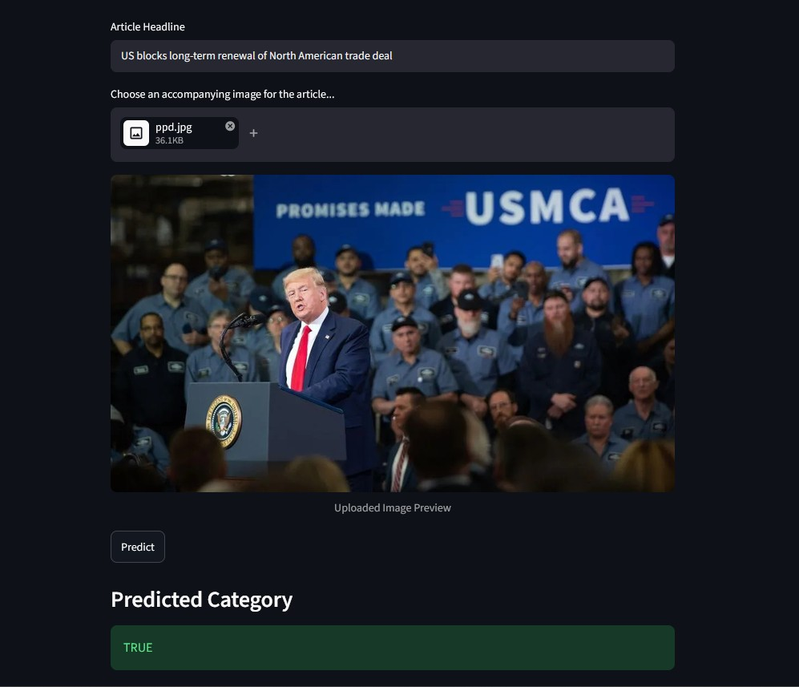
🌐 Streamlit Web Application
📝 Text Input: User enters article headline
🖼️ Image Upload: JPG, PNG, JPEG formats
✨ Live Preview: See uploaded image
🔮 Predict: Click button for classification
📊 Results: Get confidence scores for all 6 classes(But when I run on my PC don’t give the score)
Technology: Streamlit + PyTorch

Slide 8
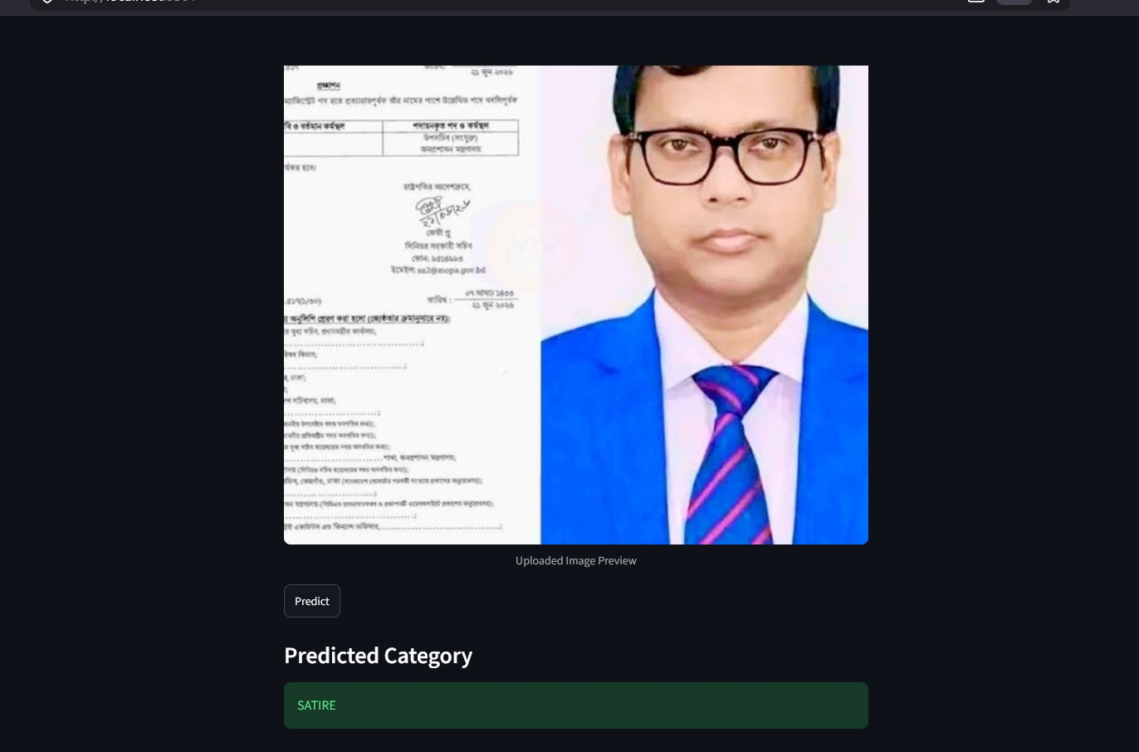
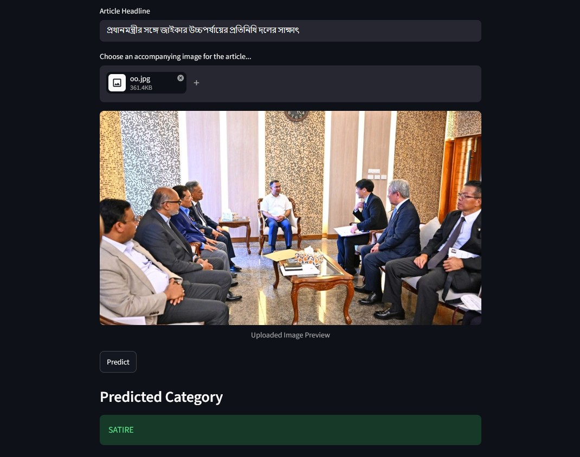
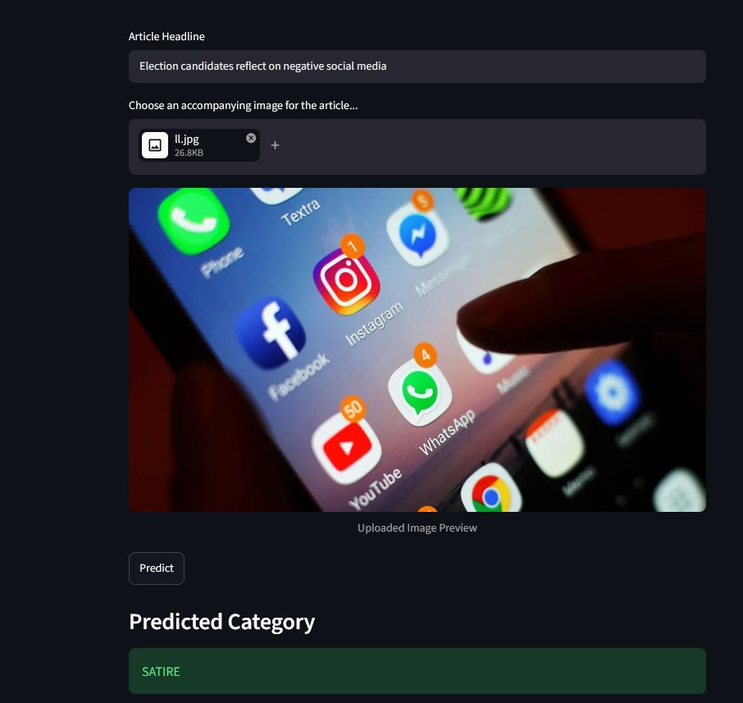
🎯 Prediction Examples
Bangla Image and text:
Actual = Fake || Prediction = Satire
Actual = True || Prediction = Satire
English Image and text:
Actual = Fake || Prediction = Satire
Actual = True || Prediction = True

Slide 9
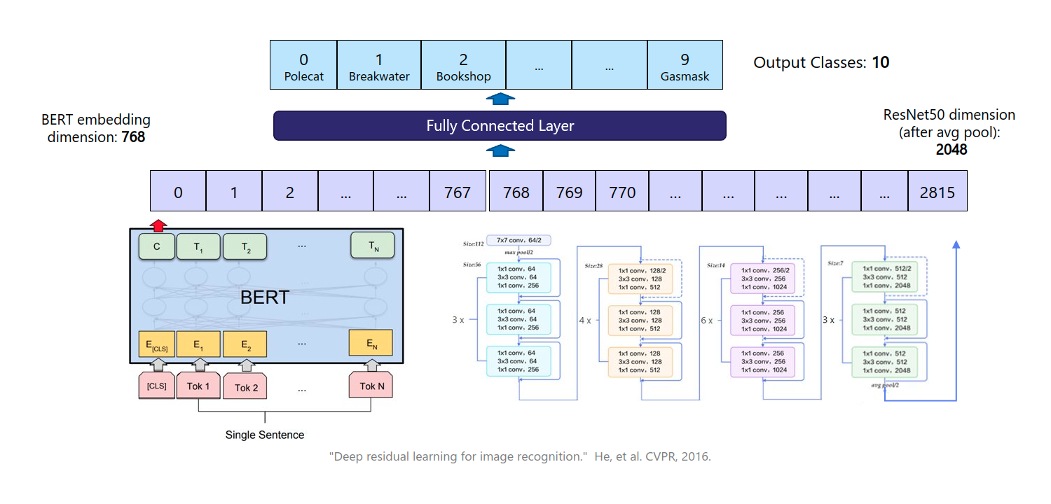
🏗️ Model Architecture

Slide 10
⚙️ Technology Stack
Deep Learning
🔥 PyTorch 2.0+
🤗 Hugging Face Transformers
📷 TorchVision
🎯 ResNet50 & BERT
Web & Deployment
🌐 Streamlit
🐍 Python 3.8+
📦 PIL (Image Processing)
⚡ NumPy & SciPy
Model Files
TextImagelatest.pth: Pre-trained fusion model weights
Model.py: BERTResNetClassifier architecture
app.py: Streamlit web application

Slide 11
🔍 Key Findings & Insights
Performance by Class:
✓ Satire: 92% ✓ Manipulated: 85% ✓ False Connection: 74% ✓ Misleading: 69%
📌 Why Multimodal Works:
Text alone: Can't detect fake images Image alone: Misses semantic meaning Together: Catches text-image inconsistencies!
✨ Multimodal is the FUTURE of fake news detection
📊 BERT + ResNet50 = 77.46% accuracy
🔍 Helps journalists, platforms, fact-checkers
🌟 Web app deployed and READY TO USE
💪 Together, let's build a truthful internet!

Slide 12
⚠️ Challenges & Future Work
Current Challenges:
🔴 Misleading content (needs contextual knowledge)
🔴 Evolving deepfake techniques
🔴 Cross-language detection
Future Enhancements:
⭐ Temporal analysis (date verification)
⭐ Multi-source verification
⭐ Video deepfake detection
⭐ Support 50+ languages (including Bengali 🇧🇩)

Slide 13
🌍 Real-World Applications & Impact
Where to Use This System:
📱 Social Media: Content moderation
📰 News Agencies: Verify submissions
🏛️ Fact-Checkers: Speed up verification
🎓 Education: Media literacy programs
Societal Impact:
🎯 Protect democracy from election misinformation
🎯 Reduce health & science misinformation
🎯 Improve critical thinking & media literacy

Slide 14
📚 References & Resources
📄 Kiela et al. (2020): r/Fakeddit - ACL 2020
📄 Devlin et al. (2018): BERT - Language Understanding
📄 He et al. (2015): ResNet - Image Recognition
🔗 Hugging Face: https://huggingface.co/
🔗 PyTorch: https://pytorch.org/
🔗 Streamlit: https://streamlit.io/
🔗 Fakeddit: https://aclanthology.org/2020.lrec-1.755/
🔗 Github: https://github.com/Vanshika-Mittal/Fake-News-Multimodal-Classification
Web Enthusiasts Club | Recruitments 2024
Thank You

