Slide 1
WELCOME
COMPUTER AIDED DESIGN & DRAFTING
NAME: Joy karmokar
ID: 18-39263-3
sec: e

Slide 2
INTRODUCTION
Civil Plan Designed for ABC Housing Ltd.
This design unit flat of having 1500 sq-ft (approx.)
3 Bed Room with Veranda
Attached bath of Bed-1, Bed-2 & 1 Common Bath
Living/Drawing
Dining
Kitchen

Slide 3
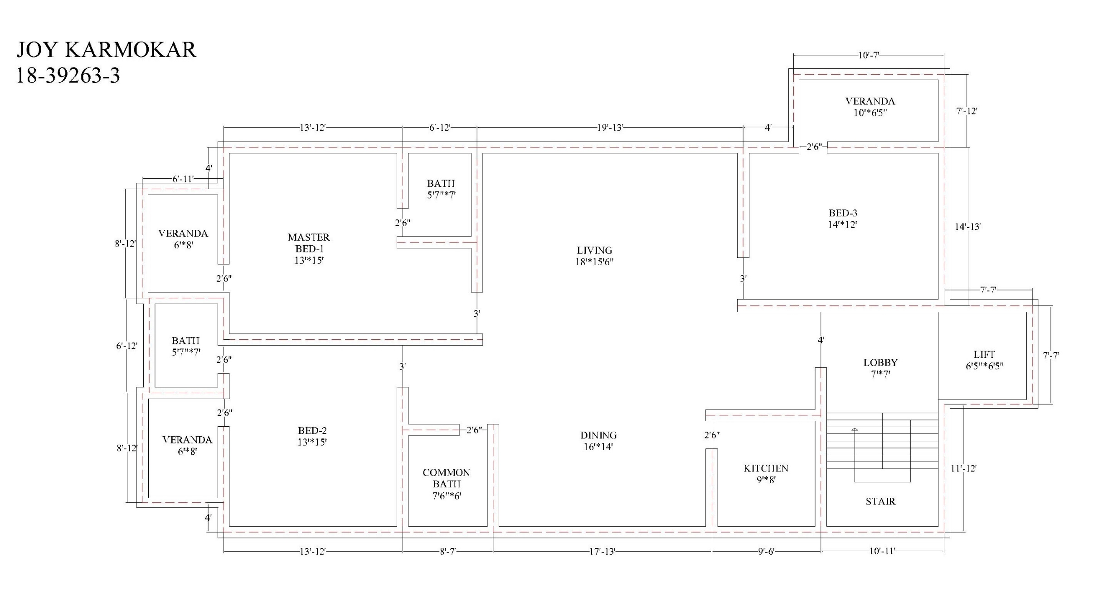
Civil Plan

Slide 4
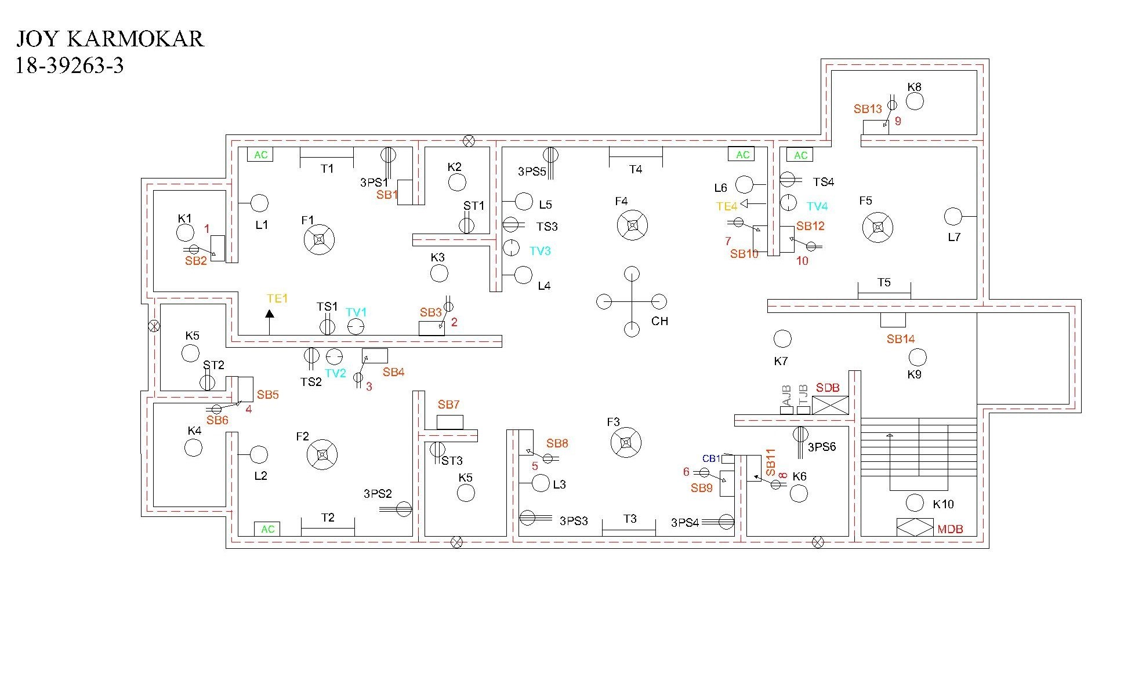
Proper Electric Fittings

Slide 5
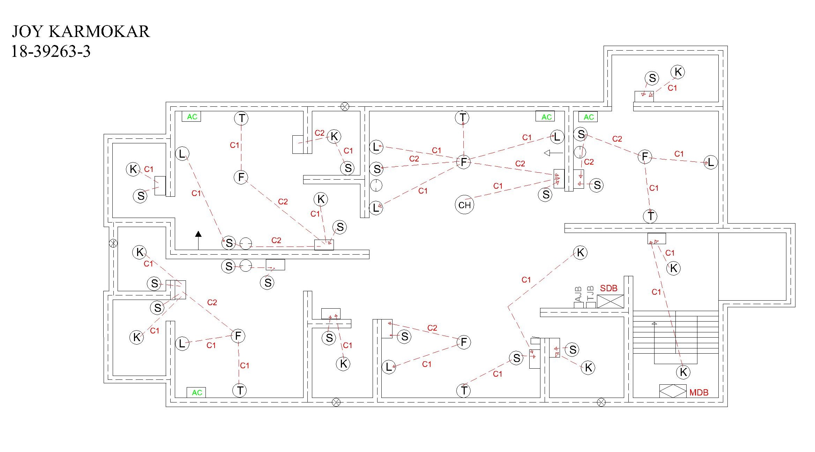
Layout (Light Load)

Slide 6
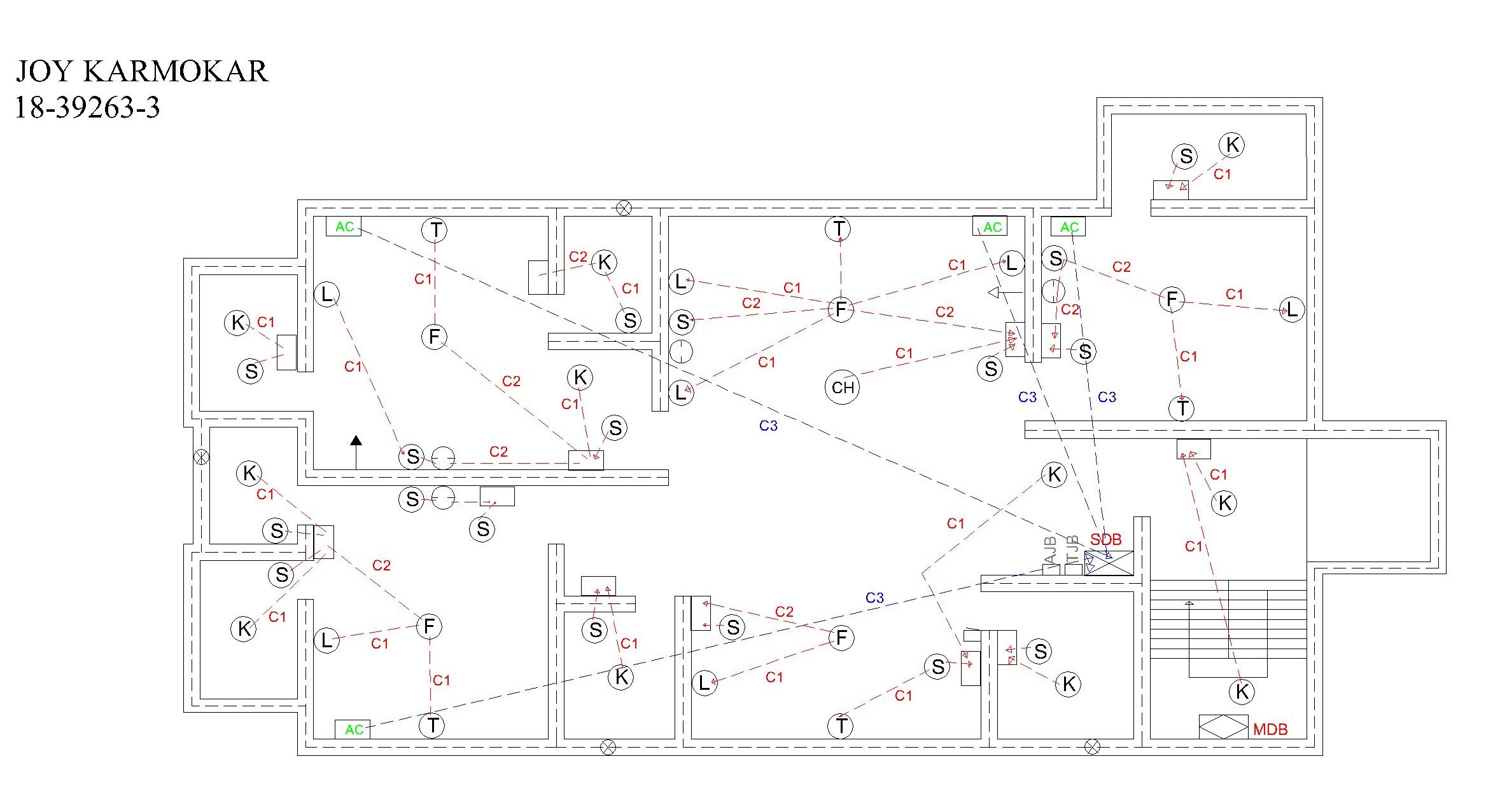
Layout (Medium Load)

Slide 7
Layout (Heavy Load)

Slide 8
Layout (SB-SDB) (SB-MDB)

Slide 9
Building and Generator Capacity

Slide 10

THANK YOU

