Slide 1
Function

Slide 2
Introduction to Functions
We have already known that in a C program, there must be a main () function
In C, we used many library functions as well- printf (), scanf (), clrscr (), or getch ()
printf() prints on the output
scanf () takes input from the user and assigns that input to a variable by going to the variable’s address

Slide 3
Introduction to Functions
clrscr () clears the output buffer
getch () waits for a key-stroke from the user
if you think uniform one thing is common to say- the function does one particular job. Isn’t it?

Slide 4
Introduction to Functions
In C, user can define functions as well- as many functions as they wish. These functions are called user defined functions

Slide 5
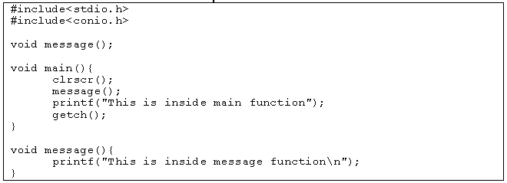
Example of Function

Slide 6
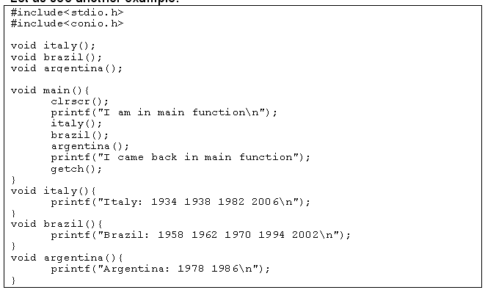
Another Example

Slide 7
What We have learnt?
There is no limit on the number of functions that might be present in a C program.
Each function in a program is called in the sequence specified by the function calls.
After each function has done its job, control returns to the place of calling that function.

Slide 8
Well, then, should all the function calls take place inside the main () function? No! Functions defined by the user can call other functions as well.

Slide 9
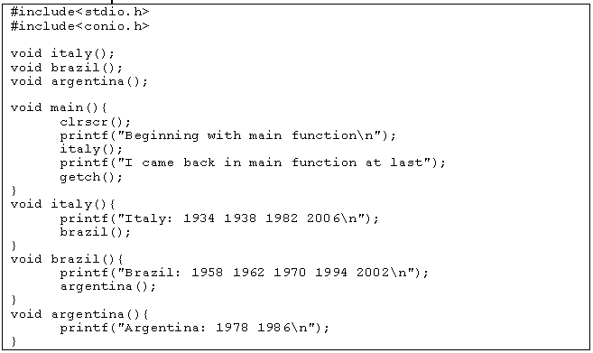

Slide 10
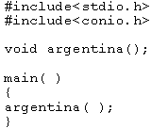
C program is a collection of one or more functions.
A function gets called when the function name is followed by a semicolon.

Slide 11

A function is defined when function name is followed by a pair of braces in which one or more statements may be present.

Slide 12
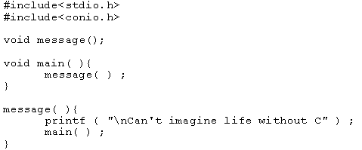
Any function can be called from any other function. Even main( ) can be called from other functions.

Slide 13
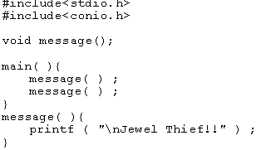
A function can be called any number of times.

Slide 14
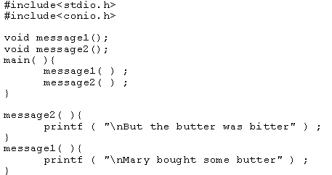
The order in which the functions are defined in a program and the order in which they get called need not necessarily be same

Slide 15

A function can be called from other function, but a function cannot be defined in another function. Thus, the following program code would be wrong, since argentina( ) is being defined inside another function, main( ).

Slide 16
There are basically two types of functions:
Library functions Ex. printf( ), scanf( ) etc.
User-defined functions Ex. argentina( ), brazil( ) etc.

Slide 17
Try
getchar()
getc()
getch()
getche()

Slide 18
#include <stdio.h>
int addNumbers(int a, int b); // function prototype
int main()
{
int n1,n2,sum;
printf("Enters two numbers: ");
scanf("%d %d",&n1,&n2);
sum = addNumbers(n1, n2); // function call
printf("sum = %d",sum);
return 0;
}
int addNumbers(int a,int b) // function definition
{
int result;
result = a+b;
return result; // return statement
}

Slide 19
Examples
Write a C program to find square of a given number using a user defined function square.
Write a C program to calculate the sum of two numbers using a user defined function sum.

Slide 20
#include<stdio.h>
float square ( float x );
int main( )
{
float m, n ;
printf ( "\nEnter some number for finding square \n");
scanf ( "%f", &m ) ;
// function call
n = square ( m ) ;
printf ( "\nSquare of the given number %f is %f",m,n );
}
float square ( float x ) // function definition
{
float p ;
p = x * x ;
return ( p ) ;
}

Slide 21
#include <stdio.h>
int addNumbers(int a, int b); // function prototype
int main()
{
int n1,n2,sum;
printf("Enters two numbers: ");
scanf("%d %d",&n1,&n2);
sum = addNumbers(n1, n2); // function call
printf("sum = %d",sum);
return 0;
}
int addNumbers(int a,int b) // function definition
{
int result;
result = a+b;
return result; // return statement
}

Slide 22
