Slide 1
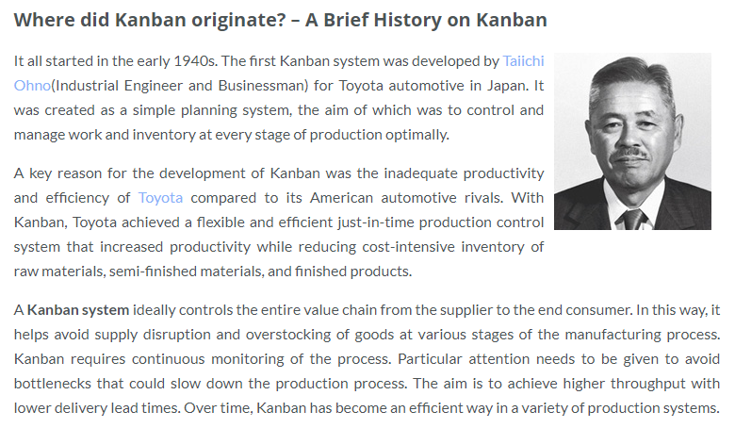
Introduction
https://www.digite.com/kanban/what-is-kanban/

Slide 2
Introduction - Kanban
C’Est quoi?
Kanban methodology focuses on having the right work done at the right time, given the skill sets of the developers.
“The main focus of Kanban is to accurately state what work needs to be done, and when it needs to be done. It does so by prioritizing tasks , and defining workflow as well as lead-time to delivery [20]. The Kanban process explicitly presents the most important tasks that need the most attention in order to reduce the risk of their incompletion, and also to increase flexibility amongst other tasks in the project.
-Origines

Slide 3
Introduction
In addition, project developers do not implement unnecessary features, do not write more specifications than they can code, do not write more code than they can test, and do not test more code than they can deploy. Therefore, Kanban methodology eliminates waste in every step, and is suitable for software engineering projects [20].

Slide 4
Principles de bases
En général, la méthode Kanban est repose sur 3 règles;
1-visualize the workflow
2- limit work in progress (WIP)
3 -measure the lead time (i.e. average time to complete
one item)
(Ikonen et coll., 2010)

Slide 5
Principles de bases
En particulier:
- Limiting Work in Process (WIP).
- Pulling value through the development process.
-Making the development process visible.
- Increasing throughput.
- Using a fixed backlog.
Embedding quality.
(Ley et coll. 2017)

Slide 7
Exemple de planification AGILE selon la méthode Kanban
En exécution
En planification
En cours de modélisation
Prochaines tâches prioritaires
Équipe de travail
Complétés
Approuvés
Parties prenantes impliquées présentement
Tâches dans la pile
Tâches
Légende
Tâches
Personne
Statut
Parties prenantes du projet à consulter
Adapté de Lei et coll. 2017

