Slide 1

OpenProject
Joyal raju
co749019

Slide 2
Introduction:
OpenProject is a Web based project management solution.
Location-independent team collaboration is made possible.
Its development is done by the open source community.
OpenProject provides add-on features via cloud linkage.

Slide 3

Webpage:

Slide 4
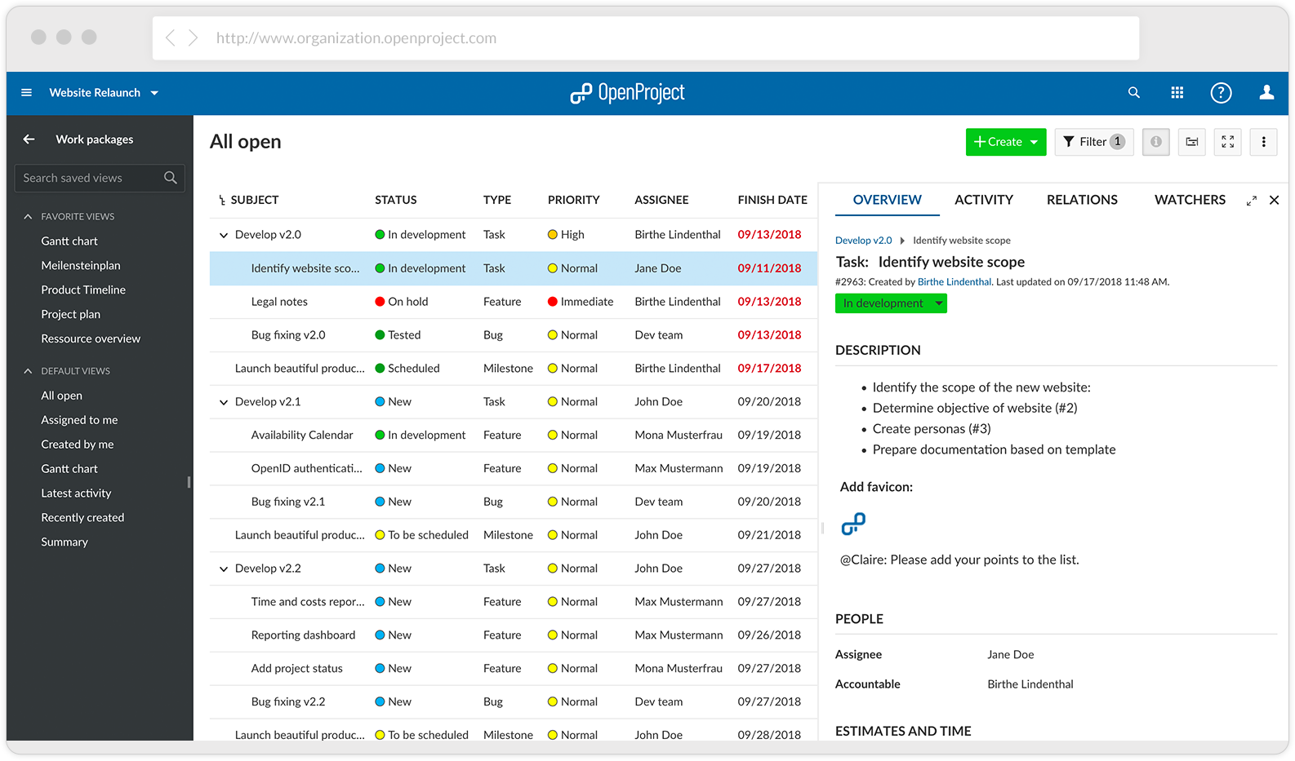
Webpage:

Slide 5
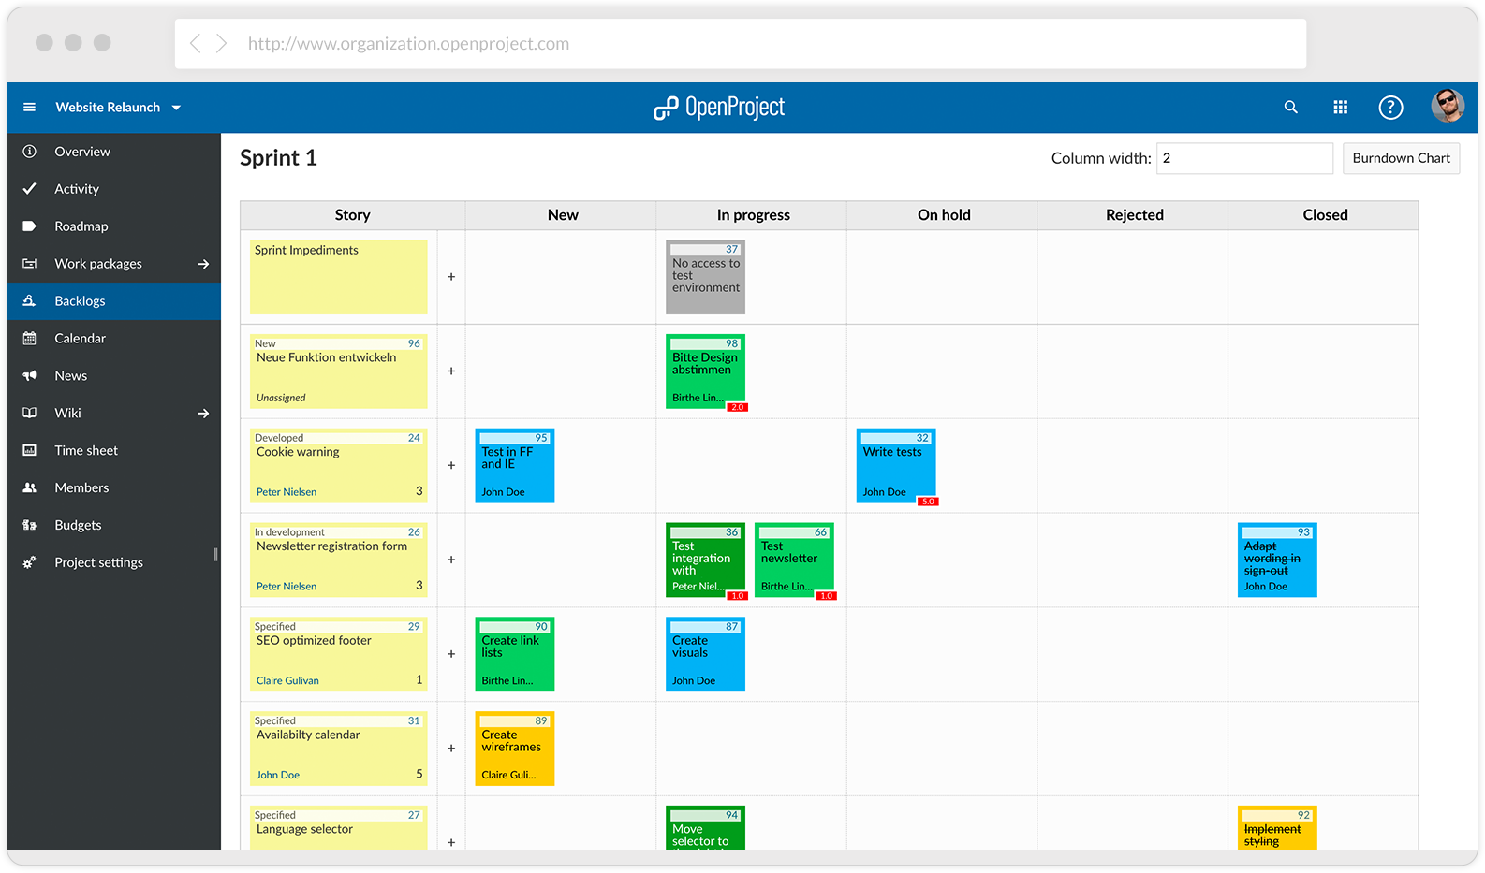
Webpage:

Slide 6
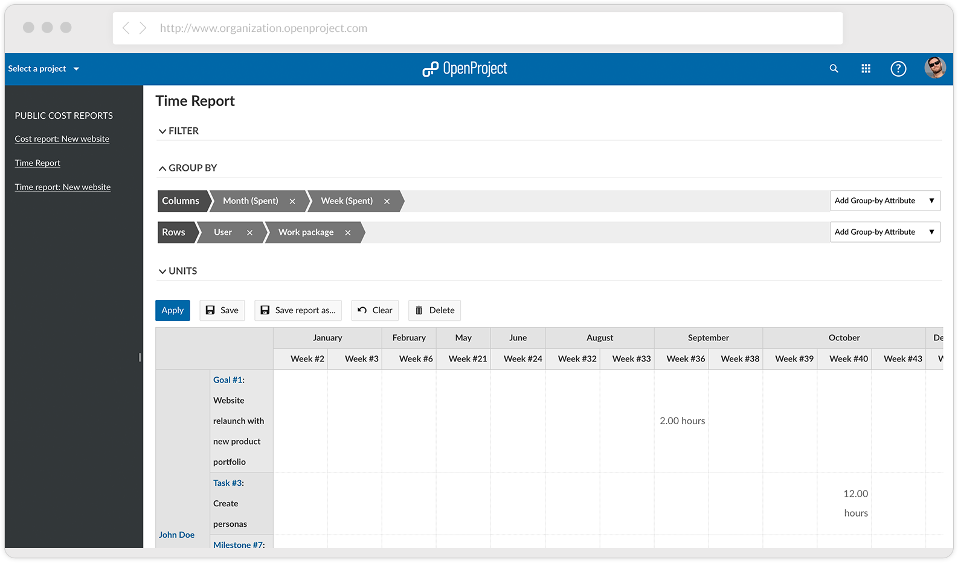
Webpage:

Slide 7
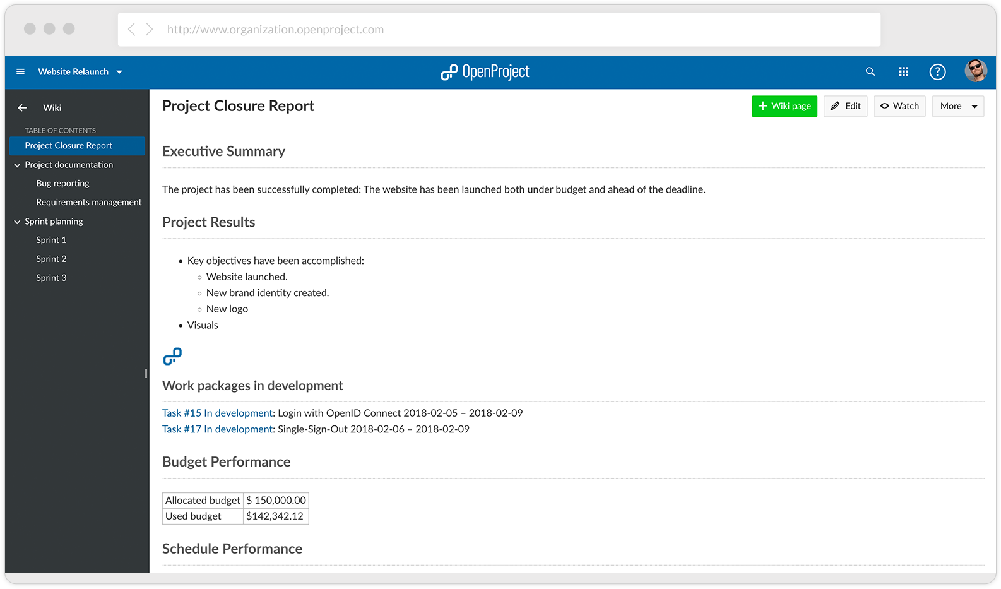
Webpage:

Slide 8
Key features:
Project planning and scheduling
Project roadmap and release planning
Effective task management and team collaboration
Agile and Scrum integration
Time tracking, budgeting and reporting of costs
Bug tracking

Slide 9
Reference:
https://www.openproject.org/

Slide 10


