Slide 1

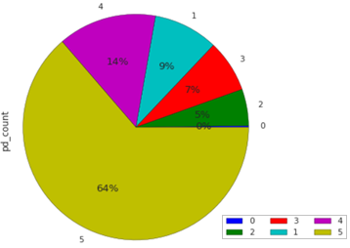
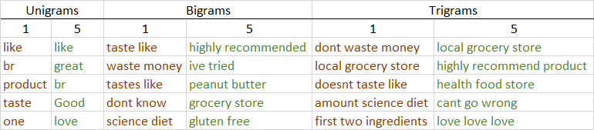
Sentiment Prediction of Consumer Reviews using Classification in PySpark
Reviews dataset taken from the saltdean server http://saltdean.nsqdc.city.ac.uk:50070/explorer.html#/data
Algorithms: Naive Bayes (NB) vs Logistic Regression (LR)
Naïve Bayes is often used in text classification because it is fast and easy to implement. However, it assumes that the features it models are conditionally independent. Because of this, when one class is over-represented it may lead to poor weight selection for the decision boundary. Given the class imbalance in our dataset, we expect results to validate our understanding of the model's limitations and offer a useful comparison to LR. Both NB and LR are linear classifiers, but differ in the way they estimate probabilities. Logistic Regression works by computing a probability from an exponential function to a weighted set of features. When confronted with many correlated features, LR is able to assigns a more accurate probability. Because of the large number of features, LR is expected to outperform on our dataset.
Analysis of Results
Table 1 shows that NB struggled to classify our imbalanced dataset. This offers an interesting comparison to Logistic Regression which obtained 78.4% accuracy, and completed the task in less time. This confirms the literature that LR is more suitable for classifying larger datasets, whereas NB performs better than LR on smaller databases or shorter documents (Wang and Manning, 2012).
Evaluation
Examining the most frequent n-grams (Table 2) for the lowest (1) and
highest (5) scores, we notice some words appear frequently in both
(like) and the presence of website artefacts (br) that could have been
removed earlier. Additionally, Rennie et al. (2003) propose some heuristic
solutions to address NB’s limitations, including adjusting the decision
boundary weights and re-distributing the text to better match the d
distribution assumptions of NB. Having now established a baseline with
this data, it would be interesting to implement these adjustments and
compare the results.
Data Selection
Reviews with numerical scores help retailers to quickly understand customer experience. Given their simplicity, scores lose much information which can only gained from the text in the review.
To help understand the likelihood of customer satisfaction, it is useful to implement a classifier able to predict the scores of unseen reviews based on the text data already obtained.
Preprocessing Steps
The dataset consists of 568162 product reviews, together with a score from 1-5. There are outliers and some null values. Punctuation is removed to reduce the level of noise. The text is cleaned of any Null values and any scores that are not in the valid range (1-5). At this stage, we observe an over-representation of scores of 5 (Figure 1).
The data is split into 80% training and 20% test set, with the training set split again by 80:20 to produce a validation set.
Estimators and Parameter Choices
We tokenize the text and remove stop words, to further reduce the noise. We convert the tokens into n-grams and experiment with different lengths of N to produce unigrams, bigrams and trigrams. This is to capture against certain conditionally dependent phrases such as “not bad” and “not that bad”.
TF (term frequency) converts the data into fixed-length feature vectors. This vectorized feature space provides a standardized basis from which to compute the term frequency. Since each n-gram represents a feature, the data runs into high dimensionality quickly. We initialize with a range starting from 1000, increasing exponentially to 100000. We then add IDF (inverse document frequency) to prioritize words that appear rarely across multiple documents in the dataset and diminishes those that appear frequently.
In PysparkML, Naive Bayes has a smoothing parameter preventing the algorithm from having a prior of zero when it encounters a new label. The parameter is set by default to 1.0, but we will use employ a range from 0.1, 0.5 to 1.0 in our Parameter Grid.
In Logistic Regression, we use a regularization parameter. As the number of features increase, so does the risk of overfitting. The regularization parameter places an increasing penalty on the cost (error) function to mitigate this.
Table 1. Model accuracy and speed
Figure 1. severe class imbalance
Table 2. Most frequent unigrams, bigrams and trigrams for labels 1 and 5
References: Jurafsky, D. and Martin, J. H. Speech and Language Processing. Available at https://web.stanford.edu/~jurafsky/slp3/
Wang, S and Manning, C. 2012. Baselines and Bigrams: Simple, Good Sentiment and Topic Classification. Available at https://nlp.stanford.edu/pubs/sidaw12_simple_sentiment.pdf
Rennie, J. D. M., Shih, L., Teevan, J., Karger, D. R. (2003) Tackling the Poor Assumptions of Naïve Bayes Classifiers. Available at https://www.stanford.edu/class/cs276/handouts/rennie.icml03.pdf

