Slide 1
Scalable (spiking) Neural Systems: Dynamics and engineering using Rank Order codes
Where I am and where to go
APT/AI Group talk
28 Oct/3 Nov 2004
Joy Bose
Notes:
WRITE NAMES OF PROGRAMS USED TO PRODUCE RESPECTIVE GRAPHS

Slide 2
Overall objectives
To investigate performance of associative memories which use rank order codes
To implement rank order codes using spiking neurons and study issues involved
To study the dynamics of such systems
To engineer useful systems built out of such memories: eg Sequence machines and their applications

Slide 3
Introduction
What is a rank order code?

Slide 4
Rank order coding
An approximation of temporal coding: better than abstracting time out completely
Spiking neurons
Used by Thorpe et al (2001) in SpikeNET
Info transmitted by a bunch of neurons is in the order of firings
How to impose input and output order sensitivity?

Slide 5
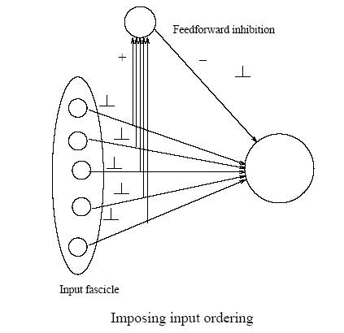
Implementing Rank Order
Feed forward inhibition
Feedback inhibition
Notes:
They may NOT be necessary…..

Slide 6
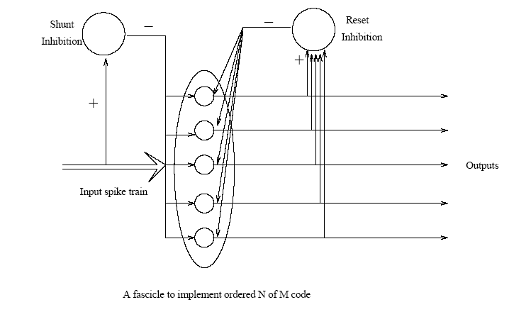

Slide 7
Section 1
Neural memories

Slide 8
How good are rank order codes in terms of information capacity?
Info content
Area of storage needed
Error tolerance
Scalability

Slide 9
Neural associative memories
Weights: binary/ bipolar/ real values
Weight matrix: Sparse/ non sparse
Connections: excitory/ inhibitory/ lateral
Feedback: present/ not present
Learning algorithm: localised/ not
Info Coding: binary/ rank order

Slide 10
Representation
As a Vector? [1 k k² k³ ….] abstraction of timing code
Other approaches : depending on the generating function, or on probability
Eg
[A B C D]
k
=Probability that A comes before B, etc
P_{AB}=Probability that neuron A fires before B (firing times generated by Poisson processes P_{A}=e-^{αA}T)

Slide 11
Memory experiments
Objective: to compare performance (in bits per bit, error tolerance, scalability etc) of an associative memory using RO codes with an equivalent memory using unordered codes
Input pattern 2
10 of 100 code used
Input
Pattern 1
CMM
Output

Slide 12
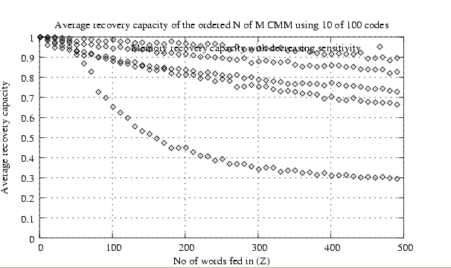
0.2
0.4
0.6
0.8
Unordered
Recovery capacity= Σ(pat1.pat2/pat2.pat2)
Verdict: recovery capacity is better for ordered codes

Slide 13
N of M Kanerva SDM (Furber et al 2004)
SDMs are Scalable, presence of a ‘access circle’
CMMs have better info capacity
Binary wts use less space
N of M: energy efficient, error correcting codes
Learning algo: hebbian with max function

Slide 14
Basic Neural memory
Pattern 1
Pattern 2
Address
Decoder
(Kanerva Type)
Data
Memory
(CMM or
Willshaw net)
Output
Pattern

Slide 15
Information content
log₂ (number of possible codes)
To find true information content: how similar are two rank order codes?
Approach 1: Dot product of the vector representations
Approach 2: depends on the probability og generation of the two codes (so also depends on how they are generated)

Slide 16
Storage of Rank Order codes
What precision is required for a memory that can successfully store rank order codes?
Peter: Binary memories can store Rank Order with (nearly) as good performance

Slide 17
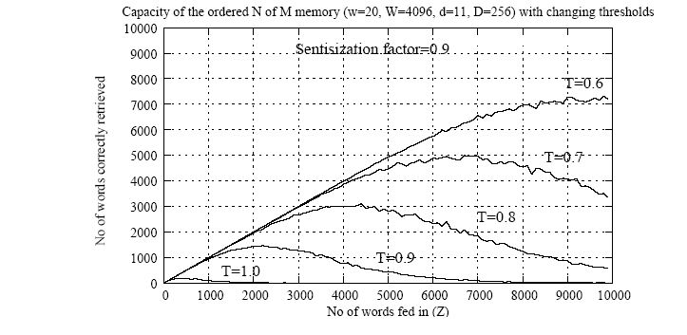
Experimental plots on NofM SDM: info capacity in bit per bit
Parameters to vary: desensitisation factor, memory sizes, code params

Slide 18
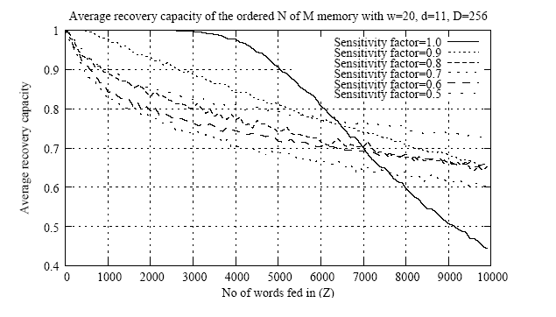
Experimental plots on NofM SDM: Average recovery capacity
(taking ratio of dot products A.B/A.A)

Slide 19
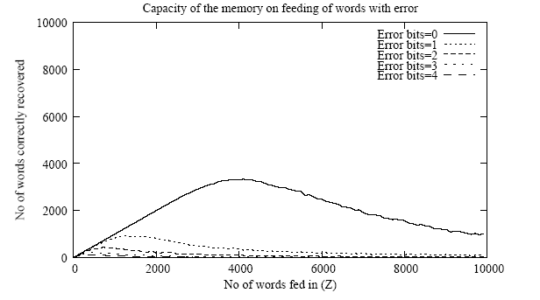
Experimental plots on N of M SDM: error tolerance
Network can be compared to a noisy channel
(Need to repeat this experiment, since error tolerance has been proved/demonstrated for unordered codes at least)

Slide 20
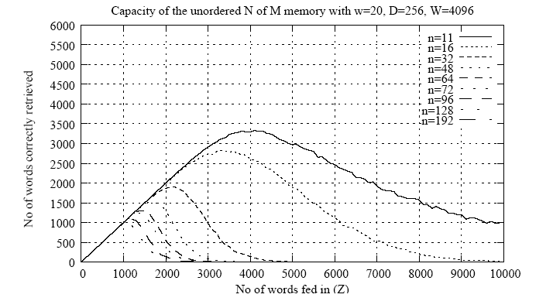
Experimental plots: scalability
Parameters to vary: memory size
Scalability demonstrated for unordered codes at least

Slide 21
Section 2
Spiking neural systems using rank order codes

Slide 22
ODSHO model
Overdamped Simple Harmonic Oscillator
Rate of feature (eg activation) modified with input, decays with time
Implementable Properties: habituation, rank order, N of M, refraction, temporal separation between bursts
Extra features: Axonal delays, dendritic delays

Slide 23


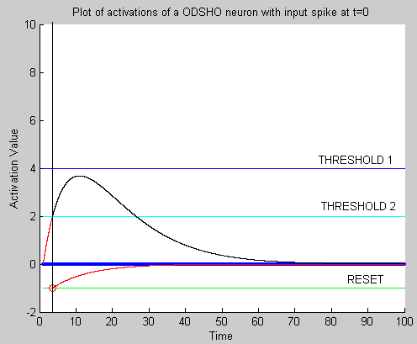

Variables: Activation a, Driving force r, their time constants of decay
Equations
where
Shape of activation curve
after spike at t=0

Slide 24
Other models
I&F
Izhikevich
SRM

Slide 25
Learning algorithm (for the assoc memory used in tests)
STDP, LTP, STP
Sequence recognition: Bi and Poo, Taylor et al etc. (BUT: they have dealt only with sequences of individual neural firings in a neural layer of burst, and not on patterns of firings)

Slide 26
Expt A: to establish that it is possible to reliably transmit a neural code

Slide 27
Steps
Step 1: choose the parameters, esp. threshold
Step 2: plot input Vs output time constants
Result: plot
Objective: to show the existence of a critical point
Note: it depends on the parameters chosen. To find appropriate relations between time constants, need to generalise.

Slide 28

Input fascicle
Output fascicle

Slide 29
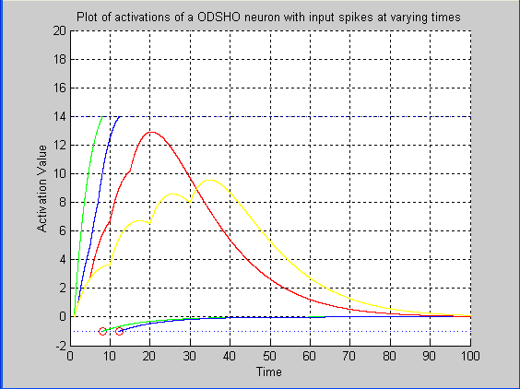
Notes:
Single1.m
Threshold=14
Actrate TC=10 ms
Activation TC=10 ms
Reset=-1

Slide 30
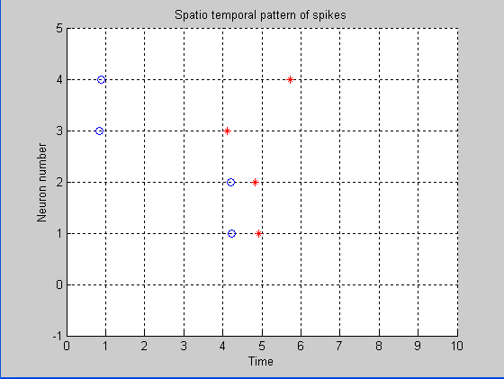
Notes:
Delta t in=5
Random weights between 0 and 1
Threshold=3.5

Slide 31
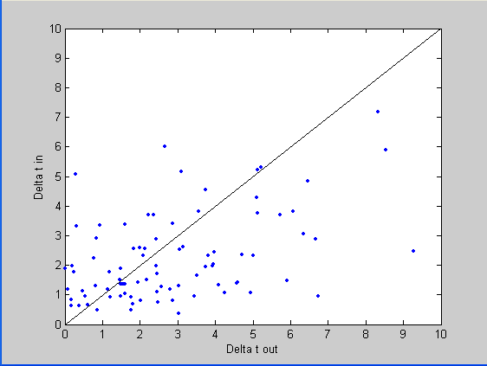
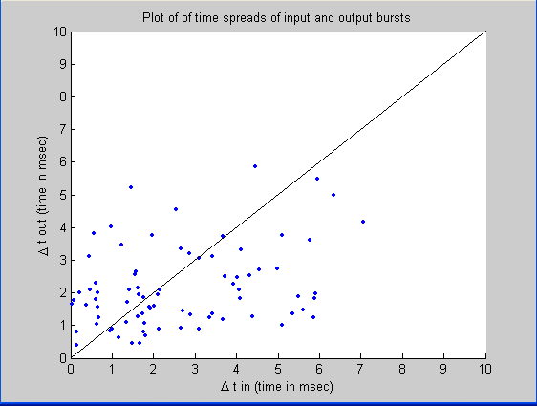
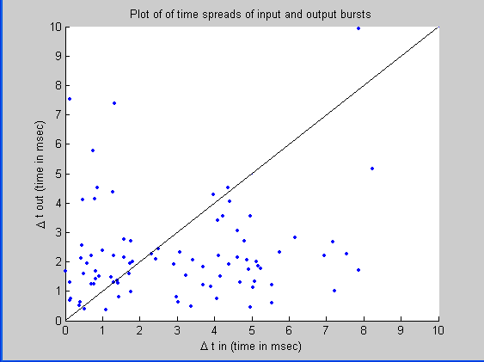
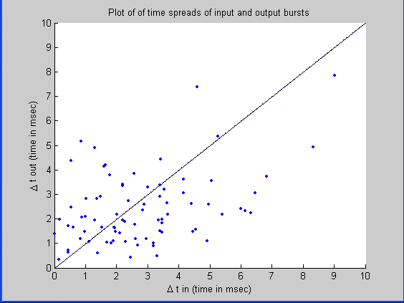
Notes:
Single2.m: multiple runs
How about the output of the feedback experiment?????

Slide 32
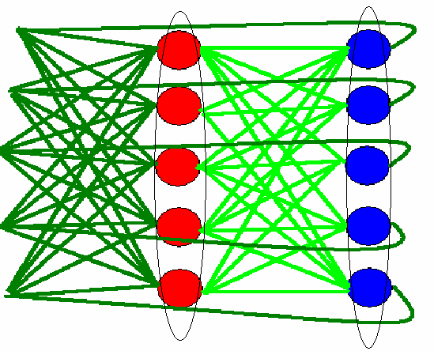
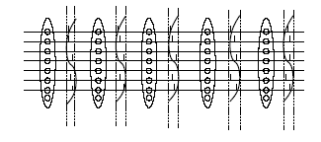
Two interconnected
fascicles
Propagating wave
of neural activity

Slide 33
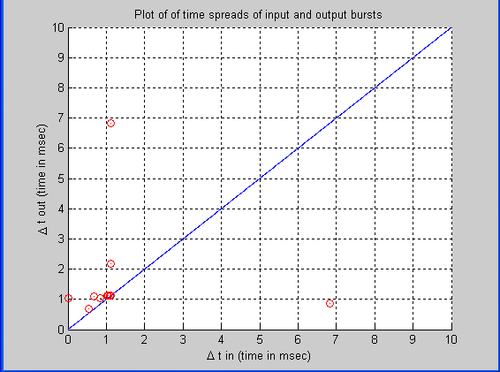
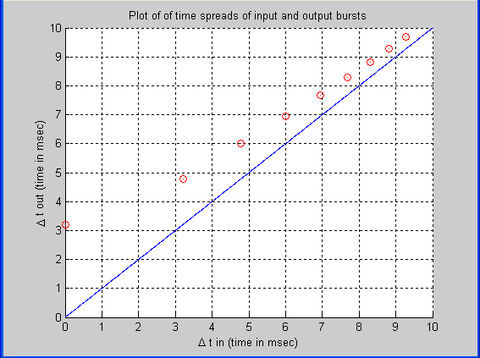
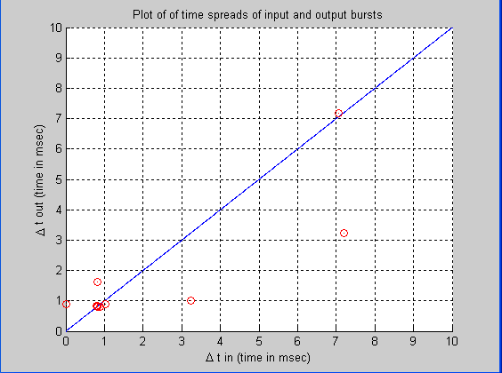
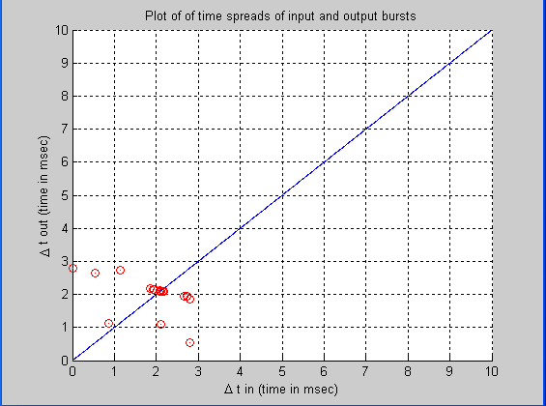
On feeding back the output spikes
All 4 neurons
fired
Only 3 neurons
fired (out of 4)
All 4 neurons
fired
All 4 neurons
fired
Notes:
SINGLE2V2.M

Slide 34
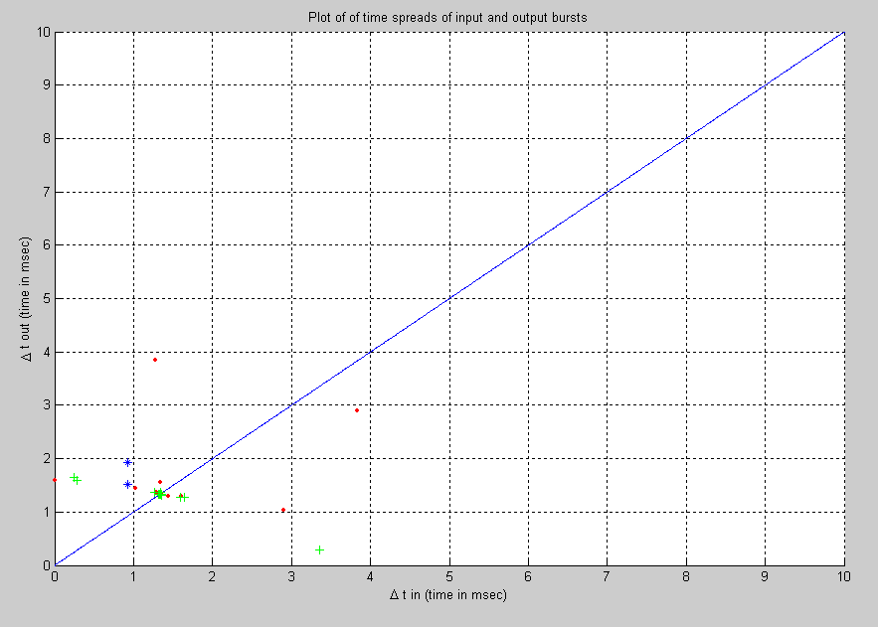
Repeating for >1 runs (same wts)
Notes:
SINGLE2V2.M

Slide 35
Expt B: to show that order of neural firings can be maintained in an autoassociative memory

Slide 36
Feedback
One off
inputs
Outputs
Auto-
Association
Feedback inhibition
(to enforce N of M)
Output
fascicle

Slide 37
Steps
Step 1: choose the neural model, parameters etc. generalise the relationship between params
Step 2: give random input order and make it learn the order through autoassociation, then give it an input order and plot output order
Step 3: repeat with errors in input order. Study effect of errors
Results: plots

Slide 38
Learning scheme
Long Term Potentiation (LTP): a localised, biologically plausible mechanism
Weight
change
Time difference
of output and input
firing

Slide 39
How to generate rank order in a bank of neurons?
Objective: have to get a bunch of neurons to remember the order of their firings
So the neuron which fires FIRST (in the fascicle) has to have the BIGGEST weight increase (so as to remember it)

Slide 40
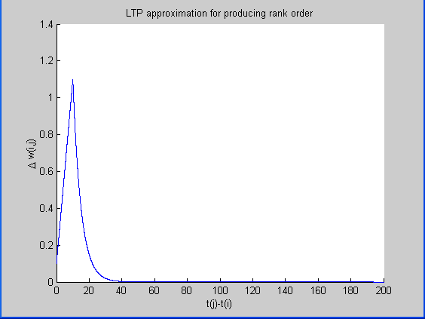

Slide 41
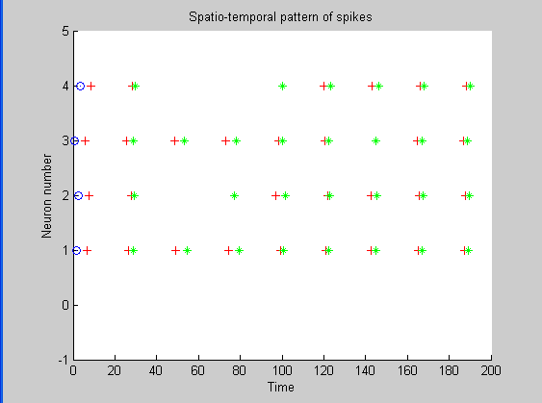
Blue: learning neurons,
Red: input neurons
Green: output neurons
Result: Rank order is learnt in cases where
all the input neurons fire when they ought to!
Notes:
RANKORDER.M
1st wave of input firings: (write mode): 5 ms after learning neurons fire
2nd wave: (read mode): 25 ms after they fire
Width of rising curve (in LTP diagram)=10 ms (decay t.c=5 ms), Width of input wave= 5 ms or less

Slide 42
Other approaches
Synfire chains (abeles)
Polysynchronous groups (izhikevich)
Cell assemblies (hebb)
Fritz hugh nagamo: dynamically coupled oscillators
Liquid state machines

Slide 43
Section 3
Dynamical properties: an analysis

Slide 44
Pulse coupled neural nets
Another approach to neural nets
Dynamical systems approach
Eg Izhikevich, Fritz Hugh Nagamo, Wilson, Haken
Approach the problem in a different way..

Slide 45
Phase diagrams
Bursting
Bifurcations
Oscillations

Slide 46
Section 4
Neural Engineering: Contextual sequence machines

Slide 47
Sequence machines
Can remember temporal sequences of patterns
Eg ABCDE, AGDFT
Feedback control systems
Context is important: FSA
Online blackbox machine: input and output interface
Sequence generation/ recognition/ prediction

Slide 48
Importance of Context
Jordan (1988)
Elman (1990)
Inspiration from biology: working memory (Baddeley, Burgess), hippocampus (LTM and STM), bird song model
LSTM (Smidhurber)

Slide 49
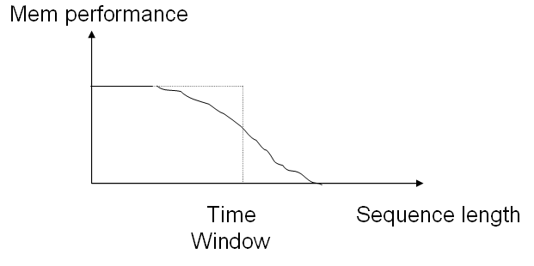
Neural model
Adapting the N of M Kanerva model using ODSHO neurons to Elman model (with context)
Structure of the model
A Context layer or shift register?
Levels of organisation

Slide 50
Pluggable components
Levels of organisation
Application level
Music, Works of Shakespeare etc
Interface level
Black box with Online learning
Structural level
Sequence machine with context
Component level
CMM, SDM, context
Fascicle level
Rank Order N of M
Neuron level
ODSHO model

Slide 51
A B A E C B Q A B A E C B Q A B ….
Online Input
Sequence machine
Encoder
Address
Decoder
Data
Memory
(CMM)
N of M SDM
Context
Decoder
Output

Slide 52


Working diagram
Input (1 of M ASCII)
Encoder
Context (K of M)
N of M coded input
Scrambler
Step 1
Data Mem
+
1
N of M coded output
Step 3
Step 2
Choose K-Max
Decoder
New Context (K of M)
Output (1 of M ASCII)

Slide 53
Experiments on the high level model
Time abstracted out as a vector…
Mem capacity: max length/number of sequences it can store and recall
Tolerance to input error
Experimental plots
DEMO: “the quick brown fox jumps over the lazy dog”
How to make it better??

Slide 54
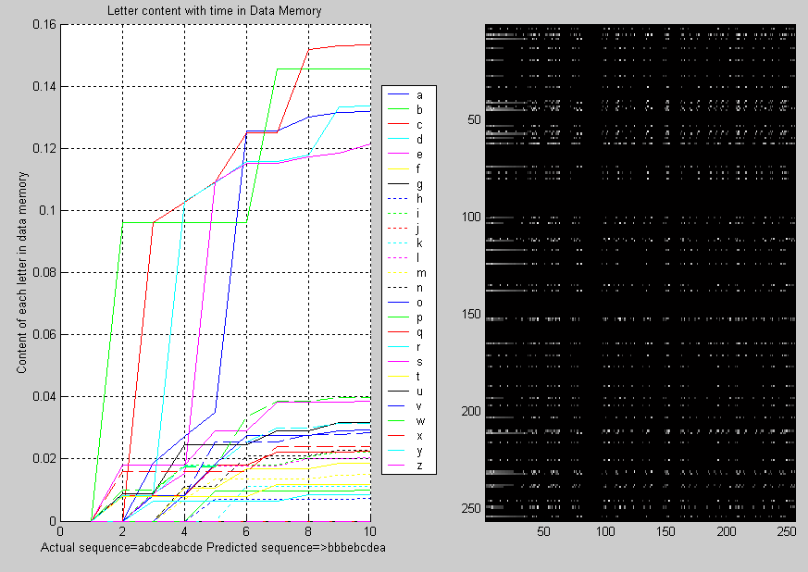

Slide 55
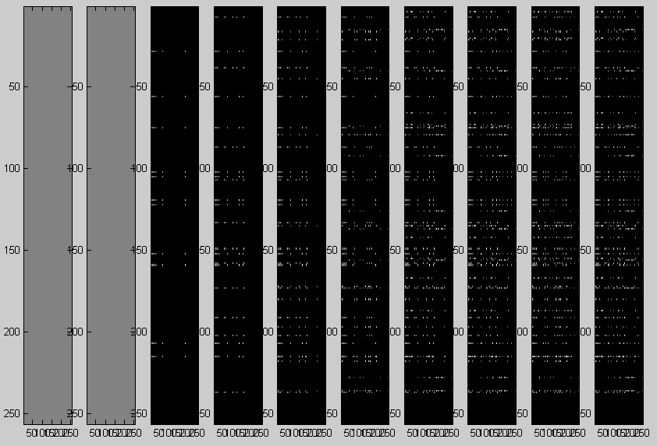
Evolution of the data memory

Slide 56
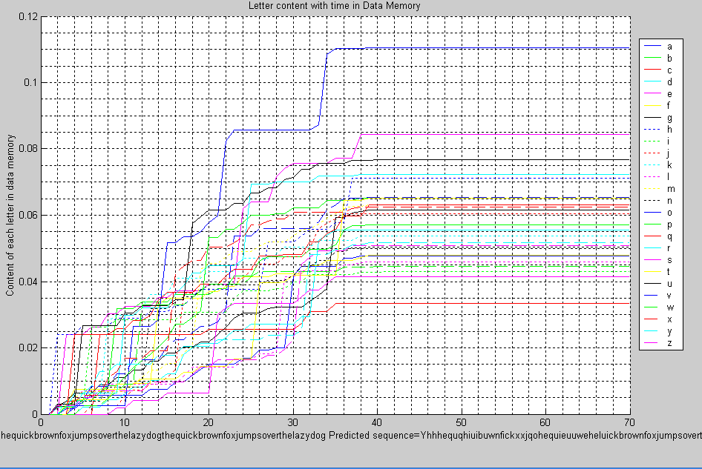
Notes:
SEQ_MACHINE.M

Slide 57
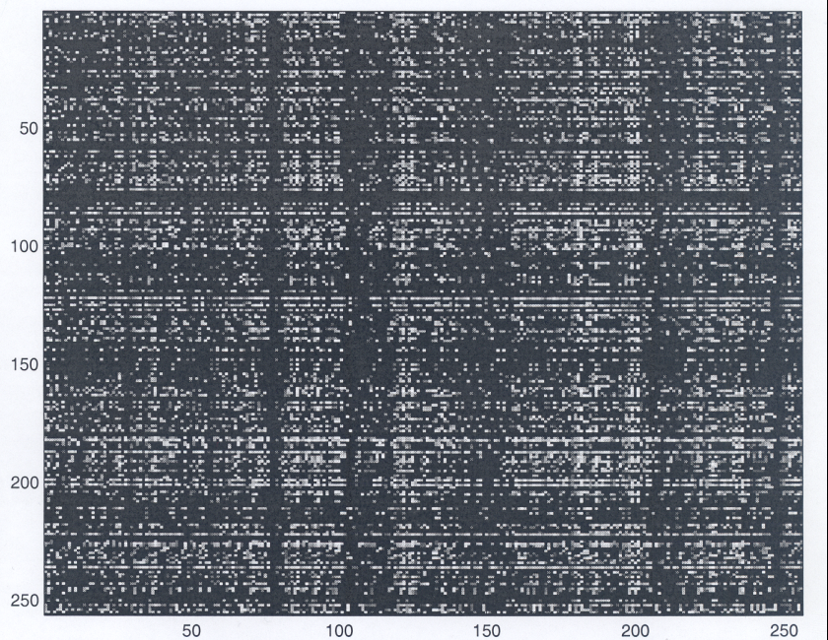
Memory on presentation of ‘thequickbrownfox…’
Data Memory size=256*256
Hypothesis: performance starts to decay as memory fills up >50%
Proof of scalability?
Notes:
Colormap(gray);imagesc(datamem); SAME MATLAB PROGRAM
Dm[i][j]=input[i]*context[j]
Colormap(gray)
imagesc

Slide 58
Issues to consider
How much does it depend on memory size (ie scalability)?
What is the optimum memory occupancy (how does the memory saturate as more letters get filled)?
How about scalability and error tolerance?
What are the types of sequences (eg with repeated letters) it can store? Longest length/ longest number of sequences? Can it be made to learn/ recognise complete works of Shakespeare?

Slide 59
A toy application
We want to find out how good the model works in the context of an application/ whether it can do something useful
Music/ phenomes/ moving images/ online handwriting
Eg NETTalk (1990), SpikeNET (2001) etc

Slide 60
Conclusion
So far
Where to?

Slide 61

Thanks for listening!
Q’s?

