Slide 1
Implementing a sequence machine using spiking neurons
Joy Bose
APT Group presentation
6 July 2006

Slide 2
Sequence machine
Memory for sequences (series of symbols over time) implementable with async spiking neurons
Includes: online sequence learning, recognition, completion/prediction
Its intuitive: we do it all the time
Similar to proposed neocortex model (Hawkins 04)
Applications: Robotic gestures, robot navigation, music notes, any kind of sequence …

Slide 3
C
B
A
B
A
C
Sequence machine
B
C
A
X
Y
Z

Slide 4
Problem description
Input is a continuous chain of symbols
For every input symbol, there is always a predicted (next) symbol
If the machine hasn’t seen an input symbol before (doesnt extrapolate), the prediction is meaningless
If it has seen it before, it looks back as far as necessary to find unambiguous prediction (more recent is preferred, memory weaker with time)
Can there still be ambiguous cases?

Slide 5
Implementation
A neural associative memory (associates one symbol with another) which can do online learning and prediction
A memory to remember the context or history of the symbol (finite state automata)
How best to store the context?

Slide 6
Encoding
Rank order codes (Thorpe 01) with N-of-M
Order of firing of neurons encodes information. Precise timing not important.
We have used rank ordered N-of-M codes to implement our sequence machine
Code= [5,6,7] represented as vector [1, α, α², 0]. Distance (similarity metric) between two codes measured by dot product.

Slide 7
Encode
Context
(history
or state)
Associative
Memory
Decode

Slide 8
Associative memory
Can understand as lookup table A->B,B->C etc
We want efficiency: error tolerance, redundancy (distributed storage), speed and spiking neural implementation (assume storage capacity is large)
N-of-M Kanerva’s SDM (Furber 04) has all the above features
SDM: encode inputs as points in huge M-dim space, data written/read from all its neighbouring addresses
Memory is like FPGA

Slide 9
Storing the context
ABCD XBCY
Context = F(old context, input)
Our model is combination of the two:
Shift register (stores a time window of fixed size)
Neural layer (stores a nonlinear function of whole past context) (Elman 90)
Storage is dynamic (short term memory): no connections are written.

Slide 10
Storing the context
Input
Old context
Expand and
Add
(weight=1)
Scramble and add
(weight<1
Recent inputs are
more important)
New context

Slide 11
Spiking neurons
Point neuron: no spatial information
Neuron makes decision to fire based merely on its input spikes (asynchronous, no global variables)
Only information in spike is time of firing
Each symbol is implemented as a burst of spikes, propagated from layer to layer
Notes:
Neuron can distinguish between different kinds of inputs
Integrate (sum) input spikes. If exceed threshold, emit output spike.
Normally, no way to ‘hold’ or latch a spike
Wire delays assume negligible (can insert extra delays), but time to integrate is not negligible

Slide 12
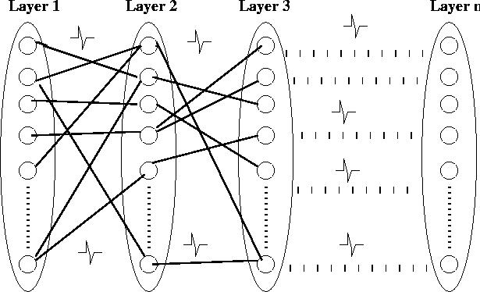
Neuron
(integrator)
Input
spikes
Output
spikes

Slide 13
Implementation by spiking neurons
The whole sequence machine can be implemented by point spiking neurons, IF we can ensure that the code (the encoded input vector, context, etc) will be transmitted reliably between neural layers
Have to worry about issues of stability of the spiking burst, coherence of the spike waves etc
Notes:
Time abstracted vector
Hawkins Elman Spikenet

Slide 14

Rank order N-of-M codes:
Implementing by spiking neurons
1
5
2
6
3
7
4
8
Code= [5,6,7] represented as vector [1, α, α², 0]
in the original sequence memory computations
Need to make sure the spiking neural model (with
vectors encoded as spike timings) gives same effect

Slide 15
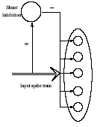
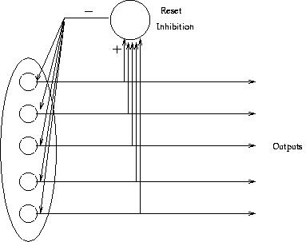
Feed forward shunt inhibition
+ Feedback reset inhibition
Rank order N-of-M codes:
Implementing by spiking neurons

Slide 16
Wheel model
Spiking neuron represented as spinning wheel
Each neuron will fire a spike after some time (as per the default spin or slope)
Phase of all neurons is initially set to 0, activated/reset with the layer
When a neuron gets an input spike, its phase is increased by strength of connection weighed by significance

Slide 17
Wheel model
Activation
Threshold
Default
slope
Time
Input
spike
Firing
time

Slide 18
Issues with spiking neural implementation
Sustaining a stable level of spike activity
Solution: feedback reset inhibition
Coherence of the spike trains
Solution: Inherent delay in neural model or large threshold
Remembering input firing order with local info
Solution: Synapses have memory
Not fire outputs until all the inputs have arrived
Solution: suitable threshold, delays
How does neuron know when to reset (burst has finished)?
Solution: counters (neurons with threshold)

Slide 19
Implementation of learning
Inputs
Data store neurons
Outputs
Address
Decoders

Slide 20
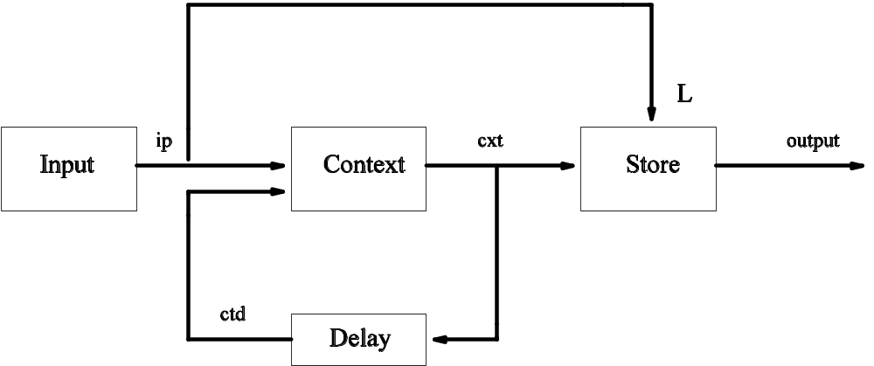
Timing relations
Both inputs to context MUST arrive around same time
Learning inputs to store must arrive BEFORE context outputs

Slide 21
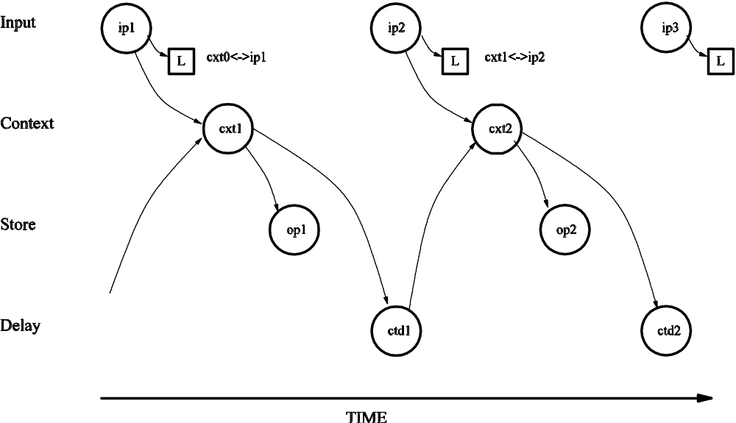
Timing relations

Slide 22
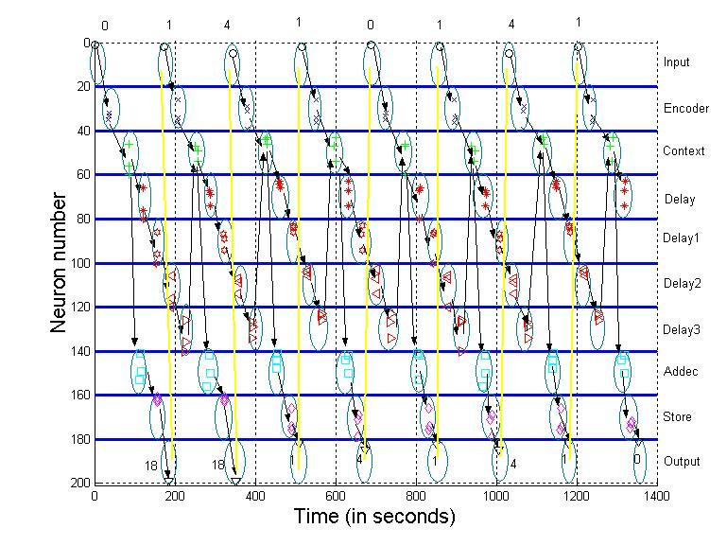
Timing diagram of spiking neural system

Slide 23
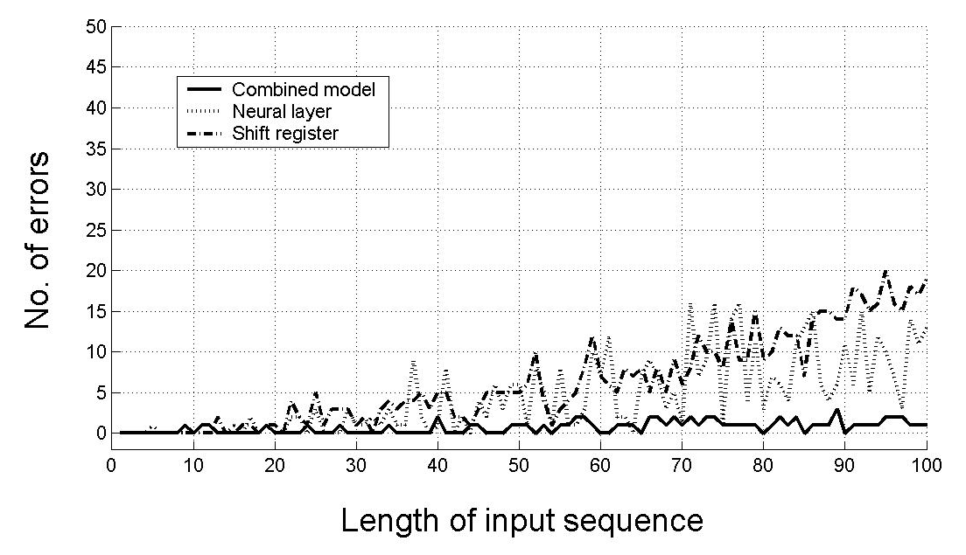
Performance Results

