Slide 1

Building a large scale hardware neural network based on spiking neurons
Joy Bose
(Amulet Group)
Supervisors
Jon Shapiro (AI Group)
Steve Furber (Amulet Group)

Slide 2
Objective
A modular neural chip
A robust dynamic neural memory

Slide 3
Motivation
Take inspiration from the brain
Commercial Applications
Modular chips
Notes:
Take inspiration from the brain and use it to build a useful framework for others to exploit. (First steps in a long project)
Commercial Applications (eg Simon Thorpe’s SPIKENET)
Modular chips: can build a network of just any size! (Potentially for computationally intensive applications.)

Slide 4

A Commercial Application

Slide 5
The Approach
Neural model: Sparse Distributed memory using N of M codes with rank order, spiking neurons
Hardware Model: Altera Chips, Programmable (FPGA) logic, asynchronous, digital, modular

Slide 6
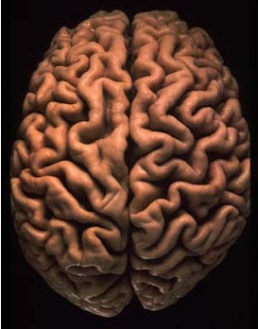
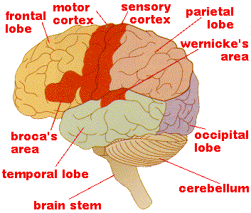
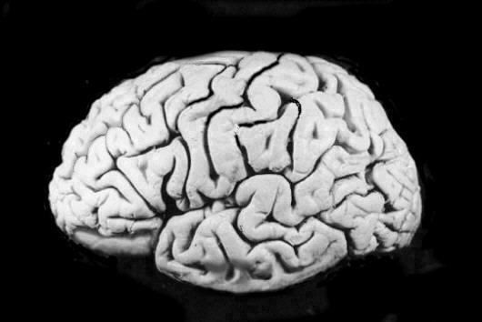
The Human Brain

Slide 7
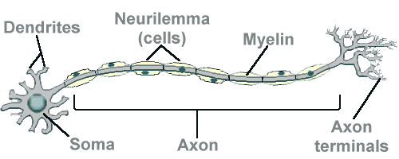
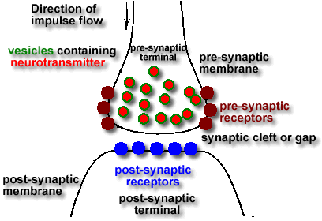
The Neuron: Brain Cell

Slide 8
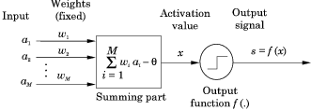
Neuron: A conventional Model

Slide 9
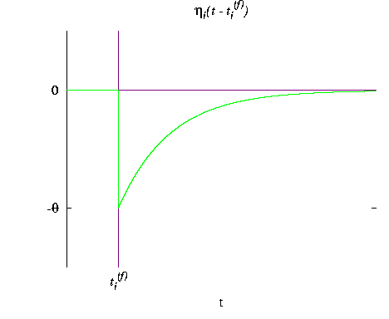
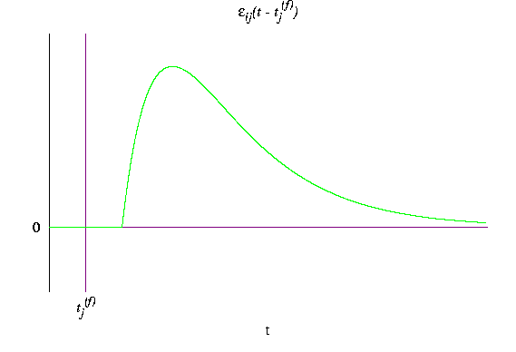


Spike Response Model

Slide 10
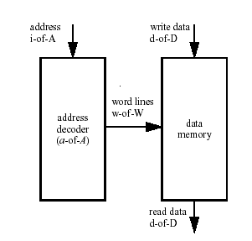
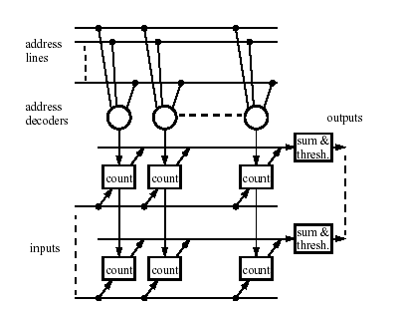
N of M Kanerva Memory
Kanerva Memory
N of M implementation

Slide 11
Present Work: FSM
Interested in seeing if a finite state machine can be built out of spiking neurons only.
Interested in dynamic sequences: repeated patterns
Objective: to observe capacity of memory
Learning will be the next step
First target: Counter!

Slide 12
Working hypothesis
It is possible to build a dynamic memory out of neurons alone, with information encoded in spike-firing patterns
Tests
To see if patterns CAN repeat: if a neural FSM is possible at all (now)
Test with: changed parameters, fixed/ random weights, different neural models, etc
See if training is possible

Slide 13
Issues
Symbol interference between bursts of neurons: delays
Model to be used: Feedback/Feedforward, lateral, +ve/-ve Connections
Memory and learning algorithm
Hardware (esp. large-scale) Issues

Slide 14
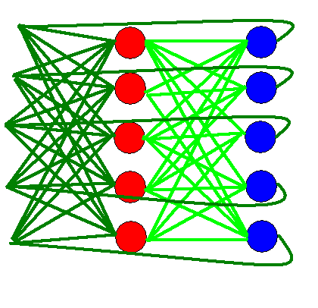
The Network Model (for FSM)

Slide 15
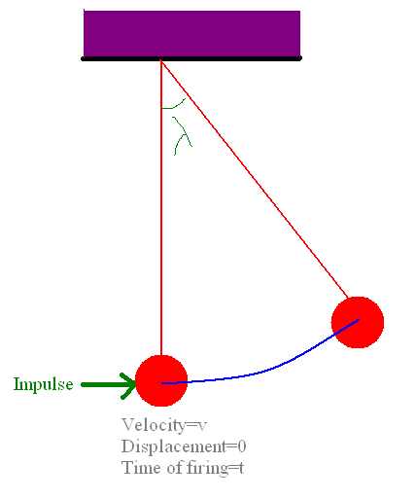
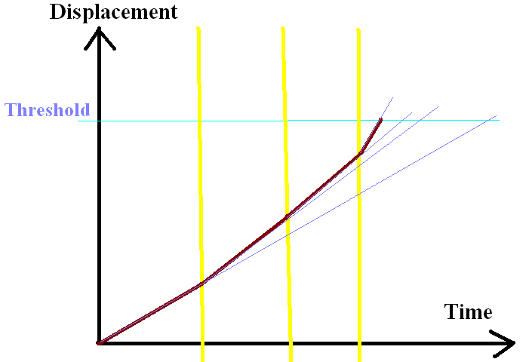
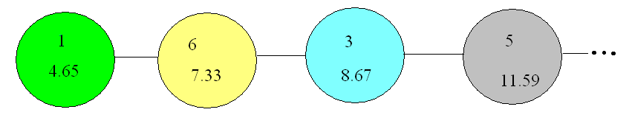
Pendulum Model and event queue

Slide 16
Justification of approach
N-of-M Code
Rank Order Code
Pendulum Model
Spiking Neurons/ Temporal Code
Digital Implementation
Notes:
Rank Order Code: More info transmitted
N-of-M: Robust against errors
Pendulum Model: To implement the time order of neurons firing: more activated neurons fire faster
Spiking Neurons/ Temporal Code : Models actual biological system
Digital Implementation: AMULET expertise, low power, high efficiency

Slide 17
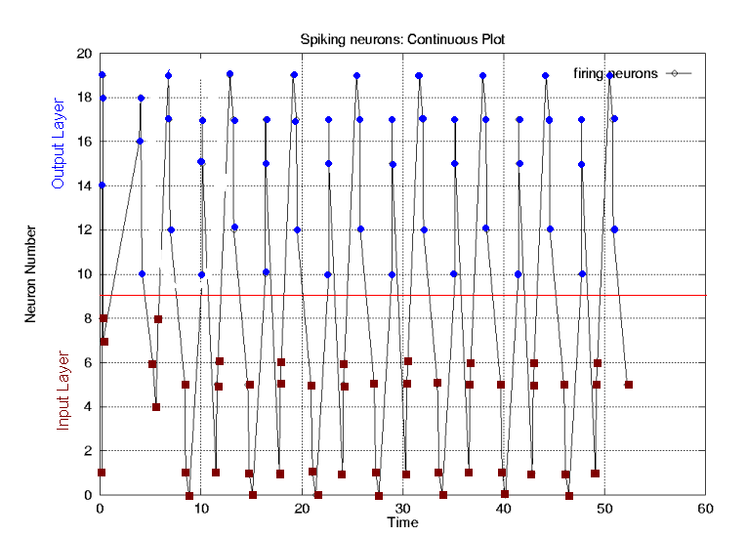
Sample Output
Outcome: Patterns do repeat!

Slide 18
Conclusion and future work
Hypothesis: It is possible to build a dynamic neural memory
Objective: To build a robust neural memory and a modular neural chip
Future work: To finalise neural model and then concentrate on hardware aspects

Slide 19
Further Information
Fire Project Home Page: www.cs.man.ac.uk/amulet/projects/fire
E Mail: joy.bose@cs.man.ac.uk
Homepage: www.cs.man.ac.uk/~bosej
Thanks!!

Slide 20
Background: SPIKENET
Simon Thorpe and Team at Salk Institute, Toulois, France
Spikenet: A simulator for modelling large networks of Integrate and Fire neurons
Used in reverse engineering of the visual system, face recognition
Real-Time computation, implemented on parallel hardware
Temporal Rank order coding+ On-center Off-surround receptive fields used

Slide 21
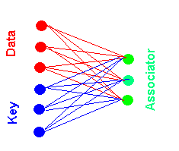
Background: AURA
Advanced Uncertain Reasoning Architecture
By Jim Austin and his team at York
A Correlation Matrix Memory + Associative
Memory Matrix=Sum of Cross-Products of key and data vectors over training set
Recall: Product of Matrix and key
Characteristics: Partial Match, online training, large-scale, parallel processing, partial match, data compression

Slide 22
Time Plan (When?)
2002: Finalise NN model
May 2003: Hardware Design/ Testing
Dec 2003: Build Prototype Processor/ Communication issues
2004/05: Experiment, finalise and present. Look for wider scope

Slide 23
Spiking Neurons: Mike’s Model
x''+ax'+bx=0
One Solution:
x=A*t*exp(-B*t)
Here
a =>Fading Force
b =>Restoring Force
x= Potential (Displacement)
Basic idea:
Firing changes the RATE of
increase of activation rather
than activation directly.
Justification:
Helps to actually implement
the time-order of neurons
firing: more activated
neurons fire faster.

Slide 24
Present (hardware) Approaches
They use:
Conventional rate-based neural models
Analog Chips
Problems:
Not too much information encoded
Analog chips slower, susceptible to noise
Not model the actual working accurately

Slide 25
Secret Weapon (Why me?)
AMULET expertise (Hardware)
Neural expertise
My Software background
Building on previous work (N of M memory)

