Slide 1




A system for transmitting a coherent burst of activity through a network of spiking neurons
J. Bose, S. B. Furber, J. L. Shapiro
Computer Science, University of Manchester, Manchester M13 9PL, UK
{bosej,sfurber,jls}@cs.manchester.ac.uk

Slide 2
Abstract
We examine issues involving the transmission of information by spike trains through networks made of real time asynchronous spiking neurons. For our convenience we use a spiking model that has an intrinsic delay between an input and output spike. We look at issues involving transmission of a desired average level of stable spiking activity over many layers, and show how feedback reset Inhibition can achieve this aim. We then deal with the coherence of spike trains and show that it is possible for a burst of spikes emitted by a layer to not diverge when passing through different layers of neurons. We present the results of simulations done on a multilayered feed-forward system to illustrate our method.

Slide 3
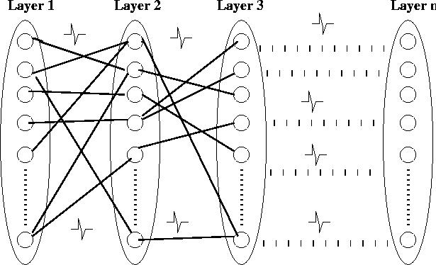
Aim
To study temporal issues of transmission of information by spikes across a feed forward network.
Issues:
Stability: Can a desired level of spiking activity be sustained across many layers?
Coherence: Will successive spike trains interfere with each other?
We assume here that information is transmitted by waves of spikes between layers, each such wave encoding a value.

Slide 4
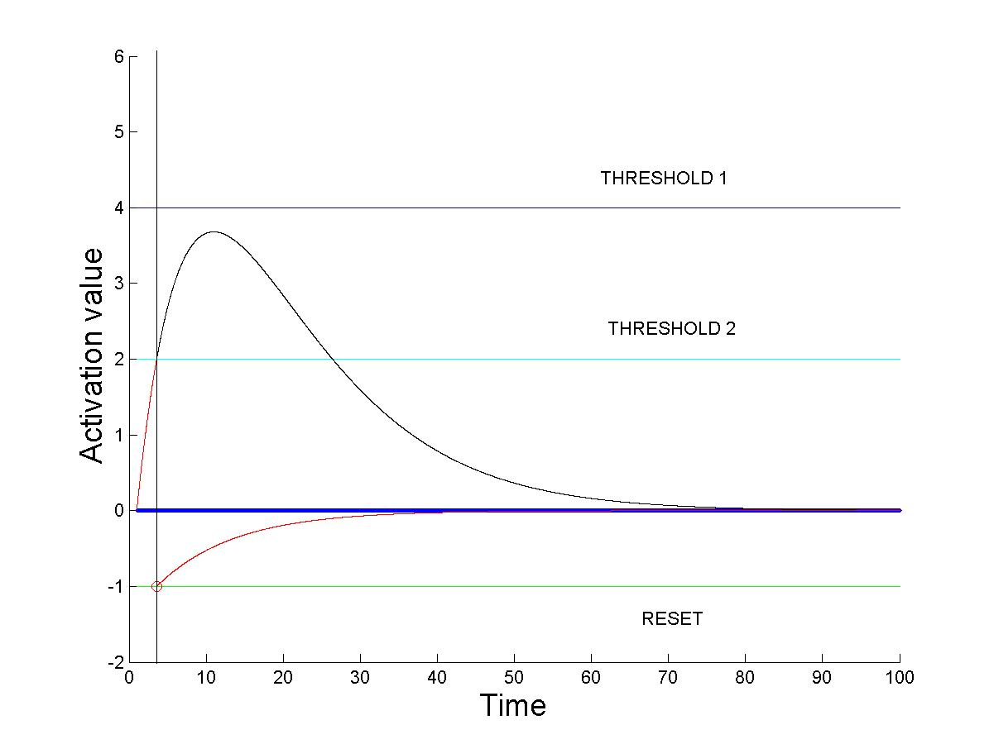
Model of spiking neuron
Rate driven leaky integrate and fire model
Two parameters: activation and rate. Incoming spikes increment rate of increase of activation. If activation exceeds threshold, the neuron fires a spike.
Time lag between input and output spike. Is necessary in a feedback loop.
Parameters
r = rate, a = activation
τ_{r} = rate time constant
τ_{a} = activation time constant
ŕ = Σ (input spike impulses) – r/ τ_{r}
á = r – a/ τ_{a}
If a >= threshold , spike fires
Solving, we get for τ_{r}=τ_{a}= τ
a = t * e^{-t/τ}

Slide 5
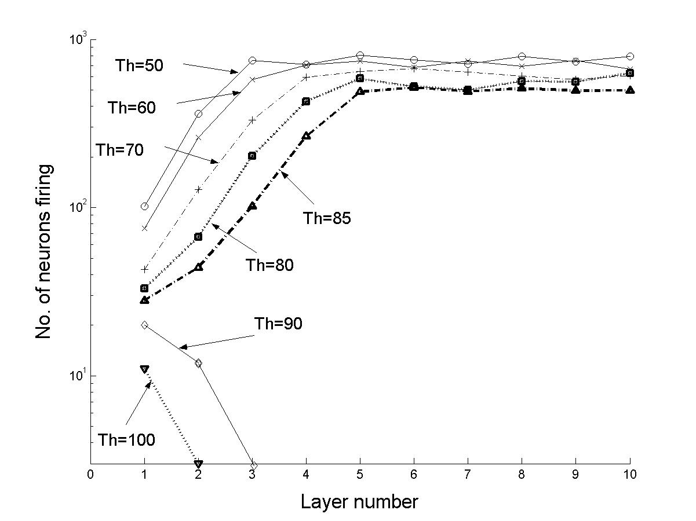
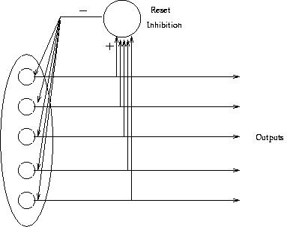
Stability problem
We found in our simulations that it was difficult to sustain a stable level of activity over many layers of neurons: the activity either died out or saturated.
To solve this problem, we used feedback reset inhibition to cut off the activity when a certain number of spikes have fired.

Slide 6
Coherence problem
If a network has feedback loops, the coherence problem becomes important.
We need to ensure that successive waves of spikes do not impinge on each other, destroying useful information.
We found that it was possible to maintain coherence of spike trains in such a system as ours (feed forward layers with feedback inhibition)

Slide 7
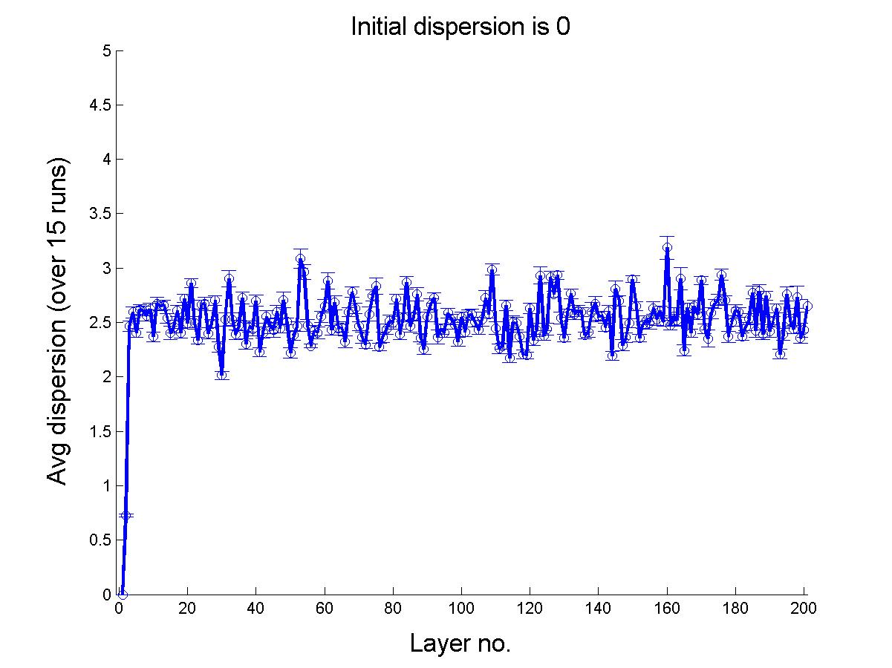
Simulation
We simulated a feed forward network of 200 layers of ODSHO neurons, with 11-of-256 encoding (implemented by feedback reset inhibition). The average connectivity of the layers is 10%.
We then plotted the average output dispersion with the input layers.
Plot of the average output dispersion over 16 runs (when the initial input dispersion is 0). The dispersion quickly settles down to a narrow range. We get similar graphs regardless of the input parameters such as connectivity, dispersion, etc.

Slide 8
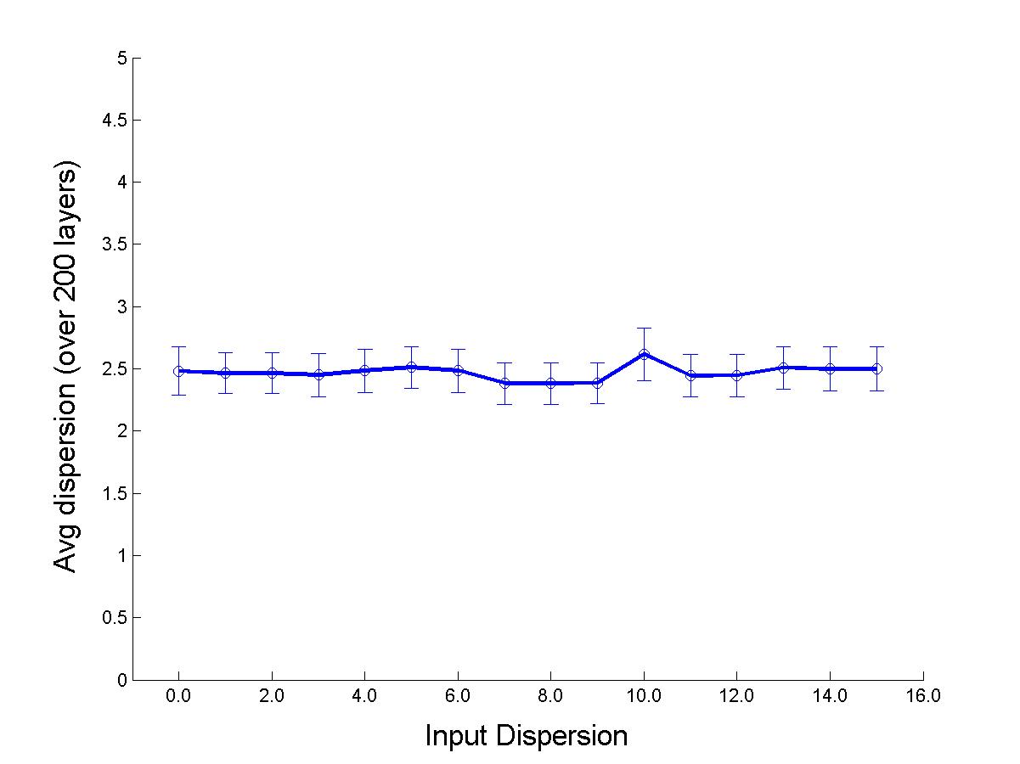
Experimental results
On varying the initial input dispersion.
We found that the range at which the output dispersion (output time spread) settles down does not vary much for different values of the input dispersion.

Slide 9
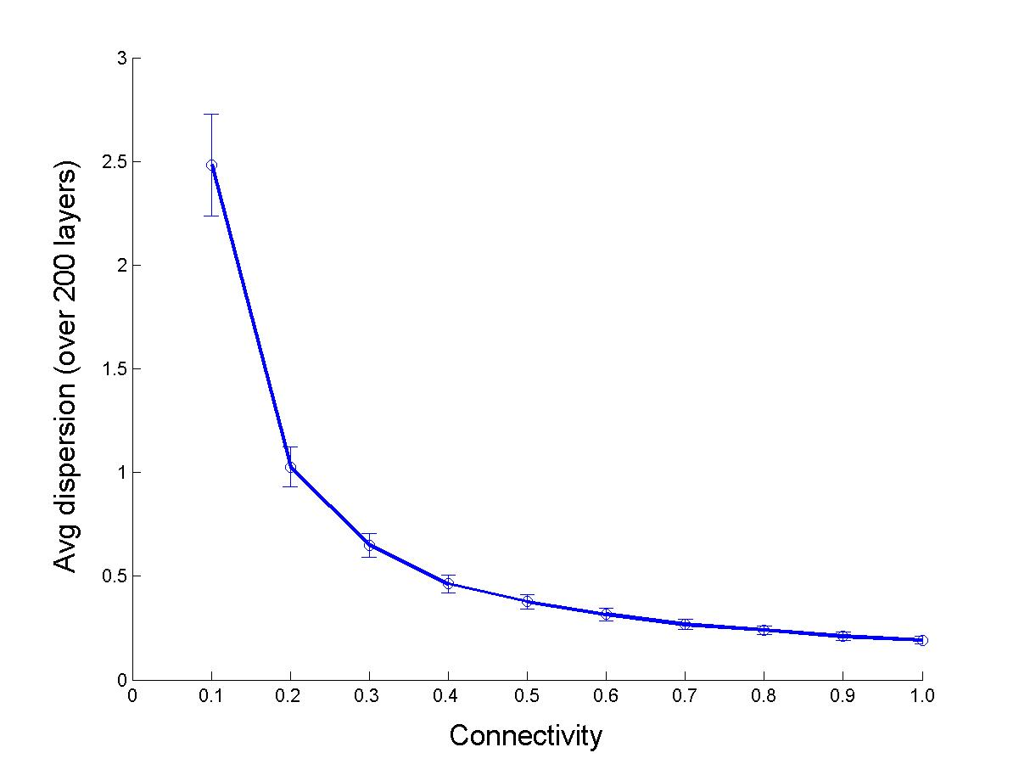
Experimental results (2)
On varying the connectivity
We found that the output dispersion was inversely proportional to the connectivity. As the connectivity increased, the dispersion (output time spread) decreased.

Slide 10
Conclusion
We have shown that it is possible to propagate a coherent burst of spiking activity of a desired level over many layers.
Future work: To model associative memories using Hebbian learning

Slide 11
References
Wolfgang Maass, Christopher M. Bishop. Pulsed Neural Networks. MIT Press, 1999
Fred Rieke, et al. Spikes: Exploring the neural code. MIT Press, 1997.
Wulfram Gerstner, Werner M. Kistler. Spiking Neuron Models: Single Neurons, Populations, Plasticity. Cambridge University Press, 2002.
S.B. Furber, J.M. Cumpstey, W.J. Bainbridge and S. Temple. Sparse distributed memory using N-of-M codes. Neural Networks, 2004, 10.

