Slide 1
Prediction of Throughput Degradation from Trouble Frequencies, given Environmental Unknowns
Joy, Ranjani, Serene, Venkatesh
GAIA,
Ericsson R&D
Ericsson
2022

Slide 2
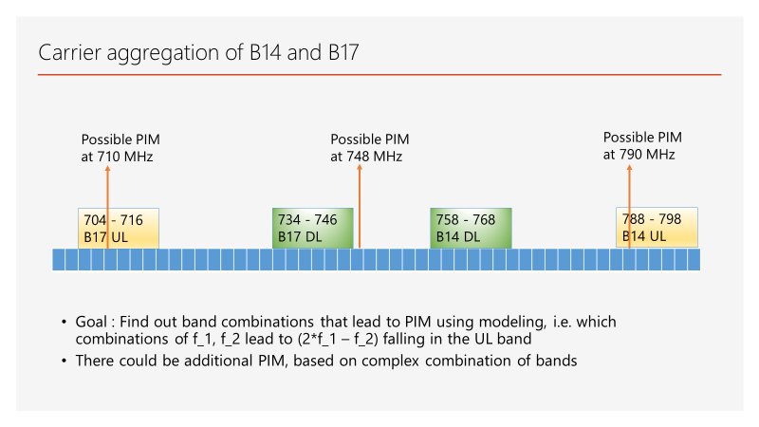
What is Passive Intermodulation (PIM)
Product of downlink transmitters which mix to yield uplink interference
Occurs when old equipment rusts out (rusty bolt effect), and sub-carriers intermix amongst themselves to cause an interference in the uplink.
Distorts the frequency bands of the receivers and thus disrupts the communication channel
Occurs due to a combination of factors including environmental factors which are variable and usually cannot be known in advance
Difficult for the networks to learn or predict in advance the effects of the PIM
Determine methods to suppress the PIM related distortion by using algorithms that do not assume anything about the PIM generation models
Our approach can work with unknown environmental factors.

Slide 3
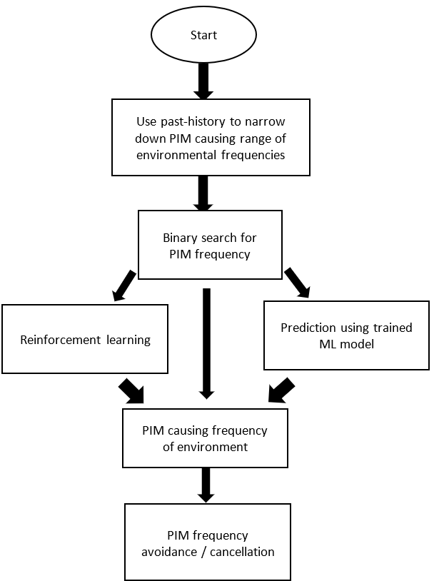
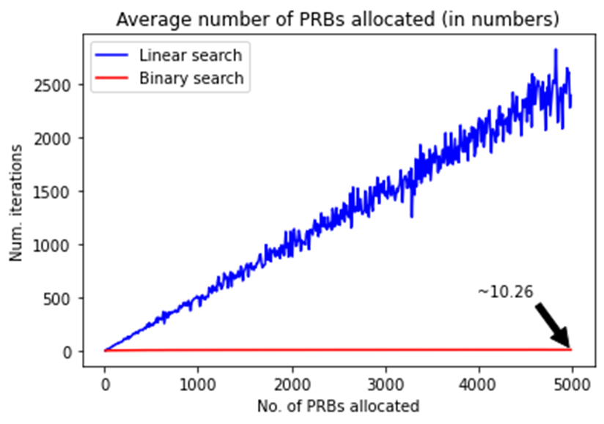
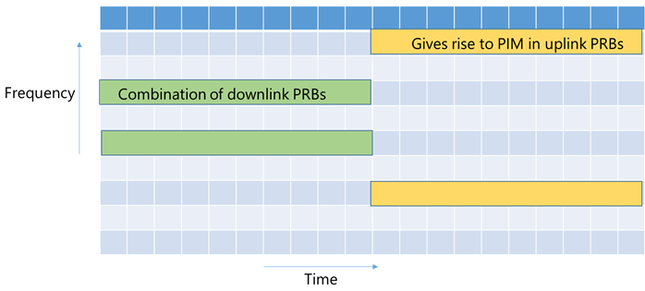
Proposed solution
Create map of frequency allocation from detected time intervals when cell experience PIM
Use created map of frequency to detect trouble frequency allocations
Using binary search and using binary search tree-based method, efficiently zero in on the operator frequencies that might be causing PIM, in real time.
Optimize the search space by using the past history of the network and the knowledge of the system to eliminate frequency bands
Reinforcement learning algorithm to determine the PIM causing frequency by giving small perturbations at certain frequencies
A machine learning algorithm that predicts, given a certain frequency, the frequency at which PIM is caused

Slide 4
Binary search for PIM frequency: Case 1
Case 1: For a given Uplink Physical Resource Block (UL PRB), the F₁ and F₂ PIM causing components in DL PRB are unknown and from same operator:
Given F_{UL}, use the historical knowledge to narrow down the search space (for candidate F₁ and F₂ components) from entire DL PRB sub carrier frequencies to a subset of tuples, represented as F₁₂ . If there is no historical knowledge, all DL PRB sub carrier frequencies of the operator can be considered
Among the candidate F₁₂ components, use binary search to arrive at the correct component.
Step 1: Blank one half of the F₁₂ candidates, check if PIM in F_{UL} has reduced
Step 2: If PIM reduced
Search space F₁₂ is updated to first half, proceed to step 1
Step 3: Update F₁₂ to second half, proceed to step 1
Stop when F₁₂ is a singleton set

Slide 5
Binary search for PIM frequency: Case 2,3
Case 2: For a given UL PRB block, only one component i.e., F₁ is from DL PRB of same operator and the other is from another operator or unknown environment:
Given F_{UL}, the historical knowledge is considered to narrow down the search space (for only candidate F₁ components) from entire DL PRB sub carrier frequencies to a subset of tuples, represented as F₁
Among the candidate F₁ carriers, use binary search to arrive at the correct component.
Step 1: Blank one half of the F₁ candidates, check if PIM in F_{UL} has reduced
Step 2: If PIM reduced
Search space F₁ is updated to first half, proceed to step 1
Step 3: Update F₁ to second half, proceed to step 1
Stop when F₁ is a singleton set
Case 3: Both is (F₁, F₂) are not in the operator’s range:
Cease to use F_{UL} as UL PRB and shift to another PRB
Append the output of the PIM frequency determining module back to the historical knowledge of F_{UL}

Slide 6
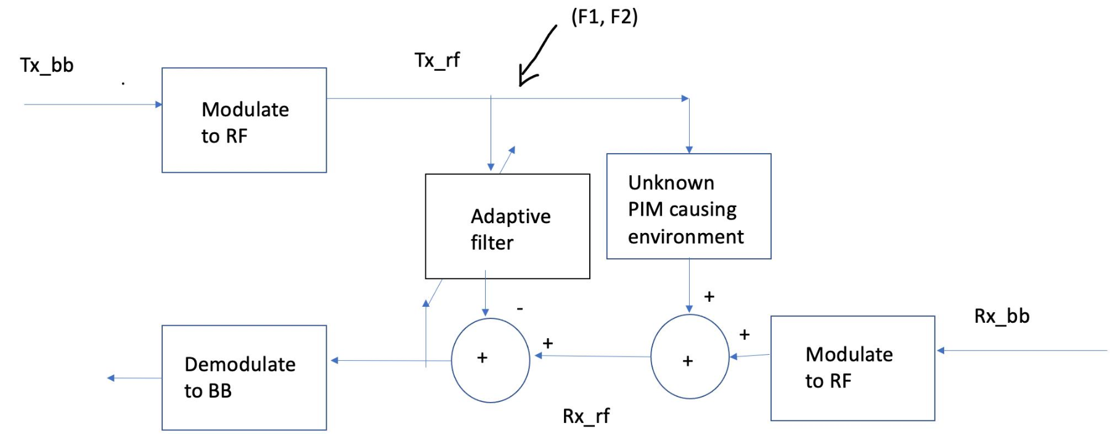
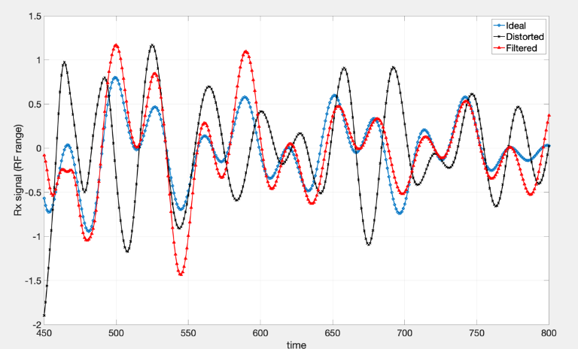
Algorithm for PIM cancellation
Once the frequencies causing degradation are determined, PIM is controlled by the system by any standard method such as the following: changing the frequency of the wireless network to avoid the determined frequencies, or by having an apparatus to cancel the noise caused by those frequencies.
Given (F₁, F₂) as determined by PIM frequency detection module:
Case 1: (F₁, F₂) both from given operator – PIM cancellation using continuous time adaptive filter (in RF domain) or using RL algorithms
Case 2: F₁ alone from given operator and F₂ is unknown, DL PRB corresponding to F₁ can be ceased to be used
Case 3: (F₁, F₂) neither are from given operator – frequency changing module for UL PRB
Sample output of a PIM cancellation module in RF band using adaptive filter

Slide 7
Simulation Environment
To study the working and efficacy of our solution, we use a home-grown simulator to simulate the effects of PIM.
In our home-grown simulator, we simulate the effect of third order PIM, based on PRB allocation in the downlink
The simulated environment considers frequency range from 700 to 900 MHz where a combination of bands B14, B17 and B29 are considered.
4 uplink channels and 4 downlink channels as described below:
B14: UL: 788 - 798 MHz, DL: 758 - 768 MHz, Channel bandwidth: 5, 10
B17: UL: 704 - 716 MHz, DL: 734 - 746 MHz, Channel bandwidth: 5, 10
B29: DL Carrier Aggregation Only. DL: 717 - 728 MHz, Channel bandwidth: 3, 5, 10
UL: 830 - 840 MHz
UL: 880 - 915 MHz
DL: 845 - 875 MHz
A comparison of exhaustive search, supervised learning and variants of Multi-Armed-Bandit (MAB) to detect and mitigate PIM was demonstrated on the homegrown PIM Simulator, under the presence of noise and frequency hopping.

Slide 8
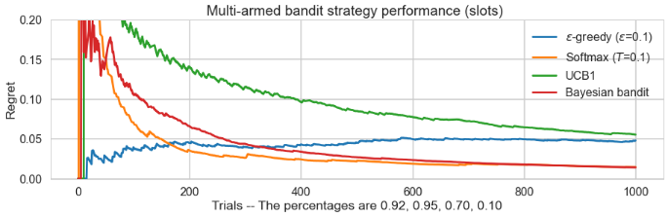
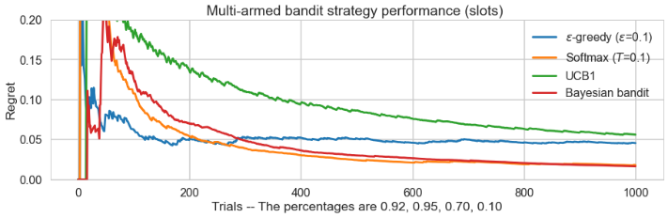
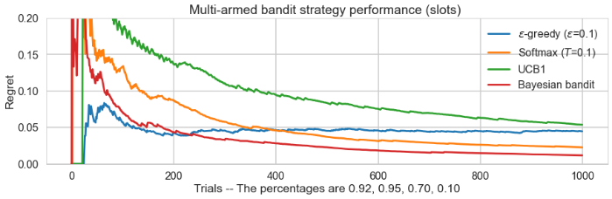
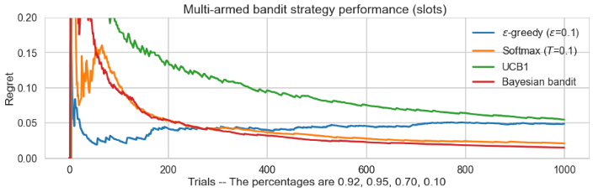
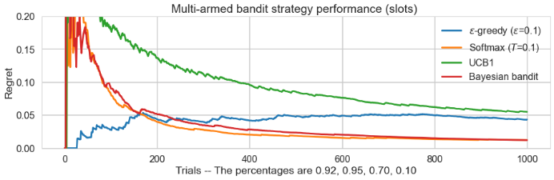
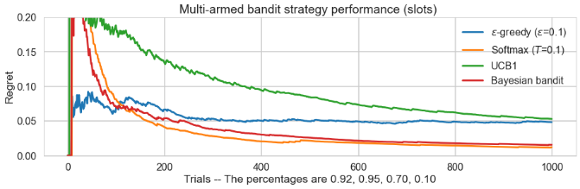
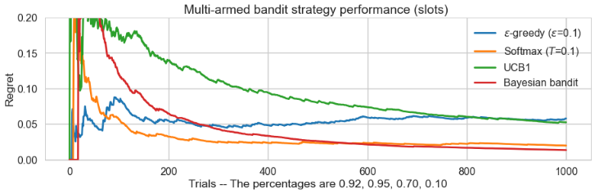
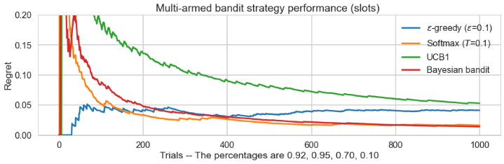
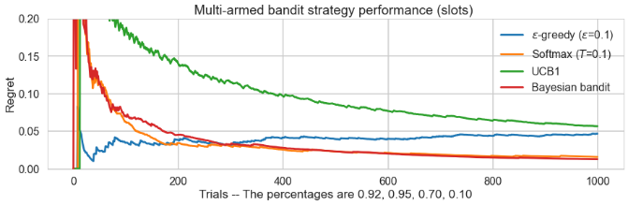
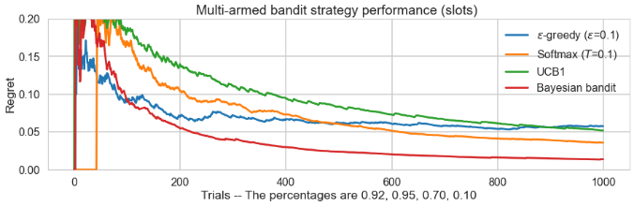
Results: convergence of learning for 10 iterations of frequency hopping

Slide 9
Use-Case Scenario: Telecom operators
Consider the use case when a telecom operator O₁ has a frequency F₁ which comes within a certain frequency band. Now another operator O₂ in the same region has a frequency F₂, which is unknown to operator O₁ (environmental unknown), also happens to come under the same frequency band. Now F₁ and F2 together cause PIM which results in degradation of the channel quality. Therefore, operator O₁ has to change its own frequency to avoid having PIM due to F₂ frequency of O₂.
Applying our solution, O₁ first narrows down the range of PIM causing frequencies, using knowledge from past history, and on the narrowed range it performs a binary search and discovers that O₂ has frequency F₂ which will cause PIM if combined with F₁. All this binary search computation and frequency changing is done in real time.
Also, by automatically notifying telecom operators of potential PIM causing frequencies, our system can help the telecom operator to reduce costs by avoiding trouble frequencies.

Slide 10
Summary and future work
In this paper, we have proposed an approach for PIM mitigation and detection. Our approach includes the following:
System that automatically detects which are the trouble frequencies that when changed could mitigate PIM, given environmental unknowns.
The PIM causing frequencies are determined using a search strategy comprising of the following methods:
Generating a binary search tree in real time to search the PIM causing frequency
Using one or more variants of Reinforcement Learning (such as Q learning, proximal-policy optimization, or the like)
Our solution is equally applicable in case of RAN, hearing aids, or any other systems with PIM frequency related throughput degradation.
We have demonstrated the real-life feasibility of the solution by using a home-grown PIM simulator, simulating PIM and showing that the solution converges. Our key contribution is proposing binary search to help finding our correct PRB combination, given the environmental knowns. To the best of our knowledge this is the first solution to mitigate PIM, given environmental unknowns.
In future, we plan to implement the system for real life use cases such as with telecom operators.

