Slide 1

Sparse Distributed Memory using Spiking Neural Networks on Nengo

Slide 2
Objective
To understand how spiking neurons can be used to implement SDMs
To compare the memory capacity achieved with non-spiking SDMs

Slide 3
Sparse Distributed Memory
Form of an Associative memory
data is encoded and stored using sparse representations
Introduced by Kanerva in 1998 [1]
subsequently implemented by Furber et. al. using N-of-M codes [2] as well as using Rank-order Codes [3]
Motivation: to test the plausibility of implementing associative memories using large scale low-power hardware, which was also amenable to a spiking neural implementation and good memory
They used the N-of-M codes from Verhoeff [4], as well as the biologically inspired Rank-order codes, proposed by van Rullen and Thorpe [5]
Implementations of SNN-based SDMs have additionally been studied by Bose [6] and Sharp [7], although these did not focus on the memory capacity of such memories

Slide 4
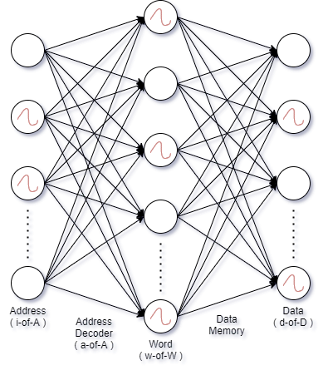
SDM using Spiking Neural Networks

Slide 5
Storing and Retrieving from Memory
During the write phase (storing data), the weights of the data memory are initialized to zero.
These weights are updated depending on the input and output spikes using the BCM [8] learning rule.
During the read phase (retrieving data), these weights are used to construct output spikes, producing a d-of-D code.

Slide 6
N-of-M code and Spikes
The effect of the input spikes is modelled by considering the rise in current of the neurons.
During the write phase, the inputs to the input and output layer are given as currents arising from the spikes.
During the read phase, we provide a current only to the input layer, using the same vector as previously used in the write phase.
For each layer, we select the n neurons that fire first, corresponding to an N-of-M code.

Slide 7
Memory Capacity
During the read phase, we compare the output d-of-D code with the desired code, which was provided during the write phase.
If the output matches the desired code, we consider it as correctly recalled, otherwise, it is incorrect.
We do this for a large set of codes. After a certain point, the memory saturates, and the SDM starts producing larger number of incorrect codes during the read phase.
We measure the memory capacity, computed as the point at which the memory starts making mistakes while recall.

Slide 8
Application: Storing MNIST Images
We took images of handwritten numbers from the MNIST dataset [9], along with the labels of the numbers corresponding to those images.
We fed the image to an N-of-M encoder neural network, that converted each 28*28 MNIST image to a 22-of-256 code, to feed to the SDM.
The encoder weights were fixed, and the output was an N-of-M code corresponding to the MNIST image.
This served as the ‘address’ in the SDM, while the ‘data’ was the label corresponding to each MNIST image, converted to a 1-of-10 code.

Slide 9
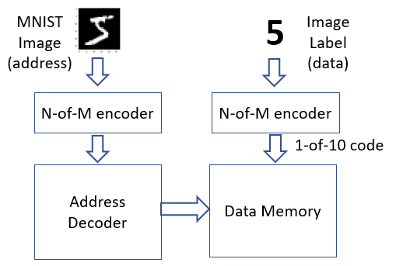
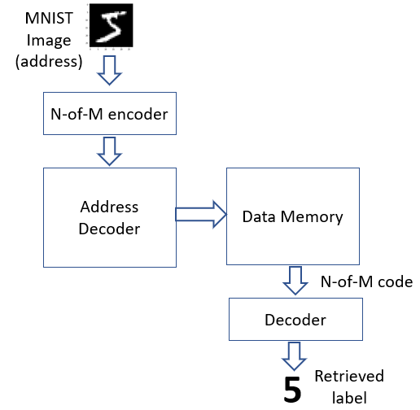
Application: Storing MNIST Images
Read Phase
Write Phase

Slide 10
Nengo and NengoDL
Nengo [10] is a Python based simulator for spiking neurons. As a simulator, it has a few advantages: It offers flexibility in writing code to simulate spiking neurons, it has graphical and scripting interfaces, it works with multiple learning rules and spiking neural models, it is getting wider acceptance in the machine learning and computational neuroscience community. All of these inspired us to use Nengo for simulating our model.
NengoDL [11] is a simulator for SNNs that combines Nengo and Deep Learning. The input to NengoDL is a Nengo network. Using NengoDL, a user can simulate the SNN using a deep learning model such as Tensorflow, thus they can get the best of both worlds.
To switch from Nengo to NengoDL, only the simulator needs to be changed, while the model is same as that built for the Nengo simulator. NengoDL has a faster simulation speed on both CPUs and GPUs. Additionally, NengoDL allows batch processing, which significantly reduces the computation time.

Slide 11
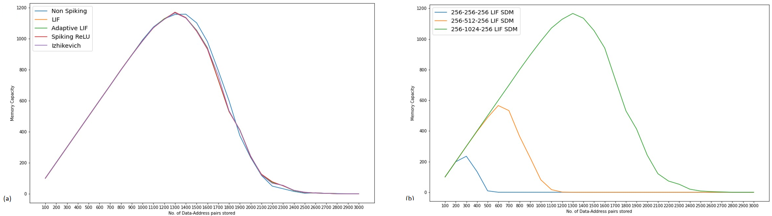
Results
We observed that the memory capacity for spiking implementation is similar to the non-spiking implementation.
We measure the memory capacity using LIF, Adaptive-LIF [12], Spiking Rectified Linear Unit, and Izhikevich[13] neurons and obtained similar results.

Slide 12
Results
We tested the model for address decoder sizes of 256, 512 and 1024 neurons, and found it to be scalable with similar performance.

Slide 13
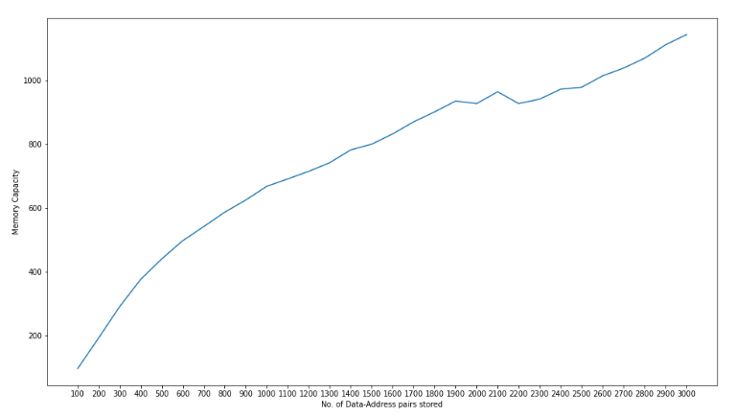
Results
For the application with MNIST images, we used an SDM with input of size 256 and middle layer of size 512.
The memory capacity grows linearly until around 400 address-data pairs, after which it starts degrading slowly.
However, a peak could not be discerned in the memory capacity graph. We simulated the memory until we reached 3000 address data pairs.
One reason why we could not see a clear peak in the memory capacity plot is because the data is only one of a fixed number of values (0 to 9) even though the number of addresses (MNIST images) is more, and hence the memory capacity is vastly increased as the memory learns to generalize from the address-data mapping.

Slide 14
Conclusion
We concluded that it is feasible to develop associative memories using spiking neurons whose memory capacity and other features are similar to the performance without SNNs.
Our work provides an entry point for studying SNN based associative memory models, which could be used in applications such as storing images or text encoded as binary vectors, using significantly lower power than conventional memory systems, in a biologically plausible manner.

Slide 15
References
[1] Kanerva P. Sparse distributed memory. MIT press; 1988.
[2] Furber SB, Bainbridge WJ, Cumpstey JM, Temple S. “Sparse distributed memory using N-of-M codes.” Neural Networks. 2004 Dec 1;17(10):1437-51.
[3] Furber SB, Brown G, Bose J, Cumpstey JM, Marshall P, Shapiro JL. “Sparse distributed memory using rank-order neural codes.” IEEE Transactions on neural networks. 2007 May 7;18(3):648-59.
[4] Verhoeff T. “Delay-insensitive codes—an overview.” Distributed computing. 1988 Mar;3(1):1-8.
[5] Rullen RV, Thorpe SJ. “Rate coding versus temporal order coding: what the retinal ganglion cells tell the visual cortex.” Neural computation. 2001 Jun 1;13(6):1255-83.
[6] Bose, J., “Engineering a Sequence Machine Through Spiking Neurons Employing Rank-order Codes.” Doctoral dissertation, University of Manchester. 2007.
[7] Sharp T. “Application of Sparse Distributed Memory to the Inverted Pendulum Problem.” Masters Thesis. University of Manchester. 2009.

Slide 16
References
[8] Blais BS, Cooper L. “BCM theory.” Scholarpedia. 2008 Mar 28;3(3):1570
[9] LeCun Y., Cortes C., Burges C. The MNIST database. [Online]. Available: http://yann.lecun.com/exdb/mnist/
[10] Bekolay T, Bergstra J, Hunsberger E, DeWolf T, Stewart TC, Rasmussen D, Choo X, Voelker A, Eliasmith C. “Nengo: a Python tool for building large-scale functional brain models.” Frontiers in neuroinformatics. 2014 Jan 6;7:48.
[11] Rasmussen D. “NengoDL: Combining deep learning and neuromorphic modelling methods.” Neuroinformatics. 2019 Oct;17(4):611-28.
[12] Brette R, Gerstner W. “Adaptive exponential integrate-and-fire model as an effective description of neuronal activity.” Journal of neurophysiology. 2005 Nov;94(5):3637-42.
[13] Izhikevich EM. “Simple model of spiking neurons.” IEEE Transactions on neural networks. 2003 Nov;14(6):1569-72.

Slide 17
Thank You

