Slide 1

Vel Tech Rangarajan Dr. Sagunthala R&D Institute of Science and Technology
School of Computing
Department of Computer Science and Engineering
10211CS224 / FULL STACK APPLICATION DEVELOPMENT (JAVA)
PROJECT REVIEW : MILESTONE PROJECT – 2
Date: 24-04-26
Job Portal Management System
SDG: SDG No – SDG Title(Example: SDG 4 – Quality Education)
Presented By:
V Prajeeth Preetham – VTU26554 – Reg.No.23UECS0919
Courses Handling Faculty:
Dr. XArogya Presskila – B.E,M.E,Ph.D.,

Slide 2
INTRODUCTION
Recruitment is a critical process in every organization, but traditional hiring methods are often slow, inefficient, and geographically limited.
With the rise of digital transformation, job portals have become essential platforms that bridge the gap between job seekers and employers.
A job portal system enables candidates to search for jobs, upload resumes, and apply instantly, while recruiters can post vacancies and manage applications efficiently.
This project aims to design and develop a full-stack job portal system that provides real-time interaction, secure authentication, and seamless data handling.
The system ensures accessibility, scalability, and improved hiring efficiency for both users and organizations.
1
2
3
.
4
5
6
7
8
9

Slide 3
PROBLEM STATEMENT
1
Traditional recruitment relies heavily on manual processes, leading to delays and inefficiencies.
Job seekers often struggle to find relevant opportunities due to scattered job listings across platforms.
Recruiters face difficulty in managing large volumes of applications without a centralized system.
Lack of real-time communication between candidates and employers causes delays in hiring decisions.
Data inconsistency and absence of proper tracking mechanisms reduce transparency in the recruitment process.
There is a need for a centralized, automated, and scalable job portal system to streamline recruitment activities.
2
3
4
5
6
7
8
9

Slide 4
OBJECTIVE(S)
1
Project Objectives:
To design and develop a user-friendly full-stack job portal application.
To implement secure user authentication for both recruiters and job seekers.
To enable recruiters to post, update, and manage job listings efficiently.
To allow candidates to search, filter, and apply for jobs in real time.
To store and manage data using a structured database system.
To ensure scalability and responsiveness across multiple devices.
2
3
4
5
6
7
8
9

Slide 5
PROPOSED SYSTEM
PROPOSED SYSTEM
The proposed system is a web-based job portal that automates the entire recruitment process.
It provides a centralized platform where recruiters can post job openings and candidates can apply instantly.
The system uses a database-driven architecture to store user profiles, job listings, and application data.
It includes a secure login system to protect sensitive user information.
Real-time updates ensure that users receive the latest job opportunities and application statuses.
Advantages
Eliminates manual paperwork and reduces hiring time.
Provides global access to job opportunities.
Enhances data accuracy and consistency.
Improves communication between recruiters and candidates.
Enables efficient tracking of applications and hiring progress.
1
2
3
4
5
6
7
8
9

Slide 6
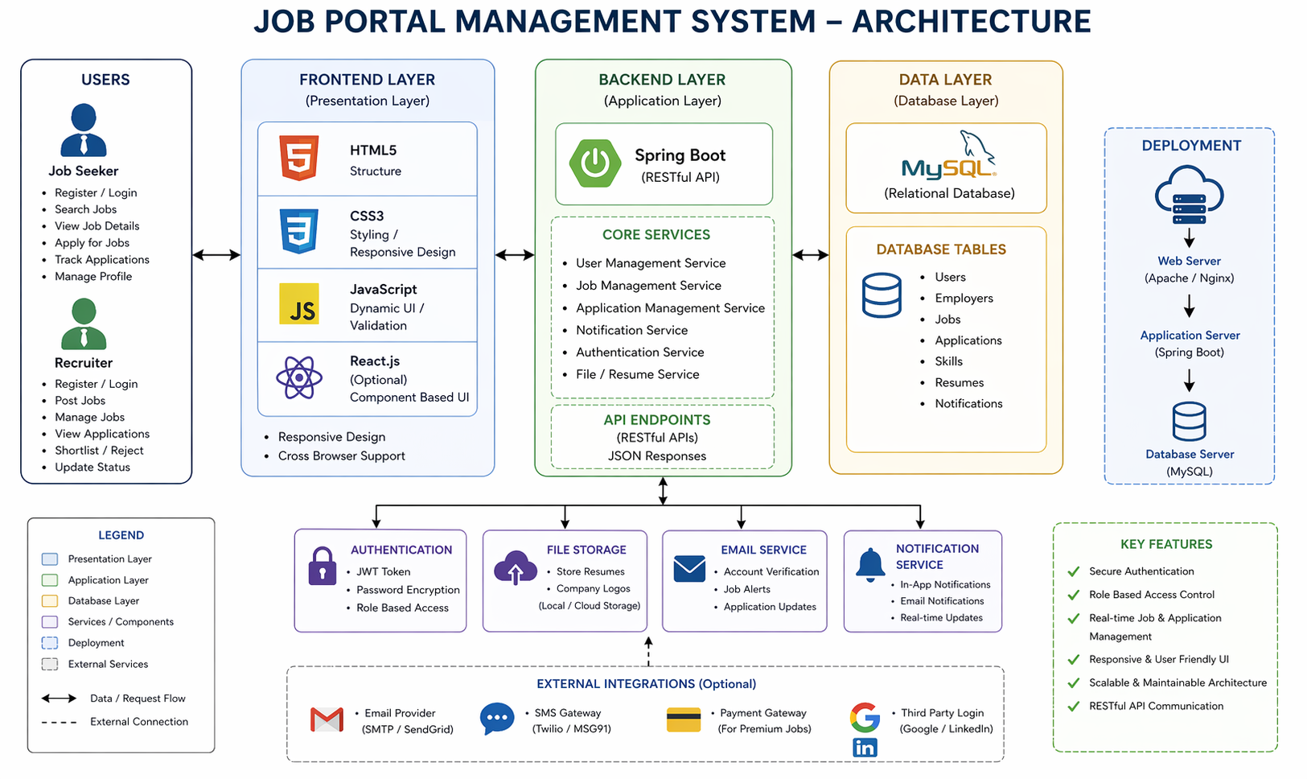
PROPOSED SYSTEM ARCHITECTURE
1
1. Presentation Layer (Frontend)
Developed using HTML, CSS, JavaScript (or React).
Provides interactive UI for users.
Handles user input and displays results dynamically.
2. Application Layer (Backend)
Implemented using Java (Spring Boot) or Node.js.
Handles business logic such as authentication, job processing, and application handling.
3. Data Layer (Database)
Uses MySQL or MongoDB for data storage.
Stores user data, job postings, and applications.
Data Flow
User → Frontend → Backend → Database → Backend → Frontend
2
3
4
5
6
7
8
9

Slide 7
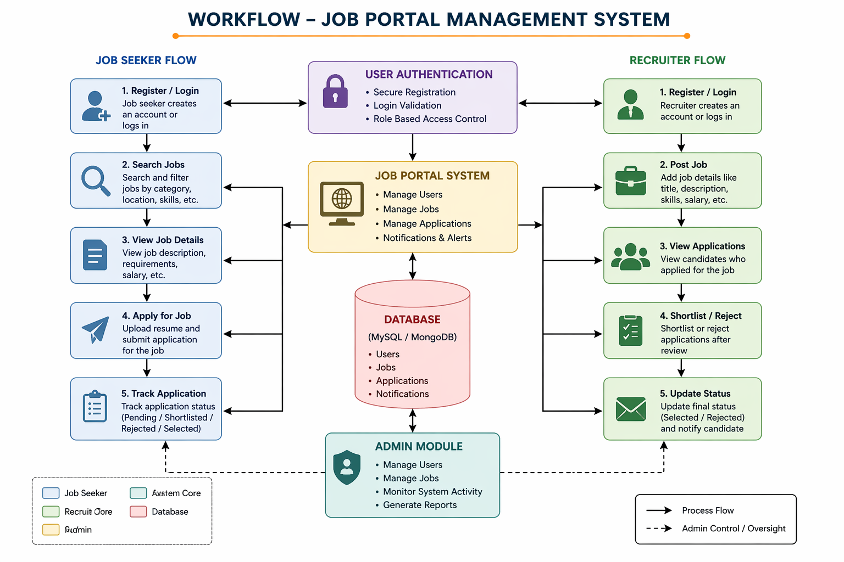
WORKFLOW
User registers as Job Seeker or Recruiter
User logs into the system securely
Recruiter posts job openings with required details
Job seeker searches and filters jobs
Candidate applies by submitting resume/details
Application is stored in the database
Recruiter reviews applications
Status is updated (Selected/Rejected/Pending)
1
2
3
4
5
6
7
8
9

Slide 8
TECHNOLOGIES USED
1
Frontend
HTML5 – Structure of web pages
CSS3 – Styling and responsiveness
JavaScript – Dynamic behavior and validation
Backend
Java (Spring Boot) / Node.js – Server-side logic
REST APIs – Communication between frontend and backend
Database
MySQL – Relational database
MongoDB – NoSQL database (optional)
Tools
VS Code / Eclipse
Git & GitHub
Postman (API testing)
Chrome DevTools
.
2
3
4
5
6
7
8
9

Slide 9
MODULE DESCRIPTION
1. User Module
Handles registration and login
Maintains user profiles
Ensures authentication and authorization
2. Job Management Module
Allows recruiters to post, edit, and delete jobs
Displays job listings dynamically
3. Application Module
Enables candidates to apply for jobs
Tracks application status
Stores resume and user data
4. Admin Module
Manages users and job postings
Monitors system activity
Ensures data integrity
1
2
3
4
5
6
7
8
9

Slide 10
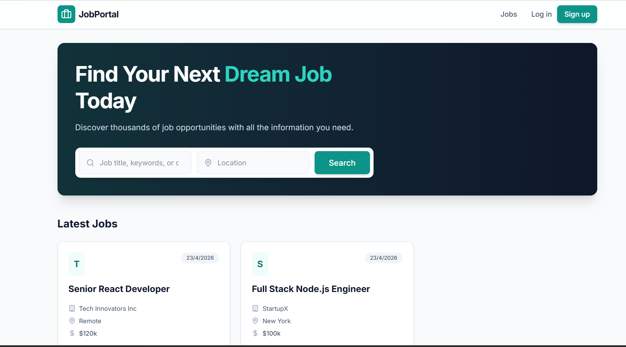
IMPLEMENTATION SCREENSHOTS
Home page:
This is the TechStore home page, featuring a dynamic product catalog that allows users to search, filter by categories like Mobiles or Laptops, and view item specifications. Each product card is designed with an "Add to Cart" button to trigger the JavaScript-based state management and real-time cart updates.
1
2
3
4
5
6
7
8
9

Slide 11
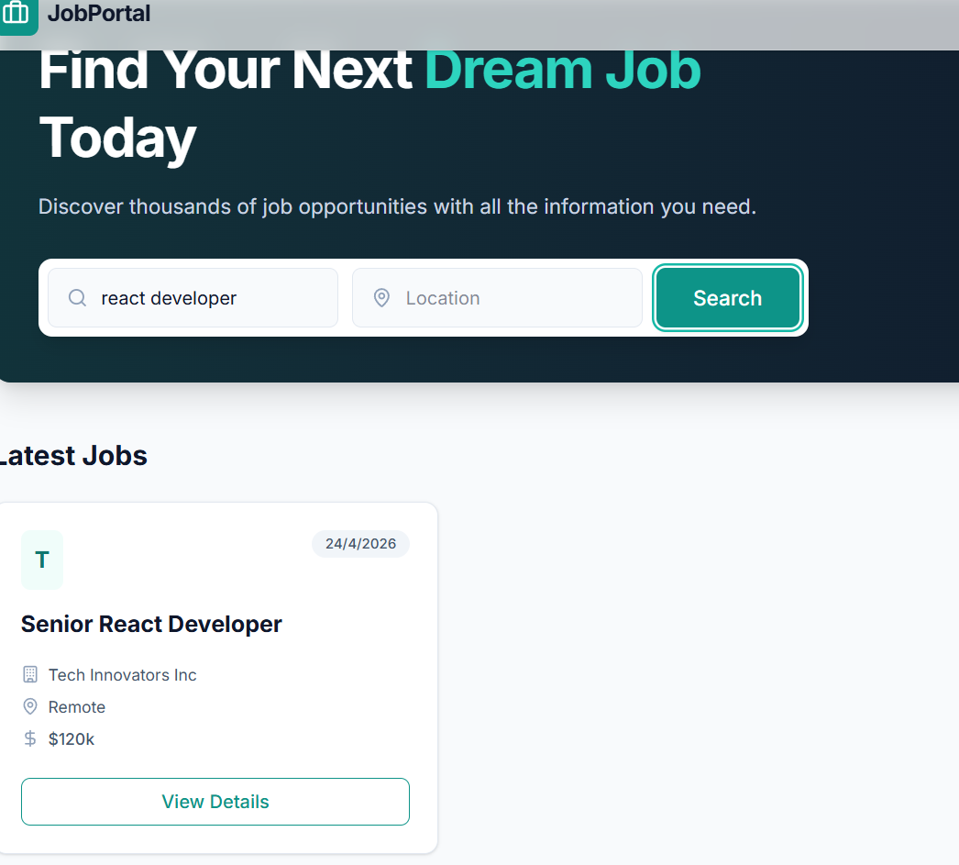
IMPLEMENTATION SCREENSHOTS
Search Module:
This image demonstrates the Search and Category Filtering logic in action, where the system processes user input to display relevant results. By entering "google" and selecting the "Mobiles" category, the JavaScript logic filters the product array to show only the matching Google Pixel device.
1
2
3
4
5
6
7
8(A)
9

Slide 12
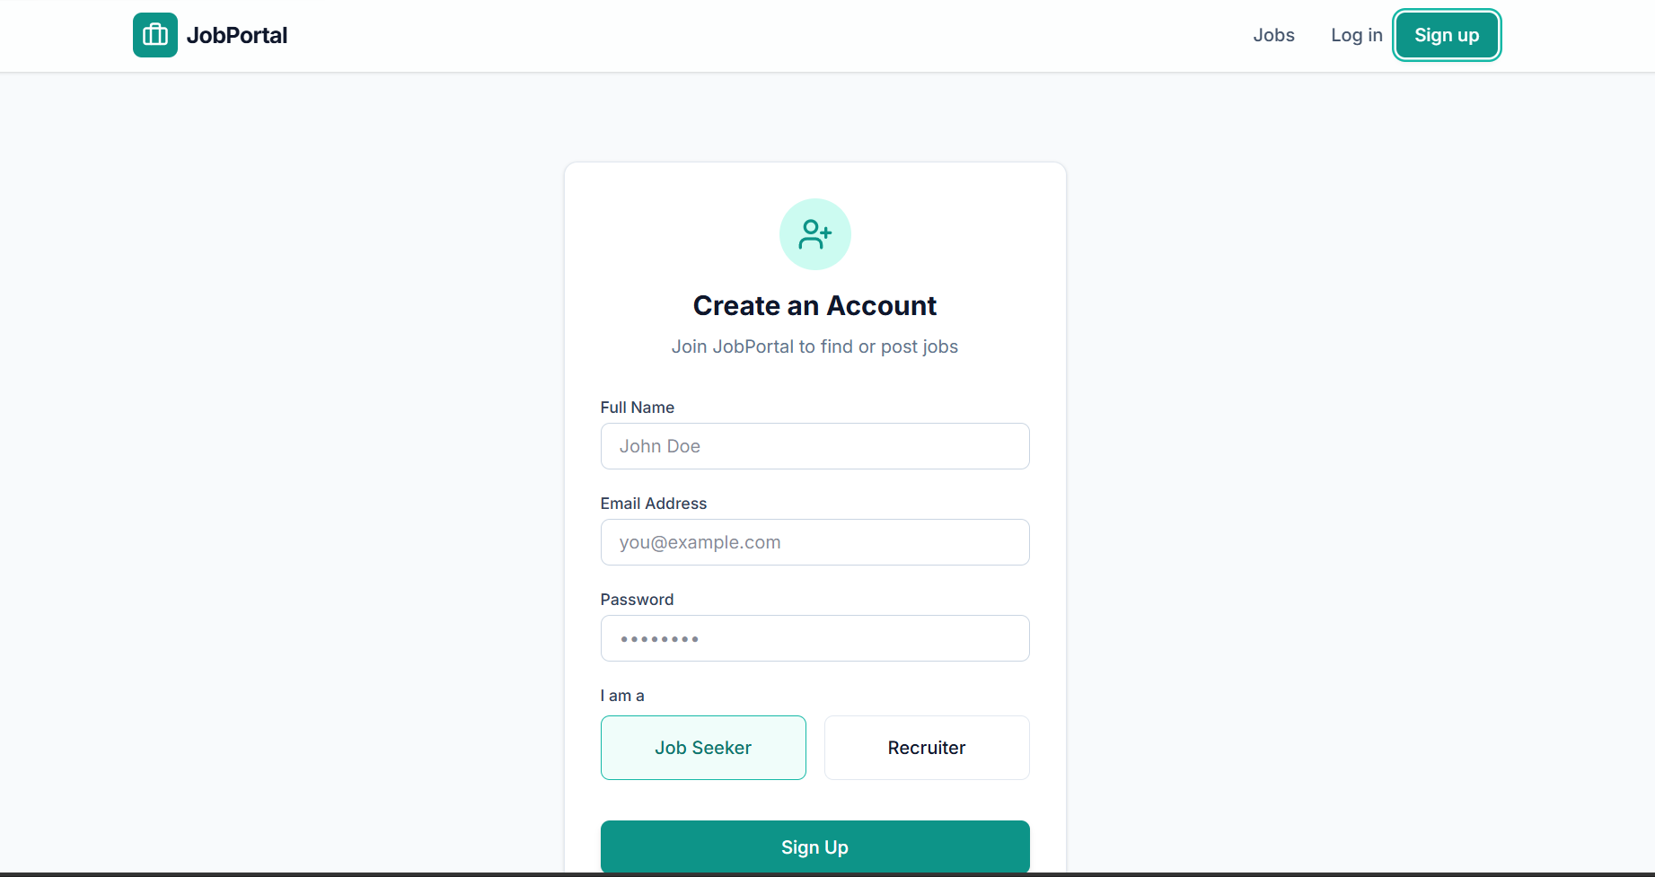
IMPLEMENTATION SCREENSHOTS
Sign Up module:
This is the Shopping Cart Overlay, which serves as the core functional hub for the application's business logic. It utilizes JavaScript to dynamically calculate the subtotal, apply a 2.5% GST, and add delivery charges to produce the final grand total in real-time.
1
2
3
4
5
6
7
8(B)
9

Slide 13
ADVANTAGES & LIMITATIONS
1
ADVANTAGES
Centralized system for recruitment
Faster and more efficient hiring
Easy access to job opportunities
Secure data handling
Scalable and flexible architecture
LIMITATIONS
Requires stable internet connection
Initial development complexity
Security risks if not properly implemented
Dependency on server availability
2
3
4
5
6
7
8
9

Slide 14
Thank you

