Slide 1

Battleship
Diganta Barai
Julius Freiny

Slide 2
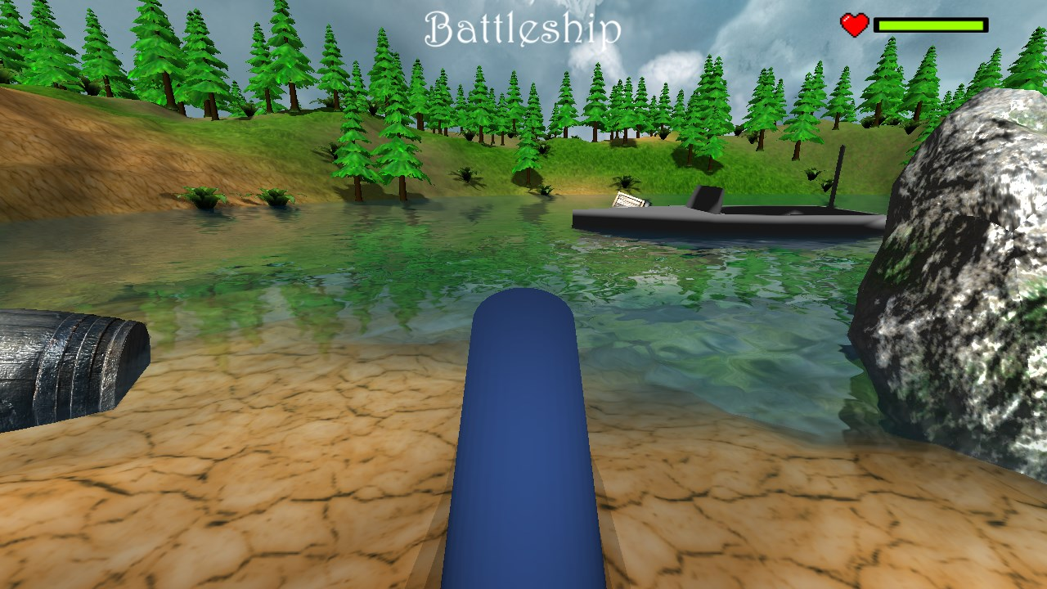
What is Battleship?
simple 3D target shooting game
cannon shoots cannonball at ship
Ship has 3 lifes

Slide 3
Features: Game
Ship:
  moving on circular path
  healthbar
  stops, when defeated
cannon:
  rotates (limited)
  shoots cannonball
cannonball:
  gets affected by gravity
collision detection

Slide 4
Features: Game engine
entities
textures
terrain
water
skybox
light
shadow
fonts
time
GUI-Textures
particles
normal mapping
loading .obj-files
3D sound
Post processing (Contrast)

Slide 5
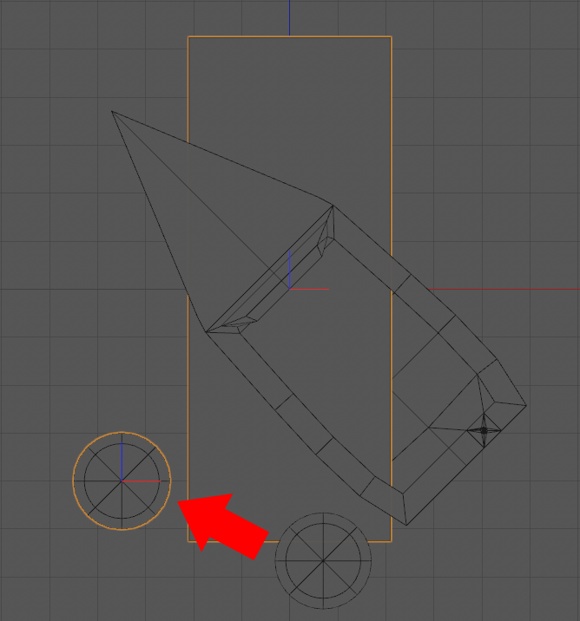
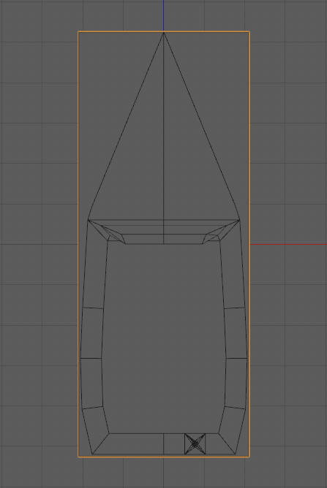
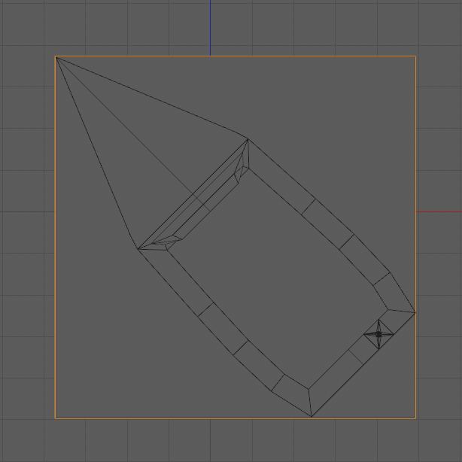
Tricks
Collision:
  AABB with rotated objects

Slide 6
References
wiki.lwjgl.org/wiki/Learning_LWJGL.html
thecodinguniverse.com/lwjgl-tutorials/
github.com/lwjglgamedev/lwjglbook-bookcontents
youtube.com
stackoverflow.com

Slide 7
Live-Demo!

