Slide 1

A
SECURITY / MACHINE LEARNING / CRYPTOGRAPHY
AegisCloud
Adaptive security for
cloud sessions.
An educational prototype combining MFA, authenticated
encryption and explainable synthetic risk scoring.
SYNTHETIC HOLDOUT
SUCCESS-CLASS F1
ISOLATED TESTS
83.0%
0.883
26
accuracy
synthetic test
passed
PRESENTED BY · PRAVEEN SUDIREDDY
SIMULATED RECOMMENDATIONS ONLY

Slide 2
WALKTHROUGH
Agenda
01
Problem & motivation
02
Project scope & boundaries
why perimeter security fails in the cloud
what the prototype does and does not do
03
Proposed architecture
04
Identity & hybrid cryptography
four pillars, one decision point
TOTP, AES-256-GCM, Shamir sharing
05
Risk engine & ML pipeline
06
Results, testing & future work
features, model selection, explainability
synthetic holdout, tests and roadmap
AEGISCLOUD · SECURITY DEMONSTRATION
2

Slide 3
01 · PROBLEM & MOTIVATION
Cloud access needs context beyond the network
▸ Stolen credentials: passwords can be phished or replayed, potentially exposing protected resources.
▸ Unauthenticated encryption: without an integrity tag, modified ciphertext may not be detected.
▸ Limited context: unfamiliar devices, unusual times or geographic changes may merit further review.
▸ Alert fatigue: coarse static thresholds can create too many alerts or miss unusual activity.
▸ Audit gaps: mutable logs can make investigation and integrity verification harder.
Design objectives
▸ Explore session-level recommendations informed by identity and context.
▸ ML probability + deterministic policy can be fused so the verdict is still explainable.
▸ Cryptography can combine authenticated envelopes with a separate threshold-sharing demo.
▸ Adaptation should be measured: PSI monitoring, manual retraining and model versions.
AEGISCLOUD · SECURITY DEMONSTRATION
3

Slide 4
02 · PROTOTYPE SCOPE
A practical scope, clearly bounded
01
02
03
04
IDENTITY
RISK
CRYPTOGRAPHY
OPERATIONS
Password hashing, demo MFA, TOTP endpoints and revocable sessions.
Synthetic sessions scored with model output and explainable rule points.
Authenticated file encryption and an independent k-of-n sharing demo.
Synthetic replay, model evaluation, PSI and hash-linked audit records.
BOUNDARY
No real cloud access enforcement. Training data and replay are synthetic. Demo OTP and local keys are not production controls.
AEGISCLOUD · SECURITY DEMONSTRATION
4

Slide 5
03 · PROPOSED SYSTEM
Four pillars, one decision point
MFA
ADAPTIVE
HYBRID
CONTINUOUS
Identity
Risk engine
Cryptography
Intelligence
scrypt passwords, RFC-6238 TOTP, recovery codes,
trusted devices, revocable sessions, RBAC
ML P(success) + behavioural rules →
0-100 risk score with additive explanation
AES-256-GCM envelope encryption,
tamper detection, Shamir secret-sharing demo
PSI comparison, manual retraining,
versioned champion promotion
Simulated sessions → suggested ALLOW · STEP-UP · REVIEW · BLOCK — not enforced on cloud resources
AEGISCLOUD · SECURITY DEMONSTRATION
5

Slide 6
03 · PROPOSED SYSTEM
System architecture
SOC console (SPA)
Identity service
Policy decision point
Champion model
vanilla JS · SVG charts
security.py
demo thresholds
per-user adaptation
four recommendations
MLPClassifier · synthetic model
Risk engine
Flask API
risk.py
Model registry
auth · risk · vault · model
versions · metrics · promote
Crypto vault
crypto_vault.py
Evidence store
decisions · feedback
labels · alerts
audit hash chain
SQLite (WAL)
ML service
users · decisions · audit
Training pipeline
ml.py
time-ordered split · 4 candidates
Drift monitor
Instance store
drift.py
AES-GCM blobs · master key
Approval queue
TOTP / demo OTP
demo only
no SMTP provider
Conceptual architecture · local single-node demonstration
AEGISCLOUD · SECURITY DEMONSTRATION
6

Slide 7
03 · PROPOSED SYSTEM
Risk recommendations for simulated sessions
Session
ingested
Feature
engineering
P(success)
ML
Rule
evidence
Fusion
0-100
cloud · auth ·
resource · device
17 numeric + derived
features
MLPClassifier
ROC-AUC 0.8701
8 deterministic
signals
additive in risk
points
ALLOW
STEP-UP
REVIEW
BLOCK
risk < 38
risk 38-64
risk 64-82
risk ≥ 82
suggested outcome
suggest challenge
queue for review
suggest denial
How to interpret the score:
▸ demo thresholds may shift based on the scored subject’s past scores
▸ the explanation is exact — contributions sum to the score
▸ every decision stores features, probability, verdict and reasons
▸ feedback is recorded, but retraining does not yet ingest it
AEGISCLOUD · SECURITY DEMONSTRATION
7

Slide 8
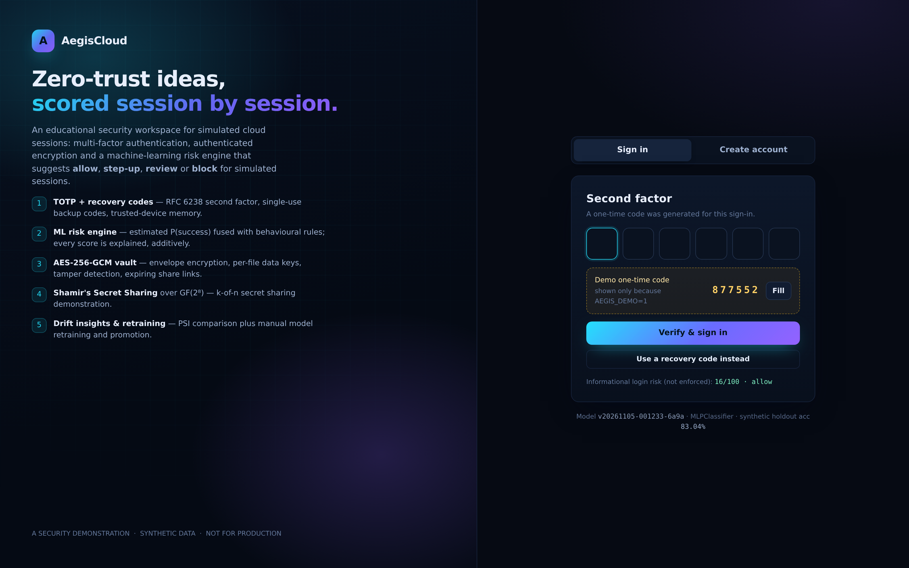
04 · IDENTITY
Pillar 1 — identity & session security
▸ Password storage: scrypt (N=2¹⁴, r=8, p=1) with a per-user 16-byte salt; constant-time verify.
▸ Policy engine: length, character classes, block-list, sequence detection, entropy estimate — scored live in the UI.
▸ Second factor: RFC 6238 TOTP with enrollment API, plus 10 single-use recovery codes (scrypt-hashed).
▸ Session tokens: HMAC-SHA256 signed payload + server-side row; revocation and 8 h TTL.
▸ Brute force: per-account failure counter with exponential lockout, per-attempt risk scoring, audit of every failure.
▸ Device memory: a first-seen device adds +16 to the informational login-risk score; trust can be recorded.
▸ RBAC: role checks protect administrative routes; demo OTP is not production MFA.
Login is itself a scored event
new device and failures change displayed risk; MFA is required in the demo
AEGISCLOUD · SECURITY DEMONSTRATION
8

Slide 9
04 · CRYPTOGRAPHY
Pillar 2 — authenticated cryptography
Envelope encryption (per file)
Shamir's Secret Sharing over GF(2⁸)
file bytes
AES-256-GCM
ciphertext
▸ one random polynomial per secret byte, evaluated at x = 1…n
▸ any k shares reconstruct via Lagrange interpolation
▸ fewer than k shares do not determine the secret
▸ generic secret-sharing demo; not integrated with vault recovery
DEK random
+ tag
DEK is wrapped by the master key (AES-GCM key wrap). AAD binds ciphertext to owner:filename,
so a blob moved to another record fails authentication.
Control | Implementation | Scope
File encryption | AES-256-GCM per-file data key | authenticated ciphertext and metadata
Key wrapping | local master key wraps each data key | local demonstration; not managed KMS
Tamper test | GCM authentication tag rejects changes | test temporarily alters and restores a byte
Secret sharing | GF(2⁸) k-of-n on a user-supplied string | standalone; not connected to vault recovery
Local key storage and rotation are demonstration features, not a production key-management workflow.
AEGISCLOUD · SECURITY DEMONSTRATION
9

Slide 10
05 · ML PIPELINE
Pillar 3 — features & training pipeline
Engineered feature | Why it helps
duration_z, duration_absdev | deviation from *this user's* own session length
velocity_score, velocity_excess | request rate vs. baseline of 8 req/min
off_hours | access outside configured hours
auth_strength | ordinal encoding: password .15 → hardware key 1.0
novelty_score, interaction_risk | new device + geo mismatch, weighted by auth strength
failed_attempts, anomaly_flag | synthetic anomaly indicators
resource_sensitivity | blast radius of the resource being touched
Pipeline
generate / load session corpus (9 000 rows)
fit feature baselines on training only
train 4 candidate families
select champion on validation (F1)
tune threshold (success recall ≥ .80)
score the untouched holdout once
37 features: 9 numeric + 8 derived + one-hot
▸ time-ordered split: first 70% train / 15% validation / 15% holdout
▸ some baselines use class weights; validation is not resampled
▸ threshold tuned for success-class recall ≥ 0.80
register version + hot-swap in API
monitor PSI → manually retrain if needed
bootstrap reuses an existing model; delete it only to retrain
AEGISCLOUD · SECURITY DEMONSTRATION
10

Slide 11
05 · RESULTS
Model selection: validation, then holdout
Candidate | Accuracy | Precision | Recall | F1 | ROC-AUC | Train
MLPClassifier ★ | 0.801 | 0.836 | 0.869 | 0.852 | 0.866 | 0.22s
RandomForest | 0.793 | 0.839 | 0.851 | 0.845 | 0.852 | 1.8s
HistGradientBoosting | 0.787 | 0.820 | 0.869 | 0.844 | 0.850 | 0.64s
LogisticRegression | 0.787 | 0.883 | 0.780 | 0.828 | 0.874 | 0.02s
ACCURACY
83.0%
SUCCESS F1
0.8829
★ registered champion · table: validation at 0.50; holdout: 1,350 synthetic sessions
ROC-AUC
0.8701
What the numbers say
▸ holdout MLPClassifier: accuracy 83.0%, success F1 0.8829
▸ Brier score 0.1292; calibration requires a reliability check
▸ failure recall is 0.6085; these are synthetic outcome metrics
SUCCESS RECALL
0.932
AEGISCLOUD · SECURITY DEMONSTRATION
11

Slide 12
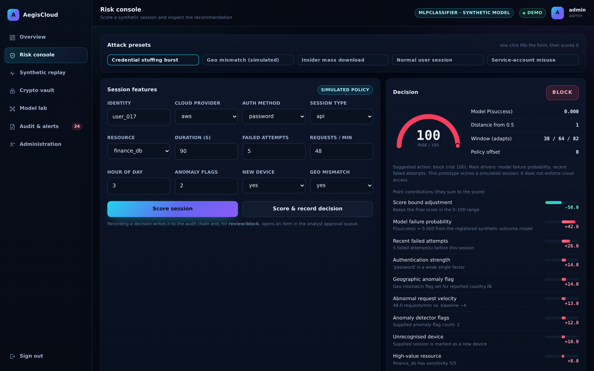
05 · EXPLAINABILITY
Explainable, adaptive recommendations
Additive by construction
▸ rules and model contribute points; a cap adjustment makes the sum exact
▸ fusion points are explicit; the ML probability remains a model output
▸ policy window can shift based on prior scored subject history
▸ attack presets let the examiner test credential stuffing, a geo flag, and insider download
▸ one click records a simulated decision; no cloud access is changed
AEGISCLOUD · SECURITY DEMONSTRATION
12

Slide 13
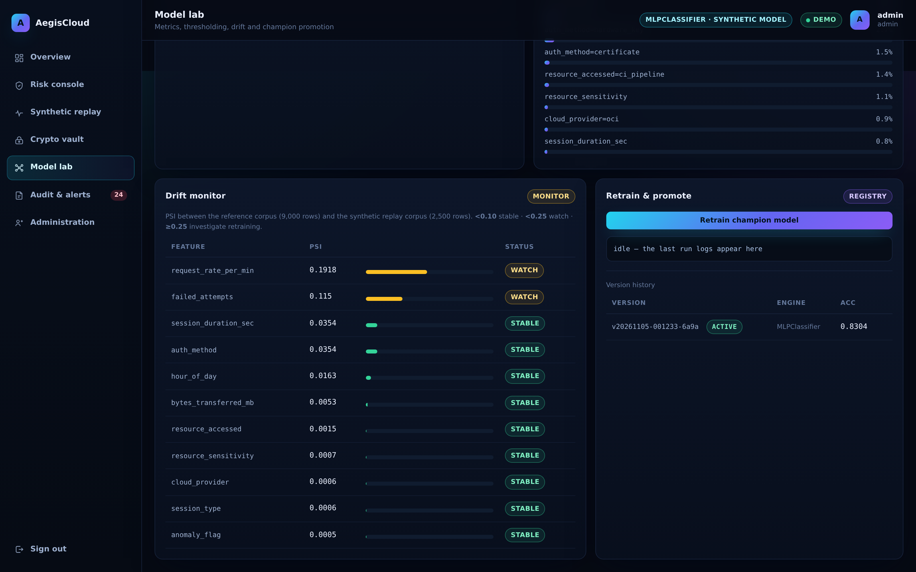
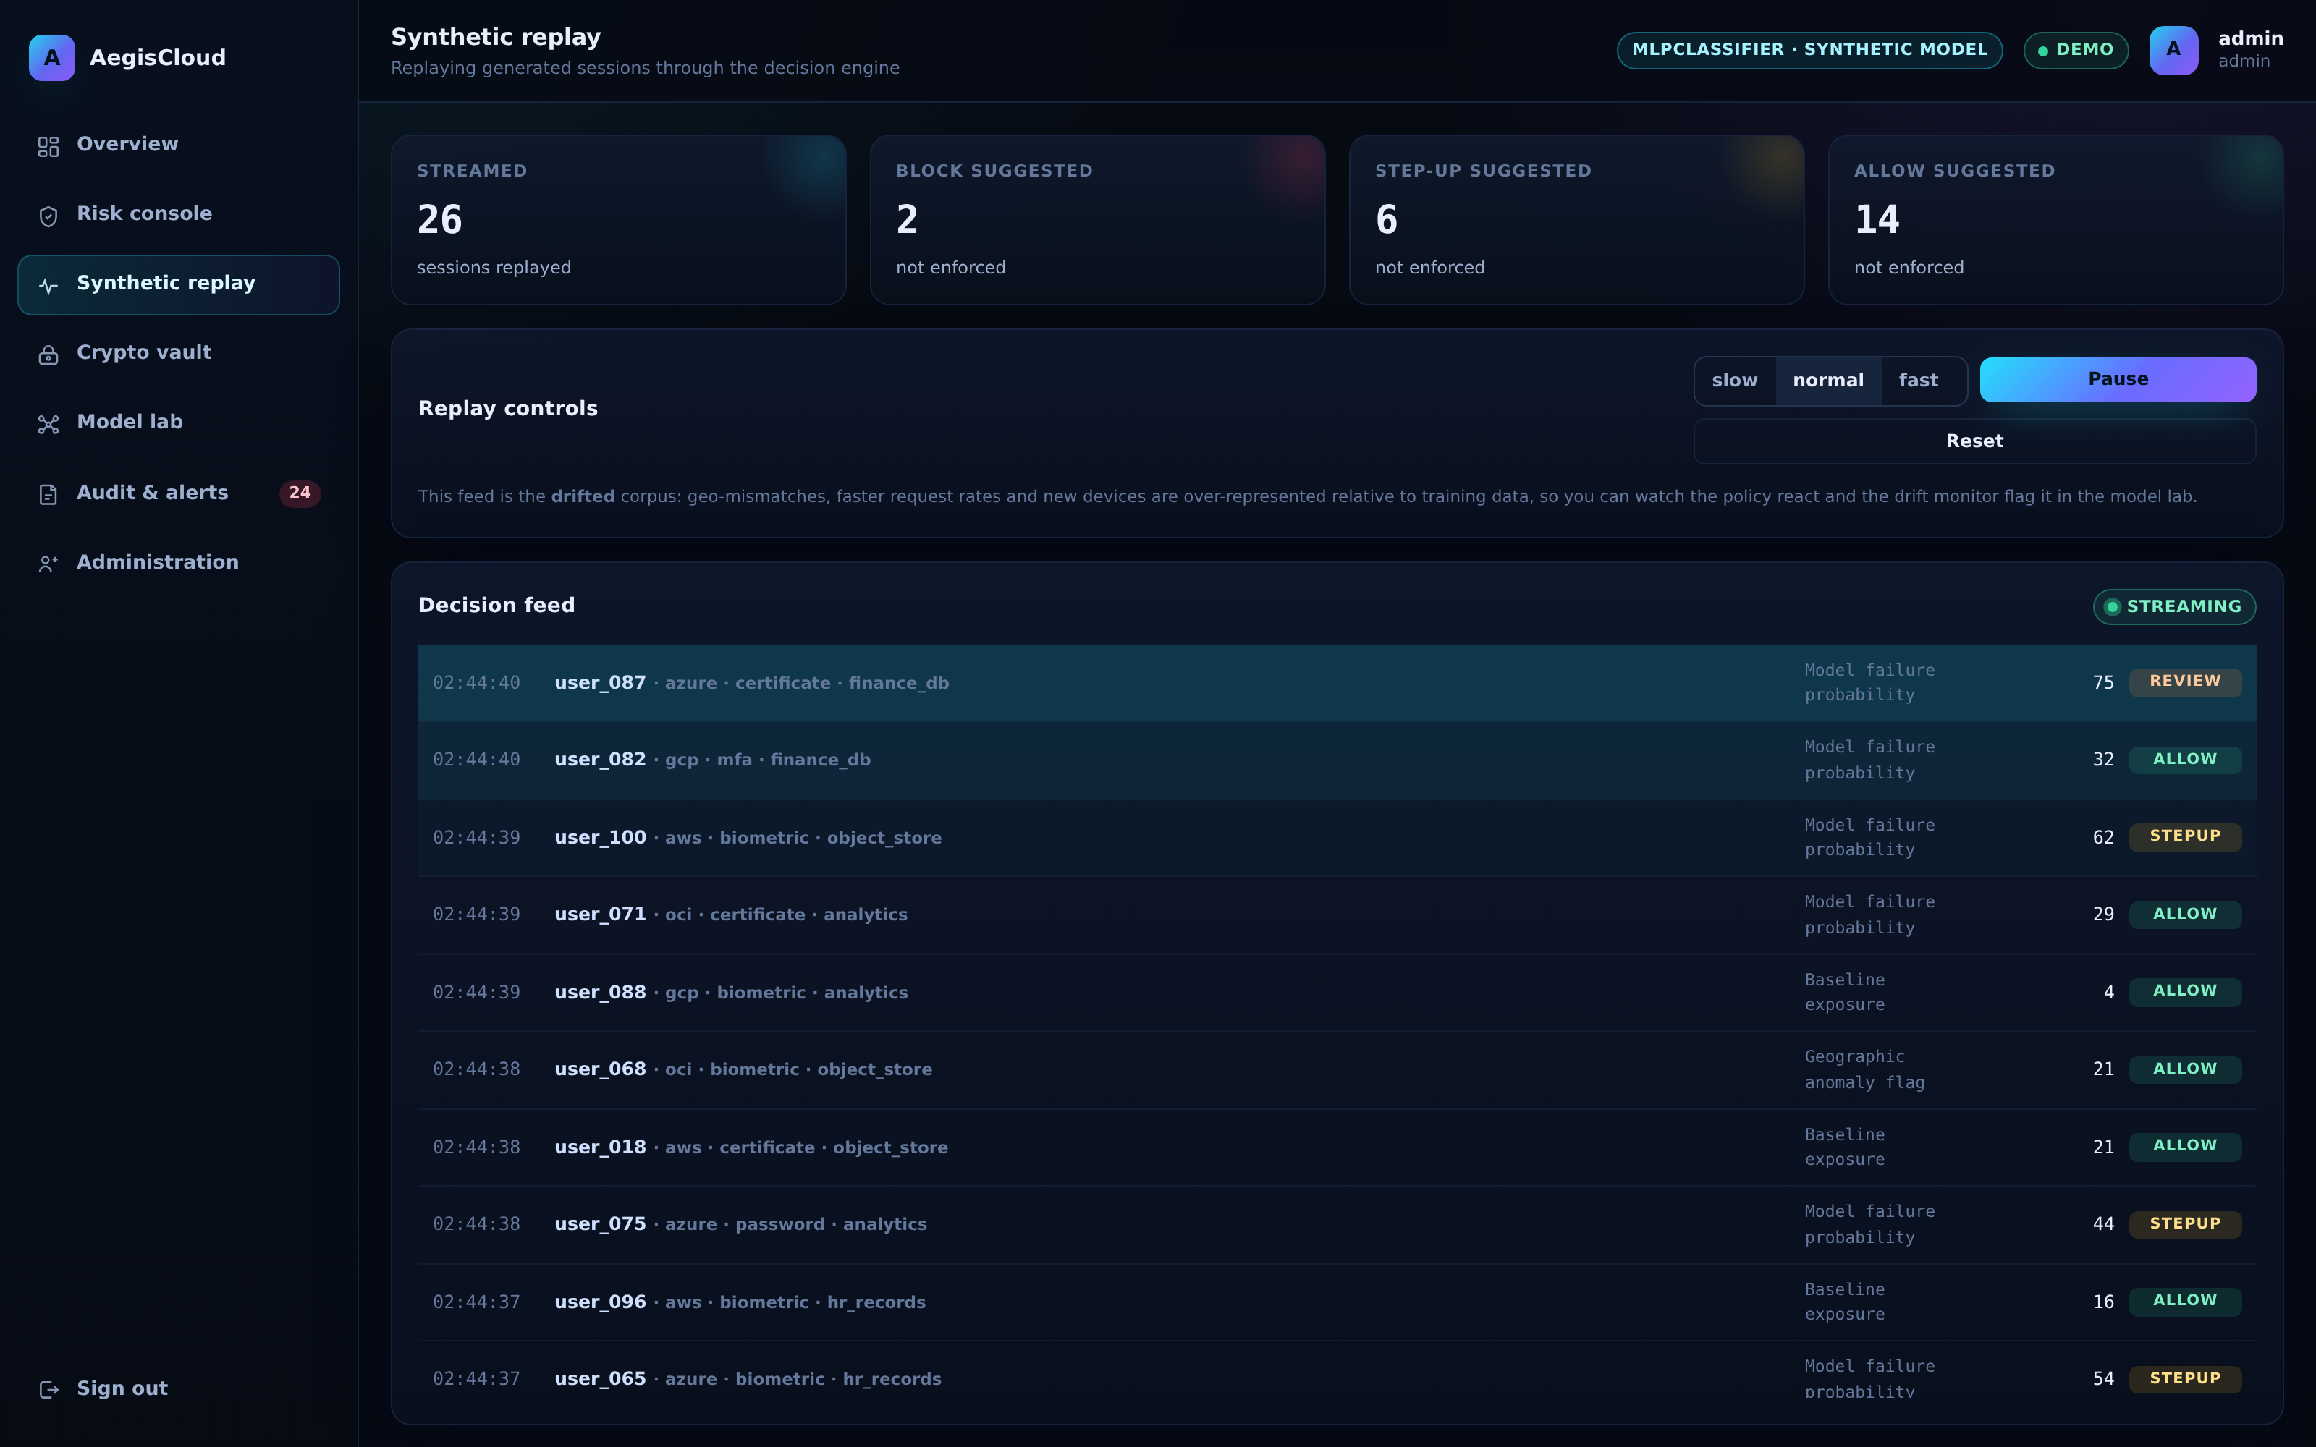
05 · ADAPTATION
Synthetic replay and drift comparison
PSI → action
▸ < 0.10 stable · 0.10-0.25 watch · ≥ 0.25 review
▸ request rate and failed attempts are in the watch band in this stream
▸ manual retraining reuses the reference corpus; it does not ingest feedback
AEGISCLOUD · SECURITY DEMONSTRATION
13

Slide 14
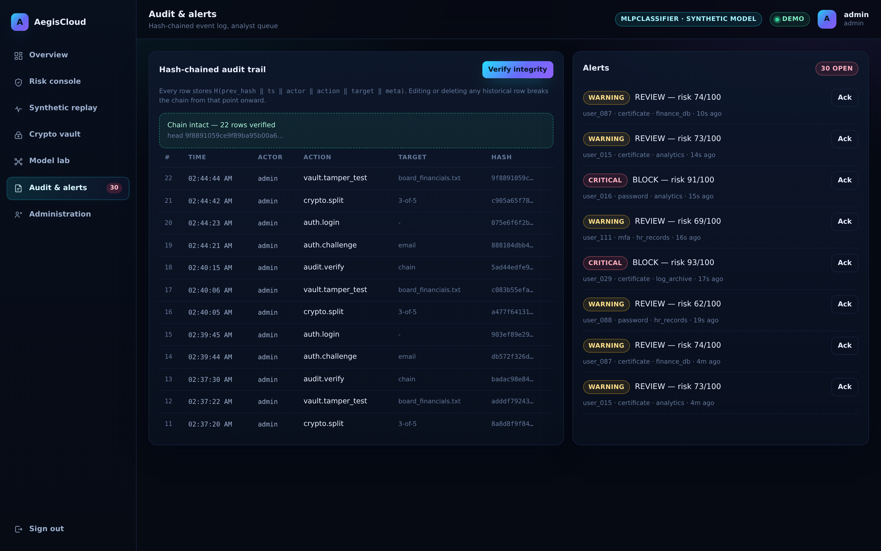
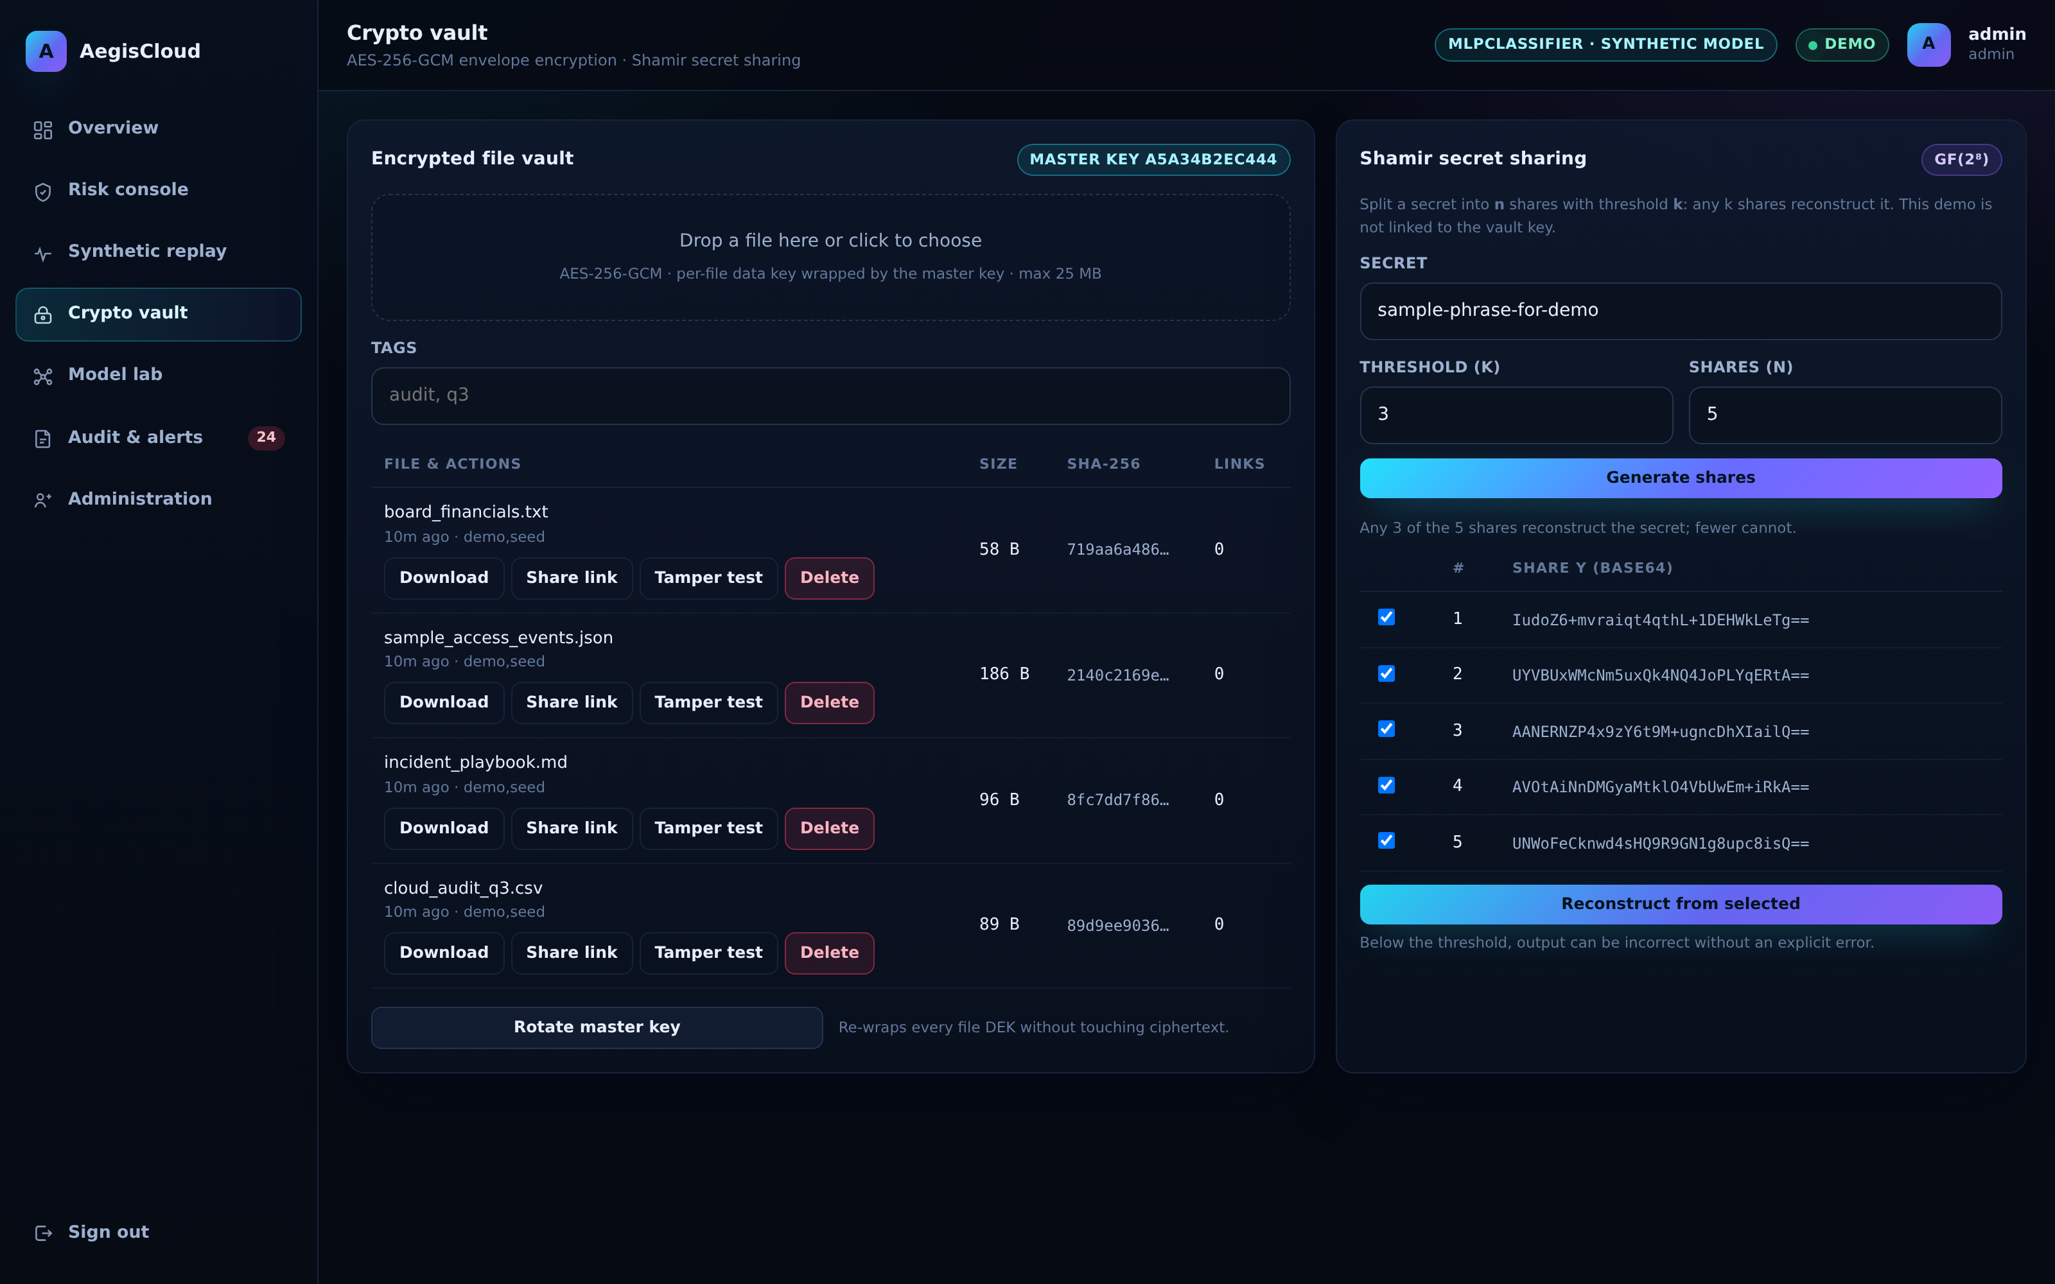
04 · EVIDENCE
Tamper-evident audit and the encrypted vault
AEGISCLOUD · SECURITY DEMONSTRATION
14

Slide 15
06 · TESTING
Testing & security validation
PASS
GF(2⁸) tables vs AES reference
PASS
TOTP RFC 6238 vectors
0x53 · 0xCA = 0x01
287082 & 081804 reproduced
PASS
Shamir roundtrip (k-of-n)
PASS
Token forgery & revocation
k reconstructs; fewer do not reveal the secret
modified signature rejected
PASS
Vault roundtrip + SHA-256
PASS
Audit chain tampering
plaintext and digest match
edited row localised by verifier
PASS
Tamper detection
PASS
Risk monotonicity
one flipped byte ⇒ AES-GCM InvalidTag
hostile session scores higher, blocks
PASS
Share link is one-time
PASS
Additive explanation
2nd download / wrong token refused
Σ contributions == score
PASS
Password policy & salting
same password ⇒ different hashes
pytest -q → 26 passed. Tests are isolated from the demo database and vault.
AEGISCLOUD · SECURITY DEMONSTRATION
15

Slide 16
06 · PROJECT OUTCOMES
Results, without overclaiming
SYNTHETIC TEST ACCURACY
SUCCESS-CLASS F1
ROC-AUC
ISOLATED PYTEST SUITE
83.0%
0.8829
0.8701
26 passed
1,350 later sessions
success = class 1
synthetic outcomes
DB and vault isolated
What is demonstrated
What is not established
▸ working identity, vault, scoring and audit flows
▸ validation-based model selection and holdout evaluation
▸ repeatable local tests and synthetic traffic replay
▸ real-world attack detection or cloud enforcement
▸ production-grade key management or MFA delivery
▸ LSTM / CNN results — notebook training has not run
Evaluation uses generated labels. Failure recall = 0.6085; results do not measure attack-detection recall.
AEGISCLOUD · SECURITY DEMONSTRATION
16

Slide 17
06 · ROADMAP
Future work
Production hardening
Deeper models
Postgres + Redis, HTTPS reverse proxy, secrets manager, rate limiting at the edge
run the supplied LSTM/1D-CNN notebook and report actual results
Federation
Real telemetry
SAML/OIDC single sign-on, SCIM provisioning, WebAuthn/passkey as a factor
CloudTrail / Azure Activity / GCP Audit Log ingestion instead of a synthetic replay
Deeper explainability
Evaluation
counterfactual “what would make this allow?” suggestions for analysts
adversarial testing, false-positive cost analysis, latency budget under load
AEGISCLOUD · SECURITY DEMONSTRATION
17

Slide 18
Thank you
Demo: login → second factor → risk console → synthetic replay → vault → model lab
Questions we expect: why not a pure LSTM? · how are thresholds chosen? · what happens when the model
is wrong? · how would key recovery be integrated? · what is still missing for production?
Presented by Praveen Sudireddy

