Slide 1

Traffic Signals Recognition
z5271698 Zhaoyan Liu (Joyce)
z5272579 Peng Zhang (Tim)
z5141973 Ruiqi Xie (Rachel)
z5285206 Zhao Huang (Troye)
Z5311209 Silin Lin (Celine)

Slide 2
Introduction
Traffic Signals Recognition
Aim: Developing models that employ forward-sensing cameras to recognise traffic signals

Slide 3
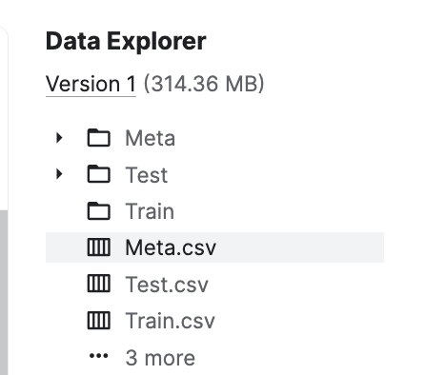
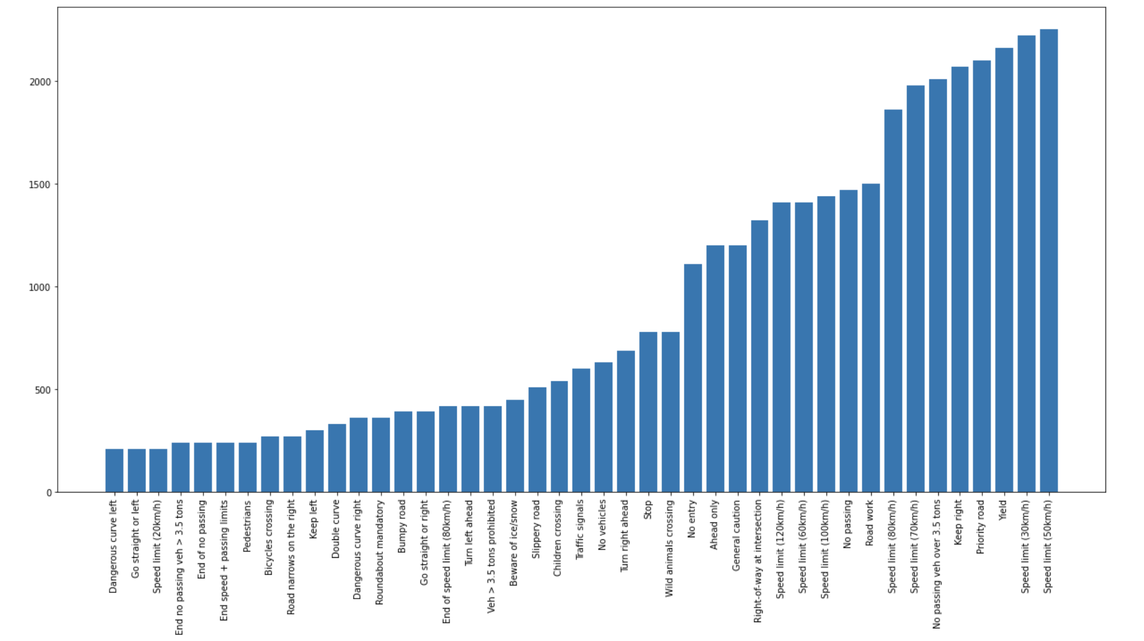
Data source and Analysis

Slide 4
Methods
5 Models ordered by accuracy

Slide 5
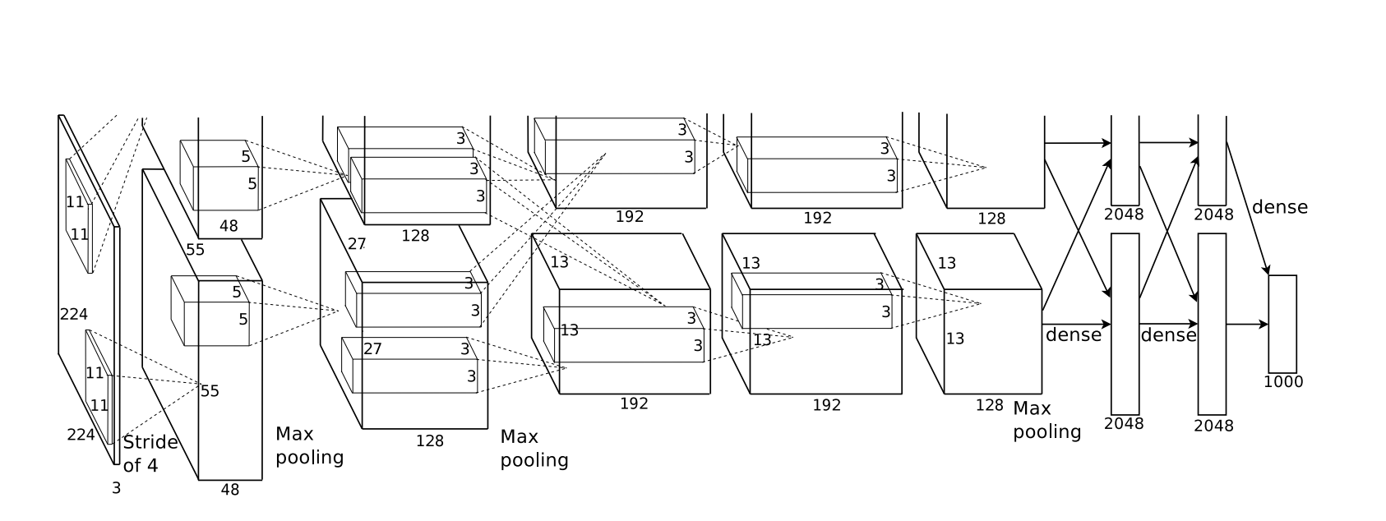
Model 1- AlexNet

Slide 6
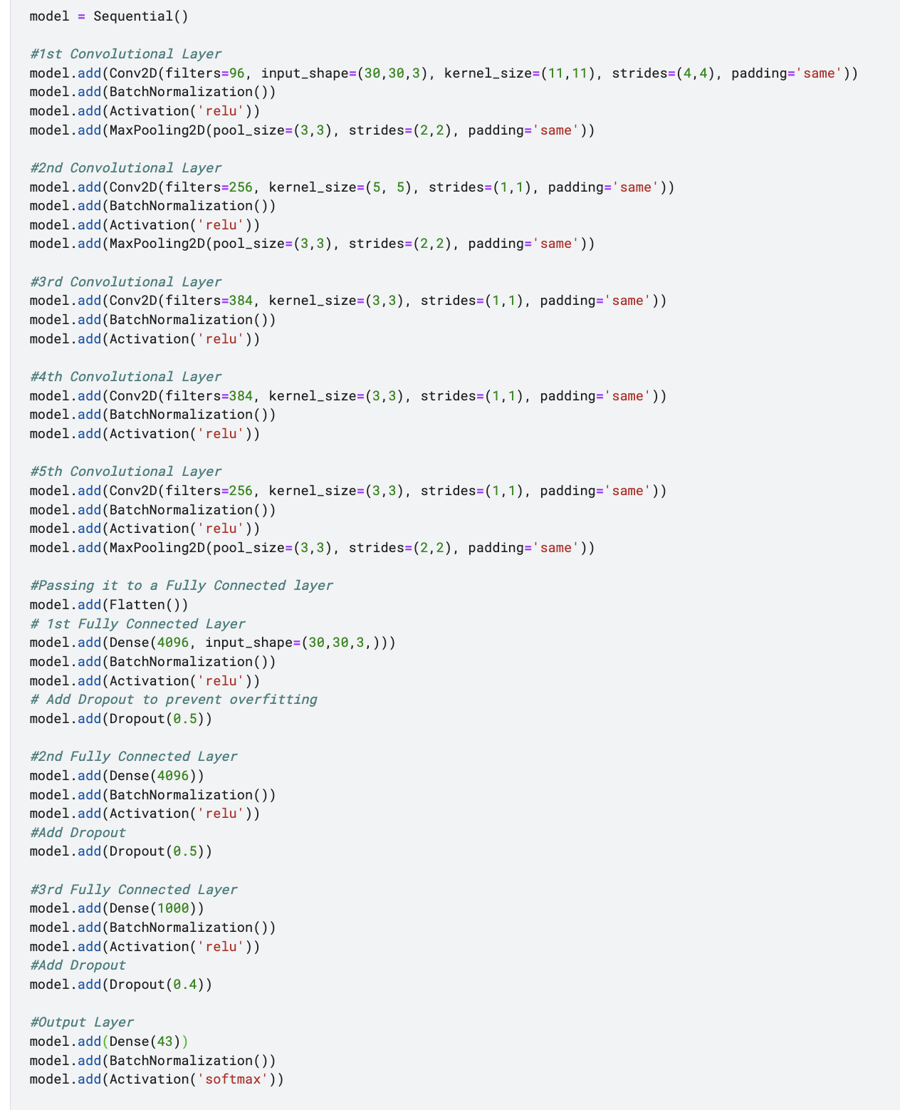
Model 1 - AlexNet Layers

Slide 7
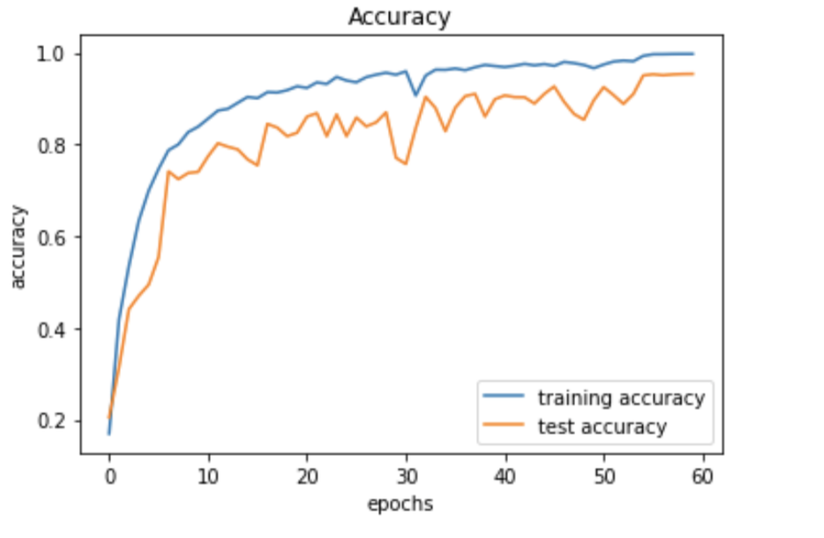
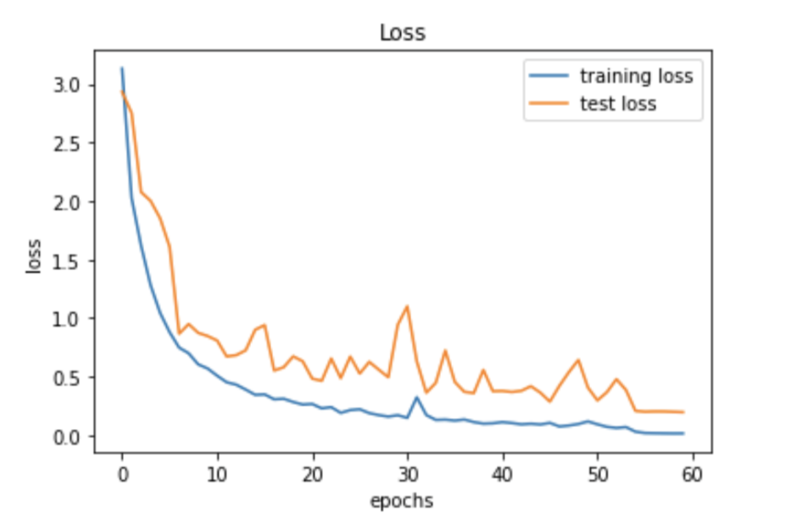
Training and Test Result

Slide 8
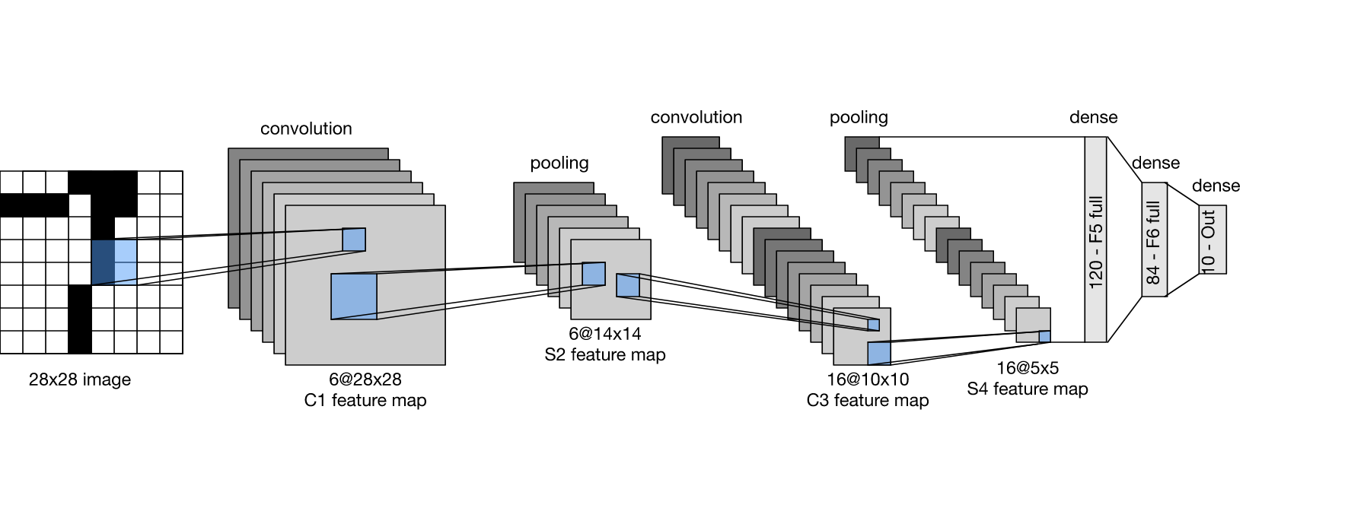
Method 2 – LeNet Structure Introduction
Consists of Two Section:
a convolutional encoder
a dense block

Slide 9
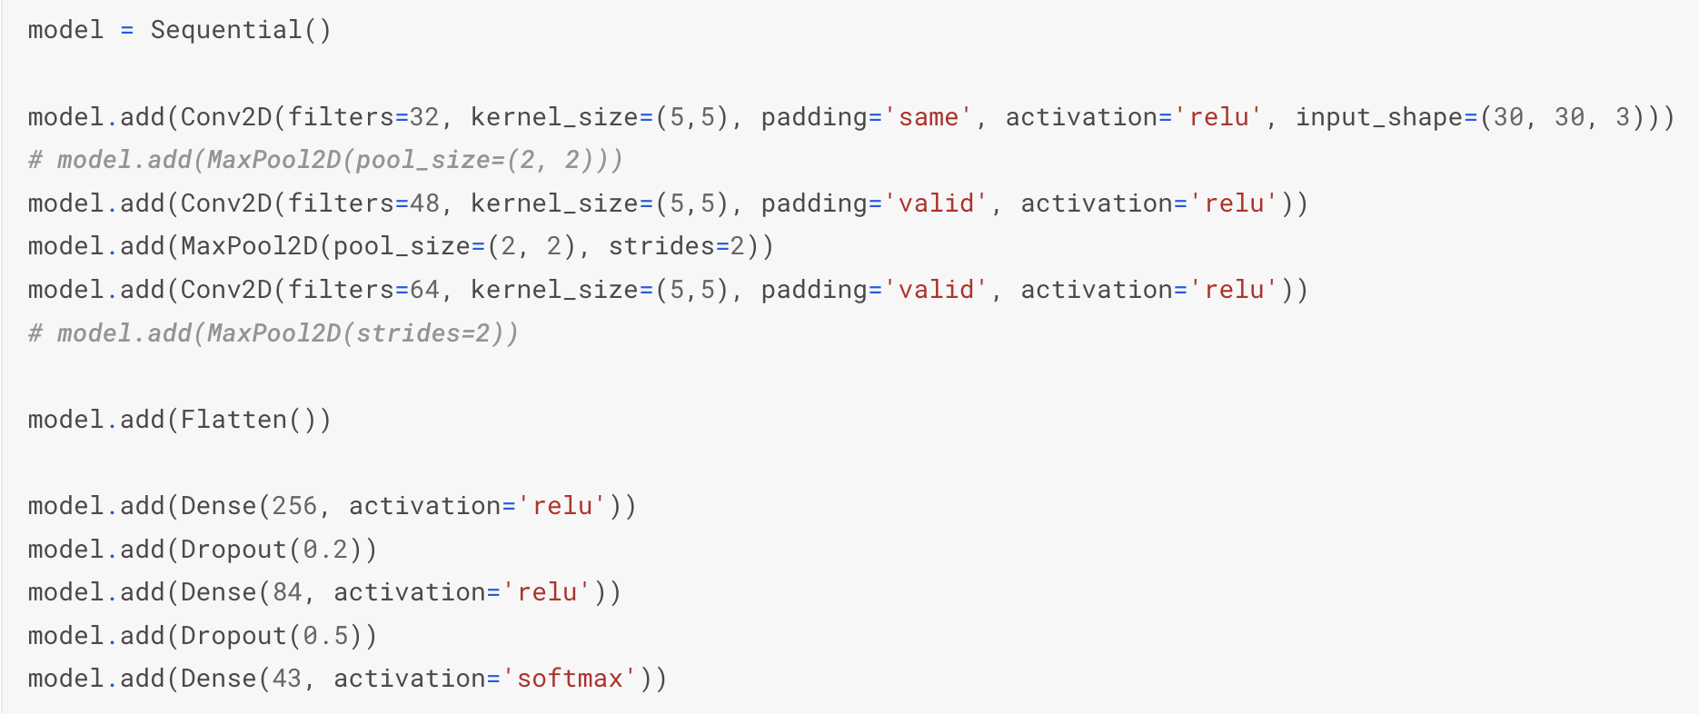
Layers
 | Original LeNet | My LeNet
The Number of Convolution layer | 2 | 3
Max Pooling | 2 | 1
Dropout | 0 | 1*0.2 + 1*0.5

Slide 10
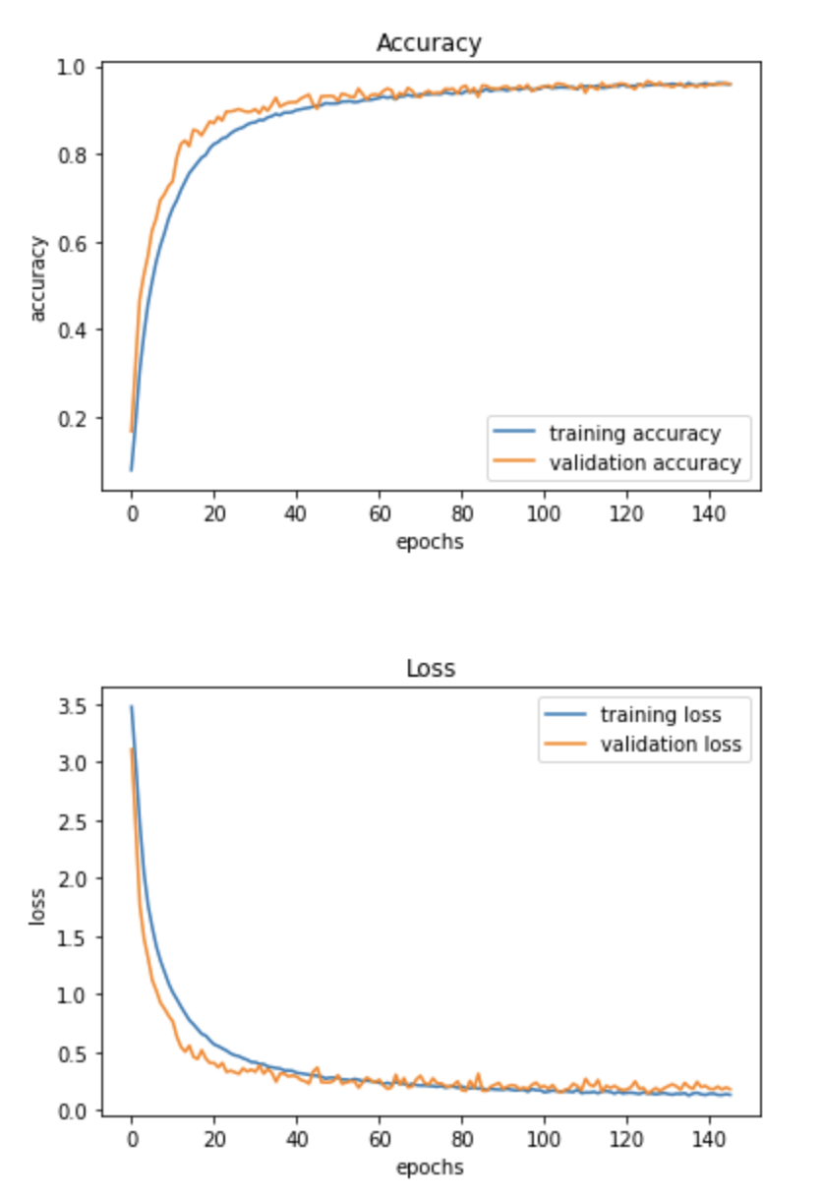
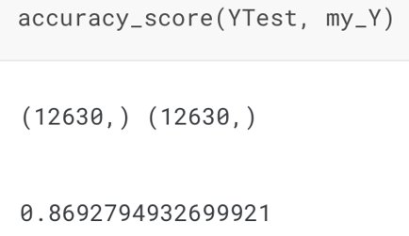
Training and Test Result
Training Accuracy: 96%
Validation Accuracy: 96%
Test Accuracy: 87%

Slide 11
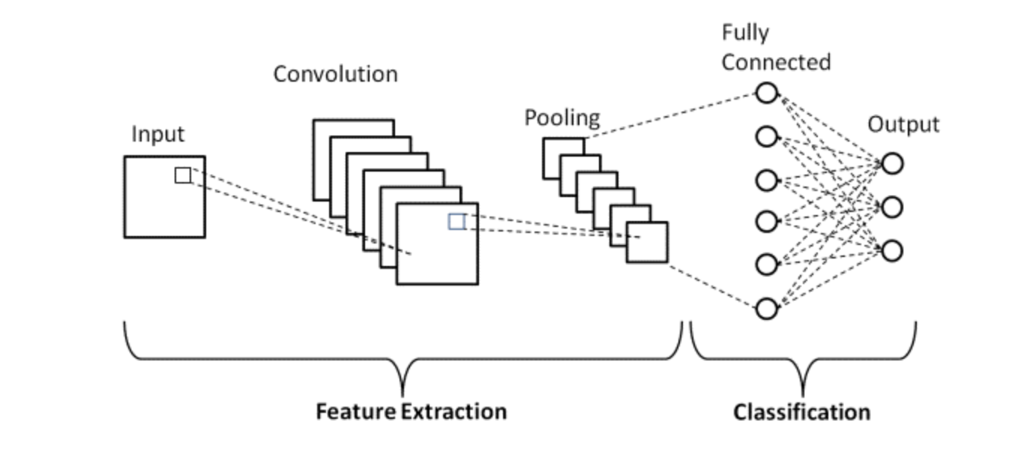
Model 3 - CNN

Slide 12
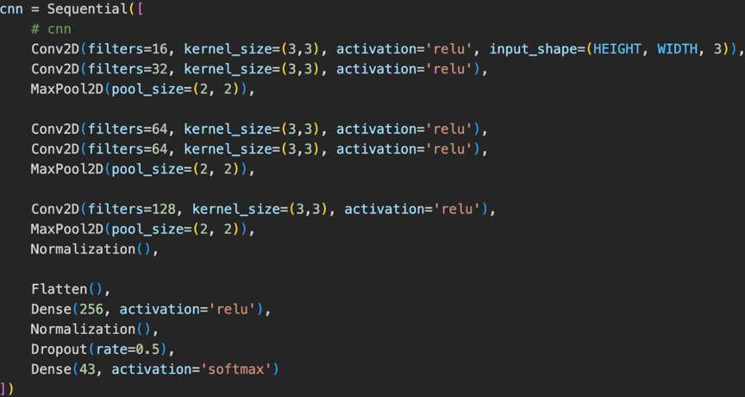
Layers and Parameters

Slide 13
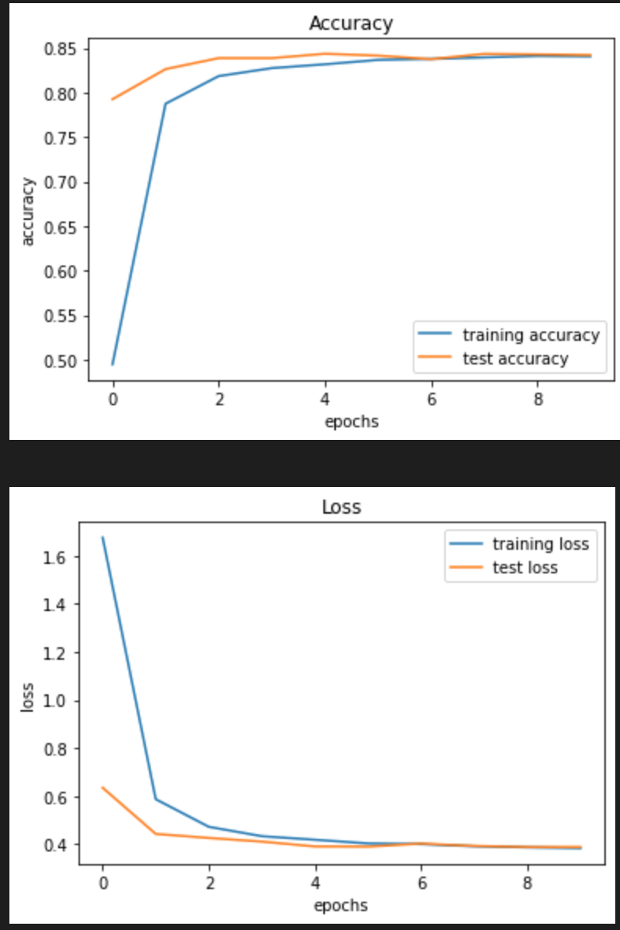
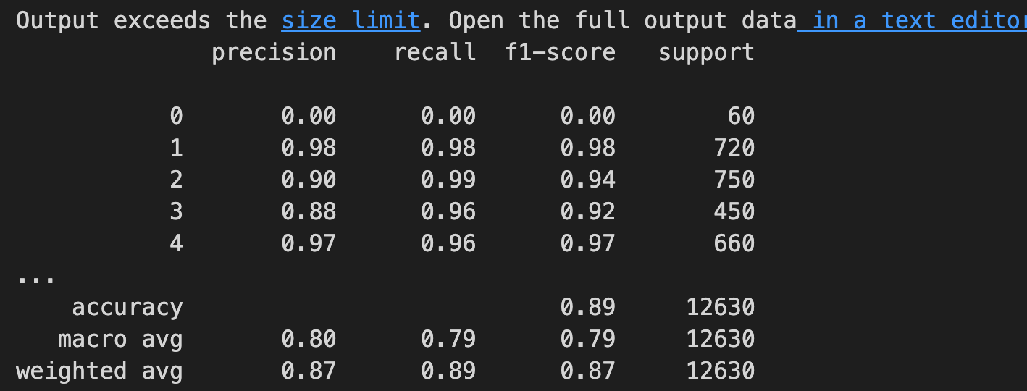
Result
Validation accuracy is 84% and loss is 0.4%
Test accuracy is 89%

Slide 14
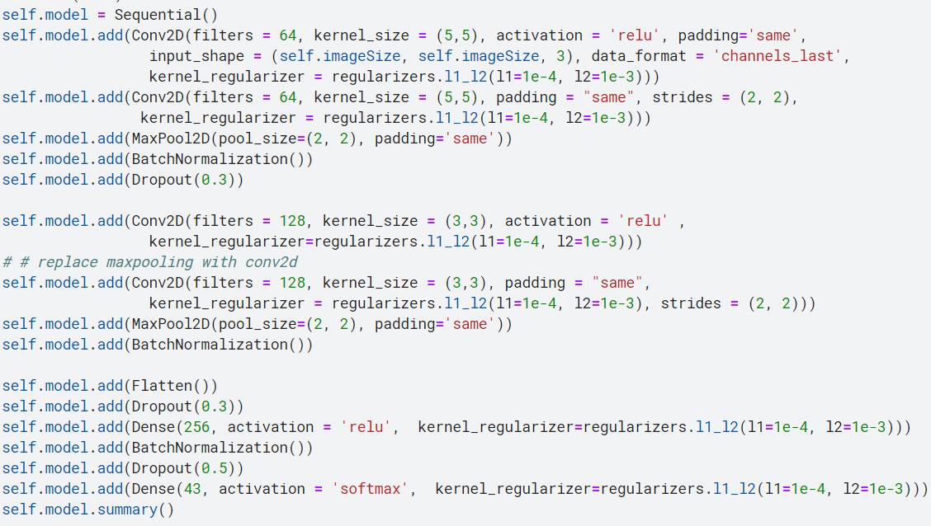
Model 4 – Deep CNN Model
Based on CNN network
More number of filters
Larger kernel size
Prevents overfitting
MaxPooling Layer
BatchNormalization
Dropout Layer

Slide 15
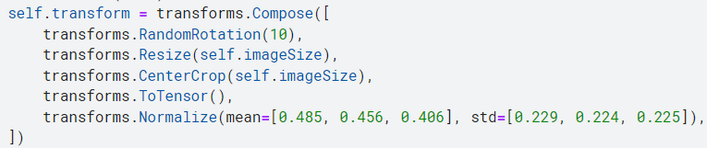
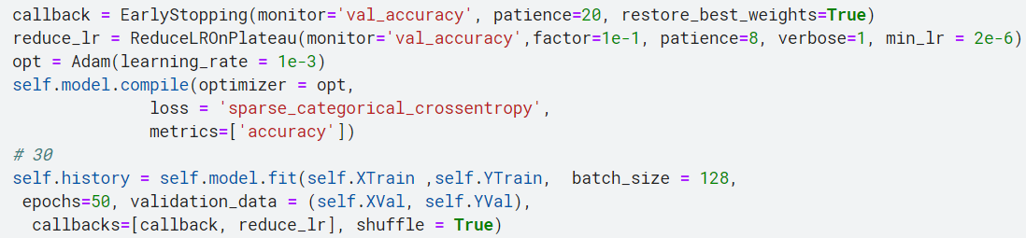
Model 4 – Deep CNN Tuning
Preprocessing
Random rotation - avoid overfitting
Adjust image size – train faster
Normalize array – less sensitive to scale of features, avoid exploding/vanishing gradient
Optimization
Early stopping – avoid overfitting
Adam optimizer – provides optimized gradient descent (Momentum && Root Mean Square Propagation)

Slide 16
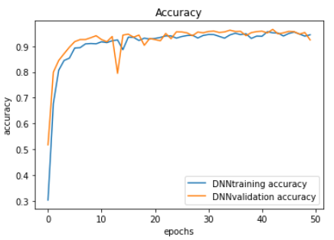
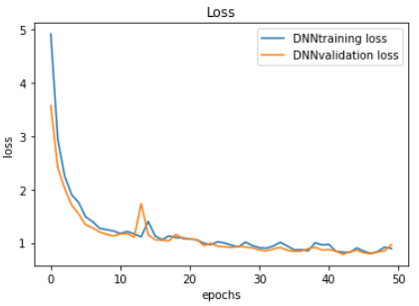
Model 4 – Deep CNN Result
High accuracy
Validation loss: 0.966
Validation accuracy: 96.9%
Test accuracy: 92.2%
Low speed
Larger conv2D layer size
Large value of batch size: 128
Large number of epoch: 50

Slide 17
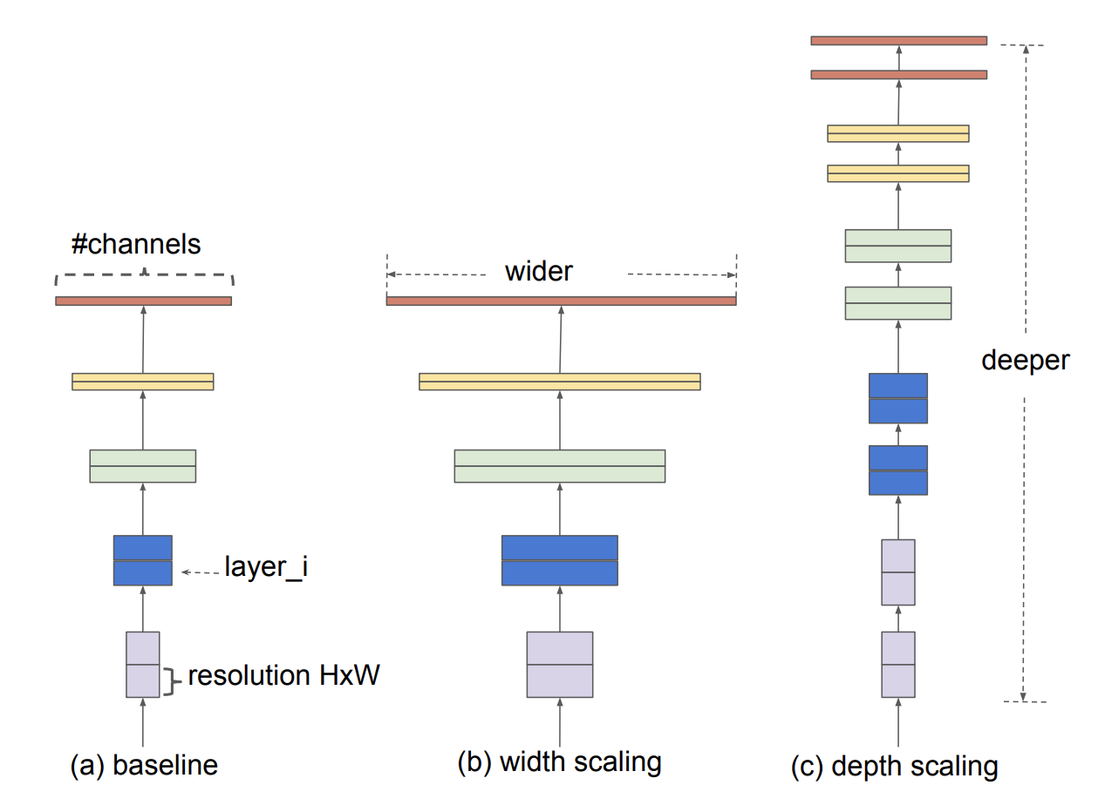
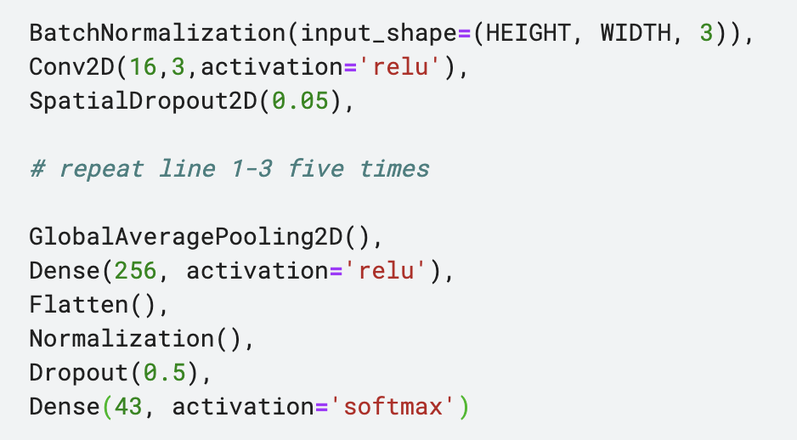
Model 5 – 'Efficient CNN'
Simulates EfficientNet
Deep and wide of convolutional layers
2D Dropout and Batchnormalization layers

Slide 18
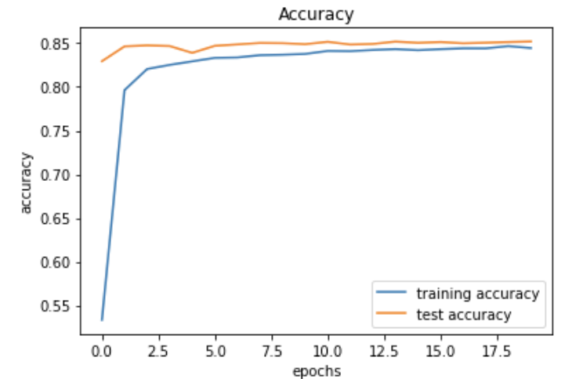
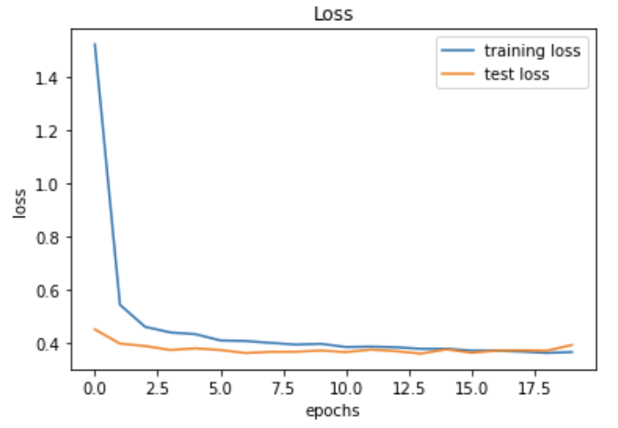
Model 5 – 'Efficient CNN'
High accuracy
Training accuracy: 84%
Validation accuracy: 85%
Test accuracy: 90.2%
Low loss
Training loss: 0.39
Validation loss: 0.38

Slide 19
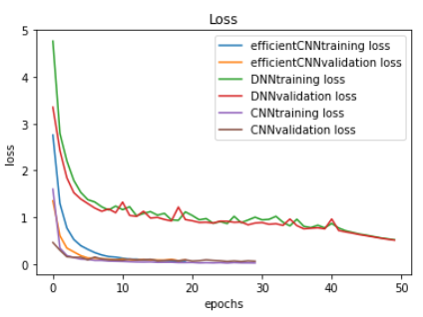
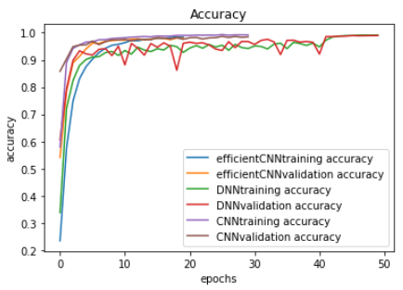

Ensembled Model
Combined the top three models
Max Voting
Use the highest accuracy as the default choice
Test Accuracy
CNN | EfficientCNN | Deep CNN
2 | 2 | 1
1 | 2 | 3

Slide 20
 | Number of Epochs | Validation Accuracy | Test Accuracy
LeNet | 146 | 96% | 87%
AlexNet | 20 | 95% | 81.2%
CNN | 10 | 84% | 88.7%
Deep CNN | 50 | 96% | 92.2%
Efficient CNN | 20 | 85% | 90.2%
Ensembled | --- | --- | 93.5%
Results & Conclusion: Compare the result

