Slide 1

CSCI E-25 Computer Vision
Convolution, Image Filtering and Spectral Analysis
Steve Elston
Copyright 2022, 2023, 2024, 2025, 2026, Stephen F Elston. All rights reserved.

Slide 2
Image Filtering
Almost all computer vision pipelines require filtering
Without good image data preparation, state-of-the-art CV algorithms will not produce good results
Classical CV filters apply the mathematical operation of convolution
Noise suppression
Edge and corner enhancement
Anti-aliasing
Resampling
We can understand the effects of filtering through spectral analysis
Filter changes power spectrum of image
Typical filters reduce high-frequency energy – noise
Higher frequency components include sharp edges and corners – typically blurred by filtering

Slide 3
Image Filtering
Common digital image problems
Poor lighting conditions
Low or limited contrast camera sensors
Limits of image sensor resolution
Noisy image sensors
Environmental conditions, fog, smoke, etc.
Occlusion of objects of interest
Poor geometry of camera placement
…

Slide 4
Image Filtering
Key points for this lesson
Convolution in 1-d, and 2-d
Applying padding, stride and tiling for convolution
Constructing convolutional filter kernels
Linear separation of convolutional kernels
The Fourier transform and frequency components of images
The relationship between filtering and the spectrum of images
Importance of scale and application of multiscale image pyramids

Slide 5
Convolution

Slide 6
Convolution
Convolution operations are a computationally efficient method of applying filters
Convolutional kernel weights determine characteristics of filters
Filtering noise
Creating and enhancing features
Convolutional filtering is computationally efficient
High volume applications
Real-time CV

Slide 7
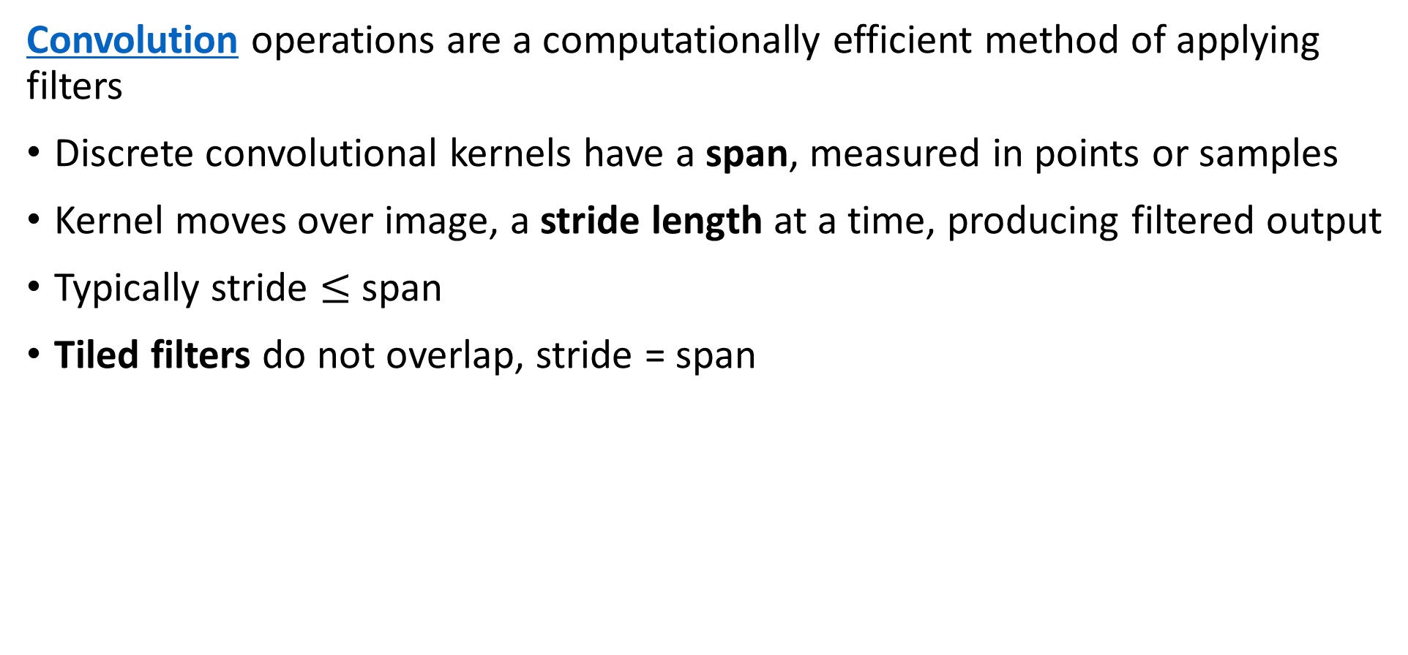
Convolution
Convolution operations are a computationally efficient method of applying filters
Discrete convolutional kernels have a span, measured in points or samples
Kernel moves over image, a stride length at a time, producing filtered output
Typically stride $≤$ span
Tiled filters do not overlap, stride = span

Slide 8
Convolution
Convolution operations are a computationally efficient method of applying filters to discretely
Convolution kernel is moved along the input tensor
Kernel has a small span compared to dimension of input tensor
At each step a weighted output value is computed
Output tensor can have different number of dimensions from input tensor
1-D convolutions are a simple, but useful example
Time series data
Speech
Medical signals

Slide 9

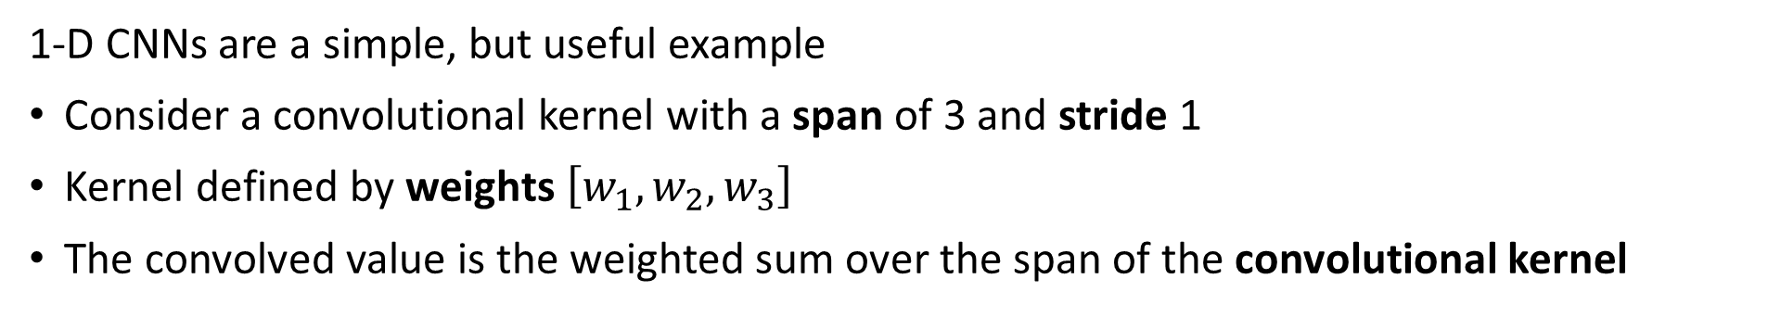



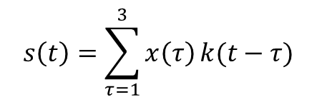




1-D Convolution
1-D CNNs are a simple, but useful example
Consider a convolutional kernel with a span of 3 and stride 1
Kernel defined by weights $\left[w_{1},w_{2},w_{3}\right]$
The convolved value is the weighted sum over the span of the convolutional kernel
$$s\left(t\right)=\sum_{τ=1}^{3}{x\left(τ\right)}k(t−τ)$$
t = 3
W₂
W₃
W₁
$$∙∙∙$$
$$x\left(1\right)$$
$$x\left(2\right)$$
$$x\left(3\right)$$
$$x\left(4\right)$$
$$x\left(4\right)$$
$$x\left(6\right)$$
$$x\left(n\right)$$
Kernel Span
or
Receptive Field

Slide 10
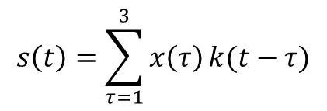
1-D Convolution
1-D CNNs are a simple, but useful example
Move kernel by stride 1
The convolutional kernel moves one sample per step
$$s\left(t\right)=\sum_{τ=1}^{3}{x\left(τ\right)}k(t−τ)$$
t = 4
W₁
W₂
W₃
$$∙∙∙$$
Kernel Span
or
Receptive Field

Slide 11
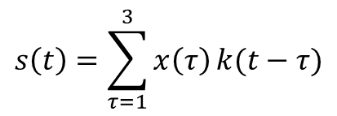
1-D Convolution
1-D CNNs are a simple, but useful example
Continue to produce one output value per time step
$$s\left(t\right)=\sum_{τ=1}^{3}{x\left(τ\right)}k(t−τ)$$
t = 5
W₁
W₂
W₃
$$∙∙∙$$
Kernel Span
or
Receptive Field

Slide 12
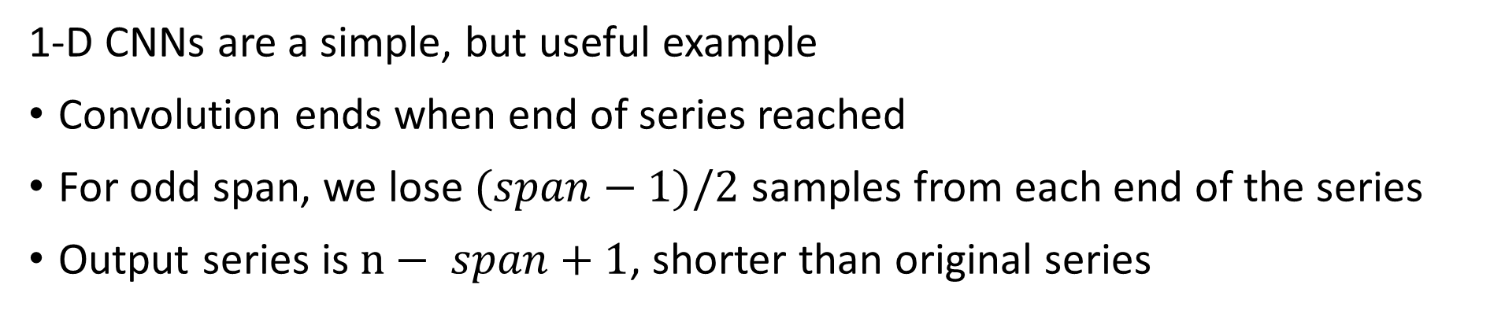


1-D Convolution
1-D CNNs are a simple, but useful example
Convolution ends when end of series reached
For odd span, we lose $(span−1)/2$ samples from each end of the series
Output series is $n− span+1$, shorter than original series
$$∙∙∙$$
t = n
W₁
W₂
W₃
$$∙∙∙$$
Kernel Span
or
Receptive Field

Slide 13
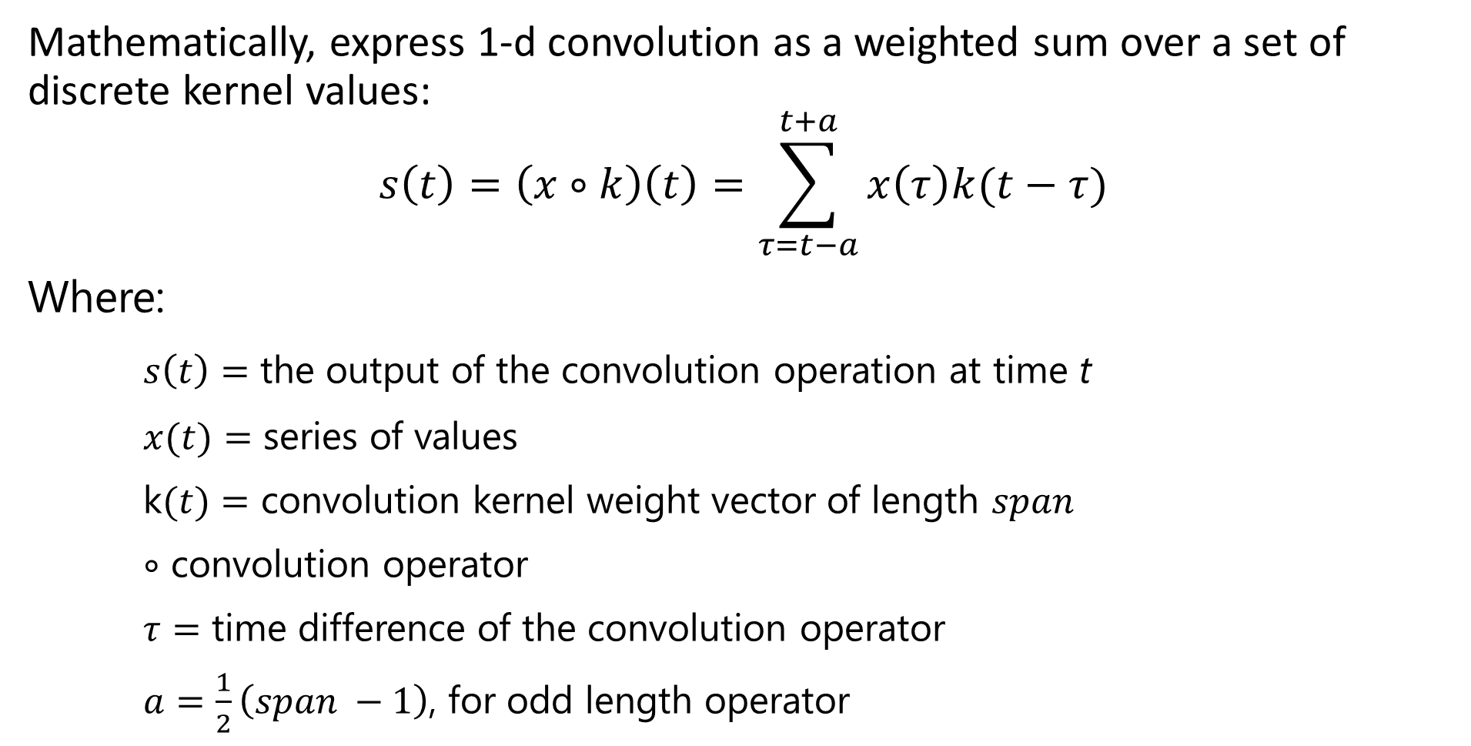
1-D Convolution
Mathematically, express 1-d convolution as a weighted sum over a set of discrete kernel values:
$$s\left(t\right)=\left(x∘k\right)\left(t\right)=\sum_{τ=t−a}^{t+a}{x\left(τ\right)k(t−τ)}$$
Where:
$s\left(t\right)=$ the output of the convolution operation at time t
$x(t)=$ series of values
k$(t)=$ convolution kernel weight vector of length $span$
$∘$ convolution operator
$τ=$ time difference of the convolution operator
$a=\frac{1}{2}\left(span −1\right)$, for odd length operator

Slide 14
2-D Convolution
4 x 4 input tensor
3 x 3 convolution operator, stride = 1
2 x 2 output tensor
Input
Output

Slide 15
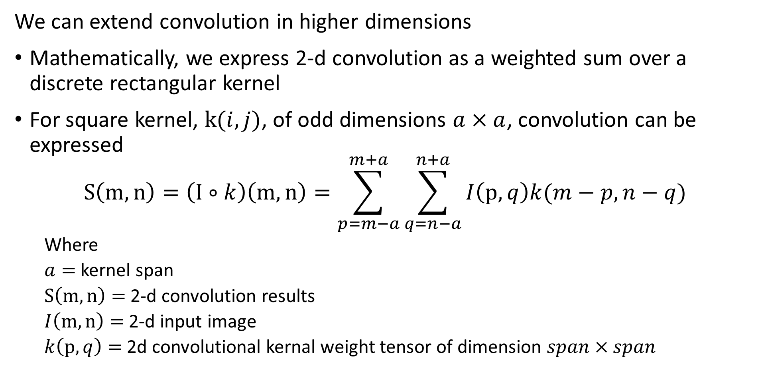
2-D Convolution
We can extend convolution in higher dimensions
Mathematically, we express 2-d convolution as a weighted sum over a discrete rectangular kernel
For square kernel, $k(i,j)$, of odd dimensions $a×a$, convolution can be expressed
$$S\left(m,n\right)=\left(I∘k\right)\left(m,n\right)=\sum_{p=m−a}^{m+a}{\sum_{q=n−a}^{n+a}{I\left(p,q\right)k(m−p,n−q)}}$$
Where
$a=$ kernel span
$S\left(m,n\right)=$ 2-d convolution results
$I\left(m,n\right)=$ 2-d input image
$k\left(p,q\right)=$ 2d convolutional kernal weight tensor of dimension $span×span$

Slide 16
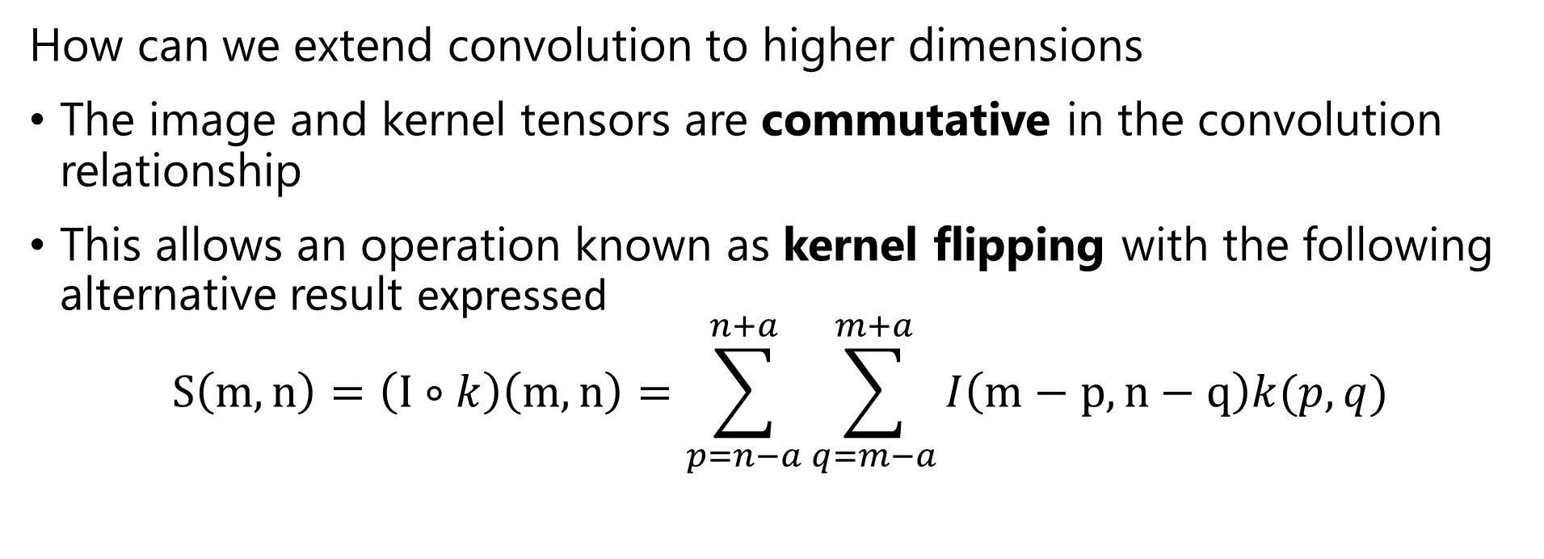
2-D Convolution
How can we extend convolution to higher dimensions
The image and kernel tensors are commutative in the convolution relationship
This allows an operation known as kernel flipping with the following alternative result expressed
$$S\left(m,n\right)=\left(I∘k\right)\left(m,n\right)=\sum_{p=n−a}^{n+a}{\sum_{q=m−a}^{m+a}{I\left(m−p,n−q\right)k(p,q)}}$$

Slide 17
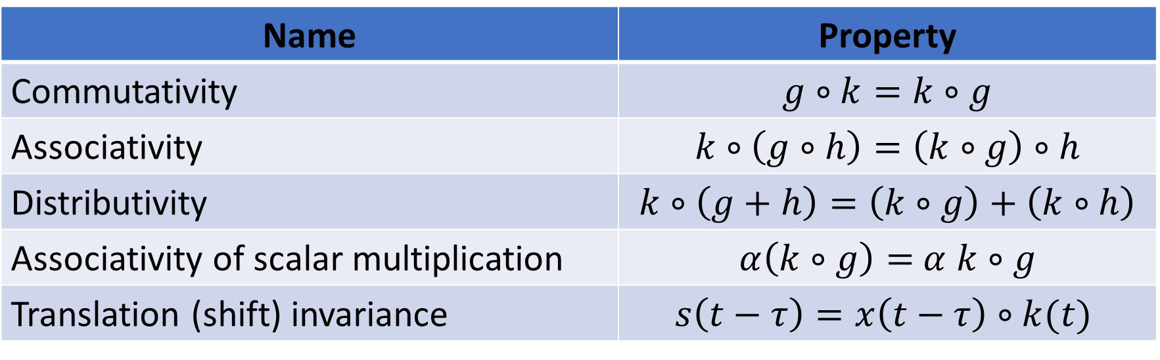
Algebraic Properties of Convolution
Convolution operations have useful algebraic properties
Notice five of these properties are identical to the familiar algebraic properties of multiplication
Name | Property
Commutativity | $$g∘k=k∘g$$
Associativity | $$k∘\left(g∘h\right)=\left(k∘g\right)∘h$$
Distributivity | $$k∘\left(g+h\right)=\left(k∘g\right)+\left(k∘h\right)$$
Associativity of scalar multiplication | $α\left(k∘g\right)=$ $α$ $k∘g$
Translation (shift) invariance | $$s\left(t−τ\right)=x\left(t−τ\right)∘k(t)$$

Slide 18
Stride, Tiling and Padding for Convolution

Slide 19
Stride and Tiling
Do we always move the convolution kernel by stride 1 (1 sample)?
No!
May not need the full resolution of the input
Or, change the dimension of the input tensor
Stride > 1 down-samples the data
Output of lower resolution
Stride < 1 up-samples the data
Use fractional stride
Output of higher pixel count
Or, use transposed convolution – more on this later
Use fractional stride to compute tensor with required output dimension

Slide 20
Stride and Tiling
Tiling is a special case when stride = span
Stride
Stride
Input
Output
Stride >1 reduces dimensionality, down-sampling

Slide 21
Padding for Convolution
How can we deal with edges of the input tensor when performing convolution?
We always work with a finite spatial and temporal (video) sample creating edge effects
A valid convolution confines the kernel to the input tensor dimensions
For odd kernel shape, output dimension is (span + 1)/2 less than input dimension
After many convolution layers, dimension is reduced further
We can zero pad the input tensor
Dimensionality is maintained
Use circular convolution
Wrap the ends of the finite sample to form a ‘circle’ creating a continuous sample
Can wrap in multiple dimensions

Slide 22
Padding for Convolution
Example: 4x4 input tensor with 3x3 kernel
0
0
0
0
0
0
Convolution
Operations
0
0
0
0
0
0
0
0
0
0
0
0
0
0
Input
Output
Dimension of output tensor = dimension of input tensor
0 values have little effect with max pooling

Slide 23
Circular Convolution
Example: 4x4 input tensor with 3x3 kernel
Values are wrapped from the other side of the sample
0
v
v
Convolution
Operations
v
v
Input
Output
Dimension of output tensor = dimension of input tensor

Slide 24
Commonly Used Convolution Kernels

Slide 25
Common Convolution Kernels
Convolutional filters are widely used for image enhancement in CV pipelines
Image processing packages support many convolutional filters
The Scikit-Image Filters package has a wide selection of filters
The OpenCV Image Processing Models supports many more filter types
We will only review a few convolutional filters here
We will investigate convolutional neural networks in subsequent lessons

Slide 26
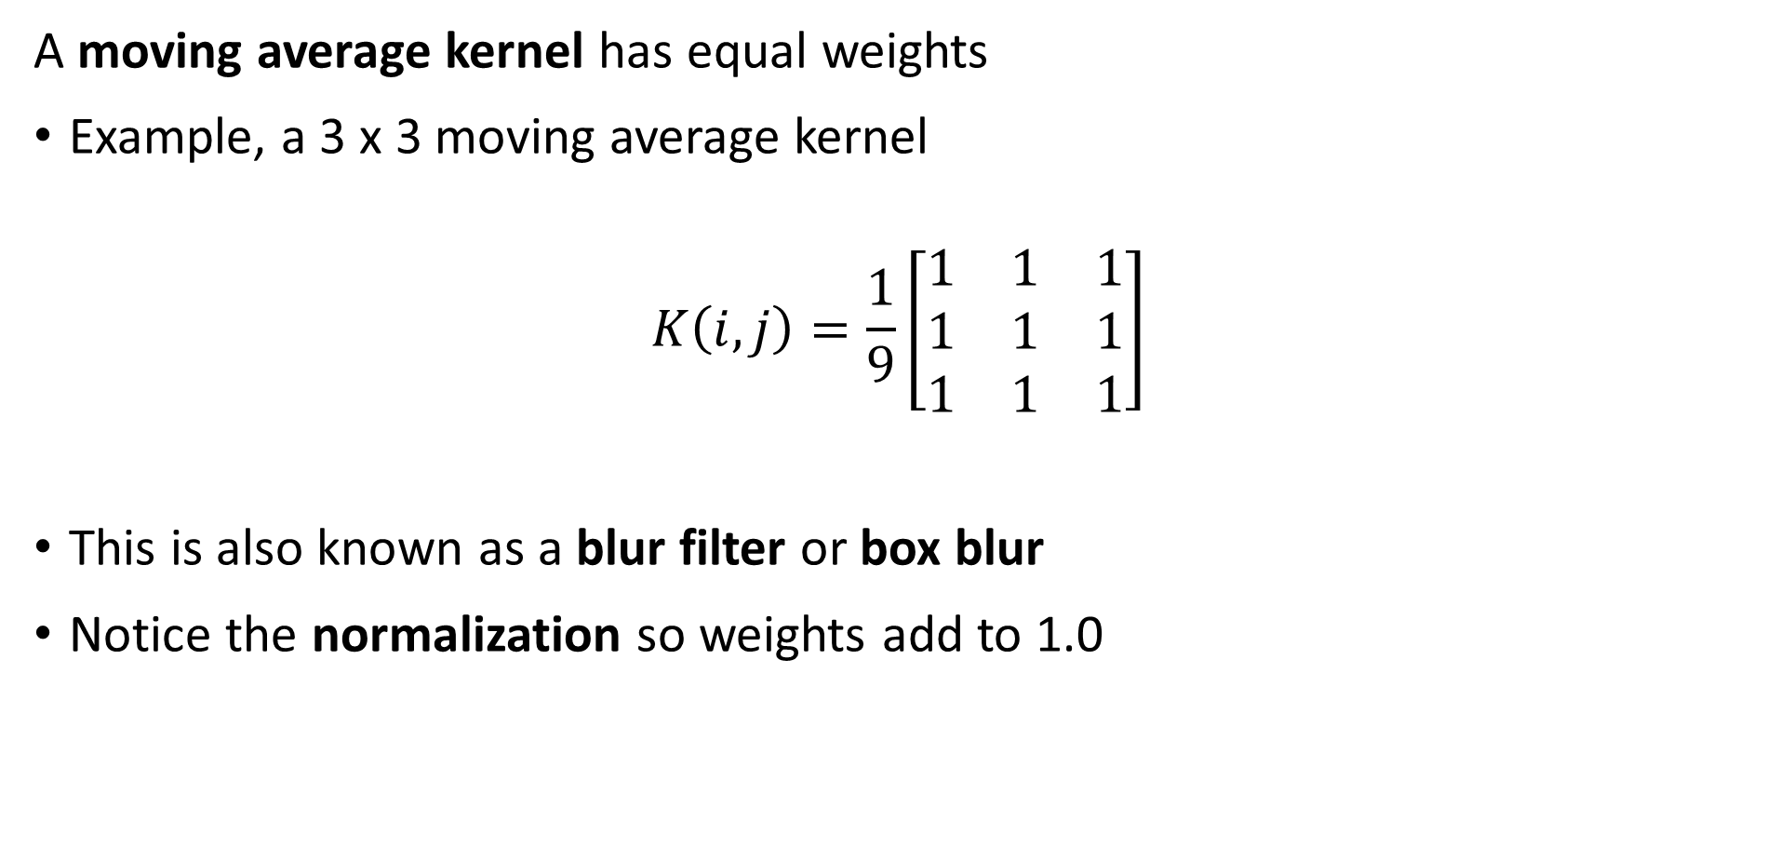
Common Convolution Kernels
A moving average kernel has equal weights
Example, a 3 x 3 moving average kernel
$$K\left(i,j\right)=\frac{1}{9}\left[\begin{matrix}1 & 1 & 1 \\ 1 & 1 & 1 \\ 1 & 1 & 1\end{matrix}\right]$$
This is also known as a blur filter or box blur
Notice the normalization so weights add to 1.0

Slide 27
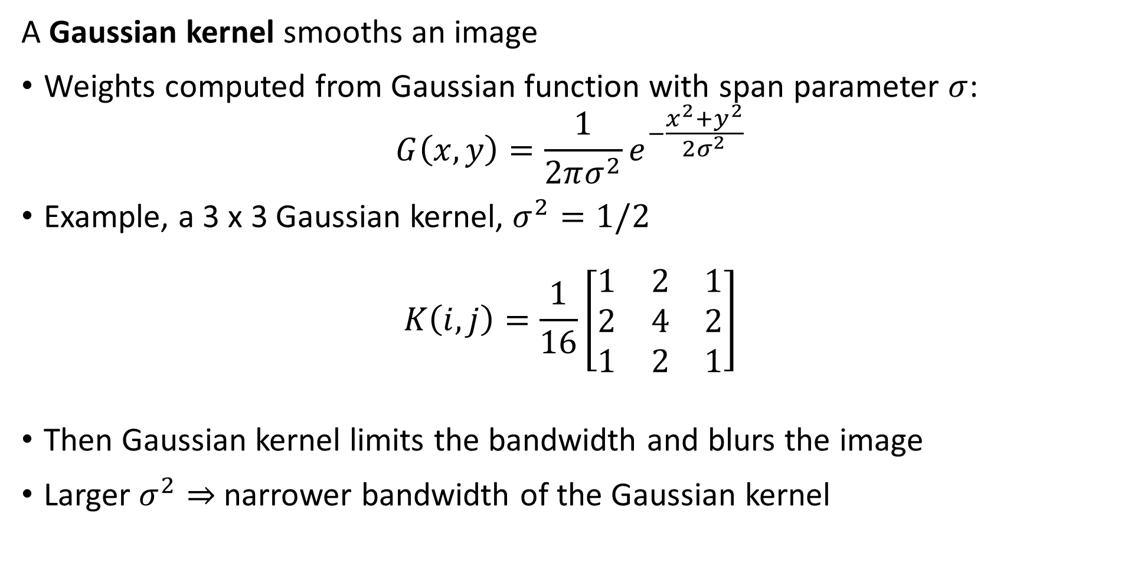
Common Convolution Kernels
A Gaussian kernel smooths an image
Weights computed from Gaussian function with span parameter $σ$:
$$G\left(x,y\right)=\frac{1}{2πσ^{2}}e^{−\frac{x^{2}+y^{2}}{2σ^{2}}}$$
Example, a 3 x 3 Gaussian kernel, $σ^{2}=1/2$
$$K\left(i,j\right)=\frac{1}{16}\left[\begin{matrix}1 & 2 & 1 \\ 2 & 4 & 2 \\ 1 & 2 & 1\end{matrix}\right]$$
Then Gaussian kernel limits the bandwidth and blurs the image
Larger $σ^{2}⇒$ narrower bandwidth of the Gaussian kernel

Slide 28
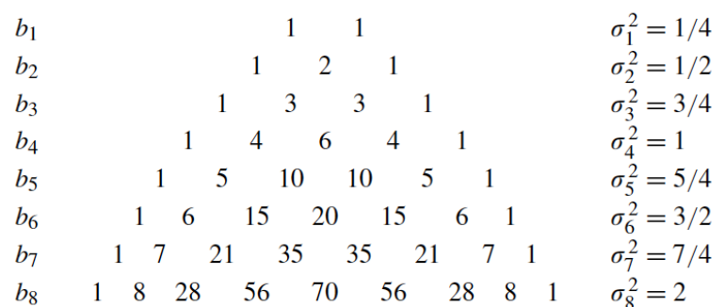

Common Convolution Kernels
A Gaussian kernel smooths an image
Weights computed from Gaussian function with span parameter $σ$:
$$G\left(x,y\right)=\frac{1}{2πσ^{2}}e^{−\frac{x^{2}+y^{2}}{2σ^{2}}}$$
We create approximate Gaussian kernels with the binomial approximation
Credit, Antonio Torralba, Lecture 2016

Slide 29
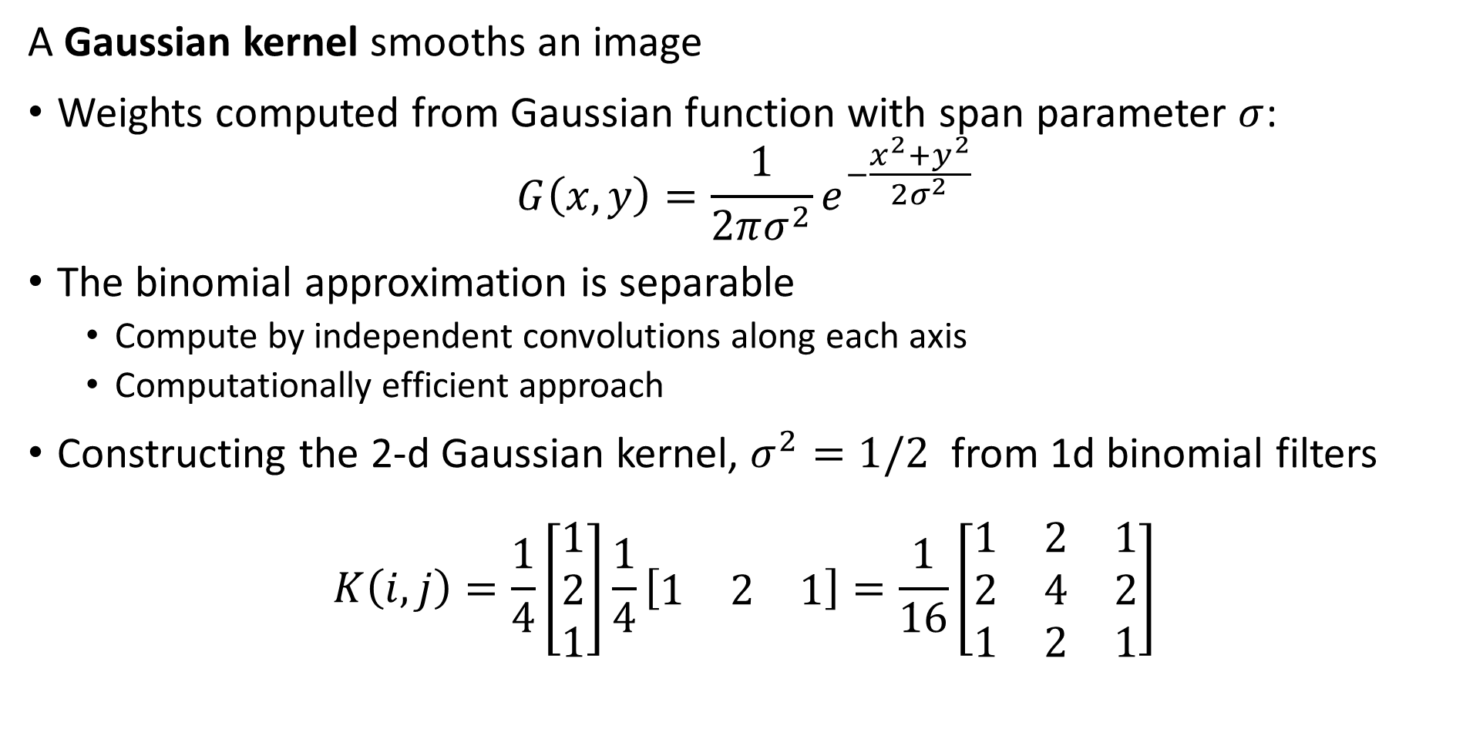
Common Convolution Kernels
A Gaussian kernel smooths an image
Weights computed from Gaussian function with span parameter $σ$:
$$G\left(x,y\right)=\frac{1}{2πσ^{2}}e^{−\frac{x^{2}+y^{2}}{2σ^{2}}}$$
The binomial approximation is separable
Compute by independent convolutions along each axis
Computationally efficient approach
Constructing the 2-d Gaussian kernel, $σ^{2}=1/2$ from 1d binomial filters
$$K\left(i,j\right)=\frac{1}{4}\left[\begin{matrix}1 \\ 2 \\ 1\end{matrix}\right]\frac{1}{4}\left[\begin{matrix}1 & 2 & 1\end{matrix}\right]=\frac{1}{16}\left[\begin{matrix}1 & 2 & 1 \\ 2 & 4 & 2 \\ 1 & 2 & 1\end{matrix}\right]$$

Slide 30
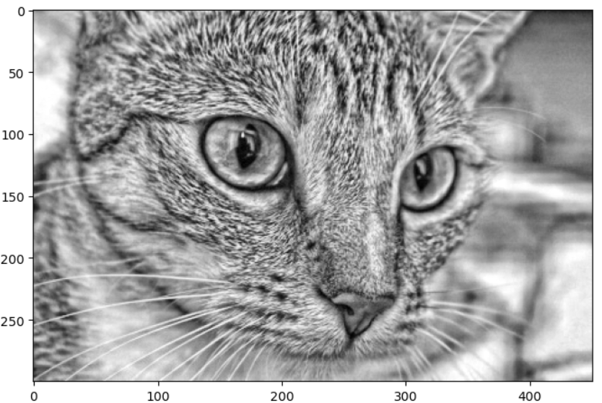
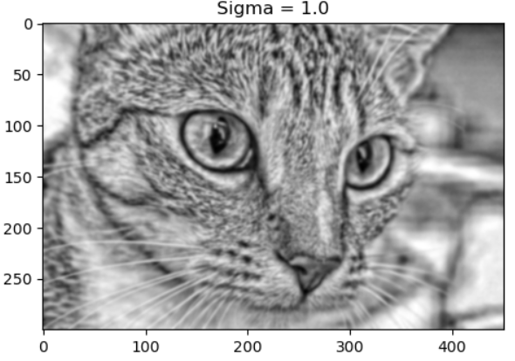
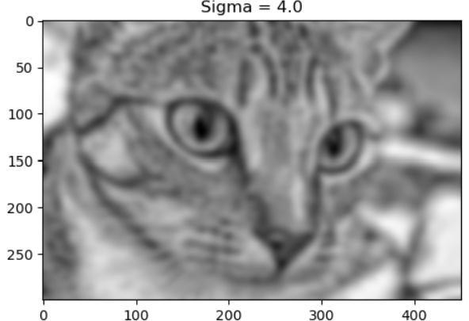
Common Convolution Kernels
Example of Gaussian kernel filtering of image
Broad band Gaussian Filter
Narrow band Gaussian Filter

Slide 31
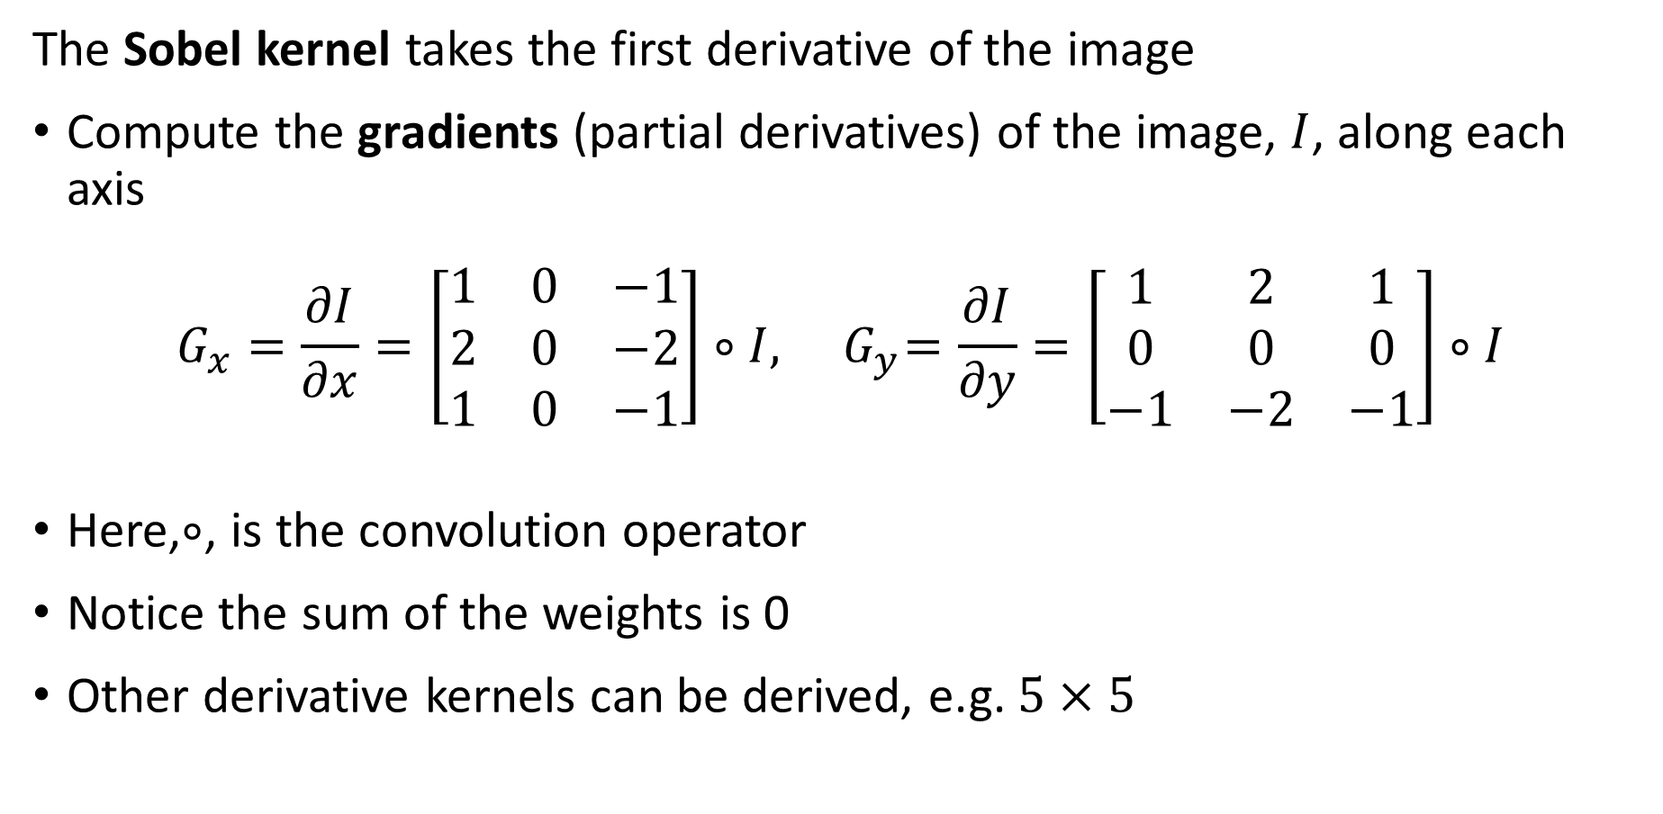
Common Convolution Kernels
The Sobel kernel takes the first derivative of the image
Compute the gradients (partial derivatives) of the image, $I$, along each axis
$$G_{x}=\frac{∂I}{∂x}=\left[\begin{matrix}1 & 0 & −1 \\ 2 & 0 & −2 \\ 1 & 0 & −1\end{matrix}\right]∘I,{ G}_{y}=\frac{∂I}{∂y}=\left[\begin{matrix}1 & 2 & 1 \\ 0 & 0 & 0 \\ −1 & −2 & −1\end{matrix}\right]∘I$$
Here,$∘$, is the convolution operator
Notice the sum of the weights is 0
Other derivative kernels can be derived, e.g. $5×5$

Slide 32
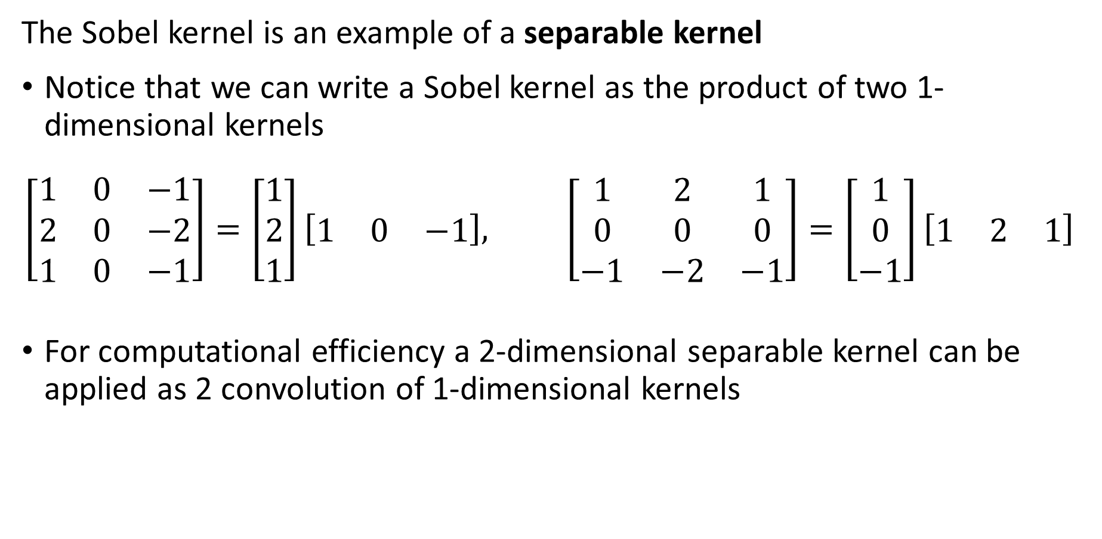
Common Convolution Kernels
The Sobel kernel is an example of a separable kernel
Notice that we can write a Sobel kernel as the product of two 1-dimensional kernels
$$\left[\begin{matrix}1 & 0 & −1 \\ 2 & 0 & −2 \\ 1 & 0 & −1\end{matrix}\right]=\left[\begin{matrix}1 \\ 2 \\ 1\end{matrix}\right]\left[\begin{matrix}1 & 0 & −1\end{matrix}\right], \left[\begin{matrix}1 & 2 & 1 \\ 0 & 0 & 0 \\ −1 & −2 & −1\end{matrix}\right]=\left[\begin{matrix}1 \\ 0 \\ −1\end{matrix}\right]\left[\begin{matrix}1 & 2 & 1\end{matrix}\right]$$
For computational efficiency a 2-dimensional separable kernel can be applied as 2 convolution of 1-dimensional kernels

Slide 33
Median Filter
Median filter is a special case
Median filter outputs median value of the pixel values within patch
Typically use odd patch sizes – e.g., 3 x 3, 5 x 5, 7 x 7
Median filter is not easily formulated using convolution
Use an incremental update algorithm for computational efficiency
Median filter has interesting properties
Suppresses noise
Sharpens edges and corners
Median filter can alter image
Response is not isotropic – not same along diagonals of image
Can move edges and corners

Slide 34
Filtering and Spectral Properties of Images

Slide 35
Spectral Properties of Images
The power spectrum of an image reveals fundamental properties
Power spectrum reveals the vertical and horizontal frequency components of the image
Low frequency components of an image represent regions with slowly changing properties
High frequency components of an image arise from local features with rapid changes
Edges
Corners
Texture
Filtering changes the power spectrum of an image

Slide 36
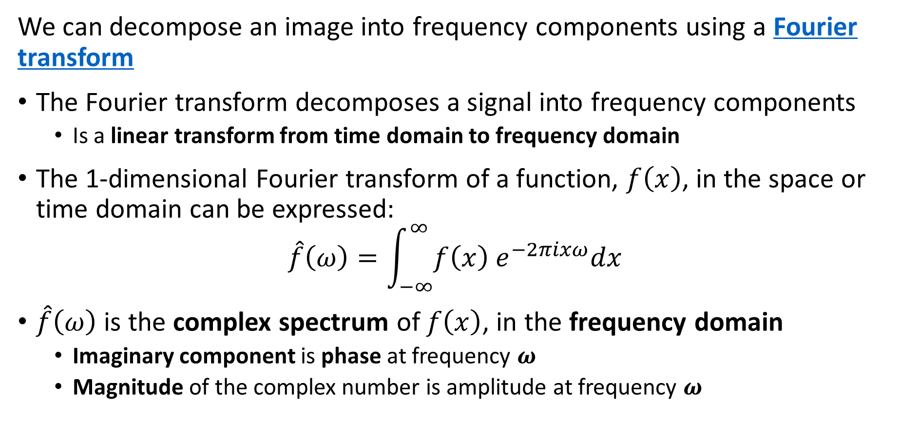
Spectral Properties of Images
We can decompose an image into frequency components using a Fourier transform
The Fourier transform decomposes a signal into frequency components
Is a linear transform from time domain to frequency domain
The 1-dimensional Fourier transform of a function, $f\left(x\right)$, in the space or time domain can be expressed:
$$\hat{f}\left(ω\right)=\int_{−∞}^{∞}{f\left(x\right) e^{−2πixω}dx}$$
$\hat{f}\left(ω\right)$ is the complex spectrum of $f\left(x\right)$, in the frequency domain
Imaginary component is phase at frequency $ω$
Magnitude of the complex number is amplitude at frequency $ω$

Slide 37
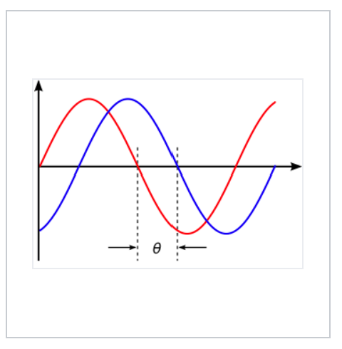
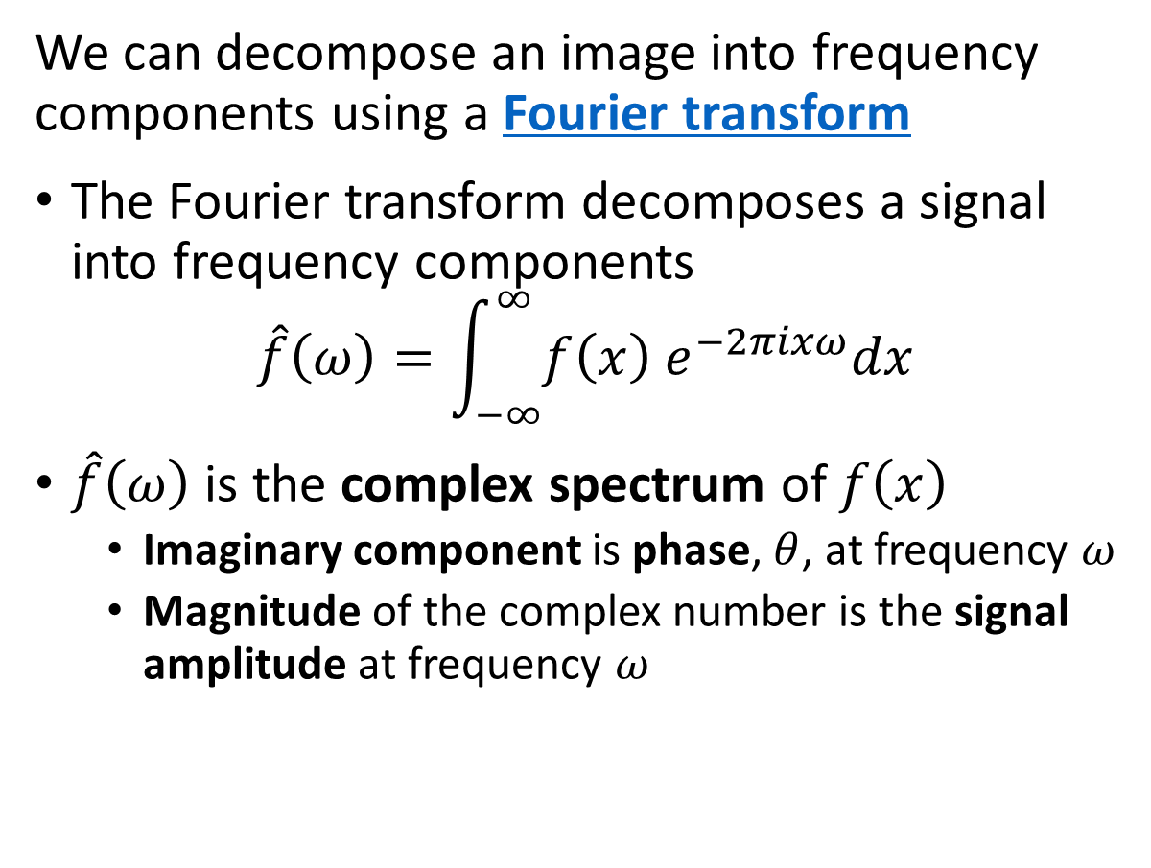
Spectral Properties of Images
We can decompose an image into frequency components using a Fourier transform
The Fourier transform decomposes a signal into frequency components
$$\hat{f}\left(ω\right)=\int_{−∞}^{∞}{f\left(x\right) e^{−2πixω}dx}$$
$\hat{f}\left(ω\right)$ is the complex spectrum of $f\left(x\right)$
Imaginary component is phase, $θ$, at frequency $ω$
Magnitude of the complex number is the signal amplitude at frequency $ω$
Amplitude
Two sinusoidal signals with identical frequency and amplitude, phase shifted by θ
Credit, Wikipedia commons

Slide 38
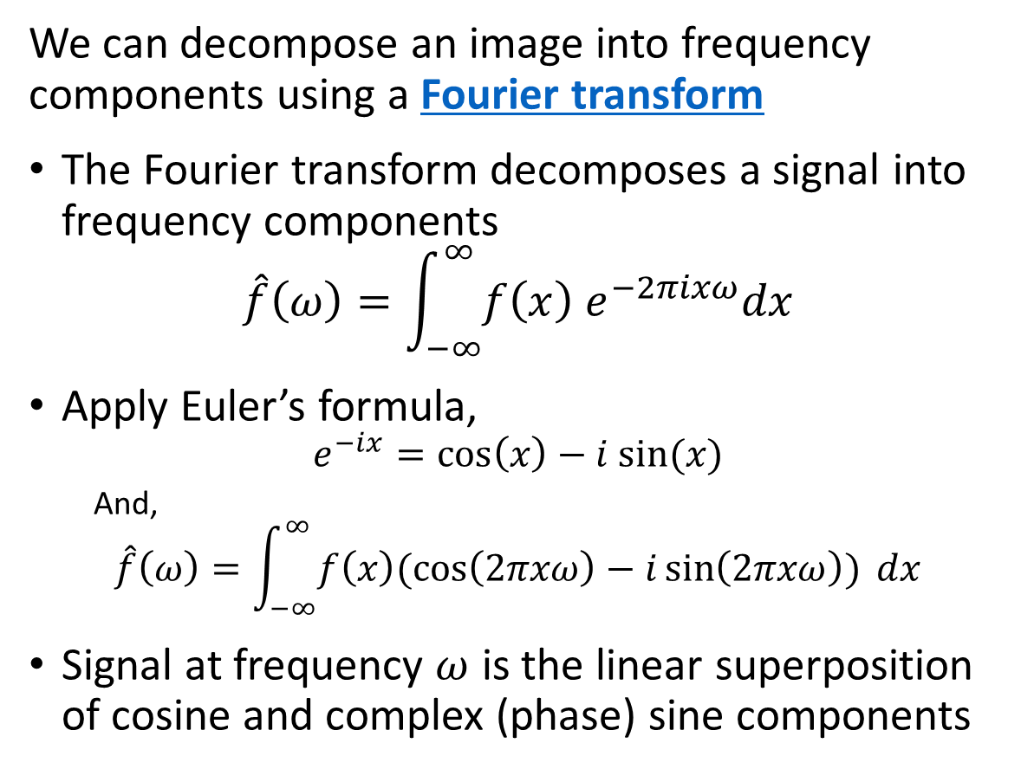
Spectral Properties of Images
We can decompose an image into frequency components using a Fourier transform
The Fourier transform decomposes a signal into frequency components
$$\hat{f}\left(ω\right)=\int_{−∞}^{∞}{f\left(x\right) e^{−2πixω}dx}$$
Apply Euler’s formula,
$$e^{−ix}=\cos\left(x\right)−i sin⁡(x)$$
And,
$$\hat{f}\left(ω\right)=\int_{−∞}^{∞}{f\left(x\right)(\cos\left(2πxω\right)−i\sin\left(2πxω\right)) dx}$$
Signal at frequency $ω$ is the linear superposition of cosine and complex (phase) sine components
Amplitude
Two sinusoidal signals with identical frequency and amplitude, phase shifted by θ
Credit, Wikipedia commons

Slide 39
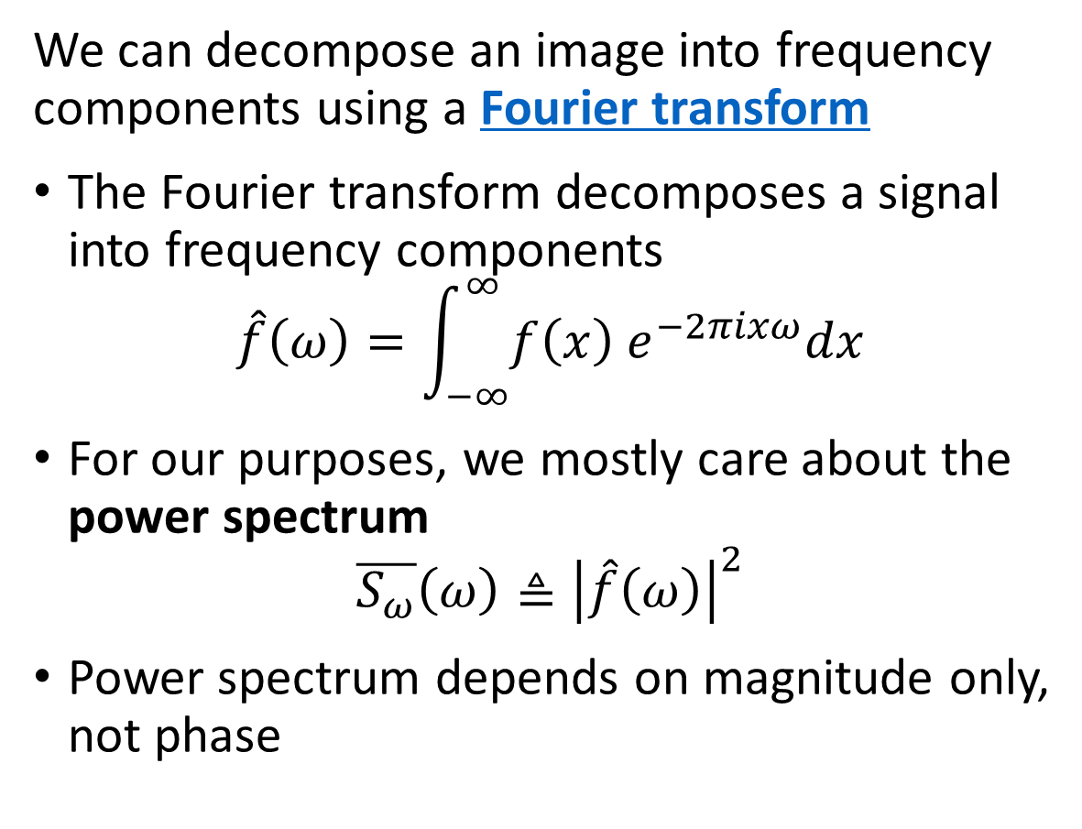
Spectral Properties of Images
We can decompose an image into frequency components using a Fourier transform
The Fourier transform decomposes a signal into frequency components
$$\hat{f}\left(ω\right)=\int_{−∞}^{∞}{f\left(x\right) e^{−2πixω}dx}$$
For our purposes, we mostly care about the power spectrum
$$\overline{S_{ω}}\left(ω\right)≜{\left|\hat{f}\left(ω\right)\right|}^{2}$$
Power spectrum depends on magnitude only, not phase
Amplitude
Two sinusoidal signals with identical frequency and amplitude, phase shifted by θ
Credit, Wikipedia commons

Slide 40
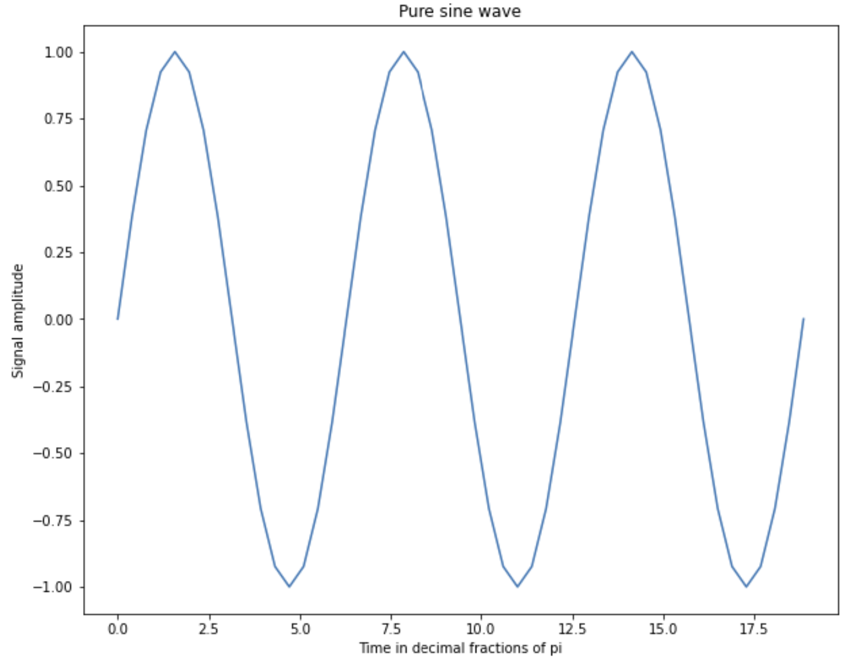
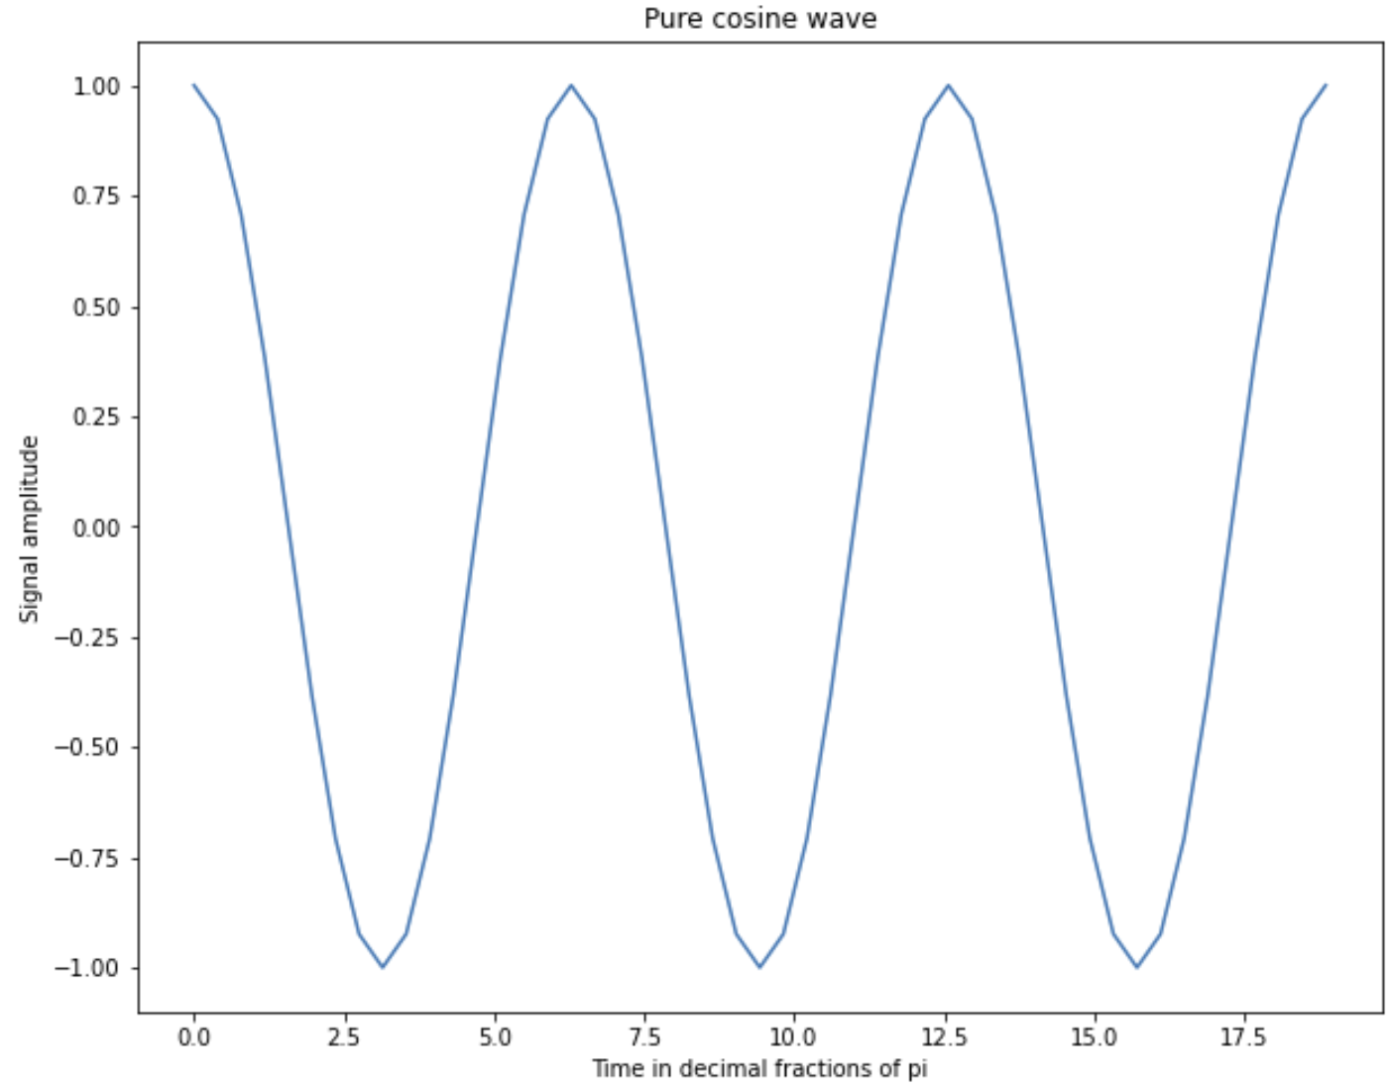
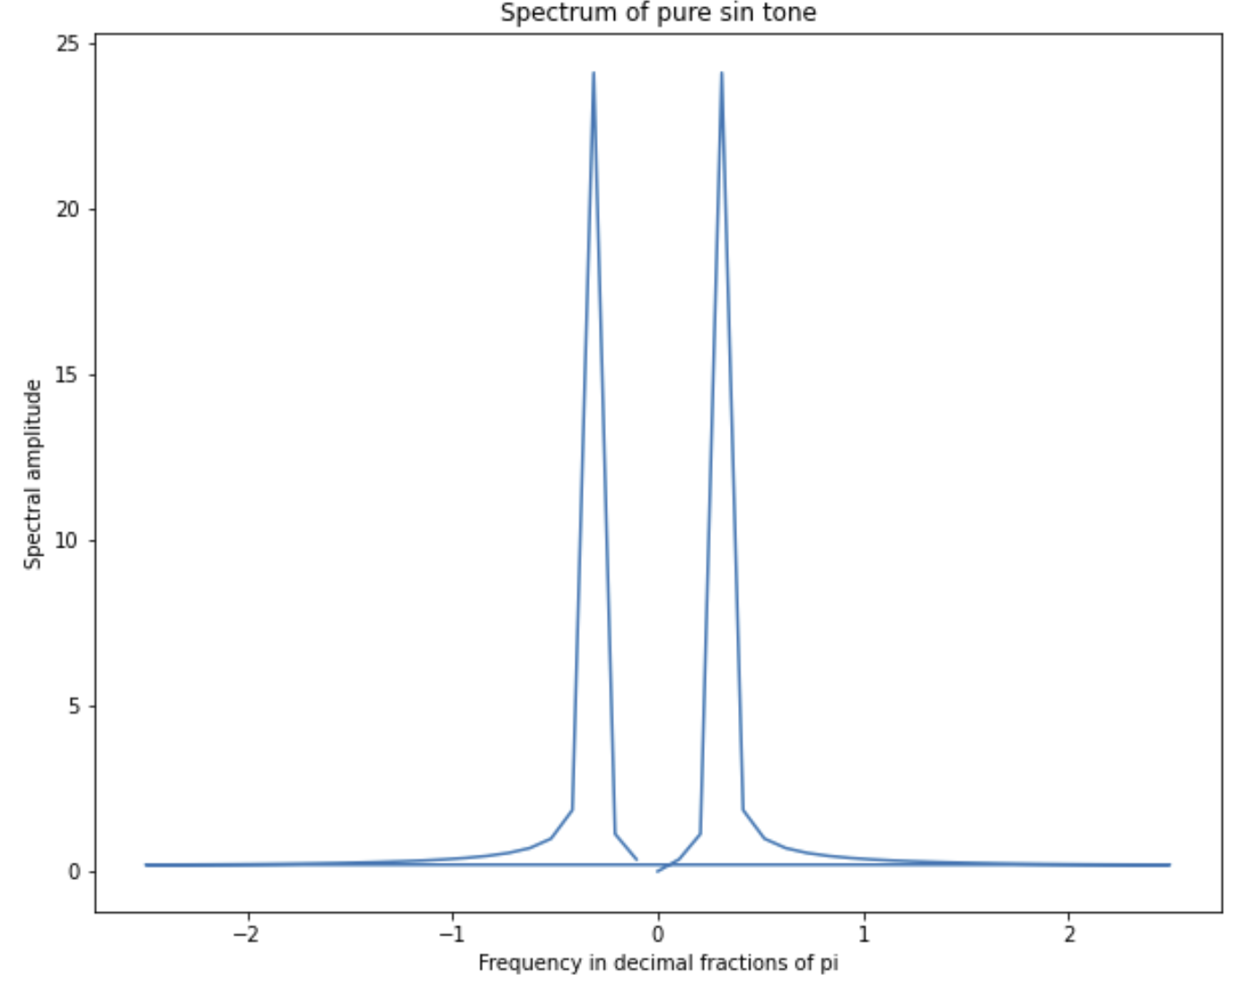
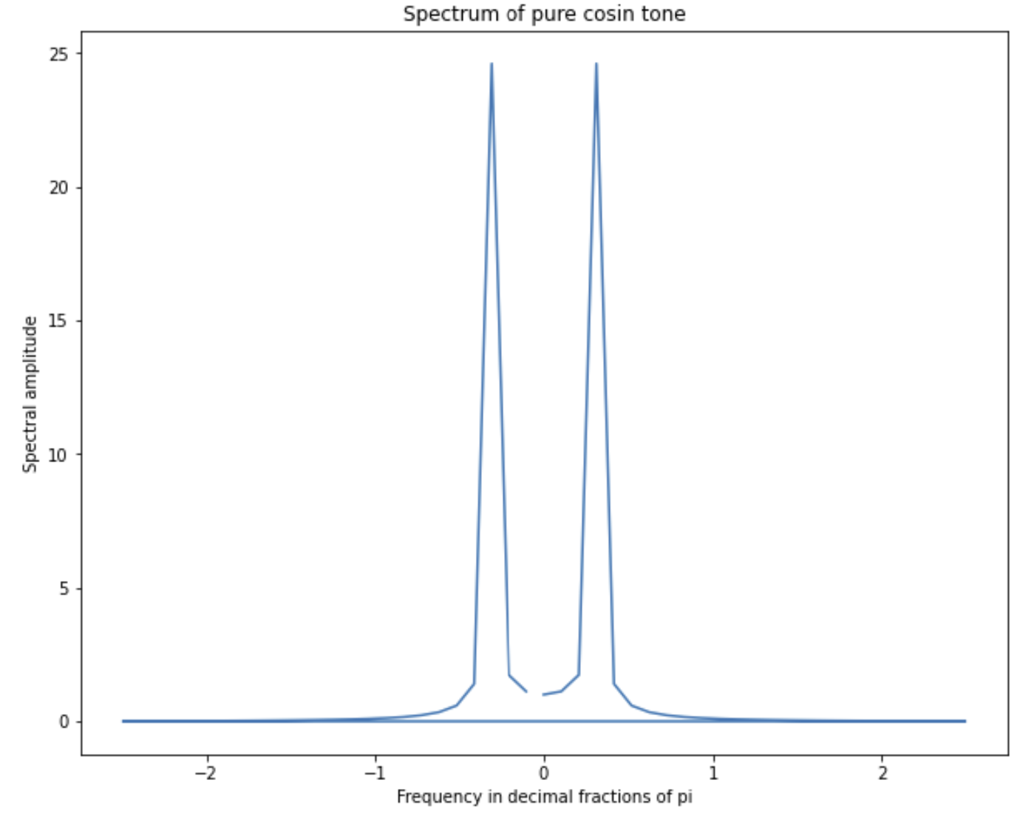
Spectral Properties of Images
Example of single frequency signals and their power spectrum
Phase shifted signal
Power spectrum invariant to phase

Slide 41
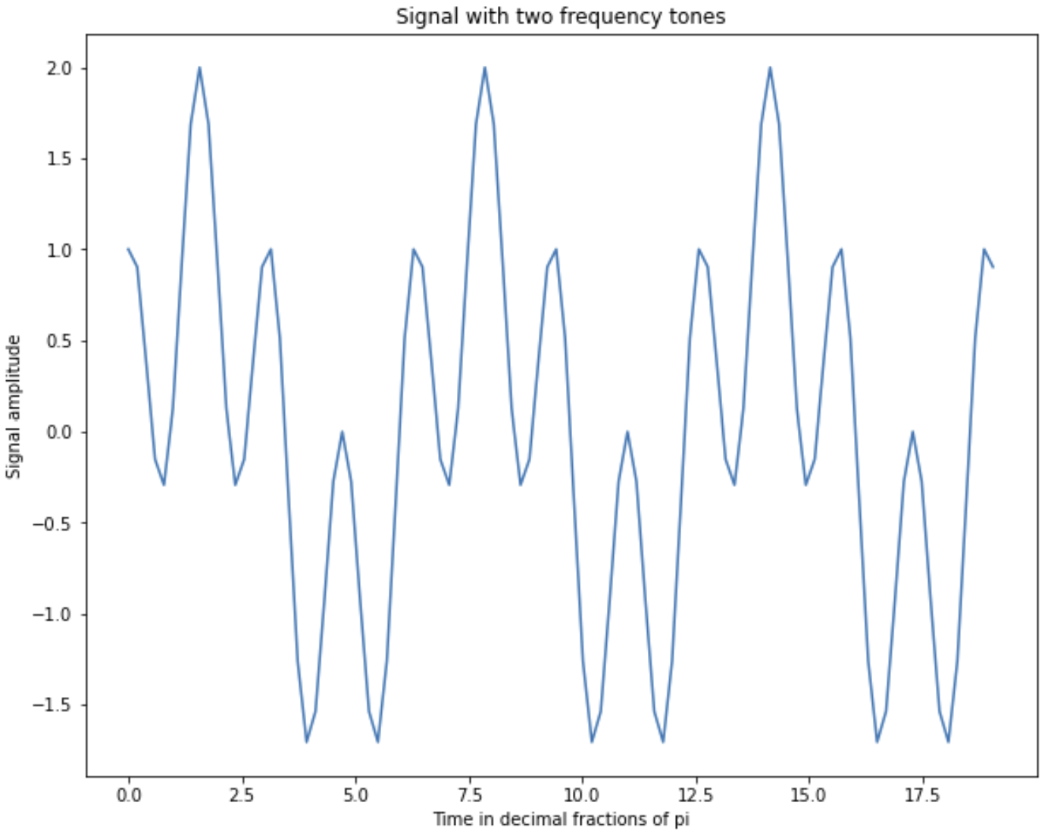
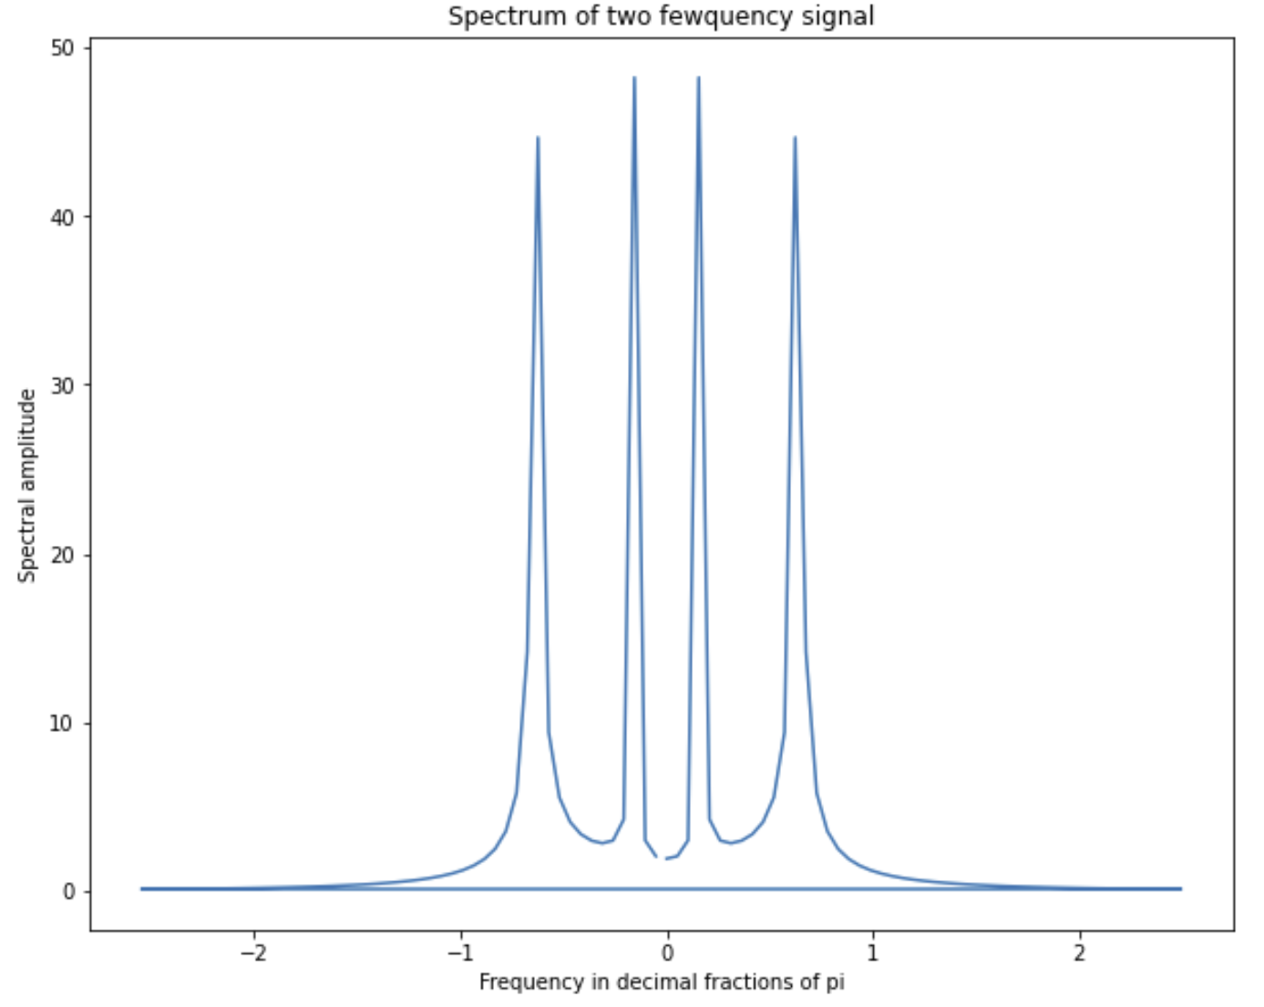
Spectral Properties of Images
Example of signal with two frequencies and the power spectrum

Slide 42
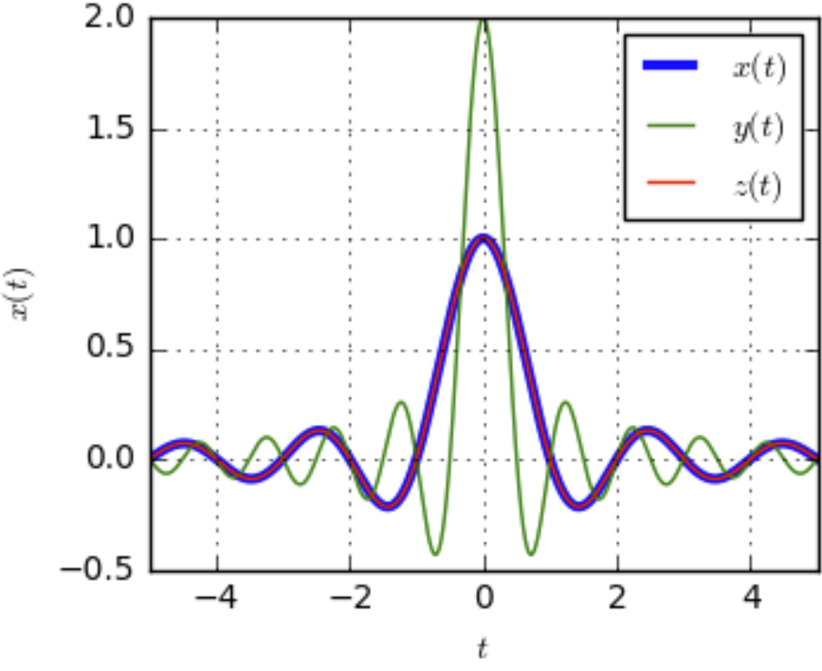
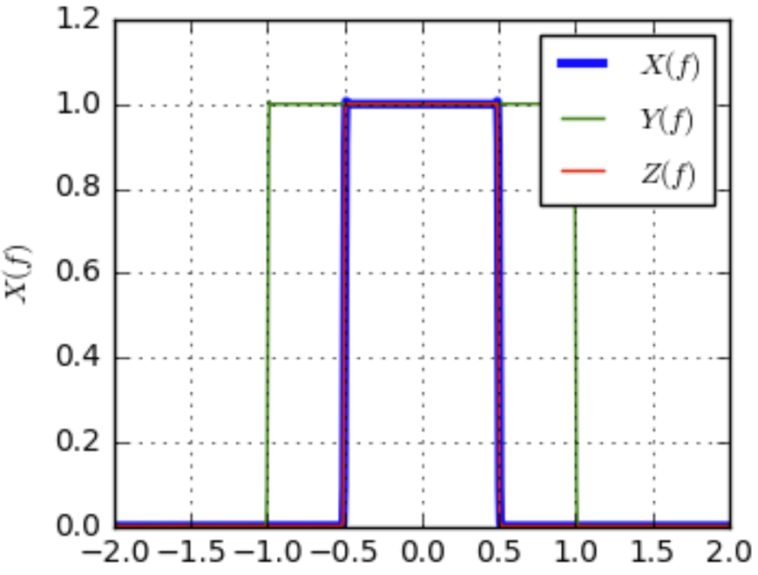
Spectral Properties of Images
Impulse response of a convolutional filter is the Fourier transform in the frequency domain
Fourier Transform
Response in time (or frequency) domain
Response in frequency (or time) domain
Credit, DSP Illustrations
Relationship is invertible (inverse Fourier transform) and commutable: exchange time and frequency

Slide 43
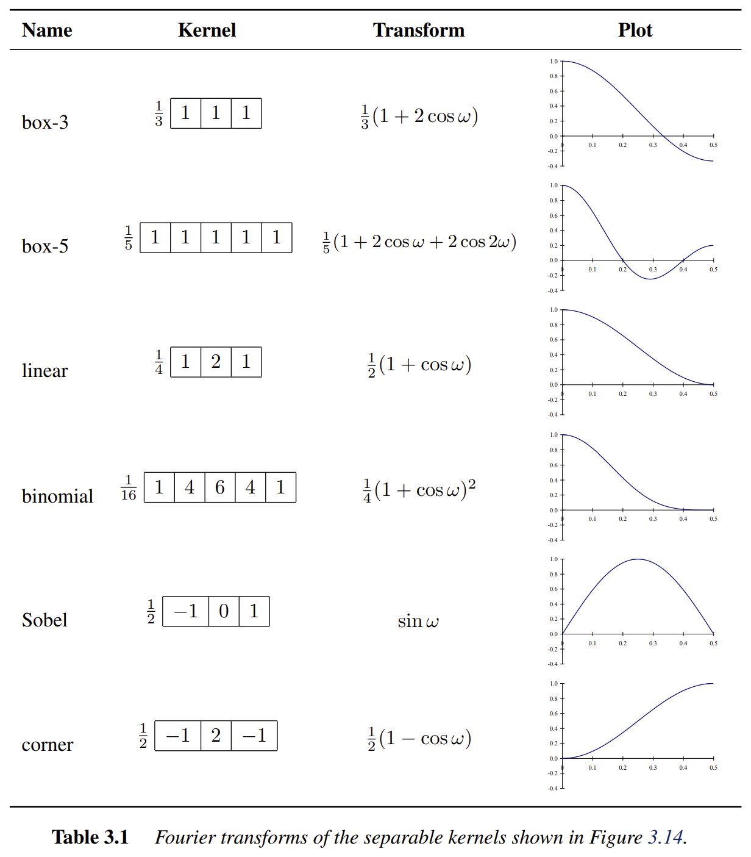
Spectral Properties of Images
Impulse response of some commonly used convolutional filters, showing:
Name of the filter
Values of the kernel operator
Analytic representation of the Fourier transform
Graph of the Fourier transform or impulse response
Credit: Szeliski, 2nd Edition, 2022

Slide 44
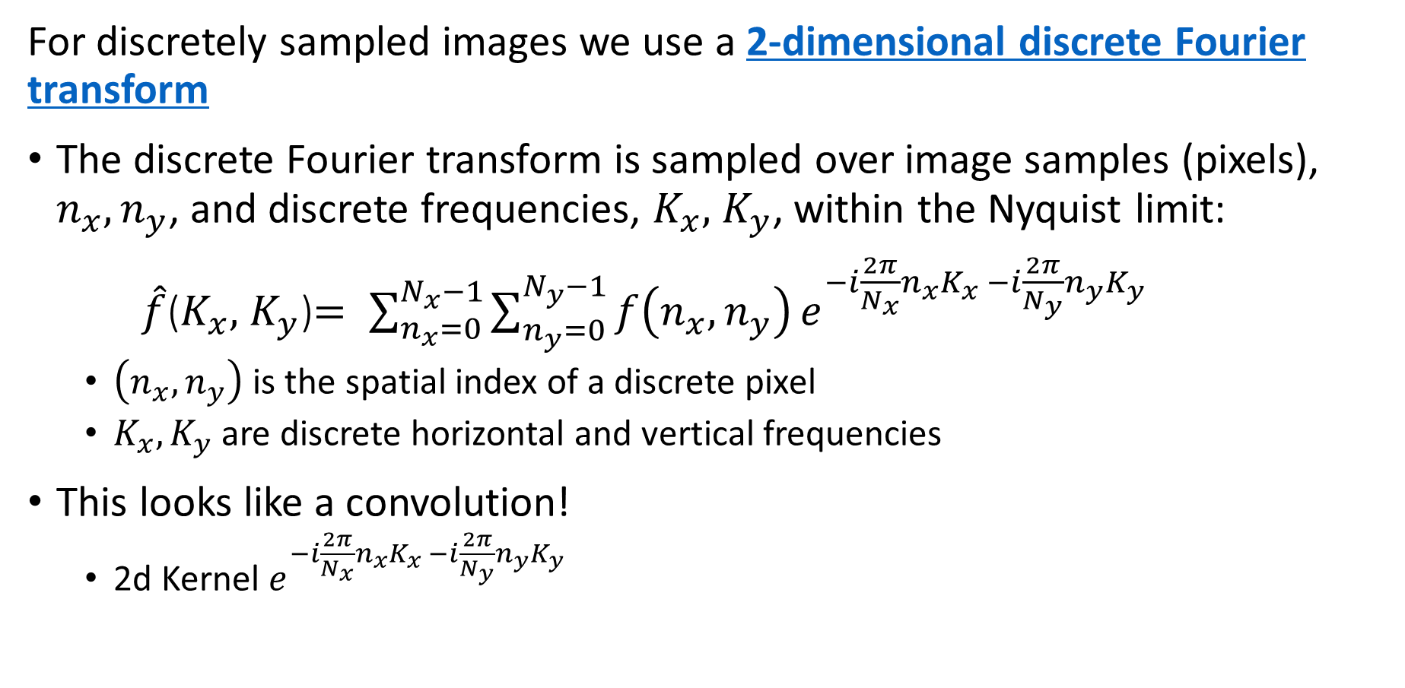
Spectral Properties of Images
For discretely sampled images we use a 2-dimensional discrete Fourier transform
The discrete Fourier transform is sampled over image samples (pixels), $n_{x},n_{y}$, and discrete frequencies, $K_{x},$ $K_{y}$, within the Nyquist limit:
$\hat{f}$($K_{x},$ $K_{y}$)$= \sum_{n_{x}=0}^{N_{x}−1}{\sum_{n_{y}=0}^{N_{y}−1}{f\left(n_{x},n_{y}\right)}}e^{−i\frac{2π}{N_{x}}n_{x}K_{x} −i\frac{2π}{N_{y}}n_{y}K_{y}}$
$\left(n_{x},n_{y}\right)$ is the spatial index of a discrete pixel
$K_{x},K_{y}$ are discrete horizontal and vertical frequencies
This looks like a convolution!
2d Kernel $e^{−i\frac{2π}{N_{x}}n_{x}K_{x} −i\frac{2π}{N_{y}}n_{y}K_{y}}$

Slide 45
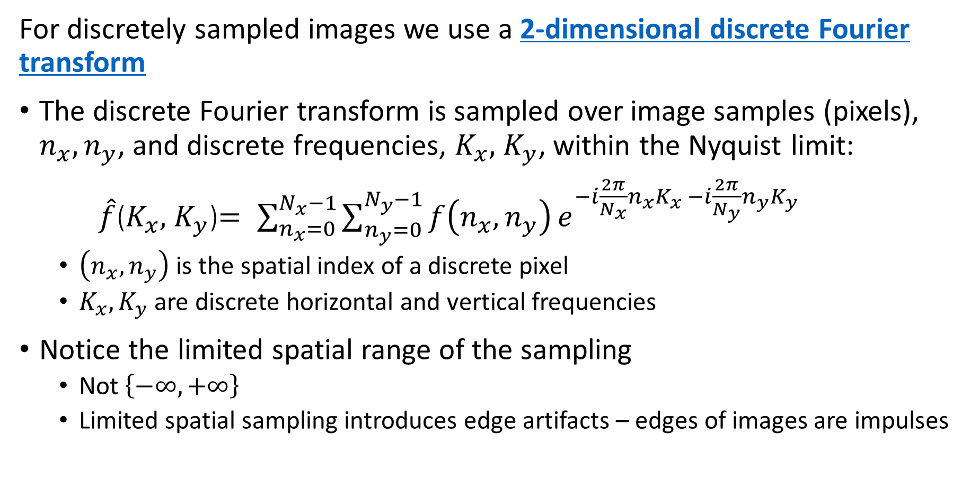
Spectral Properties of Images
For discretely sampled images we use a 2-dimensional discrete Fourier transform
The discrete Fourier transform is sampled over image samples (pixels), $n_{x},n_{y}$, and discrete frequencies, $K_{x},$ $K_{y}$, within the Nyquist limit:
$\hat{f}$($K_{x},$ $K_{y}$)$= \sum_{n_{x}=0}^{N_{x}−1}{\sum_{n_{y}=0}^{N_{y}−1}{f\left(n_{x},n_{y}\right)}}e^{−i\frac{2π}{N_{x}}n_{x}K_{x} −i\frac{2π}{N_{y}}n_{y}K_{y}}$
$\left(n_{x},n_{y}\right)$ is the spatial index of a discrete pixel
$K_{x},K_{y}$ are discrete horizontal and vertical frequencies
Notice the limited spatial range of the sampling
Not $\left\{−∞, +∞\right\}$
Limited spatial sampling introduces edge artifacts – edges of images are impulses

Slide 46
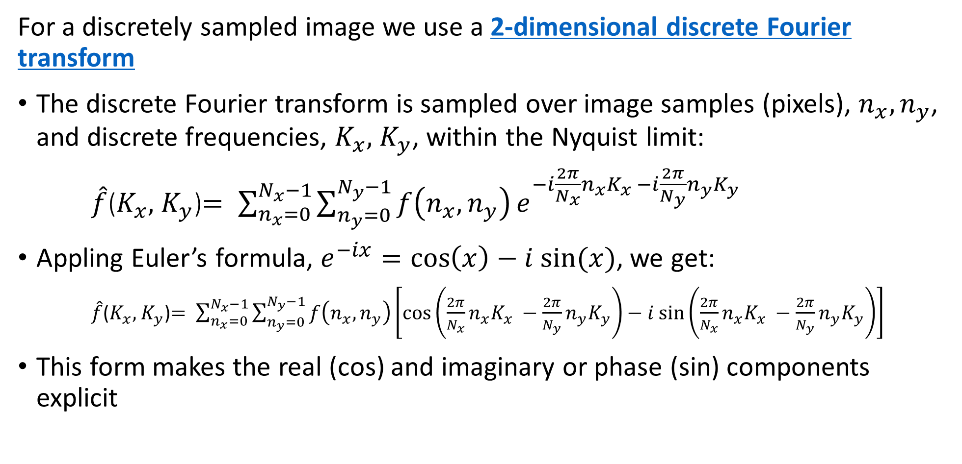
Spectral Properties of Images
For a discretely sampled image we use a 2-dimensional discrete Fourier transform
The discrete Fourier transform is sampled over image samples (pixels), $n_{x},n_{y}$, and discrete frequencies, $K_{x},$ $K_{y}$, within the Nyquist limit:
$\hat{f}$($K_{x},$ $K_{y}$)$= \sum_{n_{x}=0}^{N_{x}−1}{\sum_{n_{y}=0}^{N_{y}−1}{f\left(n_{x},n_{y}\right)}}e^{−i\frac{2π}{N_{x}}n_{x}K_{x} −i\frac{2π}{N_{y}}n_{y}K_{y}}$
Appling Euler’s formula, $e^{−ix}=\cos\left(x\right)−i sin⁡(x)$, we get:
$\hat{f}$($K_{x},$ $K_{y}$)$= \sum_{n_{x}=0}^{N_{x}−1}{\sum_{n_{y}=0}^{N_{y}−1}{f\left(n_{x},n_{y}\right)}}\left[\cos\left(\frac{2π}{N_{x}}n_{x}K_{x} −\frac{2π}{N_{y}}n_{y}K_{y}\right)−i sin⁡\left(\frac{2π}{N_{x}}n_{x}K_{x} −\frac{2π}{N_{y}}n_{y}K_{y}\right)\right]$
This form makes the real (cos) and imaginary or phase (sin) components explicit

Slide 47
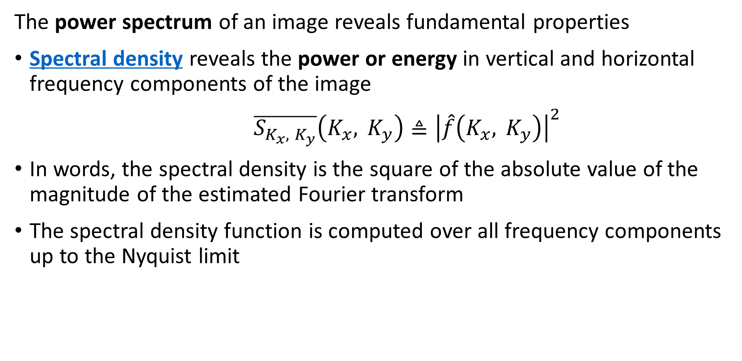
Spectral Properties of Images
The power spectrum of an image reveals fundamental properties
Spectral density reveals the power or energy in vertical and horizontal frequency components of the image
$\overline{S_{K_{x}, K_{y}}}\left(K_{x}, K_{y}\right)≜{\left|\hat{f}\left(K_{x}, K_{y}\right)\right|}^{2}$
In words, the spectral density is the square of the absolute value of the magnitude of the estimated Fourier transform
The spectral density function is computed over all frequency components up to the Nyquist limit

Slide 48
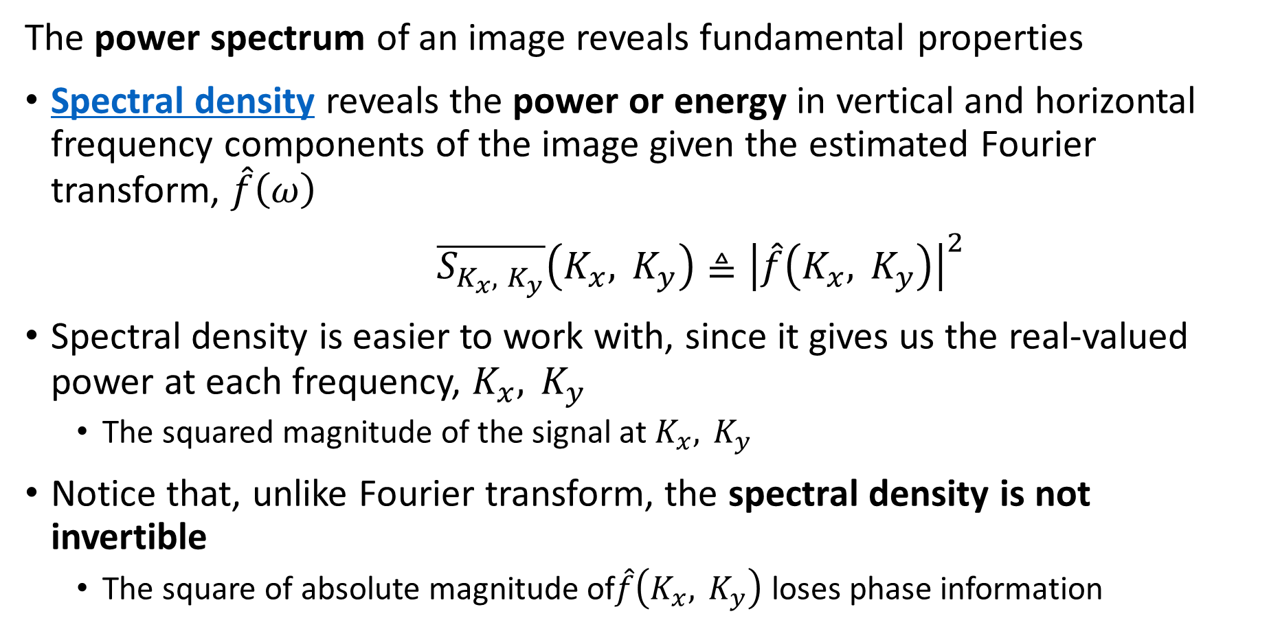
Spectral Properties of Images
The power spectrum of an image reveals fundamental properties
Spectral density reveals the power or energy in vertical and horizontal frequency components of the image given the estimated Fourier transform, $\hat{f}\left(ω\right)$
$\overline{S_{K_{x}, K_{y}}}\left(K_{x}, K_{y}\right)≜{\left|\hat{f}\left(K_{x}, K_{y}\right)\right|}^{2}$
Spectral density is easier to work with, since it gives us the real-valued power at each frequency, $K_{x}, K_{y}$
The squared magnitude of the signal at $K_{x}, K_{y}$
Notice that, unlike Fourier transform, the spectral density is not invertible
The square of absolute magnitude of$\hat{f}\left(K_{x}, K_{y}\right)$ loses phase information

Slide 49
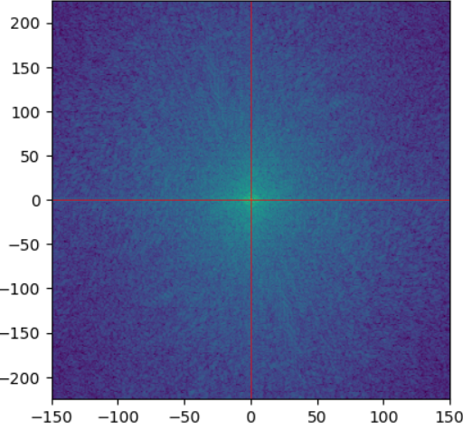
Spectral Properties of Images
Spectral density reveals the power or energy of vertical and horizontal frequency components of the image
Increasing Horizontal frequency
Increasing Horizontal frequency
For real-valued image, spectral density is symmetric about zero frequency
Rapid changes (e.g. edges, corners) are the high frequency components
Increasing vertical frequency
Vertical frequency = 0
Increasing vertical frequency
Horizontal frequency = 0

Slide 50
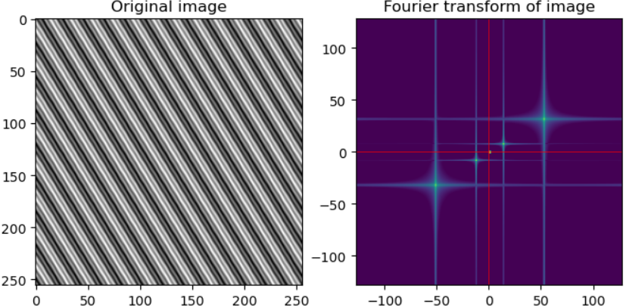
Spectral Properties of Images
Spectral density reveals the power or energy in vertical and horizontal frequency components of the image
Example; image with vertical and horizontal composite sinusoidal components
Power spectrum of image shows peaks at horizontal and vertical frequency components – notice the symmertry

Slide 51
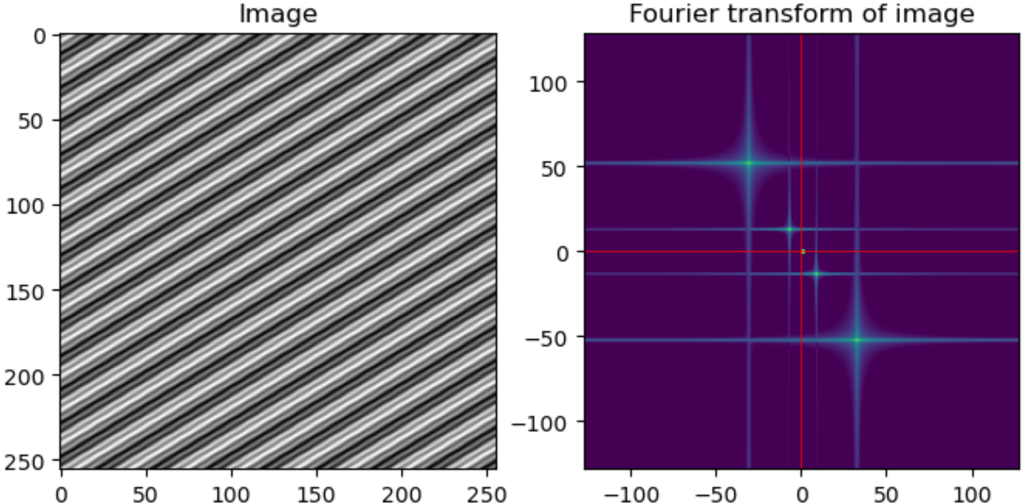
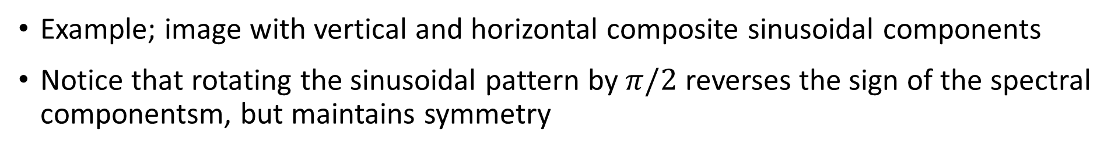
Spectral Properties of Images
Spectral density reveals the power or energy in vertical and horizontal frequency components of the image
Example; image with vertical and horizontal composite sinusoidal components
Notice that rotating the sinusoidal pattern by $π/2$ reverses the sign of the spectral componentsm, but maintains symmetry

Slide 52
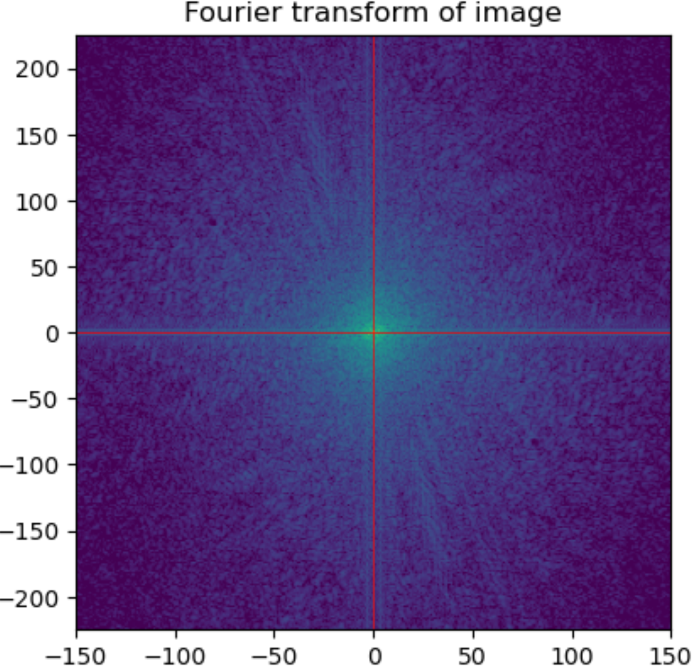
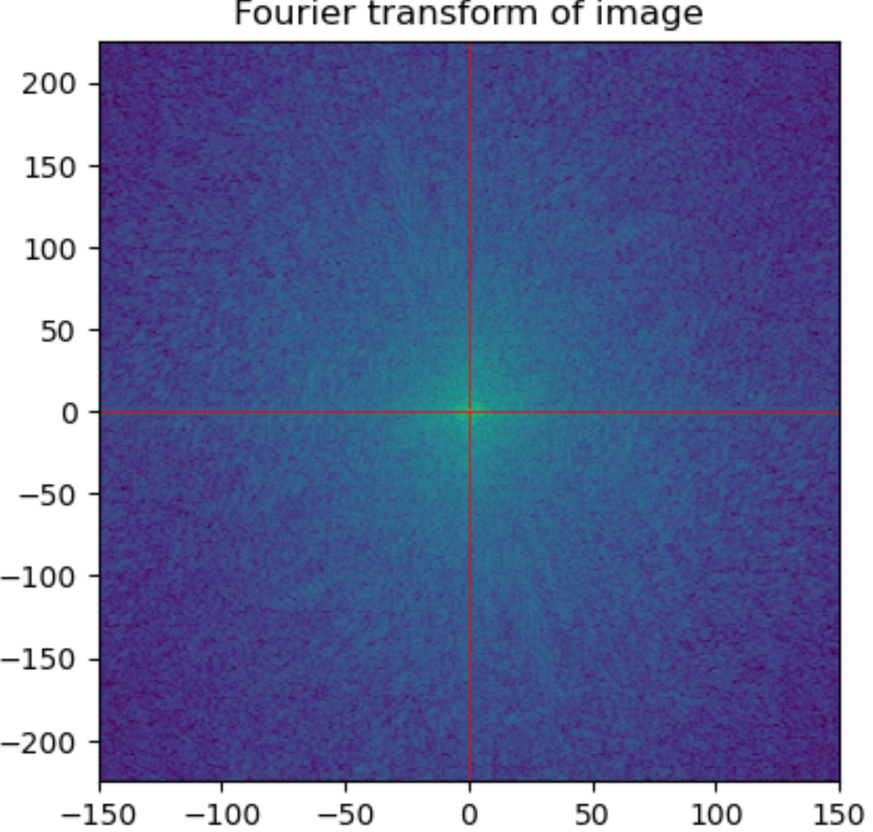
Spectral Properties of Images
Changes in spectral density show the effect of filtering
Filters change the spectral characteristics of images
Equalization distributes the power spectrum more uniformly
Equalization boosts higher frequency components
Contrast Limited Adaptive Histogram Equalization

Slide 53
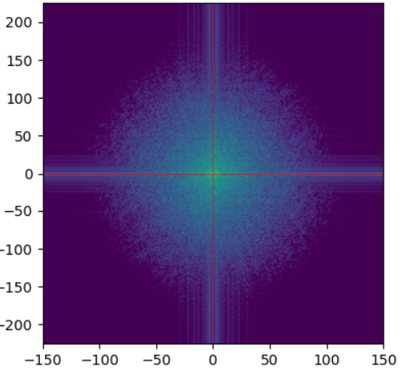
Spectral Properties of Images
Changes in spectral density show the effect of filtering
Filters change the spectral characteristics of images
Filters can suppress unwanted high frequency noise
Filtering reduces aliasing
Lower frequency image is blurred – edges and corners less sharp
Gaussian Filter
σ = 1.0

Slide 54
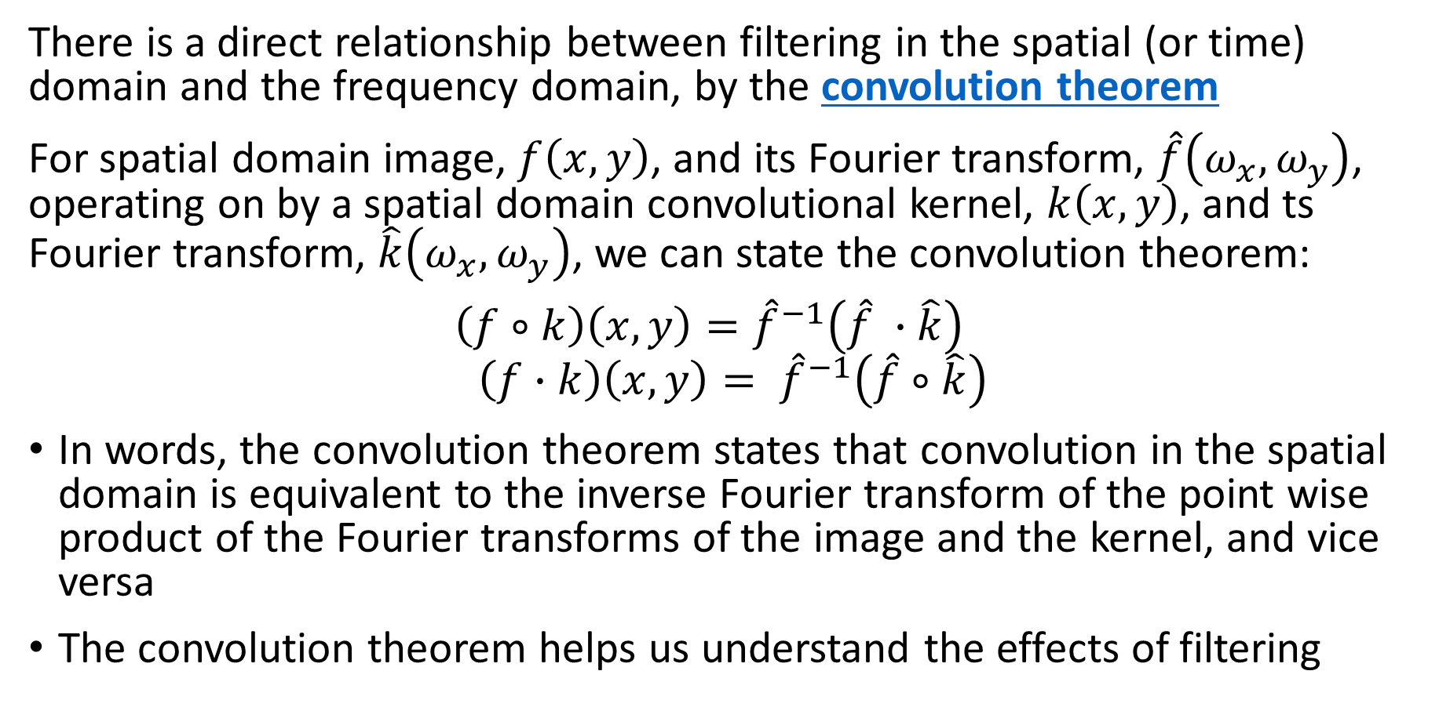
The Convolution Theorem
There is a direct relationship between filtering in the spatial (or time) domain and the frequency domain, by the convolution theorem
For spatial domain image, $f\left(x,y\right)$, and its Fourier transform, $\hat{f}\left(ω_{x},ω_{y}\right)$, operating on by a spatial domain convolutional kernel, $k\left(x,y\right)$, and ts Fourier transform, $\hat{k}\left(ω_{x},ω_{y}\right)$, we can state the convolution theorem:
$\left(f∘k\right)\left(x,y\right)={\hat{f}}^{−1}\left(\hat{f} ∙\hat{k}\right)$
$$\left(f∙k\right)\left(x,y\right)= {\hat{f}}^{−1}\left(\hat{f}∘\hat{k}\right)$$
In words, the convolution theorem states that convolution in the spatial domain is equivalent to the inverse Fourier transform of the point wise product of the Fourier transforms of the image and the kernel, and vice versa
The convolution theorem helps us understand the effects of filtering

Slide 55
Gaussian Filtering and Image Pyramids

Slide 56
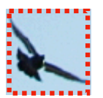
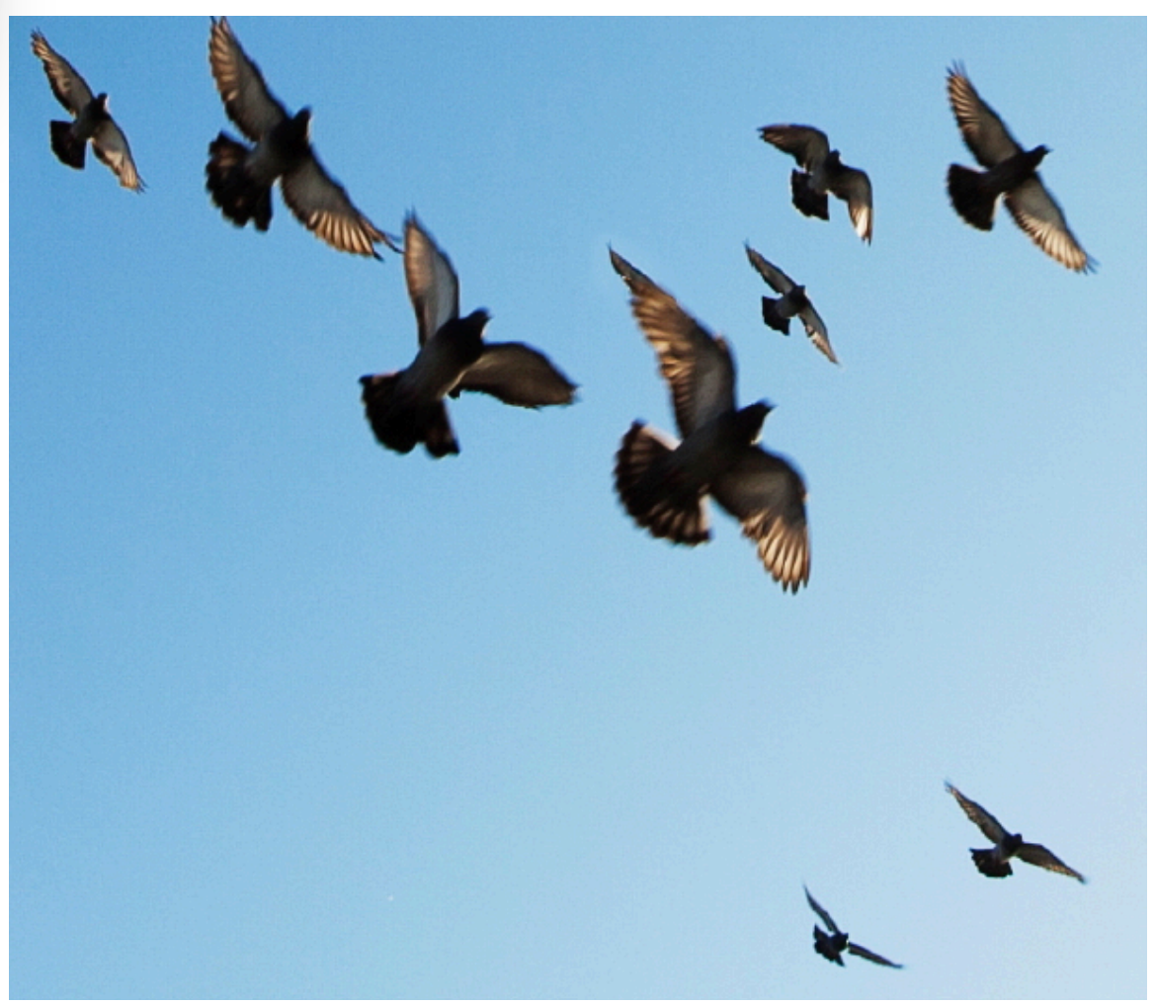
Image Pyramid Example
Search an image for objects matching a template
Similar objects in the image can appear with different scales
Template has fixed scale
Image credit, Lecture slides, Sitzmann, Konaković Luković, and Freeman, 2023
Template

Slide 57
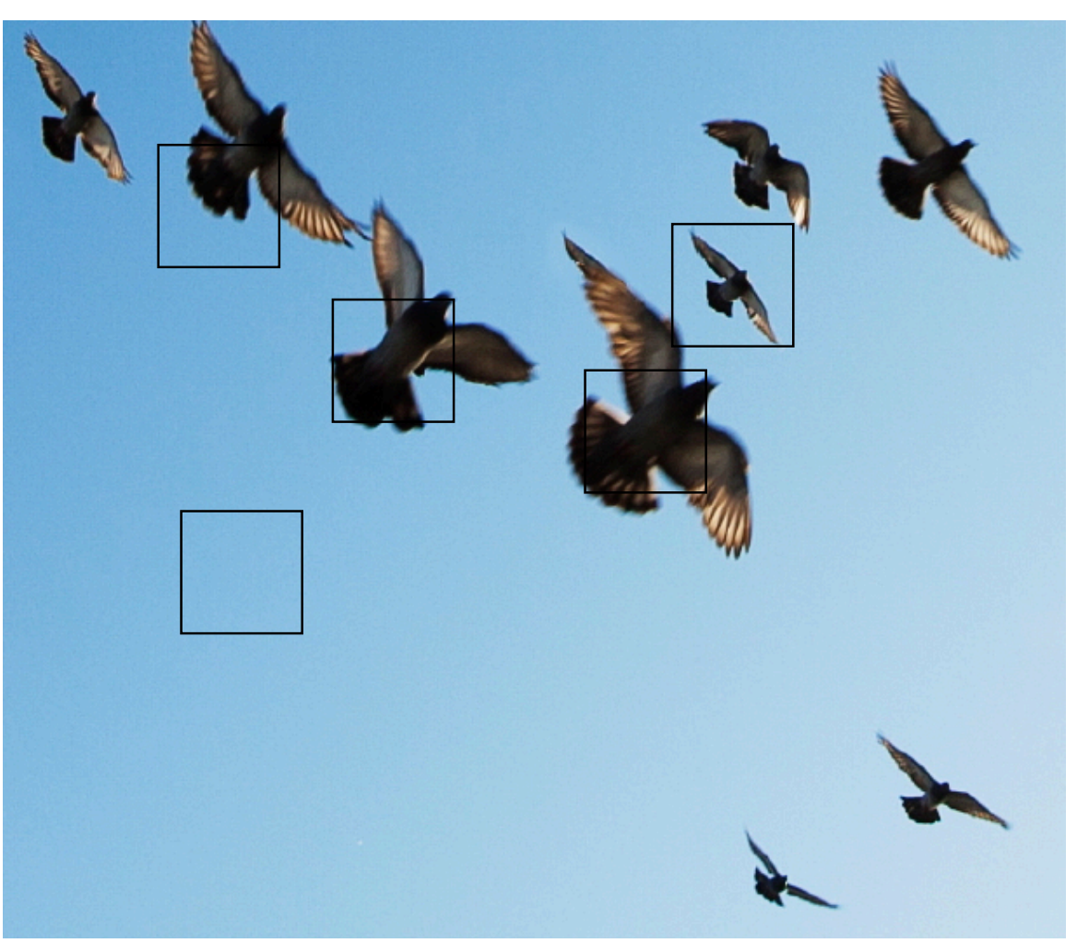

Image Pyramid Example
Search an image for objects matching a template
Using only 1 scale leads to poor results
Search with template
Result
Template
Image credit, Lecture slides, Sitzmann, Konaković Luković, and Freeman, 2023

Slide 58

Image Pyramid Example
Search an image for objects matching a template
Search on multi-scale pyramid leads to scale intendent results
More satisfactory result
Template
Image credit, Lecture slides, Sitzmann, Konaković Luković, and Freeman, 2023

Slide 59

Gaussian filtering and down sampling
Use Gaussian filtering allows down sampling without aliasing
Convolve image with Gaussian filter
Subsampling performed at stride >1
Filtering image to lower resolution eliminates aliasing
Create image pyramid by Gaussian down sampling by octaves (factor of 2)

Slide 60
Summary
Key points for this lesson
How convolutional works in 1-d, 2-d and higher dimension
How to apply padding, stride and tiling for convolution
Constructing convolutional filter kernels
Linear separation of convolutional kernels
The relationship between filtering and the spectrum of images
Image pyramids address the issue of multiple scales in images

