Slide 1

CSCI E-25 Computer Vision
Generative Diffusion Models
Steve Elston
Copyright 2022, 2023, 2024, 2025, 2026, Stephen F Elston. All rights reserved.

Slide 2
Generative Models for CV
Generative CV models have many purposes
Super resolution models to enhance images
Create ‘skins’ for skeletons of design tools
Generation of scenes given text prompts
Inpainting to fill gaps in image mosaics
Creation of images for virtual worlds
Generation of 3-d scene maps
Segmentation of images
Optical flow and motion detection
Etc….

Slide 3
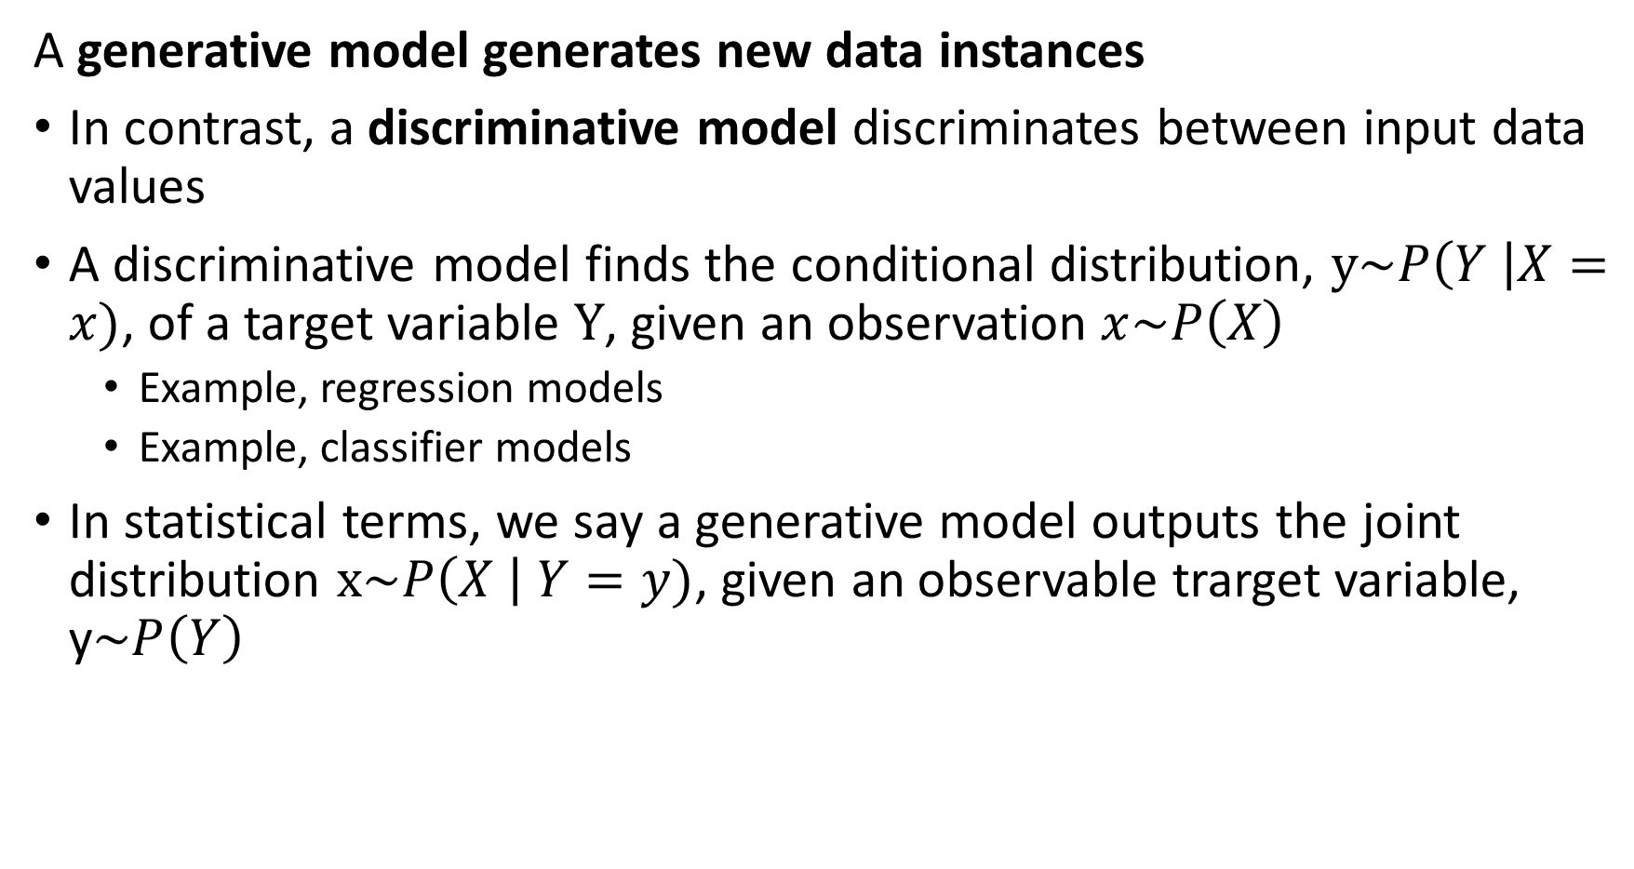
Generative Models
A generative model generates new data instances
In contrast, a discriminative model discriminates between input data values
A discriminative model finds the conditional distribution, $y\sim P\left(Y \right|X=x)$, of a target variable $Y$, given an observation $x\sim P\left(X\right)$
Example, regression models
Example, classifier models
In statistical terms, we say a generative model outputs the joint distribution $x\sim P\left(X \right| Y=y)$, given an observable trarget variable, y$\sim P\left(Y\right)$

Slide 4
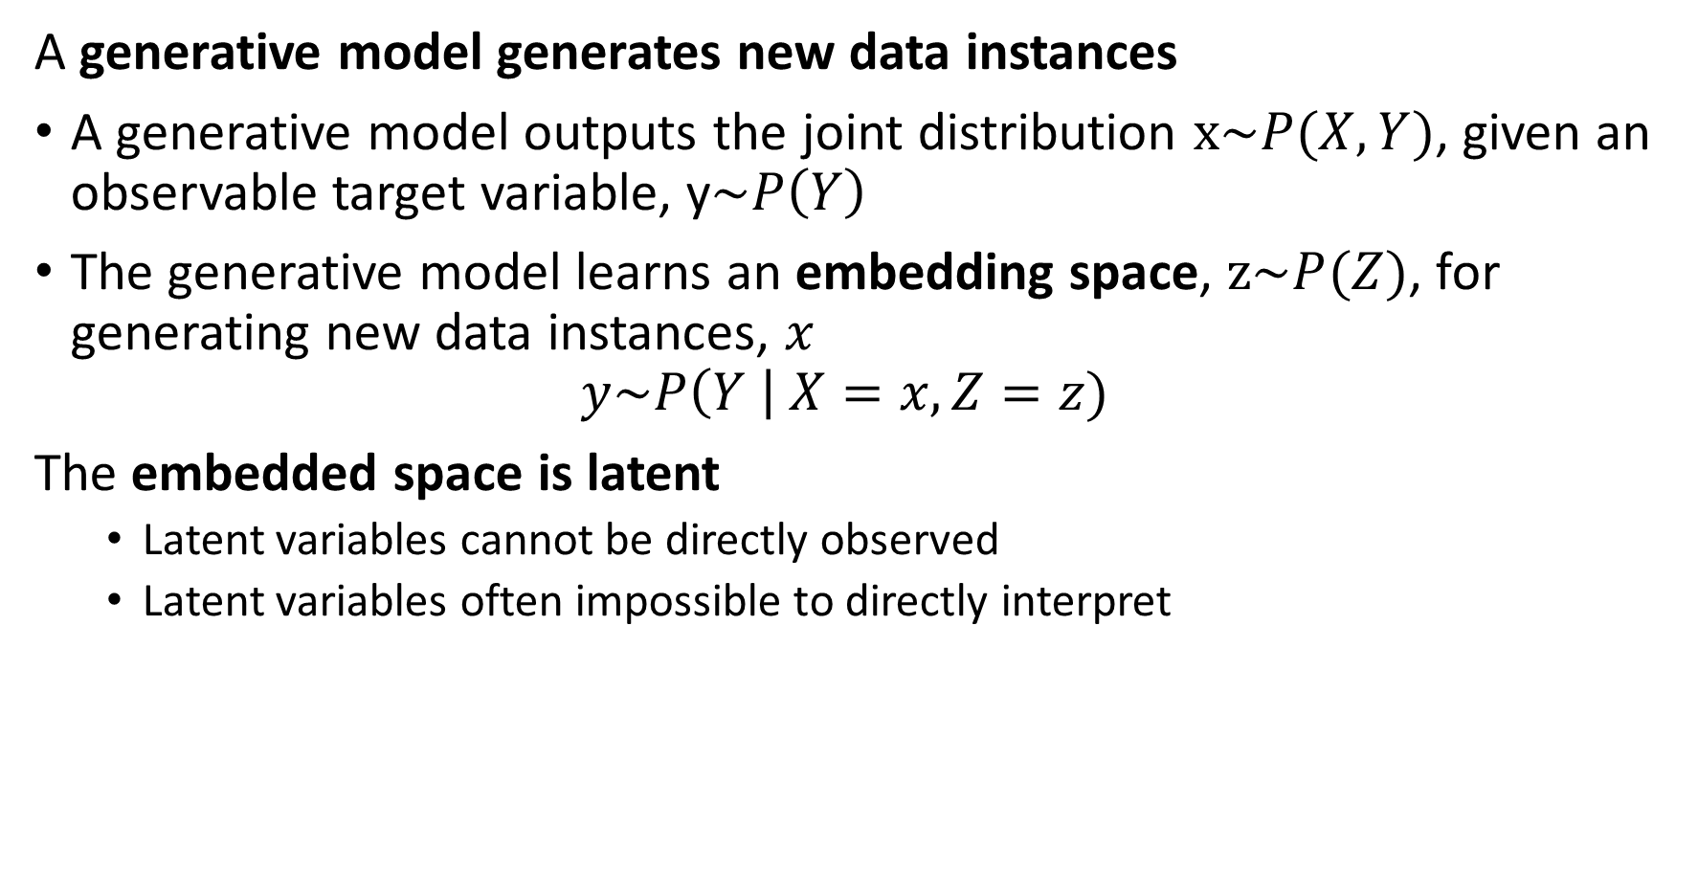
Generative Models
A generative model generates new data instances
A generative model outputs the joint distribution $x\sim P(X,Y)$, given an observable target variable, y$\sim P\left(Y\right)$
The generative model learns an embedding space, $z\sim P(Z)$, for generating new data instances, $x$
$$y\sim P\left(Y \right| X=x,Z=z)$$
The embedded space is latent
Latent variables cannot be directly observed
Latent variables often impossible to directly interpret

Slide 5
Generative Models
Generative Models output new data cases
A generator learns an embedding space from data input
Generator produces output data from embedding space from random seed, z
A critic or discriminative model evaluates the quality of the output with feedback used to improve learning of embedding space
Training Data
Z
Critic
Embedding Space
Generator
Output

Slide 6
Generative Models
Key references used to prepare this lesson
Denoising Diffusion Probabilistic Models, Ho, Jain and Abbeel, 2020
Denoising Diffusion Implicit Models, Song, Meng and Ermon, 2022
Classifier-Free Diffusion Guidance, Ho and Salimans, 2022
Understanding Diffusion Models: A Unified Perspective, Luo, 2022
What are Diffusion Models?, Lian Weng’s blog post, updated, 2024
Generative image models are an active area of research with rapidly growing literature. We can only discuss the basics in one short lesson
Score matching, an alternative approach to learning in diffusion networks can be found in Song, et. al., 2019

Slide 7
Algorithms for Generative Models

Slide 8
Algorithms for Generative Models
Generative AI models are a hot topic presently
Generative image models have a long history
Generative Adversarial Network (GAN) algorithm proposed by Goodfellow, et.al. 2014
Other contenders for generative image models include:
Autoregressive models
Variational autoencoders
Flow-based models
Diffusion models – our focus here
More recently generative diffusion models have come to dominate generative image models

Slide 9
Algorithms for Generative Models
There are two broad categories of generative image models
Generative Adversarial Networks (GANs) are based on adversarial learning in a zero-sum non-cooperative game
Generator learns to fool the discriminator
Discriminator learns to discriminate between real and generated images
Alternating learning between generator and discriminator improves both
Models that maximize likelihood of the generated image using a latent space are our focus
Autoregressive models – see text
Variational autoencoders
Flow-based models
Diffusion models

Slide 10
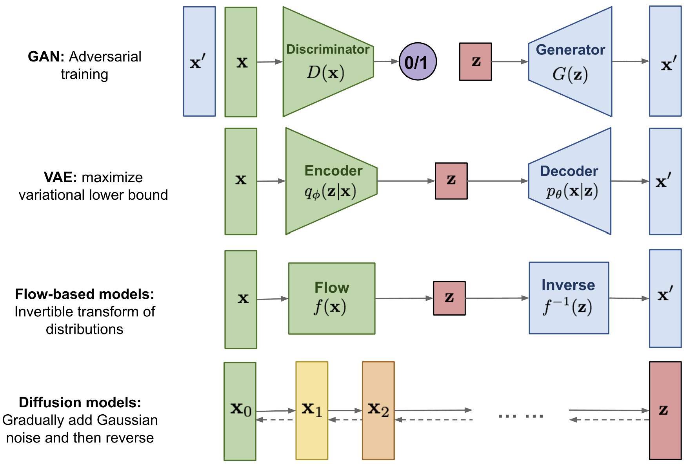
Alternatives to GANs
Lilian Weng’s blog post compares 4 approaches to image generative models

Slide 11
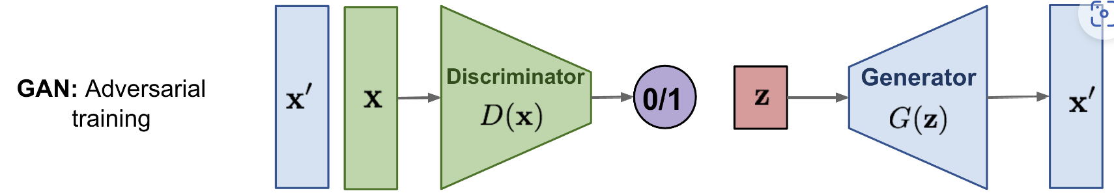
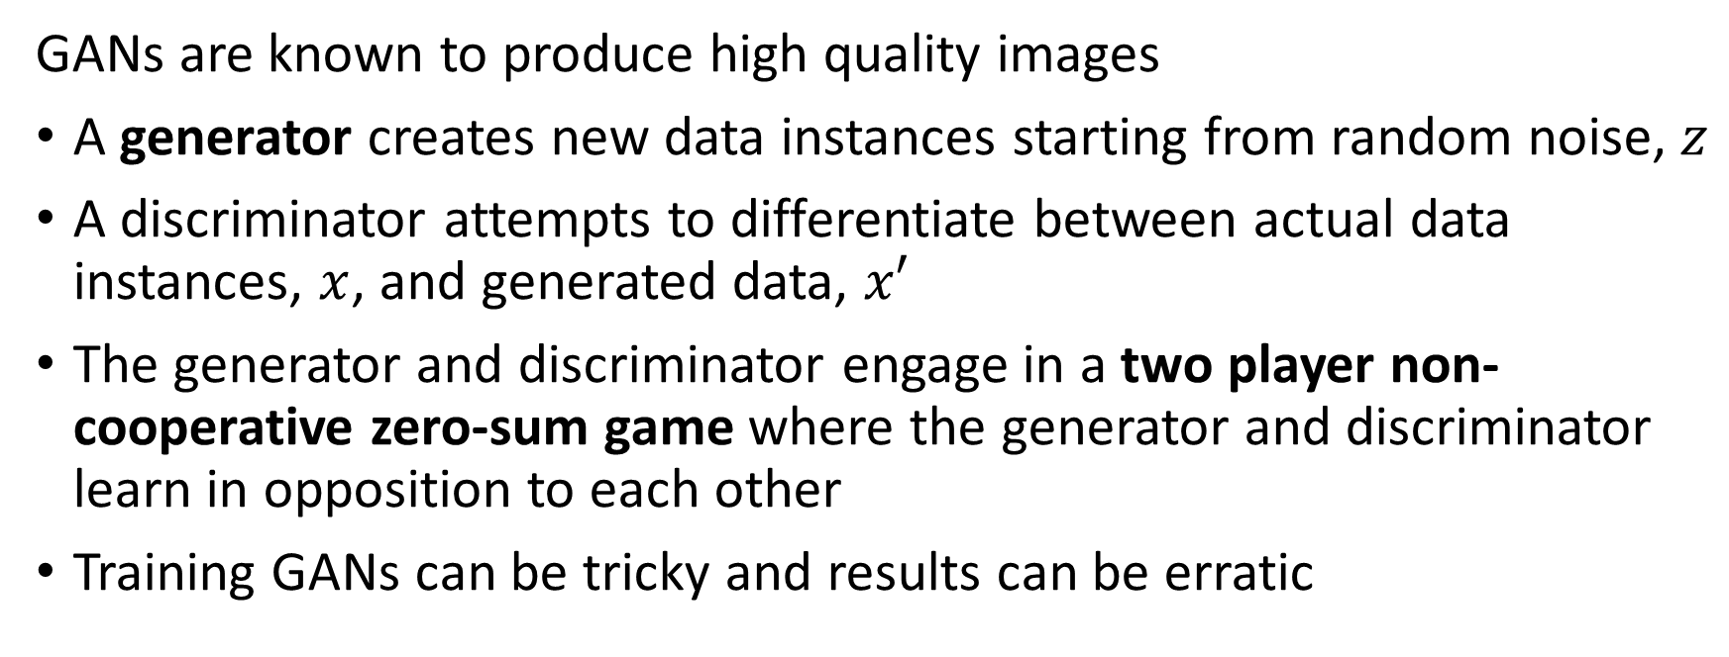
Generative Adversarial Networks, GANs
GANs are known to produce high quality images
A generator creates new data instances starting from random noise, $z$
A discriminator attempts to differentiate between actual data instances, $x$, and generated data, $x′$
The generator and discriminator engage in a two player non-cooperative zero-sum game where the generator and discriminator learn in opposition to each other
Training GANs can be tricky and results can be erratic

Slide 12
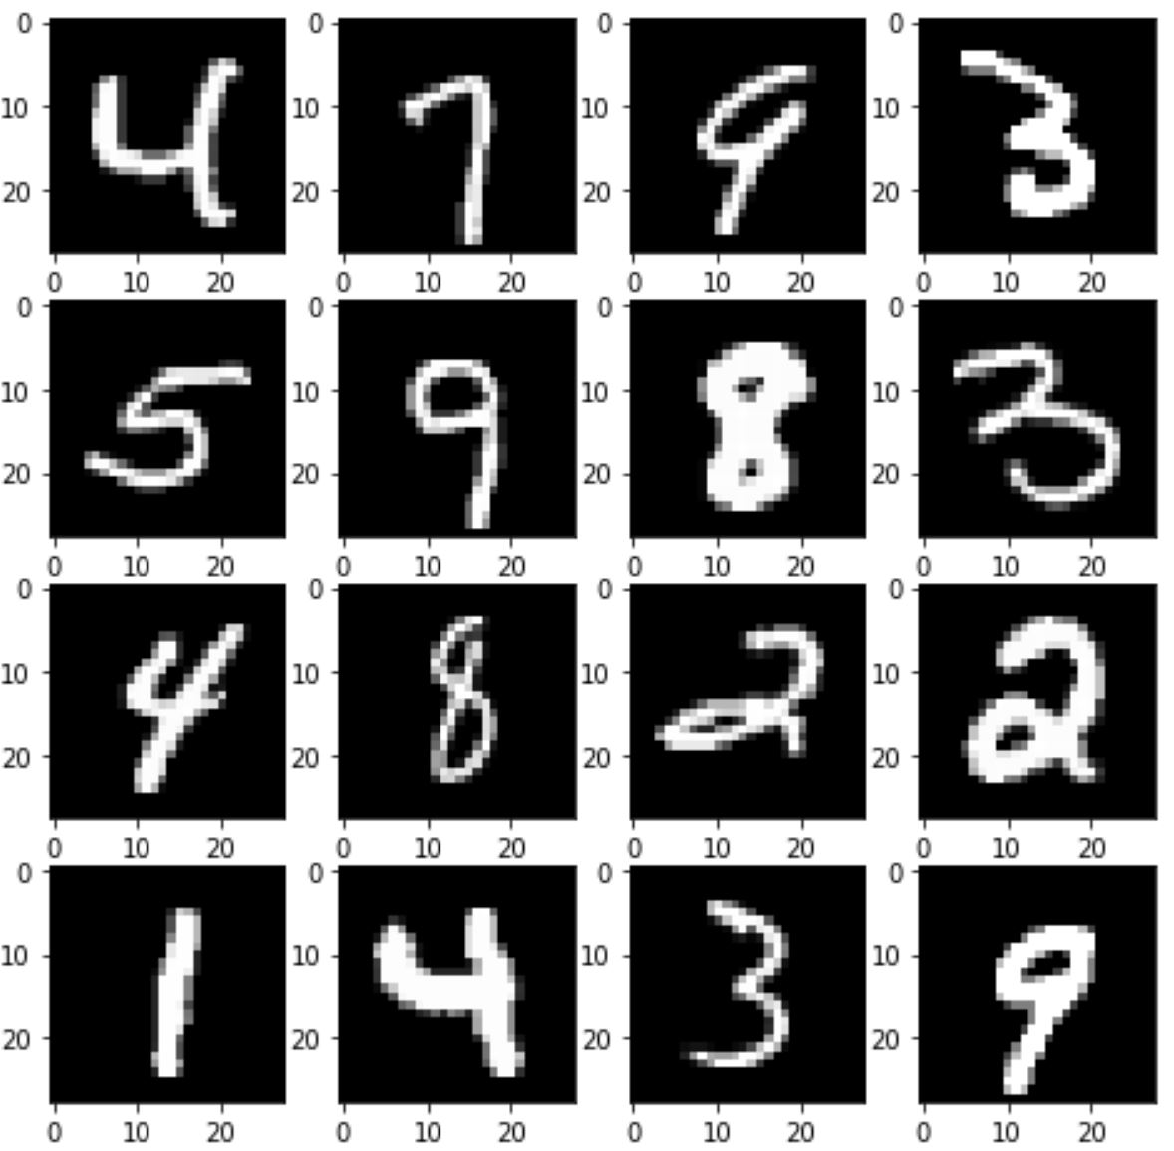
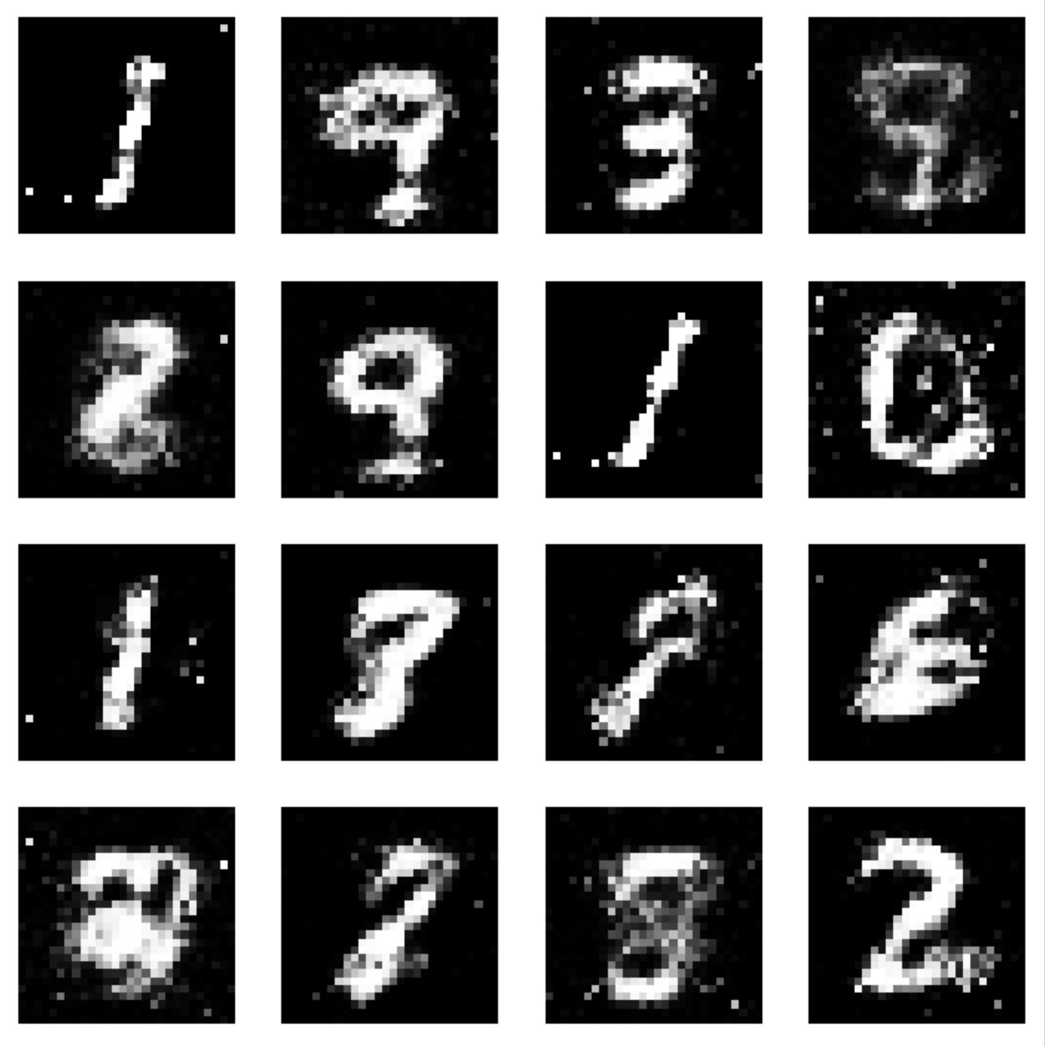
Basic GAN architecture
Discriminator
Loss
Training Data
Real Images
Generator
Noise
Generated Images

Slide 13
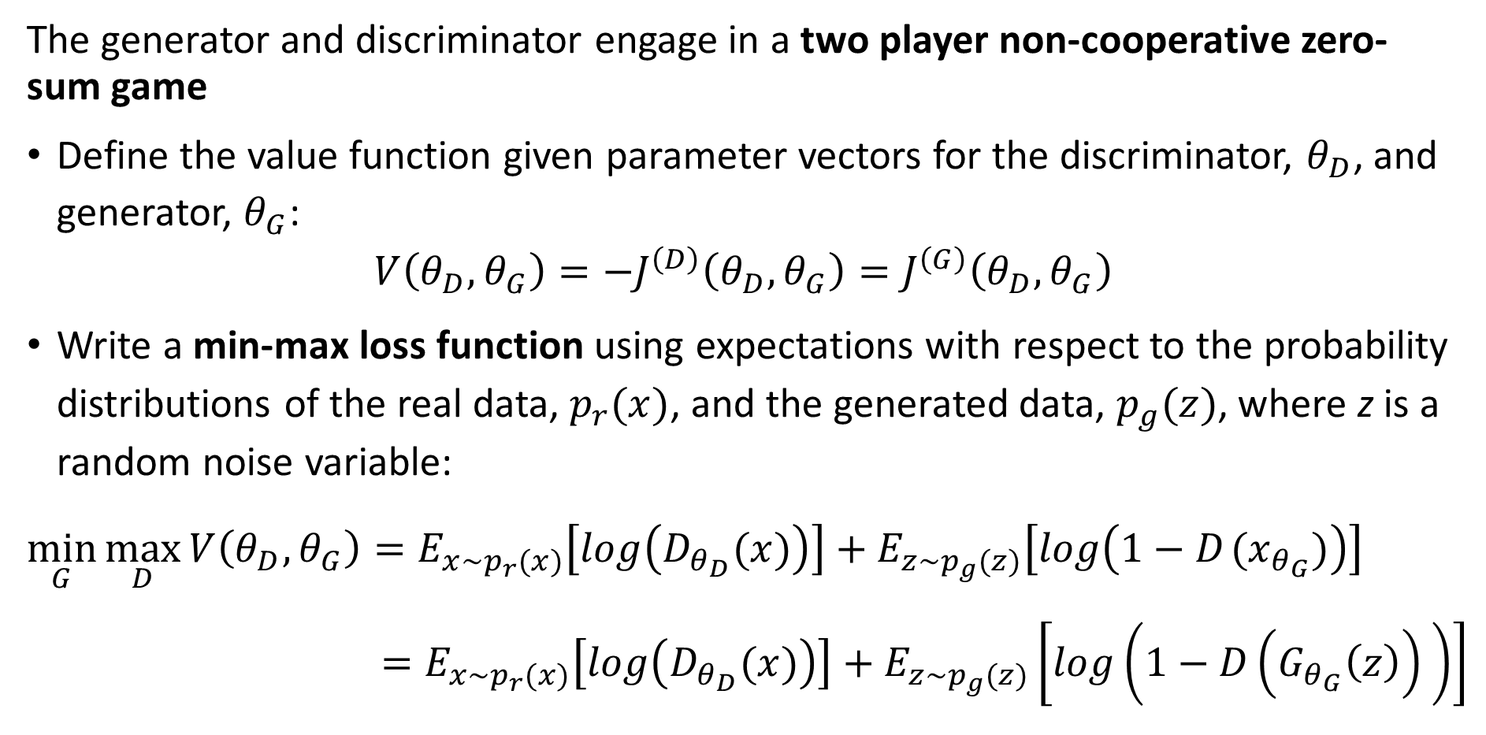
Game theory and GAN training
The generator and discriminator engage in a two player non-cooperative zero-sum game
Define the value function given parameter vectors for the discriminator, $θ_{D}$, and generator, $θ_{G}$:
$$V\left(θ_{D},θ_{G}\right)=−J^{\left(D\right)}\left(θ_{D},θ_{G}\right)=J^{\left(G\right)}\left(θ_{D},θ_{G}\right)$$
Write a min-max loss function using expectations with respect to the probability distributions of the real data, $p_{r}(x)$, and the generated data, $p_{g}(z)$, where z is a random noise variable:
$$\min_{G}{\max_{D}{V\left(θ_{D},θ_{G}\right)=E_{x\sim p_{r}(x)}\left[log\left(D_{θ_{D}}(x)\right)\right]+E_{z\sim p_{g}(z)}\left[log\left({1−D}_{ }(x_{θ_{G}})\right)\right] \underset{ }{}{{ =E_{x\sim p_{r}(x)}\left[log\left(D_{θ_{D}}(x)\right)\right]+E_{z\sim p_{g}(z)}\left[log\left({1−D\left(G_{θ_{G}}\left(z\right)\right)}_{ }\right)\right]}}}}$$

Slide 14
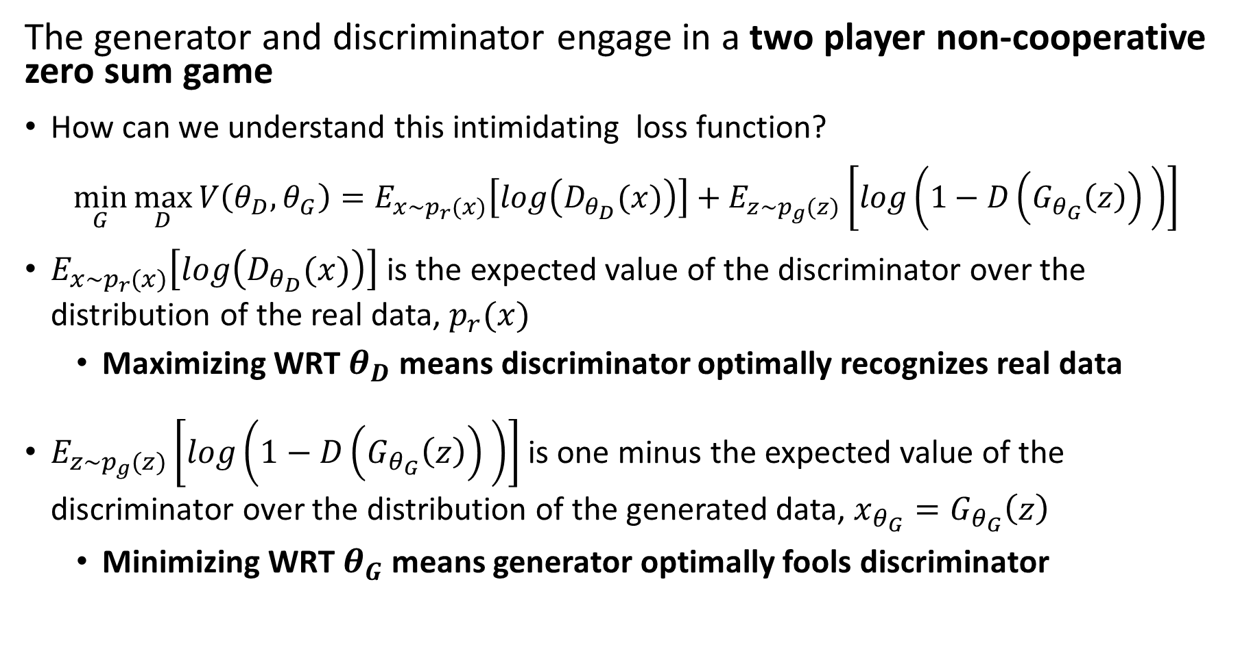
Game theory and GAN training
The generator and discriminator engage in a two player non-cooperative zero sum game
How can we understand this intimidating loss function?
$$\min_{G}{\max_{D}{V\left(θ_{D},θ_{G}\right)=E_{x\sim p_{r}(x)}\left[log\left(D_{θ_{D}}(x)\right)\right]+E_{z\sim p_{g}(z)}\left[log\left({1−D\left(G_{θ_{G}}\left(z\right)\right)}_{ }\right)\right] }}$$
$E_{x\sim p_{r}(x)}\left[log\left(D_{θ_{D}}(x)\right)\right]$ is the expected value of the discriminator over the distribution of the real data, $p_{r}(x)$
Maximizing WRT $θ_{D}$ means discriminator optimally recognizes real data
$E_{z\sim p_{g}(z)}\left[log\left({1−D\left(G_{θ_{G}}\left(z\right)\right)}_{ }\right)\right]$ is one minus the expected value of the discriminator over the distribution of the generated data, $x_{θ_{G}}=G_{θ_{G}}\left(z\right)$
Minimizing WRT $θ_{G}$ means generator optimally fools discriminator

Slide 15
Introduction to GANs
Why do we need GANs when we have other image generative algorithms?
GANs are effective image generators
GANs are used for other generative tasks
Segmentation of images
3-D depth maps
…
But, GANs are notoriously hard to train
GANs can easily learn the wrong distribution
GAN loss function can focus on just one mode of the distribution, known as mode collapse
Christopher Beckham’s blog post with practical advice on training GANs

Slide 16
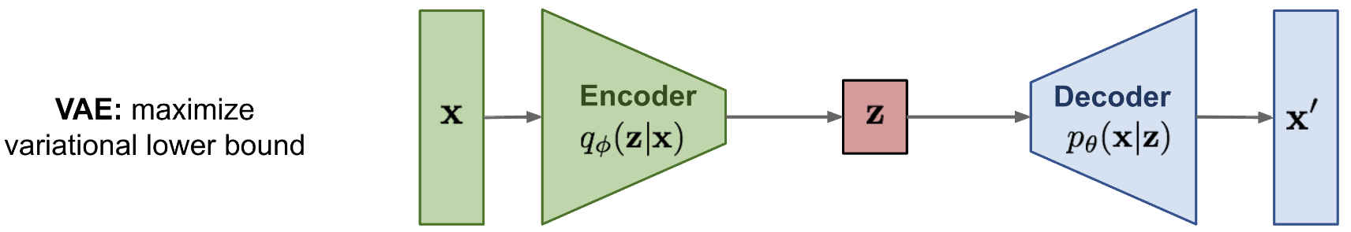
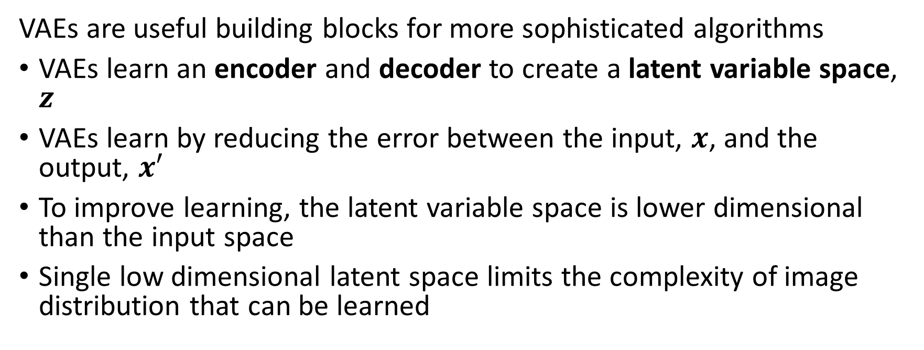
Variational Autoencoders, VAEs
VAEs are useful building blocks for more sophisticated algorithms
VAEs learn an encoder and decoder to create a latent variable space, $z$
VAEs learn by reducing the error between the input, $x$, and the output, $x′$
To improve learning, the latent variable space is lower dimensional than the input space
Single low dimensional latent space limits the complexity of image distribution that can be learned

Slide 17
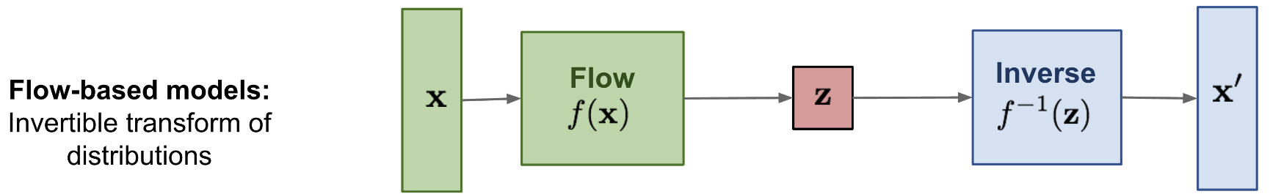
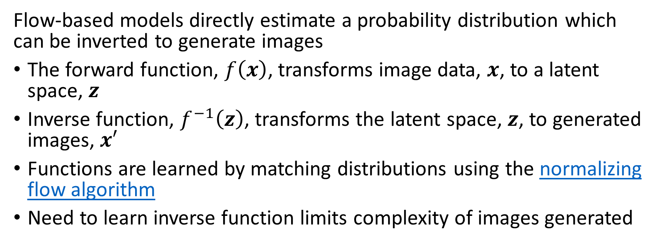
Flow-Based Models
Flow-based models directly estimate a probability distribution which can be inverted to generate images
The forward function, $f\left(x\right)$, transforms image data, $x$, to a latent space, $z$
Inverse function, $f^{−1}\left(z\right)$, transforms the latent space, $z$, to generated images, $x′$
Functions are learned by matching distributions using the normalizing flow algorithm
Need to learn inverse function limits complexity of images generated

Slide 18
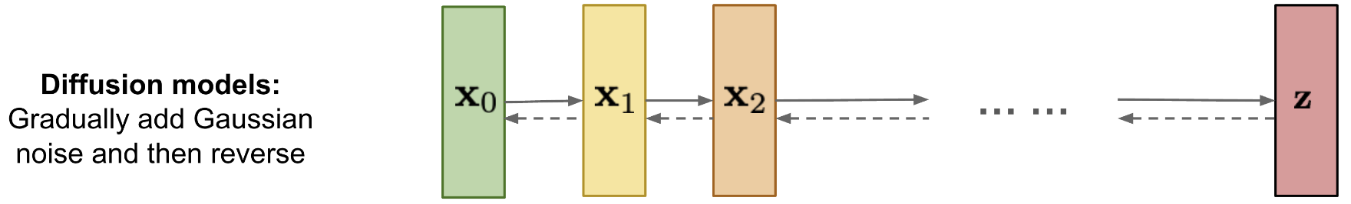
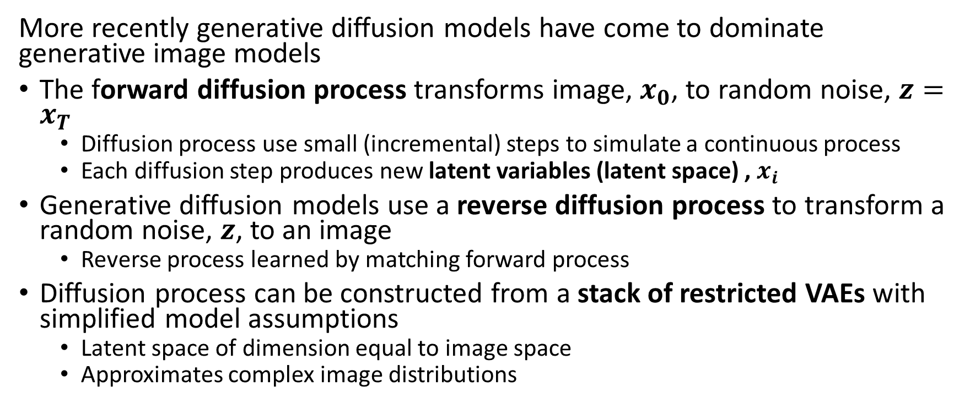
Generative Diffusion Models
More recently generative diffusion models have come to dominate generative image models
The forward diffusion process transforms image, $x_{0}$, to random noise, $z=x_{T}$
Diffusion process use small (incremental) steps to simulate a continuous process
Each diffusion step produces new latent variables (latent space) , $x_{i}$
Generative diffusion models use a reverse diffusion process to transform a random noise, $z$, to an image
Reverse process learned by matching forward process
Diffusion process can be constructed from a stack of restricted VAEs with simplified model assumptions
Latent space of dimension equal to image space
Approximates complex image distributions

Slide 19
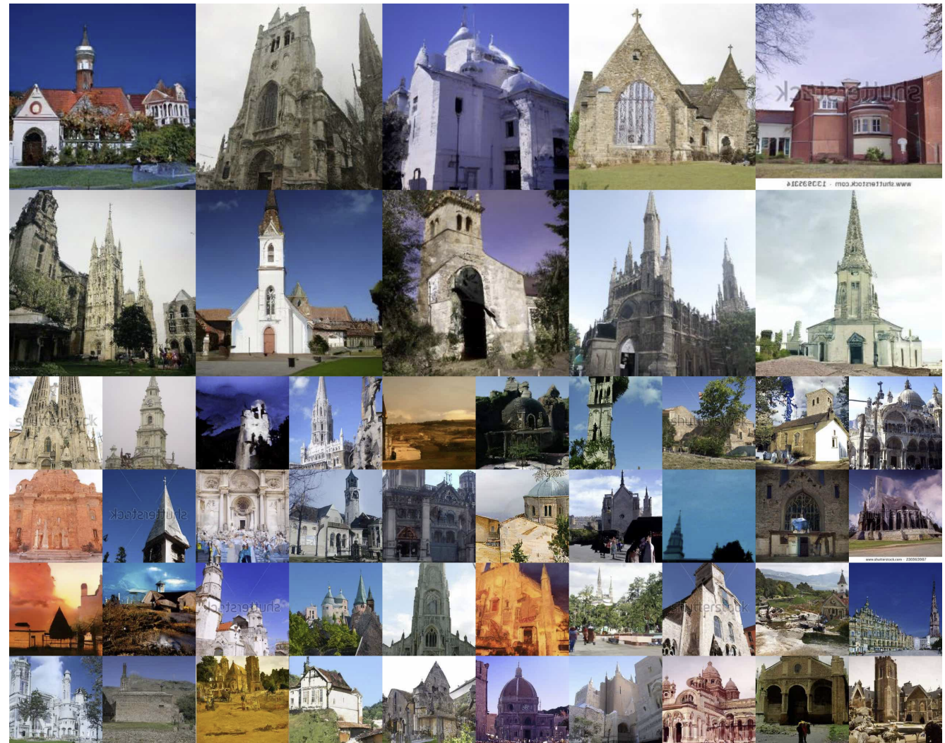
Generative Diffusion Models
Church steeple images generated by Denoising Diffusion Probabilistic Models, Ho, et. al., 2020

Slide 20
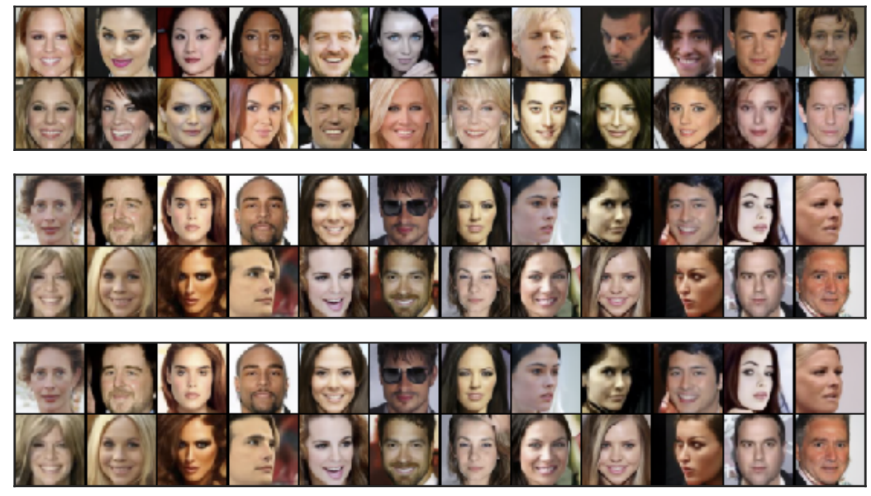
Generative Diffusion Models
Images generated by Denoising Diffusion Implicit Models, Song, et. al., 2022

Slide 21
Variational Autoencoders

Slide 22
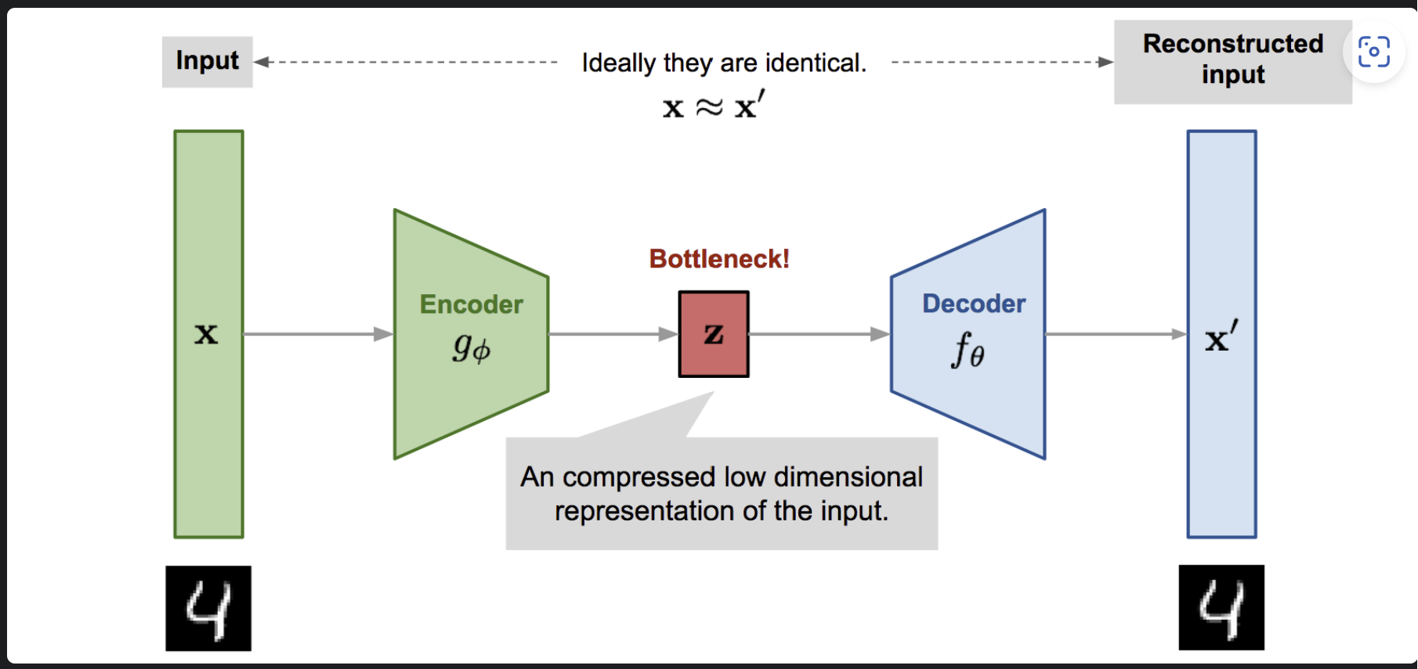
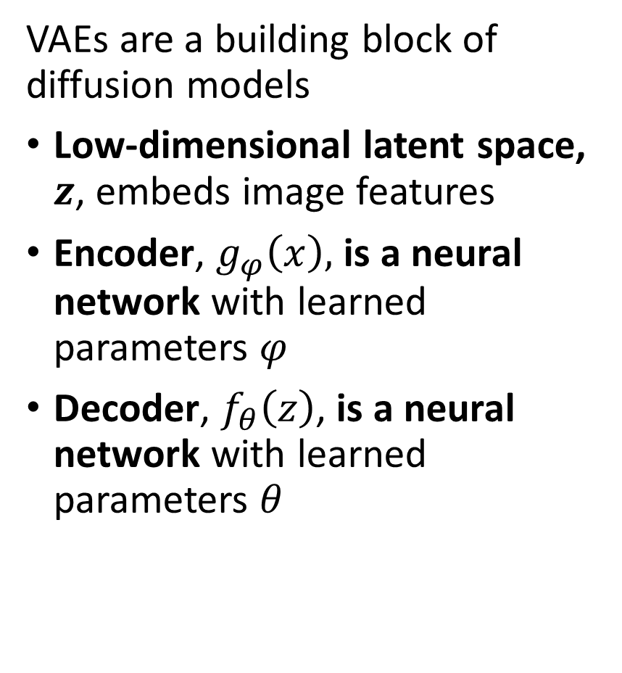
Variational Autoencoders
VAEs are a building block of diffusion models
Low-dimensional latent space, $z$, embeds image features
Encoder, $g_{φ}\left(x\right),$ is a neural network with learned parameters $φ$
Decoder, $f_{θ}\left(z\right)$, is a neural network with learned parameters $θ$
Image from Lilian Weng’s VAE blog post From Autoencoder to Beta-VAE

Slide 23
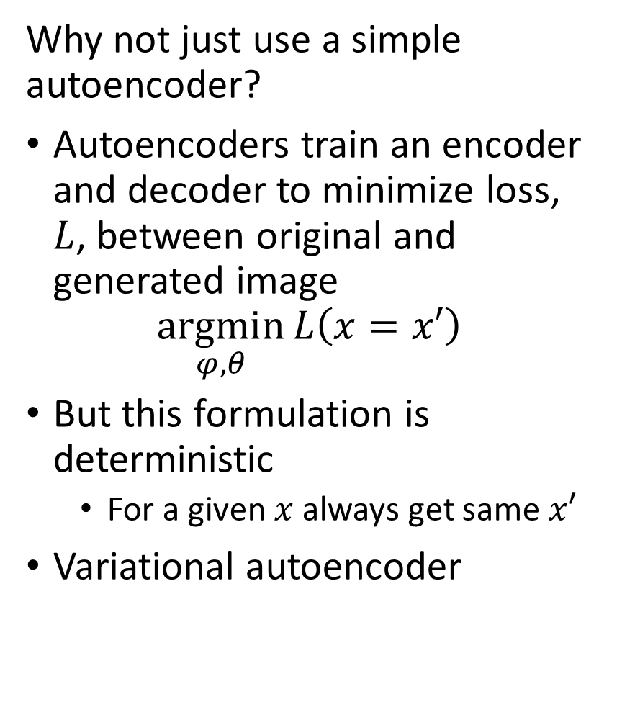
Variational Autoencoders
Why not just use a simple autoencoder?
Autoencoders train an encoder and decoder to minimize loss, $L$, between original and generated image
$$\underset{φ,θ}{argmin}{L\left(x=x′\right)}$$
But this formulation is deterministic
For a given $x$ always get same $x′$
Variational autoencoder
Image from Lilian Weng’s VAE blog post From Autoencoder to Beta-VAE

Slide 24
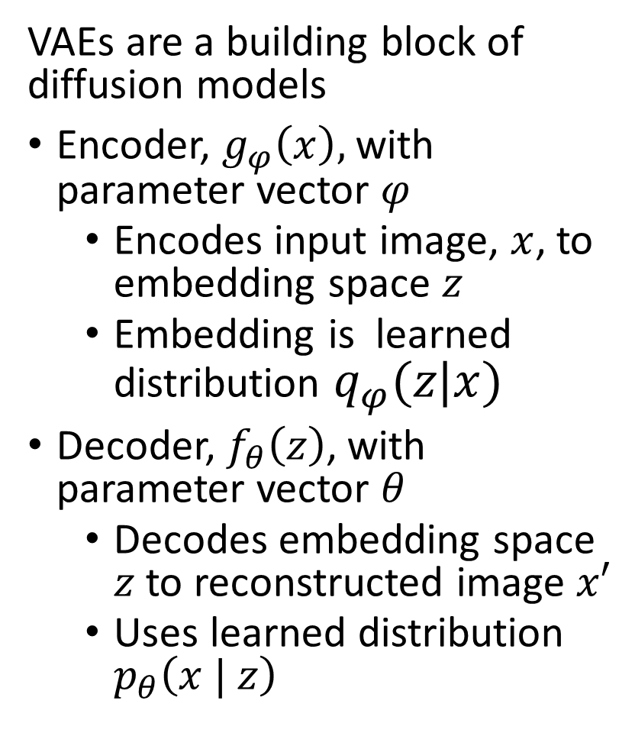
Variational Autoencoders
VAEs are a building block of diffusion models
Encoder, $g_{φ}\left(x\right),$ with parameter vector $φ$
Encodes input image, $x$, to embedding space $z$
Embedding is learned distribution $q_{φ}(z|x)$
Decoder, $f_{θ}\left(z\right)$, with parameter vector $θ$
Decodes embedding space $z$ to reconstructed image $x′$
Uses learned distribution $p_{θ}\left(x | z\right)$
Image from Lilian Weng’s VAE blog post From Autoencoder to Beta-VAE

Slide 25
Variational Theory and Evidence Lower Bound

Slide 26
Variational Theory and the Evidence Lower Bound
We can maximize likelihood by maximizing the evidence lower bound (ELBO)
Image data has complex probability distributions
Image generative models must approximate these complex distributions
Finding exact representation of these distributions is an intractable problem
We seek an approximate representation using Bayesian variational theory
This mathematical method is the basis for deriving VAEs and generative diffusion models

Slide 27
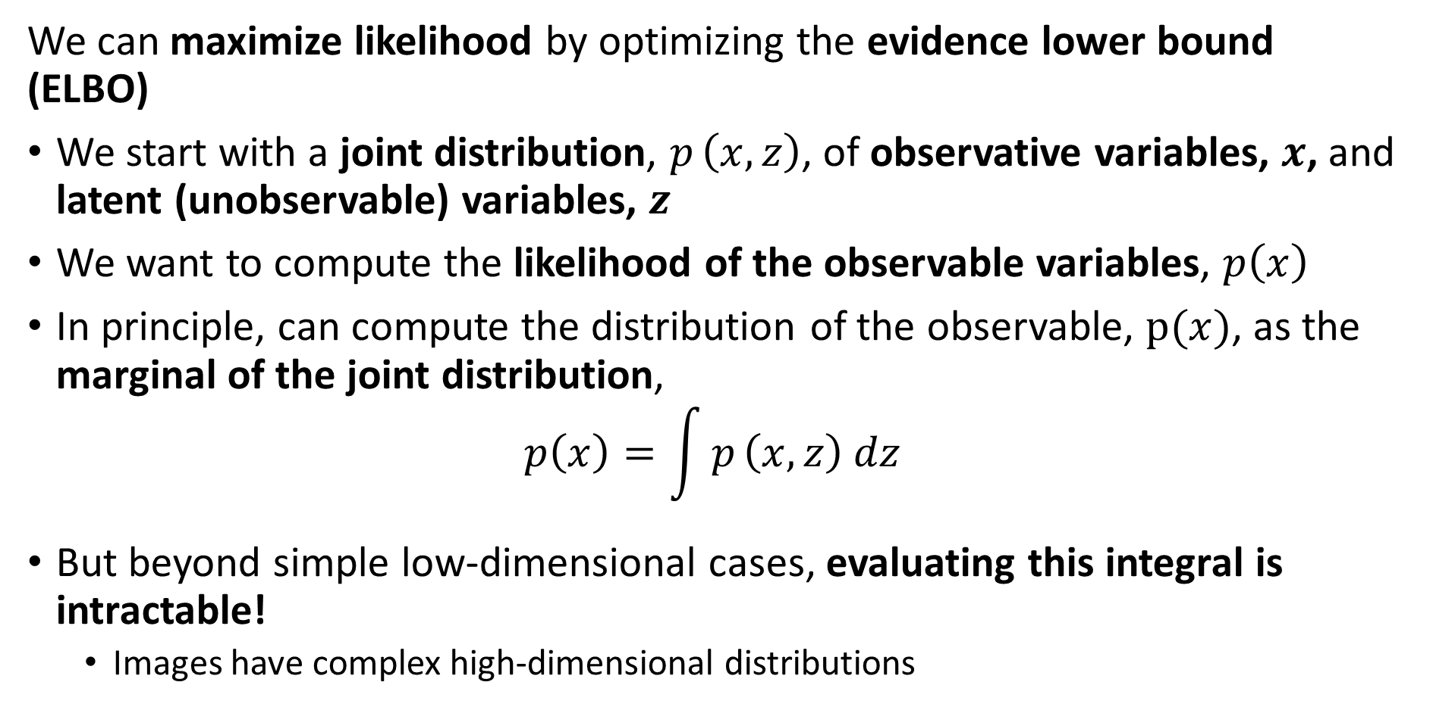
Variational Theory and the Evidence Lower Bound
We can maximize likelihood by optimizing the evidence lower bound (ELBO)
We start with a joint distribution, $p_{ }\left(x,z\right)$, of observative variables, $x$, and latent (unobservable) variables, $z$
We want to compute the likelihood of the observable variables, $p\left(x\right)$
In principle, can compute the distribution of the observable, $p(x)$, as the marginal of the joint distribution,
$$p\left(x\right)=\int{p_{ }\left(x,z\right) dz}$$
But beyond simple low-dimensional cases, evaluating this integral is intractable!
Images have complex high-dimensional distributions

Slide 28
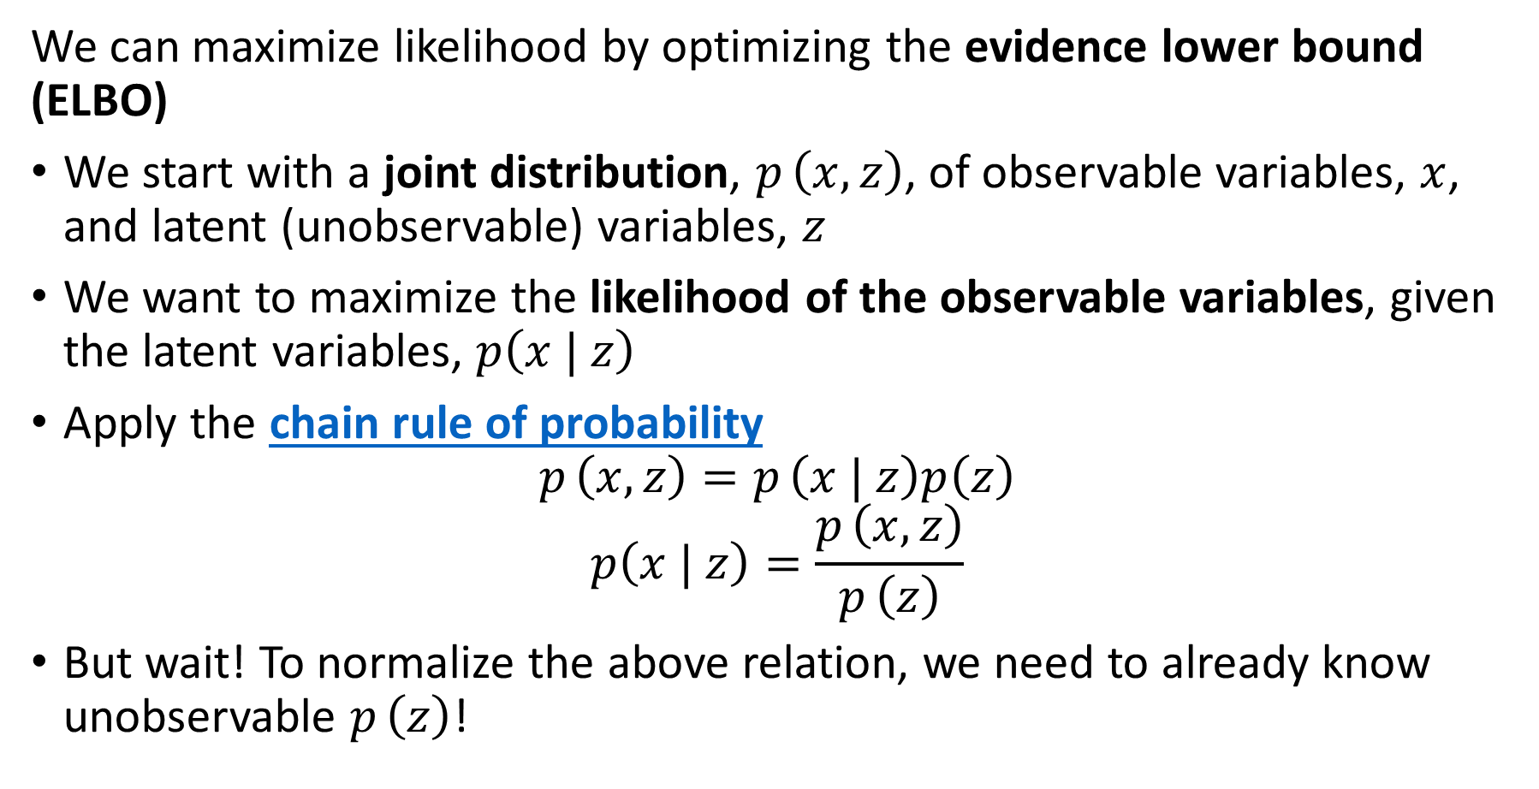
Variational Theory and the Evidence Lower Bound
We can maximize likelihood by optimizing the evidence lower bound (ELBO)
We start with a joint distribution, $p_{ }\left(x,z\right)$, of observable variables, $x$, and latent (unobservable) variables, $z$
We want to maximize the likelihood of the observable variables, given the latent variables, $p\left(x | z\right)$
Apply the chain rule of probability
$$p_{ }\left(x,z\right)=p_{ }\left(x | z\right)p\left(z\right)$$
$$p\left(x | z\right)=\frac{p_{ }\left(x,z\right)}{p_{ }\left(z\right)}$$
But wait! To normalize the above relation, we need to already know unobservable $p_{ }\left(z\right)$!

Slide 29
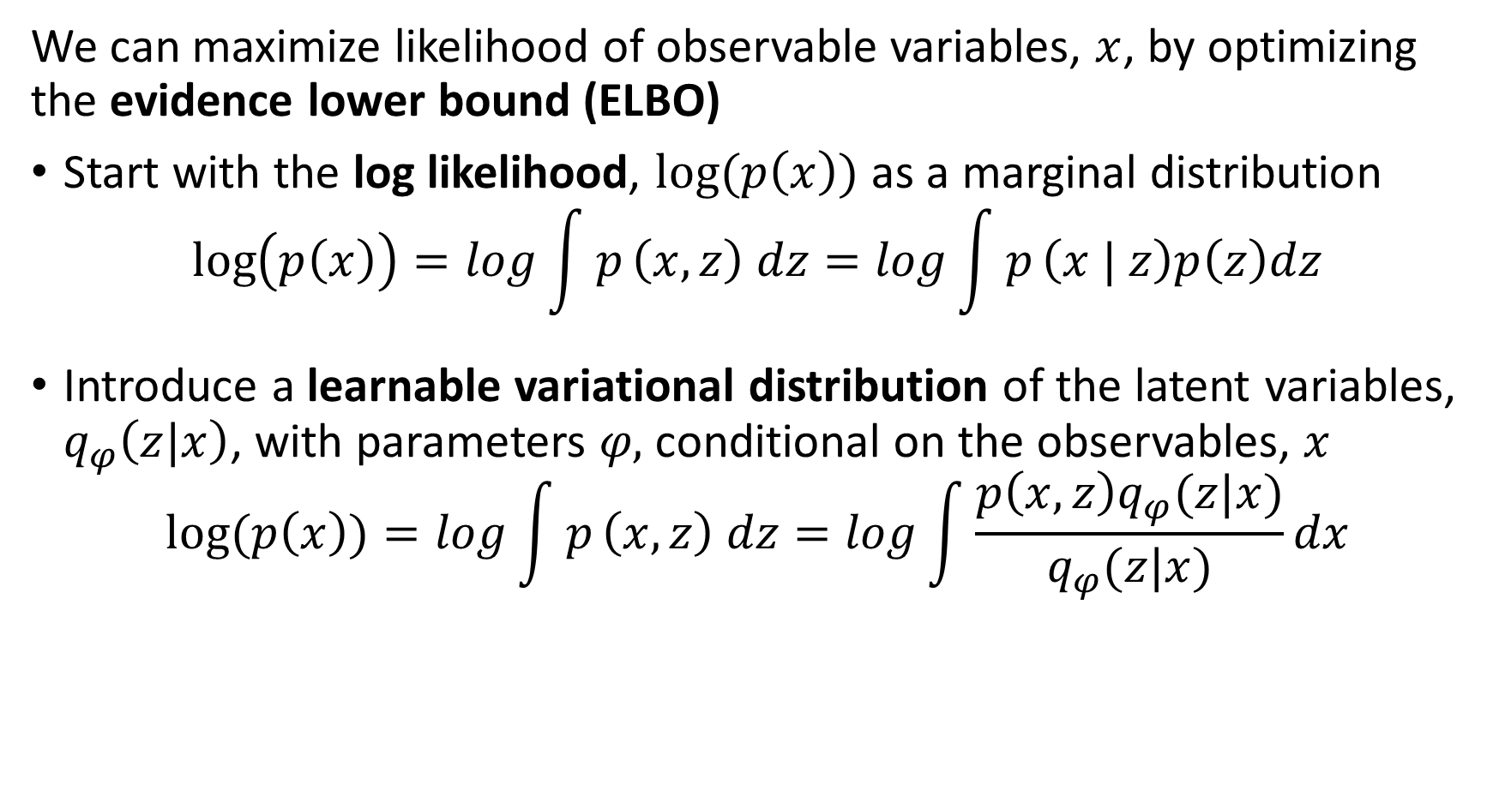
Variational Theory and the Evidence Lower Bound
We can maximize likelihood of observable variables, $x$, by optimizing the evidence lower bound (ELBO)
Start with the log likelihood, $log(p\left(x\right))$ as a marginal distribution
$$\log\left(p\left(x\right)\right)=log\int{p_{ }\left(x,z\right) dz}=log\int{p_{ }\left(x | z\right)p\left(z\right)dz}$$
Introduce a learnable variational distribution of the latent variables, $q_{φ}\left(z|x\right)$, with parameters 𝜑, conditional on the observables, $x$
$$log⁡(p\left(x\right))=log\int{p_{ }\left(x,z\right) dz}=log\int{\frac{p\left(x,z\right)q_{φ}(z|x)}{q_{φ}(z|x)}dx}$$

Slide 30
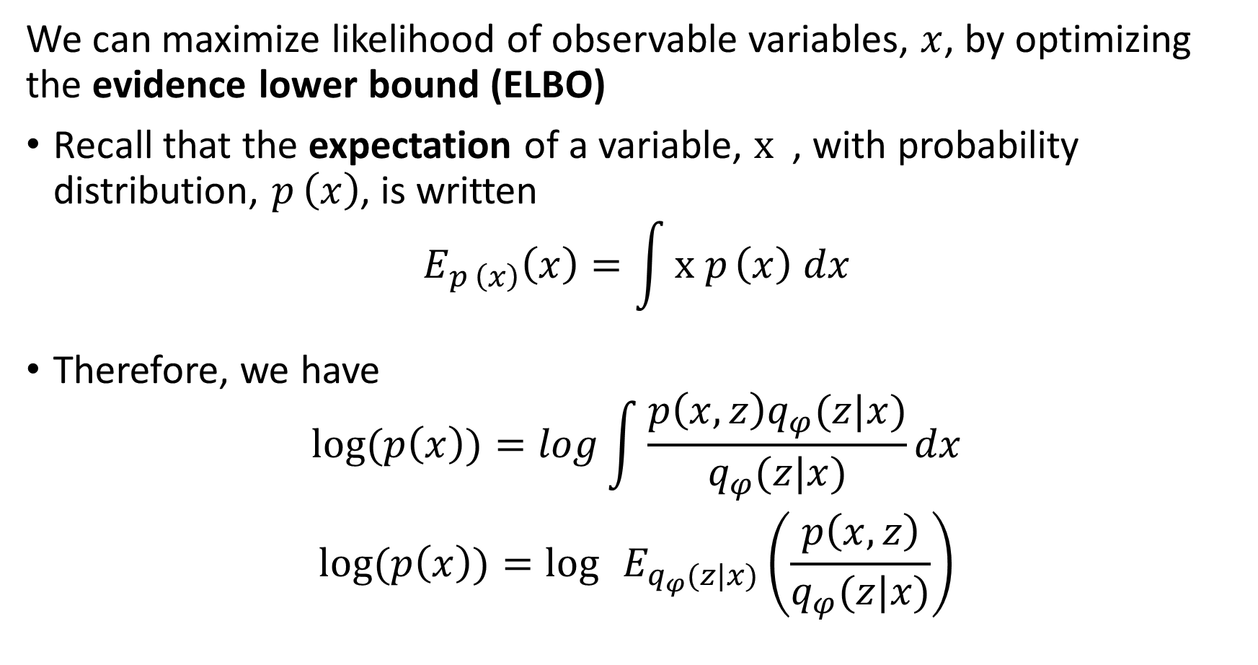
Variational Theory and the Evidence Lower Bound
We can maximize likelihood of observable variables, $x$, by optimizing the evidence lower bound (ELBO)
Recall that the expectation of a variable, ${x }_{ }$, with probability distribution, $p_{ }\left(x\right)$, is written
$$E_{p_{ }\left(x\right)}\left(x\right)=\int{{x p}_{ }\left(x\right) dx}$$
Therefore, we have
$$log⁡(p\left(x\right))=log\int{\frac{p\left(x,z\right)q_{φ}(z|x)}{q_{φ}(z|x)}dx}$$
$$log⁡(p\left(x\right))=\log{ }E_{q_{φ}(z|x)}\left(\frac{p\left(x,z\right)}{q_{φ}(z|x)}\right)$$

Slide 31
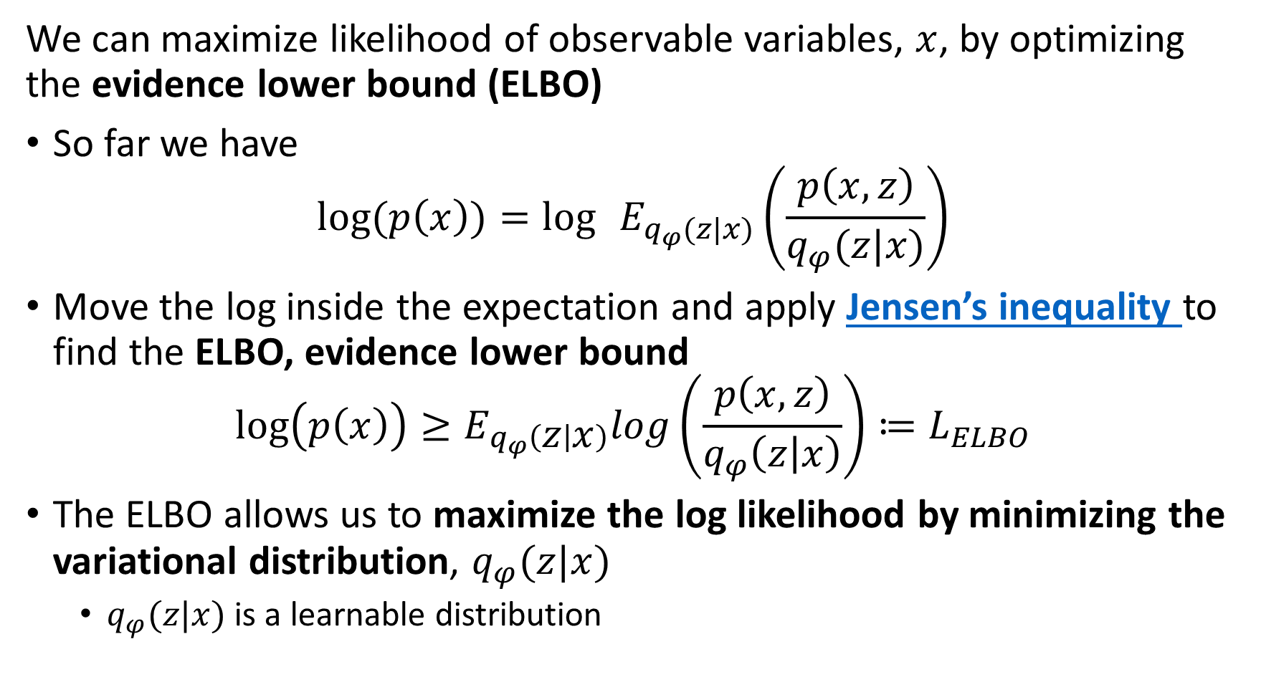
Variational Theory and the Evidence Lower Bound
We can maximize likelihood of observable variables, $x$, by optimizing the evidence lower bound (ELBO)
So far we have
$$log⁡(p\left(x\right))=\log{ }E_{q_{φ}(z|x)}\left(\frac{p\left(x,z\right)}{q_{φ}(z|x)}\right)$$
Move the log inside the expectation and apply Jensen’s inequality to find the ELBO, evidence lower bound
$$\log\left(p\left(x\right)\right)≥E_{q_{φ}\left(z | x\right)}log\left(\frac{p\left(x,z\right)}{q_{φ}\left(z | x\right)}\right)≔L_{ELBO}$$
The ELBO allows us to maximize the log likelihood by minimizing the variational distribution, $q_{φ}(z|x)$
$q_{φ}(z|x)$ is a learnable distribution

Slide 32
Applying the ELBO to Variational Autoencoders

Slide 33
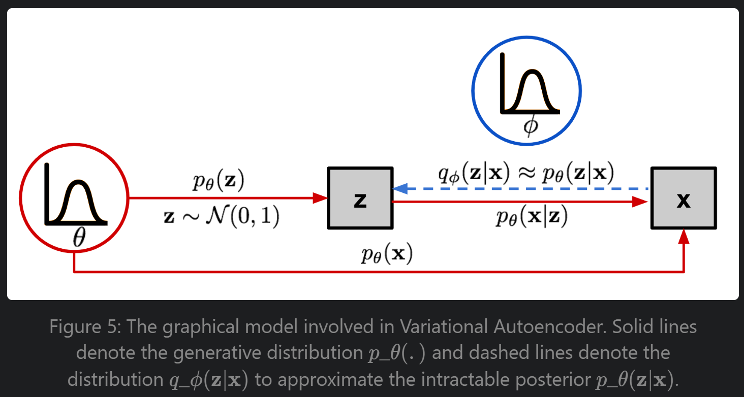
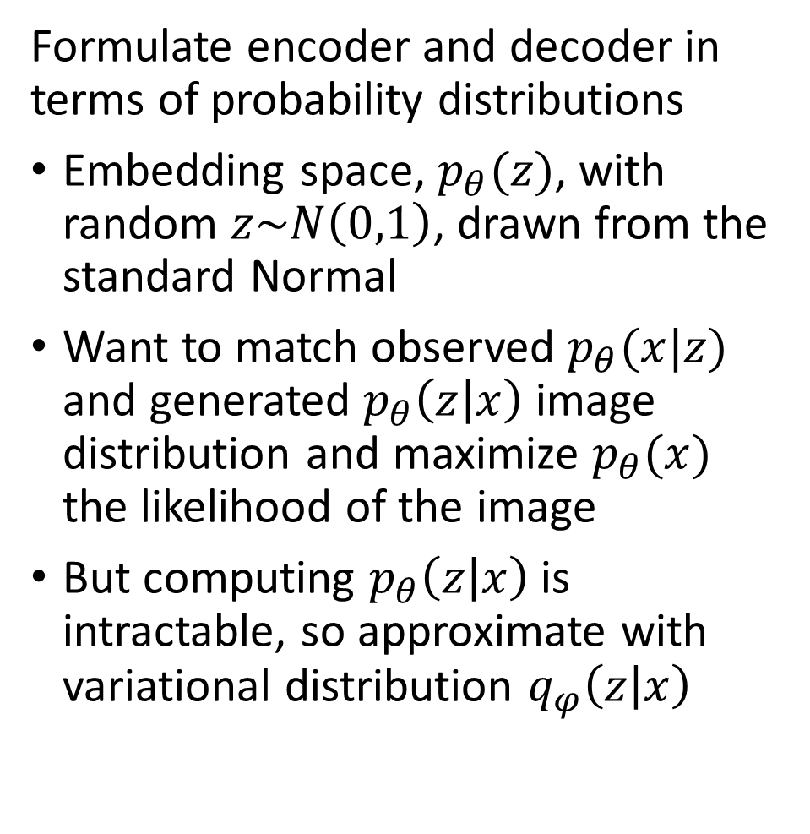
Variational Autoencoders
Formulate encoder and decoder in terms of probability distributions
Embedding space, $p_{θ}(z)$, with random $z\sim N\left(0,1\right)$, drawn from the standard Normal
Want to match observed $p_{θ}(x|z)$ and generated $p_{θ}\left(z | x\right)$ image distribution and maximize $p_{θ}(x)$ the likelihood of the image
But computing $p_{θ}\left(z | x\right)$ is intractable, so approximate with variational distribution $q_{φ}\left(z | x\right)$
Image from Lilian Weng’s VAE blog post

Slide 34
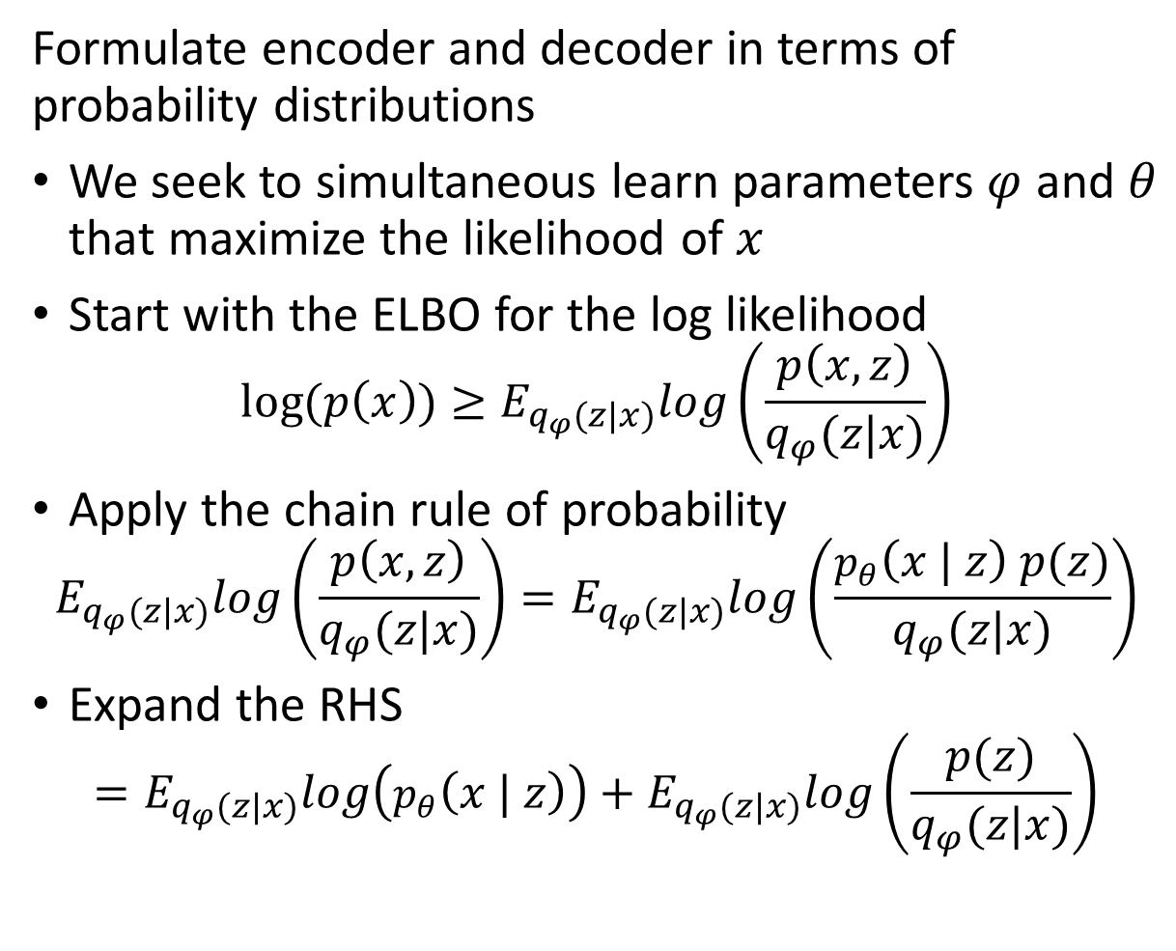
Variational Autoencoders
Formulate encoder and decoder in terms of probability distributions
We seek to simultaneous learn parameters $φ$ and $θ$ that maximize the likelihood of $x$
Start with the ELBO for the log likelihood
$$log⁡(p\left(x\right))≥E_{q_{φ}(z|x)}log\left(\frac{p\left(x,z\right)}{q_{φ}(z|x)}\right)$$
Apply the chain rule of probability
$$E_{q_{φ}(z|x)}log\left(\frac{p\left(x,z\right)}{q_{φ}(z|x)}\right)=E_{q_{φ}(z|x)}log\left(\frac{p_{θ}\left(x | z\right) p(z)}{q_{φ}(z|x)}\right)$$
Expand the RHS
$$=E_{q_{φ}(z|x)}log\left(p_{θ}\left(x | z\right)\right)+E_{q_{φ}(z|x)}log\left(\frac{p(z)}{q_{φ}(z|x)}\right)$$
Image from Lilian Weng’s VAE blog post

Slide 35
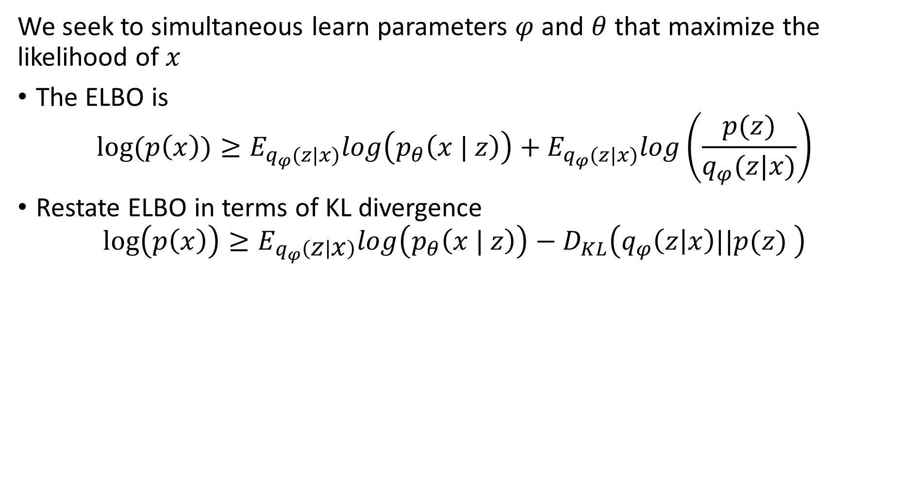
Variational Autoencoders
We seek to simultaneous learn parameters $φ$ and $θ$ that maximize the likelihood of $x$
The ELBO is
$$log⁡(p\left(x\right))≥E_{q_{φ}(z|x)}log\left(p_{θ}\left(x | z\right)\right)+E_{q_{φ}(z|x)}log\left(\frac{p(z)}{q_{φ}(z|x)}\right)$$
Restate ELBO in terms of KL divergence
$$\log\left(p\left(x\right)\right)≥E_{q_{φ}\left(z | x\right)}log\left(p_{θ}\left(x | z\right)\right)−D_{KL}\left(q_{φ}\left(z | x\right)||p(z) \right)$$

Slide 36
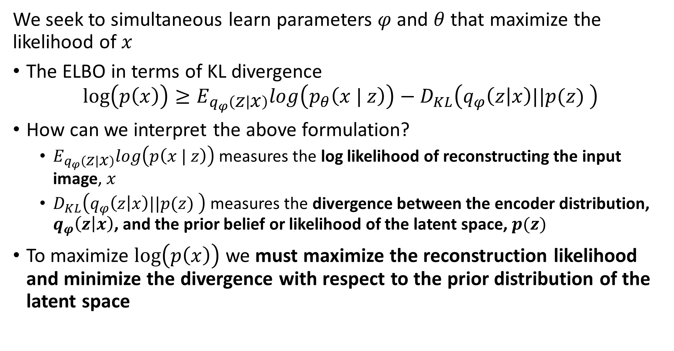
Variational Autoencoders
We seek to simultaneous learn parameters $φ$ and $θ$ that maximize the likelihood of $x$
The ELBO in terms of KL divergence
$$\log\left(p\left(x\right)\right)≥E_{q_{φ}\left(z | x\right)}log\left(p_{θ}\left(x | z\right)\right)−D_{KL}\left(q_{φ}\left(z | x\right)||p(z) \right)$$
How can we interpret the above formulation?
$E_{q_{φ}\left(z | x\right)}log\left(p\left(x | z\right)\right)$ measures the log likelihood of reconstructing the input image, $x$
$D_{KL}\left(q_{φ}\left(z | x\right)||p(z) \right)$ measures the divergence between the encoder distribution, $q_{φ}\left(z | x\right)$, and the prior belief or likelihood of the latent space, $p(z)$
To maximize $\log\left(p\left(x\right)\right)$ we must maximize the reconstruction likelihood and minimize the divergence with respect to the prior distribution of the latent space

Slide 37
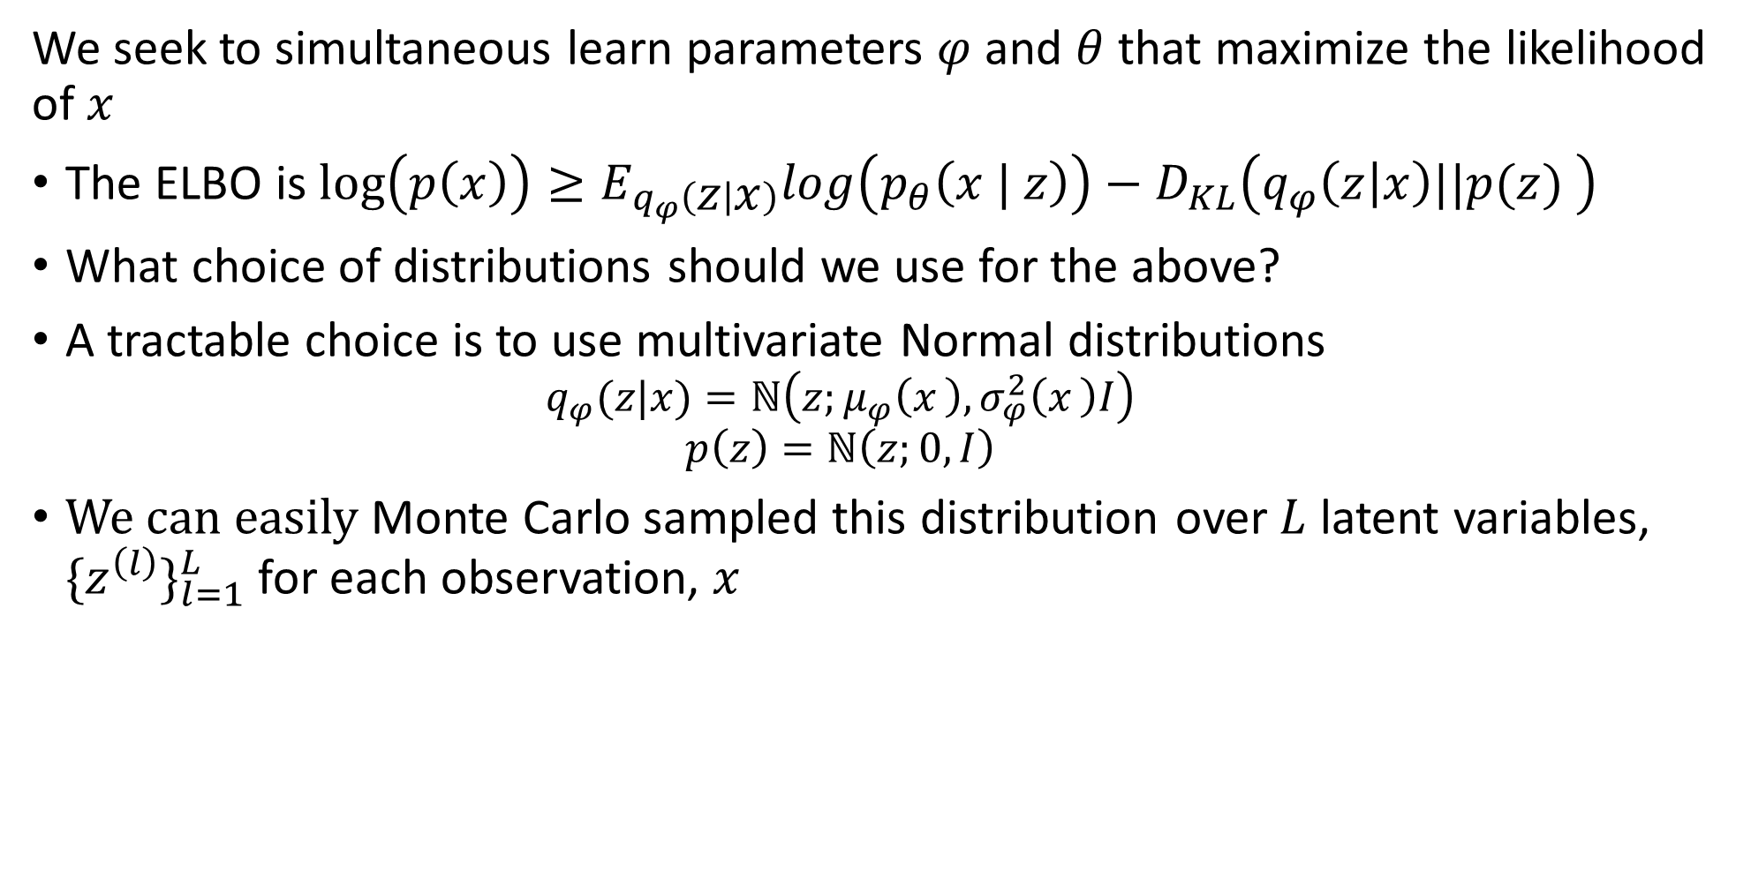
Variational Autoencoders
We seek to simultaneous learn parameters $φ$ and $θ$ that maximize the likelihood of $x$
The ELBO is $\log\left(p\left(x\right)\right)≥E_{q_{φ}\left(z | x\right)}log\left(p_{θ}\left(x | z\right)\right)−D_{KL}\left(q_{φ}\left(z | x\right)||p(z) \right)$
What choice of distributions should we use for the above?
A tractable choice is to use multivariate Normal distributions
$$q_{φ}(z|x)=ℕ\left(z;μ_{φ}\left(x_{ }\right),σ_{φ}^{2}\left(x_{ }\right)I\right)$$
$$p\left(z\right)=ℕ\left(z;0, I\right)$$
We can easily Monte Carlo sampled this distribution over $L$ latent variables, ${\{z^{\left(l\right)}\}}_{l=1}^{L}$ for each observation, $x$

Slide 38
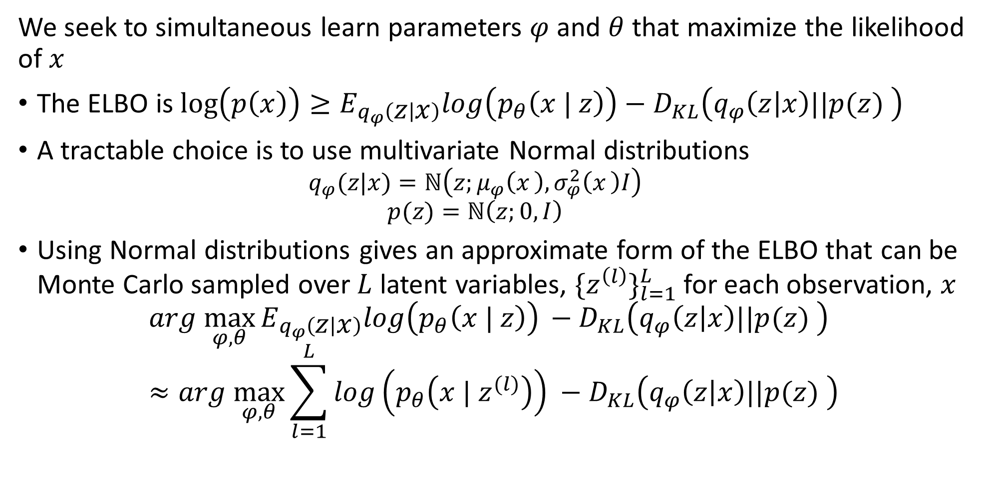
Variational Autoencoders
We seek to simultaneous learn parameters $φ$ and $θ$ that maximize the likelihood of $x$
The ELBO is $\log\left(p\left(x\right)\right)≥E_{q_{φ}\left(z | x\right)}log\left(p_{θ}\left(x | z\right)\right)−D_{KL}\left(q_{φ}\left(z | x\right)||p(z) \right)$
A tractable choice is to use multivariate Normal distributions
$$q_{φ}(z|x)=ℕ\left(z;μ_{φ}\left(x_{ }\right),σ_{φ}^{2}\left(x_{ }\right)I\right)$$
$$p(z)=ℕ\left(z;0, I\right)$$
Using Normal distributions gives an approximate form of the ELBO that can be Monte Carlo sampled over $L$ latent variables, ${\{z^{\left(l\right)}\}}_{l=1}^{L}$ for each observation, $x$
$${arg \max_{φ,θ}{E_{q_{φ}\left(z | x\right)}log\left(p_{θ}\left(x | z\right)\right)}}_{ }−D_{KL}\left(q_{φ}\left(z | x\right)||p(z) \right)≈{arg \max_{φ,θ}{\sum_{l=1}^{L}{log\left(p_{θ}\left(x | z^{(l)}\right)\right)}}}_{ }−D_{KL}\left(q_{φ}\left(z | x\right)||p(z) \right)$$

Slide 39
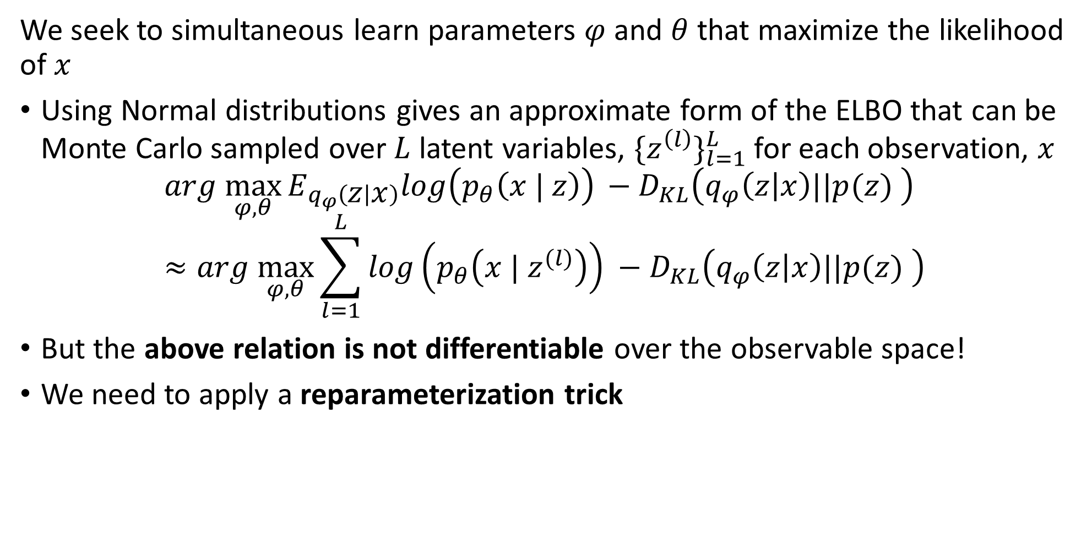
Variational Autoencoders
We seek to simultaneous learn parameters $φ$ and $θ$ that maximize the likelihood of $x$
Using Normal distributions gives an approximate form of the ELBO that can be Monte Carlo sampled over $L$ latent variables, ${\{z^{\left(l\right)}\}}_{l=1}^{L}$ for each observation, $x$
$${arg \max_{φ,θ}{E_{q_{φ}\left(z | x\right)}log\left(p_{θ}\left(x | z\right)\right)}}_{ }−D_{KL}\left(q_{φ}\left(z | x\right)||p(z) \right)≈{arg \max_{φ,θ}{\sum_{l=1}^{L}{log\left(p_{θ}\left(x | z^{(l)}\right)\right)}}}_{ }−D_{KL}\left(q_{φ}\left(z | x\right)||p(z) \right)$$
But the above relation is not differentiable over the observable space!
We need to apply a reparameterization trick

Slide 40
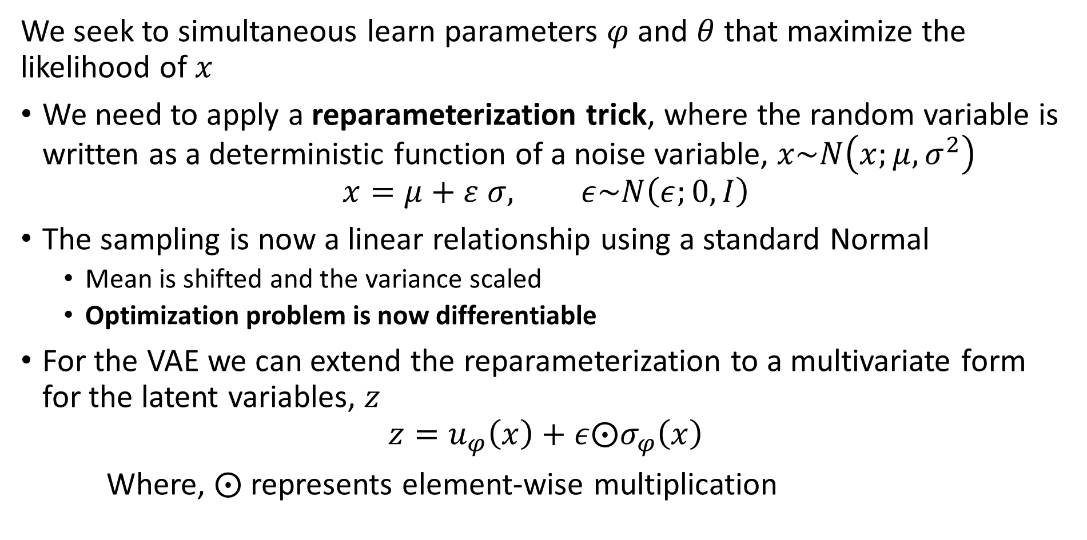
Variational Autoencoders
We seek to simultaneous learn parameters $φ$ and $θ$ that maximize the likelihood of $x$
We need to apply a reparameterization trick, where the random variable is written as a deterministic function of a noise variable, $x\sim N\left(x;μ,σ^{2}\right)$
$$x=μ+ε σ, ε\sim N\left(ε;0,I\right)$$
The sampling is now a linear relationship using a standard Normal
Mean is shifted and the variance scaled
Optimization problem is now differentiable
For the VAE we can extend the reparameterization to a multivariate form for the latent variables, $z$
$$z=u_{φ}\left(x\right)+ε⨀σ_{φ}\left(x\right)$$
Where, $⨀$ represents element-wise multiplication

Slide 41
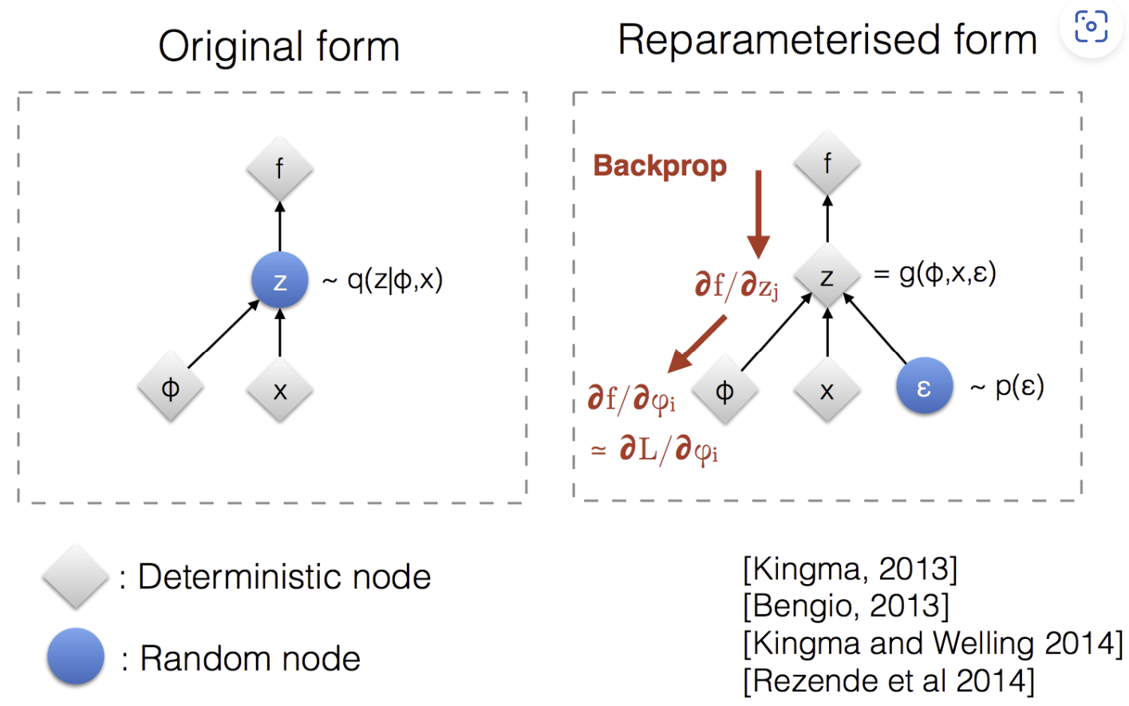
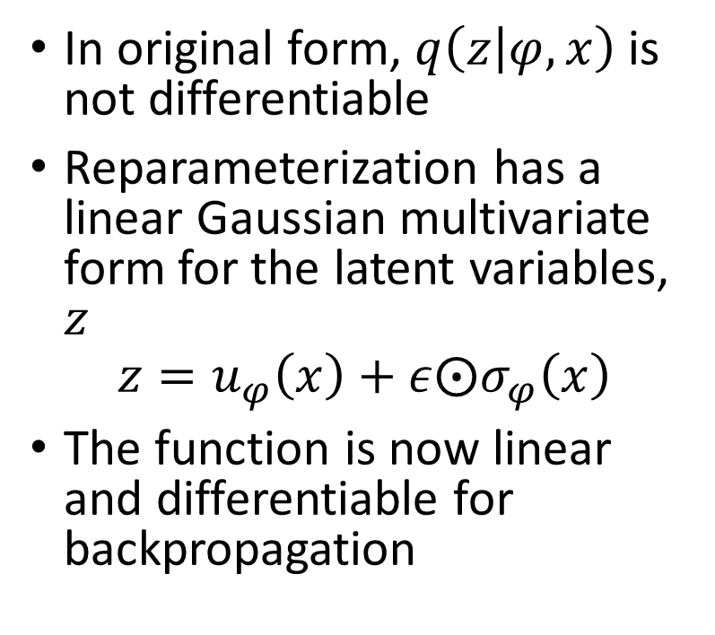
Variational Autoencoders
We seek to simultaneous learn parameters $φ$ and $θ$ that maximize the likelihood of $x$
In original form, $q\left(z | φ,x\right)$ is not differentiable
Reparameterization has a linear Gaussian multivariate form for the latent variables, $z$
$$z=u_{φ}\left(x\right)+ε⨀σ_{φ}\left(x\right)$$
The function is now linear and differentiable for backpropagation
Image source: Slide 12 in Kingma’s NIPS 2015 workshop talk

Slide 42
Image Captioning with VAE

Slide 43
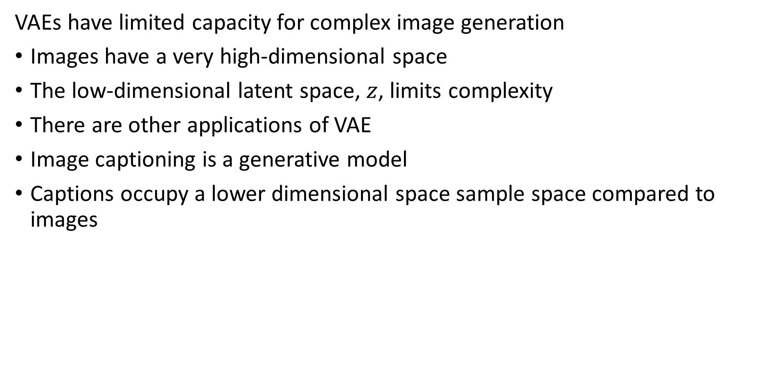
Image Captioning with VAEs
VAEs have limited capacity for complex image generation
Images have a very high-dimensional space
The low-dimensional latent space, $z$, limits complexity
There are other applications of VAE
Image captioning is a generative model
Captions occupy a lower dimensional space sample space compared to images

Slide 44
Forward and Reverse Diffusion Processes

Slide 45
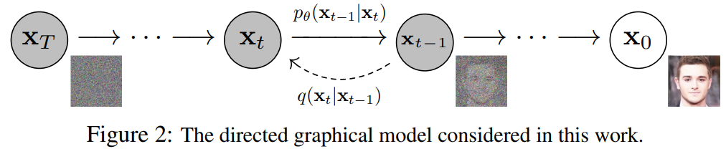
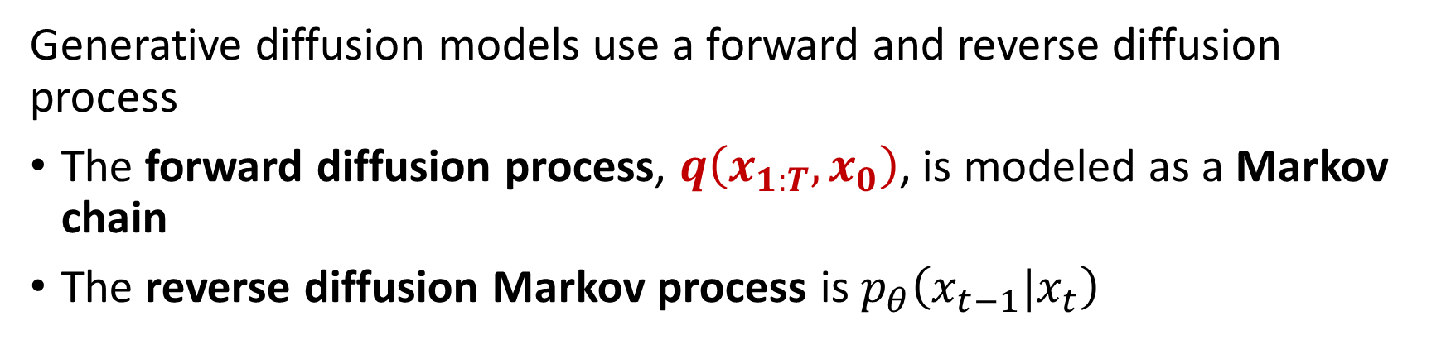
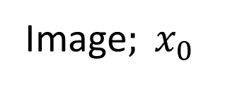
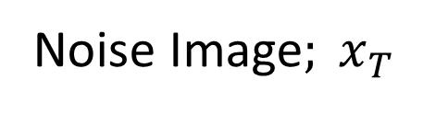
Diffusion Processes
Generative diffusion models use a forward and reverse diffusion process
The forward diffusion process, $q\left(x_{1:T},x_{0}\right)$, is modeled as a Markov chain
The reverse diffusion Markov process is $p_{θ}\left(x_{t−1}|x_{t}\right)$
Noise Image$; x_{T}$
Image$; x_{0}$
Figure credit: Ho, et. al. 2020

Slide 46
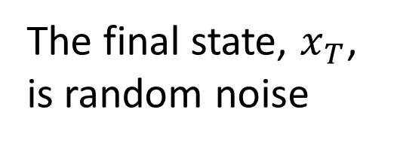
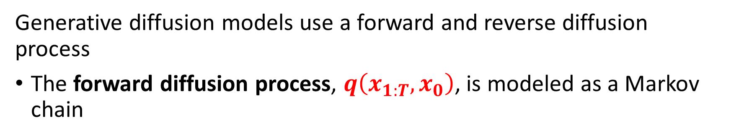
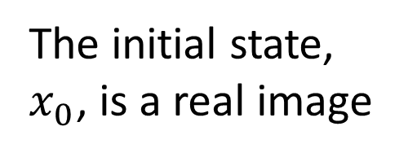
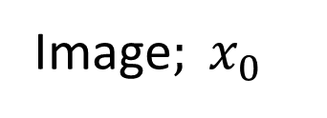
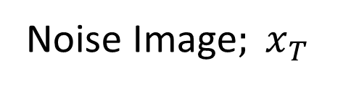
Diffusion Processes
Generative diffusion models use a forward and reverse diffusion process
The forward diffusion process, $q\left(x_{1:T},x_{0}\right)$, is modeled as a Markov chain
The initial state, $x_{0}$, is a real image
The final state, $x_{T}$, is random noise
Noise Image$; x_{T}$
Image$; x_{0}$
Figure credit: Ho, et. al. 2020

Slide 47
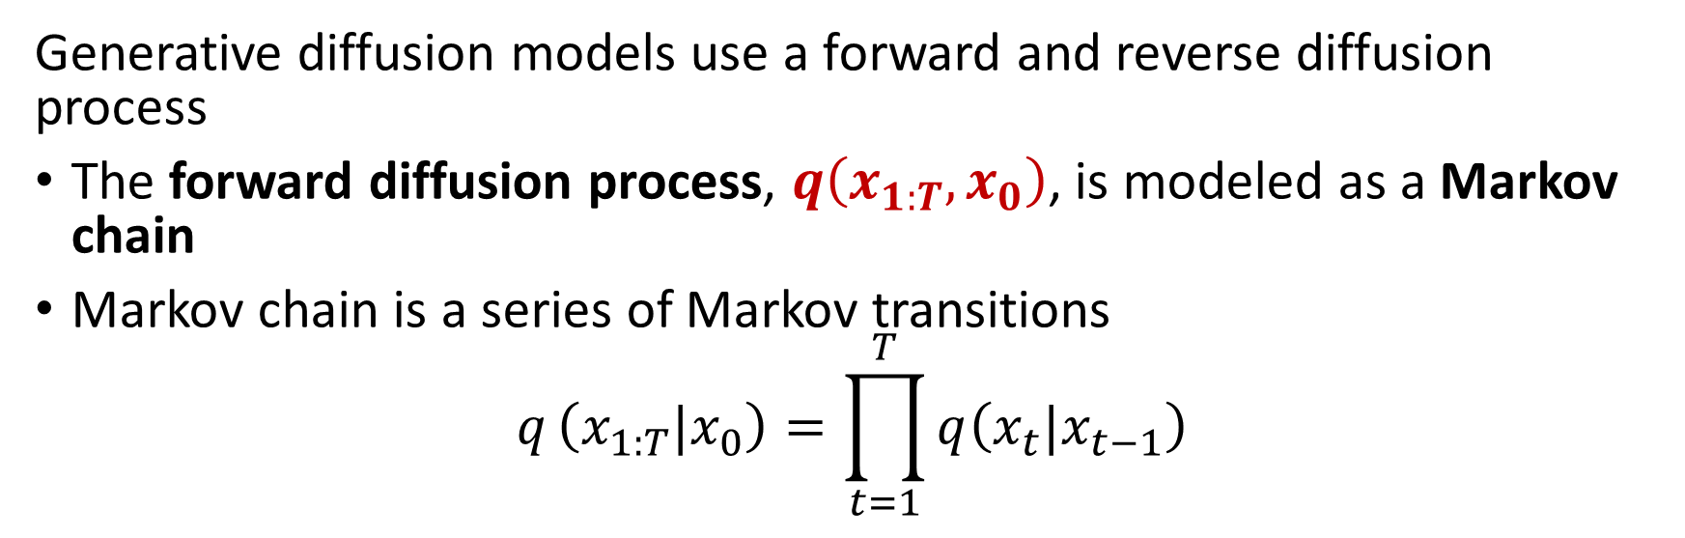
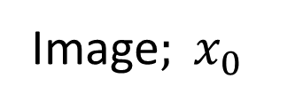
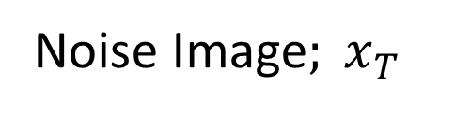
Diffusion Processes
Generative diffusion models use a forward and reverse diffusion process
The forward diffusion process, $q\left(x_{1:T},x_{0}\right)$, is modeled as a Markov chain
Markov chain is a series of Markov transitions
$$q_{ }\left(x_{1:T}|x_{0}\right)=\prod_{t=1}^{T}{q\left(x_{t}|x_{t−1}\right)}$$
Noise Image$; x_{T}$
Figure credit: Ho, et. al. 2020
Image$; x_{0}$

Slide 48



Diffusion Processes
Generative diffusion models use a forward and reverse diffusion process
What makes $q\left(x_{t}|x_{t−1}\right)$ a Markov process?
The value of a random variable, $x_{t}$, at the next time step of a Markov process depends only on the current state, $x_{t−1}$
$q\left(x_{t}|x_{t−1}\right)$ only conditional on last state, $x_{t−1}$, not prior history, $x_{t−2}$, $x_{t−3}$,…, $x_{0}$
Noise Image$; x_{T}$
Image$; x_{0}$
Figure credit: Ho, et. al. 2020

Slide 49



Diffusion Processes
Generative diffusion models use a forward and reverse diffusion process
$x_{1},x_{2},…,x_{T}$ are a series of latent variables
Latent variables are images with increasing noise at each step
The latent variables are not observable
Learn to match the latent variables, $x_{t}$, $x_{t−1}$, between forward and reverse processes
Noise Image$; x_{T}$
Image$; x_{0}$
Figure credit: Ho, et. al. 2020

Slide 50

Diffusion Processes
Generative diffusion models use a forward and reverse diffusion process
The forward diffusion process, $q\left(x_{1:T},x_{0}\right)$, is modeled as a Markov chain
The reverse diffusion process, $p_{θ}\left(x_{0:T}\right)$, learns parameters, $θ$, to match the forward process
$$q\left(x_{t}|x_{t−1}\right)=p_{θ}\left(x_{t}|x_{t+1}\right)$$
Generates images from a noise image
Introduced by Sohl-Dickstein, et. al., 2015 and Ho, Jain and Abbeel, 2020

Slide 51





Diffusion Processes
Generative diffusion models use a forward and reverse diffusion process
The reverse diffusion process, $p_{θ}\left(x_{0:T}\right)$, learns parameters, $θ$, to match the latent variables, $x_{T:0}$, of the forward process
The final state, $x_{0}$, is a generated image
The initial state, $x_{T}$, is random noise
Noise Image$; x_{T}\sim ℕ\left(0, α_{T}I\right)$
Image$; x_{0}$
Figure credit: Ho, et. al. 2020

Slide 52
Diffusion Processes as Stack of Restricted VAEs

Slide 53

Diffusion Processes Built From Restricted VAEs
Generative diffusion models can be constructed as a stack of restricted VAEs
The dimensionality of the latent space, $x_{t}$, is identical to the image space, $x_{0}$
The latent encoder for each time step uses a predefined Gaussian model, with mean of the previous step , not a learned model
The parameters of the Gaussians change with time step, such that the latent variables at the last time step is a standard Normal

Slide 54
Forward Diffusion Processes
Generative diffusion models use a forward and reverse diffusion process
The forward diffusion process is modeled as a Markov chain
The conditional distribution at each step depends only on the current distribution
At each step, the forward diffusion process adds a small amount of Gaussian noise to the image
The diffusion process continues through many small steps
At termination, the image is a Gaussian mixture

Slide 55

Forward Diffusion Processes
Generative diffusion models use a forward and reverse diffusion process
The forward diffusion process, $q\left(x_{1:T},x_{0}\right)$, is modeled as a Markov chain
Adds deterministic noise at each time step with increasing variance
Bounded to restrict variance over time steps
Must not collapse toward 0 variance
One possibility is Gaussian noise with mean, $μ_{i}\left(x_{t}\right)={\sqrt{α_{t}}x}_{t−1}$, and variance, $Σ_{t}\left(x_{t}\right)=β_{t}I=\left(1−α_{t}\right)I$, for some constants, $β_{t}=1−α_{t}$
$$q\left(x_{t}|x_{t−1}\right)=ℕ\left(x_{t};{\sqrt{α_{t}}x}_{t−1},\left(1−α_{t}\right)I\right)$$

Slide 56


Forward Diffusion Processes
Generative diffusion models use a forward and reverse diffusion process
For a single Gaussian step we can compute the mean of the next step:
$$x_{t}=\sqrt{α_{t}}x_{t−1}+{\sqrt{α_{t}−1}ε}_{t−1}, where{ ε}_{t−1},{ ε}_{t−2},…=ℕ\left(0,I\right)$$
Including a previous step
$$x_{t}=\sqrt{α_{t}α_{t−1}}x_{t−2}+{\sqrt{α_{t}α_{t−1}−1}}_{ }{\overline{ε}}_{t−2}$$
And finally, for $T$ time steps
$$x_{T}=\sqrt{{\overline{α}}_{t}}x_{0}+{\sqrt{{\overline{α}}_{t}−1}ε, where \overline{α}=\prod_{i=1}^{t}{α_{i}}}_{ }$$

Slide 57

Forward Diffusion Processes
Generative diffusion models use a forward and reverse diffusion process
The complete forward Markov diffusion process, is the product of the steps
$$q_{ }\left(x_{1:T}|x_{0}\right)=\prod_{t=1}^{T}{q\left(x_{t}|x_{t−1}\right)}$$
With increasing variance schedule $α_{1},α_{2},α_{3},…,α_{T}$ the Gaussian Markov transition probabilities are:
$$q\left(x_{t}|x_{t−1}\right)=ℕ\left(x_{t};\sqrt{{\overline{α}}_{t}}x_{0}, \left({\overline{α}}_{t}−1\right)I\right)$$

Slide 58

Forward Diffusion Processes
Generative diffusion models use a forward and reverse diffusion process
How can a diffusion Gaussian diffusion process represent the distribution of complex images?
$$q_{ }\left(x_{1:T}|x_{0}\right)=\prod_{t=1}^{T}{q\left(x_{t}|x_{t−1}\right)}$$
The product of Gaussians represents a complex mixture model

Slide 59

Reverse Diffusion Processes
Generative diffusion models use a forward and reverse diffusion process
For the reverse Markov diffusion process we would like to model $q\left(x_{t−1}|x_{t}\right)$
But this is intractable since we would need to know the complete distribution
Instead, we will work with an approximate variational distribution $p_{θ}\left(x_{t−1}|x_{t}\right)$ with learnable parameters $θ$

Slide 60

Reverse Diffusion Processes
Generative diffusion models use a forward and reverse diffusion process
The complete reverse Markov diffusion process, is the product of the transitions
$$p_{θ}\left(x_{0:T}\right)=p_{θ}\left(x_{T}\right)\prod_{t=1}^{T}{p_{θ}\left(x_{t−1}|x_{t}\right)}$$
With,
$$p_{θ}\left(x_{t−1}|x_{t}\right)=ℕ\left(x_{t−1};μ_{θ}\left(x_{t},t\right),Σ_{θ}\left(x_{t},t\right)\right)$$

Slide 61
Denoising Diffusion Probabilistic Model (DDPM)

Slide 62

DDPM
How do we learn the parameters and latent variables?
For a diffusion process with small time steps, there are many latent variables, $\left\{x_{0},x_{1},x_{2},…,x_{T}\right\}$
Start with observations, $x_{0}$, an image
Finding the joint distribution of model parameters, $θ$, and latent variables for the reverse diffusion process is an intractable problem
$$q(x_{1},x_{2},…,x_{T},θ|x_{0})$$
Must find an approximation
Monte Carlo sampling has high variance and computationally intensive
Variational methods approximate model parameters and latent variables

Slide 63

DDPM
How do we learn the parameters and latent variables?
Variational methods approximate model parameters and latent variables
Variational methods compute a lower bound on an expectation
For the diffusion model we want to maximize the variational bound, $L$, on the log likelihood the probability of the generated image:
$${\max_{θ}{E_{q\left(x_{0}\right)}}}_{ }\left[log\left(p_{θ}\left(x_{0}\right)\right)\right]≥\max_{θ}{E_{q\left(x_{0},x_{1},x_{2},…,x_{T}\right)}}\left[log\left(\frac{p_{θ}\left(x_{0:T}\right)}{q_{ }\left(x_{1:T}|x_{0}\right)}\right)\right]≔L_{ELBO}$$
$$L_{ELBO}≔\max_{θ}{E_{q\left(x_{0},x_{1},x_{2},…,x_{T}\right)}}\left[\log\left(p_{θ}\left(x_{0:T}\right)\right)−\log\left(q\left(x_{1:T}|x_{0}\right)\right)\right]$$

Slide 64

DDPM
Maximize the VLBO by matching the forward and reverse diffusion processes
Can maximize the log likelihood of $p_{ }\left(x_{ }\right)$
$$\log{ }p_{ }\left(x_{ }\right)=log\int{{p(x_{0:T})dx}_{1:T}}$$
After a great deal of algebra can factor the above into 3 terms to find ELBO
$$\log{ }p_{ }\left(x_{ }\right)≥E_{q\left(x_{1}|x_{0}\right)}\left[log{ p}_{θ}\left(x_{0}|x_{1}\right)\right]$$
$$−E_{q\left(x_{T−1}|x_{0}\right)}\left[\begin{aligned}D_{KL}\left(q\left(x_{T}|x_{T−1}\right) ||p(x_{T})\right) \\ \end{aligned}\right]$$
$$−\sum_{t=1}^{t=T−1}{E_{q\left(x_{t−1},x_{t+1}|x_{0}\right)}\left[D_{KL}\left(q\left(x_{t}|x_{t−1}\right) ||{ p}_{θ}\left(x_{t}|x_{t+1}\right)\right)\right]}$$
This is an intimidating looking formula,…, how can we interpret this?

Slide 65

DDPM
Must match the forward and reverse diffusion processes
This is an intimidating looking formula,…, how can we interpret this?
The reconstruction term is:
$${L_{0}=E}_{q\left(x_{1}|x_{0}\right)}\left[log{ p}_{θ}\left(x_{0}|x_{1}\right)\right]$$
Predicts the log probability of the original data given the first latent step in the diffusion process
We want to maximize this quantity

Slide 66

DDPM
Must match the forward and reverse diffusion processes
This is an intimidating looking formula,…, how can we interpret this?
The prior matching term is:
$$L_{t−1}=E_{q\left(x_{T−1}|x_{0}\right)}\left[\begin{aligned}D_{KL}\left(q\left(x_{T}|x_{T−1}\right) ||p(x_{T})\right) \\ \end{aligned}\right]$$
Measures the KL divergence between the final latent distribution and the Gaussian prior
This term converges toward 0 when $q\left(x_{T}|x_{T−1}\right)$ is a matching Gaussian to the prior latent distribution
There are no trainable parameters in this term
We ignore this term

Slide 67

DDPM
Must match the forward and reverse diffusion processes
This is an intimidating looking formula,…, how can we interpret this?
The consistency term is:
$$L_{t}=\sum_{t=1}^{t=T−1}{E_{q\left(x_{t−1},x_{t+1}|x_{0}\right)}\left[D_{KL}\left(q\left(x_{t}|x_{t−1}\right) ||{ p}_{θ}\left(x_{t}|x_{t+1}\right)\right)\right]}$$
The KL divergence between the forward and reverse diffusion process
Minimize this term by matching the forward and reverse diffusion processes for $x_{t}$ match at each time step, $t$

Slide 68

DDPM
There are several ways we can match${ p}_{θ}\left(x_{t}|x_{t+1}\right)$ to $q\left(x_{t}|x_{t−1}\right)$
Match the means of the learned distribution, $μ_{θ}$, to the forward process $μ_{q}$
Match the learned noise term, $ε_{θ}$, to the forward noise $ε_{t}$
Match the score of the forward process
Find solution of stochastic differential equation
$$x_{t}=x_{t−1}+\frac{δ}{2}∇_{x_{t}}\log{{ p}_{θ}\left(x_{t−1}\right)}+\sqrt{δ}ε, where ε\sim N\left(0,I\right)$$
For further details see tutorial in Yang Song’s blog

Slide 69

DDPM
For a Gaussian distribution we can parameterize the training loss
$$L_{t}=E_{x_{0},ε}\left[\frac{{\left(1−α_{t}\right)}^{2}}{2α_{t}\left(1−α_{t}\right){\left\|Σ_{θ}\right\|}_{2}^{2}}{\left\|ε_{t}−ε_{θ}\left(\sqrt{{\overline{α}}_{t}}x_{0}+\sqrt{{\overline{α}}_{t}−1}ε_{t},t\right)\right\|}^{2}\right]$$
Ho, et.al., found that dropping the leading weight term simplified the relationship and improved performance
$$L_{t}=E_{t\sim [1,T]{, x}_{0},ε}\left[{\left\|ε_{t}−ε_{θ}\left(\sqrt{{\overline{α}}_{t}}x_{0}+\sqrt{{\overline{α}}_{t}−1}ε_{t},t\right)\right\|}^{2}\right]$$
Where $t\sim [1,T]$ is a uniform sampling distribution on the interval $\left[1,T\right]$
Learn to minimize $L_{t}$ by using a neural network to learn $ε_{θ}$
Neural network learns to minimize the difference with respect to $ε_{t}$, the deterministic noise

Slide 70

DDPM
The DDPM algorithm has two parts
Train a neural network, $ε_{θ}$, to minimize, $L_{t}$, a loss function
$$L_{t}=E_{t\sim [1,T]{, x}_{0},ε}\left[{\left\|ε_{t}−ε_{θ}\left(\sqrt{{\overline{α}}_{t}}x_{0}+\sqrt{{\overline{α}}_{t}−1}ε_{t},t\right)\right\|}^{2}\right]$$
Is a least squares loss problem
Learn a denoising term, $ε_{θ}$, to match the forward noise, $ε_{t}$
$t\sim [1,T]$ is a uniform sampling distribution on the interval $\left[1,T\right]$
Sample the Markov chain with the learned parameters to generate new images
$$x_{t−1}=\frac{1}{\sqrt{α_{t}}}\left[x_{t−1}−\frac{1−α_{t}}{\sqrt{{1−α}_{t}}}{ε_{θ}}_{ }\left(x_{t},t\right)\right]−σ_{t}z$$
The full derivation of these terms can be found in Ho, et. al., 2020

Slide 71


DDPM
Ho, et. al., 2020 used a UNET architecture of $Rosenburger, et. al., 2015$ to learn the noise, $ε_{θ}$
UNET accommodates multiple scales
UNET has an encoder-decoder architecture with a low dimensional latent bottle neck
Down-sample over multiple scales
Up-sample to integrate samples
UNET uses skip connections to maintain gradient
We will explore UNET further in a subsequent lesson

Slide 72



DDPM
The DDPM algorithm of Ho, et. al., 2020 learns a neural network, $ε_{θ}$, for the distribution by minimizing loss function
Draw a sample from the image distribution
Sample from uniform distribution of time steps
Draw additive noise of time step from standard Normal
Take gradient step to update parameters, $θ$, of learned noise model, $ε_{θ}$

Slide 73

DDPM
The DDPM algorithm of Ho, et. al., 2020 learns a neural network, $ε_{θ}$, for the distribution by minimizing loss function
Take gradient step to update parameters, $θ$, of learned noise model, $ε_{θ}$
Gradient is of the squared differences between noise, , and noise predicted by the neural network
Absolute difference is more robust to outliers and is sometimes used

Slide 74


DDPM
The DDPM algorithm of Ho, et. al., 2020 samples from the learned distribution to generate images by denoising
Start with random noise image
Sample backwards in time
Standard Normal noise at each time step
Denoise image at each time step by removing learned noise, $ε_{θ}$, injecting randomness, $σ_{t}$

Slide 75
Denoising Diffusion Implicit Models (DDIM)

Slide 76
DDIM
How can we improve the efficiency of the DDPM?
The DDPM algorithm of Ho, et. al., 2020 is inefficient
Requires sampling 1000s of steps of the forward and reverse processes
Iterating over these steps requires a massive number of samples
Song et.al. 2020, proposed the diffusion denoising implicit model (DDIP) to reduce sampling requirements
An alternative approach to more efficient diffusion model sampling is Progressive Distillation for Fast Sampling of Diffusion Models, Salimans and Ho, 2022

Slide 77


DDIM
How can we improve the efficiency of the DDPM?
Song et.al. 2020, proposed the diffusion denoising implicit model (DDIP) with sampling improvements
The forward diffusion process to state $x_{t}$, depends not only on the prior state, $x_{t−1}$, but on the initial state, $x_{0}$
This is no longer a Markov diffusion process!
Figure from Song et.al. 2020

Slide 78

DDIM
Must match the forward and reverse diffusion processes
The DDPM consistency term is complex to optimize since there is dependency on two terms, $x_{t−1}$ and $x_{t+1}$ in the expectation:
$$−\sum_{t=1}^{t=T−1}{E_{q\left(x_{t−1},x_{t+1}|x_{0}\right)}\left[D_{KL}\left(q\left(x_{t}|x_{t−1}\right) ||{ p}_{θ}\left(x_{t}|x_{t+1}\right)\right)\right]}$$
Rather than working with a Markov process, DDIM adds dependency on $x_{0}$
$$q\left(x_{t}|x_{t−1}\right)=q\left(x_{t}|x_{t−1},x_{0}\right)$$
And by Bayes’ theorem:
$$q\left(x_{t}|x_{t−1},x_{0}\right)=\frac{q\left(x_{t−1}|x_{t},x_{0}\right)q\left(x_{t}|x_{0}\right)}{q\left(x_{t−1}|x_{0}\right)}$$

Slide 79

DDIM
Must match the forward and reverse diffusion processes
Substitute the Bayes formula for $q\left(x_{t}|x_{t−1},x_{0}\right)$ and after a lot of algebra we get a consistency term:
$$L_{t}=\sum_{t=1}^{t=T−1}{E_{q\left(x_{t}|x_{0}\right)}\left[D_{KL}\left(q\left(x_{t−1}|x_{t},x_{0}\right) ||{ p}_{θ}\left(x_{t−1}|x_{t}\right)\right)\right]}$$
We call $L_{t}$the denoising matching term, with no dependence on $x_{t+1}$
${ p}_{θ}\left(x_{t−1}|x_{t}\right)$ is the learnable image denoising transition step
Use $q\left(x_{t−1}|x_{t},x_{0}\right)$ as a ground truth to compare with learnable ${ p}_{θ}\left(x_{t−1}|x_{t}\right)$
The KL divergence is minimized when the two steps converge
The sum of these KL divergences is the main term to optimize

Slide 80

Gaussian Diffusion Processes
For a Gaussian diffusion process we can find an analytical form for the distributions
For a single Gaussian step, we can compute the next step:
$$x_{t−1}=\sqrt{α_{t−1}}x_{0}+{\sqrt{α_{t−1}−1}ε}_{t−1}$$
Substituting gives the form of the conditional distribution of the reverse time step
$$q\left(x_{t−1}|x_{t},x_{0}\right)=ℕ\left(x_{t−1};\sqrt{{\overline{α}}_{t−1}}x_{0}+\sqrt{{1−\overline{α}}_{t−1}+σ^{2}}\frac{{\sqrt{{\overline{α}}_{t}}x}_{t}}{\sqrt{{1−\overline{α}}_{t}}}, σ^{2}I\right)$$

Slide 81

Gaussian Diffusion Processes
For a Gaussian diffusion process we can find an analytical form for the distributions
We can also express the sampling distribution as
$$q\left(x_{t−1}|x_{t},x_{0}\right)=ℕ\left(x_{t−1}; \tilde{μ}\left(x_{t},x_{0}\right), {\tilde{β}}_{t}I\right)$$
and
$${\tilde{β}}_{t}=σ^{2}=\frac{{1−\overline{α}}_{t−1}}{{1−\overline{α}}_{t}}β_{t}=ηβ_{t}$$
If we let $η⟶0$ the sampling is deterministic for the noise distribution
Reduces the required number of samples dramatically
This is the key to the DDIM of Song et. al. 2020

Slide 82
Gaussian Diffusion Processes
Comparing the DDPM and DDIM
DDIM generates much higher quality samples with many fewer steps
Deterministic sampling is consistent so samples conditioned on the same latent variables have similar high-level features leading to faster convergence
The consistency allows the DDIM to interpolate over the latent variables reducing required number of samples

Slide 83
Evaluation of Generative Image Models

Slide 84
Evaluation of Generative Image Models
Need an objective metric for evaluation of generative image models
Early GAN research inhibited by use of only subjective human judgement
Need an objective evaluation metric that agrees with human judgement of generated image quality
Inception score was proposed by Salimans, et. al., 2016
Fréchet Inception distance proposed by Heusel, et. al., 2017 is an improvement on inception score
Kernel inception distance (KDI) of Bińkowski, et. al., 2018 is a robust measure using maximums
Perceptual path length (PPL) by Karas, et. al., 2020, uses a style GAN to evaluate differences in latent spaces

Slide 85
Evaluation of Generative Image Models
Inception score attempts to balance accuracy at creating real objects and diversity of objects created
Inception score is based on classifications by the pre-trained Inception Network
Generative models should produce object images that closely resemble real-world objects
Inception should clearly recognize objects
Classification probabilities should have only one high value
Poorly recognized objects have indeterminant probabilities
Generative models should produce a diversity of objects – not the same few many times
Should be a nearly uniform distribution of probability of occurrence of each recognized object class

Slide 86

Evaluation of Generative Image Models
Inception score attempts to balance accuracy at creating real objects and diversity of objects created
Recall the relationship of entropy for a probability distributions
For a classifier with feature vector, x, and prediction, y, we what the output, $p(y|x)$, to have low entropy
For diversity of objects from a generator, $G\left(z\right)$, given random noise input, z, recognized we want the marginal distribution, $p\left(y\right)=\int{p(y|x=G\left(z\right))}dz$, to have high entropy
Combining these measures we can write the inception score in terms of expected Kullback-Leibler (KL) divergence:
$${score}_{Inception}=exp\left[E_{x}\left(KL\left(p(x,y\right)∥p(y)\right)\right]$$

Slide 87

Evaluation of Generative Image Models
Inception score attempts to balance accuracy at creating real objects and diversity of objects created
How can we interpret the inception score?
$${score}_{Inception}=exp\left[E_{x}\left(KL\left(p(x,y\right)∥p(y)\right)\right]$$
Want $p(y|x)$ with low entropy and $p(y)$ with high entropy
High KL divergence indicates high difference in entropy between $p(y|x)$ and $p(y)$
Inception score in range $\left[0,∞\right]$
KL divergence of 0 means $p(y|x)$ and $p(y)$ are the same
Higher inception score is better

Slide 88

Evaluation of Generative Image Models
Inception score has significant limitations
Only object classes used to train the Inception Network will be well recognized
Must be in training dataset, typically ILSCRC 2014
Additionally, labels used to train the generative model must agree with Inception training data labels
If either condition is violated, $p(y|x)$ will have high entropy and inception score will be low
Conversely, objects that make no sense, like an animal with two heads, can have high inception scores
As a result of the above problems human evaluators may not agree with the quality based on inception score

Slide 89

Evaluation of Generative Image Models
The Fréchet Inception distance (FID) was proposed to overcome the limitations of inception score
Rather than use the output of the Inception network, the FID compares distributions of activations in a hidden layer, typically Inception V4
Model the distribution of activations as multivariate Normal distributions
$N\left(μ,Σ\right)$ is the distribution of activations from the generated images
$N\left(μ_{w},Σ_{w}\right)$ is the distribution of activations from the real-world, denoted by w
The FID is the square of the Wasserstein distance between these distributions
$$FID={\left\|μ−μ_{w}\right\|}_{2}^{2}+tr\left[Σ+Σ_{w}−2{\left(Σ^{1/2}Σ_{w}Σ^{1/2}\right)}^{1/2}\right]$$

Slide 90

Evaluation of Generative Image Models
How can we interpret the Fréchet Inception distance?
The FID is the square of the Wasserstein distance between activations from generated and real-world distributions
$$FID={\left\|μ−μ_{w}\right\|}_{2}^{2}+tr\left[Σ+Σ_{w}−2{\left(Σ^{1/2}Σ_{w}Σ^{1/2}\right)}^{1/2}\right]$$
Notice that to compute FID we only need the means and covariances of the distributions – easy to estimate
To understand FID, consider the behavior of the two terms
The first term is the Euclidean difference between the mean vectors
The second term is the difference in standard deviations between the two distributions

Slide 91

Evaluation of Generative Image Models
How can we interpret the Fréchet Inception distance?
The FID is the square of the Wasserstein distance between activations from generated and real-world distributions
$$FID={\left\|μ−μ_{w}\right\|}_{2}^{2}+tr\left[Σ+Σ_{w}−2{\left(Σ^{1/2}Σ_{w}Σ^{1/2}\right)}^{1/2}\right]$$
If generated images have activation distributions similar to real-world images, the difference in mean vectors and standard deviation vectors is small
Perfect match in distributions gives $FID=0$
Smaller FID better

Slide 92

Evaluation of Generative Image Models
Example of Fréchet Inception distance – agrees with human perception

Slide 93

Evaluation of Generative Image Models
An innovation in generative model evaluation metrics is the Kernel Inception Distance (KID) introduced by Binkowski et. al., 2018
The kernel inception distance (Bińkowski, et. al., 2018) is the maximum mean discrepancy (MMD) between the inception representations
$$k\left(μ,μ_{W}\right)={\left(\frac{1}{d}μ^{T}μ_{W}+1\right)}^{3}$$
Where $d$ is the dimension of the activation vectors
The polynomial kernel avoid correlations with the loss function used to train the generative model
The smaller the absolute value of KDI the better the generator

Slide 94

Evaluation of Generative Image Models
A recent innovation in generative model evaluation metrics is the Kernel Inception Distance (KID) introduced by Binkowski et. al., 2018
$$k\left(μ,μ_{W}\right)={\left(\frac{1}{d}μ^{T}μ_{W}+1\right)}^{3}$$
The kernel inception distance has several advantages over FID
KID makes no parametric distributional assumptions about the representation differences
KID is an unbiased estimator, whereas FID can only have positive values

Slide 95
Guided Image Generation

Slide 96

Guided Image Generation
How can we guide diffusion models to generate the image we want?
Example, we want to generate the image specified by a text prompt
Condition the reverse diffusion process on the query, $y$
$$p_{θ}\left(x_{0:T}|y\right)=p_{θ}\left(x_{T}\right)\prod_{t=1}^{T}{p_{θ}\left(x_{t−1}|x_{t},y\right)}$$
We can learn the model parameters with neural networks by applying Bayes rule to compute the gradient of the likelihood (score function)
$$∇_{x_{t}}\log{{ p}_{θ}\left(x_{t}|y\right)}=∇_{x_{t}}\log{\frac{{{ p}_{θ}\left({y|x}_{t}\right)p}_{θ}\left(x_{t}\right)}{{ p}_{ }\left(y\right)}}$$
$$∇_{x_{t}}\log{{ p}_{θ}\left(x_{t}|y\right)}=∇_{x_{t}}\log{{ p}_{θ}\left(x_{t}\right)}+∇_{x_{t}}\log{{ p}_{θ}\left(y|x_{t}\right)}$$
$${since ∇}_{x_{t}}\log{{ p}_{ }\left(y\right)=0}$$

Slide 97

Guided Image Generation
How can we guide diffusion models to generate the image we want?
We can learn the model parameters with neural networks to compute the gradient, simplifying notation with $∇_{x_{t}}=∇_{ }$
$$∇_{ }\log{{ p}_{θ}\left(x_{t}|y\right)}=∇_{ }\log{{ p}_{θ}\left(x_{t}\right)}+∇_{ }\log{{ p}_{θ}\left(y|x_{t}\right)}$$
Adding a trade-off hyperparameter, s
$$∇_{ }\log{{ p}_{θ}\left(x_{t}|y\right)}=∇_{ }\log{{ p}_{θ}\left(x_{t}\right)}+{s∇}_{ }\log{{ p}_{θ}\left(y|x_{t}\right)}$$
$$∇_{ }\log{{ p}_{θ}\left(x_{t}|y\right)}=Gradient of unguided+s Gradient of classifier$$
The foregoing is the gradient of a multitask loss function
Hyperparameter $s$ trades off image generation with category of image generated

Slide 98

Guided Image Generation
How can we guide diffusion models to generate the image we want?
What methods can we use to find the maximum of $\log{{ p}_{θ}\left(x_{t}|y\right)}$ given this gradient
$$∇_{ }\log{{ p}_{θ}\left(x_{t}|y\right)}=∇_{ }\log{{ p}_{θ}\left(x_{t}\right)}+{s∇}_{ }\log{{ p}_{θ}\left(y|x_{t}\right)}$$
Solve two parallel problems
Image generation model maximizes $\log{{ p}_{θ}\left(x_{t}\right)}$, the unconditional problem
A classifier algorithm maximizes $\log{{ p}_{θ}\left(y|x_{t}\right)}$ for the conditional problem, specificity of image type
Working with two models is cumbersome

Slide 99
Guided Image Generation
What are the alternatives to classifier guidance?
In practice, classifier guidance has proved to be problematic
Generality limited by number of categories known to classifier
Complex loss function derivatives make learning with backpropagation difficult
Classifier-free guidance algorithms were introduced by Ho and Salimans, 2021
An alternative is Grounded Language Image Pretraining (GLIP) algorithms
Applies multi-task vision and language pre-training
See Li, et. al., 2022 and Zhang, et. al., 2022
A foundation model useful for many tasks, object detection, segmentation, etc.
Generally found to have worse performance compared to classifier-free guidance for generative tasks

Slide 100

Guided Image Generation
Classifier-free guidance algorithms overcome limitations of classifier guidance
We can rearrange the terms of the gradient
$$∇_{ }\log{{ p}_{θ}\left(x_{t}|y\right)}=∇_{ }\log{{ p}_{θ}\left(x_{t}\right)}+∇_{ }\log{{ p}_{θ}\left(y|x_{t}\right)}$$
$${∇_{ }\log{{ p}_{θ}\left(y|x_{t}\right)}=∇}_{ }\log{{ p}_{θ}\left(x_{t}|y\right)−∇ log{{ p}_{θ}\left(x_{t}\right)}}$$
Now substitute the above for the $∇_{ }\log{{ p}_{θ}\left(y|x_{t}\right)}$ term
$$∇_{ }\log{{ p}_{θ}\left(x_{t}|y\right)}=∇_{ }\log{{ p}_{θ}\left(x_{t}\right)}+∇ log{{ p}_{θ}\left(x_{t}|y\right)−∇ log{{ p}_{θ}\left(x_{t}\right)}}$$
Introduce a trade-off parameter, $s$, between conditional gradient and likelihood of image
$$∇_{ }\log{{ p}_{θ}\left(x_{t}|y\right)}={\left(1−s\right)∇}_{ }\log{{ p}_{θ}\left(x_{t}\right)}+s ∇ log{{ p}_{θ}\left(x_{t}|y\right)}$$
Gradient of the guided generative model with no classifier term

Slide 101

Guided Image Generation
Example of classifier-free guidance
Unconditional diffusion model on left
Classifier-free guidance on right
Notice more specific response with classifier-free guidance
Ho and Salimans, 2021

Slide 102
Guided Image Generation
Other references on guided image generation
Photorealistic Text-to-Image Diffusion Models with Deep Language Understanding, Saharia, et. al., 2022
Text2Human: Text-Driven Controllable Human Image Generation, Jaing, et. al., 2022
Hierarchical Text-Conditional Image Generation with GLIP Latents, Ramesh, et. al. 2022

Slide 103
Summary
Generative diffusion models have come to dominate generative image models
Generative diffusion models learn by matching a reverse diffusion process to a forward diffusion process
Forward diffusion process adds small amount of noise at each step until final image is random noise
Reverse diffusion process denoises the random noise to generate images
The denoising diffusion implicit model reduces the number of samples required to learn the model
Can evaluate generative diffusion models with FID or KID
Guide image generation by using a reverse process conditional on a query

