Slide 1

THREE PORTALS, ONE PLATFORM
Admin console
PLATFORM PROGRESS REVIEW
Quotes, contracts, payroll and settings for every country
The new Intermediano ERP
One platform for our team, our clients and our employees, from first quote to final payslip.
Client portal
Customers approve hours, time off and expenses
Friday, November 6, 2026
Employee hub
Presented by Reiniel · Software Engineering
Workers log time, request leave, claim expenses, get payslips
Notes:
Open by framing the purpose: this is a progress check on the new Intermediano ERP, which replaces the legacy Laravel/Filament system. Today I'll show what is already working end to end, then walk through it live, and finish with what is next and the decisions I need.

Slide 2
AGENDA
What we'll cover today
01
Where we are
What has been built in the first two weeks
02
How it fits together
Three portals on one platform, separated by country
03
The process, step by step
Following one hire from quote to payslip
04
Live demo
The same journey in the running application
05
What's next
Remaining modules, rollout plan and decisions needed
Notes:
Keep this quick, 20 seconds. Tell the CEO there will be a live demo in the middle and a short list of decisions at the end.

Slide 3
WHY WE'RE REBUILDING
Same business, a stronger foundation
The legacy Laravel Filament ERP is being rebuilt on a modern platform, module by module
1
A modern experience
2
Country rules we can trust
Fast, clean screens for each audience. Clients and employees land on a dashboard showing exactly what needs their attention.
Cost calculators for 10 countries, with automated tests that lock the figures. Saved payrolls keep a snapshot of what was billed.
3
Configurable without code
4
Safe by default
Each legal entity turns modules on or off. Roles control every module and cluster. Contract templates use a block editor.
Company single sign-on, permission checks on every action, country data kept separate, and protected portal logins.
Notes:
Explain the why in business terms. We are moving the legacy Laravel Filament ERP, with its admin, client and employee areas, onto a modern platform. Add one or two concrete pain points from the legacy system that the CEO will recognise (for example slow screens, hard-to-change pricing rules, or manual approval follow-ups). Avoid tech names unless asked: it's Next.js, TypeScript, MySQL and Microsoft SSO.

Slide 4
WHERE WE ARE
Two weeks in: the core flow works end to end
3
15
10
32
154
portals live
admin modules
country calculators
permissions
automated tests passing
Admin, Client, Employee
From quotations to payslips
Plus Colombia integral and Quebec
View or manage, per module
12 suites: payroll, calculators, approvals
DELIVERY TIMELINE
Oct 19
Oct 24
Oct 26
Oct 27
Oct 28
Oct 29
Nov 2
This week
Foundation
Access & people
Contracts
Sales
Payroll
Hardening
Portals
Employee hub
App, database, country switching
SSO, roles, employees, consultants
Contracts and PDF templates
Partners, quotations, calculators, module settings
Monthly runs with provisions
Tests, rate limits, holidays, vacations
Expenses, client portal, payslips
Profile, contract and documents
9 pull requests merged · every screen permission-checked · every record scoped to its country cluster
Notes:
These are hard numbers from the codebase. Two weeks of build so far, merged through reviewed pull requests. Emphasise that the core money flow (quote, contract, timesheet, payroll, payslip) is already in place. Employee profile, contract and documents screens are in progress this week.

Slide 5
HOW IT FITS TOGETHER
Three portals, one platform, data separated by country
Admin console
Client portal
Employee hub
Intermediano team
Customers & partners
Placed workers
Sign in with Microsoft or Google SSO
Email and password, created by our team
Email and password, or SSO
Quotations & calculators
Employees & contracts
Timesheets, vacations, expenses
Payroll & payslips
Settings, roles & templates
Overview of their team
Contracts (view & download PDF)
Approve timesheets
Approve vacations
Approve expenses
Summary dashboard
Submit monthly timesheets
Request vacation
Claim expenses with receipts
Download payslips
Country clusters
Roles & permissions
Module switches
Contract PDF engine
Every record belongs to one legal entity
View or manage, per module and cluster
Each entity turns features on or off
Templates per country, generated on demand
Notes:
One platform, three doors. Our staff sign in with company Microsoft accounts. Clients and employees get their own portals with their own logins. Underneath, everything is separated by country cluster (each Intermediano legal entity), so a Canada user never sees Brasil data unless their role allows it.

Slide 6
THE PROCESS
Following one hire from quote to payslip
Juan Pérez, Software Engineer, placed with Acme Logistics by Intermediano Colombia
1
2
3
4
5
6
Quote
Contract
Log time & requests
Client approves
Run payroll
Payslip
Admin
Admin
Employee
Client
Admin
Admin → Employee
Build the monthly cost for the client using the country calculator
Generate the contract PDF from the country template and track signatures
Submit hours, request vacation and claim expenses with receipts
Approve or reject hours, time off and expenses in the client portal
Monthly payroll with provisions tracked over time
Upload the payslip; the employee downloads it in their hub
Before step 1
Our team signs in with their Microsoft account and picks the country cluster they're working in. Everything they see from then on, including employees, contracts and payroll, belongs to that legal entity only.
Notes:
This is the story for the rest of the presentation and the demo. We follow one hire, Juan Pérez, placed with Acme Logistics in Colombia, from the first quote to his payslip. Point out that three different audiences touch this process, and today each of them has their own portal.

Slide 7
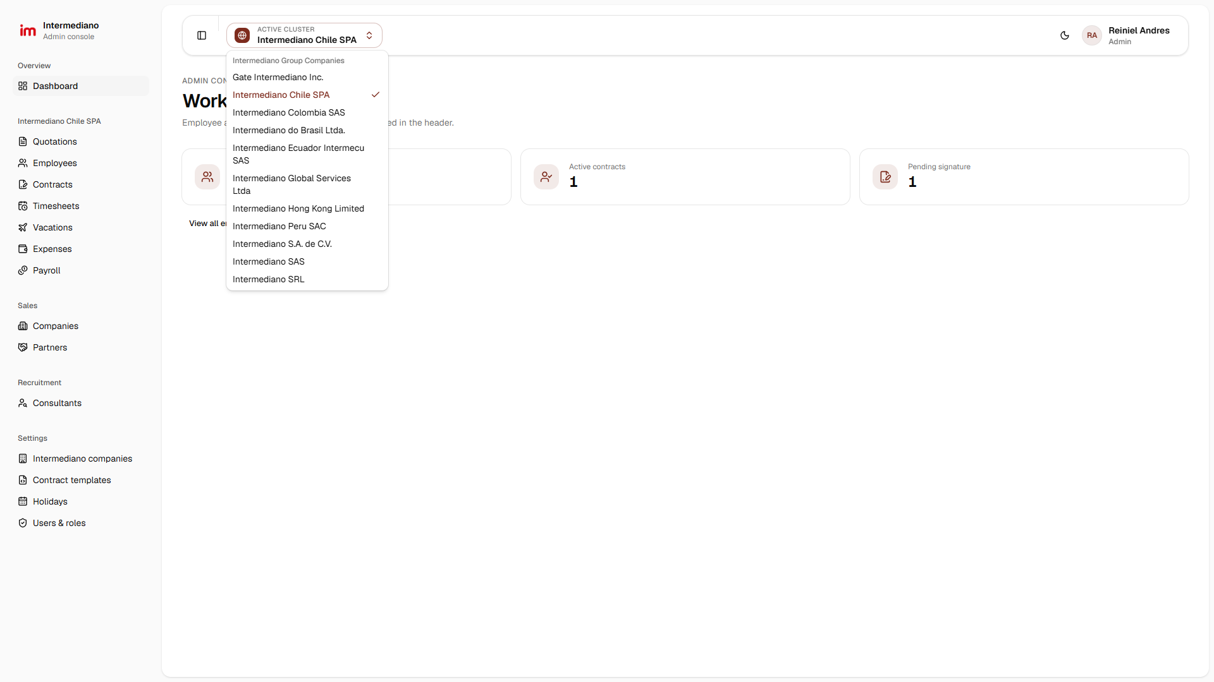
BEFORE WE START
Sign in once, then pick the country you're working in
localhost:3000/admin/dashboard
WHO
Intermediano team
WHAT HAPPENS
Staff sign in with their company Microsoft account (Google also supported)
The header shows the active cluster: one Intermediano legal entity
Switching cluster re-scopes every list: employees, contracts, payroll
Roles decide which clusters and modules each person can open
WHY IT MATTERS
No more mixing countries by mistake. A user only sees the legal entities their role allows.
Screenshot of the running admin console · test data
Notes:
Show the cluster switcher. Each Intermediano legal entity is a cluster. Switching changes every list in the sidebar to that entity's data, and modules that the entity doesn't use (for example Partner/EOR) disappear from the menu. Roles decide which clusters a person can pick.

Slide 8
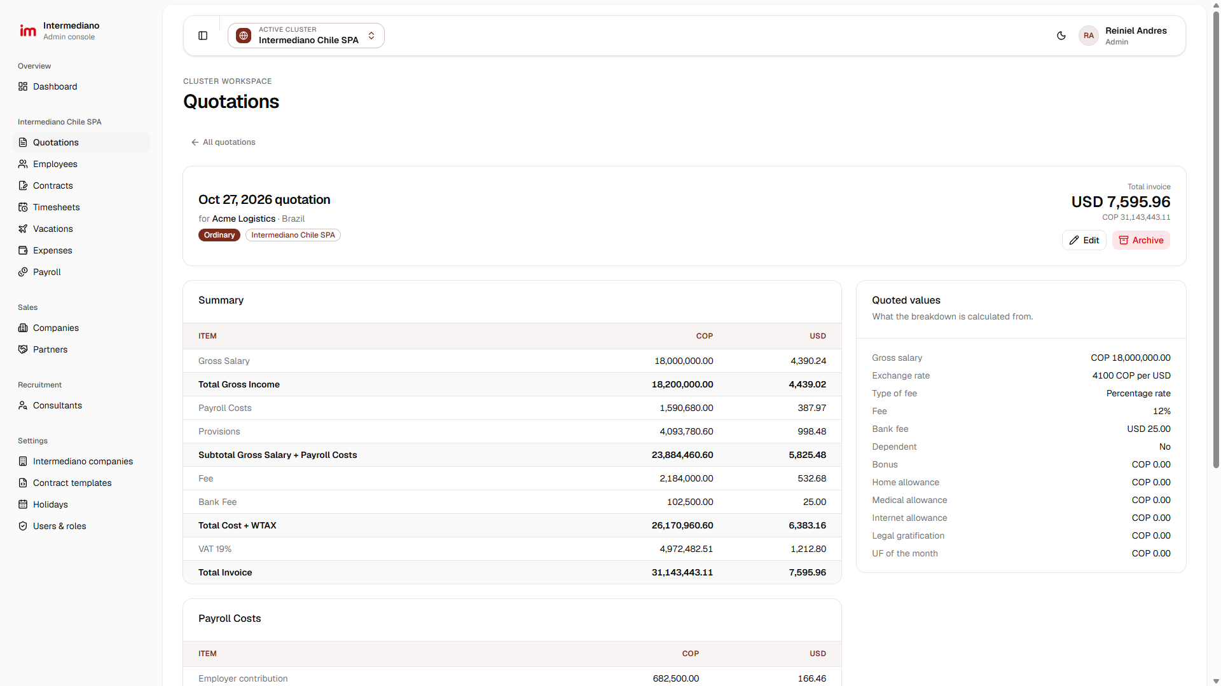
STEP 1 · ADMIN CONSOLE
Quote the client in minutes, with every cost explained
localhost:3000/admin/quotations/…
WHO
Sales / Operations
WHAT HAPPENS
Enter the gross salary, exchange rate and fee; the country calculator does the rest
Full breakdown: payroll costs, provisions, fee, bank fee and local taxes
Shown in payroll currency and billing currency side by side
10 countries covered, plus Colombia integral and Quebec rules
WHY IT MATTERS
Consistent, auditable pricing in every country. Tests lock the formulas so a change can't silently alter a client's price.
Screenshot of the running admin console · test data
1 Quote
2 Contract
3 Log time & requests
4 Client approves
5 Run payroll
6 Payslip
Notes:
Step 1. A quotation turns a gross salary into the full monthly invoice for the client: gross salary, payroll costs and provisions, then our fee, the bank fee and local taxes. Read the Total invoice at the top right and walk down the summary. Each of the 10 countries has its own rules, and automated tests lock the results so a change can't silently alter prices.

Slide 9

STEP 2 · ADMIN CONSOLE
Contracts from country templates, signatures tracked
localhost:3000/admin/contracts
WHO
Intermediano
ACTIVE CLUSTER
⌄
AU
Admin User
Operations
Legal
Admin console
◎
Intermediano Colombia SAS
Admin
OVERVIEW
CLUSTER WORKSPACE
WHAT HAPPENS
Dashboard
Contracts
Contract terms come straight from the employee, client and quotation
One click opens or downloads the PDF in the country's legal format
Templates are edited with a block editor, so most changes need no developer
Status updates automatically: upcoming, pending signature, active, ended
INTERMEDIANO COLOMBIA SAS
Every contract signed under the cluster selected in the header.
Quotations
Employees
Contracts
Contracts
Employee, customer and partner contracts under this legal entity.
Timesheets
Vacations
⌕ Search employee, position, client…
+ Add contract
Expenses
All kinds
Employee
Customer
Partner
Any period
Fixed term
Open-ended
Payroll
Payslips
EMPLOYEE | CLIENT | SIGNATURES | STATUS
Juan Pérez Software Engineer · Jan 1, 2026 – open-ended | Acme Logistics | ✓ Employee ✓ Admin | ● Active
Camila Torres Data Analyst · Nov 1, 2026 – Oct 31, 2027 | Northwind | ◷ Employee ✓ Admin | ● Pending signature
Lucas Almeida QA Engineer · Dec 1, 2026 – open-ended | Maple Staffing | ◷ Employee ◷ Admin | ● Upcoming
Acme Logistics Customer · Service agreement | — | ✓ Customer ✓ Admin | ● Active
SALES
PDF
Companies
Partners
CONTRATO INDIVIDUAL DE TRABAJO
RECRUITMENT
Consultants
SETTINGS
Intermediano companies
WHY IT MATTERS
Contract templates
Holidays
Contracts are consistent per country, and nobody loses track of who still has to sign.
Users & roles
Open PDF
Download
Recreated from the live contracts screen · sample data
1 Quote
2 Contract
3 Log time & requests
4 Client approves
5 Run payroll
6 Payslip
Notes:
Step 2. Once the client accepts, we create the contract. The PDF is generated from the country's template (we built a block editor for templates), and the list shows at a glance who still has to sign. Status is automatic: upcoming, pending signature, active or ended, based on dates and signatures.

Slide 10
STEP 3 · EMPLOYEE HUB
Employees log their hours themselves
localhost:3000/employee/timesheets
WHO
Intermediano
Employee hub
JP
Employee
My profile
EMPLOYEE HUB
WHAT HAPPENS
Personal details, contract and payroll documents
Timesheets
Timesheet history with each month's review status
Monthly timesheet filled in day by day, then submitted for approval
Status and reviewer comments come back to the employee
Works with email and password, or SSO
Log the hours you work each month and follow their review.
Overview
My timesheets
Profile
+ New timesheet
New timesheets are sent to Acme Logistics for review.
Contract
MONTH | TOTAL HOURS | STATUS | SUBMITTED
October 2026 | 176 hrs | ● Pending | Nov 2, 2026
September 2026 | 176 hrs | ● Approved | Oct 1, 2026
August 2026 | 168 hrs | ● Approved | Sep 1, 2026
Timesheets
Vacations
Expenses
Payslips
Documents
WHY IT MATTERS
Hours come in on time, in one format, straight from the person who worked them.
Recreated from the live employee hub · sample data
1 Quote
2 Contract
3 Log time & requests
4 Client approves
5 Run payroll
6 Payslip
Notes:
Step 3. The employee signs in to the Employee hub and sees their timesheets, vacations, expenses and payslips in one place. Each month they submit a timesheet; it goes to the client for approval. Live demo: sign in as juan.perez@employee.test.

Slide 11
STEP 3 · EMPLOYEE HUB
Vacation and expense requests, with receipts
localhost:3000/employee/vacations
WHO
Intermediano
Employee hub
JP
Employee
My profile
EMPLOYEE HUB
WHAT HAPPENS
Personal details, contract and payroll documents
Vacations
Request time off; approved days come out of the vacation balance
Claim expenses item by item with the receipt attached
Local claims include taxes; abroad claims include the exchange rate
Rejected requests can be corrected and sent again
Your accrued vacation balance, your requests and their review.
Overview
Accrued
Taken
Pending
Available
Profile
15 days
3 days
2 days
10 days
Contract
15 days a year
Approved requests
Awaiting review
You can request
Timesheets
My vacation requests
Vacations
+ New request
Expenses
New requests are sent to Acme Logistics for review.
Payslips
DATES | DAYS | STATUS | SUBMITTED
Dec 22 – Dec 23, 2026 | 2 | ● Pending | Nov 2, 2026
Jul 13 – Jul 15, 2026 | 3 | ● Approved | Jun 20, 2026
Documents
WHY IT MATTERS
Every request has a clear status and a full history of who decided what, and when.
Recreated from the live employee hub · sample data
1 Quote
2 Contract
3 Log time & requests
4 Client approves
5 Run payroll
6 Payslip
Notes:
Still step 3. Vacation requests check the employee's balance; expense claims carry the receipt for each item, local or abroad, with taxes or exchange rates. Both go to the client and to our team for approval.

Slide 12
STEP 4 · CLIENT PORTAL
Clients see their team and approve in one place
localhost:3000/customer/dashboard
WHO
Intermediano
Client portal
Overview
Contracts
Timesheets
Vacations
Expenses
RS
Client HR / Manager
WHAT HAPPENS
CLIENT PORTAL
One overview of everything waiting for the client's decision
Contracts for their service agreement and placed staff, as PDFs
Accounts for client and partner contacts are managed by our team
Clients only ever see their own company's people
Welcome, Acme Logistics
Everything about the team Intermediano manages for you, from contracts to timesheet, vacation and expense approvals, in one place.
Where would you like to start?
Timesheets
3 to review
Vacations
1 to review
Approve the monthly hours your team submits.
Respond to time off requested by your staff.
Expenses
2 to review
Contracts
4 active
WHY IT MATTERS
Review expenses your team submits for reimbursement.
Your service agreements and your placed staff's contracts.
Approvals happen in one place, so payroll can start as soon as the client says yes.
Recreated from the live client portal · sample data
1 Quote
2 Contract
3 Log time & requests
4 Client approves
5 Run payroll
6 Payslip
Notes:
Step 4. This is the client's view. When Acme Logistics signs in, the overview tells them exactly what is waiting for them: timesheets, vacations and expenses to review, plus their active contracts. Client accounts are created by our team from the Portal accounts screen.

Slide 13
STEP 4 · CLIENT PORTAL
Approve hours with one click, and leave a comment
localhost:3000/customer/timesheets/…
WHO
Intermediano
Client portal
Overview
Contracts
Timesheets
Vacations
Expenses
RS
Client
Intermediano team
October 2026 timesheet
WHAT HAPPENS
TOTAL HOURS
Juan Pérez · for Acme Logistics
176 hrs
Calendar view of the month's hours, weekends greyed out
Approve or reject with an optional comment for the employee
Vacations: approve or reject with a confirmation step
Expenses: approve per item, or approve all pending at once
Pending
Daily hours
Your review
22 days with hours logged in October 2026.
The employee sees the status and your comment.
Sun
Mon
Tue
Wed
Thu
Fri
Sat
✓ Approve
✕ Reject
1
2
3
8h
8h
Comment
4
5
6
7
8
9
10
Thanks Juan, all good for October.
8h
8h
8h
8h
8h
11
12
13
14
15
16
17
8h
8h
8h
8h
8h
18
19
20
21
22
23
24
33/255 characters
8h
8h
8h
8h
8h
Save review
WHY IT MATTERS
25
26
27
28
29
30
31
Approved hours flow straight into payroll, with a record of who approved what and when.
8h
8h
8h
8h
8h
Recreated from the live client portal · sample data
1 Quote
2 Contract
3 Log time & requests
4 Client approves
5 Run payroll
6 Payslip
Notes:
The client opens a timesheet, sees the hours day by day on a calendar, and approves or rejects with a comment. The employee sees the decision and the comment in their hub. Vacations and expenses work the same way; expenses can be approved per item or all at once.

Slide 14
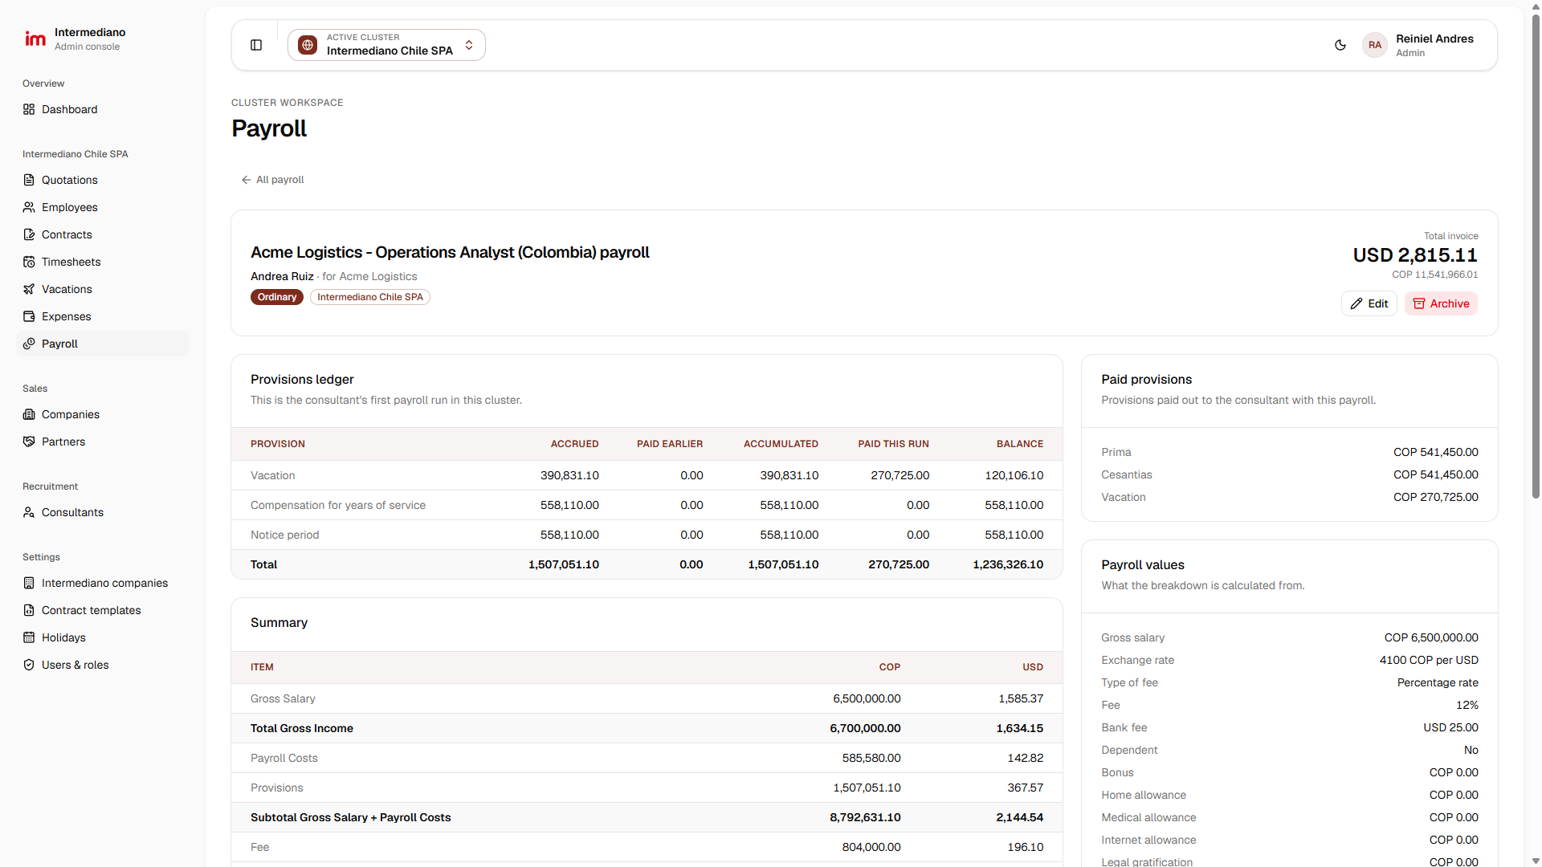
STEP 5 · ADMIN CONSOLE
Monthly payroll, every provision tracked
localhost:3000/admin/payroll/…
WHO
Payroll / Finance
WHAT HAPPENS
One payroll run per consultant per month, using the country calculator
Ledger shows accrued, already paid, and remaining balance per provision
Each saved run keeps a snapshot of its figures
Filter by month, consultant and contract type
WHY IT MATTERS
We always know what we owe each worker in provisions, and past invoices can't change when rates do.
Screenshot of the running admin console · test data
1 Quote
2 Contract
3 Log time & requests
4 Client approves
5 Run payroll
6 Payslip
Notes:
Step 5. Payroll runs monthly per consultant using the same country calculators as quotations. The provisions ledger tracks what has been accrued over every run (for Colombia: cesantías, intereses, prima, vacation, indemnization), what was already paid, and the balance. Every saved payroll keeps a snapshot, so a later rate change never alters a month that was already billed.

Slide 15
STEP 6 · ADMIN CONSOLE → EMPLOYEE HUB
Payslips delivered straight to each employee
localhost:3000/admin/payslips
WHO
Intermediano
ACTIVE CLUSTER
⌄
AU
Admin User
Payroll
Employee
Admin console
◎
Intermediano Colombia SAS
Admin
OVERVIEW
CLUSTER WORKSPACE
WHAT HAPPENS
Dashboard
Payslips
Upload the payslip PDF for an employee and period
It shows up immediately in the employee's hub
Employees download any past payslip themselves
Search and filter by employee, file name or month
INTERMEDIANO COLOMBIA SAS
Payslip PDFs for employees in the cluster selected in the header. Employees see theirs in the Employee hub.
Quotations
Employees
Payslips
Employees with payslips
Latest period
Contracts
42
21
Oct 2026
Timesheets
Vacations
Expenses
Payslips
Payroll
Uploaded payslips, newest period first.
Payslips
⌕ Search employee or file name…
⤒ Upload payslip
SALES
Companies
EMPLOYEE | PERIOD | FILE | UPLOADED
Juan Pérez | October 2026 | ⤓ payslip-2026-10-juan-perez.pdf | Nov 3, 2026
Camila Torres | October 2026 | ⤓ payslip-2026-10-camila-torres.pdf | Nov 3, 2026
Juan Pérez | September 2026 | ⤓ payslip-2026-09-juan-perez.pdf | Oct 2, 2026
Camila Torres | September 2026 | ⤓ payslip-2026-09-camila-torres.pdf | Oct 2, 2026
Partners
RECRUITMENT
Consultants
SETTINGS
Intermediano companies
WHY IT MATTERS
Contract templates
Holidays
Employees get their own payslips any time, and every document is in one secure place.
Users & roles
Recreated from the live admin console · sample data
1 Quote
2 Contract
3 Log time & requests
4 Client approves
5 Run payroll
6 Payslip
Notes:
Step 6. Our team uploads the payslip PDF for the period. It appears immediately in the employee's hub, where they can download it any time. This closes the loop we started at the quote.

Slide 16
CONTROL WITHOUT DEVELOPERS
Roles, modules and templates, managed by the business
localhost:3000/admin/users/roles
localhost:3000/admin/intermediano-companies/…
Roles
Modules
6 of 10
What this entity offers. Disabled modules are hidden from its cluster workspace.
⛨
admin
⛨
payroll officer
⛨
sales
Quotations
Employees
Protected
✓
✓
Full access to every module
Runs payroll and payslips
Quotes, companies and partners
✓
Contracts
✓
Timesheets
Users
Modules
Users
Modules
Users
Modules
✓
Expenses
✓
Payroll
2
16 of 16
3
5 of 16
4
4 of 16
◎ All clusters
◎ Colombia, Canada
◎ All clusters
Partner (EOR)
Payslips
View permissions
Edit permissions
Edit permissions
Invoices
MSP payroll
Roles & permissions
Cluster access
Module switches
Contract templates
Holidays
View or manage, per module, for 16 areas
Each role can be limited to certain legal entities
10 modules, on or off per legal entity
Block editor: clauses, tables, signatures, conditions
Public holidays per country and year
Recreated from the live settings screens · sample roles
Notes:
Behind the process there's a control layer that the business can manage without developers: roles with view/manage permissions per module, which clusters each role can access, which modules each legal entity uses, contract templates per country, and public holidays per country.

Slide 17
BUILT FOR TRUST
Payroll and personal data, protected by design
1
2
3
Company sign-in
Every action checked
Country separation
Our staff use Microsoft (or Google) single sign-on, and only people added as users can get in.
Each screen and each save checks the person's role, their cluster access and whether the module is on.
Records are tied to one legal entity; lists and searches never mix clusters.
4
5
6
Login protection
Frozen payroll figures
Automated tests
Client and employee logins are rate-limited and lock out repeated failed attempts.
Each saved payroll keeps a snapshot, so billed months don't change when rates change.
154 tests in 12 suites cover calculators, payroll ledger, approvals, portals and templates.
Notes:
For the CEO, the point is risk: this handles payroll and personal data. Key safeguards are already in: SSO, permission checks on every action, data scoped per legal entity, login rate-limiting, payroll snapshots, and automated tests on the calculators and approval flows.

Slide 18
LIVE DEMO
Let's follow Juan from quote to payslip
Pick a cluster
Quote
Contract PDF
Employee requests
Client approves
Payroll
Payslip
Notes:
Switch to the browser. Run sheet: (1) Admin: cluster switcher, (2) Quotation detail, (3) Contract → Open PDF, (4) Employee hub as Juan: timesheet, vacation, expense, (5) Client portal: approve the timesheet, (6) Admin payroll ledger, (7) Employee payslips. Backup: recorded video on the desktop.

Slide 19
SCOPE
What's live, what's in progress, what's next
● Live now
● In progress (this week)
● Next to port from legacy
Quotations & 10 country calculators
Employees & consultants
Contracts & PDF templates
Timesheets
Vacations
Expenses with receipts
Payroll & provisions ledger
Payslips
Companies & partners
Client portal & portal accounts
Users, roles, modules, holidays
Employee profile (personal, dependents, banking)
Employee contract view
Employee documents
More country contract templates (Chile)
Invoices
MSP payroll
Leads & contacts (CRM)
Vacancies (recruitment)
Investments
Data migration & cutover
Notes:
Be transparent about scope. Green is live in the new platform, amber is being finished this week, grey is still to port from the legacy system. The remaining items exist in the legacy ERP and in our permission model, so they're planned rather than open questions.

Slide 20
ROADMAP
Proposed path to go-live
Phased by country cluster, so each rollout is small and reversible
Now – mid Nov
Mid Nov – early Dec
December
January
Complete the core
Port the rest
Pilot
Roll out
Finish employee profile, contract & documents
Remaining contract templates
Invoices module
CRM: leads & contacts
Vacancies, investments, MSP payroll
Data migration scripts & dry runs
One cluster, one or two clients
Run in parallel with legacy for one payroll
Finance checks the figures
Cluster by cluster go-live
Train teams, invite clients & employees
Retire legacy per cluster
Dates are a proposal and depend on the decisions on the next slide.
Notes:
Proposed plan, not committed dates: adjust to what the CEO prioritises. The recommendation is a phased rollout, one cluster at a time, starting with a pilot, and running the legacy system in parallel for one payroll cycle.

Slide 21
WHAT I NEED FROM YOU
Five decisions to keep us on track
1
Pilot cluster
Recommend: Intermediano Colombia
Which legal entity goes first?
2
Pilot clients
Recommend: a friendly, active client
Which one or two clients test the Client portal?
3
Rollout style
Recommend: phased, with a parallel payroll
Cluster by cluster, or everyone at once?
4
Priorities
Invoices, CRM, vacancies, investments, MSP payroll
Which remaining module matters most?
5
Sign-off owners
Recommend: Finance lead + Legal per country
Who validates payroll figures and contract templates?
Notes:
This is the most important slide for the CEO. Ask for these decisions explicitly; each one unblocks part of the roadmap. My recommendation for the pilot is Intermediano Colombia, because it has the most complete calculators and templates today.

Slide 22
Thank you
Questions, feedback and priorities welcome
Notes:
Thank the CEO, take questions. If a question needs data, offer to follow up in writing.

Slide 23
APPENDIX · PRESENTER ONLY
Live demo run sheet
TIME | PORTAL | WHAT TO SHOW | LOGIN
0:00 | Admin | Sign in with SSO → dashboard → cluster switcher → Intermediano Chile SPA (has test data) | Your Microsoft account
1:00 | Admin | Quotations → open the Acme Logistics quotation → walk through the breakdown | —
3:00 | Admin | Contracts → open Juan Perez's contract → Open PDF | —
5:00 | Employee | Employee hub: dashboard → new timesheet → vacation → expense with receipt | juan.perez@employee.test
8:00 | Client | Client portal: overview → timesheet → Approve with comment | Client portal account
10:00 | Admin | Payroll → open the Acme Logistics run → provisions ledger | —
12:00 | Employee | Employee hub → Payslips → download | juan.perez@employee.test
13:00 | Admin | Users & roles → a role's permissions → a company's modules | —
Before you start: production build (npm run build && npm run start), open every demo page once to warm it up, separate browser profile per portal, backup video ready.
Notes:
Presenter-only appendix. Hide this slide in PowerPoint (right-click → Hide Slide) if you don't want it shown.

