Slide 1
Meetup event attendance prediction
Xin Pang
Monday, October 02, 2017

Slide 2
Business objective
To identify the factors that influence group members event attendance
To predict the expected number of event participants (group member and their guests)
To optimize the event settings (e.g. location, time, date) to ensure maximum attendance.
For hosting purpose: optimize the cost.
For talent acquisition purpose: to attract as many attendants as possible to find talents.

Slide 3
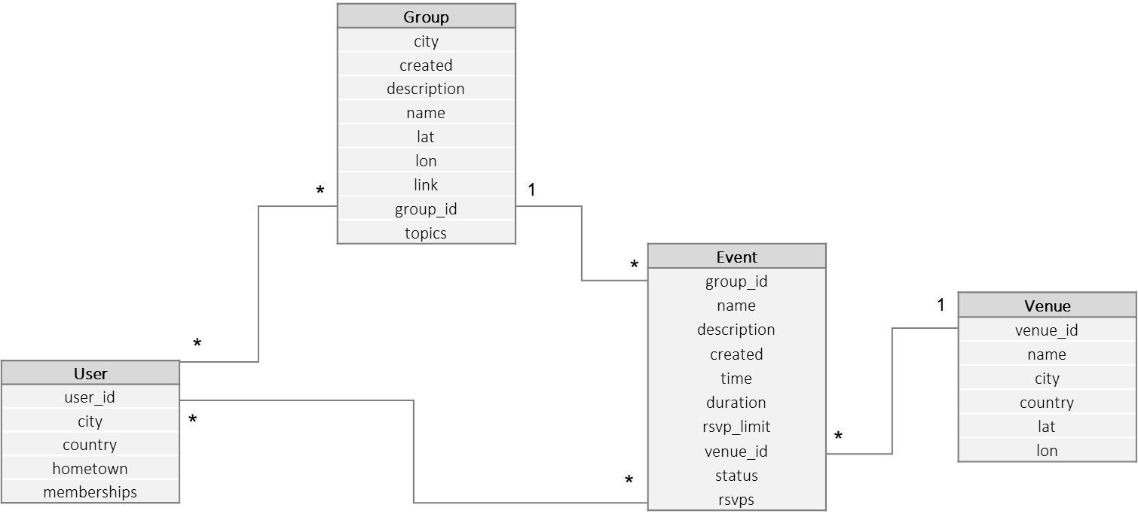
Problem statement
Given information related to groups, users, events, define features such that they are used to predict the number of group members (including guests) participating events.
Data
F(f₁, f₂, …, f_{n}) ~ N

Slide 4
Approach
Features extracted from raw data
Build predictive model using multiple techniques
Optimal model identified through testing and evaluation
Identified top variables that explain group member attendance

Slide 5
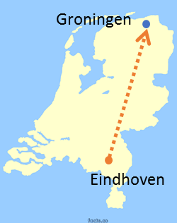
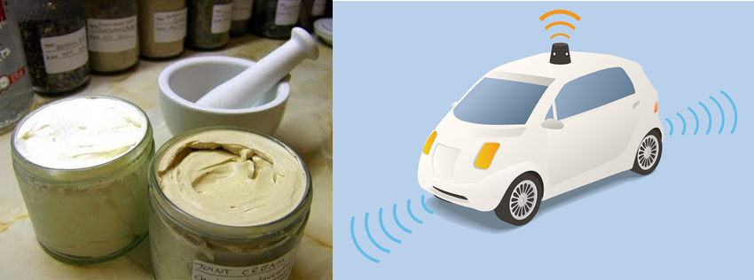
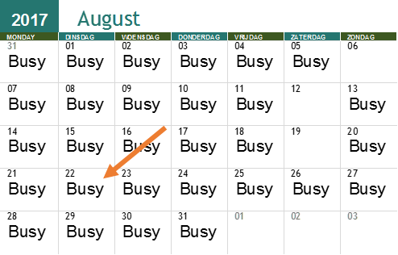
Feature engineering
 | Group attribute | Event attribute | User attribute
Spatial | geo distance with event |  | geo distance with event
Temporal | # events in past X days average # attendance in the past events | day of week hour of day event duration | # attended events in past X days # days since last event group membership time
Semantic | semantic similarity with event |  | semantic similarity with event
Others | group age number of group members
?
?
?

Slide 6
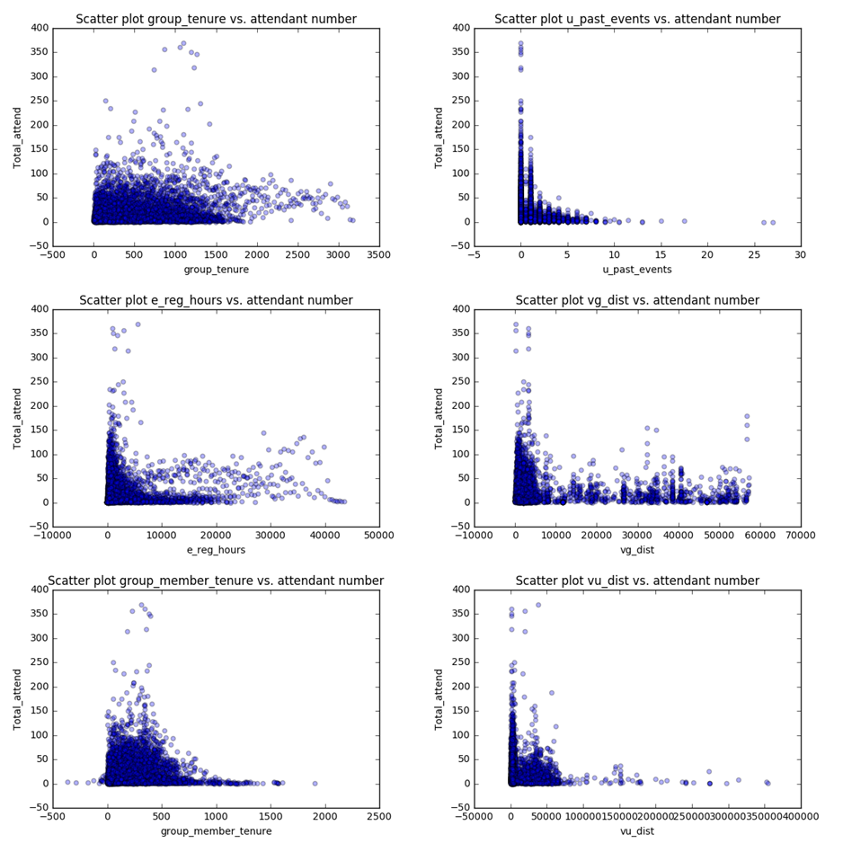
Model choice
Linear regression
Assumption of linearity between independent and dependent variables is not satisfied.
The relationship between independent variables and response variable is neither linear nor random.
Decision tree
Pros: can process non-linear relationships, easy to interpret.
Cons: only generate discrete outputs, thus not good for predicting the exact number of attendants.
For interpretation purpose, we start with building a decision tree model.
Notes:
Linear regression assumptions
(i) linearity and additivity of the relationship between dependent and independent variables:
(ii) statistical independence of the errors (in particular, no correlation between consecutive errors in the case of time series data)
(iii) homoscedasticity (constant variance) of the errors
(iv) normality of the error distribution.

Slide 7
Model building
Features
e_reg_hours, vg_dist, vu_dist, u_past_events, roup_member_tenure, g_past_events, group_tenure,
e_hour_1, e_hour_2, e_hour_3, e_hour_4, e_hour_5, e_hour_6,
e_day_1, e_day_2, e_day_3, e_day_4, e_day_5, e_day_6, e_day_7
The dataset is split into [64%, 16%, 20%] for training, validation and testing respectively.
To retrieve the best performing model, a grid search of 5-fold cross validation is applied on the following parameters.
min_samples_split, max_depth, min_samples_leaf, max_leaf_nodes
The resulted best model is with the following parameter.
max_depth: 4
max_leaf_nodes: 20
min_samples_leaf: 40
min_samples_split: 120
Performance is measured based on R2: 0.303

Slide 8
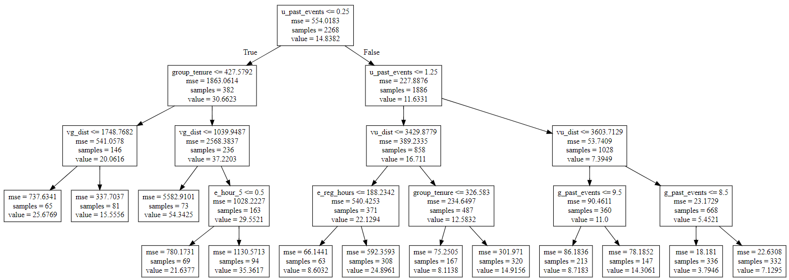
Model interpretation
The average number of events attended by group members in the past 4 weeks is an important factor. If the average number of past event attendance is high, then the attendance of current event will be slightly lower.

Slide 9
Balance between model performance and interpretation
Following approaches can be further explored to find a good balance between model performance and its explain-ability.
Generalized additive models
Quantile regression
Train a black-box model and build a surrogate explainable model on top
Use black-box models such as gradient boosting or random forests and interpret the feature importance

Slide 10
Process overview
Training Pipeline
Development environment
Aggregation Interval
Qualification Interval
Labelling Rules
3. Feature Engineering
1. Visit level data aggregation
2. Invalid data filtering
4. Model building and fine tuning
5. Model performance evaluation
3.1 User level data aggregation
3.2 Churn labelling & training data selection
Training data
Churn model
(classification)
Data warehouse
Scoring Pipeline
Chosen model from DSC
Production environment
Scoring data
Aggregation Interval
1. Visit level data aggregation
2. Invalid data filtering
3.1 User level data aggregation
6. Churn scoring
User churn probability & churn drivers
Legend
Shared process with training pipeline
Model
Input / output data
Configurable parameters
Notes:
Hive table: BDP data lake, eventually a mapping to DSC or BDP
Intermediate steps: data also stored in Hive

Slide 11
Next steps
Feature related
Number of members in group.
Event duration.
Apply LDA to generate semantic similarity of event-user pairs and event-group pairs.
Approach related
Apply different approaches in groups that has organized many events vs. groups with not many events separately.

Slide 12
Alternative approach
Predict the number attend / not attend individually based on users activity in past X days.
Suitable for users who attended certain amount of events in the past.
Can be applied to very active (many events, many active attendants) groups.
New event
Users
Attendants
User 1
User 2
User 3
…
User X
Temporal | Spatial | Semantic
Hour of day similarity with events in past X days Day of week similarity with events in past X days | Location similarity with events in past X days | # similar-topic events attended in past X days % attended similar-topic events in past X days
1
0
1 (2)
…
1

Slide 13
Details: feature related
Geo-distances
Haversine distance of (lat_1, lon_1) and (lat_2, lon_2).
Day of week
Use one-hot encoder to formulate 7 features [Mon, Tue, Wed, Thu, Fri, Sat, Sun]. For linear regression only keep the first 6, e.g. if the event is on Wednesday, then the encoding is [0, 0, 1, 0, 0, 0].
Hour of day
Use one-hot encoder to formulate 6 features [03:00~06:00, 07:00~10:00, 11:00~14:00, 15:00~18:00, 19:00~22:00, 23:00~02:00]. For linear regression only keep the first 5, e.g. if the event happens at 20:00, the encoding is [0, 0, 0, 0, 1]
Semantic similarity
Event and group semantic similarity: given the event description in free text format, use a topic modelling method (LDA) to extract a fixed number of topics (e.g. 10 topics) and compare the cosine similarity with group topics.
Event and user semantic similarity: get the users all group topics, compute the cosine similarity.

Slide 14
Details: data preprocessing
Used external city-latitude-longitude data to generate user geolocation features.
Filtered out events without a timestamp.
Removed users whose geo-distance > .96 of the complete user group.

