Slide 1

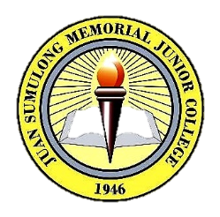

Slide 2
History
July 1, 1946 saw the birth of Juan Sumulong Memorial Junior College. It is the realization of a long-cherished dream of a group of men and women who saw the vast opportunities for service, undaunted by the multifarious obstacles that lie in wait. It was a labor of love for these men and women of vision, courage and determination who forged on where others of lesser stuff would have faltered. Armed with a faith of a Moses, the ambition of a Napoleon, and the courage of David, these mean and women pooled their meager resources together and started a molehill of a school that slowly but consistently inched its way to what it is now - a mountain of an institution very much committed to the total development of the youth and the nation's development goals.
Seventy (70) years later, JSMJC is now considered the citadel of learning and culture in the province of Rizal. The magnitude of service JSMJC has rendered is truly beyond measure as evidenced by the vast number of students, who have passed its portals and who are now among the frontliners in business, arts, industries, and in the professions.

