Slide 1
Verification and Validation
CIS 376
Bruce R. Maxim
UM-Dearborn

Slide 2
What’s the difference?
Verification
  Are you building the product right?
  Software must conform to its specification
Validation
  Are you building the right product?
  Software should do what the user really requires

Slide 3
Verification and Validation Process
Must applied at each stage of the software development process to be effective
Objectives
  Discovery of system defects
  Assessment of system usability in an operational situation

Slide 4
Static and Dynamic Verification
Software inspections (static)
  Concerned with analysis of static system representations to discover errors
  May be supplemented by tool-based analysis of documents and program code
Software testing (dynamic)
  Concerned with exercising product using test data and observing behavior

Slide 5
Program Testing
Can only reveal the presence of errors, cannot prove their absence
A successful test discovers 1 or more errors
The only validation technique that should be used for non-functional (or performance) requirements
Should to used in conjunction with static verification to ensure full product coverage

Slide 6
Types of Testing
Defect testing
  Tests designed to discover system defects
  A successful defect test reveals the presence of defects in the system
Statistical testing
  Tests designed to reflect the frequency of user inputs
  Used for reliability estimation

Slide 7
Verification and Validation Goals
Establish confidence that software is fit for its intended purpose
The software may or may not have all defects removed by the process
The intended use of the product will determine the degree of confidence in product needed

Slide 8
Confidence Parameters
Software function
  How critical is the software to the organization?
User expectations
  Certain kinds of software have low user expectations
Marketing environment
  getting a product to market early might be more important than finding all defects

Slide 9
Testing and Debugging
These are two distinct processes
Verification and validation is concerned with establishing the existence of defects in a program
Debugging is concerned with locating and repairing these defects
Debugging involves formulating a hypothesis about program behavior and then testing this hypothesis to find the error

Slide 10
Planning
Careful planning is required to get the most out of the testing and inspection process
Planning should start early in the development process
The plan should identify the balance between static verification and testing
Test planning must define standards for the testing process, not just describe product tests

Slide 11
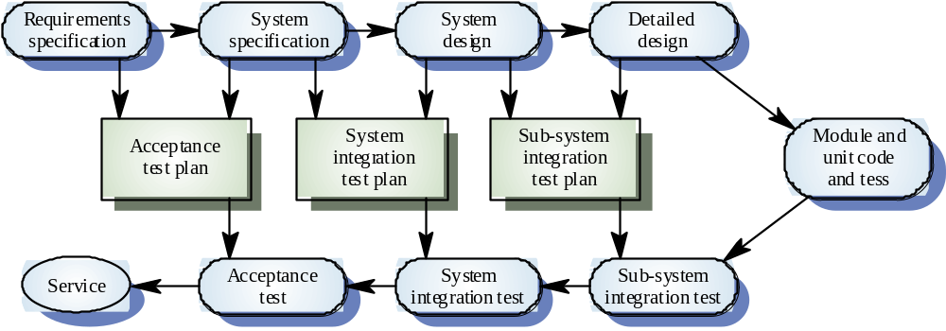
The V-model of development

Slide 12
Software Test Plan Components
Testing process
Requirements traceability
Items tested
Testing schedule
Test recording procedures
Testing HW and SW requirements
Testing constraints

Slide 13
Software Inspections
People examine a source code representation to discover anomalies and defects
Does not require systems execution so they may occur before implementation
May be applied to any system representation (document, model, test data, code, etc.)

Slide 14
Inspection Success
Very effective technique for discovering defects
It is possible to discover several defects in a single inspection
In testing one defect may in fact mask another
They reuse domain and programming knowledge (allowing reviewers to help authors avoid making common errors)

Slide 15
Inspections and Testing
These are complementary processes
Inspections can check conformance to specifications, but not with customer’s real needs
Testing must be used to check compliance with non-functional system characteristics like performance, usability, etc.

Slide 16
Program Inspections
Formalizes the approach to document reviews
Focus is on defect detection, not defect correction
Defects uncovered may be logic errors, coding errors, or non-compliance with development standards

Slide 17
Inspection Preconditions
A precise specification must be available
Team members must be familiar with organization standards
All representations must be syntactically correct
An error checklist must be prepare in advance
Management must buy into the the fact the inspections will increase the early development costs
Inspections cannot be used to evaluate staff performance

Slide 18
Inspection Procedure
System overview presented to inspection team
Code and associated documents are distributed to team in advance
Errors discovered during the inspection are recorded
Product modifications are made to repair defects
Re-inspection may or may not be required

Slide 19
Inspection Teams
Have at least 4 team members
  product author
  inspector (looks for errors, omissions, and inconsistencies)
  reader (reads the code to the team)
  moderator (chairs meeting and records errors uncovered)

Slide 20
Inspection Checklists
Checklists of common errors should be used to drive the inspection
Error checklist should be language dependent
The weaker the type checking in the language, the larger the checklist is likely to become

Slide 21
Inspection Fault Classes
Data faults (e.g. array bounds)
Control faults (e.g. loop termination)
Input/output faults (e.g. all data read)
Interface faults (e.g. parameter assignment)
Storage management faults (e.g. memory leaks)
Exception management faults (e.g. all error conditions trapped)

Slide 22
Inspection Rate
500 statements per hour during overview
125 statements per hour during individual preparation
90-125 statements per hour can be inspected by a team
Including preparation time, each 100 lines of code costs one person day (if a 4 person team is used)

Slide 23
Automated Static Analysis
Performed by software tools that process source code listing
Can be used to flag potentially erroneous conditions for the inspection team to examine
They should be used to supplement the reviews done by inspectors

Slide 24
Static Analysis Checks
Data faults (e.g. variables not initialized)
Control faults (e.g. unreachable code)
Input/output faults (e.g. duplicate variables output)
Interface faults (e.g. parameter type mismatches)
Storage management faults (e.g. pointer arithmetic)

Slide 25
Static Analysis Stages - part 1
Control flow analysis
  checks loops for multiple entry points or exits
  find unreachable code
Data use analysis
  finds initialized variables
  variable declared and never used
Interface analysis
  check consistency of function prototypes and instances

Slide 26
Static Analysis Stages - part 2
Information flow analysis
  examines output variable dependencies
  highlights places for inspectors to look at closely
Path analysis
  identifies paths through the program determines order of statements executed on each path
  highlights places for inspectors to look at closely

Slide 27
Defect Testing
Component Testing
  usually responsibility of component developer
  test derived from developer’s experiences
Integration Testing
  responsibility of independent test team
  tests based on system specification

Slide 28
Testing Priorities
Exhaustive testing only way to show program is defect free
Exhaustive testing is not possible
Tests must exercise system capabilities, not its components
Testing old capabilities is more important than testing new capabilities
Testing typical situations is more important than testing boundary value cases

Slide 29
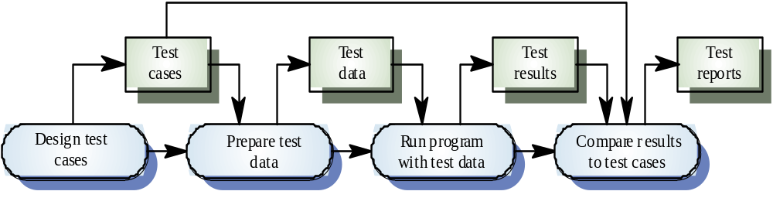
The defect testing process

Slide 30
Testing Approaches
Covered in fairly well in CIS 375
Functional testing
  black box techniques
Structural testing
  white box techniques
Integration testing
  incremental black box techniques
Object-oriented testing
  cluster or thread testing techniques

Slide 31
Interface Testing
Needed whenever modules or subsystems are combined to create a larger system
Goal is to identify faults due to interface errors or to invalid interface assumptions
Particularly important in object-oriented systems development

Slide 32
Interface Types
Parameter interfaces
  data passed normally between components
Shared memory interfaces
  block of memory shared between components
Procedural interfaces
  set of procedures encapsulated in a package or sub-system
Message passing interfaces
  sub-systems request services from each other

Slide 33
Interface Errors
Interface misuse
  parameter order, number, or types incorrect
Interface misunderstanding
  call component makes incorrect assumptions about component being called
Timing errors
  race conditions and data synchronization errors

Slide 34
Interface Testing Guidelines
Design tests so actual parameters passed are at extreme ends of formal parameter ranges
Test pointer variables with null values
Design tests that cause components to fail
Use stress testing in message passing systems
In shared memory systems, vary the order in which components are activated

Slide 35
Testing Workbenches
Provide a range of tools to reduce the time required and the total testing costs
Usually implemented as open systems since testing needs tend to be organization specific
Difficult to integrate with closed design and analysis work benches

Slide 36
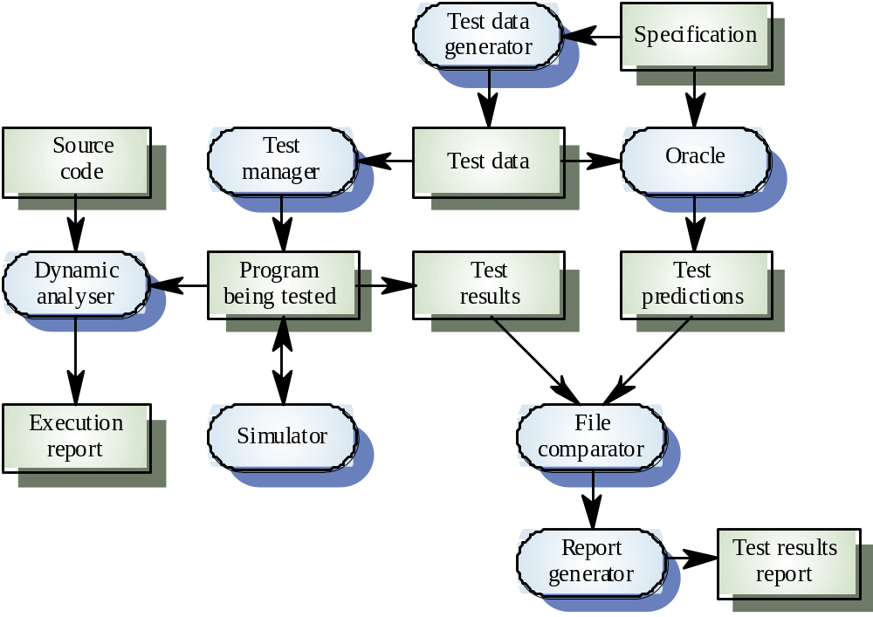
A testing workbench

Slide 37
Testing Workbench Adaptation
Scripts may be developed for user interface simulators and patterns for test data generators
Test outputs may need to be developed for comparison with actual outputs
Special purpose file comparison programs may also be useful

Slide 38
System Testing
Testing of critical systems must often rely on simulators for sensor and activator data (rather than endanger people or profit)
Test for normal operation should be done using a safely obtained operational profile
Tests for exceptional conditions will need to involve simulators

Slide 39
Arithmetic Errors
Use language exception handling mechanisms to trap errors
Use explicit error checks for all identified errors
Avoid error-prone arithmetic operations when possible
Never use floating-point numbers
Shut down system (using graceful degradation) if exceptions are detected

Slide 40
Algorithmic Errors
Harder to detect than arithmetic errors
Always err on the side of safety
Use reasonableness checks on all outputs that can affect people or profit
Set delivery limits for specified time periods, if application domain calls for them
Have system request operator intervention any time a judgement call must be made

