Slide 1
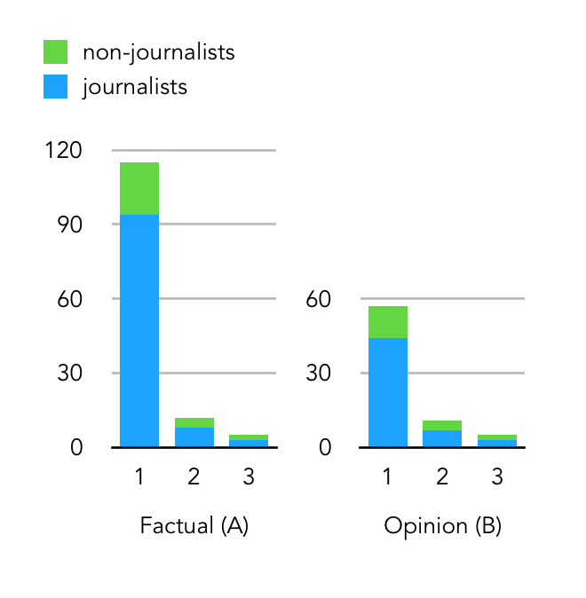
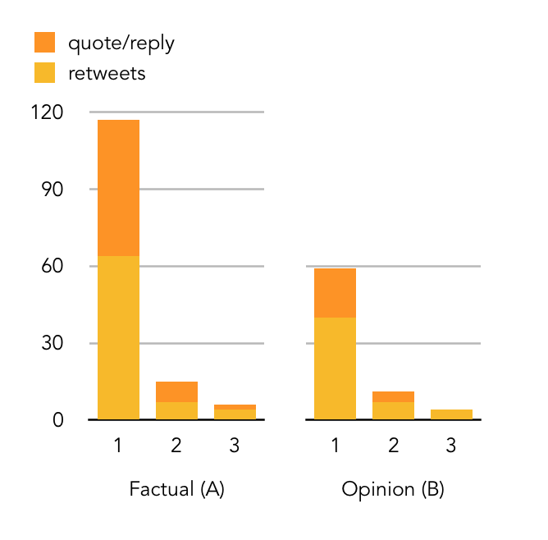
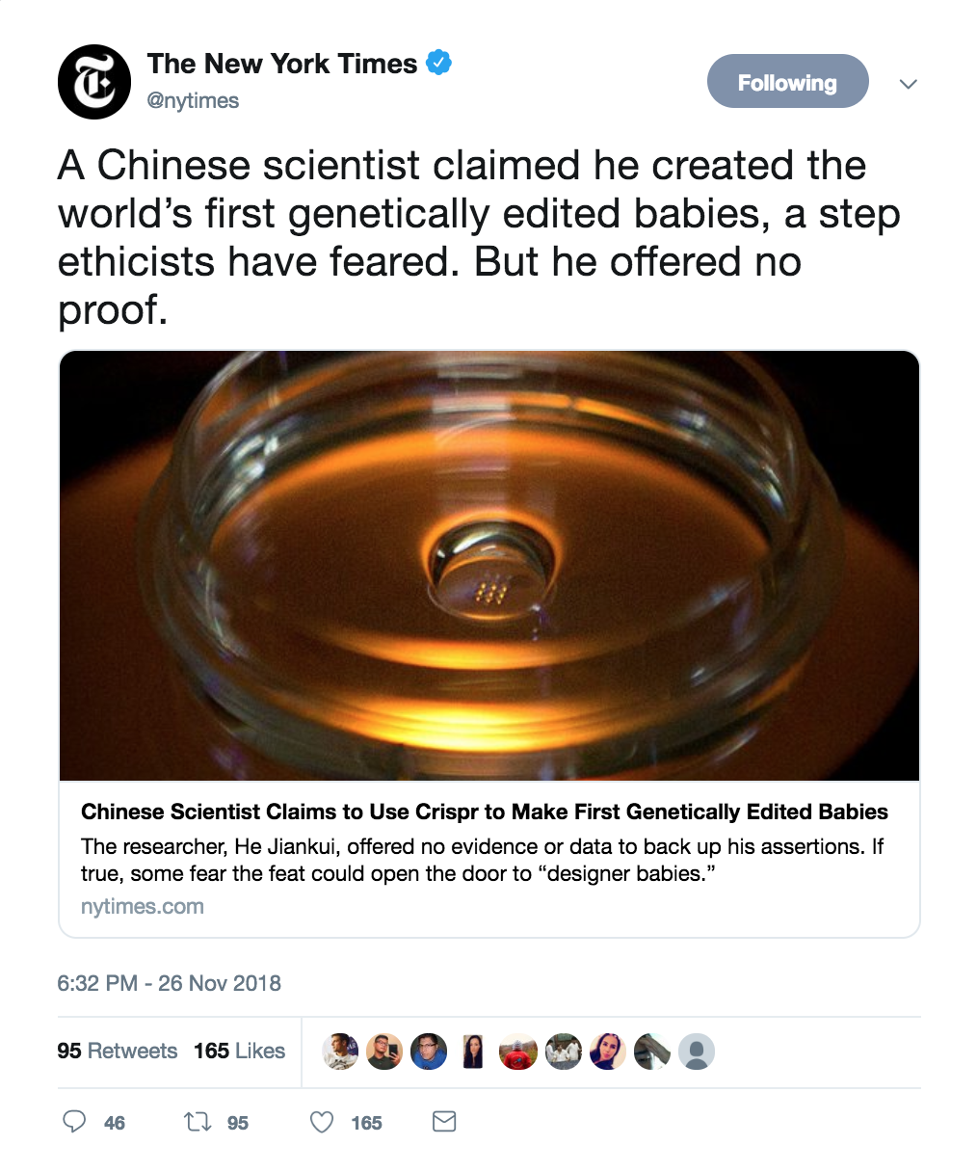
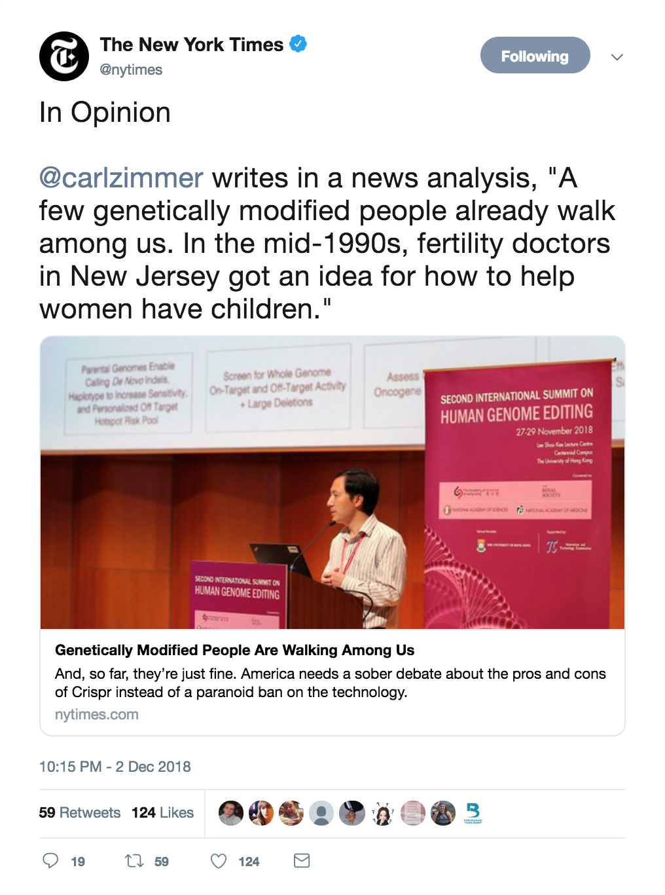
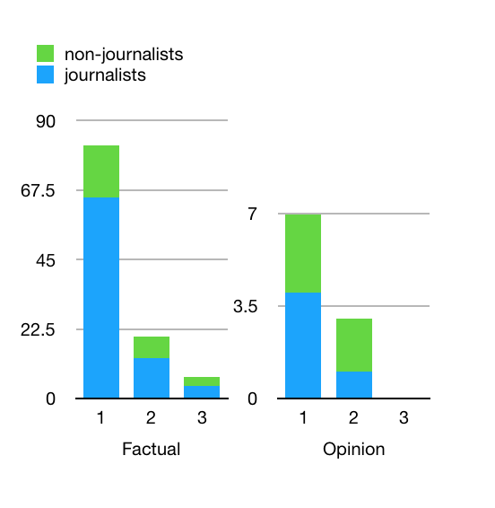
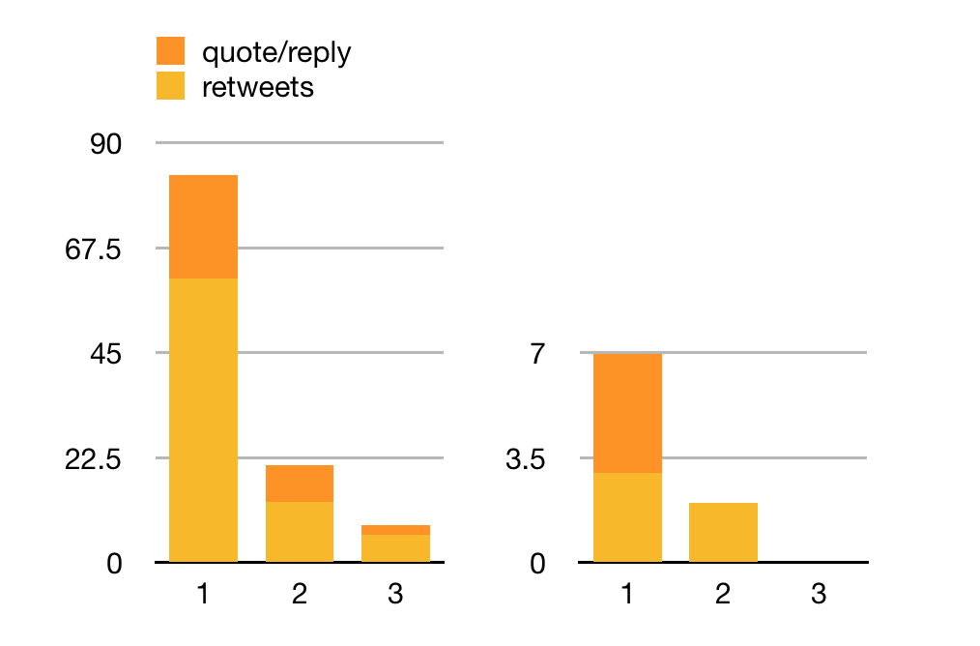
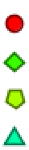
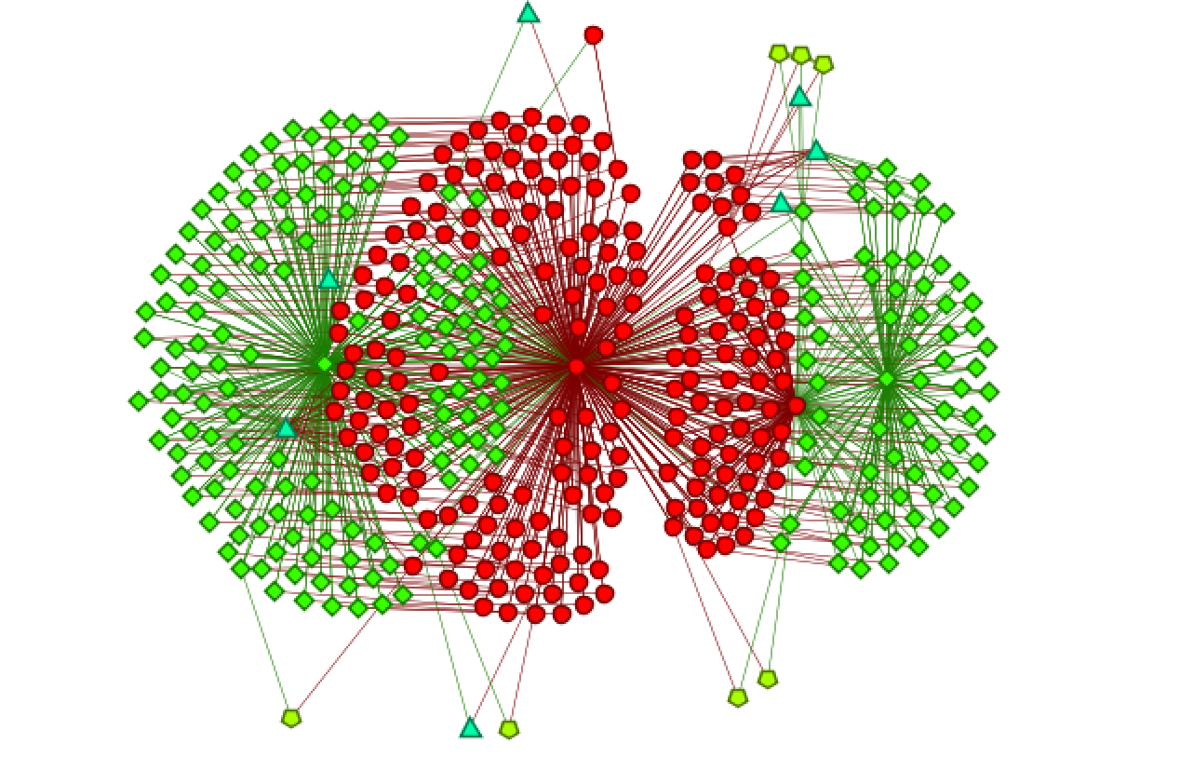
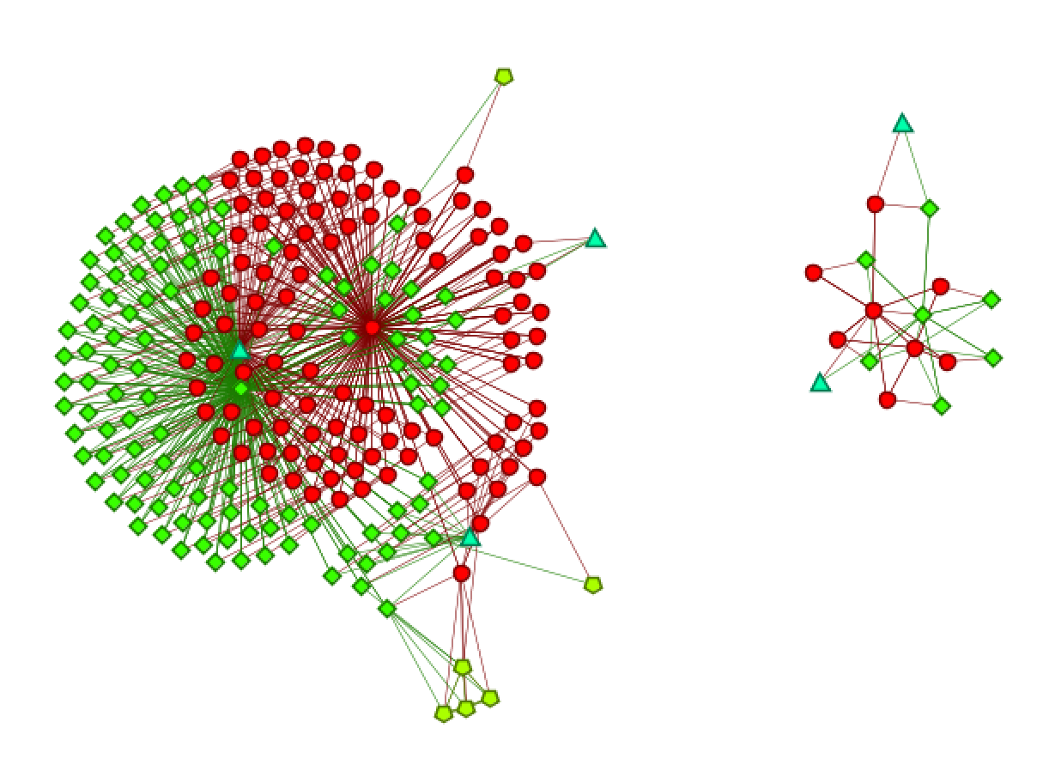
The Spread of Factual and Opinion Stories on Twitter
Joyce Wang (xinyiw), Advised by Professor Kathleen M. Carley
12/07/2018
Introduction
This work explores how factual stories and opinion stories posted by news agencies spread differently on Twitter. Using dynamic social network analysis techniques, this work compares and contrasts the readership of selected opinion and factual tweets by the same news agency around recent events.
Sample Data and Analysis
Event: Genetically modified Babies | Source: The New York Times
Event | News agency | Story Type | Agents # | Total Tweets #
Genetically modified Babies (11/26/2018) | The New York Times | Factual (posted 11/26) | 140 | 143
 |  | Opinion (posted 12/2) | 72 | 73
The Death of G.H.W.Bush (11/30/2018) | The New York Times | Factual (posted 12/2) | 111 | 111
 |  | Opinion* (posted 12/2) | 8 | 7
Table 1. Four samples of tweets by the same news agency related to two recent events; and the number of retweets, replies, quotes, and agents in the network that originates from the tweet since the day it was posted until 12/4/2018.
*The opinion story about the death of G. H. W. Bush was posted by the opinion account (@nytopinion) of the New York Times, instead of the general account (@nytimes).
Questions
How fast does an opinion story spread and how fast does a factual news story spread?
Are the audiences for factual and opinion stories composed of similar people?
How do the circulation network (retweets) and discourse network (quotes and replies) differ for opinion stories and factual stories?
(For longer-term exploration) how can news agencies create content that breaks out of existing political and ideological silos, and facilitate more diverse discourse on social media platforms beyond Twitter?
Figure 4. Proportion of journalist and non-journalist agents during the first three 3-hour periods.
Figure 5. The size of quote/reply network in comparison to the size of retweet networks for factual and opinion tweets during the first three 3-hour periods.
A
B
Event: Death of G. H. W. Bush | Source: The New York Times
Please note that the opinion tweet in this example was posted by the opinion account @nytopinion, which has fewer followers than the main @nytimes account. As a result, the network for the opinion tweet is significantly smaller.
Factual
Opinion
Data Collection
Choose English-language news agencies who mainly report on the US, and select several events that each of the news agencies have recently reported on. (Note: News agencies seldom post opinion and factual stories on the same event. Thus, the current set of <agency, event> pairs is quite limited. I will expand my dataset as time progresses and more events get covered.)
For each <agency, event> pair, select a set of tweets with links to opinion news stories, and another set of tweets with links to factual news stories
For each tweet, used the Twitter Standard Search API to collect the retweet/quote/reply network data, which is a representation of the spread of the original tweet.
Figure 6. Proportion of journalist and non-journalist agents during the first three 3-hour periods.
Figure 7. The size of quote/reply network in comparison to the size of retweet networks for factual and opinion tweets during the first three 3-hour periods.
Analysis Plan
Collect "snowballing" data (e.g., replies of replies) on more <agency, event> pairs and perform comparative analysis in ways similar to the sample
Overlaps between readers who engage with opinion tweets and those with factual tweets
Agent identity (news agencies, journalists, regular people, bots)
Density of agent-agent communication network over time
Sentiment analysis on discourse-related tweets
Aggregate opinion stories and factual stories, and compare across different agencies
Overlaps between readers who engage with different agencies
What allow an agency to generate larger reader networks from factual stories than from opinion stories, or vice versa
Examine whether either type of stories tends to attract more agents who frequently engage with an agency, or one-time agents
Collect data on viral stories
Compare and contrast the network of viral opinion stories and that of viral factual stories
Figure 1. A factual tweet (A) and an opinion tweet (B) by the same news agency around the same event.
Agent
Tweet
Hashtag
Url
Figure 2. Aggregated network generated from the opinion and factual tweets about genetically modified babies (visualization using ORA).
Figure 3. Aggregated network generated from the opinion and factual tweets about the death of G. H. W. Bush (visualization using ORA).
*Note the segregation of opinion and factual networks consistent for both events.

