Slide 1
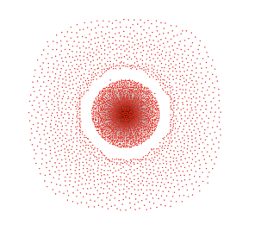
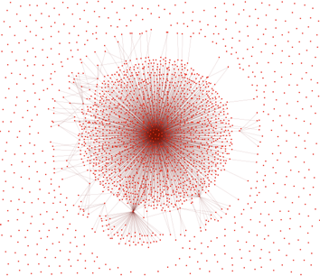
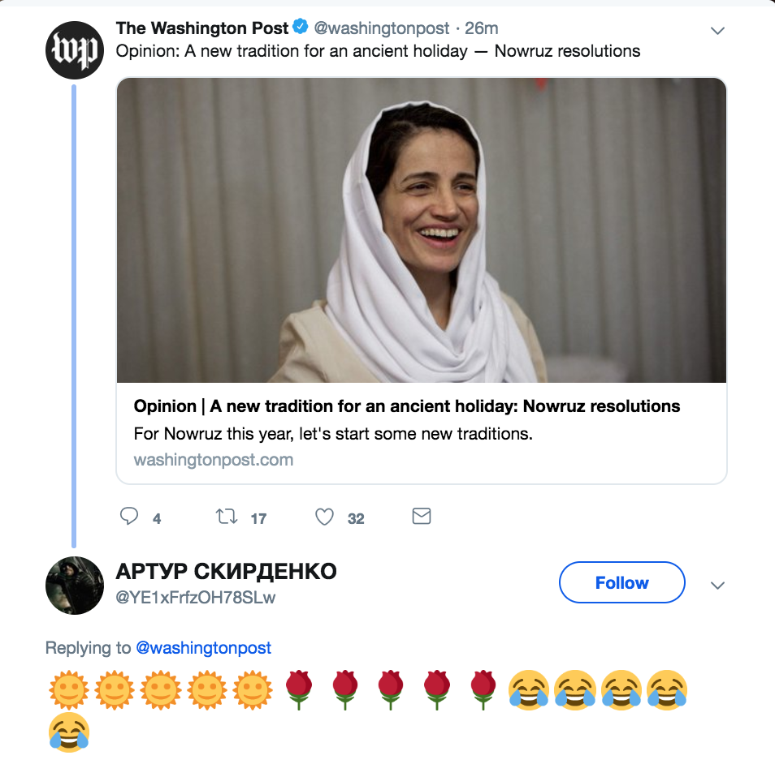
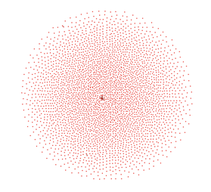
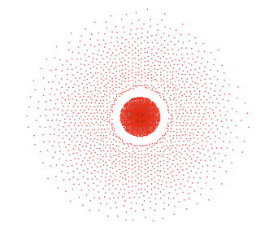
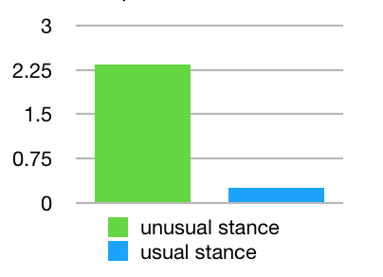
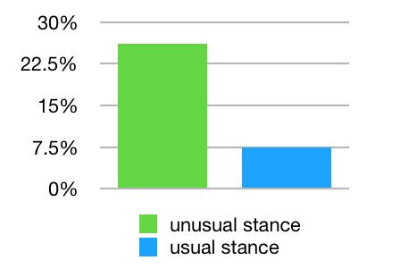
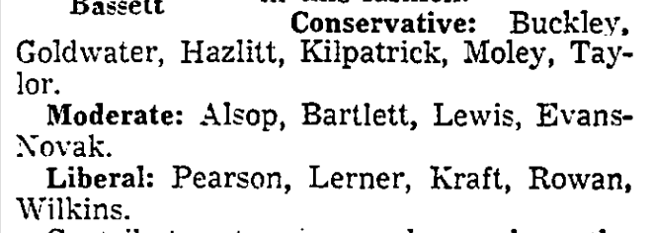

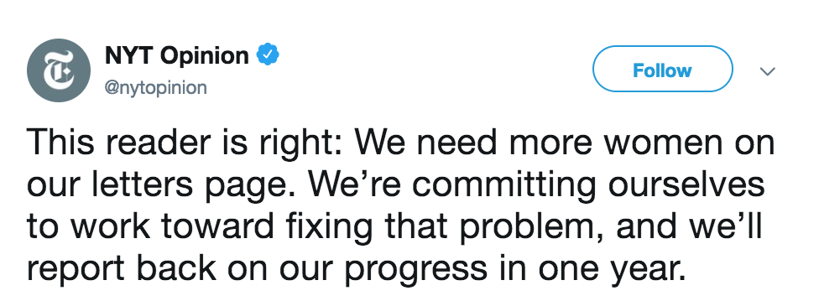
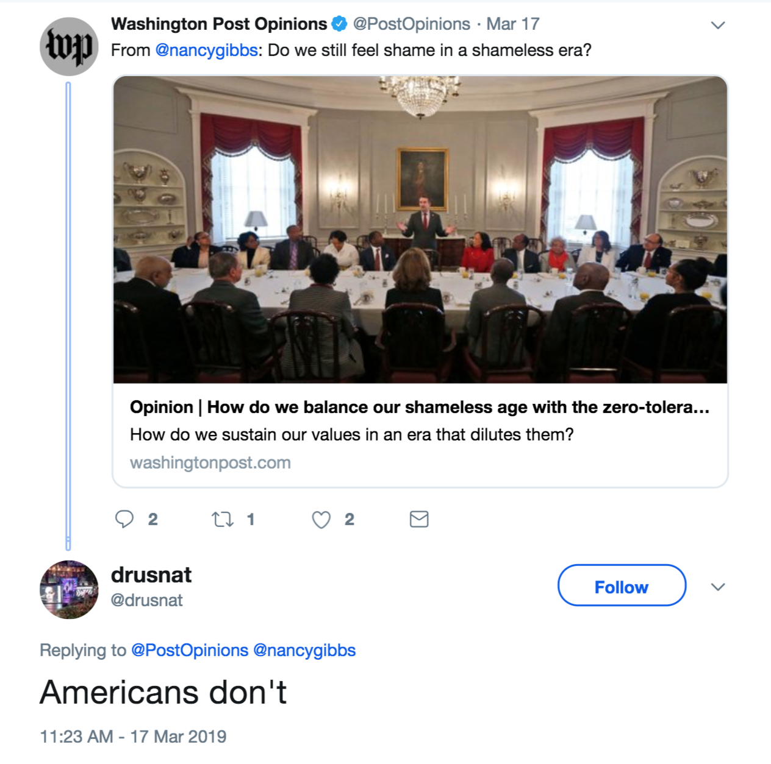
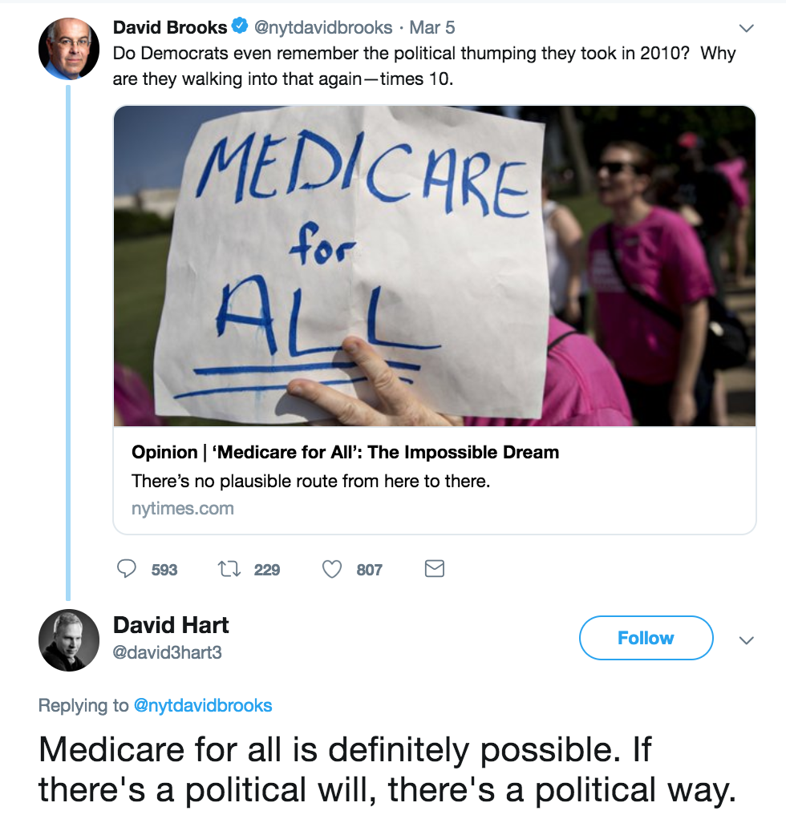
Joyce Wang
xinyiw@andrew.cmu.du
Kathleen M. Carley
kathleen.carley@cs.cmu.edu
How Op-Eds Influence Discourse on Twitter: An Online Ethnographic Study
Introduction
This study examines discourse patterns around opinion articles shared by major news agencies on the platform of Twitter.
Purpose: to help news professionals become more informed in their creation and curation of content for social media platforms, which have very different affordances from print, websites, news letters, and other channels of news dissemination.
Taking a mixed-methods approach, this work in progress
traces the history of op-eds in print
makes online observations
performs social network analysis
Data Collection
Content: all news tweets posted by six major English-language news agencies and their retweets, replies, and quotes
Time period: one month (1/18/2019–2/18/2019)
Tool: Twitter Standard API and the Tweepy python library
Categorization: Each tweet is categorized either in the “opinion network” or the “non-opinion network,” based on whether it is connected to a news tweet that links to an opinion article.
Observation C: Users engage with opinion articles mostly through retweeting (>replying >mentioning>quoting).
 | #tweets | #agents
@AJEnglish | 10127 | 7532
@washingtonpost | 64276 | 40958
@ChinaDaily | 680 | 516
@nytimes | 15683 | 13133
@NBCNews | 18687 | 11921
@WSJ | 13754 | 10369
Retweeted-by agent network
Mentioned-by agent network
Op-Eds: Past and Present
“A page of clashing opinions, however, was the aim from the beginning.”¹
—The New York Times, 2004
“We like controversy.”²
—The Los Angeles Times, 1967
In the early 1900s, major newspapers across the United States experimented with op-eds as an innovative public forum for commentary³.
Designed to democratize social and political discourse, the op-ed section includes diverse voices and opinions from a variety of professions, identities, backgrounds, and across the political spectrum.
Top: Data summary of “opinion networks”
Left: Tweets in the “opinion” network
Quoted-by agent network
Replied-by agent network
Observation A: Replies to opinion articles exhibit high level of neuroticism.
Observation D: When the opinion piece doesn’t align with the news agency’s usual stance, 1) there is a higher amount of interaction, 2) the interaction is more negative.
Based on observations on all tweets with > 50 replies by @nytopinion over a 10-day period:
Replies to opinion tweets by news accounts (and the % with indicators of strong emotions)
news agency account | # of replies | have cuss words | have all-caps words | use first-person pronouns | with second-person pronouns | with emojis | average sentiment scores
@AJEnglish | 38 | 18.42% | 13.16% | 18.42% | 13.16% | 5.26% | 0.0191
@washingtonpost | 443 | 20.54% | 22.12% | 16.70% | 12.87% | 1.81% | -0.1432
@nytimes | 34 | 8.82% | 20.59% | 11.76% | 8.82% | 0.00% | -0.0106
@NBCNews | 292 | 17.47% | 45.21% | 26.37% | 28.42% | 4.45% | -0.0752
@WSJ | 100 | 15.00% | 47.00% | 17.00% | 12.00% | 3.00% | -0.0915
average |  | 13.38% | 41.35% | 15.04% | 12.55% | 2.42% | -0.0502
The Los Angeles Times included contributors across the political spectrum (1967)
Neuroticism is positively correlated with use of negative emotion words and the frequent use of first person pronouns⁴.
reply::retweet ratio
percentage of replies that criticize the author or news agency
The commitment to include diverse opinions and voices in the op-ed section is being continued today.
Observation B: Twitter users tend to respond directly to content immediately visible in the tweet.
Future works
Extend experiments to multiple news agencies
Contextualize findings by consulting literatures
Create recommendations for social media managers and news curators
References
Shipley, David. “And Now a Word From Op-Ed,” The New York Times, Feb 1, 2004.
Bassett, James. "The Battle of the Analysts," The Los Angeles Times, November 26, 1967, p. 6.
Socolow, Michael J. "A profitable public sphere: the creation of the New York times Op-ed page." Journalism & Mass Communication Quarterly 87.2 (2010): 281-296.
Pennebaker, James W., and Laura A. King. "Linguistic styles: Language use as an individual difference." Journal of personality and social psychology 77.6 (1999): 1296.
Nowadays, many news agencies regularly share opinion pieces on social media. The social affordances of platforms such as Twitter offer the potential of amplifying influence of op-eds. However, discourse on social media are challenged by the proliferation of online trolls and disinformation.
This work aims to explore whether op-eds are able to continue serving its purpose of facilitating informed public discourse when they are shared on Twitter.
When the tweet has a question, people reply with direct answers.
Replies contain phrases that appear in the tweet.
This work was supported in part by the {INSERT FUNDING AGENCY} through, Grant {INSERT GRANT NUMBER} and the Center for Computational Analysis of Social and Organization Systems (CASOS). The views and conclusions contained in this document are those of the authors and should not be interpreted as representing official policies, either expressed or implied, of the {INSERT FUNDING AGENCY} or the U.S. government.

