Slide 1
Startup Academy
Recap
Week 6: Introduction to JavaScript

Slide 2
What does JavaScript do?
If html is the structure and css is the appearance, what about JS?

Slide 3
JavaScript is the language of the browser.
It’s primary purpose is to add interactivity to an otherwise static page.
These days you can do lotsa cool stuff with JavaScript.

Slide 4
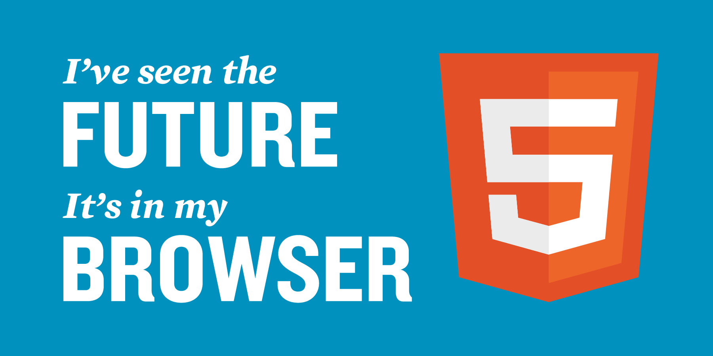
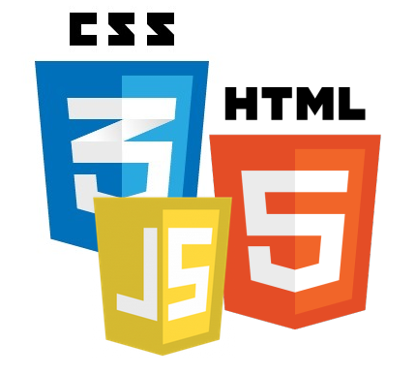
You can do powerful things with HTML5, CSS3 and JavaScript
http://www.cuttherope.ie/ http://www.atari.com/arcade

Slide 5


JavaScript is famous
JavaScript is the world's most popular programming language.
It is the language for HTML, for the web, for servers, PCs, laptops, tablets, phones, and more.
JavaScript has become sexy again in recent years with libraries like jquery ☺
http://blog.utest.com/if-programming-languages-were-women/

Slide 6
Let’s try it out
1 – example exercise: Using just 3 lines of JavaScript, you can get your browser to add some interactivity to your website. <script>
function displayDate()
{
document.getElementById("demo").innerHTML=Date();
}
</script>
Did you know?
You can put the <script> tag in any part of your HTML document, but typically we leave it in the <head>.

Slide 7
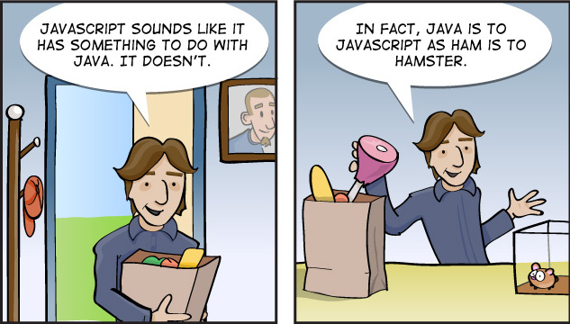
Cocktail Party FAQs
JavaScript and Java are two completely different languages, in both concept and design. Java (invented by Sun) is a more complex programming language in the same category as C.
ECMA-262 is the official name of the JavaScript standard.

Slide 8
Events

Slide 9
Events
With JavaScript you can get the webpage to react to events, such as the click of a button. Events include:
When a user clicks the mouse
When a web page has loaded
When an image has been loaded
When the mouse moves over an element
When an input field is changed
When an HTML form is submitted
When a user strokes a key

Slide 10
Example of an event:
When you click on the button, a pop up with text of “Welcome” appears.
<button type="button" onclick="alert('Welcome!')">Click Me!</button>

Slide 11
Let’s try it out now!
Exercise 2 – Events

Slide 12
Variables

Slide 13
JavaScript Variables
JavaScript variables are "containers" for storing information:
These variables act much like algebra and each alphabet can store values that you can define ☺
var x=5;
var y=6;
var z=x+y;

Slide 14
How do we name variables?
Variables can have short names (like x and y) or more descriptive names (age, sum, totalVolume).
Variable names must begin with a letter
Variable names are case sensitive (y and Y are different variables)

Slide 15
Let’s try it out now
Exercise 3 – variables

Slide 16
Data Types

Slide 17
What types of data can we use in JavaScript?
In the previous exercise, you learnt that we can store numeric values in our JavaScript variables.
Can you guess what other types of data can be used?

Slide 18
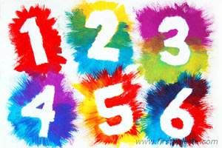
Data Types
a. numbers are quantities, just like you're used to. You can do math with them.
E.g., var x = 3.14;

Slide 19
Data Types
b. strings are sequences of characters, like the letters a-z, spaces, and even numbers. These are all strings: "Ryan", "4" and "What is your name?"
Strings are extremely useful as labels, names, and content for your programs. E.g., var userName=“Ryan”

Slide 20
Data Types
To make a number in your code, just write a number as numerals without quotes: 42, 190.12334.
To write a string, surround the string with quotes: "What is your name?“
Changing variable names:
var name = "Michael" //declare variable and give it value of "Michael"
name = "Samuel" //change value of name to "Samuel"

Slide 21
Data Types
The third type of data is a Boolean. (pronounced "bool-ee-un" and named after George Boole).
A boolean can have only two values, true or false.
*We’ll talk about Booleans once we hit if/else conditions.

Slide 22
Data Types
The fourth type of data is Undefined.
For example, a variable can have no value assigned to it yet.
e.g., var strawberries;
The fifth type of data is Null.
Variables can be emptied by setting the value to null; e.g, var pumpkins = null;

Slide 23
Let’s try it out
Exercise 4 – data types

Slide 24
Objects

Slide 25
Objects
Almost everything in JavaScript can be an Object: Strings, Functions, Arrays, Dates....
Objects are just data, with properties and methods.

Slide 26
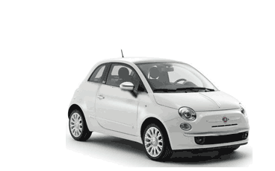
Properties and Methods
Properties are values associated with objects.
Methods are actions that objects can perform.
A real life example – A car:
Object | Properties | Methods
 | car.name = Fiat car.model = 500 car.weight = 850kg car.color = white | car.start() car.drive() car.brake()

Slide 27
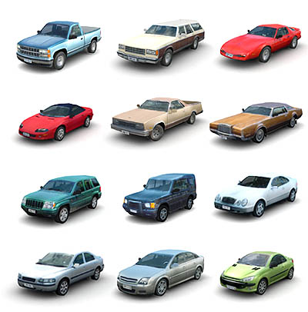
Objects
The properties of the car include name, model, weight, color, etc.
All cars have these properties, but the property values differ from car to car.
The methods of the car could be start(), drive(), brake(), etc.
All cars have these methods, but they are performed at different times.

Slide 28
Let’s try it out now
Exercise 5 - Objects

Slide 29
Accessing Object Properties
The syntax for accessing the property of an object is:
objectName.propertyName var message="Hello World!"; var x=message.length; The value of x, after execution of the code above will be:
12

Slide 30
Accessing Object Methods
You can call a method with the following syntax:
objectName.methodName()
This example uses the toUpperCase() method of the String object, to convert a text to uppercase:
var message="Hello world!"; var x=message.toUpperCase();
The value of x, after execution of the code above will be:
HELLO WORLD!

Slide 31
Functions

Slide 32
Functions
A function is a JavaScript procedure—a set of statements that performs a task or calculates a value.
It is like a reusable piece of code. Imagine , having 20 for loops ,and then having a single function to handle it all .
Example of a function: function myFunction() { alert("Hello World!"); }

Slide 33
JavaScript Function Syntax
A function is written as a code block (inside curly { } braces), preceded by the function keyword:
function functionname() { //some code to be executed } The code inside the function will be executed when "someone" calls the function.
The function can be called directly when an event occurs (like when a user clicks a button), and it can be called from "anywhere" by JavaScript code.

Slide 34
Calling a Function with Arguments
When you call a function, you can pass along some values to it, these values are called arguments or parameters.
These arguments can be used inside the function.
You can send as many arguments as you like, separated by commas (,)
myFunction(argument1,argument2)
Declare the argument, as variables, when you declare the function:
function myFunction(var1,var2) { some code }

Slide 35
Let’s try it out
Exercise 6 – functions <p>One of Forbes richest people in the world, who wears slippers to work. Who is he?</p> <--! Create a function to answer the above question.-->
<script>
function myFunction()
{
var username="Mark Zuckerberg";
var jobtitle="Founder, CEO of Facebook Inc";
document.getElementById("demo").innerHTML=username + "<br>" + jobtitle;
}
</script>

Slide 36
Operators

Slide 37
Operators
You’ve seen in previous exercises how we use operators to add and assign values to each other.
Can you guess what other operators there are?
= is used to assign values.
+ is used to add values.

Slide 38
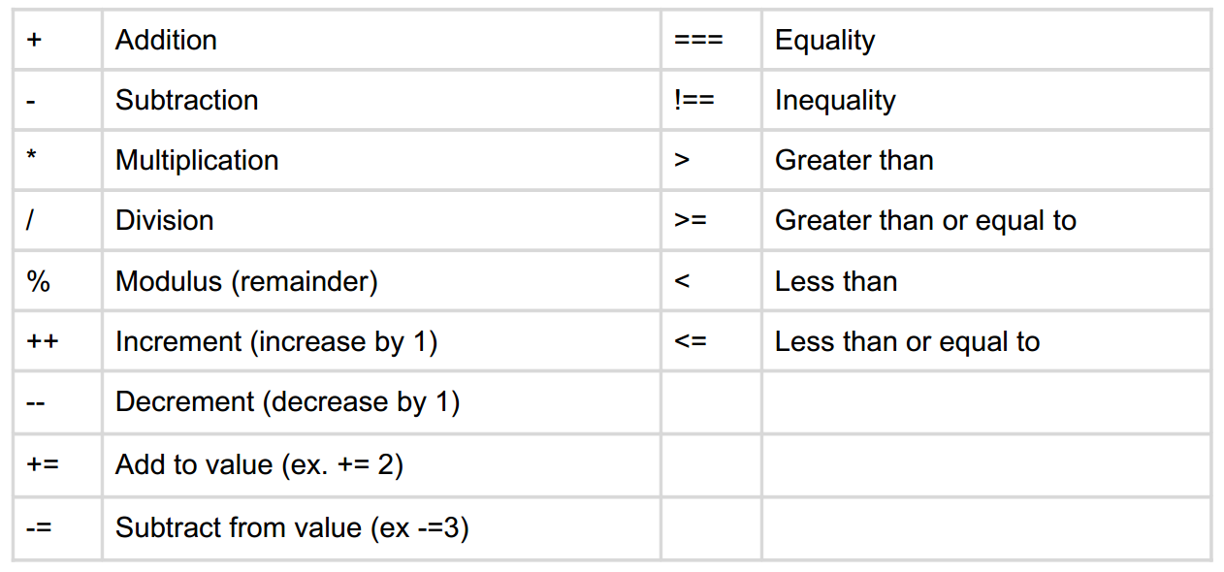
Mathematical Expressions & Comparisons

Slide 39
Let’s try it out!
Exercise 7 - Operators

Slide 40
Conditions

Slide 41
Conditional Statements
if statement - use this statement to execute some code only if a specified condition is true
if...else statement - use this statement to execute some code if the condition is true and another code if the condition is false
if...else if....else statement - use this statement to select one of many blocks of code to be executed
switch statement - use this statement to select one of many blocks of code to be executed

Slide 42
If Statement
Use the if statement to execute some code only if a specified condition is true.
Syntax
if (condition) { code to be executed if condition is true }
*Note that if is written in lowercase letters. Using uppercase letters (IF) will generate a JavaScript error!

Slide 43
If Statement Example
Make a "Good day" greeting if the time is less than 20:00:
if (time<20) { x="Good day"; }
The result of x will be:
Good day

Slide 44
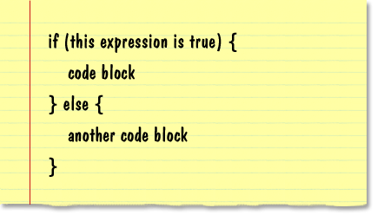
If.. Else.. Statement
if...else statement - use this statement to execute some code if the condition is true and another code if the condition is false
For example:
if (time<20)
{
x="Good day";
}
else
{
x="Good evening";
}

Slide 45
Let’s try it out now!
Exercise 8 – condition statements

Slide 46
Manipulate HTML

Slide 47
JavaScript: Changing HTML Content
Using JavaScript to manipulate the content of HTML elements is very common.
You will often see document.getElementById("some id"). This is defined in the HTML DOM.

Slide 48
You can easily manipulate HTML contents with JavaScript
<script>
function myFunction()
{
x=document.getElementById("demo"); // Find the element
x.innerHTML="I've just changed the content with JavaScript."; //
Change the content
}
</script>

Slide 49
Change images

Slide 50
You can also toggle images with JavaScript
<script>
function changeImage()
{
element=document.getElementById('myimage')
if (element.src.match("heart_full"))
{
element.src="img/heart_empty.png";
}
else
{
element.src="img/heart_full.png";
}
}
</script>

Slide 51
Let’s try it out now
<script>
function changeImage()
{
element=document.getElementById('myimage')
if (element.src.match("heart_full"))
{
element.src="img/heart_empty.png";
}
else
{
element.src="img/heart_full.png";
}
}
</script>

Slide 52
Recap & some good habits to keep..

Slide 53
Javascript Statements
JavaScript is a sequence of statements to be executed by the browser.
JavaScript statements are "commands" to the browser.
This JavaScript statement tells the browser to write "Hello World" inside an HTML element with id="demo":
document.getElementById("demo").innerHTML="Hello World";
Semicolons;
separates JavaScript statements.

Slide 54
JavaScript Code Blocks
function myFunction() { document.getElementById("demo").innerHTML="Hello World"; document.getElementById("myDIV").innerHTML="How are you?"; }
JavaScript statements can be grouped together in blocks.
Blocks start with a left curly bracket, and end with a right curly bracket. {}
The purpose of a block is to make the sequence of statements execute together.

Slide 55
JavaScript Code Blocks
A good example of statements grouped together in blocks, are JavaScript functions.
This example will run a function that will manipulate two HTML elements:
function myFunction() { document.getElementById("demo").innerHTML="Hello World"; document.getElementById("myDIV").innerHTML="How are you?"; }

Slide 56
Before we go further..
Let’s learn a little bit about good practices when writing Javascript.

Slide 57
JavaScript is Case Sensitive
JavaScript is case sensitive.
Watch your capitalization closely when you write JavaScript statements:
A function getElementById is not the same as getElementbyID.
A variable named myVariable is not the same as MyVariable.

Slide 58
White Space
JavaScript ignores extra spaces. You can add white space to your script to make it more readable. The following lines are equivalent:
var person=“Thomas"; var person = “Thomas";

Slide 59
White Space
Break up a Code Line
You can break up a code line within a text string with a backslash.
The example below will be displayed properly:
document.write("Hello \ World!");

Slide 60
JavaScript Comments
Comments will not be executed by JavaScript.
Comments can be added to explain the JavaScript, or to make the code more readable.
Single line comments start with //.
The following example uses single line comments to explain the code:
<script>
var x=5; // declare x and assign the value 5 to it
var y=x+2; // declare y and assign the expression value x+2 to it
document.getElementById("myP").innerHTML=y // write the value of y to myP
</script>

Slide 61
Why use jQuery
JavaScript, however, can be a little verbose. Let’s say that when a user—we will call her Liz Lemon—signs up for your newsletter, you want to say “Thanks for signing up, Liz Lemon!”
Using JavaScript you would need to write:
window.onload = initAll;
function initAll() { document.getElementById(“submit”).onclick = submitMessage; }
function submitMessage() { var greeting = document.getElementById(“name”).getAttribute(“value”); document.getElementById(“headline”).innerHTML = “Thanks for signing up, ” + greeting; return false; }

Slide 62
In jQuery
This is what the same script looks like in jQuery.
$(“#submit”).click(function () { var greeting = $(“#name”).val(); $(“#headline”).html(“Thanks for signing up, ” + greeting); return false; });

