Slide 1


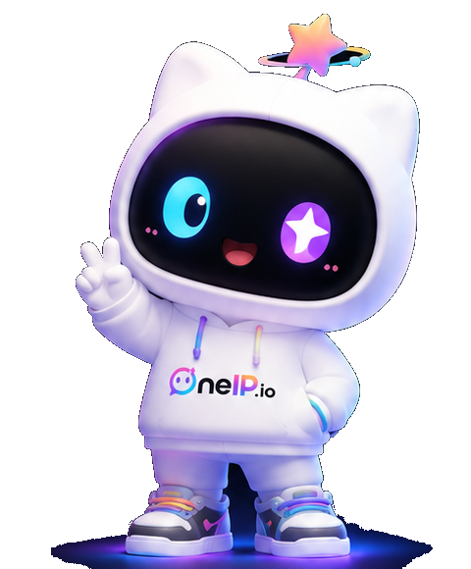
STORY DECK · 9 PAGES
neIP.io
OneIP + OPC
OPC = One Personal Company · you are the company
Launch Brand IP · Connect Fans · Co-create Value
Raise
Equity
Post-money
US$2M
20%
US$10M

Slide 2

THE SHIFT
AI Is Eating Everything Copyable
Support, design, copy, coding, entry-level roles — taken over by AI. Value migrates from copyable labor to the uncopyable person.
$4.9T
35%+
$500B
2030 global AI economy
Automatable jobs
Creator economy
→ Scarcity becomes the only premium.
oneIP.io · Story Deck
02 / 9

Slide 3

MEGATREND · INDUSTRY FORECAST
The Stronger AI Gets, the More Personal IP Is Worth
Institutional forecasts (IDC · Stanford HAI · Goldman Sachs · WEF · McKinsey): AI economy soars, jobs restructure, personal brand becomes the exit.
Metric · forecast
2027
2028
2029
2030
Global AI economic value
$3.2T
$3.8T
$4.4T
$4.9T
AI market CAGR
25%
27%
28%
30%
Workforce cut (forecast)
5–10%
10–15%
15–20%
20–30%
Automatable jobs
20%
25%
30%
35%+
Creator economy
$400B
$440B
$470B
$500B+
AI-skill demand
High
Higher
Standard
Must-have
Professionals pivot to the Creator Economy: doctors · lawyers · accountants · teachers · realtors · agents all build personal IP — OneIP's users.
Sources: IDC / Stanford AI Index / Goldman Sachs / WEF / McKinsey (2024–2026). "Workforce cut" is a blended forecast range, not official data.
oneIP.io · Story Deck
03 / 9

Slide 4
THE INSIGHT
Only People & Fans Can't Be Replaced
Personal IP / Creators
Pros pivot to creators
AI can assist, but can't BE that person. Personality, story, trust — inherently unique.
Doctors, lawyers, accountants, teachers, realtors, agents — all building personal brands.
Takeaway
Fan Data / Fan Emotion
Demand for personal brands is exploding.
Real attention & emotion can't be generated. AI amplifies — it doesn't replace.
neIP.io
oneIP.io · Story Deck
04 / 9

Slide 5
THE ANSWER · OneIP = OPC
OneIP: Turn Everyone Into a Company
One platform that turns personal brand into an issuable, tradable, monetizable asset — OPC, you are the company.
oneIP.ai
oneIP.io
Create IP · Supply
Trade IP · Liquidity
AI avatar · content at scale
1-click launch · terminal
↔
Standardized IP packs
Connect fans · co-create
Compounding supply
Fees + liquidity
Create IP × Trade IP = a real-asset-backed IP economy.
oneIP.io · Story Deck
05 / 9

Slide 6
MARKET
A Trillion-Dollar IP Economy, Moving On-chain
The creator economy is surging; making fan emotion priceable & tradable is its biggest unmet gap.
TAM
$250B+
TAM · Global creator economy
SAM
$50B
SAM · Tokenizable IP market
SOM
$1.5B
SOM · Obtainable in 3 yrs
Drivers: ~20% creator-economy CAGR · surging fan-token demand · KOL supply · fans pay for belonging
* Public-data estimates.
oneIP.io · Story Deck
06 / 9

Slide 7
THE FLYWHEEL
AI Supply × On-chain Liquidity = Flywheel
Others just launch tokens (speculative). We secure real supply via AI and liquidity via chain.
More IPs / brands onboard
Trading monetizes · rewards creators
OneIP
Flywheel
AI keeps producing IP assets
On-chain launch · liquidity
oneIP.io · Story Deck
07 / 9

Slide 8
THE FUTURE · WEB4 VISION
Web4: Fans as Assets, an IP Economy at Scale
Once enough brands, influencers and fan data aggregate, scale effects drive exponential revenue.
Brands & suppliers
Influencer / creator IP
Fans reached
Annual GMV
30,000+
200,000+
300M+
$3B+
2028E assumption
2028E assumption
2028E assumption
2028E assumption
2028E platform revenue
$150M
Valuation = revenue × 40× PE
2028E company valuation
$6B
* 40× PE estimate; vision assumption under a scale scenario, not a forecast.
oneIP.io · Story Deck
08 / 9

Slide 9
THE ASK · JOIN US
Raising US$2M · for 20% Equity
US$10M post-money · 18-month runway to prove the dual-engine loop.
Give every unique IP
its own on-chain economy.
neIP.io
OneIP + OPC · One of a Kind
oneIP.io / oneIP.ai bossses001@gmail.com

