Slide 1

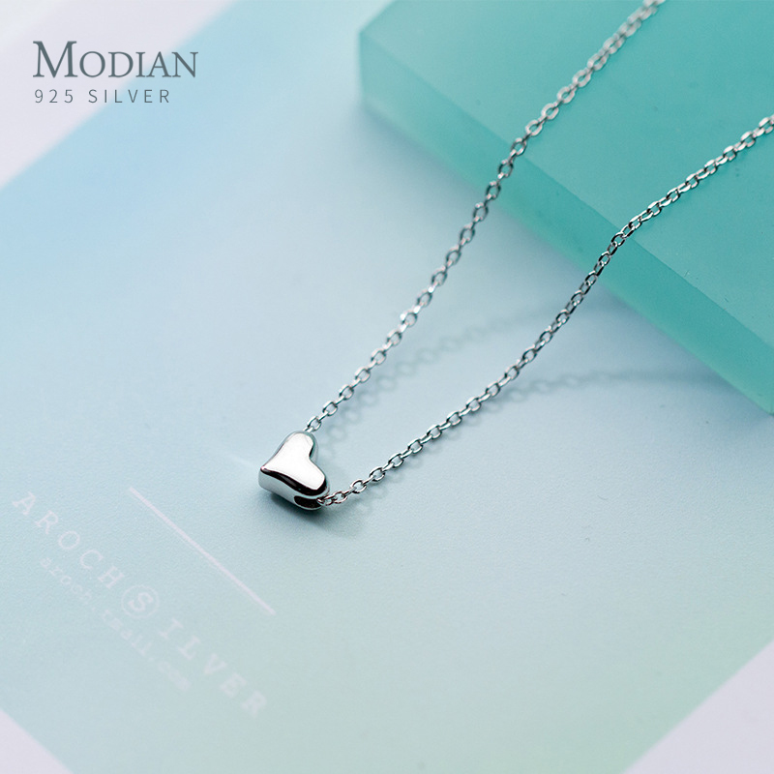
Modian: Best Quality
⭐⭐⭐⭐⭐
Mozaer provided the best combination of quality materials and reasonable pricing. 925 Sterling Silver, light, and a great warranty!
Shop Now →

