Slide 1

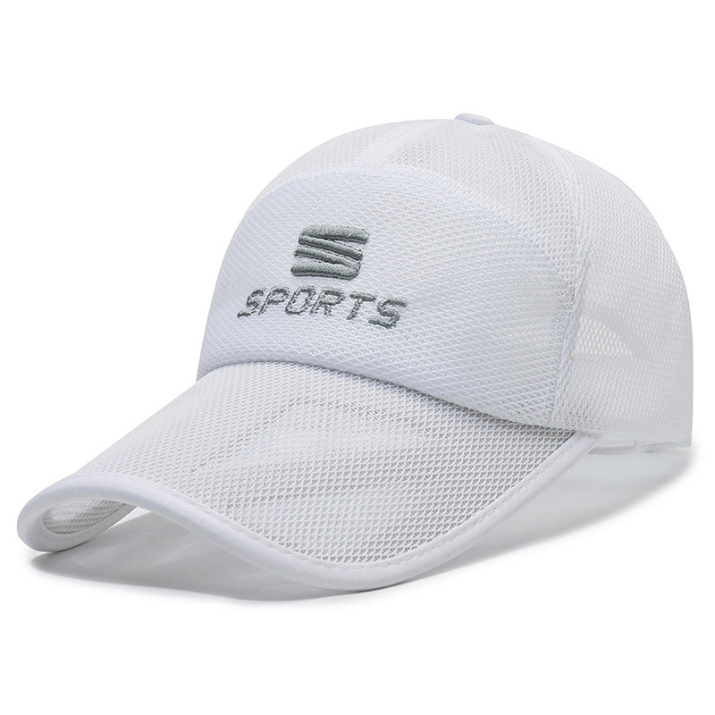
Baseball Hat Fails
⭐⭐
In my attempt to save a few dollars, I made five major errors. The result was a collection of faded, poorly made hats.
点击购买

