Slide 1

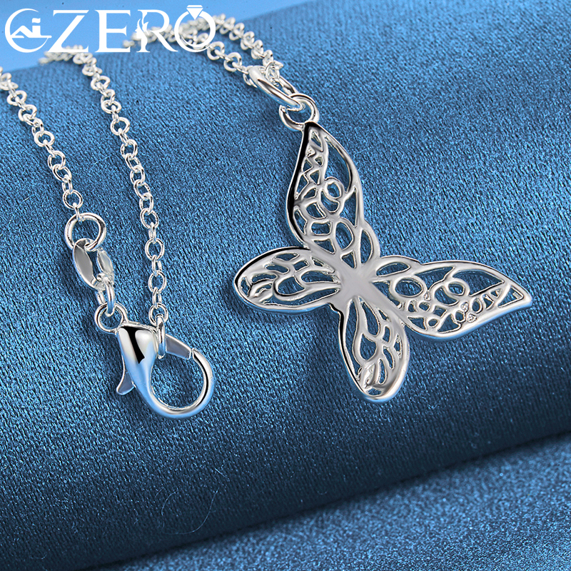
Beanie Hat Regret
⭐⭐⭐⭐⭐
I wasted about $150 and countless hours... That $150 could have bought the ALIZERO 925 Sterling Silver necklace right away.
点击购买

