Slide 1

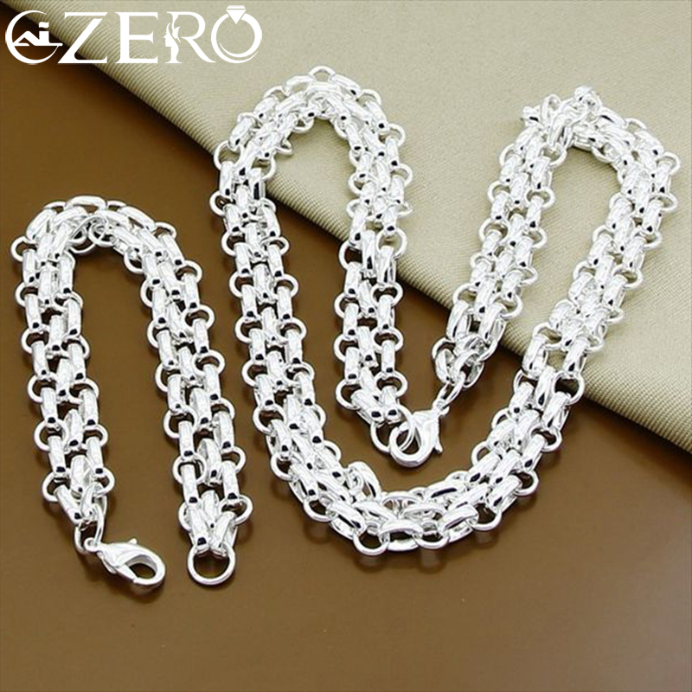
Silver Upgrade
⭐⭐⭐⭐⭐
WOW. This was 925 Sterling Silver. Silver is a real precious metal. It costs more, but the look is totally different.
点击购买

