Slide 1

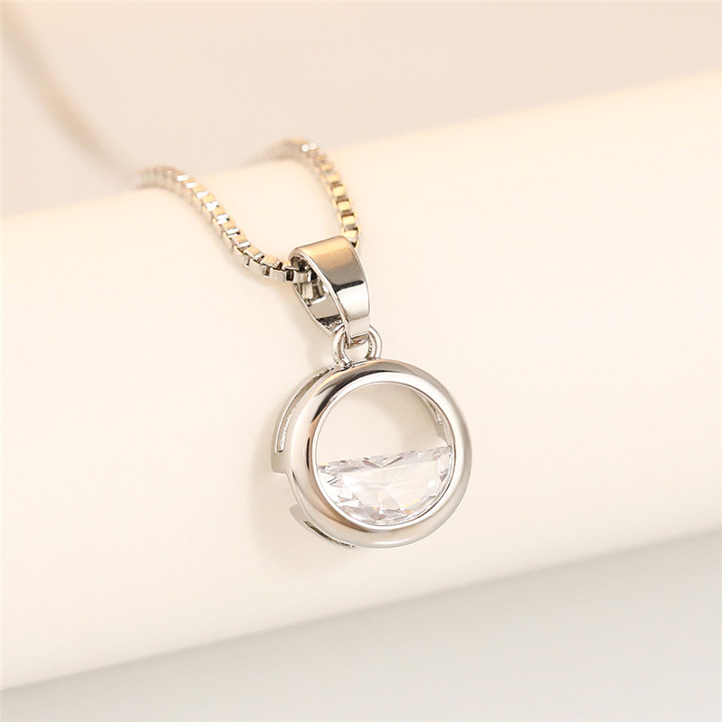
Necklace Upgrade
⭐⭐⭐⭐
Premium pieces use better metal that won't stain & CZ stones actually sparkle. You buy once, not four times a year.
点击购买

