Slide 1
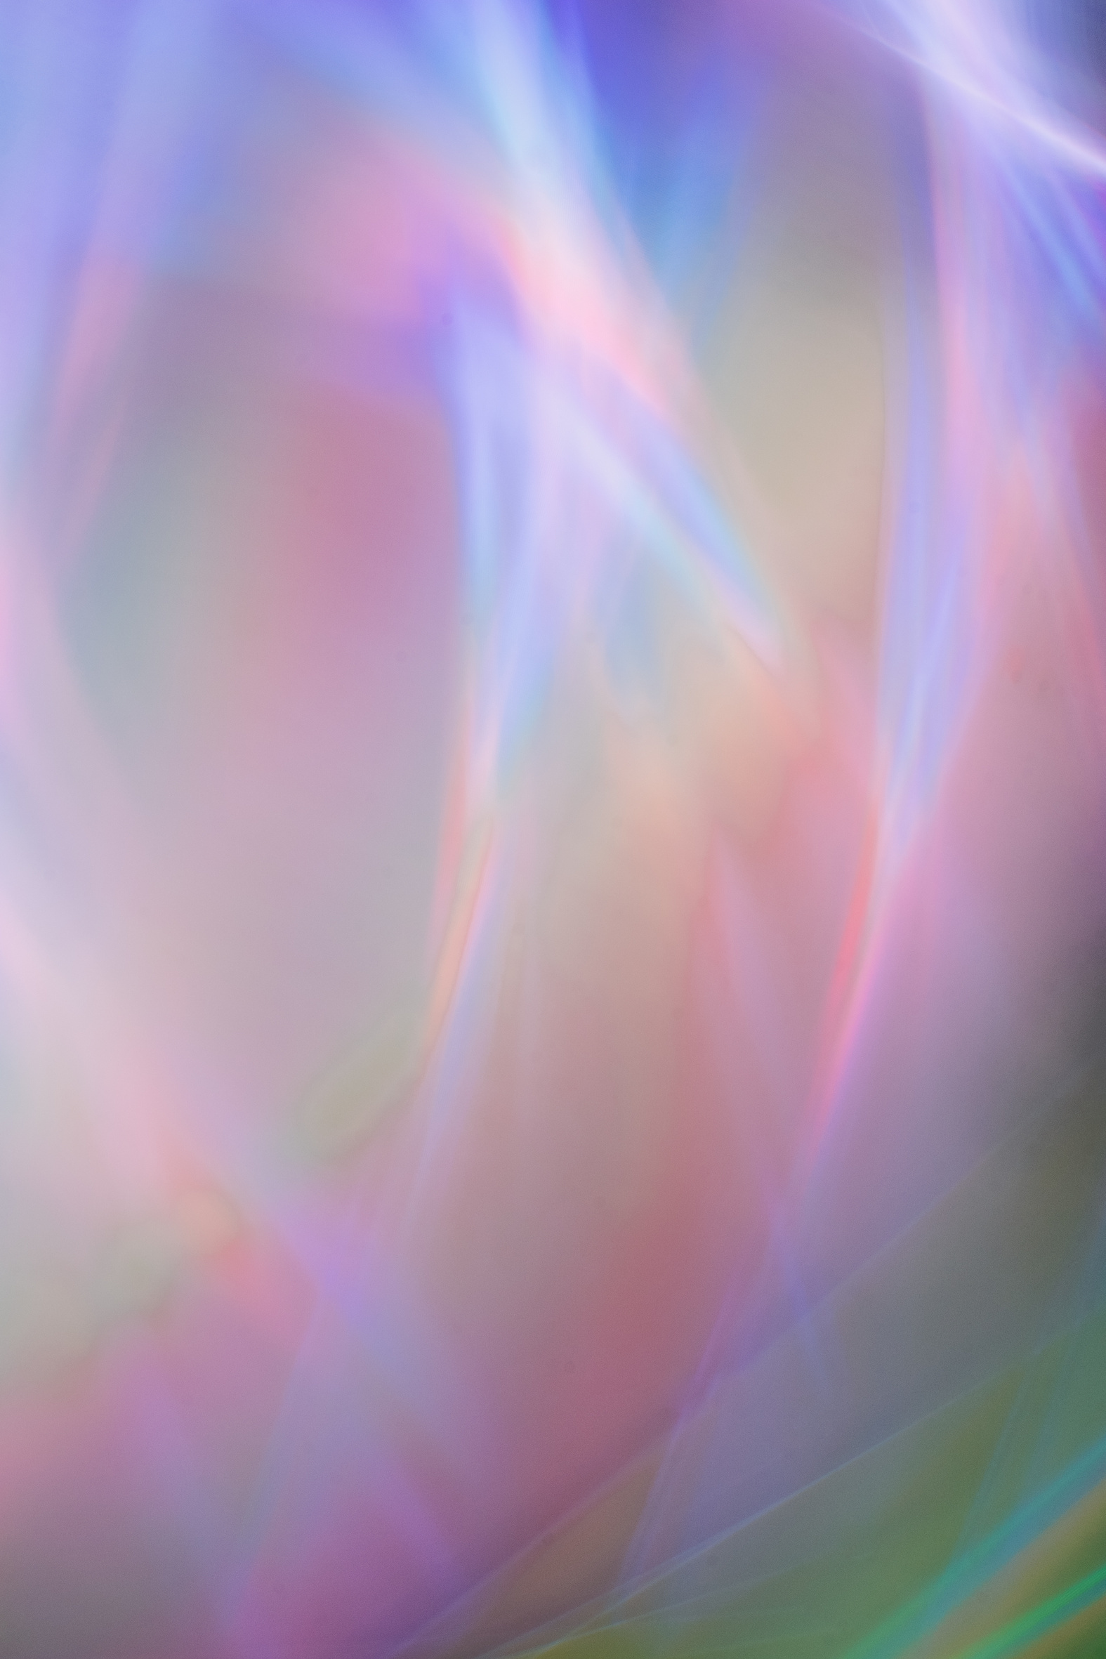
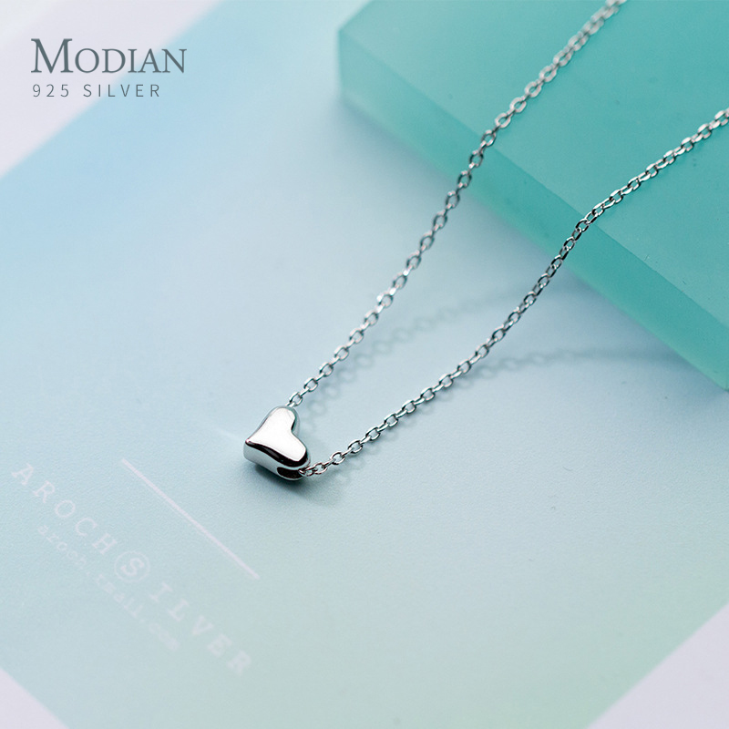
Modian Heart Review
⭐⭐⭐⭐⭐
Mozaer provided the best combination of quality materials and reasonable pricing. 925 Sterling Silver piece offers the best value for your money.
点击购买

