Slide 1
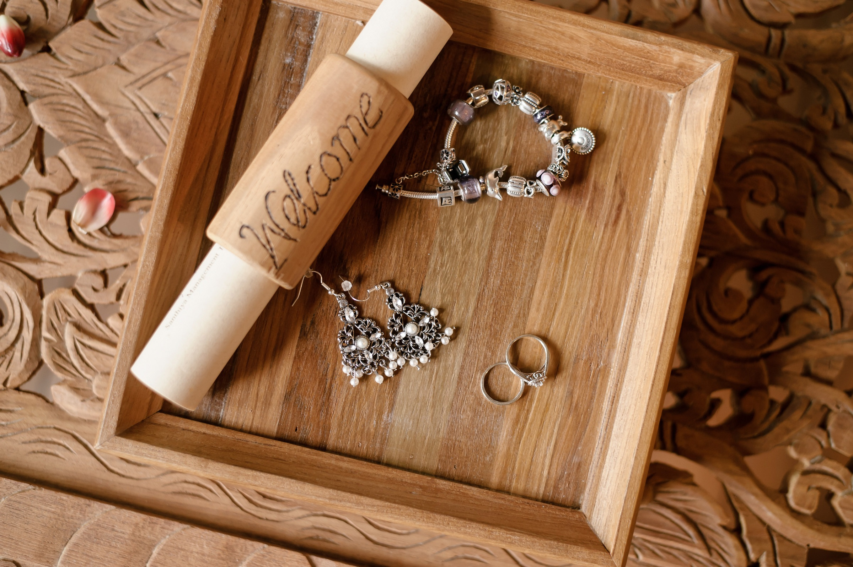
⭐
I wasted $150 and countless hours trying to find a quality necklace. I bought three cheap mistakes from shady businesses.
Wasted $150 on Necklaces
点击购买

