Slide 1
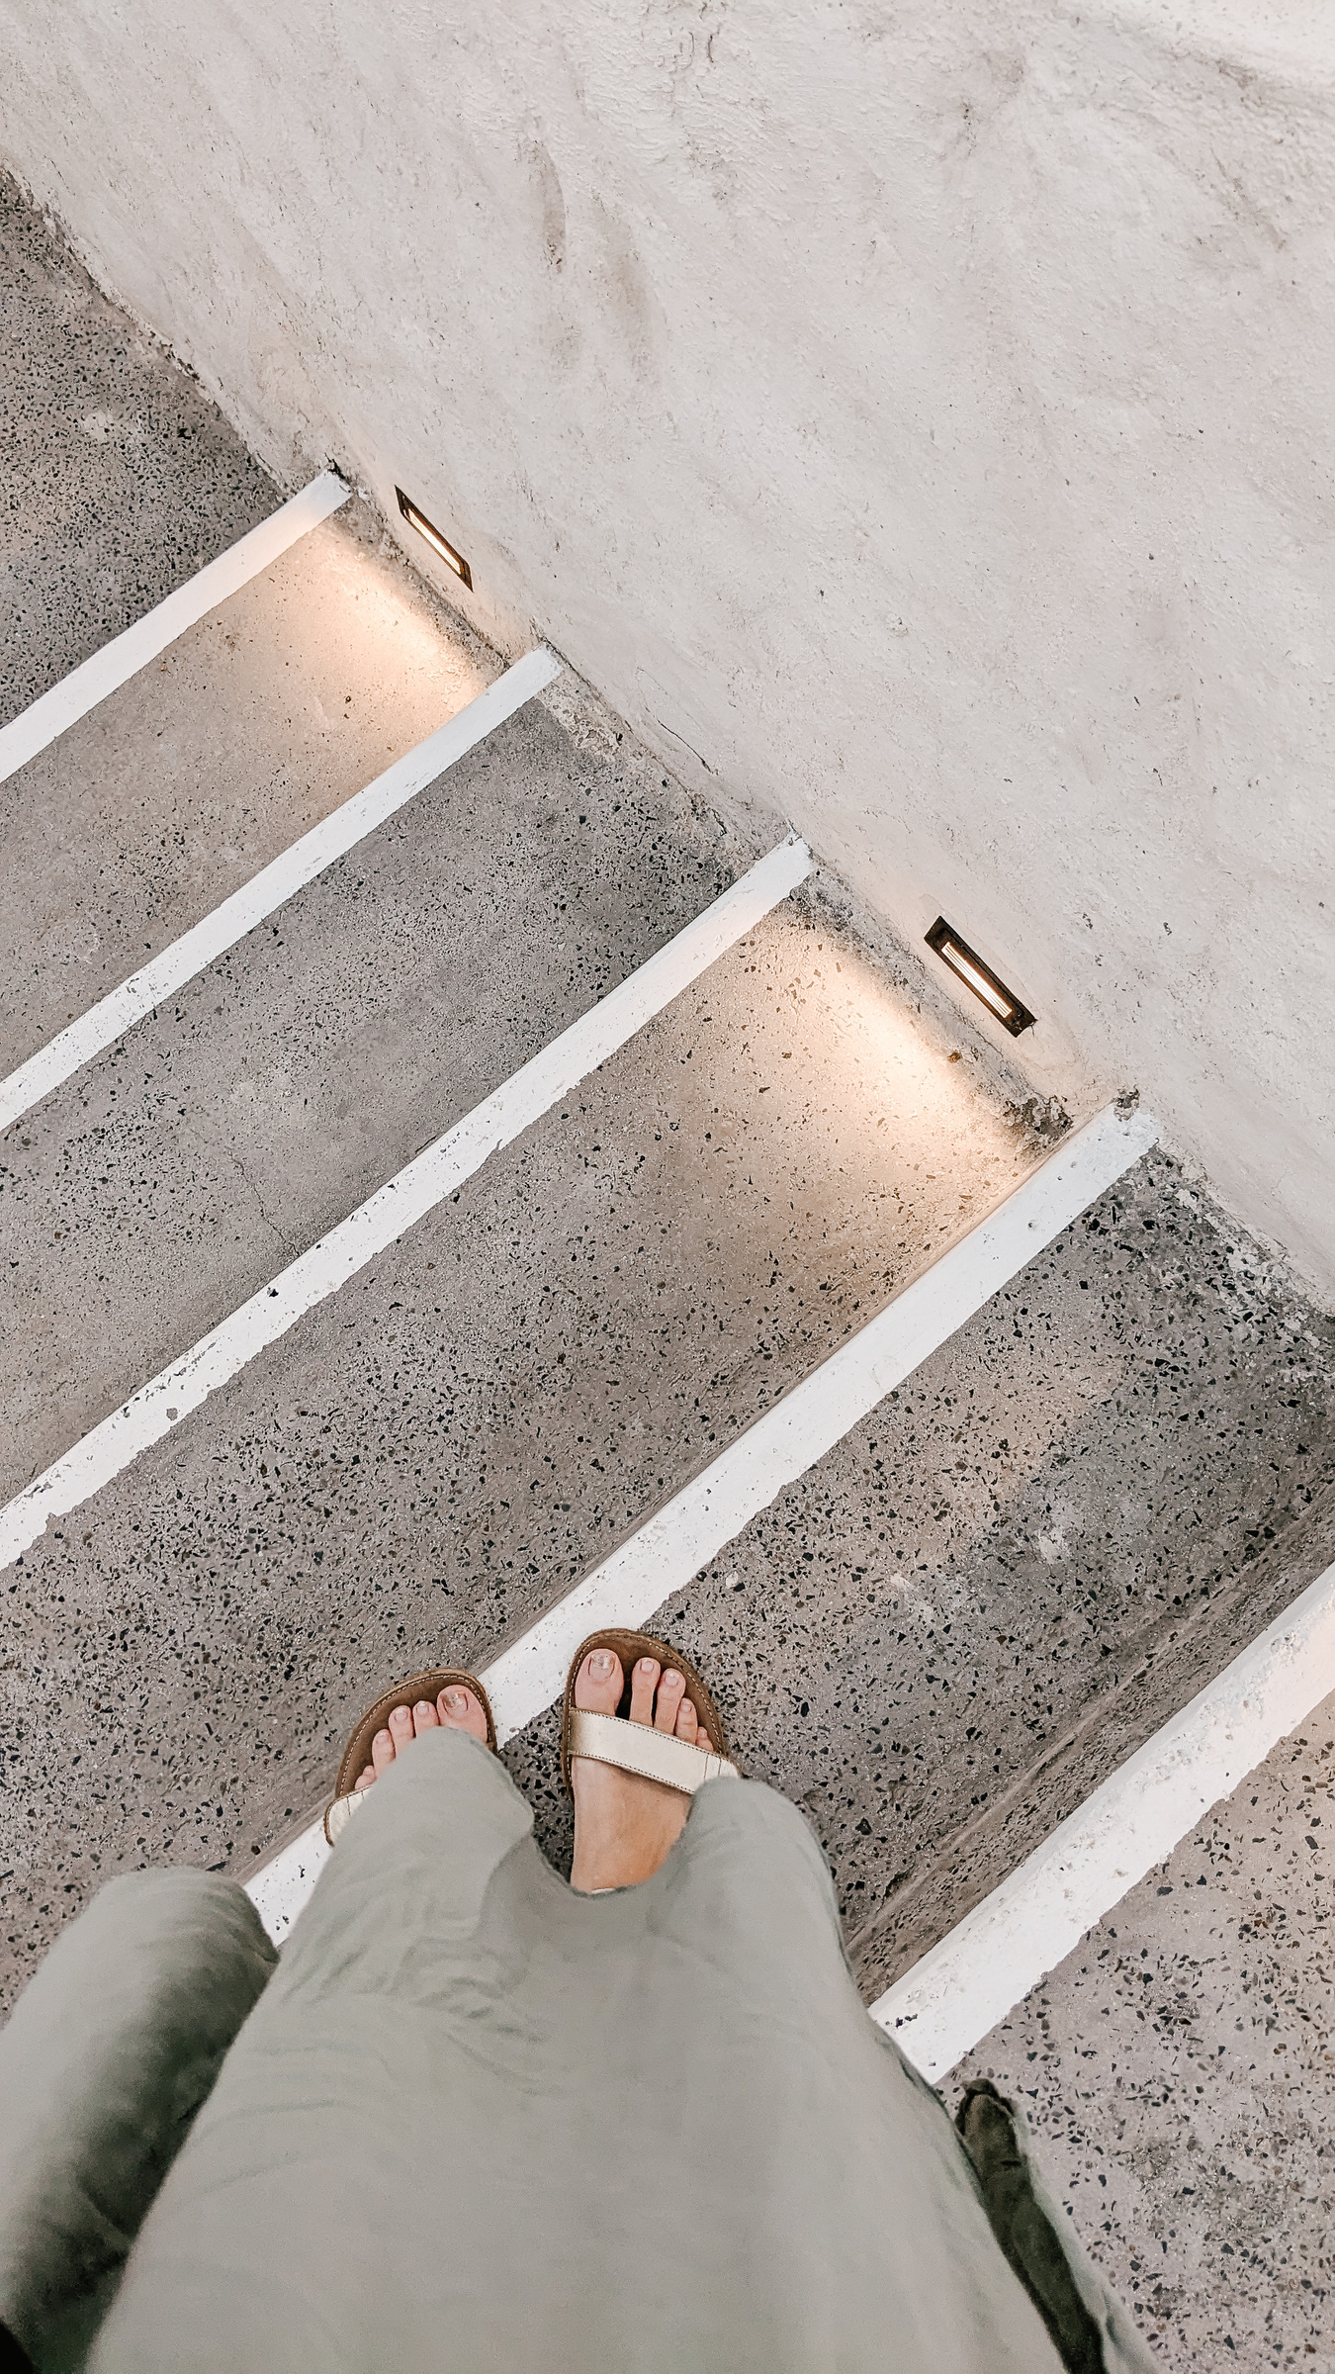
Wasted $150
⭐
I wasted about $150 and countless hours talking to terrible customer service reps. That $150 could have bought the ALIZERO necklace right away.

