Slide 1
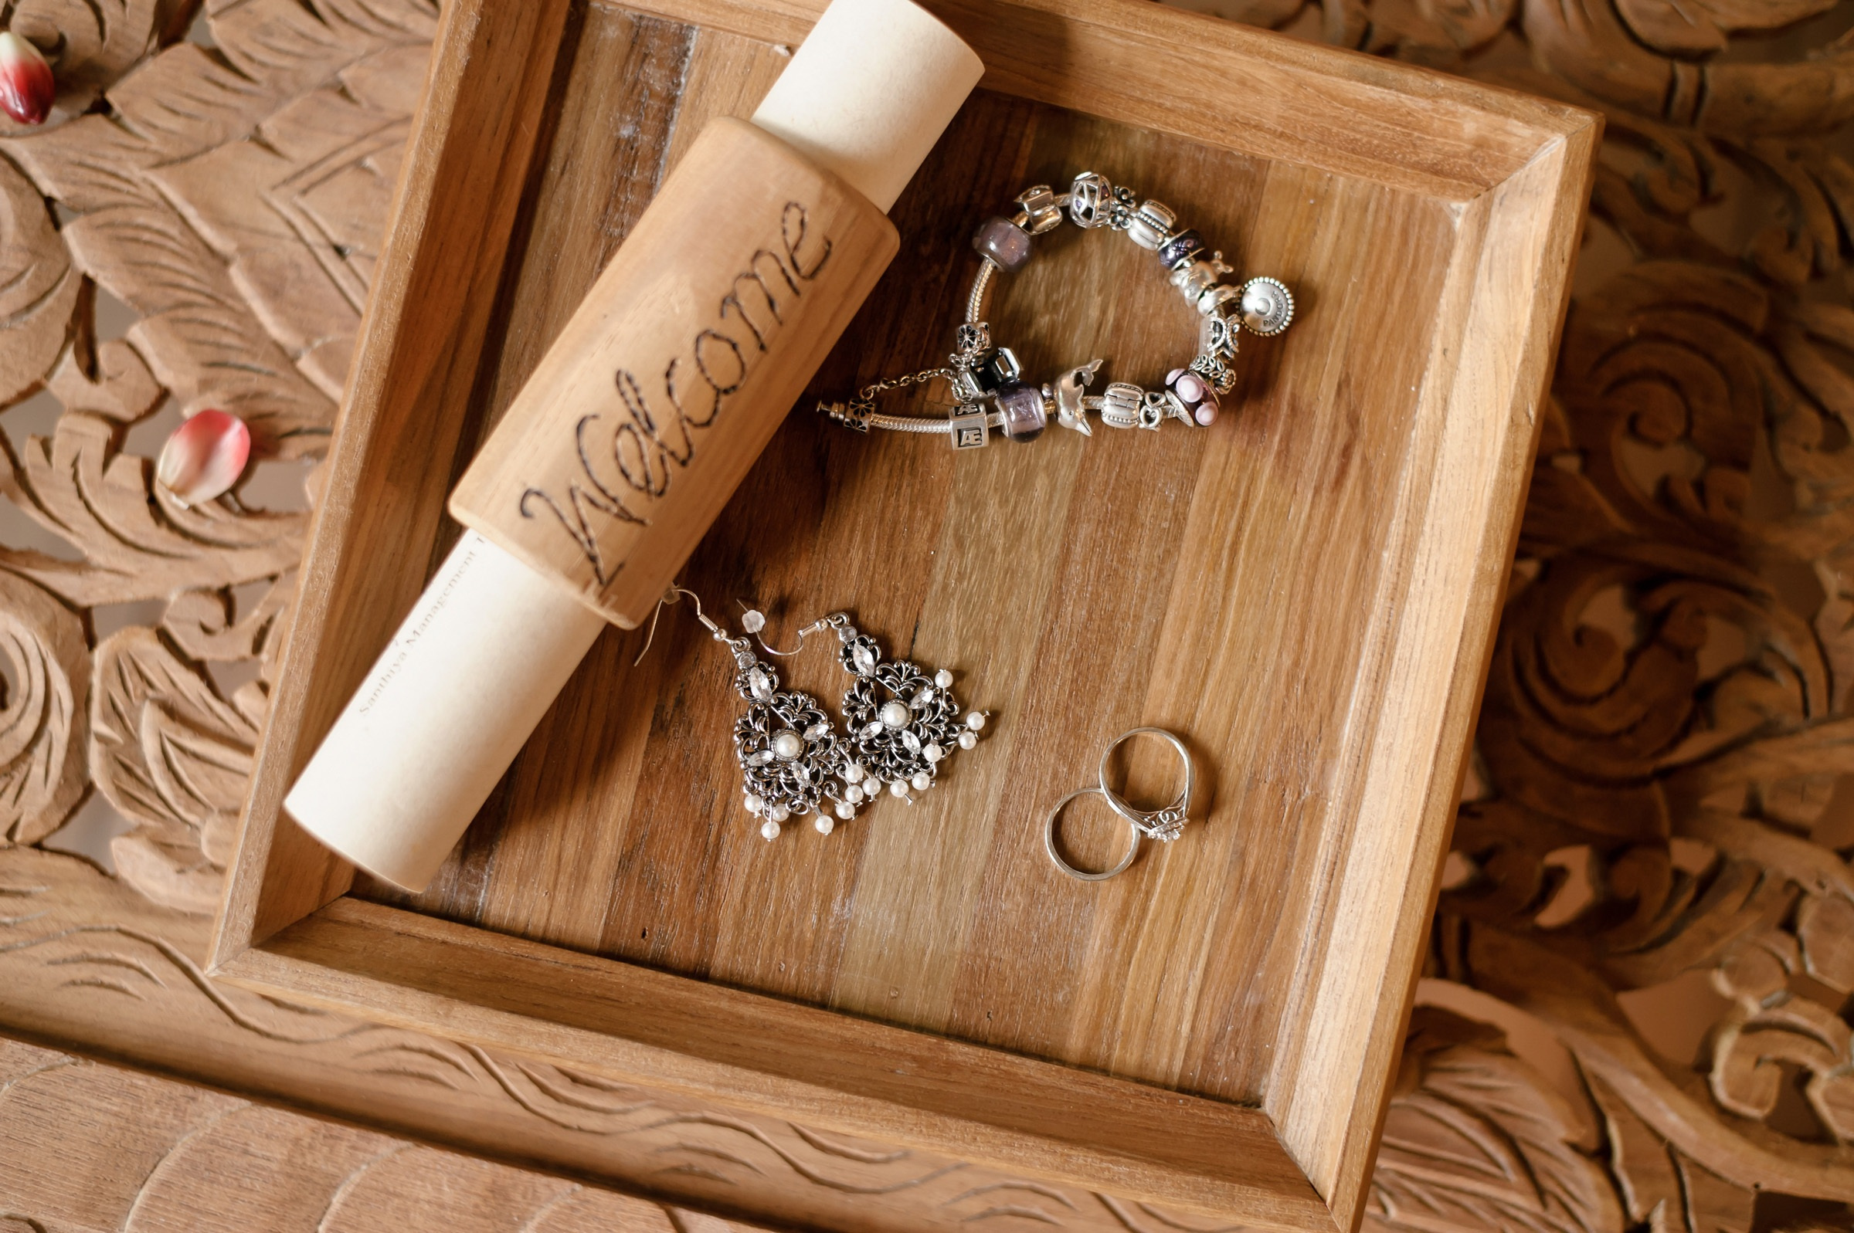
⭐⭐⭐⭐
I upgraded to $40 chains. They were... fine. Better than the cheap ones, but still not great. I wanted something with more detail.
ALIZERO Silver Chains
点击购买

