Slide 1
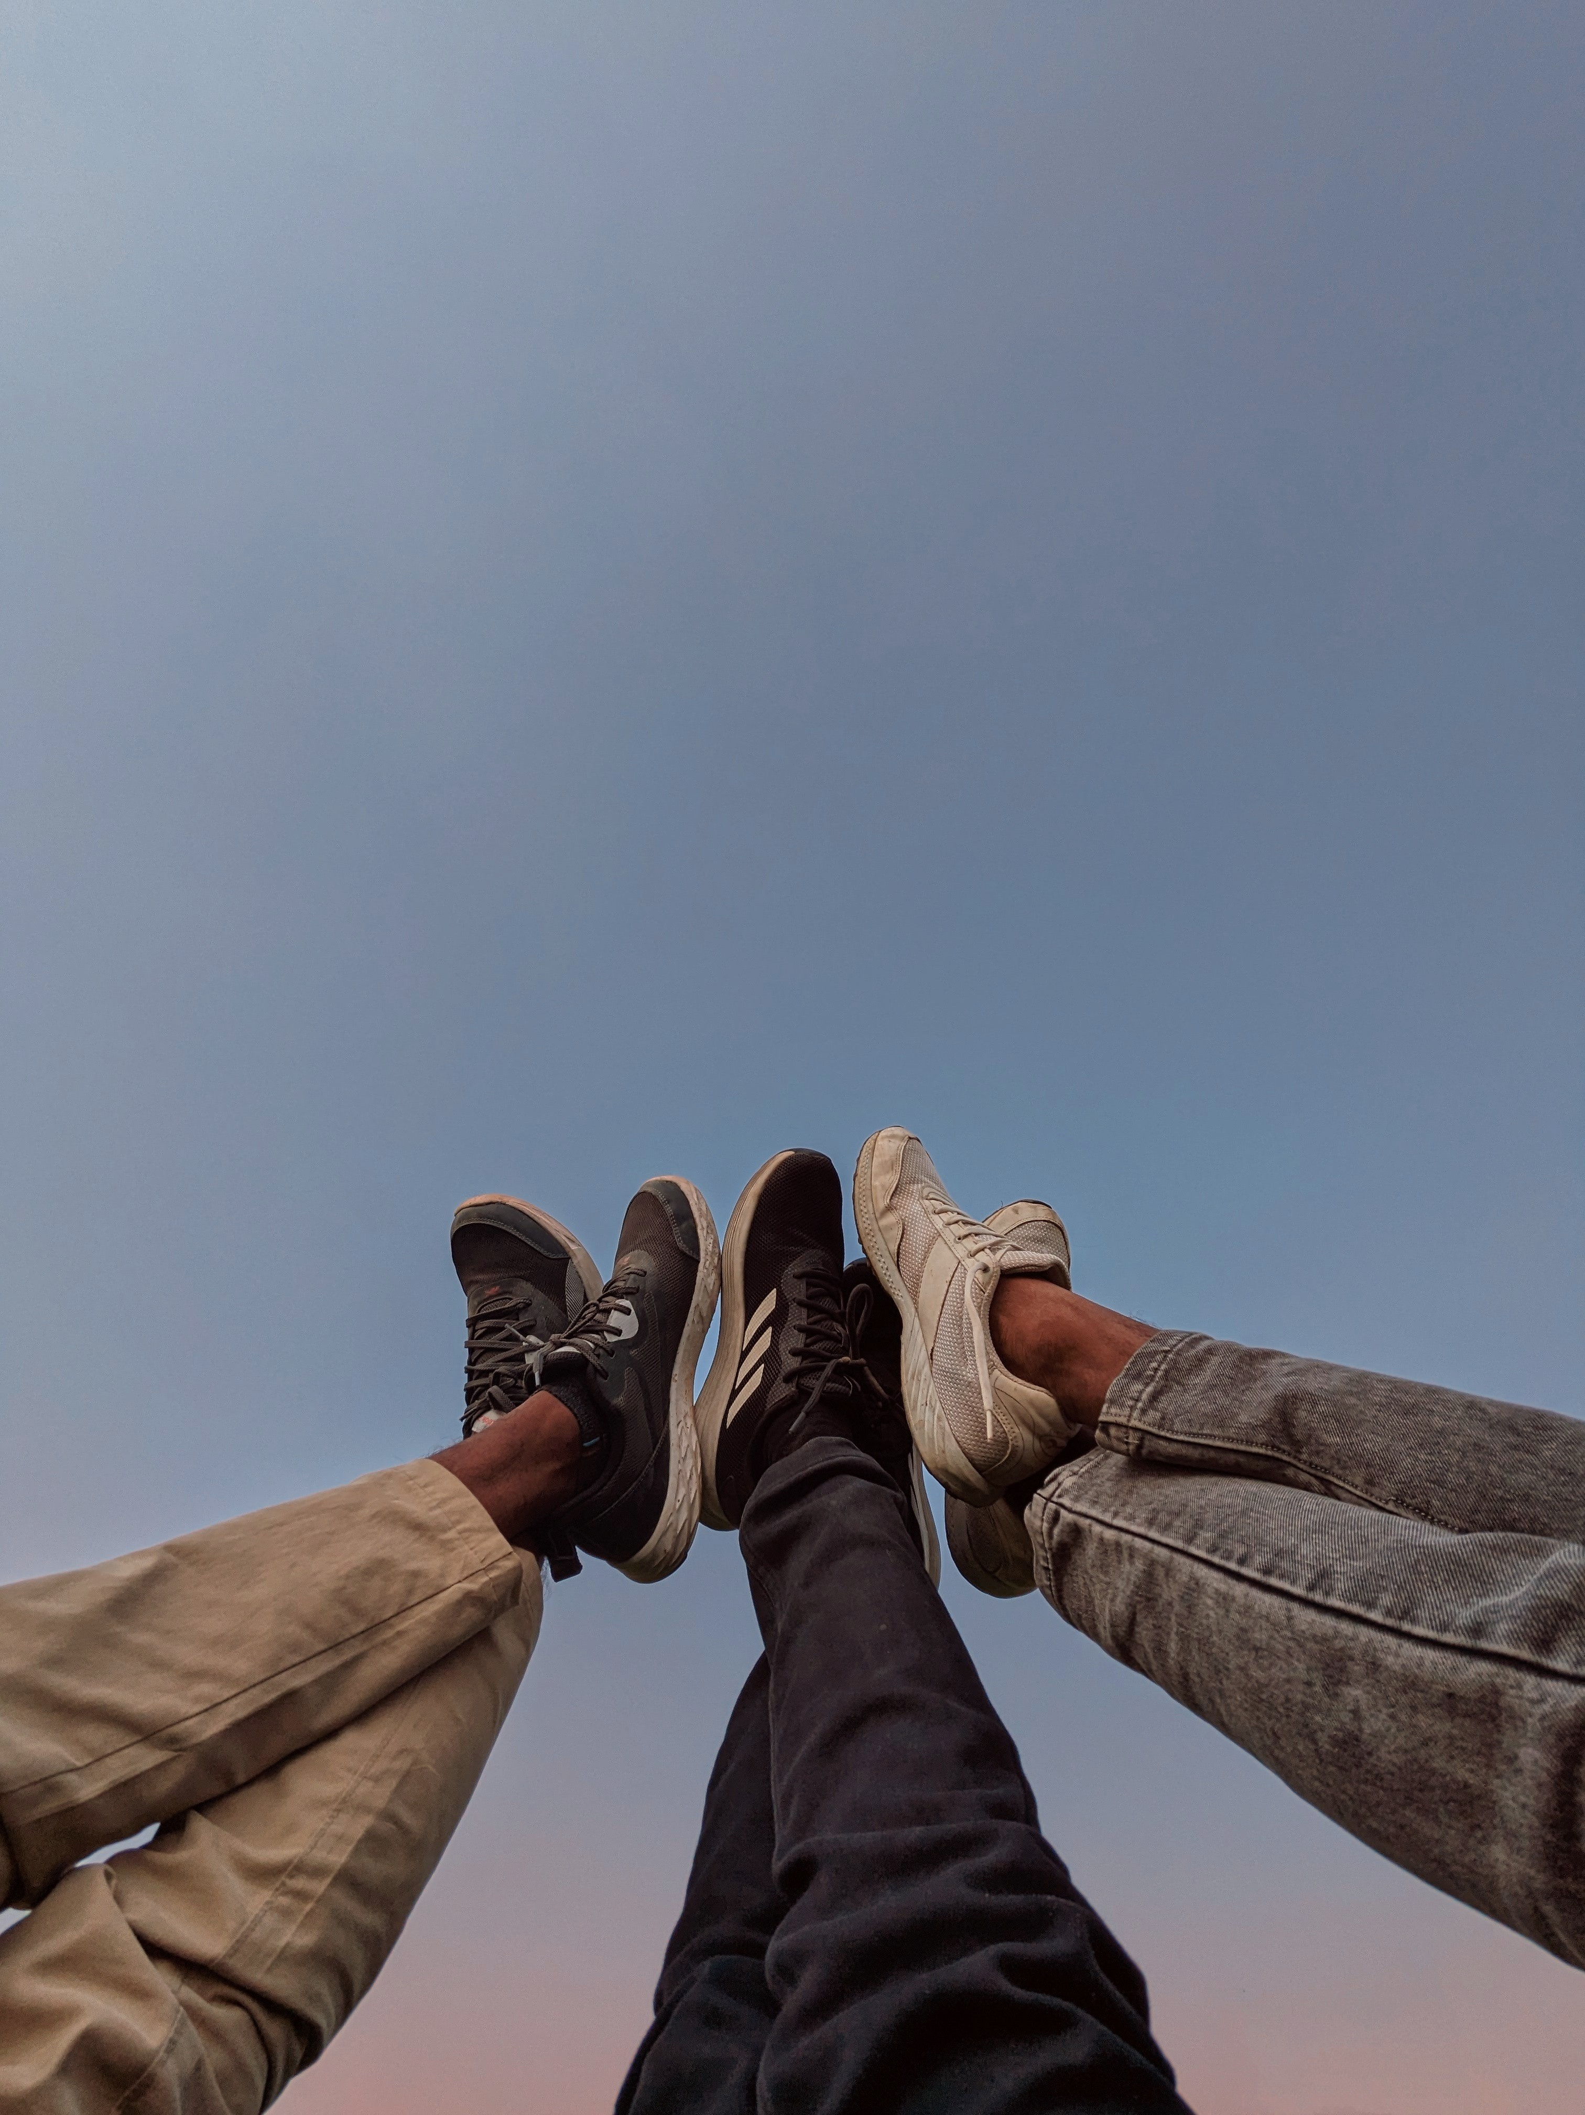
⭐⭐⭐
I upgraded to $40 chains. They were... fine. It lacked the fine detail I wanted. The color was a dull gray. It just looked generic.
ALIZERO Silver Chains
点击购买

