Slide 1
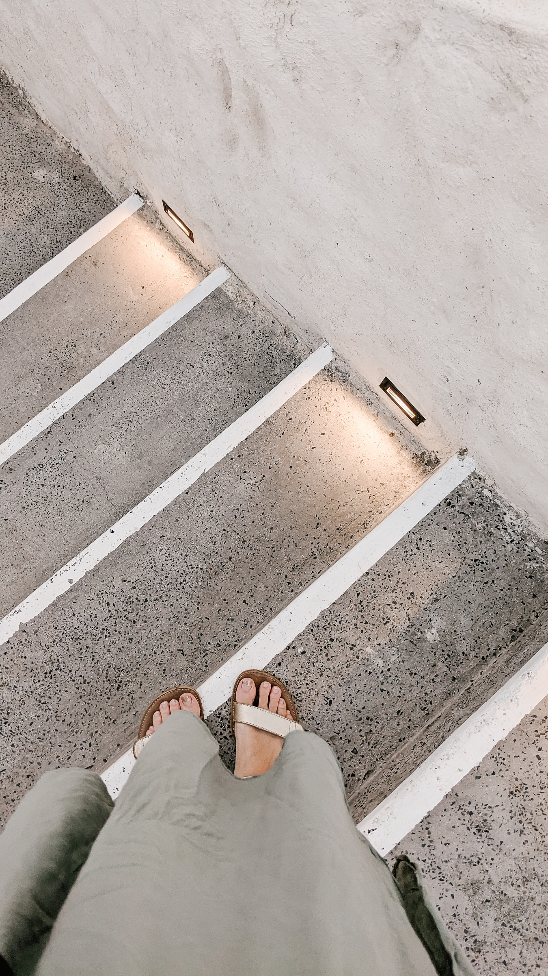
ALIZERO Silver Chains
⭐⭐⭐
I upgraded to $40 chains. They were... fine. It lacked the fine detail I wanted. The color was a dull gray. It just looked generic.

