Slide 1
SML 310 Final Project: Mental Health in the Tech Industry
Joyce Luo

Slide 2
Outline
Project Motivation/Background
Main Questions
Related Work
Project Lifecycle
Data
Data Preprocessing
Exploratory Data Analysis
Temporal Analysis
Classification Analysis
Conclusions

Slide 3
Project Motivation/Background
STATISTICS ON MENTAL HEALTH
1-in-7 people globally have one or more mental or substance abuse disorders.
1-in-5 people in the United States have mental disorders like depression, anxiety, or bipolar disorder.
Certain workplace characteristics are potential risk factors for mental health problems:
Inflexible working hours
Low levels of support for employees
Unrelenting workload
Stigma around discussing mental health

Slide 4
Why the tech industry?
Data availability
Could act as a proxy for mental health in the workplace overall
Having this knowledge is good to take into account for a potential future career in tech

Slide 5
Main Questions
How have employee perspectives on the tech industry’s handling of mental health changed over the past couple years?
Has there been any change in how the tech industry has addressed mental health issues?
Can we use workplace factors in combination with some demographic information to predict mental health problems in employees?

Slide 6
Related Work
Pandey et al. - Factors Affecting Mental Health in Employees and Their Relation to Suicide Rates at a Workplace
Used very similar dataset to predict suicidal tendency among employees within tech companies
Tate et al. - Predicting mental health problems in adolescence using machine learning techniques
Used questionnaire data to predict future mental health problems in children
Investigated tree-based models and logistic regression

Slide 7
Project Lifecycle
Obtain Data
Clean Data
EDA
Analysis/Modeling
Interpret Results
OSMI Mental Health in Tech Yearly Surveys: 2014, 2016 -2019
Parse through survey data, correct spelling errors, label encode
Get an idea of general characteristics of the survey population, figure out which characteristics might be good predictors of the targets
Temporal analysis and developing classification models
Conclude which models are the best and which trends are notable

Slide 8
Data

Slide 9
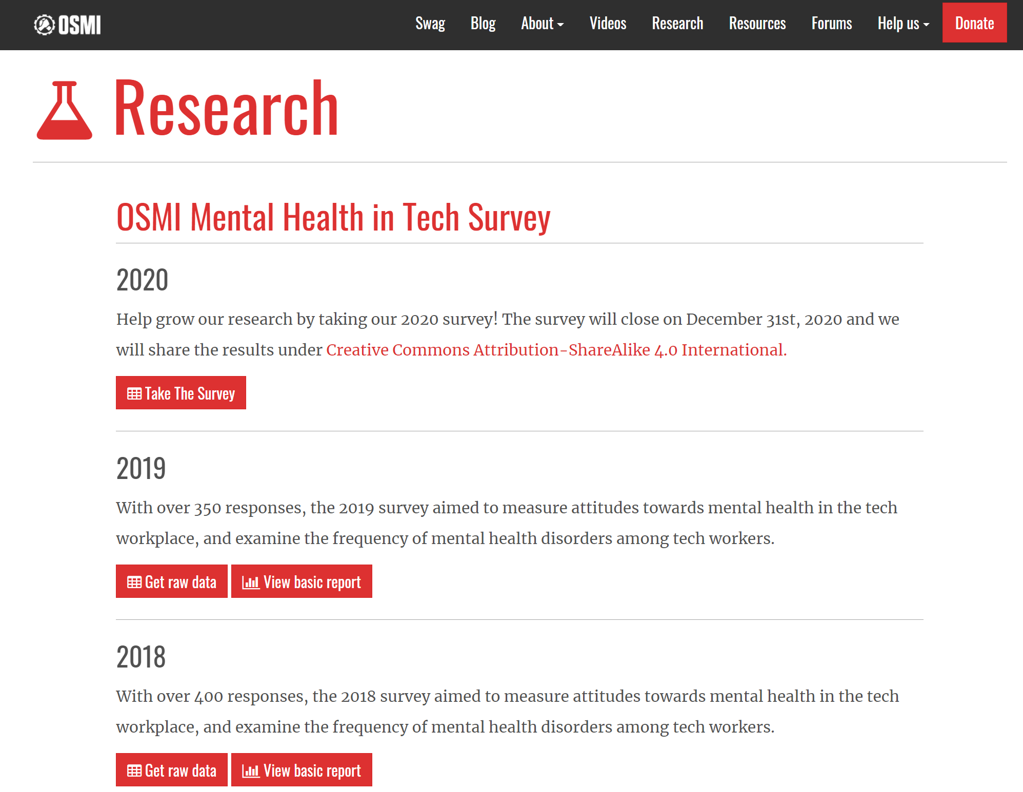
Data Source
Open Sourcing Mental Illness (OSMI) is a non-profit focused on providing open source data regarding mental health in tech

Slide 10
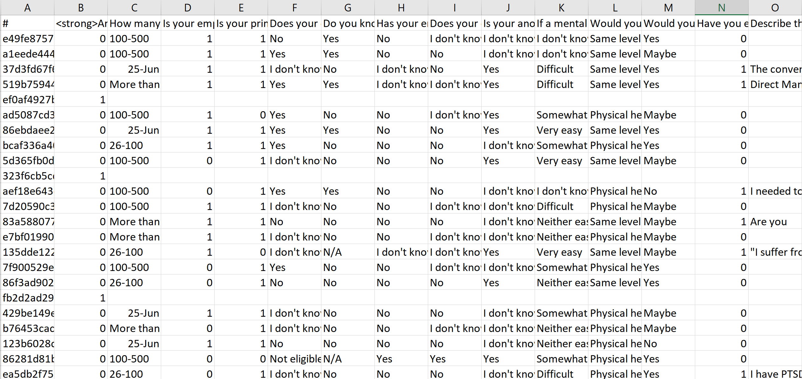
Example Section of the 2017 dataset

Slide 11
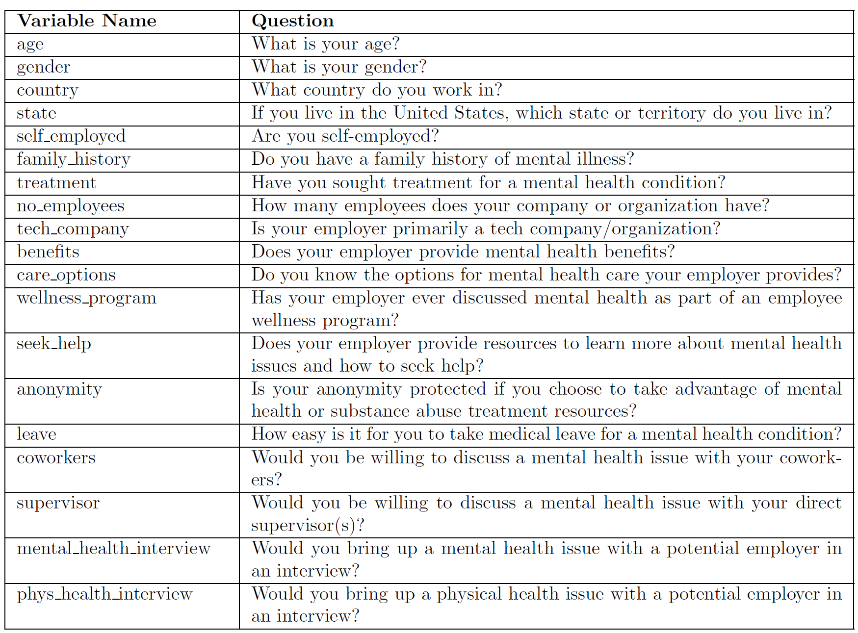
Fields included in all datasets

Slide 12
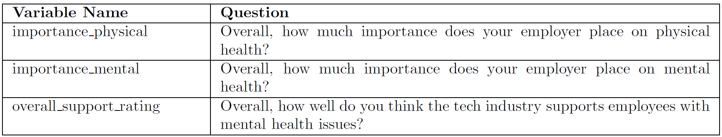
Fields included in the 2016-2019 datasets
Fields included in the 2017-2019 datasets

Slide 13
Initial Data Preprocessing
Standardized variable names and responses across datasets
Dropped values of those who were self-employed and removed or replaced null values
Corrected spelling or formatting mistakes
Converted age and gender into categorical variables
Label encoded all data

Slide 14
Exploratory Data Analysis

Slide 15
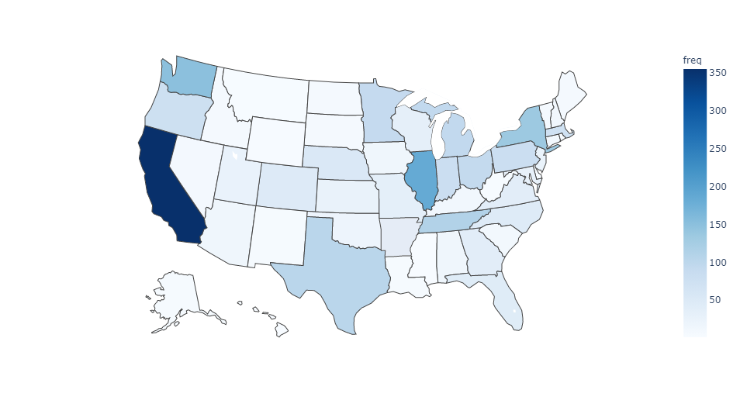
Choropleth map of the number of respondents from each state

Slide 16
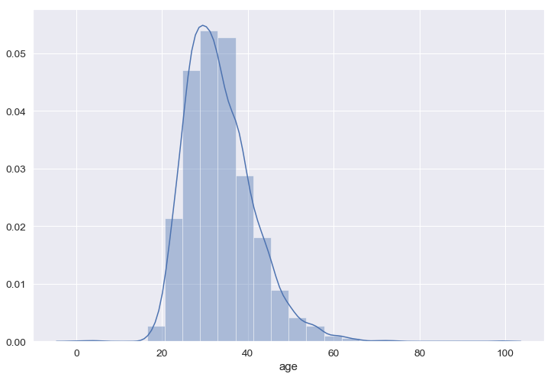
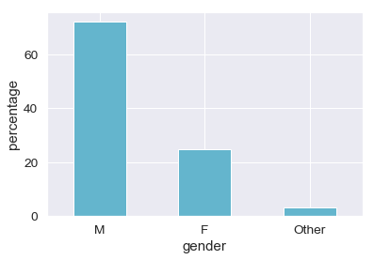
Age and Gender Distributions
Age Distribution
Gender Distribution

Slide 17
Treatment vs. Current Mental Disorder
Current Mental Disorder
 | Yes | Maybe | No
Yes | 93.24% | 54.65% | 25.74%
No | 6.76% | 45.35% | 74.26%
Treatment

Slide 18
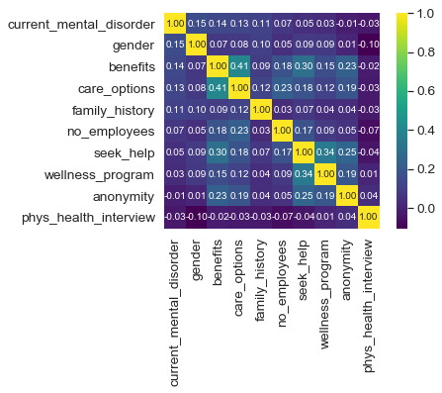
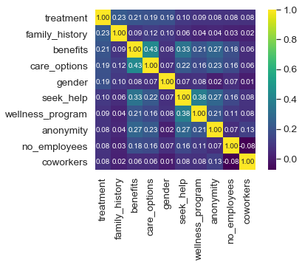
Correlations with modeling targets
Current Mental Disorder
Treatment

Slide 19
Temporal Analysis

Slide 20
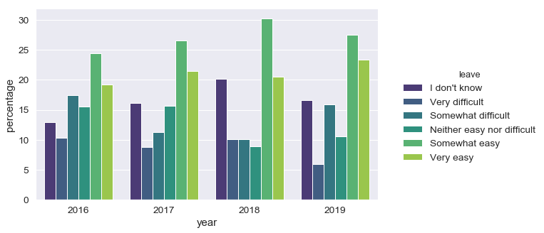
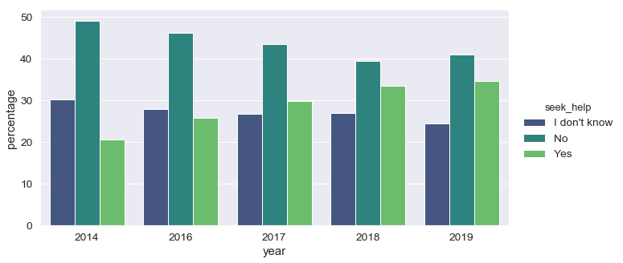
The variables leave and seek_help showed positive growth over time.

Slide 21
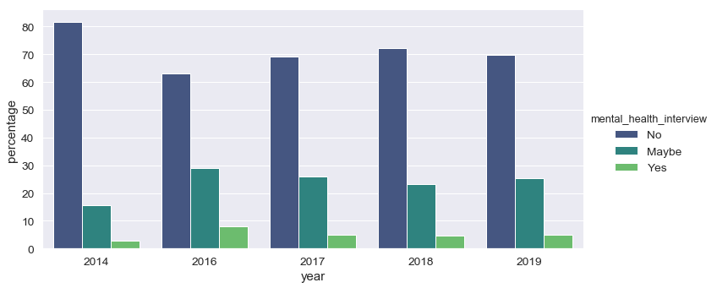
The variable mental_health_interview did not show any significant change in the distribution of reponses over time.

Slide 22
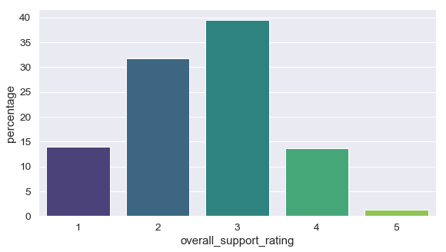
The majority of employees gave the tech industry an overall support rating of 1, 2, or 3 in every year.

Slide 23
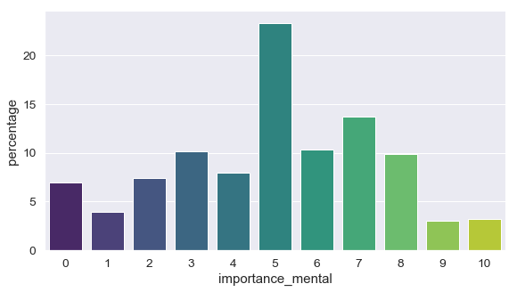
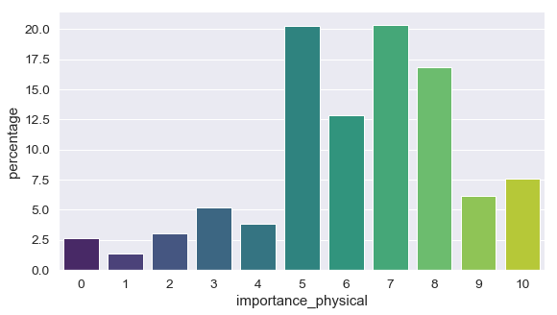
Employees thought their employers consistently placed more importance on physical rather than mental health.

Slide 24
Classification Analysis

Slide 25
Model Preprocessing
Merged 2014 and 2016-2019 datasets, and separately merged the 2016-2019 datasets
One-hot encoded certain features, and label-encoded others
Converted current_mental_disorder into a binary variable so I could do binary classification
Treated “Maybe” responses as “Yes” responses

Slide 26
Models
Targets: treatment and current_mental_disorder
Predictors: age_range, gender, no_employees, family_history, benefits, care_options, wellness_program, seek_help, anonymity, supervisor, leave, coworkers, mental_health_interview, and phys_health_interview
Tested Classification Models: L1 Penalized Logistic Regression, Random Forest, Decision Tree, Polynomial Support Vector Machine (SVM), Bernoulli Naive Bayes, and K-Nearest Neighbors
Model Evaluation: 70/30 train-test split for validation
Evaluated training accuracy, testing accuracy, confusion matrices, AUC score, and recall
Recall was very important metric

Slide 27
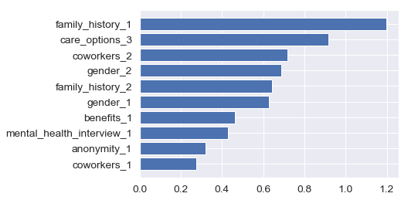
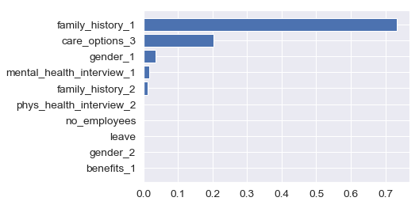
Feature Importance for predicting treatment
Logistic Regression
Decision Tree

Slide 28
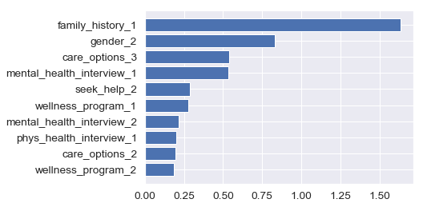
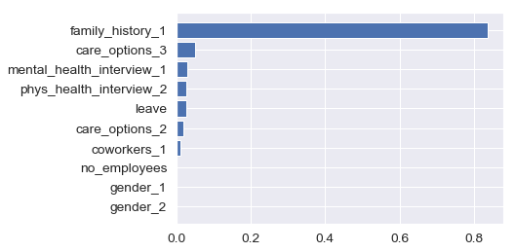
Feature Importance for predicting current_mental_disorder
Logistic Regression
Decision Tree

Slide 29
Model performance for predicting treatment
Model | Training Accuracy | Testing Accuracy | Recall | AUC Score
Logistic Regression | 73.28% | 71.06% | 78.18% | 0.764
Random Forest | 99.54% | 70.58% | 77.19% | 0.747
Decision Tree | 73.03% | 71.25% | 84.79% | 0.749
Naïve Bayes | 71.29% | 69.12% | 74.55% | 0.744
SVM | 75.44% | 71.64% | 82.31% | 0.758
KNN | 72.11% | 69.12% | 76.69% | 0.738

Slide 30
Model performance for predicting current_mental_disorder
Model | Training Accuracy | Testing Accuracy | Recall | AUC Score
Logistic Regression | 73.97% | 75.04% | 86.12% | 0.776
Random Forest | 99.94% | 72.77% | 85.68% | 0.754
Decision Tree | 73.42% | 72.06% | 86.98% | 0.742
Naïve Bayes | 72.26% | 73.76% | 81.78% | 0.771
SVM | 73.42% | 72.62% | 90.02% | 0.750
KNN | 71.17% | 71.21% | 94.36% | 0.741

Slide 31
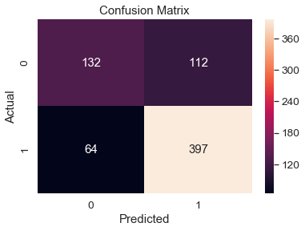
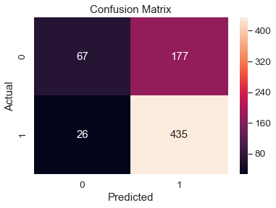
Confusion Matrices for predicting current_mental_disorder
Logistic Regression
KNN Confusion

Slide 32
Limitations and Future Work
Voluntary Response Bias – certain employees who have dealt with mental health issues or know some who has are more likely to select into filling out the surveys
There could be differences between United States data and non-USA data – in the future might be useful to analyze the two separately
Models are limited by their accuracy – would need more demographic variables or variables related to the individual’s clinical history to improve accuracy
Concrete processes could have been used to tune the model hyperparameters

Slide 33
Conclusions
Our temporal analysis shows that the stigma around discussing mental health in the workplace has not changed over the past few years and most employees still don’t feel supported.
However, more tech companies seem to be offering resources to their employees seek help and are discussing mental health as part of employee wellness programs, among other improvements over the past few years.
Models like K-Nearest Neighbors and Logistic Regression perform relatively well at predicting current mental illnesses based on workplace and demographic factors. These models could potentially be generalized to other workplaces, with some future improvements.

Slide 34
Thank you for listening!
Any questions?

