Slide 1
Object-Oriented Programming
Programming Project #3
郭建志

Slide 2
Background
Large-scale geographic routing
Every node only has the local information (i.e., its neighbors’ information) and the destination’s information
destination
source

Slide 3
Background
Large-scale geographic routing
Every node only has the local information (i.e., its neighbors’ information) and the destination’s information
So, how should a source route a packet to a designated destination?
destination
source

Slide 4
Naïve Routing Scheme: Greedy
Forward the packet towards the neighboring node that is closer to the destination
destination
source

Slide 5
Naïve Routing Scheme: Greedy
Forward the packet towards the neighboring node that is closer to the destination
However, the packet may be stuck at the dead end
dead end
destination
source

Slide 6
Face Routing
Generate a planar subgraph: no crossing links
Right-hand rule
Change faces
destination
source

Slide 7
Face Routing
Generate a planar subgraph: no crossing links
Right-hand rule
Change faces
face
destination
face
face
face
face
source

Slide 8

Programming Project #3: Step 1. Generate links and a planar subgraph
Connect two nodes $u$, $v$ if $dist\left(u,v\right)≤1$
Notes:
連結兩個點，當此兩點之間距離小於等於1
這個動作不需要用分散式的方式處理，可以整張圖掃過

Slide 9
Programming Project #3: Step 1. Generate links and a planar subgraph
Do planarization in a distributed manner
Notes:
這個動作一定要用分散式的方法做，下面兩頁會有說明

Slide 10

Programming Project #3: Step 1. Generate links and a planar subgraph
Implement a designated algorithm to remove the links
Cut a link between two neighboring nodes a and b, if there is other node c is within their closed disc, where line segment $\overline{ab}$ is a diameter

Slide 11
Note
Every node only knows its neighbors
Define you own node class
Each node privately stores it location
Use an dynamic array of vector<node> to store the neighbors before planarization in each node
Use another dynamic array of vector<node> to store the neighbors after planarization in each node
For each node u, when you compute the neighbors of u after planarization, you are allowed to use only the information of u; if you use global variable and information of other node, you will get 0 point
Notes:
一定要分散式做完平面化的動作，不得整張圖掃過
在這個圖中，每個點每個點只有自己的 neighbor 資訊，且必須各自決定哪些 edge 應該要砍掉，哪些 edge 應該要留著
vector<node> 那個要存的東西是 node，你要存哪一種type都可以
<hint> 本來不想寫的，想讓你們自己想，若看到，就賺到
前面介紹的那個演算法保證個別做也不會產生不一致的問題，這就是這個砍邊的演算法強的原因
對於線段 ab 來說，若 a 覺得要砍掉 edge ab，那麼 edge ab 的另一頭 b 也會覺得要砍掉
因為落於 ab 為直徑的圓內那個 c 點，必然是 a 和 b 的共同 neighbor，所以 a 和 b 都知道 c，因此會一致地砍掉 edge ab
所以分散式進行不會導致砍錯邊的問題

Slide 12
Programming Project #3: Step 2. Face Routing
Every source generates and sends the packet
Every relay node receives and forward the packet
Every destination receives the packet
Use right-hand rule and face change (based on the intersection point)
face
destination
face
face
face
face
source
Notes:
每次用右手摸著牆壁走在 source-destination 之間，當遇到一個新的 intersection point，會暫存起來，以當作下次切換 face 的依據

Slide 13
Programming Project #3: Step 2. Face Routing
The initial intersection point is set to the source
The packet travels along the face boundary until it finds another intersection point closer to the destination (compared with the previous intersection point)
Then, update the intersection point and change the face
face
destination
face
face
face
face
source

Slide 14
Programming Project #3: Step 2. Face Routing
Which face should we change to?
Use right-hand rule to determine
Go along the line from destination to source (use right hand to touch the line)
When you reach the intersection point, turn left
face
destination
face
face
face
face
source
Notes:
每次用右手摸著牆壁走在 source-destination 之間，當遇到一個新的 intersection point，會暫存起來，以當作下次切換 face 的依據

Slide 15
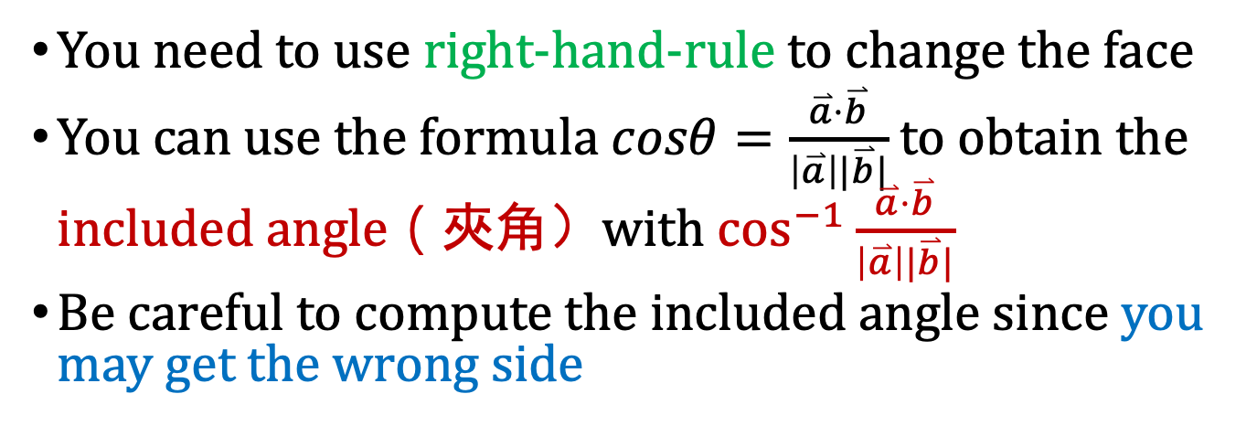
Programming Project #3: Step 2. Face Routing
You need to use right-hand-rule to change the face
You can use the formula $cosθ=\frac{\overset{⃑}{a}⋅\overset{⃑}{b}}{\left|\overset{⃑}{a}\right||\overset{⃑}{b}|}$ to obtain the included angle（夾角）with $\cos^{−1}{\frac{\overset{⃑}{a}⋅\overset{⃑}{b}}{\left|\overset{⃑}{a}\right||\overset{⃑}{b}|}}$
Be careful to compute the included angle since you may get the wrong side
destination
c
d
s
t
a
source
b
Notes:
要很小心，夾角公式算出來的是小夾角，但是如果看 d 點，st 和 sd 的夾角會算錯個，應該要有 2\pi - 這個夾角才是真的右手定則算出的夾角大小
但是 st 和 sa 之間不需要用 2\pi 來減，請自己設計方法判斷，何時需要減去 2\pi

Slide 16
Programming Project #3: Step 2. Face Routing
Worst case:
Face change can incur a considerable routing cost
(Some extension fixes the problem, but you don’t need to fix it)
face
destination
source
Notes:
每次會想辦法找到更接近 destination 的 intersection point
當遇到更近的 intersection point 時，node 會將 intersection point 記錄在 packet 裡面
下次再遇到的時候，就會經過，不change face
Change face 是用「右手定則」檢查，換 face 可能會跨 source destination 之間的線

Slide 17
Programming Project #3: Face Routing
Input:
Number of nodes
Nodes with non-negative coordinates (x, y) (the input graph is connected after adding links)
Source-destination pairs
Procedure:
Add a link between any two nodes u, v if dist(u,v) ≤ 1
Remove some links to generate a planar graph
Get the path of face routing for each pair
Output:
The routing paths for each pair

Slide 18
Note
Each node can send and receive the packet to and from others
Define your own packet class to privately store
locations of source and destination
last hop and next hop
previous intersection point
Use a queue<packet> to store the packet in each node
Write a member function “checkQueue ()” in node class
Check whether the queue is empty
If not, pop the packet in the queue (use pop_front) to receive the packet
If the next hop is me, use getNextHop() to update the last hop and next hop, and then use send to forward the packet
If the next hop is not me, drop the packet
Write a member function “getNextHop ()” in node class
Use Face Routing to compute the next hop node
Write a member function “send ()” in node class
Push the packet back to all neighbors’ queue (use push_back)
Notes:
node getNextHop() 可以讓他回傳 pointer 或 node ID 皆可，要怎麼實作可以依當下你最適合的方式來處理，但必須要回傳一個下一步應該送往哪一個 node 的辨識資訊
封包裡面會存 source, destination, last hop, next hop, previous intersection point
其中，previous intersection point 就是上次遇到和 source-destination 間的直線之交叉點

Slide 19
Programming Project #3: Face Routing
Program sketch:
Read file and generate nodes
For each node, add its neighbor to its neighbor list (centralized)
For each node, remove the neighbors to avoid crossings (you must use the introduced distributed algorithm)
Read file and get a source-destination pair
Generate a packet and initialize the packet (filling the columns of the source, destination, …)
Add the packet to the queue of the source
For each round, every node check its queue (i.e., checkQueue())
If the queue is not empty and the packet is mine, it uses Face Routing to get the next hop (i.e., getNextHop()), and then add the packet to all neighbors’ queues (i.e., send())
Otherwise, it drops the packet
Repeat getting the next source-destination pair until no source-destination pair exists
Notes:
For each round, every node check its queue (i.e., checkQueue())
這個可以用 for loop 來執行，把每個節點都掃過，每個節點都檢查他的queue

Slide 20
Input Sample: node.txt
11
0 1.4142 1.1534
1 1.97 1.85
2 0.8823 1.3926
3 1.9996 1.9484
4 0.6301 1.9145
5 0.3329 1.1756
6 1.952 0.5866
7 1.8181 0.4043
8 0.4949 1.946
9 0.2079 1.4758
10 0.1364 1.4084
3
0 1
2 8
9 3

Slide 21
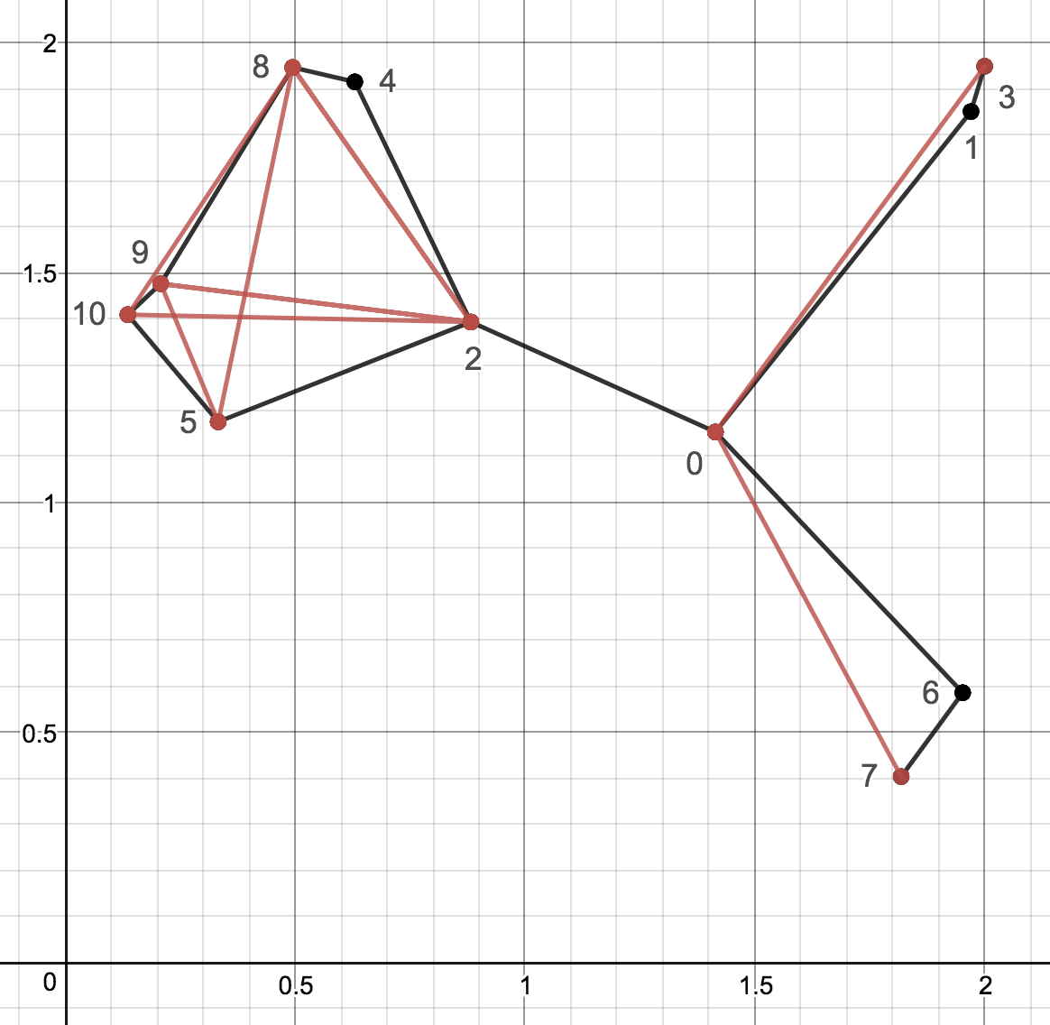
Output Sample: result.txt
22
0 0 1
1 0 2
2 0 3
3 0 6
4 0 7
5 1 3
6 2 4
7 2 5
8 2 8
9 2 9
10 2 10
11 4 5
12 4 8
13 4 9
14 4 10
15 5 8
16 5 9
17 5 10
18 6 7
19 8 9
20 8 10
21 9 10
3
0 1
2 4 8
9 10 5 2 0 1 3
11
0 0 1
1 0 2
3 0 6
5 1 3
6 2 4
7 2 5
12 4 8
17 5 10
18 6 7
19 8 9
21 9 10

Slide 22
Note
Deadline: 4/23 Tue (小老師) 5/7 Tue (所有同學)
E-course
C++ Source code

Slide 23
Further Reading
Routing with Guaranteed Delivery in Ad Hoc Wireless Networks, Wireless Networks 2001
On Delivery Guarantees of Face and Combined Greedy-Face Routing in Ad Hoc and Sensor Network, ACM MobiCom 2006
…
Long story

Slide 24

Why is the planarization correct?
Prove by contradiction
Assume that there is an intersection node on the segments $\overline{ab}$ and $\overline{cd}$
c
a
a
c
d
b
b
d

Slide 25
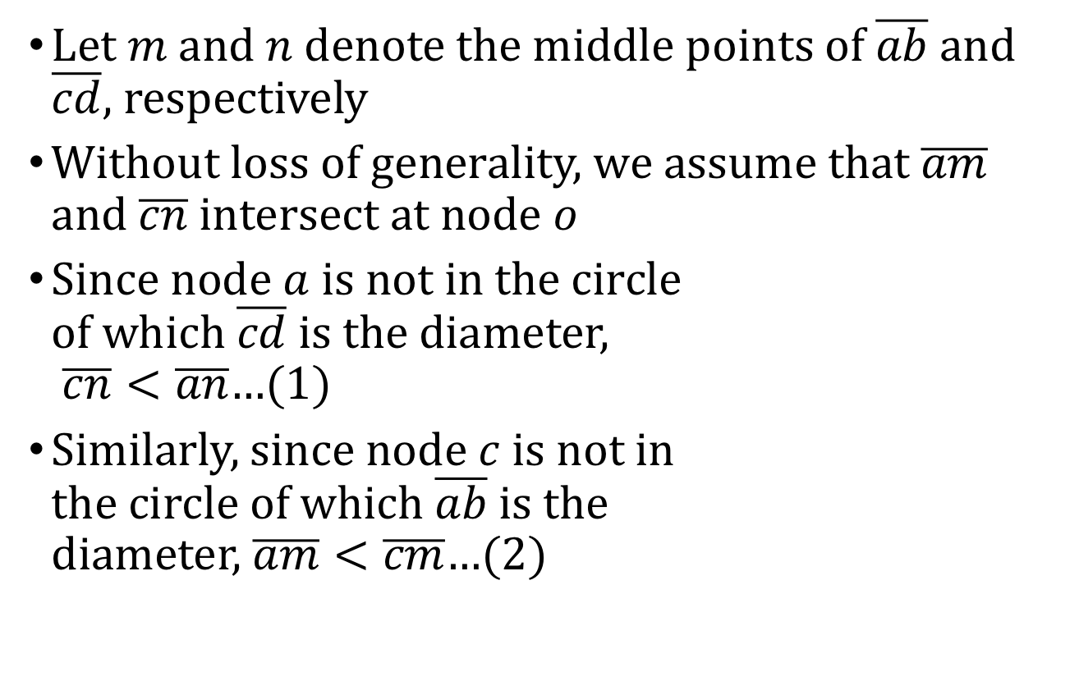
Why is the planarization correct?
Let $m$ and $n$ denote the middle points of $\overline{ab}$ and $\overline{cd}$, respectively
Without loss of generality, we assume that $\overline{am}$ and $\overline{cn}$ intersect at node $o$
Since node $a$ is not in the circle of which $\overline{cd}$ is the diameter, $\overline{cn}<\overline{an}$…(1)
Similarly, since node $c$ is not in the circle of which $\overline{ab}$ is the diameter, $\overline{am}<\overline{cm}$…(2)
c
a
o
n
m
b
d

Slide 26
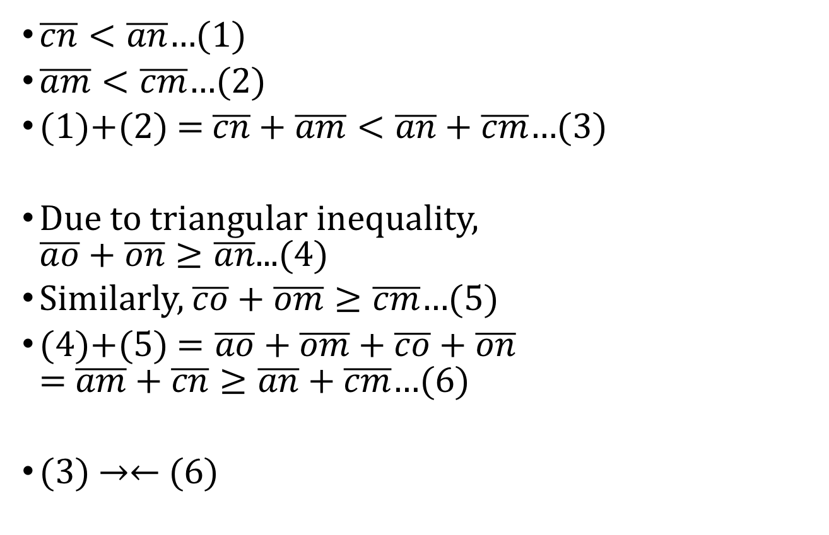
Why is the planarization correct?
$\overline{cn}<\overline{an}$…(1)
$\overline{am}<\overline{cm}$…(2)
(1)+(2) = $\overline{cn}+\overline{am}<\overline{an}+\overline{cm}$…(3)
Due to triangular inequality, $\overline{ao}+\overline{on}≥\overline{an}$...(4)
Similarly, $\overline{co}+\overline{om}≥\overline{cm}$…(5)
(4)+(5) $=\overline{ao}+\overline{om}+\overline{co}+\overline{on}$ = $\overline{am}+\overline{cn}≥\overline{an}+\overline{cm}$…(6)
(3) →← (6)
c
a
o
n
m
b
d

