Slide 1
Object-Oriented Programming
Programming Project #4
郭建志

Slide 2
Background
Large-scale geographic routing
Every node only has the local information (i.e., its neighbors’ information) and the destination’s information
destination
source

Slide 3
Background
Large-scale geographic routing
Every node only has the local information (i.e., its neighbors’ information) and the destination’s information
So, how should a source route a packet to a designated destination?
destination
source

Slide 4
Naïve Routing Scheme: Greedy
Forward the packet towards the neighboring node that is closer to the destination
destination
source

Slide 5
Naïve Routing Scheme: Greedy
Forward the packet towards the neighboring node that is closer to the destination
However, the packet may be stuck at the dead end
dead end
destination
source

Slide 6
Reuse Face Routing to Handle the Dead End
Generate a planar subgraph: no crossing links
Right-hand rule
Examine whether greedy routing can find a node that is closer to the destination compared to the dead end
destination
source

Slide 7
Reuse Face Routing to Handle the Dead End
Generate a planar subgraph: no crossing links
Right-hand rule
Examine whether greedy routing can find a node that is closer to the destination compared to the dead end
dead end
destination
source

Slide 8
Reuse Face Routing to Handle the Dead End
Generate a planar subgraph: no crossing links
Right-hand rule
Examine whether greedy routing can find a node that is closer to the destination compared to the dead end → back to greedy again
dead end
destination
source

Slide 9
Note: Reuse and refactor the code in HW3
Therefore, every node only knows its neighbors
You own node class privately stores it location
It also stores the neighbors before planarization
It also stores the neighbors after planarization
Create a class named RP (i.e., routing protocol) to be the base class for routing; must have getNextHop()
Create a class named FR (i.e., face routing) that public inherits RP and move getNextHop() and related codes for face routing in your own node class to FR
Create a class named GFG that publicly inherits FR
You can use friend class and protected members

Slide 10
Note: Reuse and refactor the code in HW3
Design greedy algorithm in GFG::getNextHop()
If there is no node returned by getNextHop(), then start Face Routing (i.e., use FR::getNextHop())
Create a new class called GFGpacket that publicly inherits your own packet class to further record the current mode (i.e., greedy mode or recovery mode)
Carefully set the new packet information to enable GFG
Greedy → dead end → enable FR → a node finds that it is closer to the destination compared to the dead end → Greedy

Slide 11
Programming Project #4: GFG (inheritance)
Input:
Number of nodes
Nodes with non-negative coordinates (x, y) (the input graph is connected after adding links)
Source-destination pairs
Procedure:
REUSE HW3
Redefine class getNextHop() to enable GFG
Output:
The routing paths for each pair

Slide 12
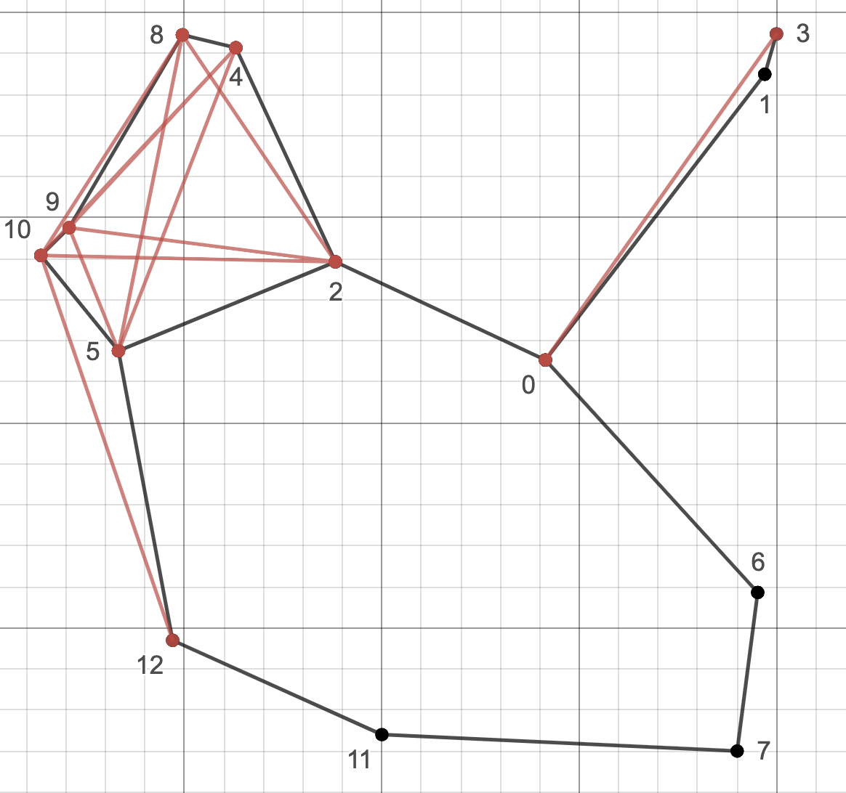
Input Sample: node.txt
13
0 1.4142 1.1534
1 1.97 1.85
2 0.8823 1.3926
3 1.9996 1.9484
4 0.6301 1.9145
5 0.3329 1.1756
6 1.952 0.5866
7 1.9 0.2
8 0.4949 1.946
9 0.2079 1.4758
10 0.1364 1.4084
11 1.0 0.24
12 0.47 0.47
2
12 0
3 11

Slide 13
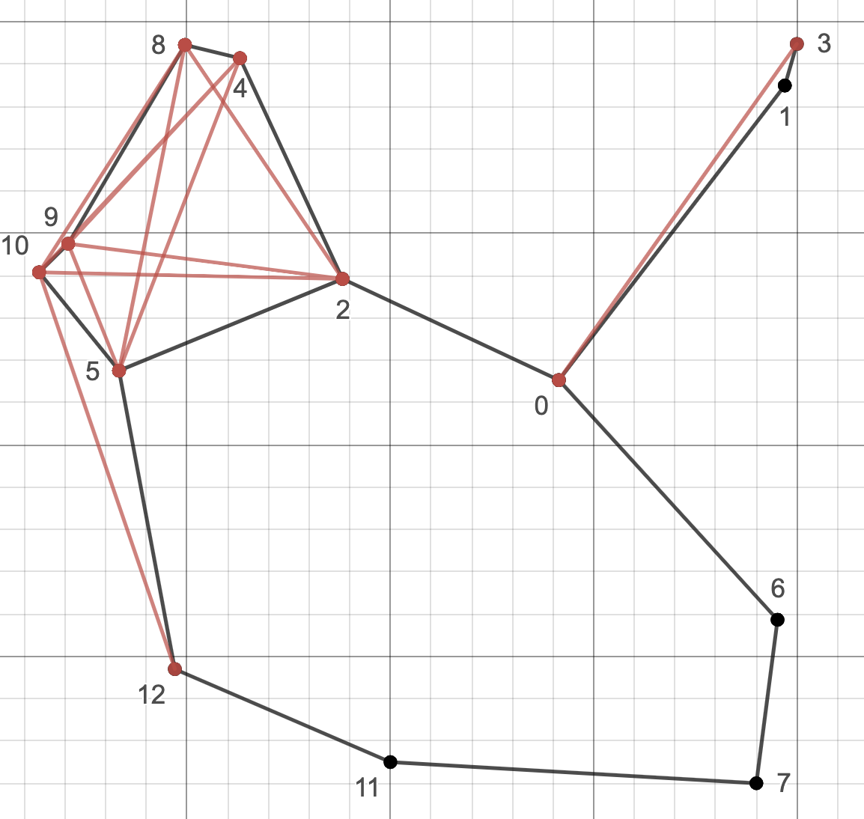
Output Sample: result.txt
22
0 0 1
1 0 2
2 0 3
3 0 6
4 0 7
5 1 3
6 2 4
7 2 5
8 2 8
9 2 9
10 2 10
11 4 5
12 4 8
13 4 9
14 4 10
15 5 8
16 5 9
17 5 10
18 6 7
19 8 9
20 8 10
21 9 10
2
12 11 7 6 0
11
0 0 1
1 0 2
3 0 6
5 1 3
6 2 4
7 2 5
12 4 8
17 5 10
18 6 7
19 8 9
21 9 10
Note: 12 → 11 (greedy)
11 → 7 (face)
7 → 6 (face)
6 → 0 (greedy)

Slide 14
Output Sample: result.txt
22
0 0 1
1 0 2
2 0 3
3 0 6
4 0 7
5 1 3
6 2 4
7 2 5
8 2 8
9 2 9
10 2 10
11 4 5
12 4 8
13 4 9
14 4 10
15 5 8
16 5 9
17 5 10
18 6 7
19 8 9
20 8 10
21 9 10
2
12 11 7 6 0
3 0 2 5 11
11
0 0 1
1 0 2
3 0 6
5 1 3
6 2 4
7 2 5
12 4 8
17 5 10
18 6 7
19 8 9
21 9 10
Note: 12 → 11 (greedy)
11 → 7 (face)
7 → 6 (face)
6 → 0 (greedy)
3 → 0 (greedy)
0 → 2 (face)
2 → 5 (face)
5 → 12 (face)
12 → 11 (greedy)

Slide 15
Note
Deadline: 5/27 Tue (小老師) 6/3 Tue (所有同學)
E-course
C++ Source code

Slide 16
Further Reading
Routing with Guaranteed Delivery in Ad Hoc Wireless Networks, Wireless Networks 2001
On Delivery Guarantees of Face and Combined Greedy-Face Routing in Ad Hoc and Sensor Network, ACM MobiCom 2006
…
Long story

